Slide 1
Severity Car Accident
Modelling using ML

Slide 2
Severity Car Accident
Introduction
Data Set
Results & Conclusion

Slide 3
Car accidents is one of the main causes of death among all countries.
Car accidents are in constant evolution of causes and causality analysis could be of use for:
Educational techiniques
Funding of new innovation for safety
Insurance evolution techniques
Health savings
Personal savings
With all this, with the data set shared it is important to have a clear understanding of the goal -> Human lives.

Slide 4
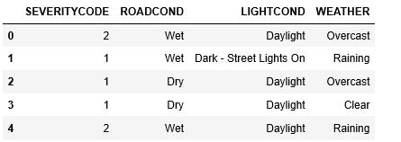
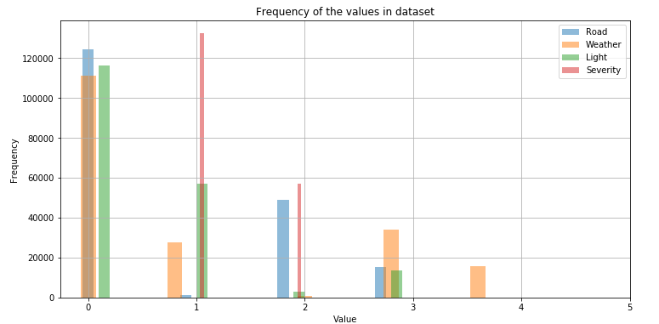
Data Set
From the complete Data Set, only the shown snapshot is selevted to avoid too many correlations among data sets

Slide 5
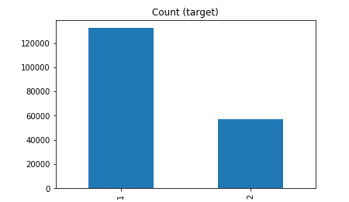
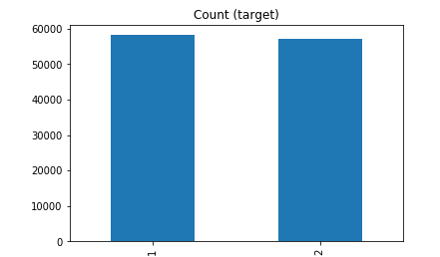
SEVERITY
Severity variable is severely imbalance
Resampling for balance perfection

Slide 6
Results & Conclusion
Due to the nature of the binary categorical variable: LOGISTIC REGRESSION is the best approach with the following results:
JACCARD SIMILARITY SCORE: 0.6985141368261681
F1- SCORE: 0.4112501166056863
LOG_LOSS: 0.5990960616849885
Logistic regression is the best match to represent the modelling techniques and the causality of accidents is affected by the weather conditions.

