Slide 1
The Alt+X Files

Slide 2
Greetings!
We are Abel Furne, Andrew Else, and Logan Hunter.
We are here to talk to you about our Key Bound project.

Slide 3

Key Bound
A remotely accessible solution to keybinding memorization and retention.

Slide 4
In many video games and software applications, there are key combinations bound to certain functions. This application aims to assist users in memorizing and retaining these “keybindings”.

Slide 5
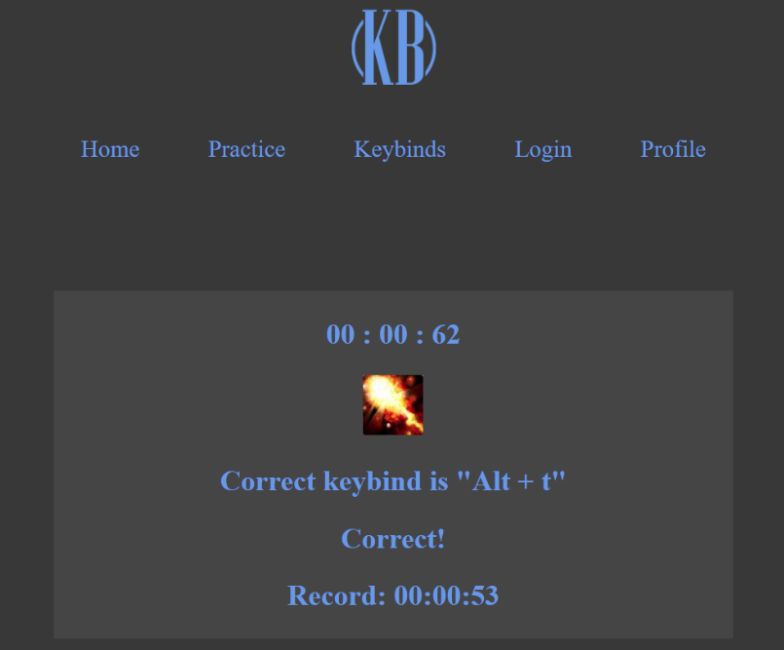
Practice Keybinds
The practice page is one of the key concepts of the Key Bound application and was intended to allow users to practice their keybinds through the use of flashcards, as well as record their timing.

Slide 6
App Purpose
The purpose of the Key Bound application is to provide users a way to practice their keybindings while they do not have access to the actual application where those keybinds are used.
Increase response time
Visualizing reaction time improvement

Slide 7
App Goal
Purpose (what real world problem did you solve?)
Improve identification and reaction time of keybinds

Slide 8

Target Audience
The targeted audience for Key Bound are PC video game players. These gamers require keyboards to interact with the virtual world they play in. Many of these games have player versus player elements that require quick reaction time to defeat their opponents. Outside of video games, this website could be used to practice general computer functions.

Slide 9
Application Features
Keybind Table
The keybind table allows users to add, edit, and delete keybinds they want to practice on the practice page.
Practice Page
The practice page is the page where users will be asked to input the correct keybind combination for the keybinds they add to their table.
Profile Page
The profile page is where the user will be able to customize their profile.

Slide 10
Development process
Concept
(1 day)
Website Creation
(2 days)
Function
(8 weeks)

Slide 11
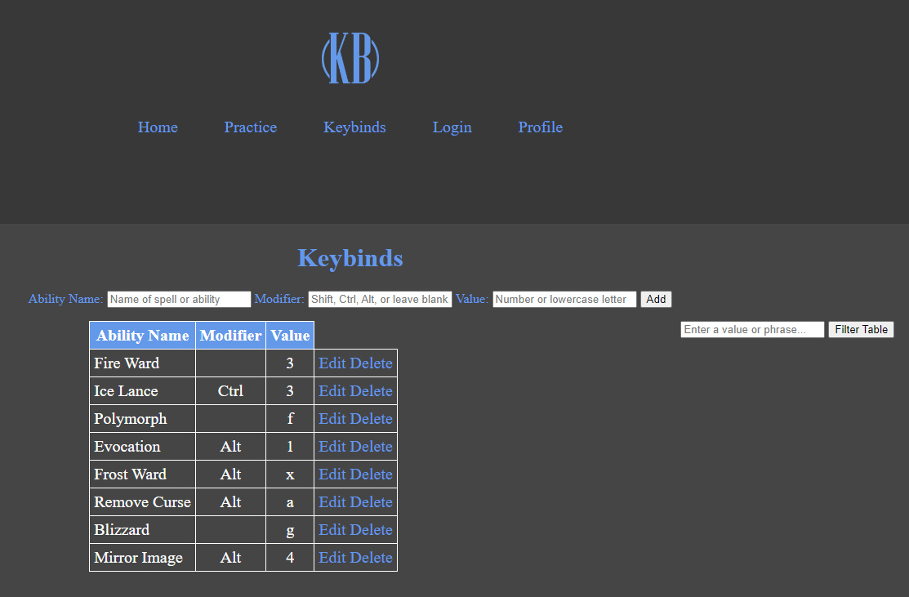
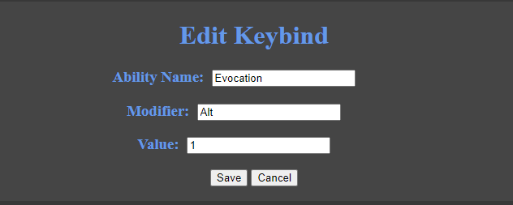
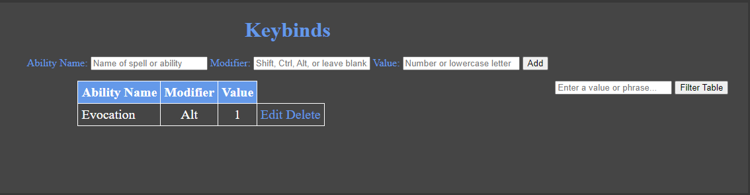

Slide 12
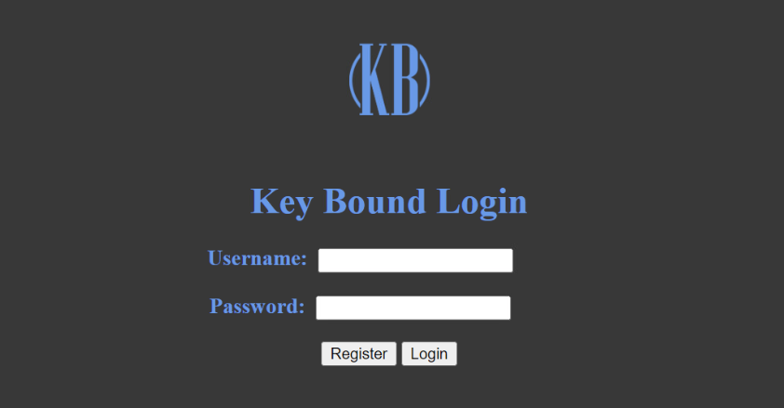

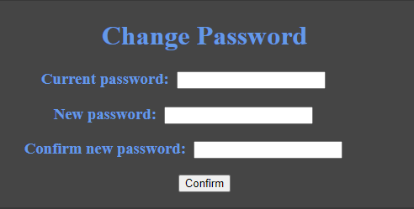

Slide 13
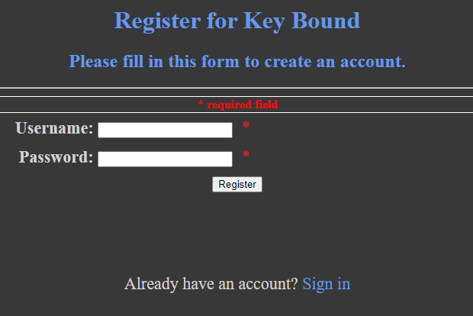
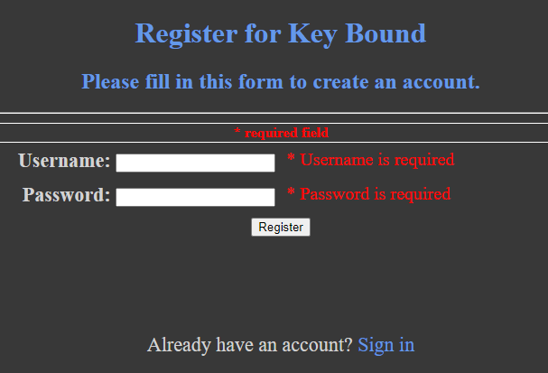
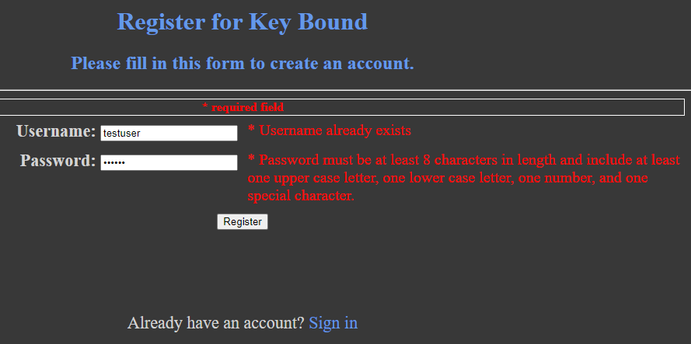

Slide 15
Thanks for listening!
Any questions ?
You can reach us at
abefur6347@students.ecpi.edu
andels4949@students.ecpi.edu
loghun2982@students.ecpi.edu

