Slide 1
GAM 325/425: Applied 3D Geometry
Lecture 1:
Exercises with Vectors and Points

Slide 2
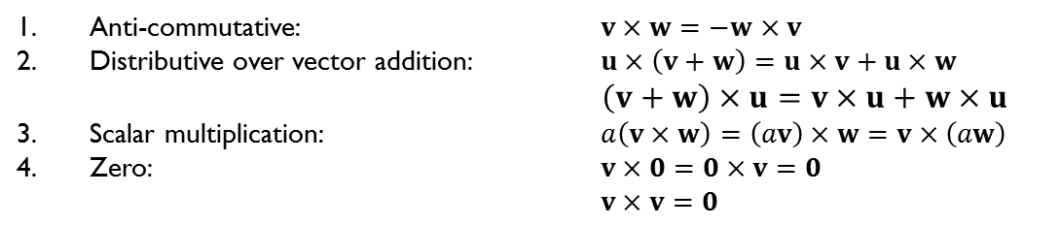
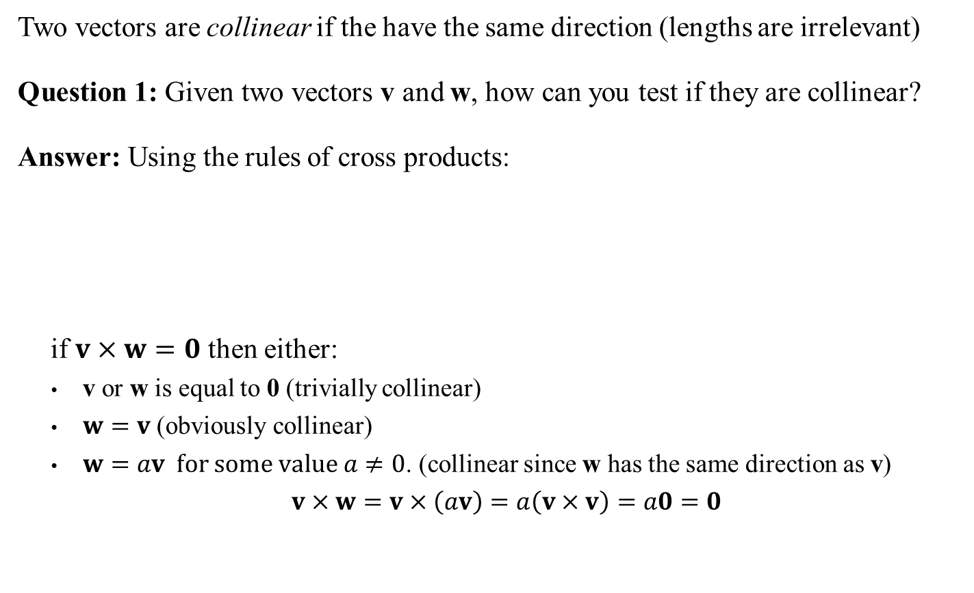
Testing Collinear Vectors
Two vectors are collinear if the have the same direction (lengths are irrelevant)
Question 1: Given two vectors v and w, how can you test if they are collinear?
Answer: Using the rules of cross products:
if $v×w=0$ then either:
v or w is equal to 0 (trivially collinear)
$w=v$ (obviously collinear)
$w=av \text{for} \text{some} \text{value} a≠0$. (collinear since w has the same direction as v)
$v×w=v×\left(av\right)=a\left(v×v\right)=a0=0$
Anti-commutative: $v×w=−w×v$
Distributive over vector addition: $u×\left(v+w\right)=u×v+u×w$
$\left(v+w\right)×u=v×u+w×u$
Scalar multiplication: $a\left(v×w\right)=\left(av\right)×w=v×\left(aw\right)$
Zero: $v×0=0×v=0$ $v×v=0$
Sidebar:
In practice, due to computer precision/round-off errors, you rarely get the actual (0,0,0) vector. You’ll need to test that the result is close enough to (0,0,0). How?
Answer: test its length (squared): if it’s near the computer’s float precision, call it.

Slide 3
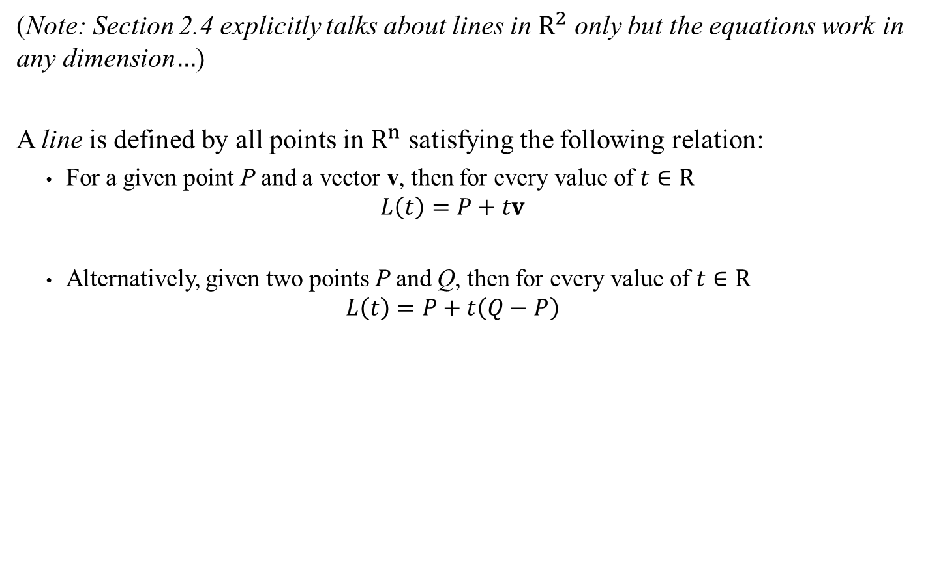



Lines in $R^{3}$
(Note: Section 2.4 explicitly talks about lines in $R^{2}$ only but the equations work in any dimension$…$)
A line is defined by all points in $R^{n}$ satisfying the following relation:
For a given point P and a vector v, then for every value of $t∈R$
$$L\left(t\right)=P+tv$$
Alternatively, given two points P and Q, then for every value of $t∈R$
$$L\left(t\right)=P+t\left(Q−P\right)$$
Q
L(t)
P
$$v$$
$$v=Q−P$$

Slide 4

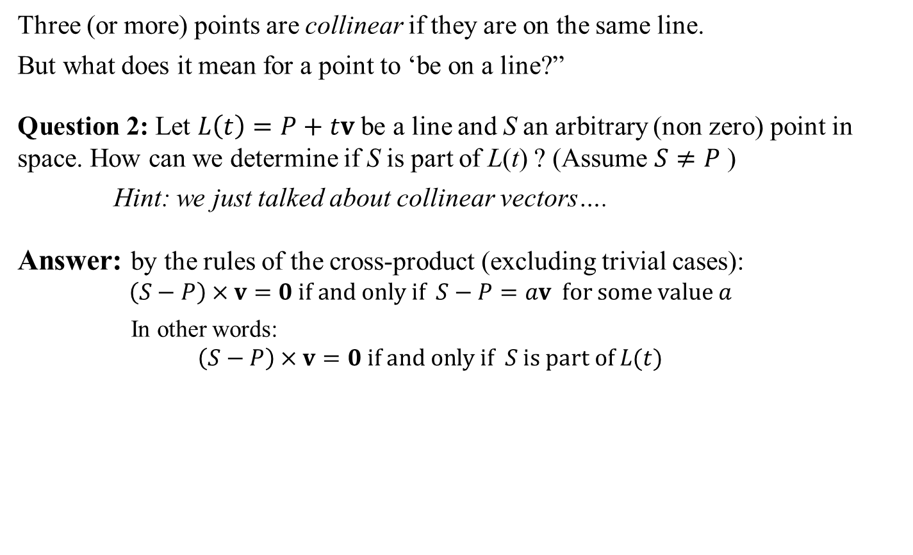

Exercise: Collinear Points
Three (or more) points are collinear if they are on the same line.
But what does it mean for a point to ‘be on a line?”
Question 2: Let $L\left(t\right)=P+tv$ be a line and S an arbitrary (non zero) point in space. How can we determine if S is part of L(t) ? (Assume $S≠P$ )
Hint: we just talked about collinear vectors….
Answer: by the rules of the cross-product (excluding trivial cases):
$$\left(S−P\right)×v=0 \text{if} \text{and} \text{only} \text{if} S−P=av \text{for} \text{some} \text{value} a$$
In other words:
$$\left(S−P\right)×v=0 \text{if} \text{and} \text{only} \text{if} S \text{is} \text{part} \text{of} L(t)$$
Sidebar: Remember: In practice, you test for close enough to (0,0,0)
L(t)
$$v$$
P
S
$$S−P$$

Slide 5




Exercise: Collinear Points
Question 3: Let $P_{0},P_{1}$ and $P_{2}$ be 3 distinct points. How can we test collinearity?
Answer: Same as Question 2, but using $\left(P_{1}−P_{0}\right)×\left(P_{2}−P_{0}\right)=0$
$$P_{0}$$
$$P_{1}$$
$$P_{2}$$
Sidebar:
Very useful in a few weeks when we’ll be dealing with planes and triangle faces…

Slide 6
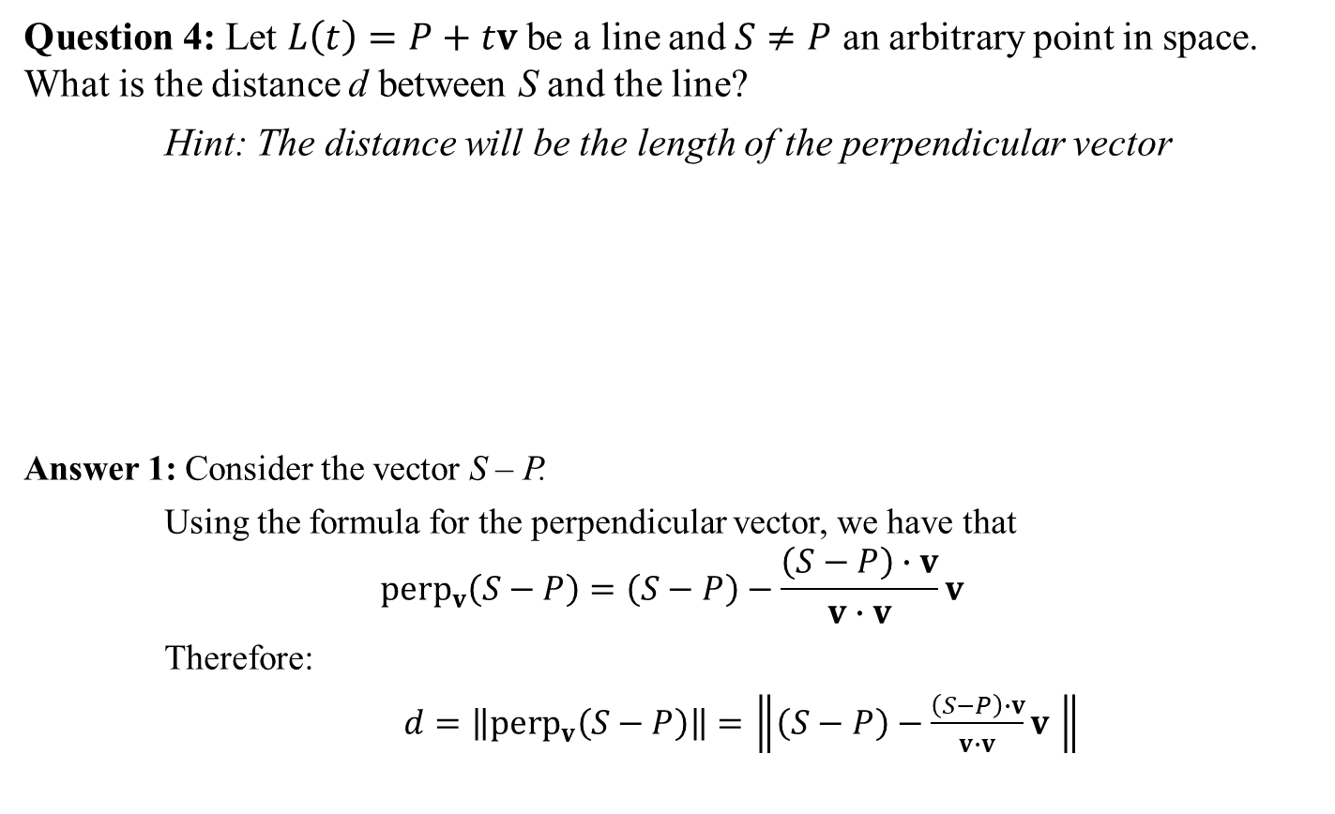
Exercise: Distance to Line
Question 4: Let $L\left(t\right)=P+tv$ be a line and $S≠P$ an arbitrary point in space. What is the distance d between S and the line?
Hint: The distance will be the length of the perpendicular vector
Answer 1: Consider the vector S – P.
Using the formula for the perpendicular vector, we have that
$${\text{perp}}_{v}\left(S−P\right)=\left(S−P\right)−\frac{\left(S−P\right)∙v}{v∙v}v$$
Therefore:
$d=\left\|{\text{perp}}_{v}\left(S−P\right)\right\|=\left\|\left(S−P\right)−\frac{\left(S−P\right)∙v}{v∙v}v \right\|$
L(t)
$$v$$
d = ?
P
S – P
S

Slide 7
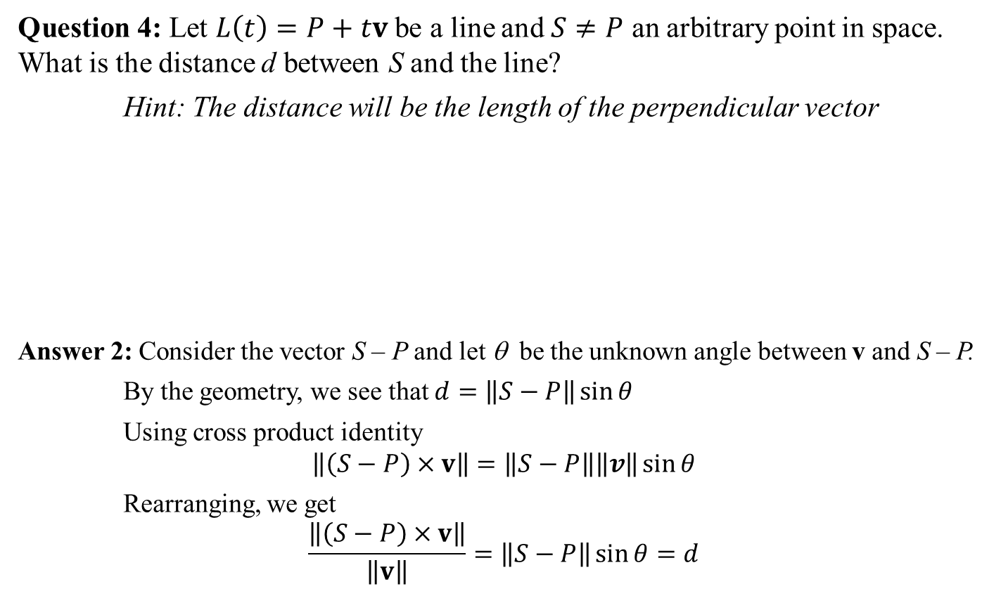
Exercise: Distance to Line
Question 4: Let $L\left(t\right)=P+tv$ be a line and $S≠P$ an arbitrary point in space. What is the distance d between S and the line?
Hint: The distance will be the length of the perpendicular vector
Answer 2: Consider the vector S – P and let θ be the unknown angle between v and S – P.
By the geometry, we see that $d=\left\|S−P\right\|\sin{θ}$
Using cross product identity
$$\left\|\left(S−P\right)×v\right\|=\left\|S−P\right\|\left\|v\right\|\sin{θ}$$
Rearranging, we get
$$\frac{\left\|\left(S−P\right)×v\right\|}{\left\|v\right\|}=\left\|S−P\right\|\sin{θ}=d$$
L(t)
$$v$$
d = ?
P
θ
S – P
S

Slide 8

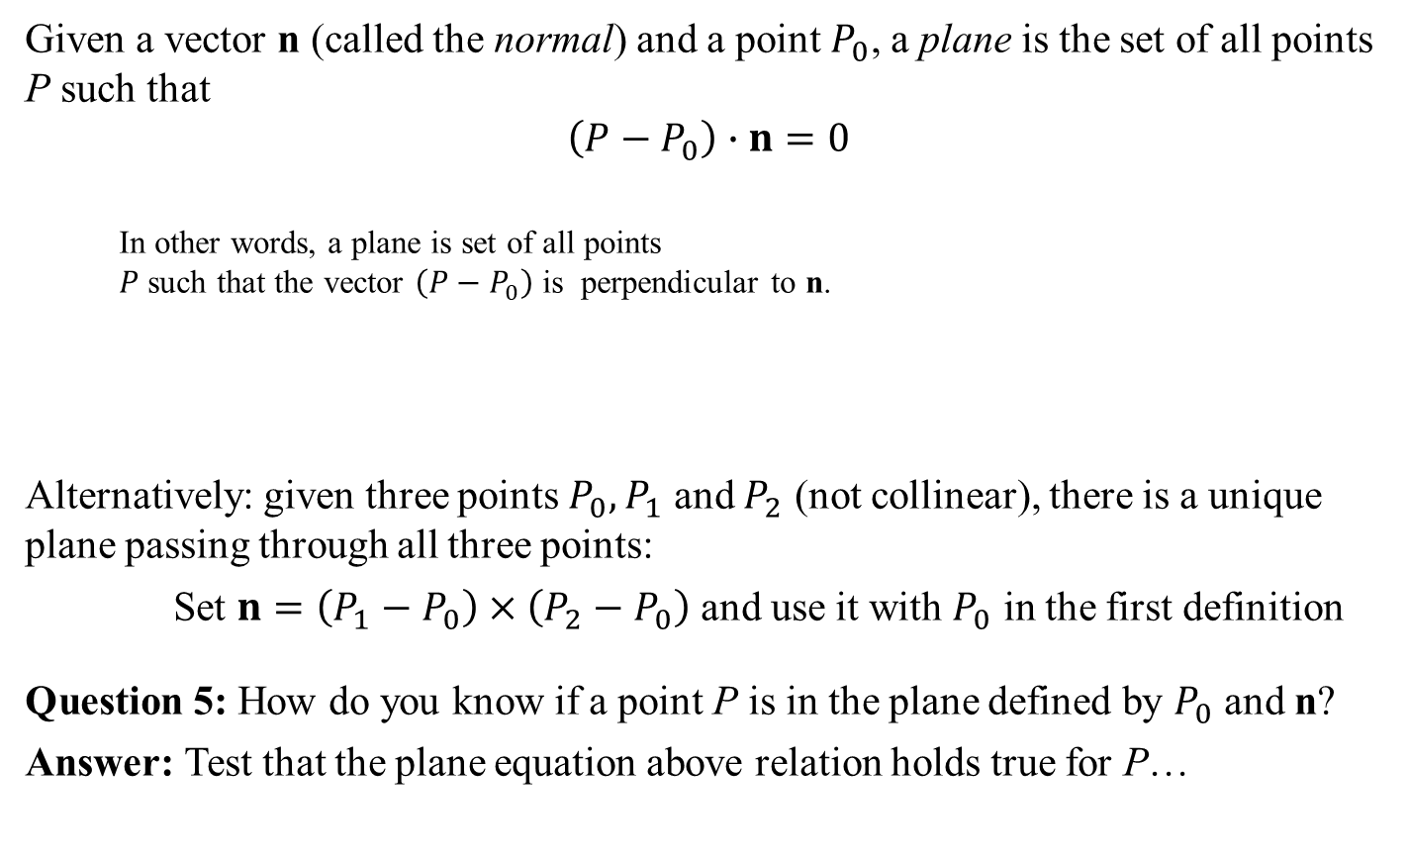
Plane
Given a vector n (called the normal) and a point $P_{0}$, a plane is the set of all points P such that
$$\left(P−P_{0}\right)∙n=0$$
In other words, a plane is set of all points $P$ such that the vector $\left(P−P_{0}\right)$ is perpendicular to n.
Alternatively: given three points $P_{0},P_{1}$ and $P_{2}$ (not collinear), there is a unique plane passing through all three points:
Set $n=\left(P_{1}−P_{0}\right)×\left(P_{2}−P_{0}\right)$ and use it with $P_{0}$ in the first definition
Question 5: How do you know if a point P is in the plane defined by $P_{0}$ and n?
Answer: Test that the plane equation above relation holds true for P…
n
$$P_{0}$$

Slide 9


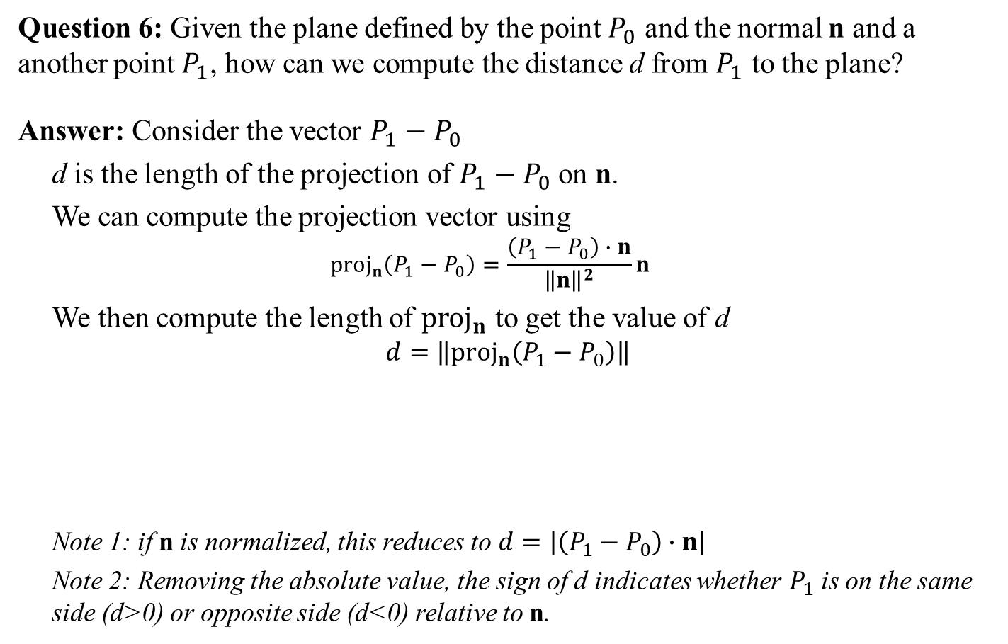
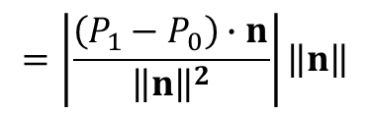


Distance to Plane
Question 6: Given the plane defined by the point $P_{0}$ and the normal n and a another point $P_{1}$, how can we compute the distance d from $P_{1}$ to the plane?
Answer: Consider the vector $P_{1}−P_{0}$
d is the length of the projection of $P_{1}−P_{0}$ on n.
We can compute the projection vector using
$${\text{proj}}_{n}\left(P_{1}−P_{0}\right)=\frac{\left(P_{1}−P_{0}\right)∙n}{{\left\|n\right\|}^{2}}n$$
We then compute the length of ${\text{proj}}_{n}$ to get the value of d
$$d=\left\|{\text{proj}}_{n}\left(P_{1}−P_{0}\right)\right\|$$
Note 1: if n is normalized, this reduces to $d=\left|\left(P_{1}−P_{0}\right)∙n\right|$
Note 2: Removing the absolute value, the sign of d indicates whether $P_{1}$ is on the same side (d>0) or opposite side (d<0) relative to n.
$$P_{1}$$
n
$$P_{1}−P_{0}$$
d = ?
$$P_{0}$$
$$=\left|\frac{\left(P_{1}−P_{0}\right)∙n}{{\left\|n\right\|}^{2}}\right|\left\|n\right\|$$
$$=\left|\frac{\left(P_{1}−P_{0}\right)∙n}{\left\|n\right\|}\right|$$

Slide 10
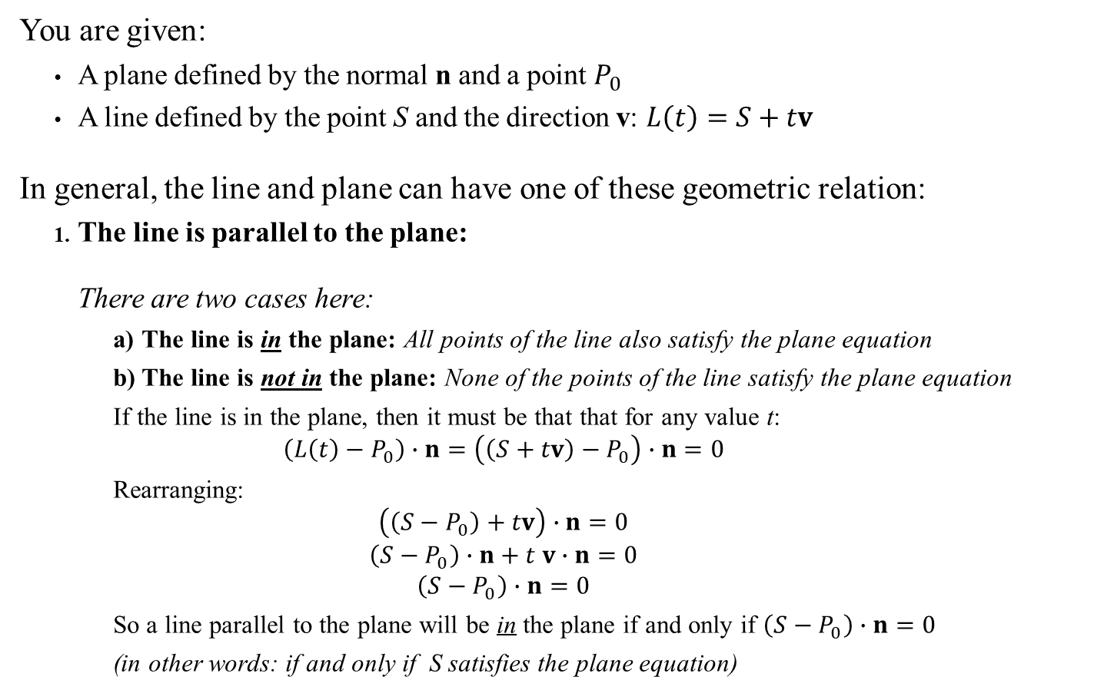

Line and Plane
n
You are given:
A plane defined by the normal n and a point $P_{0}$
A line defined by the point S and the direction v: $L\left(t\right)=S+tv$
In general, the line and plane can have one of these geometric relation:
The line is parallel to the plane:
There are two cases here:
The line is in the plane: All points of the line also satisfy the plane equation
The line is not in the plane: None of the points of the line satisfy the plane equation
If the line is in the plane, then it must be that that for any value t:
$$\left(L\left(t\right)−P_{0}\right)∙n=\left(\left(S+tv\right)−P_{0}\right)∙n=0$$
Rearranging:
$$\left(\left(S−P_{0}\right)+tv\right)∙n=0$$
$$\left(S−P_{0}\right)∙n+t v∙n=0$$
$$\left(S−P_{0}\right)∙n=0$$
So a line parallel to the plane will be in the plane if and only if $\left(S−P_{0}\right)∙n=0$
(in other words: if and only if S satisfies the plane equation)
$$P_{0}$$
Q: How do we test for this?
A: Test that $v∙n=0$

Slide 11
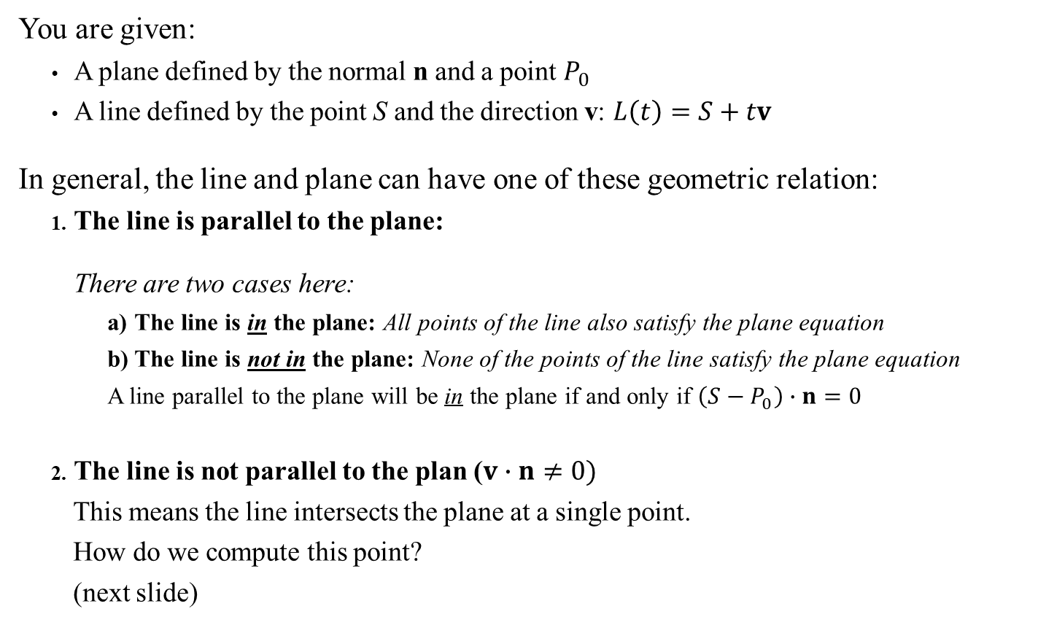
Line and Plane
n
You are given:
A plane defined by the normal n and a point $P_{0}$
A line defined by the point S and the direction v: $L\left(t\right)=S+tv$
In general, the line and plane can have one of these geometric relation:
The line is parallel to the plane:
There are two cases here:
The line is in the plane: All points of the line also satisfy the plane equation
The line is not in the plane: None of the points of the line satisfy the plane equation
A line parallel to the plane will be in the plane if and only if $\left(S−P_{0}\right)∙n=0$
The line is not parallel to the plan ($v∙n≠0)$
This means the line intersects the plane at a single point.
How do we compute this point?
(next slide)
$$P_{0}$$
Q: How do we test for this?
A: Test that $v∙n=0$

Slide 12
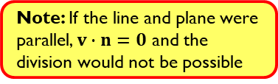
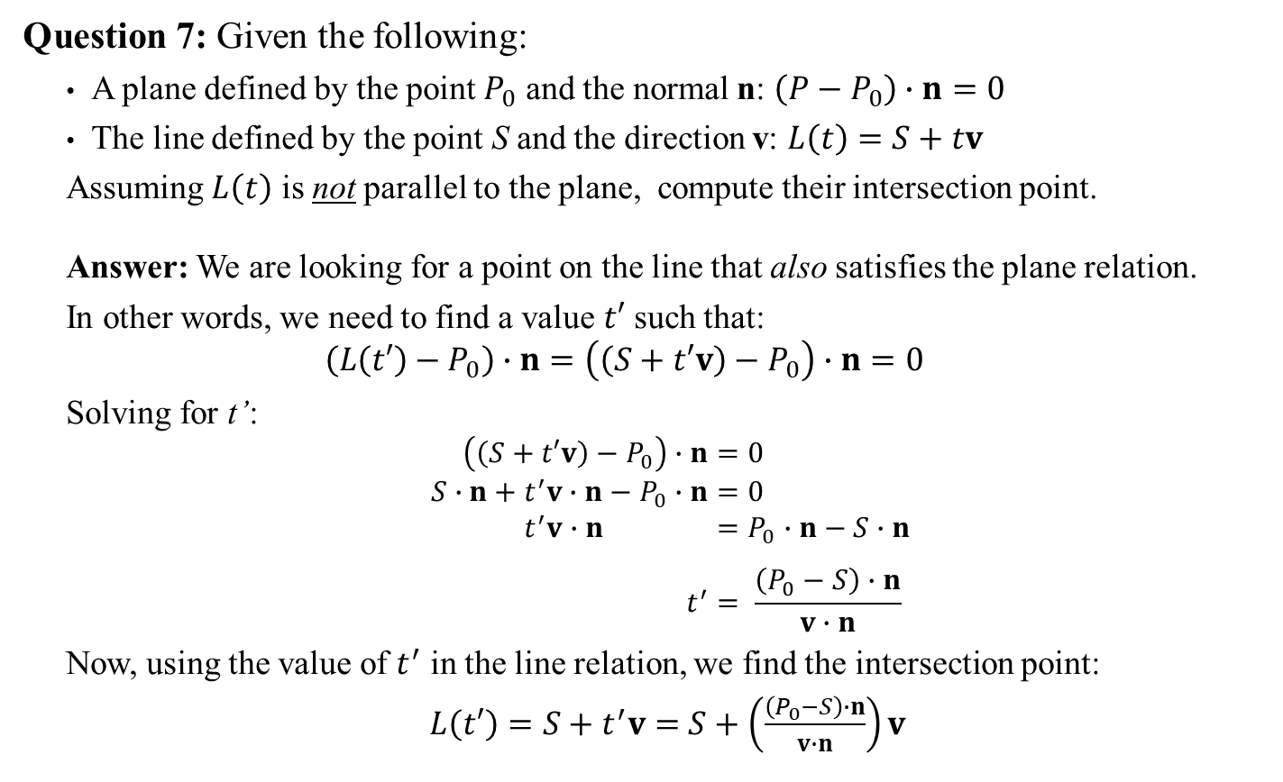
Line-Plane Intersection
Question 7: Given the following:
A plane defined by the point $P_{0}$ and the normal n: $\left(P−P_{0}\right)∙n=0$
The line defined by the point S and the direction v: $L\left(t\right)=S+tv$
Assuming $L\left(t\right)$ is not parallel to the plane, compute their intersection point.
Answer: We are looking for a point on the line that also satisfies the plane relation.
In other words, we need to find a value $t′$ such that:
$$\left(L\left(t′\right)−P_{0}\right)∙n=\left(\left(S+t′v\right)−P_{0}\right)∙n=0$$
Solving for t’:
$$\left(\left(S+t′v\right)−P_{0}\right)∙n=0 \\ S∙n+t^{′}v∙n−P_{0}∙n=0 \\ t^{′}v∙n =P_{0}∙n−S∙n \\ t^{′}= \frac{\left(P_{0}−S\right)∙n}{v∙n}$$
Now, using the value of $t^{′}$ in the line relation, we find the intersection point:
$L\left(t′\right)=S+t^{′}v=$ $S+\left(\frac{\left(P_{0}−S\right)∙n}{v∙n}\right)v$
Note: If the line and plane were parallel, $v∙n=0$ and the division would not be possible
Sidebar: Note that the final answer isn’t particularly intuitive. This is true of most linear algebra problems: understanding the how to work with the identities equations is far more important than memorizing formulas.

Slide 13

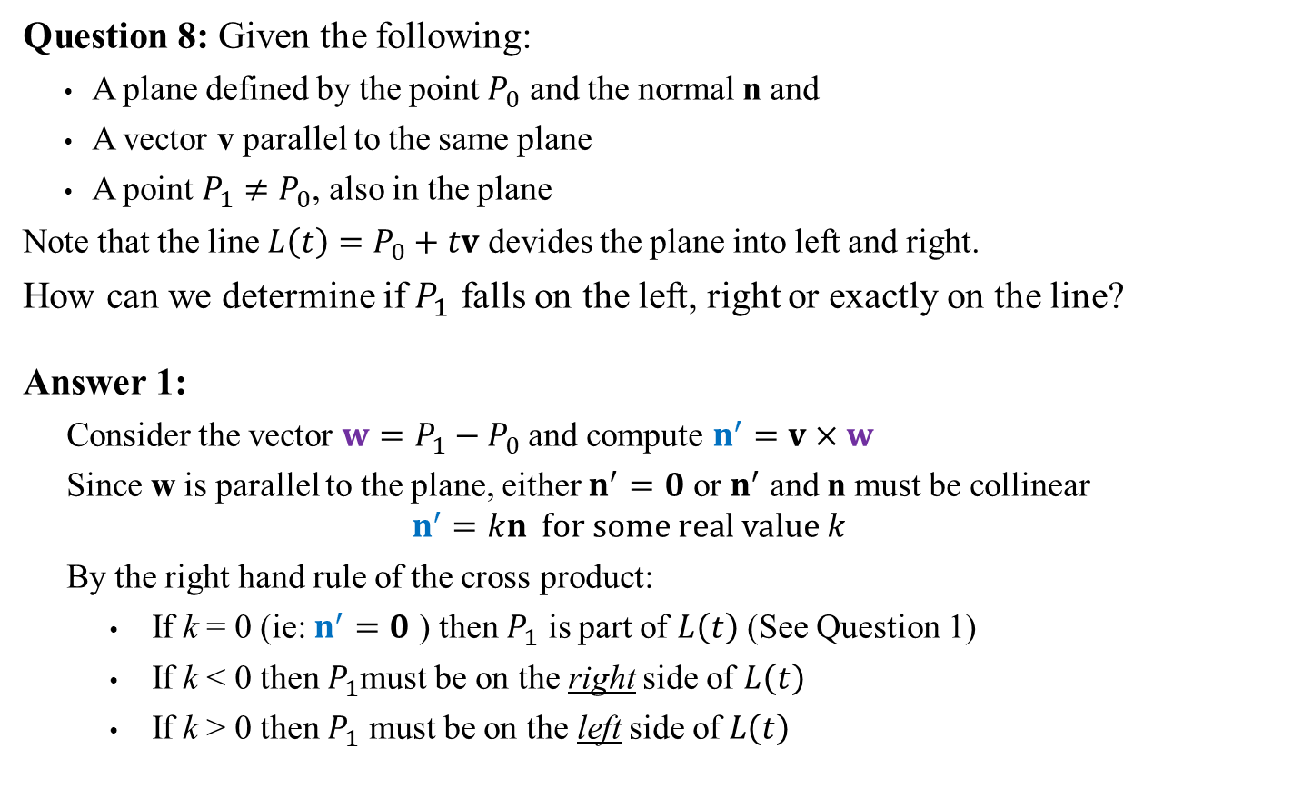



Left-Right Determination
Question 8: Given the following:
A plane defined by the point $P_{0}$ and the normal n and
A vector v parallel to the same plane
A point $P_{1}≠P_{0}$, also in the plane
Note that the line $L\left(t\right)=P_{0}+tv$ devides the plane into left and right.
How can we determine if $P_{1}$ falls on the left, right or exactly on the line?
Answer 1:
Consider the vector $w=P_{1}−P_{0}$ and compute $n^{′}=v×w$
Since w is parallel to the plane, either $n^{′}=0$ or $n^{′}$ and n must be collinear
$$n^{′}=kn \text{for} \text{some} \text{real} \text{value} k$$
By the right hand rule of the cross product:
If k = 0 (ie: $n^{′}=0$ ) then $P_{1}$ is part of $L\left(t\right)$ (See Question 1)
If k < 0 then $P_{1}$must be on the right side of $L\left(t\right)$
If k > 0 then $P_{1}$ must be on the left side of $L\left(t\right)$
n
Left
$$v$$
$$P_{1}$$
$$P_{0}$$
$$w$$
Right
Note: This depends on the order of vectors in the cross product

Slide 14

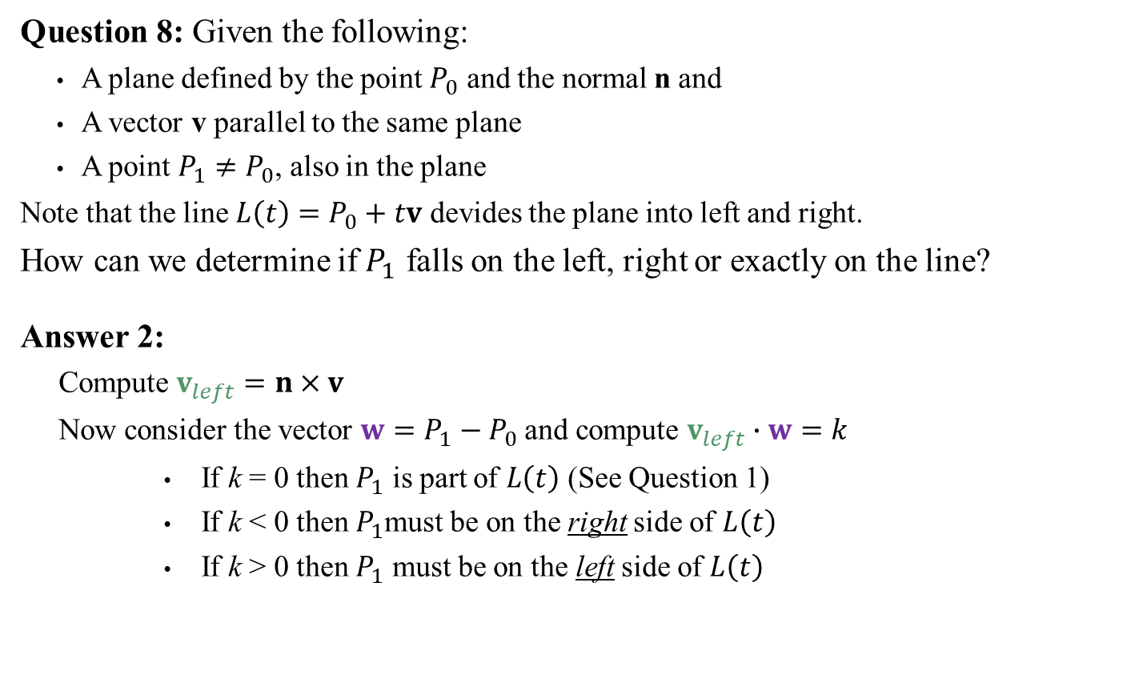
Left-Right Determination
Question 8: Given the following:
A plane defined by the point $P_{0}$ and the normal n and
A vector v parallel to the same plane
A point $P_{1}≠P_{0}$, also in the plane
Note that the line $L\left(t\right)=P_{0}+tv$ devides the plane into left and right.
How can we determine if $P_{1}$ falls on the left, right or exactly on the line?
Answer 2:
Compute $v_{left}=n×v$
Now consider the vector $w=P_{1}−P_{0}$ and compute $v_{left}∙w=k$
If k = 0 then $P_{1}$ is part of $L\left(t\right)$ (See Question 1)
If k < 0 then $P_{1}$must be on the right side of $L\left(t\right)$
If k > 0 then $P_{1}$ must be on the left side of $L\left(t\right)$
$$v_{left}$$
n
Left
$$v$$
$$P_{1}$$
$$P_{0}$$
$$w$$
Right
Note: again, the order matters

