Slide 1
GAM 325/425: Applied 3D Geometry
Lecture 1:
Vectors, Points, Vector Spaces, Handedness and Vector Operations

Slide 2
Important
These lecture notes are meant to be support material to the book.
I expect you to read the book and work on the exercises therein.
There is much to cover! The simpler topics will be left for you to learn on your own
Lectures notes will focus on clarifying the more complex/subtle topics.
You are expected to read & understand the associated chapters listed on D2L.
Ex: This week’s content page found on D2L
Piazza Forums:
Make use of the class’ Piazza forum for questions and discussions.

Slide 3


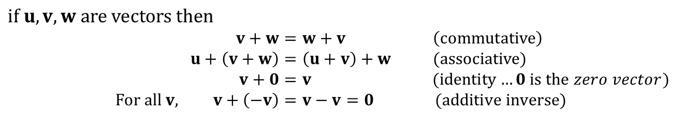
Geometric Vector: Definition
Geometric Vector: an object that has a length (magnitude) and a direction.
Note: a vector does not have a position! (There is only one b vector below)
Addition of geometric vectors can be computed by ‘chaining’ them together
The vector c below is the same as the vector resulting from a + b.
Geometric vector addition follows the familiar algebraic rules:
For example:
$$\text{if} u,v,w \text{are} \text{vectors} \text{then}$$
$$v+w=w+v \left(\text{commutative}\right) \\ u+\left(v+w\right)=\left(u+v\right)+w\text{ (}\text{associative}\text{)} \\ v+0=v \text{ (}\text{identity}…0 is the zero vector) \\ \text{For} \text{all} v, v+\left(−v\right)=v−v=0 \text{(}\text{additive} \text{inverse}\text{)}$$
Sidebar:
In other words: vectors combined with geometric addition form an abelian group
a
b
$$d=−a \\ a+d=0$$
Remember:
only length and direction matter: the position is irrelevant.
There is only one b vector in the diagram
c
$$c=a+b \\ a=c−b \\ b=c−a$$
d
b
-a

Slide 4
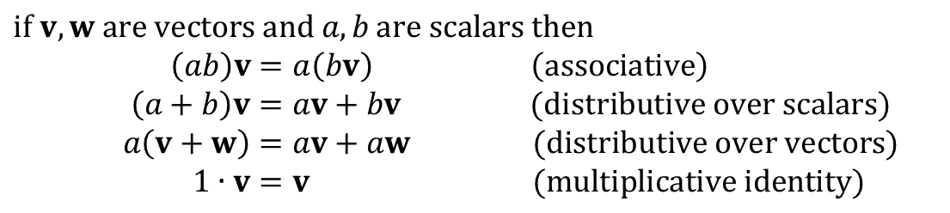

Geometric Vector: Scalar Multiplication
Vectors can also be multiplied by a scalar (a real number). The resulting vector has the same direction, but its length is multiplied by the scalar value.
Scalar multiplication on vectors follows the familiar algebraic rules:
a
$$b=2a$$
$$\text{if} v,w \text{are} \text{vectors} \text{and} a, b \text{are} \text{scalars} \text{then}$$
$$\left(ab\right)v=a\left(bv\right) \left(\text{associative}\right) \\ \left(a+b\right)v=av+bv \text{(}\text{distributive} \text{over} \text{scalars}\text{)} \\ a\left(v+w\right)=av+aw \text{(}\text{distributive} over vectors) \\ 1∙v=v \text{(}\text{multiplicative} \text{identity}\text{)}$$
Sidebar:
In other words: vectors combined with geometric addition and scalar multiplication form a Vector (linear) Space
Important:
Notice how bold & italic have meaning here: italic is used to represent real numbers and bold for vectors. This is fairly standard in the literature. We will encounter many, many more notational subtleties: get used to them!

Slide 5
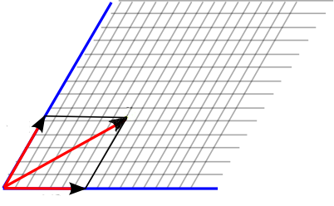


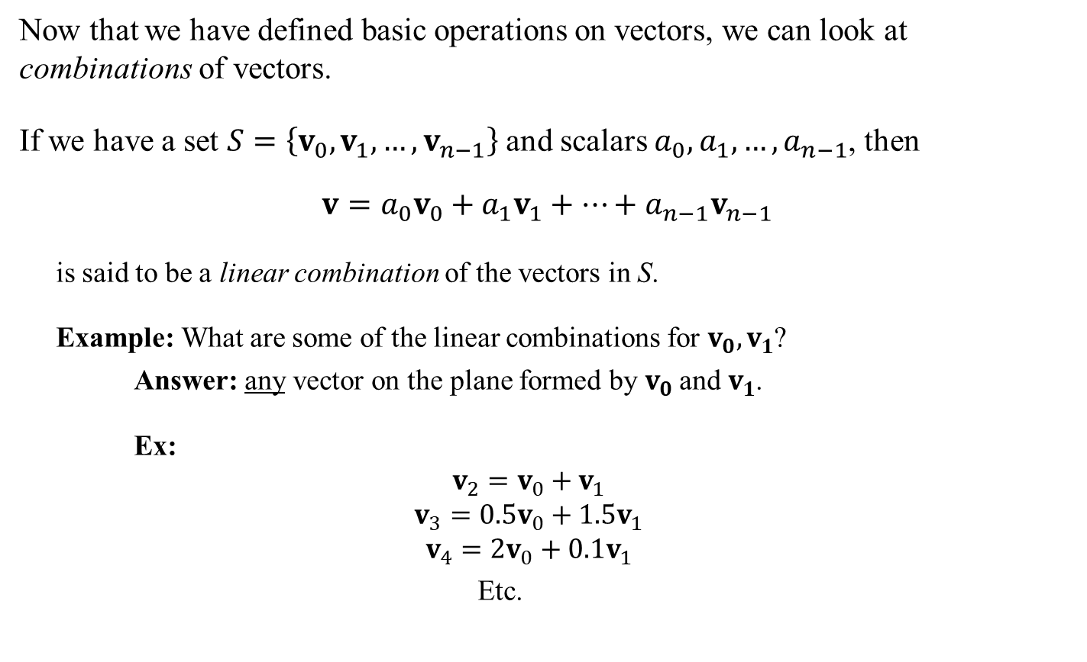



Linear Combination
Now that we have defined basic operations on vectors, we can look at combinations of vectors.
If we have a set $S=\left\{v_{0},v_{1},…,v_{n−1}\right\}$ and scalars $a_{0},a_{1},…,a_{n−1}$, then
$$v=a_{0}v_{0}+a_{1}v_{1}+…+a_{n−1}v_{n−1}$$
is said to be a linear combination of the vectors in S.
Example: What are some of the linear combinations for $v_{0},v_{1}$?
Answer: any vector on the plane formed by $v_{0}$ and $v_{1}$.
Ex:
$$v_{2}=v_{0}+v_{1}$$
$$v_{3}=0.5v_{0}+1.5v_{1}$$
$$v_{4}=2v_{0}+0.1v_{1}$$
Etc.
$$v_{3}$$
$$v_{2}$$
$$v_{1}$$
$$v_{4}$$
$$v_{0}$$

Slide 6


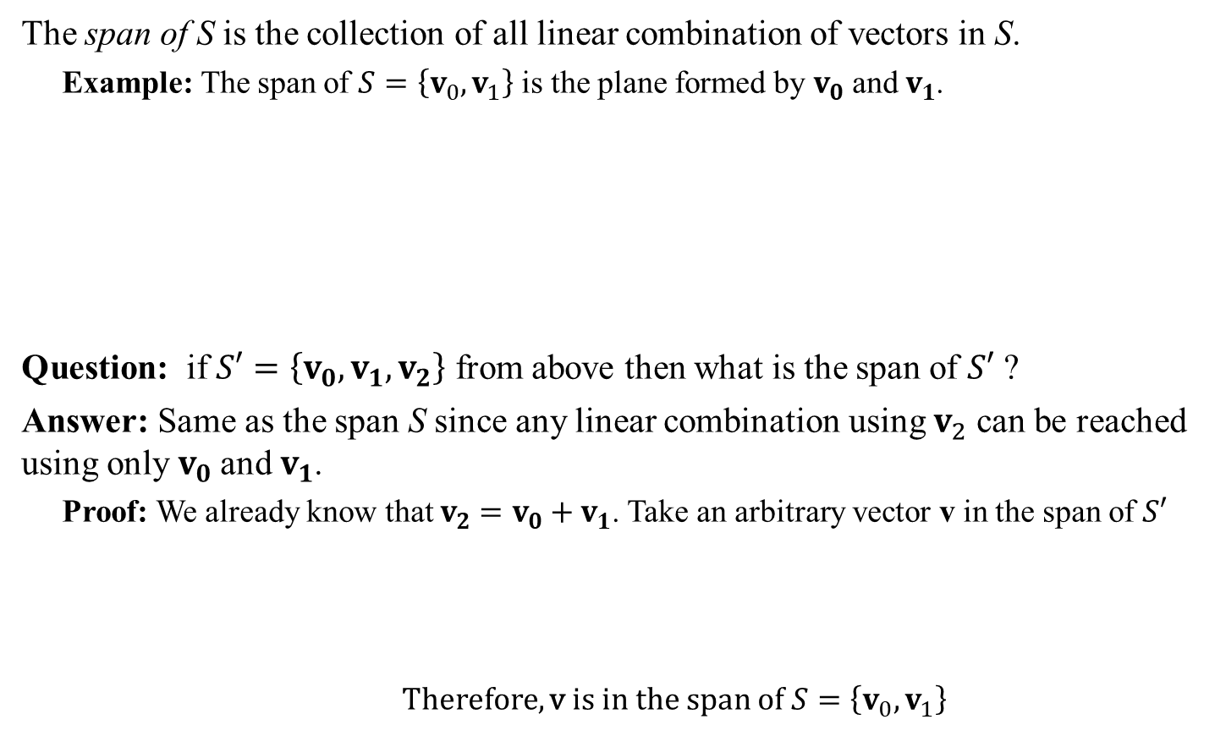




Span
The span of S is the collection of all linear combination of vectors in S.
Example: The span of $S=\left\{v_{0},v_{1}\right\}$ is the plane formed by $v_{0}$ and $v_{1}$.
Question: if $S′=\left\{v_{0},v_{1},v_{2}\right\}$ from above then what is the span of $S′$ ?
Answer: Same as the span S since any linear combination using $v_{2}$ can be reached using only $v_{0}$ and $v_{1}$.
Proof: We already know that $v_{2}=v_{0}+v_{1}$. Take an arbitrary vector v in the span of $S′$
Therefore, v is in the span of $S=\left\{v_{0},v_{1}\right\}$
$$v_{2}$$
$$v_{1}$$
$$v_{0}$$
$$v=a_{0}v_{0}+a_{1}v_{1}+a_{2}v_{2}$$
$$=a_{0}v_{0}+a_{1}v_{1}+a_{2}\left(v_{0}+v_{1}\right)$$
$$=(a_{0}+a_{2})v_{0}+(a_{1}+a_{2})v_{1}$$

Slide 7



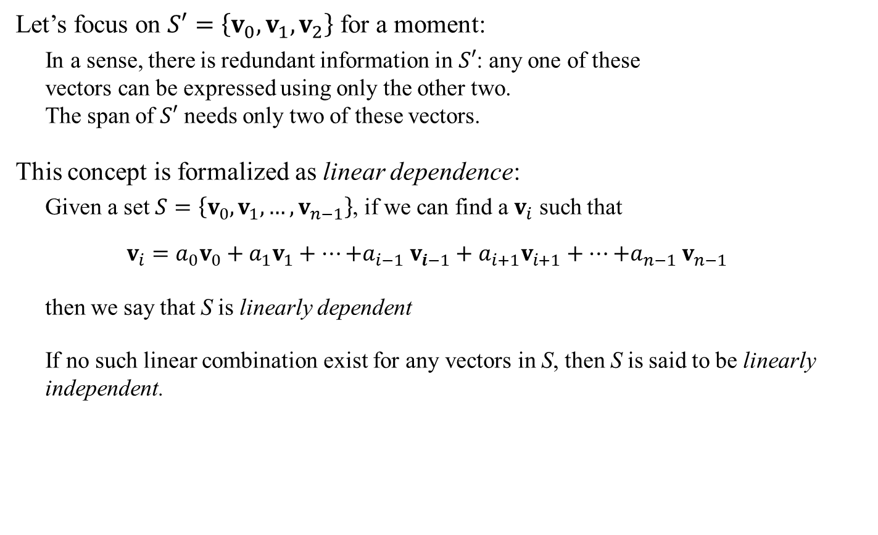

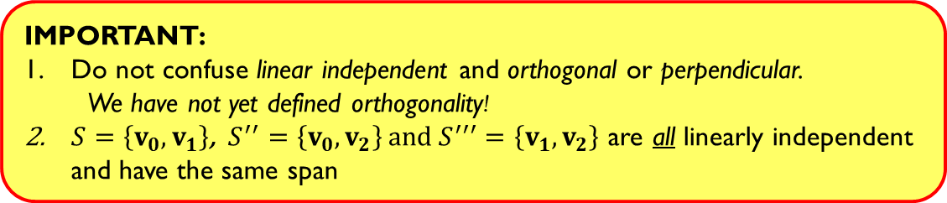
Linear Dependence
Let’s focus on $S′=\left\{v_{0},v_{1},v_{2}\right\}$ for a moment:
In a sense, there is redundant information in $S′$: any one of these vectors can be expressed using only the other two. The span of $S′$ needs only two of these vectors.
This concept is formalized as linear dependence:
Given a set $S=\left\{v_{0},v_{1},…,v_{n−1}\right\}$, if we can find a $v_{i}$ such that
$$v_{i}=a_{0}v_{0}+a_{1}v_{1}+…{+a}_{i−1}v_{i−1}+a_{i+1}v_{i+1}+…{+a}_{n−1}v_{n−1}$$
then we say that S is linearly dependent
If no such linear combination exist for any vectors in S, then S is said to be linearly independent.
$$v_{2}$$
$$v_{1}$$
$$v_{0}$$
no $v_{i}$!
IMPORTANT:
Do not confuse linear independent and orthogonal or perpendicular.
We have not yet defined orthogonality!
$S=\left\{v_{0},v_{1}\right\}$, $S^{′′}=\left\{v_{0},v_{2}\right\}$ and$S^{′′′}=\left\{v_{1},v_{2}\right\}$ are all linearly independent and have the same span

Slide 8

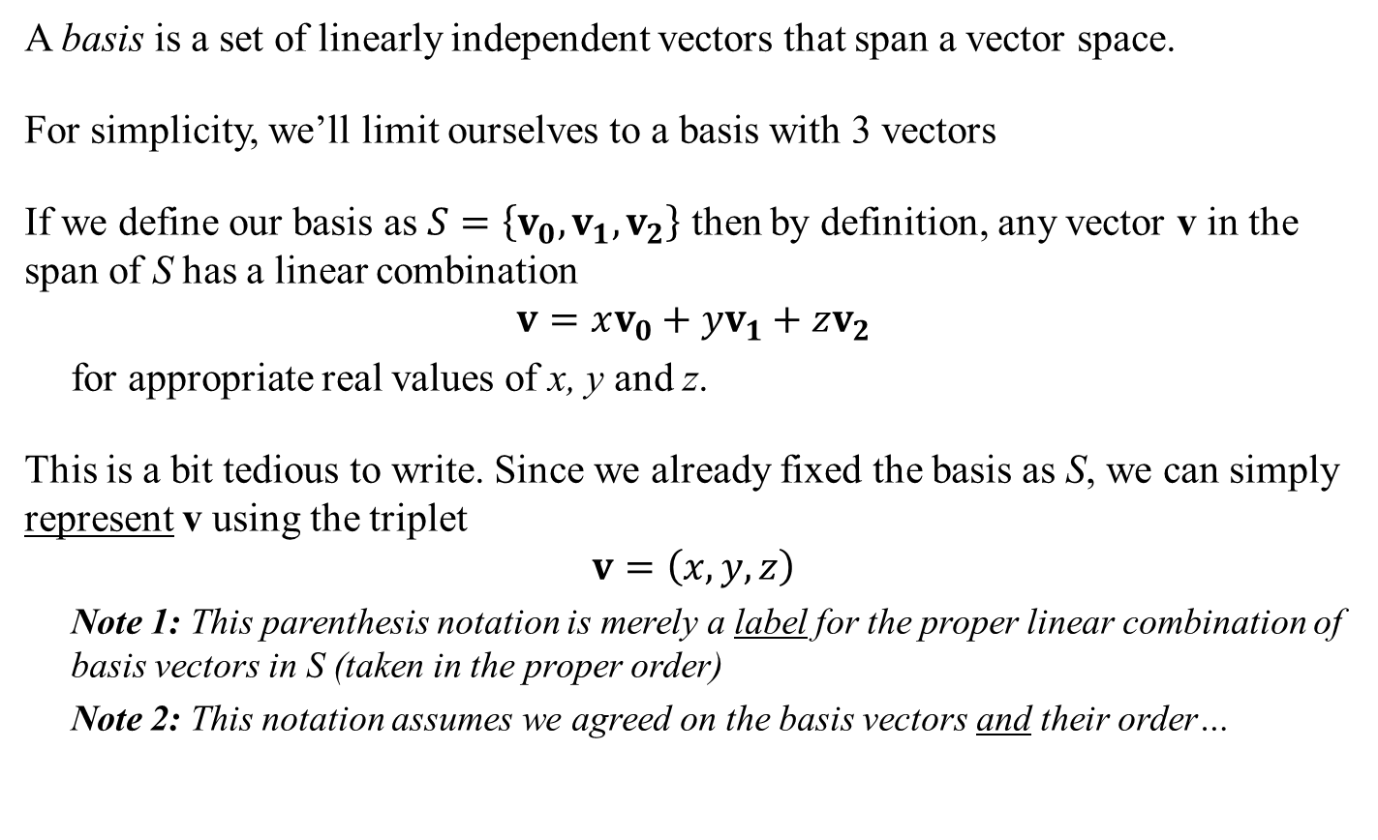
Basis and Vector Representation
A basis is a set of linearly independent vectors that span a vector space.
For simplicity, we’ll limit ourselves to a basis with 3 vectors
If we define our basis as $S=\left\{v_{0},v_{1},v_{2}\right\}$ then by definition, any vector v in the span of S has a linear combination
$$v=xv_{0}+yv_{1}+zv_{2}$$
for appropriate real values of x, y and z.
This is a bit tedious to write. Since we already fixed the basis as S, we can simply represent v using the triplet
$$v=\left(x,y,z\right)$$
Note 1: This parenthesis notation is merely a label for the proper linear combination of basis vectors in S (taken in the proper order)
Note 2: This notation assumes we agreed on the basis vectors and their order…
Again: nothing here about orthogonality!
Note: not the same $v_{0},v_{1},v_{2}$ from earlier

Slide 9
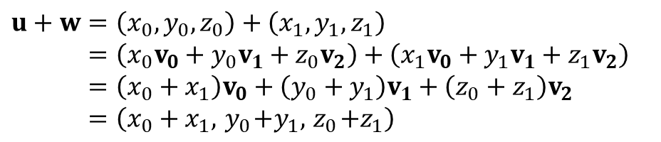
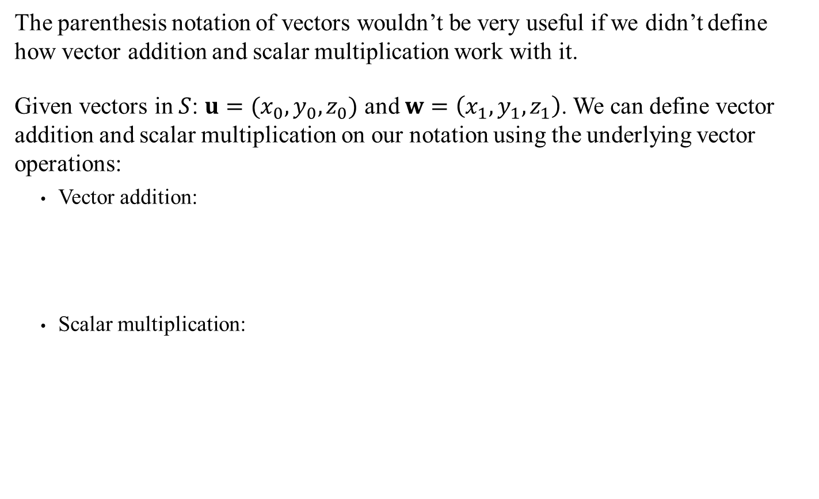

Vector Representation and Operations
The parenthesis notation of vectors wouldn’t be very useful if we didn’t define how vector addition and scalar multiplication work with it.
Given vectors in $S$: $u=(x_{0},y_{0},z_{0})$ and $w=\left(x_{1},y_{1},z_{1}\right)$. We can define vector addition and scalar multiplication on our notation using the underlying vector operations:
Vector addition:
Scalar multiplication:
$$u+w=\left(x_{0},y_{0},z_{0}\right)+\left(x_{1},y_{1},z_{1}\right) \\ =\left(x_{0}v_{0}+y_{0}v_{1}+z_{0}v_{2}\right)+\left(x_{1}v_{0}+y_{1}v_{1}+z_{1}v_{2}\right) \\ =\left(x_{0}+x_{1}\right)v_{0}+\left(y_{0}+y_{1}\right)v_{1}+\left(z_{0}+z_{1}\right)v_{2} \\ =\left(x_{0}+x_{1},{ y}_{0}+y_{1},{ z}_{0}+z_{1}\right)$$
$$av=a\left(x_{0},y_{0},z_{0}\right) \\ =a\left(xv_{0}+yv_{1}+zv_{2}\right) \\ =axv_{0}+ayv_{1}+azv_{2} \\ =\left(ax, ay, az\right)$$
Sidebar:
Labels are funny things: some parentheses are the usual arithmetic one, but the ones at the top an bottom are merely part of a notational label…

Slide 10
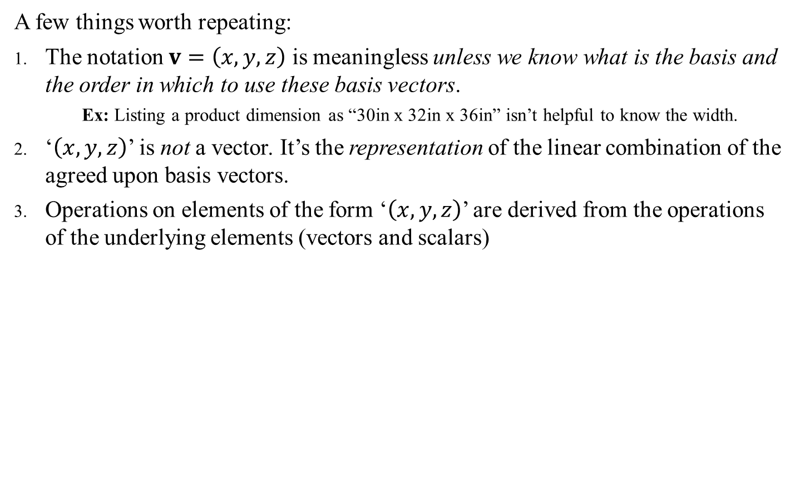
Representation Subtleties
A few things worth repeating:
The notation $v=\left(x,y,z\right)$ is meaningless unless we know what is the basis and the order in which to use these basis vectors.
Ex: Listing a product dimension as “30in x 32in x 36in” isn’t helpful to know the width.
‘$\left(x,y,z\right)$’ is not a vector. It’s the representation of the linear combination of the agreed upon basis vectors.
Operations on elements of the form ‘$\left(x,y,z\right)$’ are derived from the operations of the underlying elements (vectors and scalars)

Slide 11
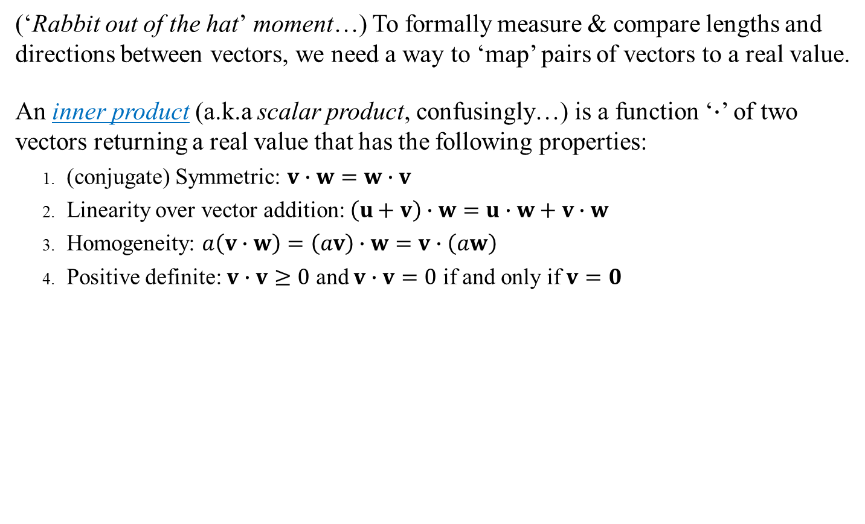
Comparing Vectors: Inner Product
Warning: This is out of order compared with our book
(‘Rabbit out of the hat’ moment…) To formally measure & compare lengths and directions between vectors, we need a way to ‘map’ pairs of vectors to a real value.
An inner product (a.k.a scalar product, confusingly…) is a function ‘$∙$’ of two vectors returning a real value that has the following properties:
(conjugate) Symmetric: $v∙w=w∙v$
Linearity over vector addition: $\left(u+v\right)∙w=u∙w+v∙w$
Homogeneity: $a\left(v∙w\right)=\left(av\right)∙w=v∙\left(aw\right)$
Positive definite: $v∙v≥0$ and $v∙v=0$ if and only if $v=0$
Note: a is not distributed!!!
Sidebar:
Abstract algebra (the parent field of mathematics for linear algebra and many others) normally defines the desired/needed properties of an operations before determining whether one or more functions exists that satisfies those properties. It’s sounds backwards but that’s how the field works.

Slide 12
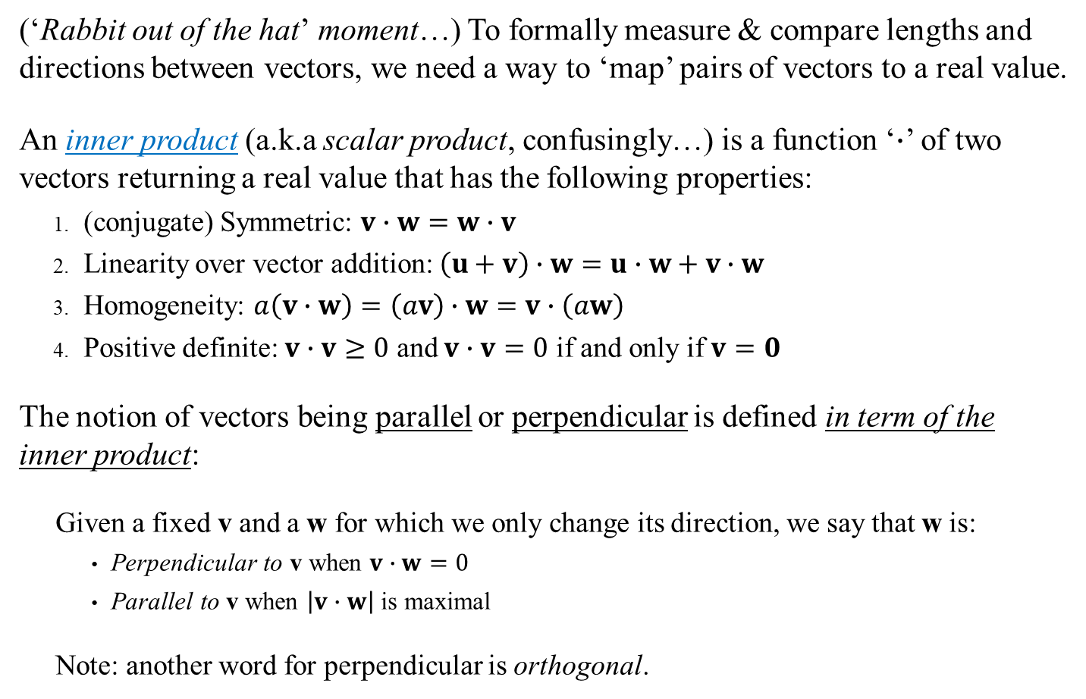
Comparing Vectors: Inner Product
Warning: This is out of order compared with our book
(‘Rabbit out of the hat’ moment…) To formally measure & compare lengths and directions between vectors, we need a way to ‘map’ pairs of vectors to a real value.
An inner product (a.k.a scalar product, confusingly…) is a function ‘$∙$’ of two vectors returning a real value that has the following properties:
(conjugate) Symmetric: $v∙w=w∙v$
Linearity over vector addition: $\left(u+v\right)∙w=u∙w+v∙w$
Homogeneity: $a\left(v∙w\right)=\left(av\right)∙w=v∙\left(aw\right)$
Positive definite: $v∙v≥0$ and $v∙v=0$ if and only if $v=0$
The notion of vectors being parallel or perpendicular is defined in term of the inner product:
Given a fixed v and a w for which we only change its direction, we say that w is:
Perpendicular to v when $v∙w=0$
Parallel to v when $\left|v∙w\right|$ is maximal
Note: another word for perpendicular is orthogonal.
Note: a is not distributed!!!
Sidebar:
Are we ok using the absolute value symbol?

Slide 13
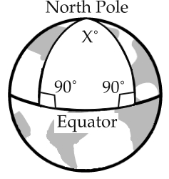
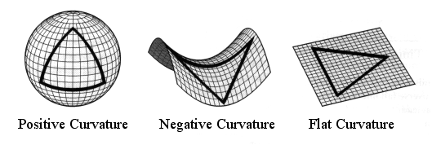
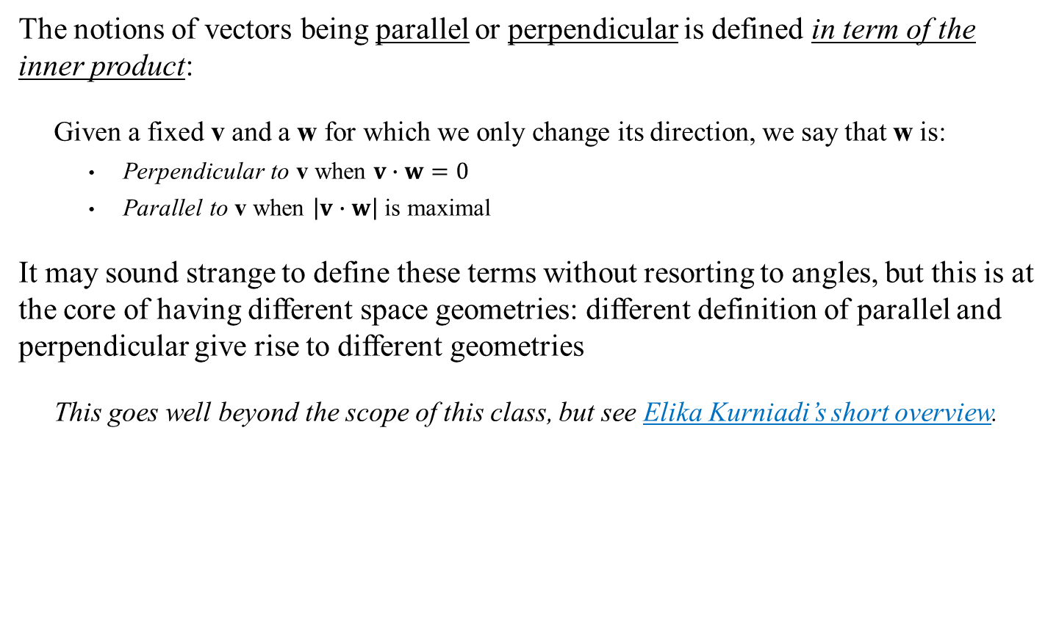
Parallel and Perpendicular
The notions of vectors being parallel or perpendicular is defined in term of the inner product:
Given a fixed v and a w for which we only change its direction, we say that w is:
Perpendicular to v when $v∙w=0$
Parallel to v when $\left|v∙w\right|$ is maximal
It may sound strange to define these terms without resorting to angles, but this is at the core of having different space geometries: different definition of parallel and perpendicular give rise to different geometries
This goes well beyond the scope of this class, but see Elika Kurniadi’s short overview.

Slide 14
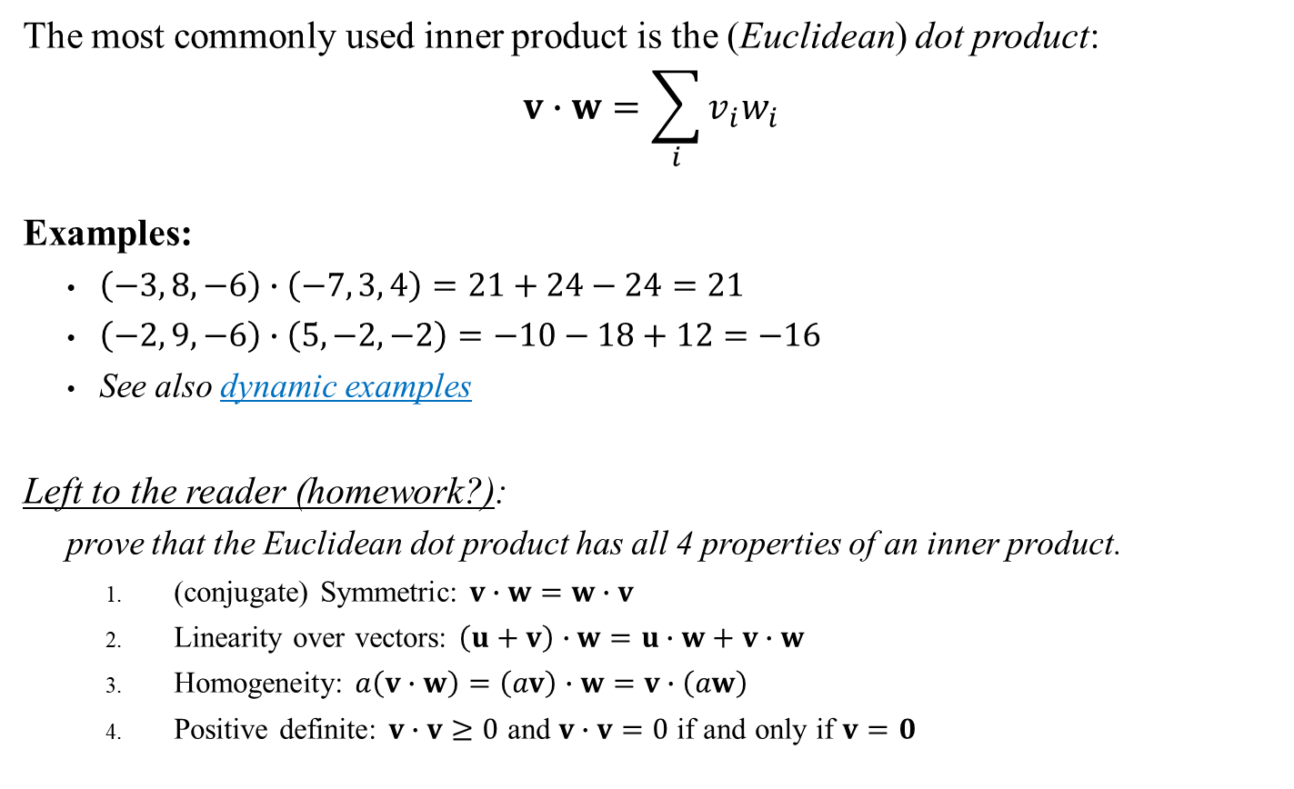
Standard Inner Product: Dot Product
The most commonly used inner product is the (Euclidean) dot product:
$$v∙w=\sum_{i}{v_{i}w_{i}}$$
Examples:
$\left(−3, 8, −6\right)∙\left(−7, 3, 4\right)=21+24−24=21$
$\left(−2, 9, −6\right)∙\left(5, −2, −2\right)=−10−18+12=−16$
See also dynamic examples
Left to the reader (homework?):
prove that the Euclidean dot product has all 4 properties of an inner product.
(conjugate) Symmetric: $v∙w=w∙v$
Linearity over vectors: $\left(u+v\right)∙w=u∙w+v∙w$
Homogeneity: $a\left(v∙w\right)=\left(av\right)∙w=v∙\left(aw\right)$
Positive definite: $v∙v≥0$ and $v∙v=0$ if and only if $v=0$
Sidebar:
Are we ok using the sigma notation for sums?

Slide 15

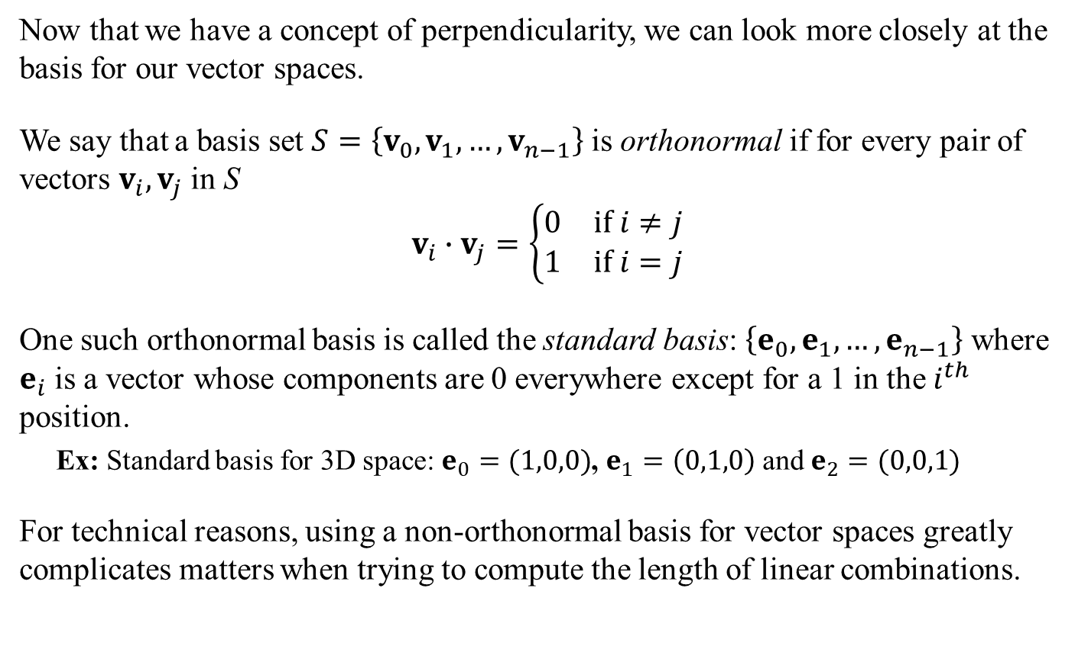
Standard Orthonormal Basis
Now that we have a concept of perpendicularity, we can look more closely at the basis for our vector spaces.
We say that a basis set $S=\left\{v_{0},v_{1},…,v_{n−1}\right\}$ is orthonormal if for every pair of vectors $v_{i}, v_{j}$ in S
$$v_{i}∙v_{j}=\left\{\begin{matrix}0 & \text{if} i≠j \\ 1 & \text{if} i=j\end{matrix}\right.$$
One such orthonormal basis is called the standard basis: $\left\{e_{0},e_{1},…,e_{n−1}\right\}$ where $e_{i}$ is a vector whose components are 0 everywhere except for a 1 in the $i^{th}$ position.
Ex: Standard basis for 3D space: $e_{0}=(1,0,0)$, $e_{1}=\left(0,1,0\right)$ and $e_{2}=(0,0,1)$
For technical reasons, using a non-orthonormal basis for vector spaces greatly complicates matters when trying to compute the length of linear combinations.
Orthonormal: both orthogonal and $v_{i}∙v_{i}=1$
Therefore, from here on out (unless explicitly stated) we will always assume we have an orthonormal basis for our vector space.

Slide 16
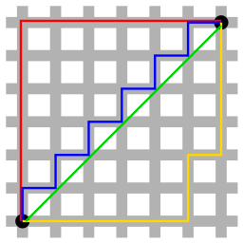
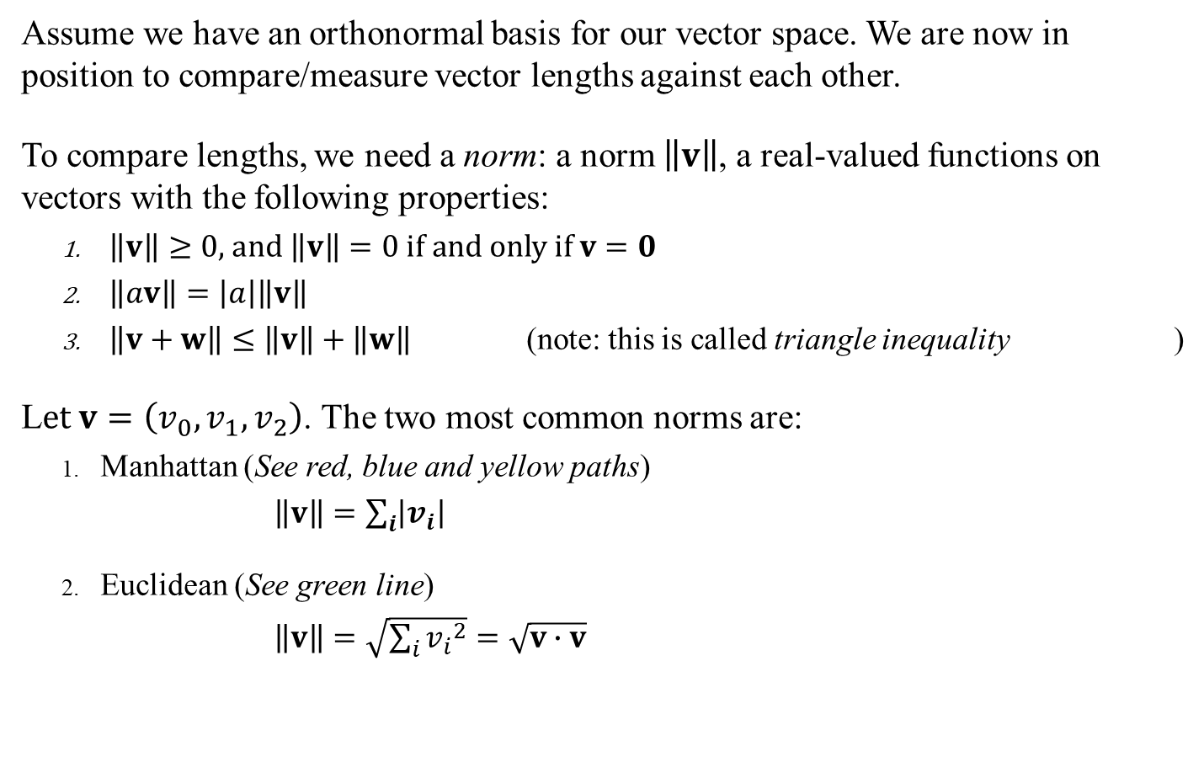
Measuring Vectors: Comparing Lengths
Assume we have an orthonormal basis for our vector space. We are now in position to compare/measure vector lengths against each other.
To compare lengths, we need a norm: a norm $\left\|v\right\|$, a real-valued functions on vectors with the following properties:
$\left\|v\right\|≥0\text{, }\text{and} \left\|v\right\|=0 \text{if} \text{and} \text{only} \text{if} v=0$
$\left\|av\right\|=\left|a\right|\left\|v\right\|$
$\left\|v+w\right\|≤\left\|v\right\|+\left\|w\right\|$ (note: this is called triangle inequality )
L$et v=\left(v_{0},v_{1},v_{2}\right)$. The two most common norms are:
Manhattan (See red, blue and yellow paths)
$\left\|v\right\|=\sum_{i}{\left|v_{i}\right|}$
Euclidean (See green line)
$\left\|v\right\|=\sqrt{\sum_{i}{{v_{i}}^{2}}}=\sqrt{v∙v}$
v
w
v+w
See also dynamic examples
Manhattan and Euclidean norms in 2D
Sidebar:
If you think these norms are oddly close to the dot product, you are correct. While the norm is not unique, the properties of norms and inner products are such that defining an inner product on a vector space yields a ‘natural’ norm for the space.

Slide 17
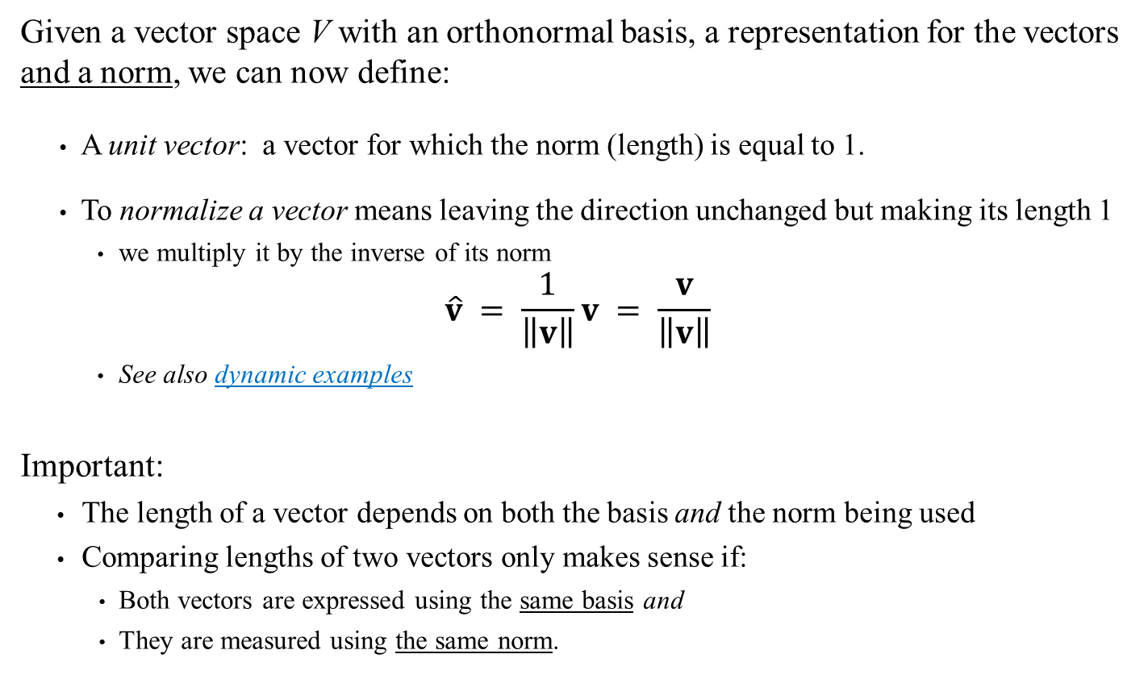
Unit Vectors and Normalizing
Given a vector space V with an orthonormal basis, a representation for the vectors and a norm, we can now define:
A unit vector: a vector for which the norm (length) is equal to 1.
To normalize a vector means leaving the direction unchanged but making its length 1
we multiply it by the inverse of its norm
$$\hat{v} = \frac{1}{\left\|v\right\|}v = \frac{v}{\left\|v\right\|}$$
See also dynamic examples
Important:
The length of a vector depends on both the basis and the norm being used
Comparing lengths of two vectors only makes sense if:
Both vectors are expressed using the same basis and
They are measured using the same norm.

Slide 18
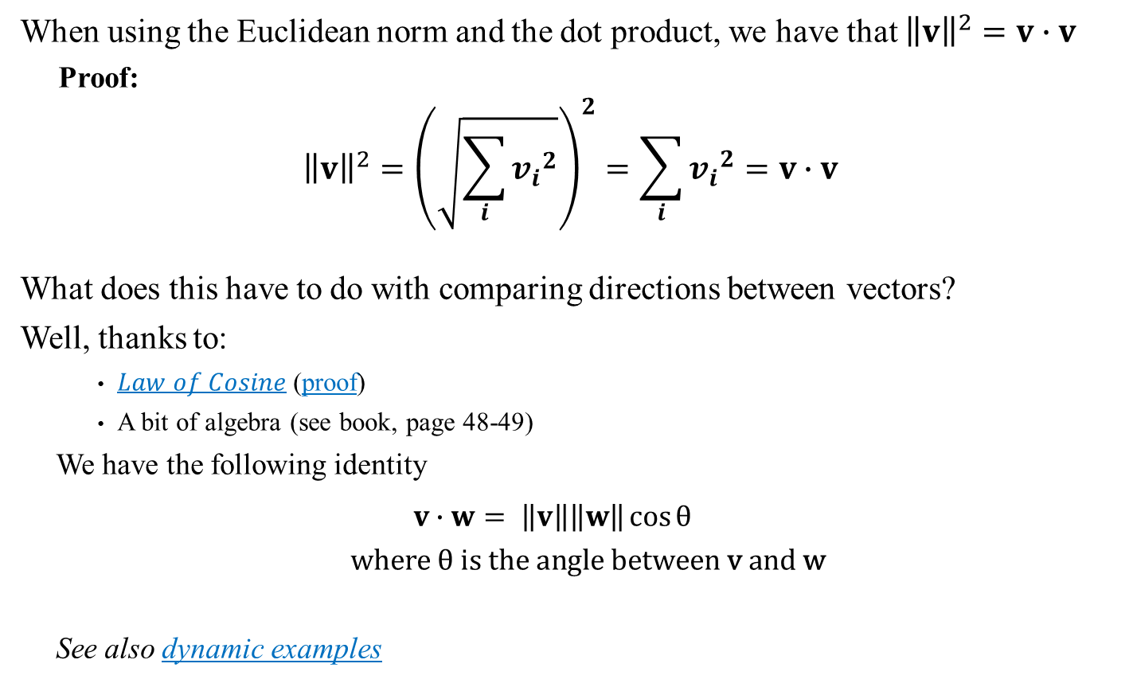
Dot Product, Euclidian Norm and Angles
When using the Euclidean norm and the dot product, we have that ${\left\|v\right\|}^{2}=v∙v$
Proof:
$${\left\|v\right\|}^{2}={\left(\sqrt{\sum_{i}{{v_{i}}^{2}}}\right)}^{2}=\sum_{i}{{v_{i}}^{2}}=v∙v$$
What does this have to do with comparing directions between vectors?
Well, thanks to:
$Law of Cosine$ (proof)
A bit of algebra (see book, page 48-49)
We have the following identity
$$v∙w= \left\|v\right\|\left\|w\right\|\cos{θ}$$ $where θ \text{is} \text{the} \text{angle} \text{between} \text{v} \text{and} \text{w}$
See also dynamic examples
v
θ
w

Slide 19
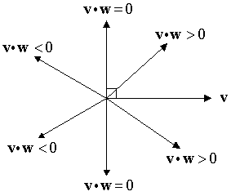

Comparing Directions
Let’s look more closely at this relation
$v∙w= \left\|v\right\|\left\|w\right\|\cos{θ}$ $where θ \text{is} \text{the} \text{angle} \text{between} \text{v} \text{and} \text{w}$
Given two vectors, the dot product and the Euclidean norm gives you a measure of how different their directions are.
Sidebar:
Calculation the cosine is computationally costly while calculating the dot product is very computationally efficient. There are many instances in graphics and/or game development where you need information about angles and in almost all cases, the information provided by the dot product will be more than enough, saving you the need to use a computationally expensive trig function.
As a rule, always try to recast geometry problems in terms of vector operations!

Slide 20

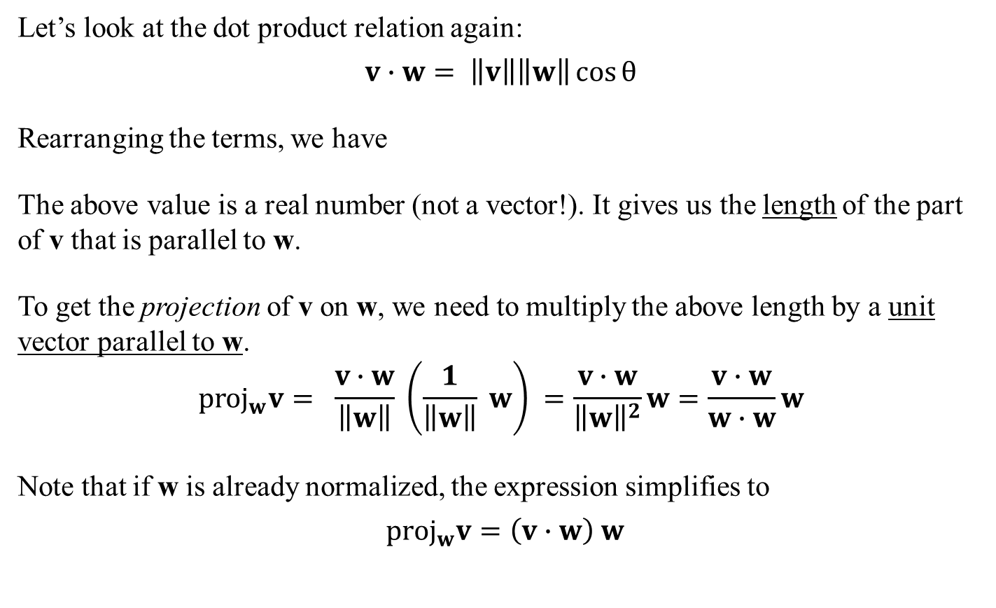
Projection Vector
Let’s look at the dot product relation again:
$v∙w= \left\|v\right\|\left\|w\right\|\cos{θ}$
Rearranging the terms, we have
The above value is a real number (not a vector!). It gives us the length of the part of v that is parallel to w.
To get the projection of v on w, we need to multiply the above length by a unit vector parallel to w.
$${\text{proj}}_{w}v= \frac{v∙w}{\left\|w\right\|} \left(\frac{1}{\left\|w\right\|} w\right) =\frac{v∙w}{{\left\|w\right\|}^{2}}w=\frac{v∙w}{w∙w}w$$
Note that if w is already normalized, the expression simplifies to
${\text{proj}}_{w}v=\left(v∙w\right) w$
v
θ
w
$\frac{v∙w}{\left\|w\right\|}= \left\|v\right\|\cos{θ}$
Sidebar:
This is why people often claim that a ‘dot product’ is ‘like a projection’. It’s true, but only under the right conditions.
See also dynamic examples

Slide 21

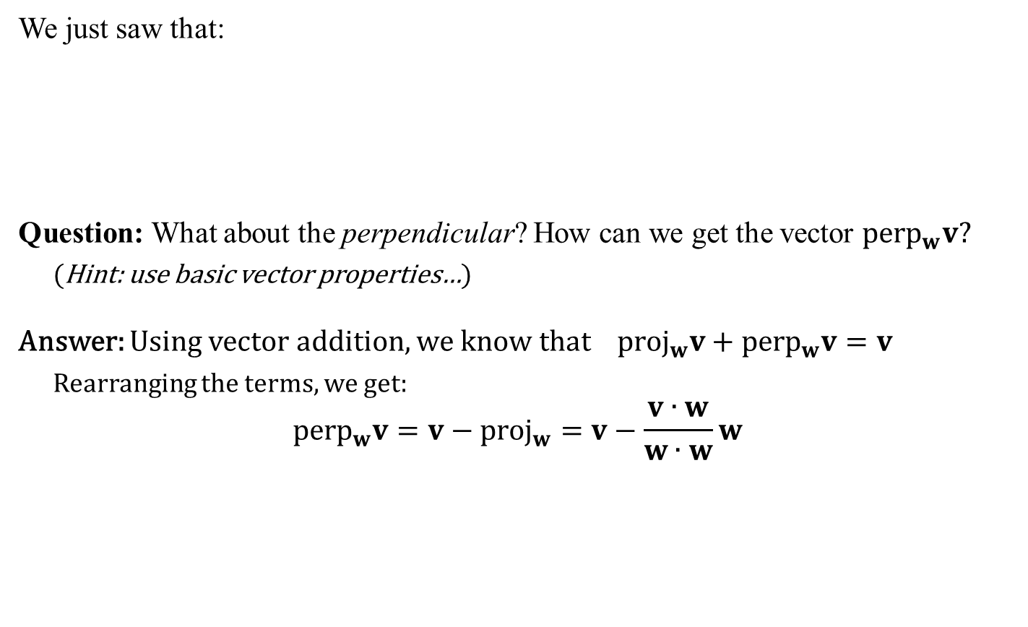


Perpendicular Vector
We just saw that:
Question: What about the perpendicular? How can we get the vector ${\text{perp}}_{w}v?$
(Hint: use basic vector properties…)
Answer: Using vector addition, we know that ${\text{proj}}_{w}v+{\text{perp}}_{w}v=v$
Rearranging the terms, we get:
$${\text{perp}}_{w}v=v−{\text{proj}}_{w}=v−\frac{v∙w}{w∙w}w$$
$${\text{perp}}_{w}v$$
$${\text{where} \text{proj}}_{w}v=\frac{v∙w}{w∙w}w$$
v
w
θ
$${\text{proj}}_{w}v$$
Sidebar:
The perpendicular vector here falls in the span generated by v and w. Not to be confused with the cross product (next slide) which will be outside the span
See also dynamic examples

Slide 22


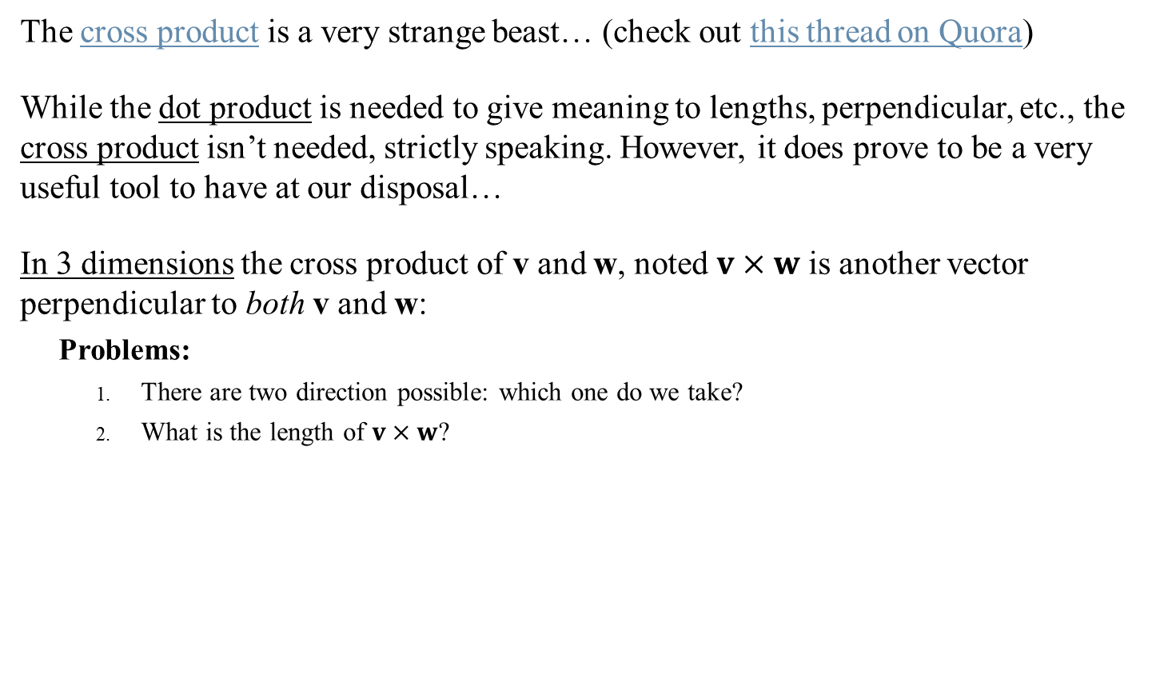
Cross Product
The cross product is a very strange beast… (check out this thread on Quora)
While the dot product is needed to give meaning to lengths, perpendicular, etc., the cross product isn’t needed, strictly speaking. However, it does prove to be a very useful tool to have at our disposal…
In 3 dimensions the cross product of v and w, noted $v×w$ is another vector perpendicular to both v and w:
Problems:
There are two direction possible: which one do we take?
What is the length of $v×w$?
$v×w$?
v
θ
w
$v×w$?

Slide 23
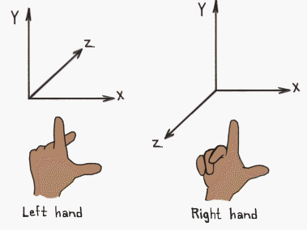
Space Handedness
By defining a cross product, we are forcing ourselves to define the handedness of our vector space.
Which one to use?
Just about everybody in mathematics, science and engineering uses right-hand space.
The ONLY exceptions: Computer graphics and animation. Sometimes left-hand space is used, sometimes right-hand space. No standards exist…
IMPORTANT: This will cause you problems in the future!!!
Always double check which handedness is being used
(in books, in code libraries, in graphics software, etc)

Slide 24
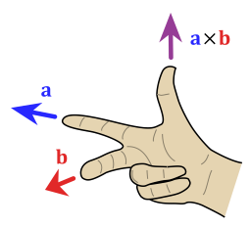
Space Handedness
By defining a cross product, we are forcing ourselves to define the handedness of our vector space.
We will be using right hand spaces throughout the class!
But you must be vigilant about this!!! The fact that our area of work (graphics and animation) is so flaky about handedness means you will encounter many traps.
(See this Wikipedia page for one trap that cost me 3 days of headache…)

Slide 25

Cross Product ‘Definition’
The formula for the cross product is:
$$v×w=\left(v_{2}w_{3}−v_{3}w_{2},{ v}_{3}w_{1}−v_{1}w_{3},{ v}_{1}w_{2}−v_{2}w_{1}\right)$$
A more ‘visual’ trick to compute it:
$$v=\left( v_{1} , v_{2} , v_{3} \right) \\ w=\left( w_{1} , w_{2} , w_{3} \right)$$ 1 -1 1
$$v×w=\left(v_{2}w_{3}−v_{3}w_{2},{ v}_{3}w_{1}−v_{1}w_{3},{ v}_{1}w_{2}−v_{2}w_{1}\right)$$

Slide 26
Cross Product ‘Definition’
The formula for the cross product is:
$$v×w=\left(v_{2}w_{3}−v_{3}w_{2},{ v}_{3}w_{1}−v_{1}w_{3},{ v}_{1}w_{2}−v_{2}w_{1}\right)$$
A more ‘visual’ trick to compute it:
$$v=\left( v_{1} , v_{2} , v_{3} \right) \\ w=\left( w_{1} , w_{2} , w_{3} \right)$$ 1 -1 1
$$v×w=\left(v_{2}w_{3}−v_{3}w_{2},{ v}_{3}w_{1}−v_{1}w_{3},{ v}_{1}w_{2}−v_{2}w_{1}\right)$$

Slide 27

Cross Product ‘Definition’
The formula for the cross product is:
$$v×w=\left(v_{2}w_{3}−v_{3}w_{2},{ v}_{3}w_{1}−v_{1}w_{3},{ v}_{1}w_{2}−v_{2}w_{1}\right)$$
A more ‘visual’ trick to compute it:
$$v=\left( v_{1} , v_{2} , v_{3} \right) \\ w=\left( w_{1} , w_{2} , w_{3} \right)$$ 1 -1 1
$$v×w=\left(v_{2}w_{3}−v_{3}w_{2},{ v}_{3}w_{1}−v_{1}w_{3},{ v}_{1}w_{2}−v_{2}w_{1}\right)$$
$$−(v_{1}w_{3}−v_{3}w_{1})$$

Slide 28


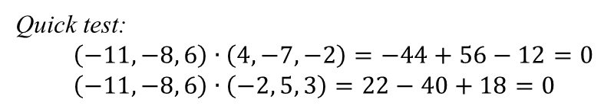
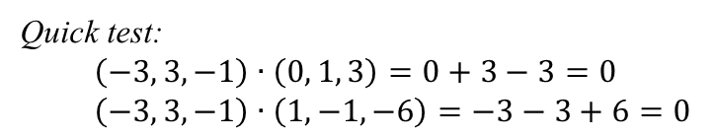

Cross Product ‘Definition’
The formula for the cross product is:
$$v×w=\left(v_{2}w_{3}−v_{3}w_{2},{ v}_{3}w_{1}−v_{1}w_{3},{ v}_{1}w_{2}−v_{2}w_{1}\right)$$
A more ‘visual’ trick to compute it:
$$v=\left( v_{1} , v_{2} , v_{3} \right) \\ w=\left( w_{1} , w_{2} , w_{3} \right)$$ 1 -1 1
$$v×w=\left(v_{2}w_{3}−v_{3}w_{2},{ v}_{3}w_{1}−v_{1}w_{3},{ v}_{1}w_{2}−v_{2}w_{1}\right)$$
Examples:
$$\frac{\begin{aligned} \left(0, 1, 3\right) \\ × \left(1 , −1, −6 \right)\end{aligned}}{ ( , , )}$$
Quick test:
$$\left(−3, 3,−1\right)∙\left(0, 1, 3\right)=0+3−3=0 \\ \left(−3, 3,−1\right)∙\left(1,−1,−6\right)=−3−3+6=0$$
-3
3
-1
See also
dynamic examples
$$\frac{\begin{aligned} \left( 4, −7, −2\right) \\ × \left(−2 , 5, 3 \right)\end{aligned}}{ ( , , )}$$
Quick test:
$$\left(−11,−8, 6\right)∙\left(4,−7,−2\right)=−44+56−12=0 \\ \left(−11,−8, 6\right)∙\left(−2, 5, 3\right)=22−40+18=0$$
-11
-8
6

Slide 29

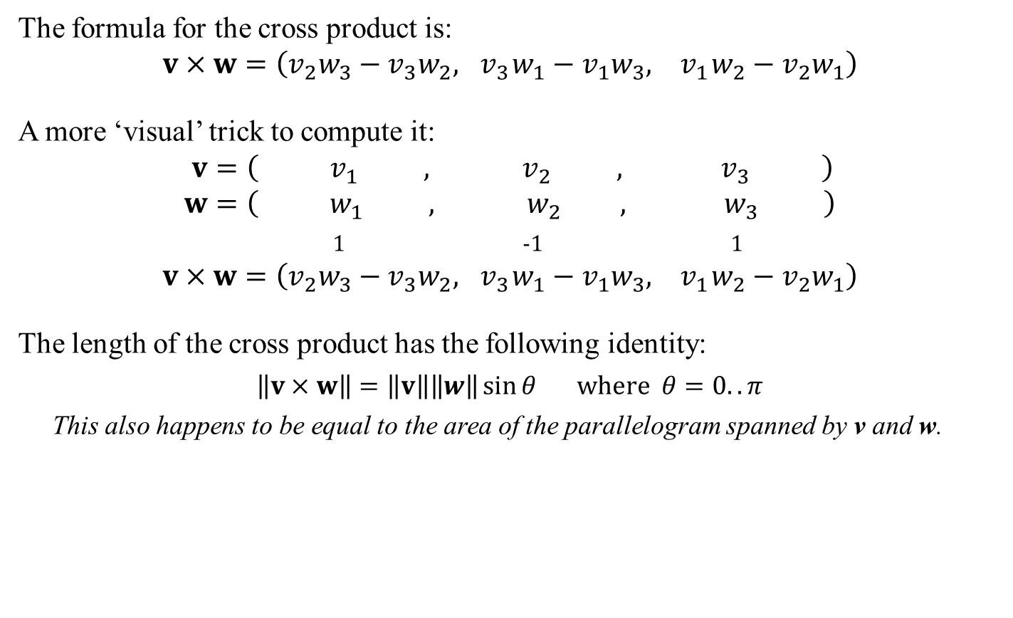

Cross Product ‘Definition’
The formula for the cross product is:
$$v×w=\left(v_{2}w_{3}−v_{3}w_{2},{ v}_{3}w_{1}−v_{1}w_{3},{ v}_{1}w_{2}−v_{2}w_{1}\right)$$
A more ‘visual’ trick to compute it:
$$v=\left( v_{1} , v_{2} , v_{3} \right) \\ w=\left( w_{1} , w_{2} , w_{3} \right)$$ 1 -1 1
$$v×w=\left(v_{2}w_{3}−v_{3}w_{2},{ v}_{3}w_{1}−v_{1}w_{3},{ v}_{1}w_{2}−v_{2}w_{1}\right)$$
The length of the cross product has the following identity:
$\left\|v×w\right\|=\left\|v\right\|\left\|w\right\|\sin{θ} \text{where} θ=0..π$
This also happens to be equal to the area of the parallelogram spanned by v and w.
See also
dynamic examples
$$v×w$$
w
$$\left\|v×w\right\|$$
θ
v

Slide 30

Cross Product: Properties
The cross product has the following properties:
Anti-commutative: $v×w=−\left(w×v \right)$
Distributive over vector addition: $u×\left(v+w\right)=u×v+u×w$
$\left(v+w\right)×u=v×u+w×u$
Scalar multiplication: $a\left(v×w\right)=\left(av\right)×w=v×\left(aw\right)$
Zero: $v×0=0×v=0$ $v×v=0$

Slide 31
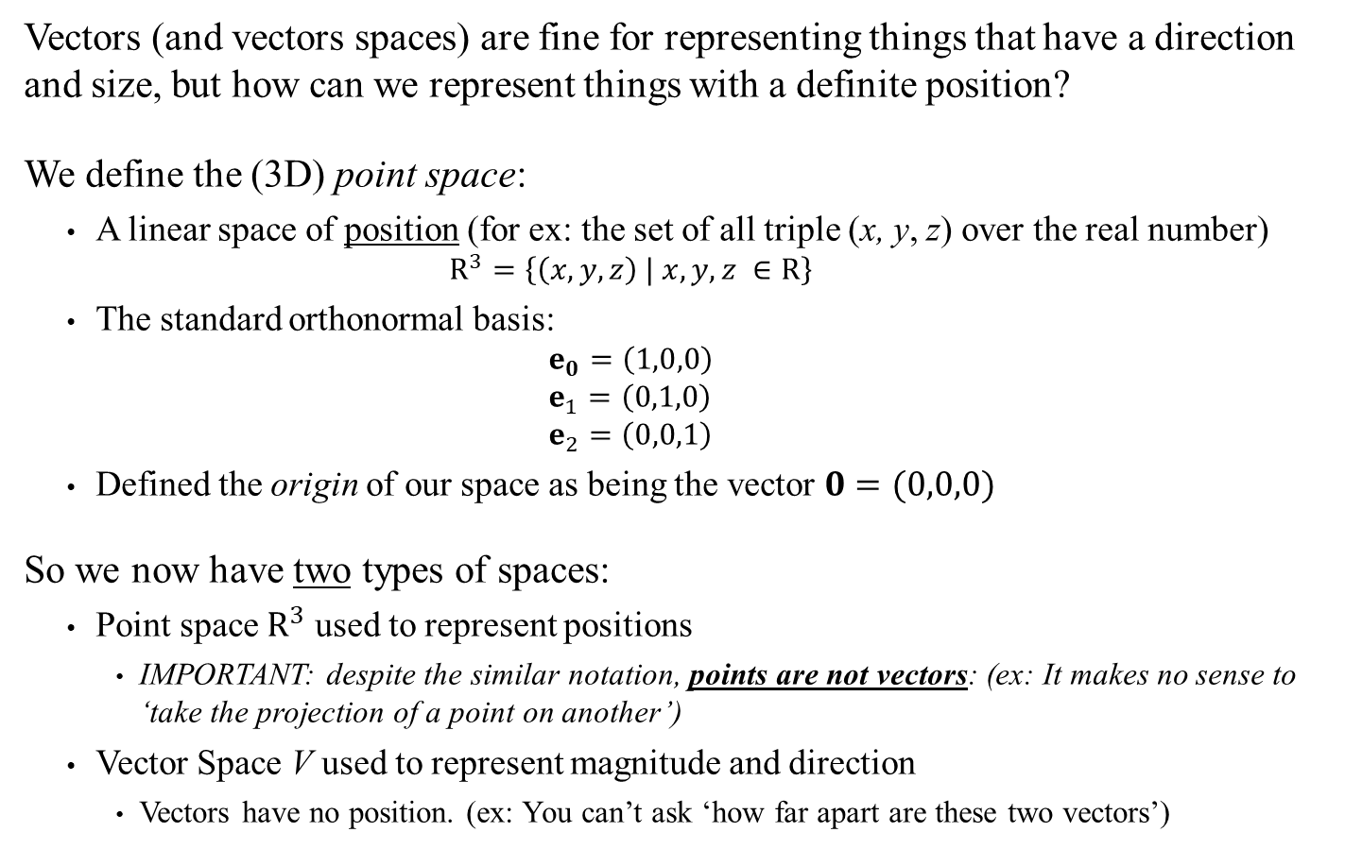
Vectors Versus Points… (This is to clarify Section 2.3 of the book, which is a tad esoteric)
Vectors (and vectors spaces) are fine for representing things that have a direction and size, but how can we represent things with a definite position?
We define the (3D) point space:
A linear space of position (for ex: the set of all triple (x, y, z) over the real number)
$$R^{3}=\left\{\left(x,y,z\right) | x,y,z ∈R\right\}$$
The standard orthonormal basis:
$$e_{0}=\left(1,0,0\right) \\ e_{1}=\left(0,1,0\right) \\ e_{2}=\left(0,0,1\right)$$
Defined the origin of our space as being the vector $0=(0,0,0)$
So we now have two types of spaces:
Point space $R^{3}$ used to represent positions
IMPORTANT: despite the similar notation, points are not vectors: (ex: It makes no sense to ‘take the projection of a point on another’)
Vector Space V used to represent magnitude and direction
Vectors have no position. (ex: You can’t ask ‘how far apart are these two vectors’)

Slide 32
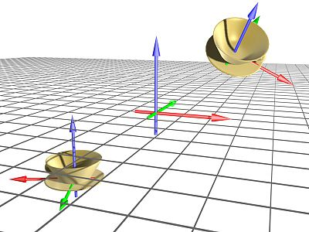

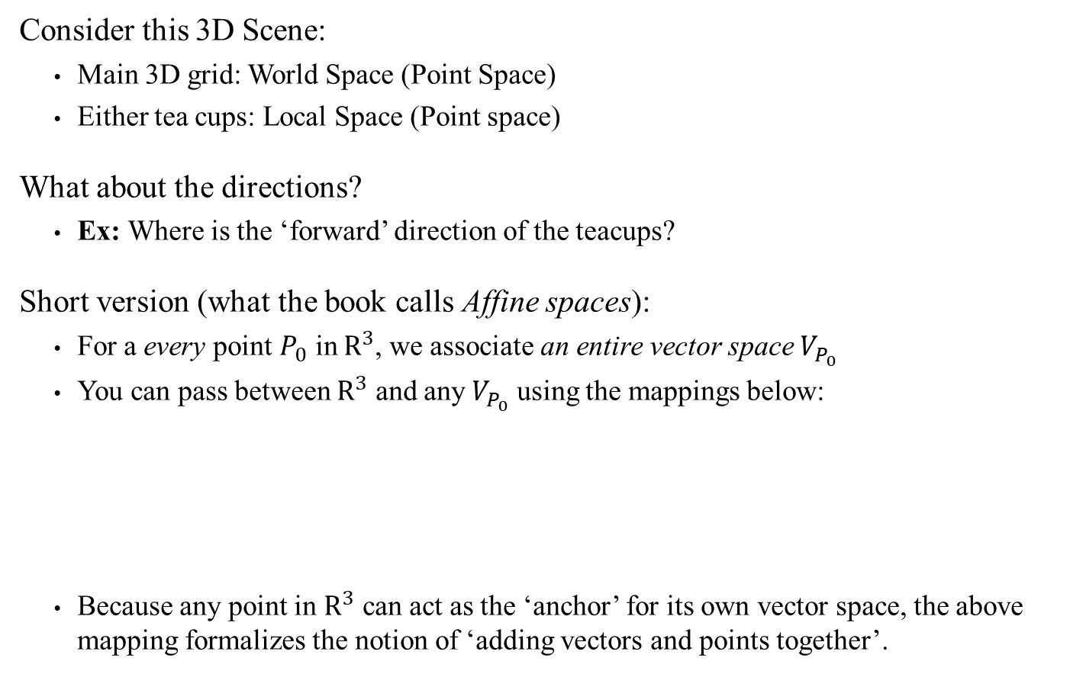



Vectors Versus Points… (This is to clarify Section 2.3 of the book, which is a tad esoteric)
Consider this 3D Scene:
Main 3D grid: World Space (Point Space)
Either tea cups: Local Space (Point space)
What about the directions?
Ex: Where is the ‘forward’ direction of the teacups?
Short version (what the book calls Affine spaces):
For a every point $P_{0}$ in $R^{3}$, we associate an entire vector space $V_{P_{0}}$
You can pass between $R^{3}$ and any $V_{P_{0}}$ using the mappings below:
Because any point in $R^{3}$ can act as the ‘anchor’ for its own vector space, the above mapping formalizes the notion of ‘adding vectors and points together’.
$$v=P−P_{0}$$
$$P=P_{0}+(v_{0},v_{1},v_{2})$$
$$P=(x,y,z) \text{in} R^{3}$$
$$v=(v_{o},v_{1},v_{2}) \text{in} V_{P_{0}}$$

