Slide 1
GAM 325/425: Applied 3D Geometry
Lecture 2, Part A:
Matrices and Transforms

Slide 2
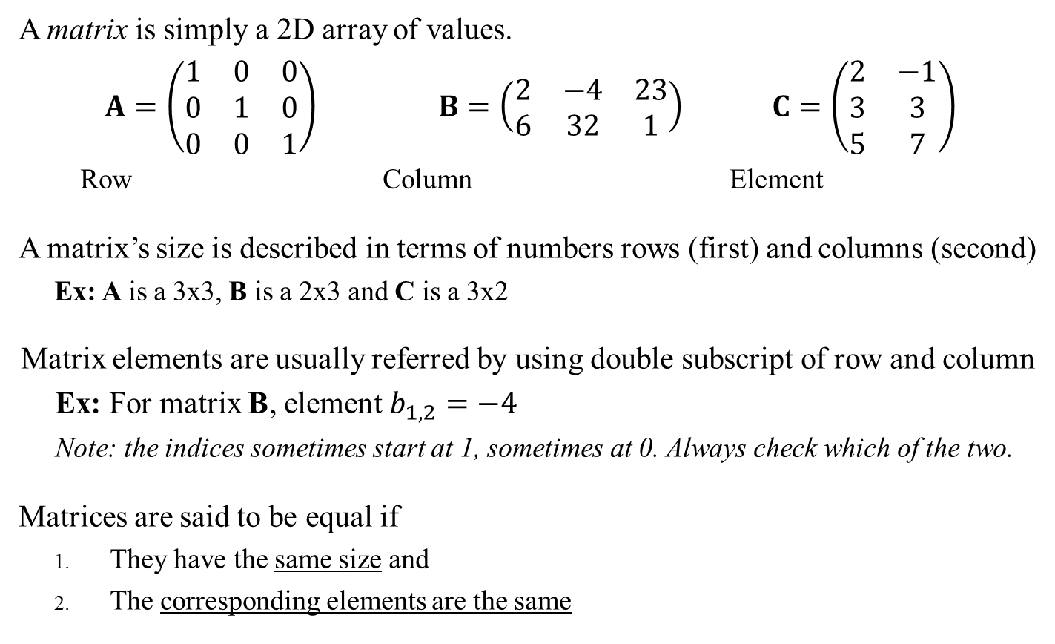
Matrix Terminology
Sidebar:
Matrix notation can use either parenthesis (which I prefer) or square brackets (which the book uses)
A matrix is simply a 2D array of values.
$A=\left(\begin{matrix}1 & 0 & 0 \\ 0 & 1 & 0 \\ 0 & 0 & 1\end{matrix}\right)$ $B=\left(\begin{matrix}2 & −4 & 23 \\ 6 & 32 & 1\end{matrix}\right)$ $C=\left(\begin{matrix}2 & −1 \\ 3 & 3 \\ 5 & 7\end{matrix}\right)$
Row Column Element
A matrix’s size is described in terms of numbers rows (first) and columns (second)
Ex: A is a 3x3, B is a 2x3 and C is a 3x2
Matrix elements are usually referred by using double subscript of row and column
Ex: For matrix B, element $b_{1,2}=−4$
Note: the indices sometimes start at 1, sometimes at 0. Always check which of the two.
Matrices are said to be equal if
They have the same size and
The corresponding elements are the same

Slide 3
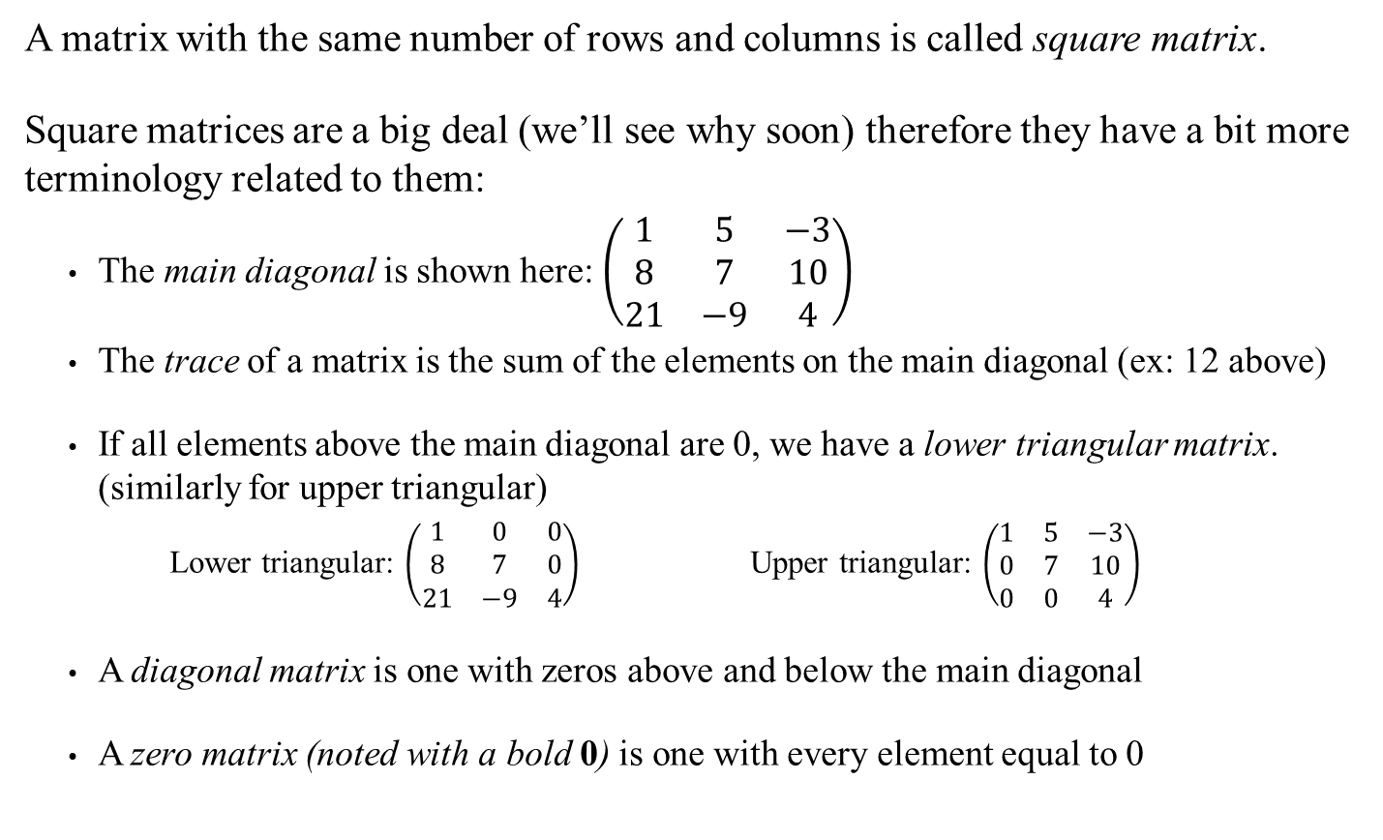
Matrix Terminology
A matrix with the same number of rows and columns is called square matrix.
Square matrices are a big deal (we’ll see why soon) therefore they have a bit more terminology related to them:
The main diagonal is shown here: $\left(\begin{matrix}1 & 5 & −3 \\ 8 & 7 & 10 \\ 21 & −9 & 4\end{matrix}\right)$
The trace of a matrix is the sum of the elements on the main diagonal (ex: 12 above)
If all elements above the main diagonal are 0, we have a lower triangular matrix. (similarly for upper triangular)
Lower triangular: $\left(\begin{matrix}1 & 0 & 0 \\ 8 & 7 & 0 \\ 21 & −9 & 4\end{matrix}\right)$ Upper triangular: $\left(\begin{matrix}1 & 5 & −3 \\ 0 & 7 & 10 \\ 0 & 0 & 4\end{matrix}\right)$
A diagonal matrix is one with zeros above and below the main diagonal
A zero matrix (noted with a bold 0) is one with every element equal to 0

Slide 4
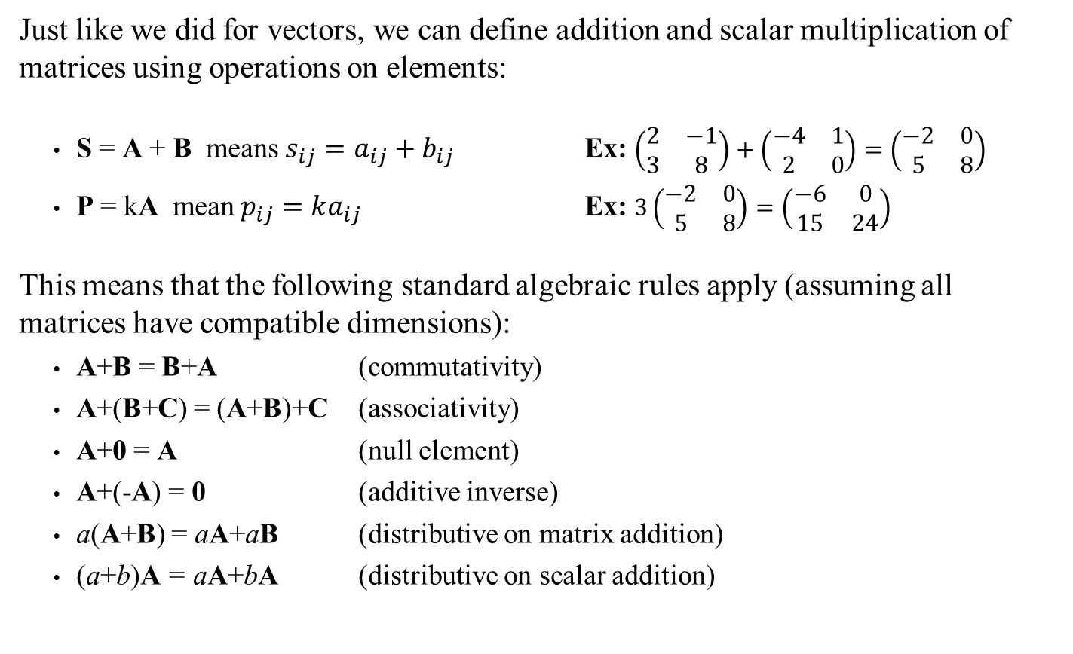
Matrix Operations
Just like we did for vectors, we can define addition and scalar multiplication of matrices using operations on elements:
S = A + B means $s_{ij}=a_{ij}+b_{ij}$ Ex: $\left(\begin{matrix}2 & −1 \\ 3 & 8\end{matrix}\right)+\left(\begin{matrix}−4 & 1 \\ 2 & 0\end{matrix}\right)=\left(\begin{matrix}−2 & 0 \\ 5 & 8\end{matrix}\right)$
P = kA mean $p_{ij}=ka_{ij}$ Ex: $3\left(\begin{matrix}−2 & 0 \\ 5 & 8\end{matrix}\right)=\left(\begin{matrix}−6 & 0 \\ 15 & 24\end{matrix}\right)$
This means that the following standard algebraic rules apply (assuming all matrices have compatible dimensions):
A+B = B+A (commutativity)
A+(B+C) = (A+B)+C (associativity)
A+0 = A (null element)
A+(-A) = 0 (additive inverse)
a(A+B) = aA+aB (distributive on matrix addition)
(a+b)A = aA+bA (distributive on scalar addition)
Note: Addition only possible if the matrices have the same dimensions

Slide 5
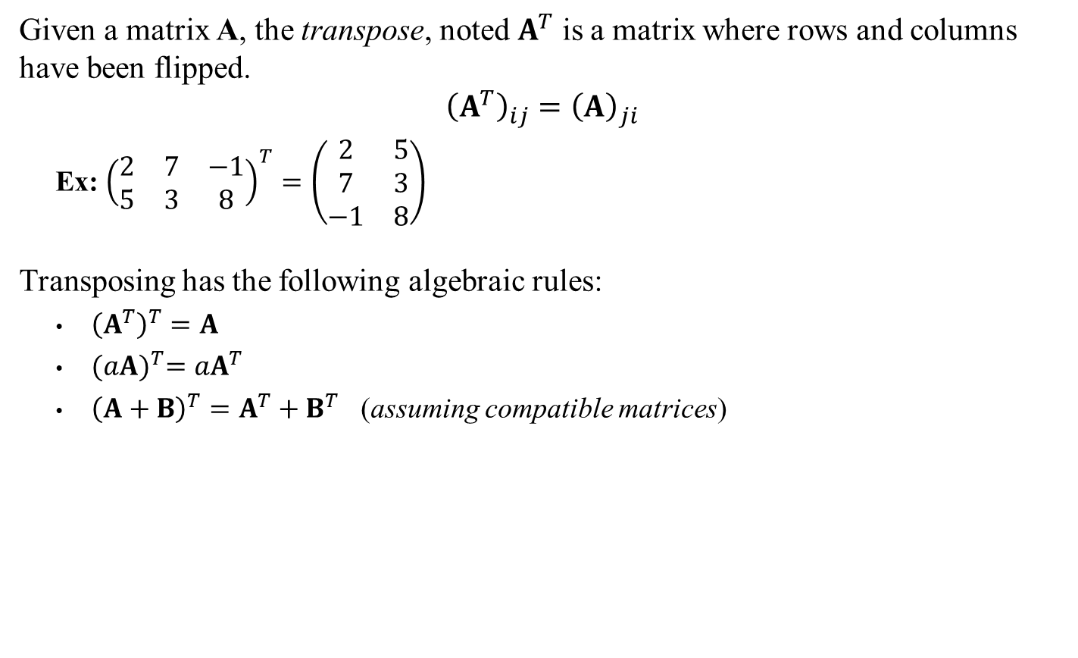
Matrix Transpose
Given a matrix A, the transpose, noted $A^{T}$ is a matrix where rows and columns have been flipped.
$${\left(A^{T}\right)}_{ij}={\left(A\right)}_{ji}$$
Ex: ${\left(\begin{matrix}2 & 7 & −1 \\ 5 & 3 & 8\end{matrix}\right)}^{T}=\left(\begin{matrix}2 & 5 \\ 7 & 3 \\ −1 & 8\end{matrix}\right)$
Transposing has the following algebraic rules:
${\left(A^{T}\right)}^{T}=A$
${(aA)}^{T}=aA^{T}$
${\left(A+B\right)}^{T}=A^{T}+B^{T}$ (assuming compatible matrices)

Slide 6
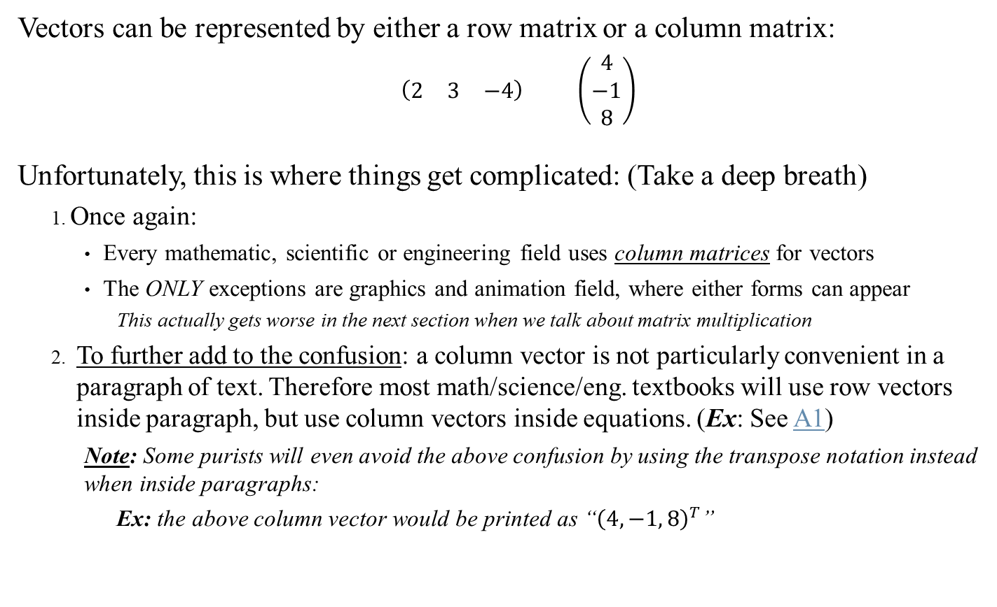
Vectors
Vectors can be represented by either a row matrix or a column matrix:
$\left(\begin{matrix}2 & 3 & −4\end{matrix}\right)$ $\left(\begin{matrix}4 \\ −1 \\ 8\end{matrix}\right)$
Unfortunately, this is where things get complicated: (Take a deep breath)
Once again:
Every mathematic, scientific or engineering field uses column matrices for vectors
The ONLY exceptions are graphics and animation field, where either forms can appear
This actually gets worse in the next section when we talk about matrix multiplication
To further add to the confusion: a column vector is not particularly convenient in a paragraph of text. Therefore most math/science/eng. textbooks will use row vectors inside paragraph, but use column vectors inside equations. (Ex: See A1)
Note: Some purists will even avoid the above confusion by using the transpose notation instead when inside paragraphs:
Ex: the above column vector would be printed as “${\left(4, −1, 8\right)}^{T}$”
We will follow standard practice: vectors are column matrices but when inside a paragraph, row vectors are acceptable

Slide 7
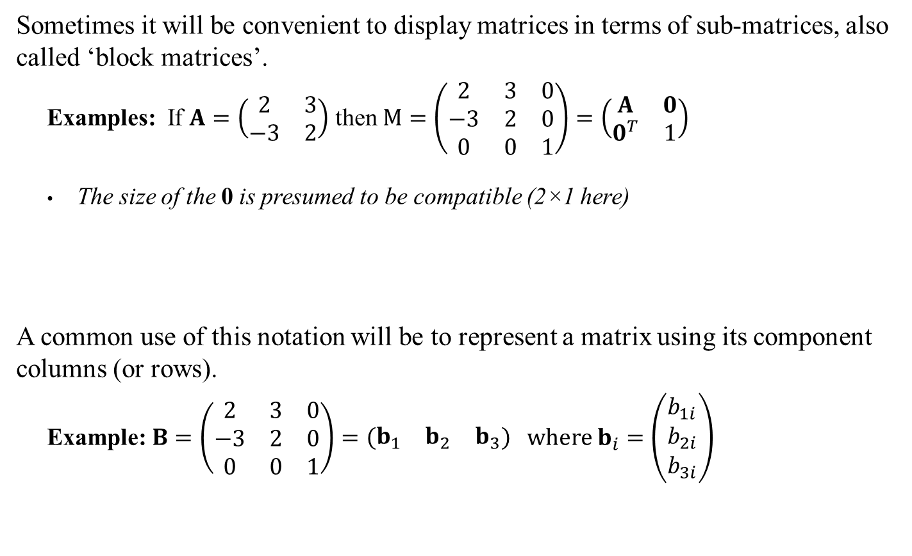
Block Matrix
Sometimes it will be convenient to display matrices in terms of sub-matrices, also called ‘block matrices’.
Examples: If $A=\left(\begin{matrix}2 & 3 \\ −3 & 2\end{matrix}\right)$ then $M=\left(\begin{matrix}2 & 3 & 0 \\ −3 & 2 & 0 \\ 0 & 0 & 1\end{matrix}\right)=\left(\begin{matrix}A & 0 \\ 0^{T} & 1\end{matrix}\right)$
The size of the 0 is presumed to be compatible (2×1 here)
A common use of this notation will be to represent a matrix using its component columns (or rows).
Example: $B=\left(\begin{matrix}2 & 3 & 0 \\ −3 & 2 & 0 \\ 0 & 0 & 1\end{matrix}\right)=\left(\begin{matrix}b_{1} & b_{2} & b_{3}\end{matrix}\right) \text{where} b_{i}=\left(\begin{matrix}b_{1i} \\ b_{2i} \\ b_{3i}\end{matrix}\right)$
Sidebar:
We will use this extensively starting next week!
Note: this is merely a notational trick used in proofs or construction. It’s a way to simplify the writing of large matrices.

Slide 8
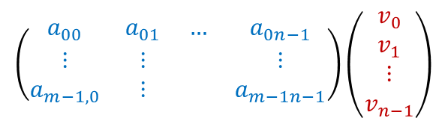
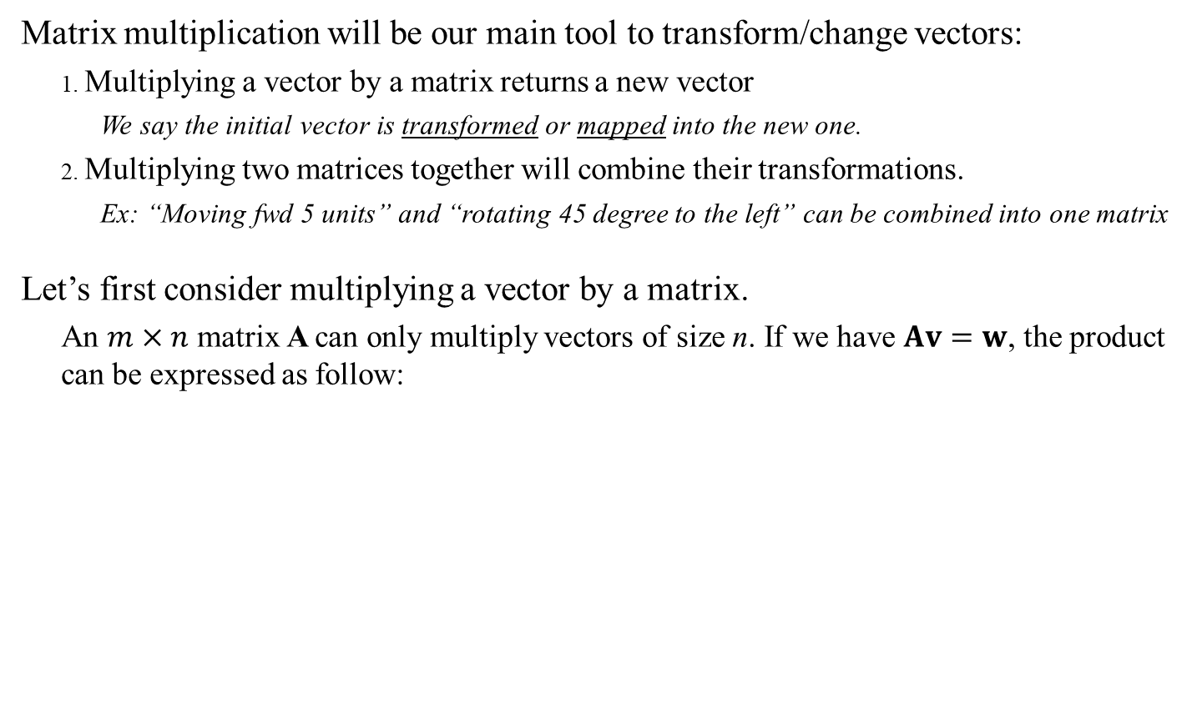
Matrix Multiplication:
Matrix multiplication will be our main tool to transform/change vectors:
Multiplying a vector by a matrix returns a new vector
We say the initial vector is transformed or mapped into the new one.
Multiplying two matrices together will combine their transformations.
Ex: “Moving fwd 5 units” and “rotating 45 degree to the left” can be combined into one matrix
Let’s first consider multiplying a vector by a matrix.
An $m×n$ matrix A can only multiply vectors of size n. If we have $Av=w$, the product can be expressed as follow:
$$\left(\begin{matrix}a_{00} & a_{01} & … & a_{0n−1} \\ ⋮ & ⋮ & & ⋮ \\ a_{m−1,0} & ⋮ & & a_{m−1n−1}\end{matrix}\right)\left(\begin{matrix}v_{0} \\ v_{1} \\ ⋮ \\ v_{n−1}\end{matrix}\right)$$
n rows
n columns

Slide 9
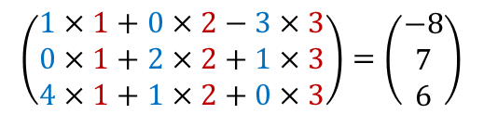
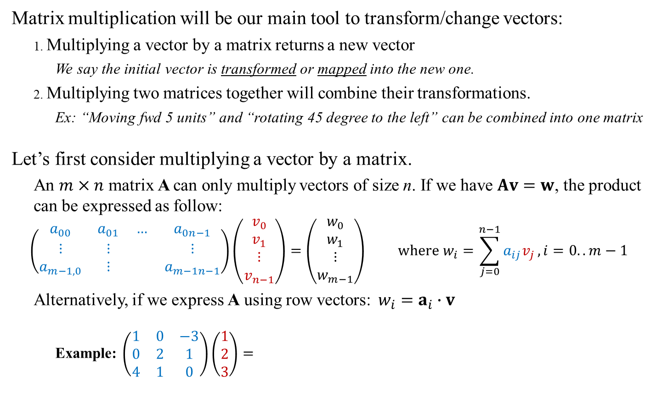
Matrix Multiplication:
Matrix multiplication will be our main tool to transform/change vectors:
Multiplying a vector by a matrix returns a new vector
We say the initial vector is transformed or mapped into the new one.
Multiplying two matrices together will combine their transformations.
Ex: “Moving fwd 5 units” and “rotating 45 degree to the left” can be combined into one matrix
Let’s first consider multiplying a vector by a matrix.
An $m×n$ matrix A can only multiply vectors of size n. If we have $Av=w$, the product can be expressed as follow:
$$\left(\begin{matrix}a_{00} & a_{01} & … & a_{0n−1} \\ ⋮ & ⋮ & & ⋮ \\ a_{m−1,0} & ⋮ & & a_{m−1n−1}\end{matrix}\right)\left(\begin{matrix}v_{0} \\ v_{1} \\ ⋮ \\ v_{n−1}\end{matrix}\right)=\left(\begin{matrix}w_{0} \\ w_{1} \\ ⋮ \\ w_{m−1}\end{matrix}\right) \text{where} w_{i}=\sum_{j=0}^{n−1}{a_{ij}v_{j}}, i=0..m−1$$
Alternatively, if we express A using row vectors:$w_{i}=a_{i}∙v$
Example: $\left(\begin{matrix}1 & 0 & −3 \\ 0 & 2 & 1 \\ 4 & 1 & 0\end{matrix}\right)\left(\begin{matrix}1 \\ 2 \\ 3\end{matrix}\right)=$
$$\left(\begin{matrix}1×1+0×2−3×3 \\ 0×1+2×2+1×3 \\ 4×1+1×2+0×3\end{matrix}\right)=\left(\begin{matrix}−8 \\ 7 \\ 6\end{matrix}\right)$$
See also Dynamic Examples

Slide 10
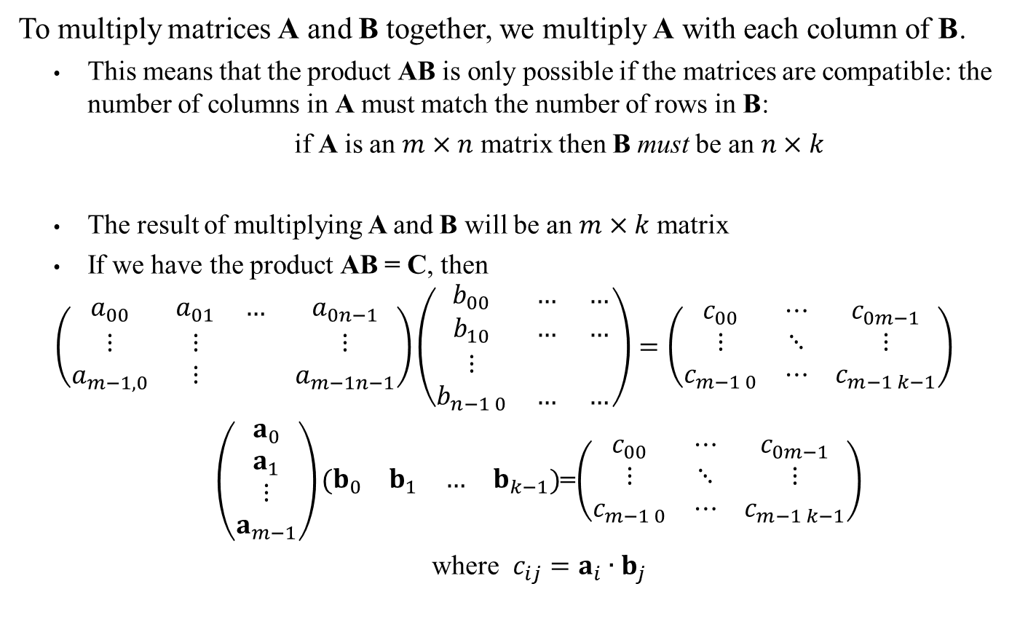
Matrix Multiplication:
To multiply matrices A and B together, we multiply A with each column of B.
This means that the product AB is only possible if the matrices are compatible: the number of columns in A must match the number of rows in B:
if A is an $m×n$ matrix then B must be an $n×k$
The result of multiplying A and B will be an $m×k$ matrix
If we have the product AB = C, then
$$\left(\begin{matrix}a_{00} & a_{01} & … & a_{0n−1} \\ ⋮ & ⋮ & & ⋮ \\ a_{m−1,0} & ⋮ & & a_{m−1n−1}\end{matrix}\right)\left(\begin{matrix}b_{00} & … & … \\ b_{10} & … & … \\ ⋮ & & \\ b_{n−1 0} & … & …\end{matrix}\right)=\left(\begin{matrix}c_{00} & ⋯ & c_{0m−1} \\ ⋮ & ⋱ & ⋮ \\ c_{m−1 0} & ⋯ & c_{m−1 k−1}\end{matrix}\right)$$
$\left(\begin{matrix}a_{0} \\ a_{1} \\ ⋮ \\ a_{m−1}\end{matrix}\right)\left(\begin{matrix}b_{0} & b_{1} & … & b_{k−1}\end{matrix}\right)$=$\left(\begin{matrix}c_{00} & ⋯ & c_{0m−1} \\ ⋮ & ⋱ & ⋮ \\ c_{m−1 0} & ⋯ & c_{m−1 k−1}\end{matrix}\right)$
where $c_{ij}=a_{i}∙b_{j}$

Slide 11
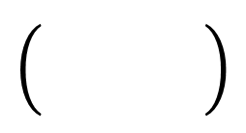



Matrix Multiplication : Examples
Ex 1: $\left(\begin{matrix}1 & 0 & 2 \\ 5 & 2 & 3\end{matrix}\right)\left(\begin{matrix}3 & 2 \\ 10 & 2\end{matrix}\right)= ?$
Ex 2: $\left(\begin{matrix}1 & 0 & 2 \\ 5 & 2 & 3\end{matrix}\right)\left(\begin{matrix}5 & 2 \\ −1 & 0 \\ 1 & 2\end{matrix}\right)= ?$
Ex 3: $\left(\begin{matrix}1 & 0 & 0 \\ 0 & 1 & 0 \\ 0 & 0 & 1\end{matrix}\right)\left(\begin{matrix}5 & 2 \\ −1 & 0 \\ 1 & 2\end{matrix}\right)=?$
Ex 4:$\left(\begin{matrix}−4 & 1 & 3 \\ −4 & 0 & 1 \\ −1 & 1 & −1\end{matrix}\right)\left(\begin{matrix}−3 & −5 & 4 \\ 0 & −2 & 1 \\ 2 & 0 & −1\end{matrix}\right)=?$
Incompatible dimensions
7
6
26
16
$$\left(\begin{matrix}5 & 2 \\ −1 & 0 \\ 1 & 2\end{matrix}\right)$$
$$\left(\begin{matrix}18 & 18 & −18 \\ 14 & 20 & −17 \\ 1 & 3 & −2\end{matrix}\right)$$
See also Dynamic Examples

Slide 12
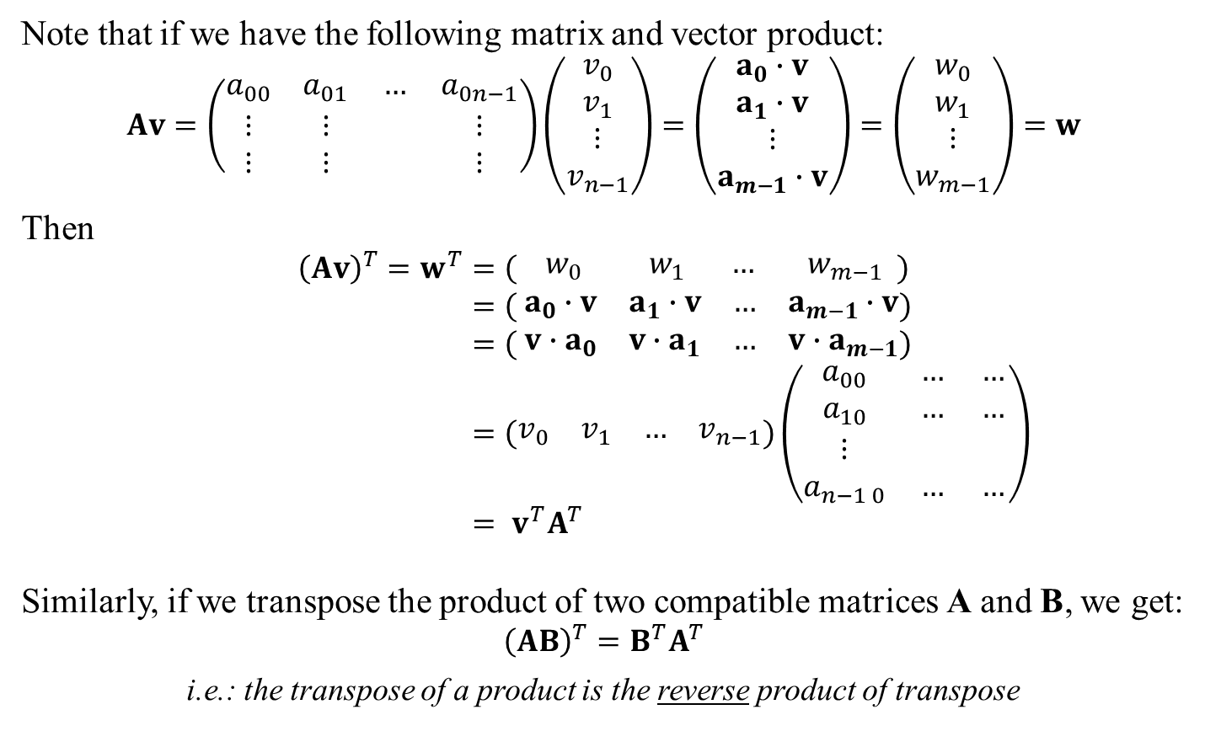
Matrix Multiplication and Transpose
Note that if we have the following matrix and vector product:
$$Av=\left(\begin{matrix}a_{00} & a_{01} & … & a_{0n−1} \\ ⋮ & ⋮ & & ⋮ \\ ⋮ & ⋮ & & ⋮\end{matrix}\right)\left(\begin{matrix}v_{0} \\ v_{1} \\ ⋮ \\ v_{n−1}\end{matrix}\right)=\left(\begin{matrix}a_{0}∙v \\ a_{1}∙v \\ ⋮ \\ a_{m−1}∙v\end{matrix}\right)=\left(\begin{matrix}w_{0} \\ w_{1} \\ ⋮ \\ w_{m−1}\end{matrix}\right)=w$$
Then
$${\left(Av\right)}^{T}=w^{T}=\left(\begin{matrix} w_{0} & w_{1} & … & w_{m−1}\end{matrix} \right) \\ =\left( \begin{matrix}a_{0}∙v & a_{1}∙v & … & a_{m−1}∙v\end{matrix}\right) \\ =\left(\begin{matrix}{ v∙a}_{0} & {v∙a}_{1} & … & {v∙a}_{m−1}\end{matrix}\right)$$
$$=\left(\begin{matrix}v_{0} & v_{1} & … & v_{n−1}\end{matrix}\right)\left(\begin{matrix}a_{00} & … & … \\ a_{10} & … & … \\ ⋮ & & \\ a_{n−1 0} & … & …\end{matrix}\right) \\ = v^{T}A^{T}$$
Similarly, if we transpose the product of two compatible matrices A and B, we get:
$${\left(AB\right)}^{T}=B^{T}A^{T}$$
i.e.: the transpose of a product is the reverse product of transpose
Dot product is commutative

Slide 13
Matrix Multiplication and Transpose
Note that if we have the following matrix and vector product:
$$Av=\left(\begin{matrix}a_{00} & a_{01} & … & a_{0n−1} \\ ⋮ & ⋮ & & ⋮ \\ ⋮ & ⋮ & & ⋮\end{matrix}\right)\left(\begin{matrix}v_{0} \\ v_{1} \\ ⋮ \\ v_{n−1}\end{matrix}\right)=\left(\begin{matrix}a_{0}∙v \\ a_{1}∙v \\ ⋮ \\ a_{m−1}∙v\end{matrix}\right)=\left(\begin{matrix}w_{0} \\ w_{1} \\ ⋮ \\ w_{m−1}\end{matrix}\right)=w$$
Then
$${\left(Av\right)}^{T}=w^{T}=\left(\begin{matrix} w_{0} & w_{1} & … & w_{m−1}\end{matrix} \right) \\ =\left( \begin{matrix}a_{0}∙v & a_{1}∙v & … & a_{m−1}∙v\end{matrix}\right) \\ =\left(\begin{matrix}{ v∙a}_{0} & {v∙a}_{1} & … & {v∙a}_{m−1}\end{matrix}\right)$$
$$=\left(\begin{matrix}v_{0} & v_{1} & … & v_{n−1}\end{matrix}\right)\left(\begin{matrix}a_{00} & … & … \\ a_{10} & … & … \\ ⋮ & & \\ a_{n−1 0} & … & …\end{matrix}\right) \\ = v^{T}A^{T}$$
Similarly, if we transpose the product of two compatible matrices A and B, we get:
$${\left(AB\right)}^{T}=B^{T}A^{T}$$
i.e.: the transpose of a product is the reverse product of transpose
WARNING: This will cause you grief!
Remember how some sources use row vectors while other use column vectors? Because of this transpose rule, that also means the multiplication orders must be flipped.
To make matters worse, many (most?) math libraries use row notation, so you will often need to transpose between the two notations…
That’s one more thing to keep track: see Linear Algebra Safety Rules

Slide 14
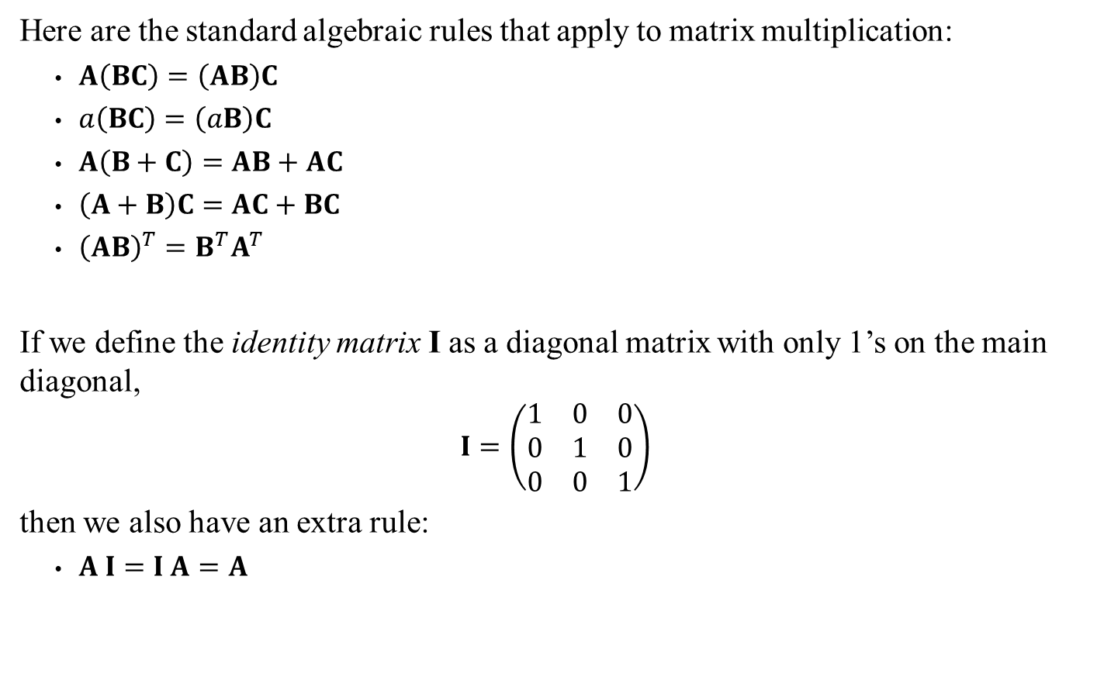
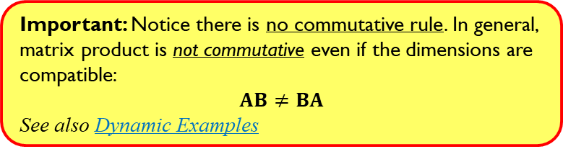
Matrix Multiplication: Algebraic rules
Here are the standard algebraic rules that apply to matrix multiplication:
$A\left(BC\right)=\left(AB\right)C$
$a\left(BC\right)=\left(aB\right)C$
$A\left(B+C\right)=AB+AC$
$\left(A+B\right)C=AC+BC$
${\left(AB\right)}^{T}=B^{T}A^{T}$
If we define the identity matrix I as a diagonal matrix with only 1’s on the main diagonal,
$$I=\left(\begin{matrix}1 & 0 & 0 \\ 0 & 1 & 0 \\ 0 & 0 & 1\end{matrix}\right)$$
then we also have an extra rule:
$A I=I A=A$
Important: Notice there is no commutative rule. In general, matrix product is not commutative even if the dimensions are compatible:
$$AB≠BA$$
See also Dynamic Examples

Slide 15
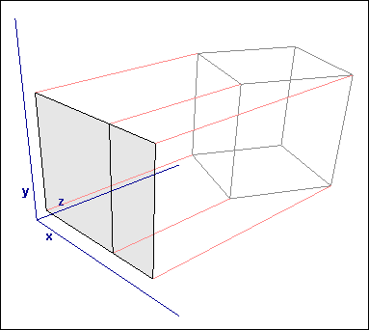

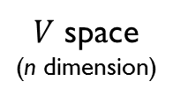
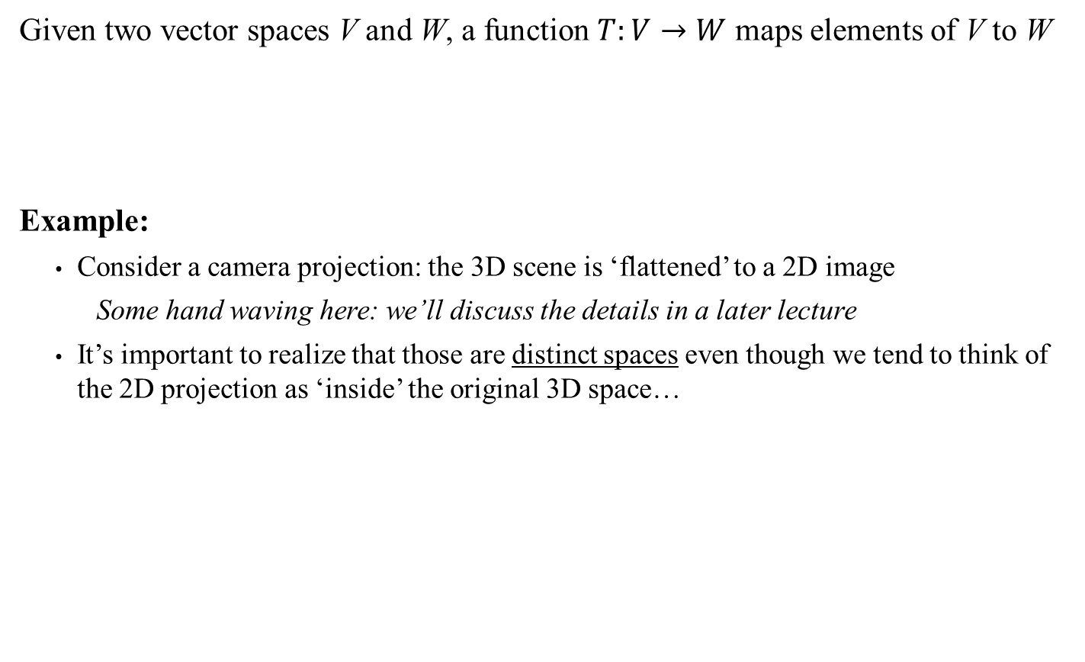

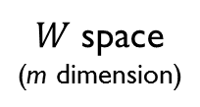

Linear Transformations (This is to clarify Section 3.2 of the book)
Given two vector spaces V and W, a function $T:V→W$ maps elements of V to W
Example:
Consider a camera projection: the 3D scene is ‘flattened’ to a 2D image
Some hand waving here: we’ll discuss the details in a later lecture
It’s important to realize that those are distinct spaces even though we tend to think of the 2D projection as ‘inside’ the original 3D space…
v
$$T\left(v\right)=b$$
b
Any v in $V$
Some b in $W$
$V$ space
(n dimension)
$W$ space
(m dimension)
Sidebar:
What’s wrong with this image?
Warning!
Left-Hand space image!

Slide 16
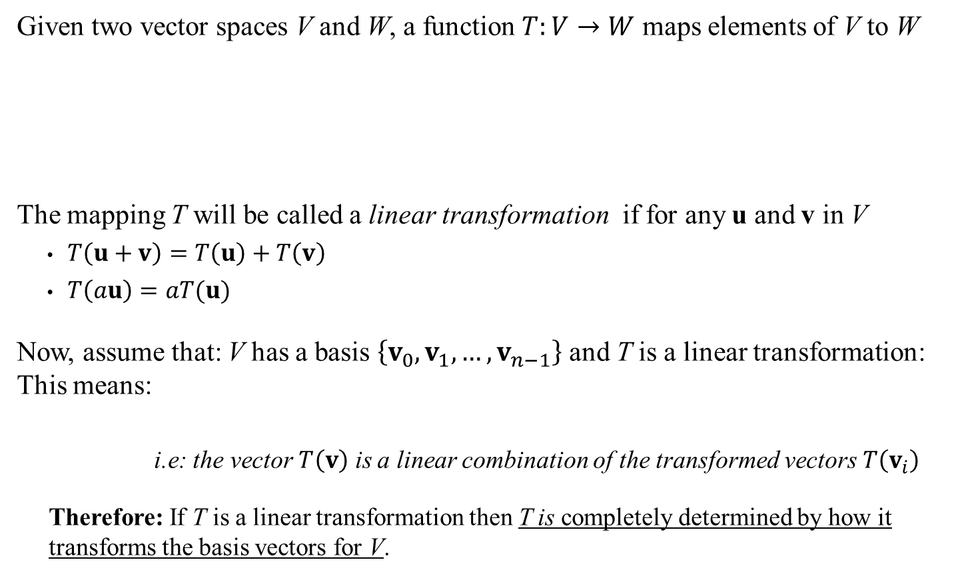
Linear Transformations (This is to clarify Section 3.2 of the book)
Given two vector spaces V and W, a function $T:V→W$ maps elements of V to W
The mapping T will be called a linear transformation if for any u and v in V
$T\left(u+v\right)=T\left(u\right)+T\left(v\right)$
$T\left(au\right)=aT(u)$
Now, assume that: V has a basis $\left\{v_{0},v_{1},…,v_{n−1}\right\}$ and T is a linear transformation: This means:
i.e: the vector $T\left(v\right)$ is a linear combination of the transformed vectors $T\left(v_{i}\right)$
Therefore: If T is a linear transformation then T is completely determined by how it transforms the basis vectors for V.
v
$$T\left(v\right)=b$$
b
Any v in $V$
Some b in $W$
$V$ space
(n dimension)
$W$ space
(m dimension)
$$T\left(v\right)=T\left(a_{0}v_{0}+a_{1}v_{1}+…+a_{n−1}v_{n−1}\right) \text{for} \text{some} a_{0}, …,a_{n−1}$$
Using these properties
$$=a_{0}{T(v}_{0})+a_{1}T(v_{1})+…+a_{n−1}T(v_{n−1})$$

Slide 17
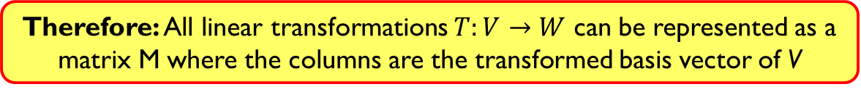
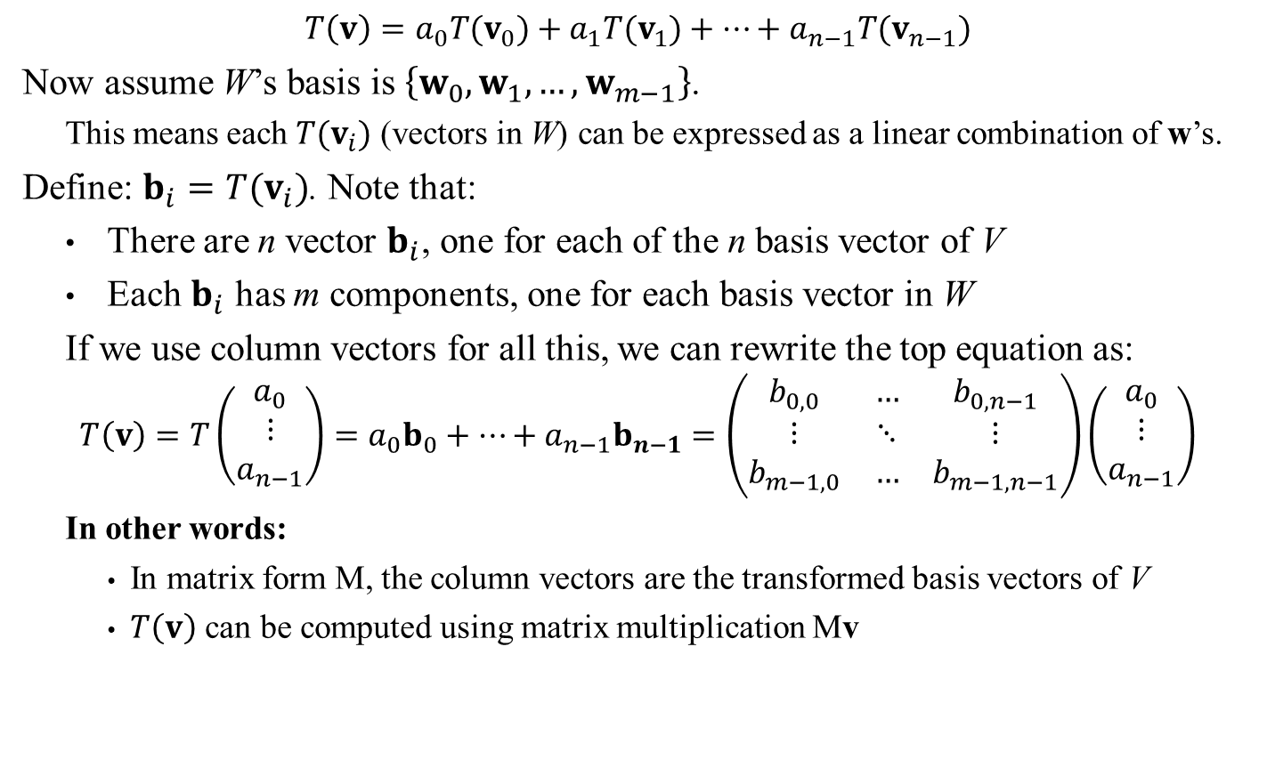
Linear Transformations (This is to clarify Section 3.2 of the book)
$$T\left(v\right)=a_{0}{T(v}_{0})+a_{1}T(v_{1})+…+a_{n−1}T(v_{n−1})$$
Now assume W’s basis is $\left\{w_{0},w_{1},…,w_{m−1}\right\}$.
This means each ${T(v}_{i})$ (vectors in W) can be expressed as a linear combination of w’s.
Define: $b_{i}={T(v}_{i})$. Note that:
There are n vector $b_{i}$, one for each of the n basis vector of V
Each $b_{i}$ has m components, one for each basis vector in W
If we use column vectors for all this, we can rewrite the top equation as:
$$T\left(v\right)=T\left(\begin{matrix}a_{0} \\ ⋮ \\ a_{n−1}\end{matrix}\right)=a_{0}b_{0}+…+a_{n−1}b_{n−1}=\left(\begin{matrix}b_{0,0} & … & b_{0,n−1} \\ ⋮ & ⋱ & ⋮ \\ b_{m−1,0} & … & b_{m−1,n−1}\end{matrix}\right)\left(\begin{matrix}a_{0} \\ ⋮ \\ a_{n−1}\end{matrix}\right)$$
In other words:
In matrix form M, the column vectors are the transformed basis vectors of V
$T\left(v\right)$ can be computed using matrix multiplication Mv
Therefore: All linear transformations $T:V→W$ can be represented as a matrix M where the columns are the transformed basis vector of V

Slide 18
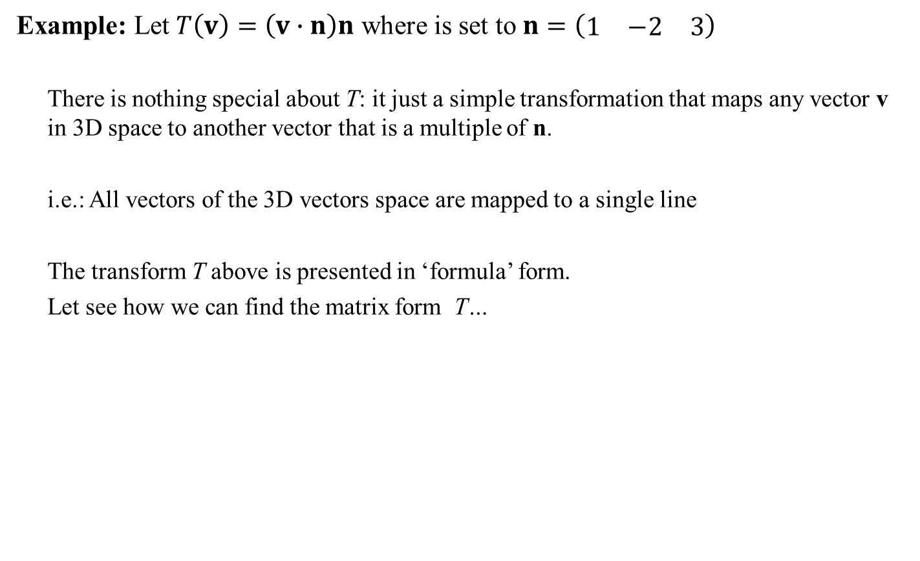
Linear Transformations (This is to clarify Section 3.2 of the book)
Example: Let $T\left(v\right)=\left(v∙n\right)n$ where is set to $n=\left(\begin{matrix}1 & −2 & 3\end{matrix}\right)$
There is nothing special about T: it just a simple transformation that maps any vector v in 3D space to another vector that is a multiple of n.
i.e.: All vectors of the 3D vectors space are mapped to a single line
The transform T above is presented in ‘formula’ form.
Let see how we can find the matrix form T…
Sidebar: Why do we care?
Many transforms in their ‘standard’/formula form can be very inefficient to compute. However matrix operations are easily parallelizable and therefore highly efficient. Indeed: GPUs are simply highly specialized parallel matrix computation machines.

Slide 19
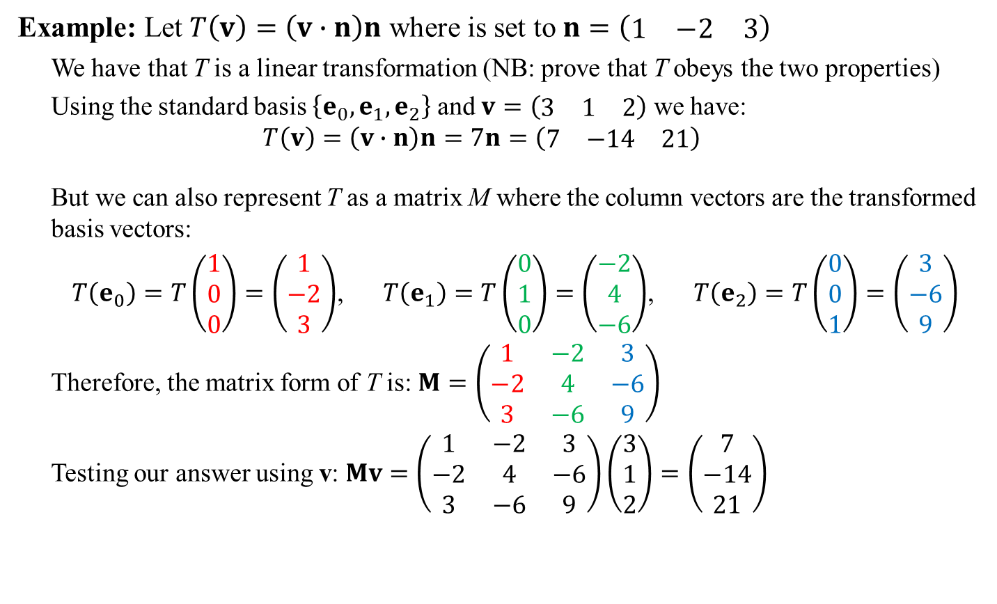
Linear Transformations (This is to clarify Section 3.2 of the book)
See also Dynamic Examples
Example: Let $T\left(v\right)=\left(v∙n\right)n$ where is set to $n=\left(\begin{matrix}1 & −2 & 3\end{matrix}\right)$
We have that T is a linear transformation (NB: prove that T obeys the two properties)
Using the standard basis $\left\{e_{0},e_{1},e_{2}\right\}$ and $v=\left(\begin{matrix}3 & 1 & 2\end{matrix}\right)$ we have:
$$T\left(v\right)=\left(v∙n\right)n=7n=\left(\begin{matrix}7 & −14 & 21\end{matrix}\right)$$
But we can also represent T as a matrix M where the column vectors are the transformed basis vectors:
$T\left(e_{0}\right)=T\left(\begin{matrix}1 \\ 0 \\ 0\end{matrix}\right)=\left(\begin{matrix}1 \\ −2 \\ 3\end{matrix}\right)$, $T\left(e_{1}\right)=T\left(\begin{matrix}0 \\ 1 \\ 0\end{matrix}\right)=\left(\begin{matrix}−2 \\ 4 \\ −6\end{matrix}\right)$, $T\left(e_{2}\right)=T\left(\begin{matrix}0 \\ 0 \\ 1\end{matrix}\right)=\left(\begin{matrix}3 \\ −6 \\ 9\end{matrix}\right)$
Therefore, the matrix form of T is: $M=\left(\begin{matrix}1 & −2 & 3 \\ −2 & 4 & −6 \\ 3 & −6 & 9\end{matrix}\right)$
Testing our answer using v: $Mv=\left(\begin{matrix}1 & −2 & 3 \\ −2 & 4 & −6 \\ 3 & −6 & 9\end{matrix}\right)\left(\begin{matrix}3 \\ 1 \\ 2\end{matrix}\right)=\left(\begin{matrix}7 \\ −14 \\ 21\end{matrix}\right)$
Matching answers
Sidebar: Why do we care?
Many transforms in their ‘standard’/formula form can be very inefficient to compute. However matrix operations are easily parallelizable and therefore highly efficient. Indeed: GPUs are simply highly specialized parallel matrix computation machines.

Slide 20
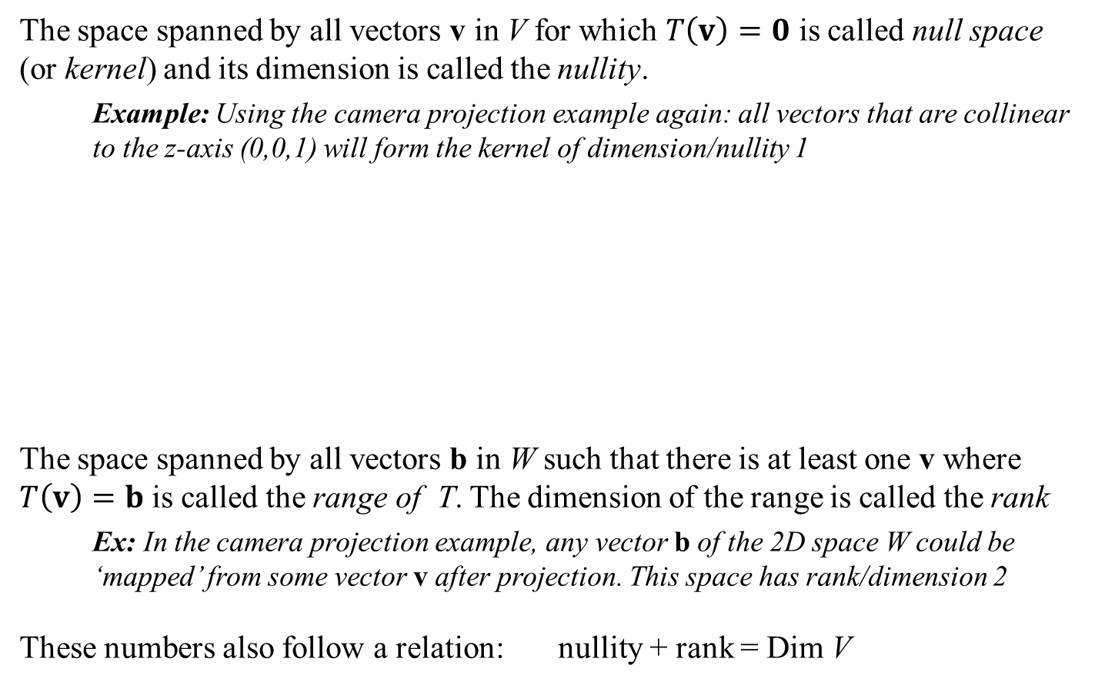

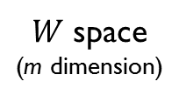
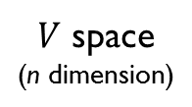
Linear Transformations (This is to clarify Section 3.2 of the book)
The space spanned by all vectors v in V for which $T\left(v\right)=0$ is called null space (or kernel) and its dimension is called the nullity.
Example: Using the camera projection example again: all vectors that are collinear to the z-axis (0,0,1) will form the kernel of dimension/nullity 1
The space spanned by all vectors b in W such that there is at least one v where $T\left(v\right)=b$ is called the range of T. The dimension of the range is called the rank
Ex: In the camera projection example, any vector b of the 2D space W could be ‘mapped’ from some vector v after projection. This space has rank/dimension 2
These numbers also follow a relation: nullity + rank = Dim V
v
$$T\left(v\right)=b$$
b
$V$ space
(n dimension)
$W$ space
(m dimension)
Warning! Left-Hand space image!

Slide 21
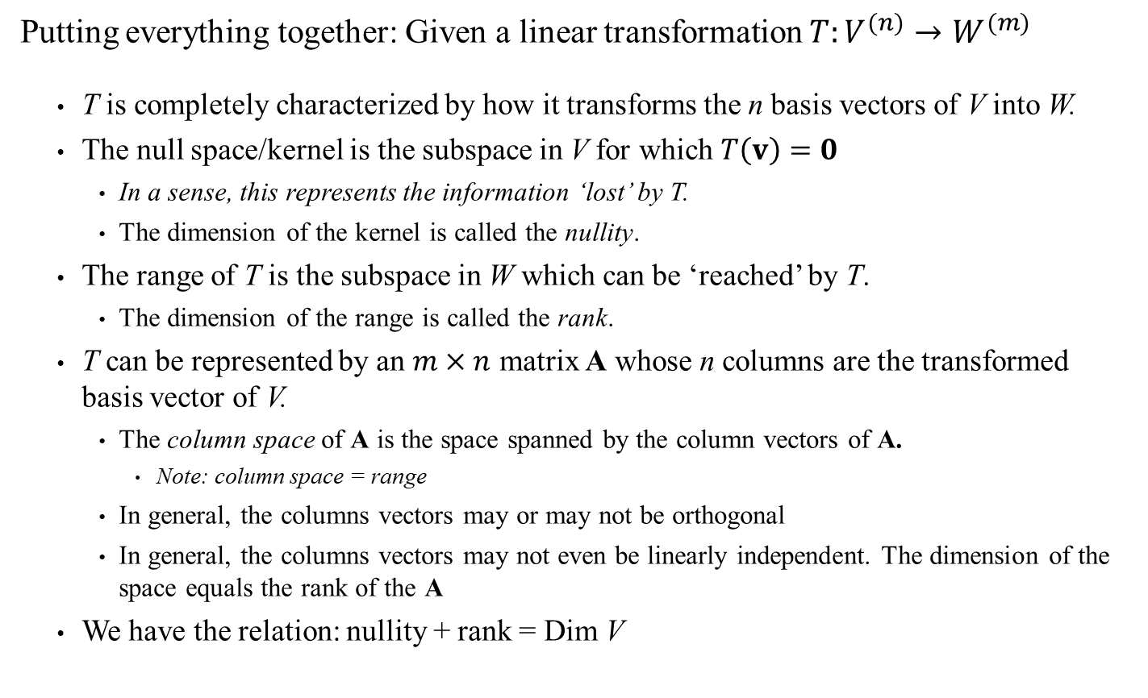
Linear Transformations (This is to clarify Section 3.2 of the book)
Putting everything together: Given a linear transformation $T:V^{(n)}→W^{(m)}$
T is completely characterized by how it transforms the n basis vectors of V into W.
The null space/kernel is the subspace in V for which $T\left(v\right)=0$
In a sense, this represents the information ‘lost’ by T.
The dimension of the kernel is called the nullity.
The range of T is the subspace in W which can be ‘reached’ by T.
The dimension of the range is called the rank.
T can be represented by an $m×n$ matrix A whose n columns are the transformed basis vector of V.
The column space of A is the space spanned by the column vectors of A.
Note: column space = range
In general, the columns vectors may or may not be orthogonal
In general, the columns vectors may not even be linearly independent. The dimension of the space equals the rank of the A
We have the relation: nullity + rank = Dim V

