Slide 1
GAM 325/425: Applied 3D Geometry
Lecture 2, Part B:
Matrix Inverse and
Determinant

Slide 2
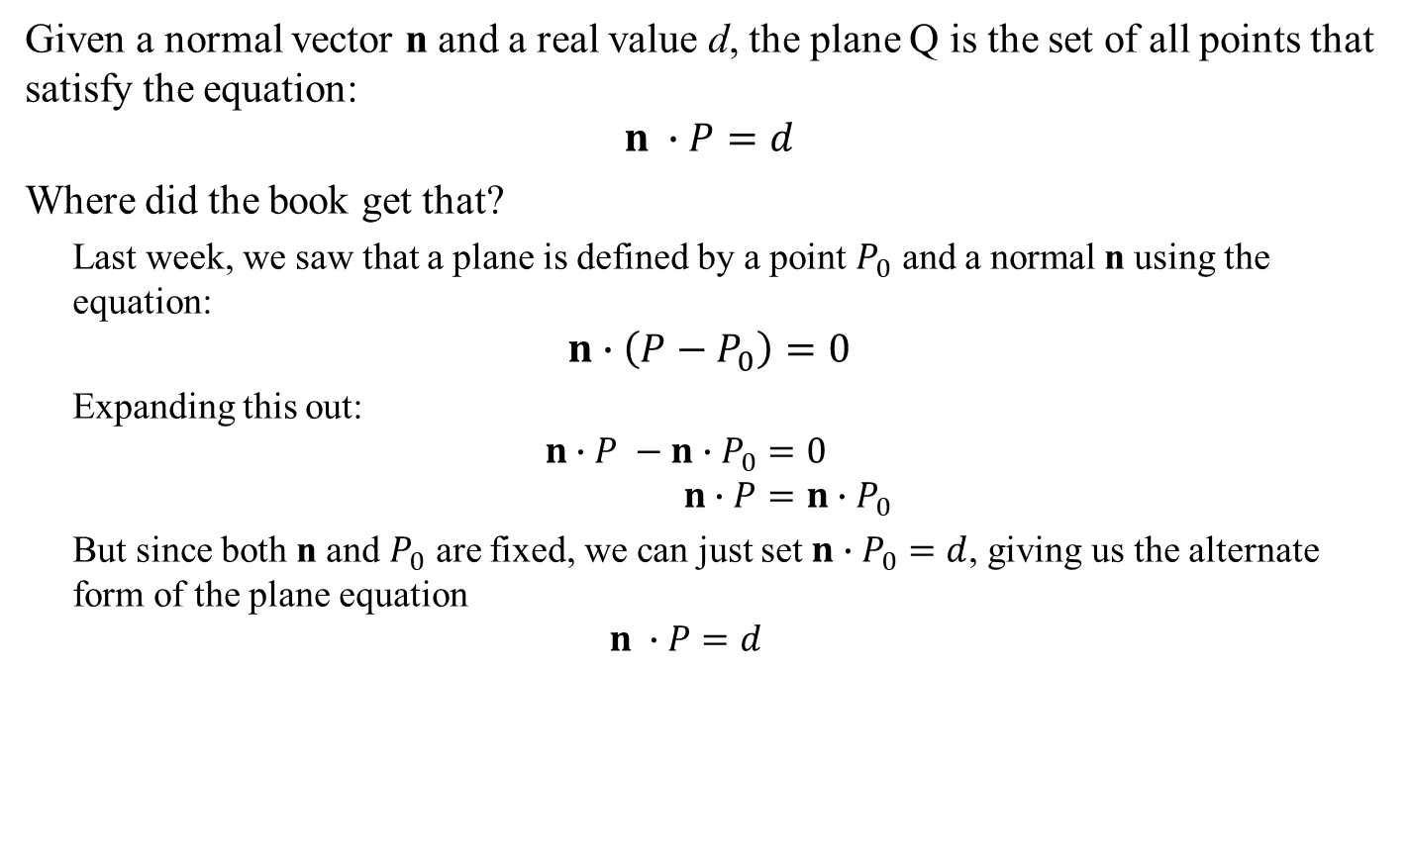
System of Linear Equations (A necessary detour before the next few topics)
Given a normal vector n and a real value d, the plane Q is the set of all points that satisfy the equation:
$$n ∙P=d$$
Where did the book get that?
Last week, we saw that a plane is defined by a point $P_{0}$ and a normal n using the equation:
$$n∙\left(P−P_{0}\right)=0$$
Expanding this out:
$$n∙P −n∙P_{0}=0 \\ n∙P=n∙P_{0}$$
But since both n and $P_{0}$ are fixed, we can just set $n∙P_{0}=d$, giving us the alternate form of the plane equation
$$n ∙P=d$$
Technically, it’s a stretch to take the dot product of a vector and a point, but here it’s ok.

Slide 3
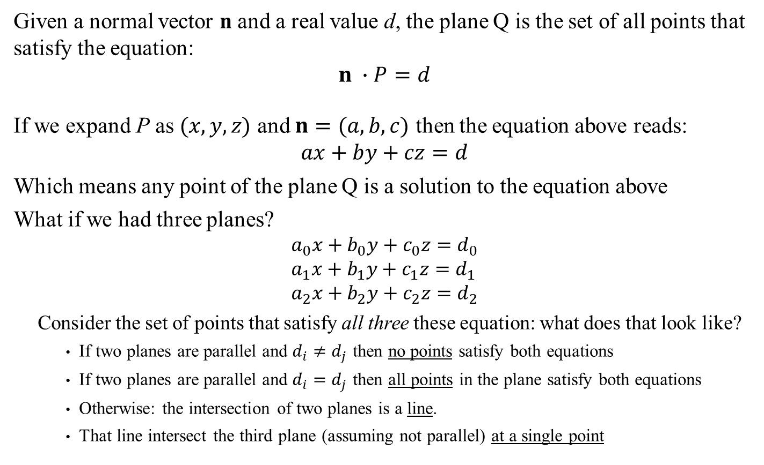
System of Linear Equations (A necessary detour before the next few topics)
Given a normal vector n and a real value d, the plane Q is the set of all points that satisfy the equation:
$$n ∙P=d$$
If we expand P as $(x,y,z)$ and $n=(a,b,c)$ then the equation above reads:
$$ax+by+cz=d$$
Which means any point of the plane Q is a solution to the equation above
What if we had three planes?
$$a_{0}x+b_{0}y+c_{0}z=d_{0} \\ a_{1}x+b_{1}y+c_{1}z=d_{1} \\ a_{2}x+b_{2}y+c_{2}z=d_{2}$$
Consider the set of points that satisfy all three these equation: what does that look like?
If two planes are parallel and $d_{i}≠d_{j}$ then no points satisfy both equations
If two planes are parallel and $d_{i}=d_{j}$ then all points in the plane satisfy both equations
Otherwise: the intersection of two planes is a line.
That line intersect the third plane (assuming not parallel) at a single point

Slide 4
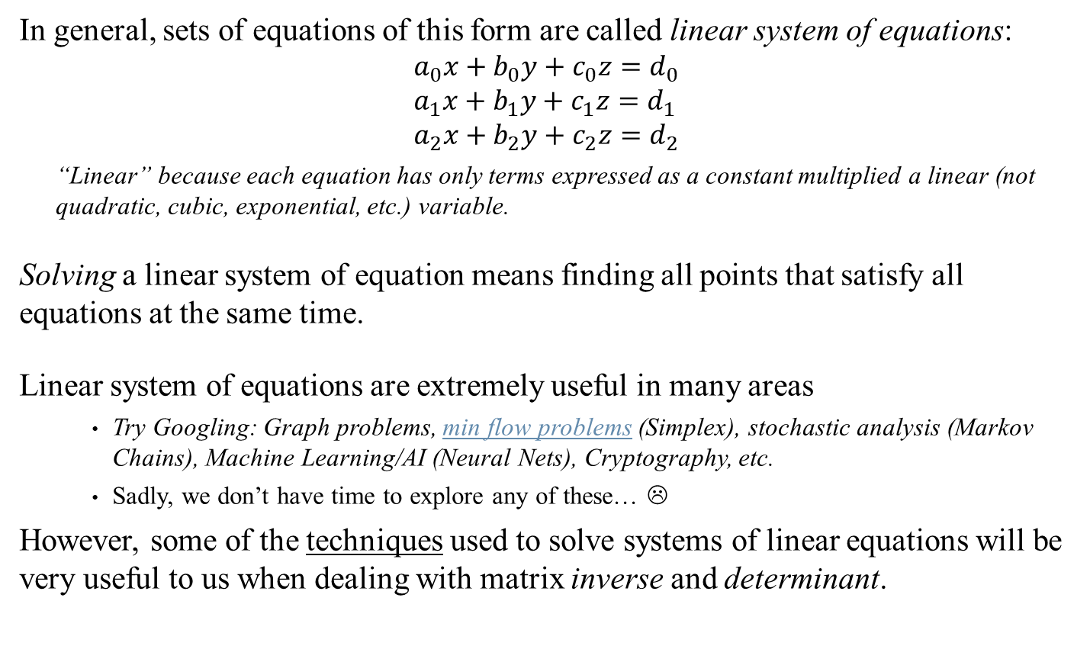
System of Linear Equations (A necessary detour before the next few topics)
In general, sets of equations of this form are called linear system of equations:
$$a_{0}x+b_{0}y+c_{0}z=d_{0} \\ a_{1}x+b_{1}y+c_{1}z=d_{1} \\ a_{2}x+b_{2}y+c_{2}z=d_{2}$$
“Linear” because each equation has only terms expressed as a constant multiplied a linear (not quadratic, cubic, exponential, etc.) variable.
Solving a linear system of equation means finding all points that satisfy all equations at the same time.
Linear system of equations are extremely useful in many areas
Try Googling: Graph problems, min flow problems (Simplex), stochastic analysis (Markov Chains), Machine Learning/AI (Neural Nets), Cryptography, etc.
Sadly, we don’t have time to explore any of these… ☹
However, some of the techniques used to solve systems of linear equations will be very useful to us when dealing with matrix inverse and determinant.

Slide 5



System of Linear Equations (A necessary detour before the next few topics)
To solve a system of equation, we want to manipulate the equations such that:
Finding the solution is ‘easier’ after the manipulations
The manipulations we performed don’t change the solution to the original equations
There are three manipulations we can perform:
Changing the order or equations.
Clearly any solution to one set of equation will be the same as the solutions to the other set.
$$x−3y+z=5 \\ 2x−y+2z=5 \\ 3x+6y+9z=3$$
$$3x+6y+9z=3 \\ 2x−y+2z=5 \\ x−3y+z=5$$
$$r_{1}↔r_{3}$$

Slide 6
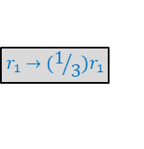
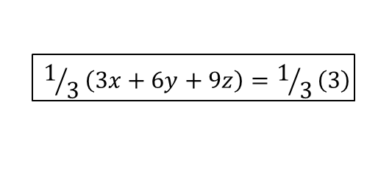






System of Linear Equations (A necessary detour before the next few topics)
To solve a system of equation, we want to manipulate the equations such that:
Finding the solution is ‘easier’ after the manipulations
The manipulations we performed don’t change the solution to the original equations
There are three manipulations we can perform:
Changing the order or equations.
Take the same operation on both sides of an equation.
Ex 1:
Ex 2:
Note: In general, any operation would work too: (Trigonometry, logarithm, etc.). As long as you take the same operation on both side of the equation, the solution to the equations remains the same.
$$r_{1}→(1/3)r_{1}$$
$$3x+6y+9z=3$$
$$1/3\left(3x+6y+9z\right)=1/3\left(3\right)$$
$$x+2y+3z=1$$
$$x+2y+3z=1$$
$$x+2y+3z −1 =1 −1$$
$$x+2y+3z−1=0$$
$$r_{1}→r_{1}−1$$

Slide 7
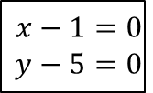



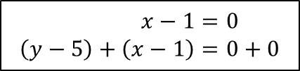
System of Linear Equations (A necessary detour before the next few topics)
To solve a system of equation, we want to manipulate the equations such that:
Finding the solution is ‘easier’ after the manipulations
The manipulations we performed don’t change the solution to the original equations
There are three manipulations we can perform:
Changing the order or equations.
Take the same operation on both sides of an equation.
Adding a multiple of one equation to another.
Ex 1:
$$x=1 \\ y=5$$
$$x−1=0 \\ y−5=0$$
$$r_{2}→r_{2}+r_{1}$$
$$x−1=0 \\ \left(y−5\right)+\left(x−1\right)=0+0$$
$$x=1 \\ x+y=6$$
Both parenthesis equal 0. We’re adding 0 to both sides of the equation, so surely we’re not changing anything

Slide 8
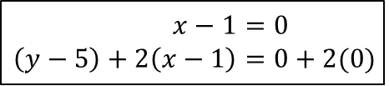
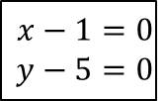




System of Linear Equations (A necessary detour before the next few topics)
To solve a system of equation, we want to manipulate the equations such that:
Finding the solution is ‘easier’ after the manipulations
The manipulations we performed don’t change the solution to the original equations
There are three manipulations we can perform:
Changing the order or equations.
Take the same operation on both sides of an equation.
Adding a multiple of one equation to another.
Ex 1:
Ex 2:
$$x=1 \\ y=5$$
$$x−1=0 \\ y−5=0$$
$$r_{2}→r_{2}+r_{1}$$
$$x−1=0 \\ \left(y−5\right)+\left(x−1\right)=0+0$$
$$x=1 \\ x+y=6$$
$$x=1 \\ y=5$$
$$x−1=0 \\ y−5=0$$
$$r_{2}→r_{2}+2r_{1}$$
$$x−1=0 \\ \left(y−5\right)+2\left(x−1\right)=0+2(0)$$
$$x=1 \\ 2x+y=7$$
Again: We’re adding 0 to both sides of the equation, so surely we’re not changing anything

Slide 9
System of Linear Equations (A necessary detour before the next few topics)
To solve a system of equation, we want to manipulate the equations such that:
Finding the solution is ‘easier’ after the manipulations
The manipulations we performed don’t change the solution to the original equations
There are three manipulations we can perform:
Changing the order or equations.
Take the same operation on both sides of an equation.
Adding a multiple of one equation to another.
Ex 1:
Ex 2:
In general adding a multiple of one equation to another doesn’t change the solution. Any solution to the original system of equations is also a solution to the final system, and vice versa.
$$x=1 \\ y=5$$
$$x−1=0 \\ y−5=0$$
$$r_{2}→r_{2}+r_{1}$$
$$x−1=0 \\ \left(y−5\right)+\left(x−1\right)=0+0$$
$$x=1 \\ x+y=6$$
$$x=1 \\ y=5$$
$$x−1=0 \\ y−5=0$$
$$r_{2}→r_{2}+2r_{1}$$
$$x−1=0 \\ \left(y−5\right)+2\left(x−1\right)=0+2(0)$$
$$x=1 \\ 2x+y=7$$

Slide 10
System of Linear Equations (A necessary detour before the next few topics)
To solve a system of equation, we want to manipulate the equations such that:
Finding the solution is ‘easier’ after the manipulations
The manipulations we performed don’t change the solution to the original equations
There are three manipulations we can perform:
Changing the order or equations.
Take the same operation on both sides of an equation.
Adding a multiple of one equation to another.
To solve a linear system of equations, we will use the above three manipulations to collectively ‘simplify’ the equations and find a solution.

Slide 11


System of Linear Equations (A necessary detour before the next few topics)
How to solve a system of linear equation (find values for x, y and z where these equation all hold)
$$r_{1}↔r_{3}$$
$$x−3y+z=5 \\ 2x−y+2z=5 \\ 3x+6y+9z=3$$
$$3x+6y+9z=3 \\ 2x−y+2z=5 \\ x−3y+z=5$$
To be honest, we don’t really need to swap the lines here, but I wanted to give it as a example

Slide 12
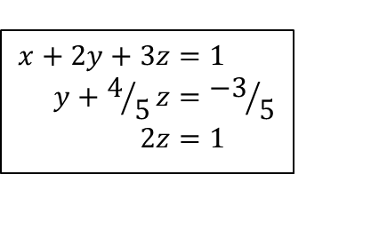
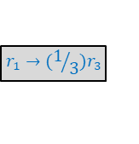

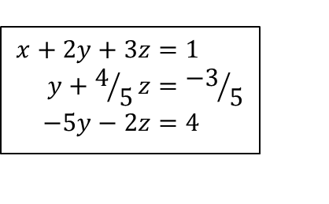
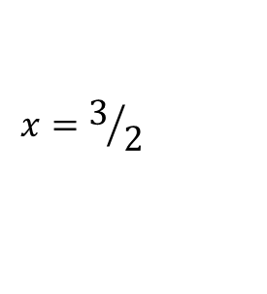
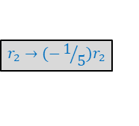





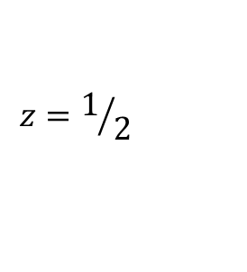


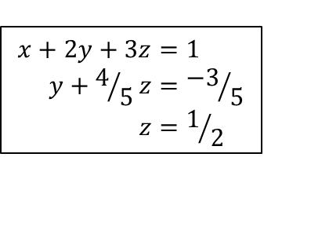
System of Linear Equations (A necessary detour before the next few topics)
How to solve a system of linear equation (find values for x, y and z where these equation all hold)
(See also p101 of the book: it includes some commentary for each above steps)
Note that to solve the above, the only operations we used were:
Exchanging two lines
Multiplying a row by a constant
Adding a multiple of one row to another
$$r_{1}↔r_{3}$$
$$r_{1}→(1/3)r_{3}$$
$$r_{2}→r_{2} −2r_{1}$$
$$3x+6y+9z=3 \\ 2x−y+2z=5 \\ x−3y+z=5$$
$$r_{3}→r_{3} −r_{1}$$
$$x+2y+3z=1 \\ −5y−4z=3 \\ −5y−2z=4$$
$$x−3y+z=5 \\ 2x−y+2z=5 \\ 3x+6y+9z=3$$
$$x+2y+3z=1 \\ 2x−y+2z=5 \\ x−3y+z=5$$
$$x+2y+3z=1 \\ y+4/5z={−3}/5 \\ −5y−2z=4$$
$$x+2y+3z=1 \\ y+4/5z={−3}/5 \\ 2z=1$$
$$x+2y+3z=1 \\ y+4/5z={−3}/5 \\ z=1/2$$
$$x=3/2$$
$$r_{2}→(−1/5)r_{2}$$
$$y=−1$$
$$z=1/2$$
$$r_{3}→r_{3}+5r_{2}$$
$$r_{3}→(1/2)r_{3}$$

Slide 13


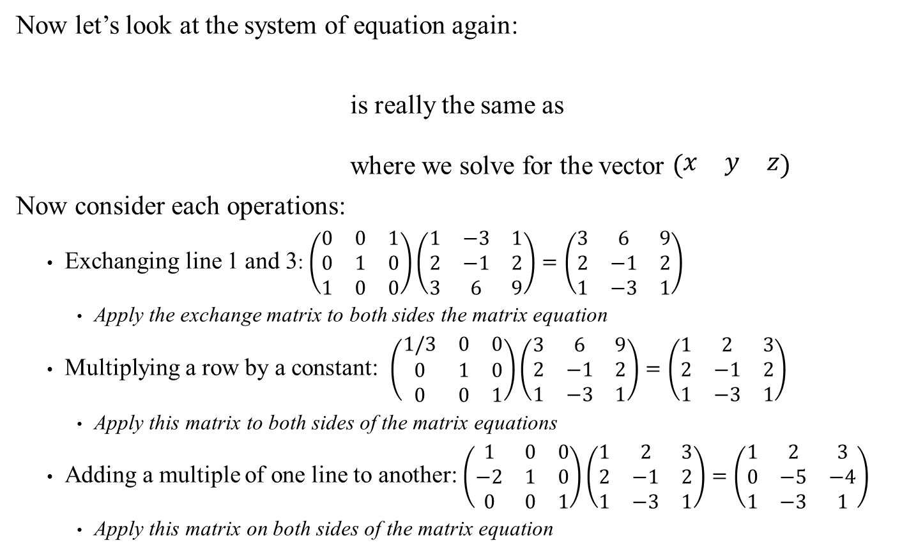

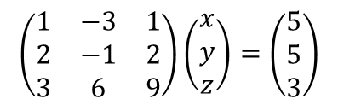
System of Linear Equations (A necessary detour before the next few topics)
Now let’s look at the system of equation again:
is really the same as
where we solve for the vector $\left(\begin{matrix}x & y & z\end{matrix}\right)$
Now consider each operations:
Exchanging line 1 and 3: $\left(\begin{matrix}0 & 0 & 1 \\ 0 & 1 & 0 \\ 1 & 0 & 0\end{matrix}\right)\left(\begin{matrix}1 & −3 & 1 \\ 2 & −1 & 2 \\ 3 & 6 & 9\end{matrix}\right)=\left(\begin{matrix}3 & 6 & 9 \\ 2 & −1 & 2 \\ 1 & −3 & 1\end{matrix}\right)$
Apply the exchange matrix to both sides the matrix equation
Multiplying a row by a constant: $\left(\begin{matrix}1/3 & 0 & 0 \\ 0 & 1 & 0 \\ 0 & 0 & 1\end{matrix}\right)\left(\begin{matrix}3 & 6 & 9 \\ 2 & −1 & 2 \\ 1 & −3 & 1\end{matrix}\right)=\left(\begin{matrix}1 & 2 & 3 \\ 2 & −1 & 2 \\ 1 & −3 & 1\end{matrix}\right)$
Apply this matrix to both sides of the matrix equations
Adding a multiple of one line to another: $\left(\begin{matrix}1 & 0 & 0 \\ −2 & 1 & 0 \\ 0 & 0 & 1\end{matrix}\right)\left(\begin{matrix}1 & 2 & 3 \\ 2 & −1 & 2 \\ 1 & −3 & 1\end{matrix}\right)=\left(\begin{matrix}1 & 2 & 3 \\ 0 & −5 & −4 \\ 1 & −3 & 1\end{matrix}\right)$
Apply this matrix on both sides of the matrix equation
$$x−3y+z=5 \\ 2x−y+2z=5 \\ 3x+6y+9z=3$$
$$\left(\begin{matrix}1 & −3 & 1 \\ 2 & −1 & 2 \\ 3 & 6 & 9\end{matrix}\right)\left(\begin{matrix}x \\ y \\ z\end{matrix}\right)=\left(\begin{matrix}5 \\ 5 \\ 3\end{matrix}\right)$$
$$r_{1}↔r_{3}$$
$$r_{1}→(1/3)r_{3}$$
$$r_{2}→r_{2} −2r_{1}$$

Slide 14





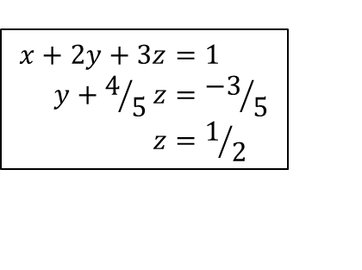

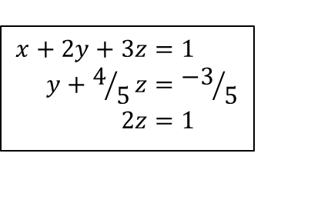

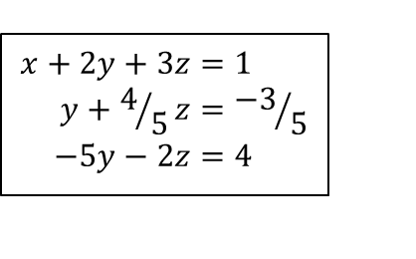
System of Linear Equations (A necessary detour before the next few topics)
Therefore, we can replace this sequence of steps:
With matrix operations:
Etc.
Actually, that’s still a bit tedious… Let’s simplify the notation a bit…
$$x−3y+z=5 \\ 2x−y+2z=5 \\ 3x+6y+9z=3$$
$$3x+6y+9z=3 \\ 2x−y+2z=5 \\ x−3y+z=5$$
$$x+2y+3z=1 \\ 2x−y+2z=5 \\ x−3y+z=5$$
$$x+2y+3z=1 \\ −5y−4z=3 \\ −5y−2z=4$$
$$x+2y+3z=1 \\ y+4/5z={−3}/5 \\ −5y−2z=4$$
$$x+2y+3z=1 \\ y+4/5z={−3}/5 \\ 2z=1$$
$$x+2y+3z=1 \\ y+4/5z={−3}/5 \\ z=1/2$$
$$\left(\begin{matrix}1 & −3 & 1 \\ 2 & −1 & 2 \\ 3 & 6 & 9\end{matrix}\right)\left(\begin{matrix}x \\ y \\ z\end{matrix}\right)=\left(\begin{matrix}5 \\ 5 \\ 3\end{matrix}\right)$$
$$\left(\begin{matrix}3 & 6 & 9 \\ 2 & −1 & 2 \\ 1 & −3 & 1\end{matrix}\right)\left(\begin{matrix}x \\ y \\ z\end{matrix}\right)=\left(\begin{matrix}3 \\ 5 \\ 5\end{matrix}\right)$$
$$\left(\begin{matrix}1 & 2 & 3 \\ 2 & −1 & 2 \\ 1 & −3 & 1\end{matrix}\right)\left(\begin{matrix}x \\ y \\ z\end{matrix}\right)=\left(\begin{matrix}1 \\ 5 \\ 5\end{matrix}\right)$$

Slide 15







System of Linear Equations (A necessary detour before the next few topics)
Therefore, we can replace this sequence of steps:
…with something called an augmented matrix
The above process is called Gaussian elimination.
The final triangular matrix is said to be in row echelon form.
$$x−3y+z=5 \\ 2x−y+2z=5 \\ 3x+6y+9z=3$$
$$3x+6y+9z=3 \\ 2x−y+2z=5 \\ x−3y+z=5$$
$$x+2y+3z=1 \\ 2x−y+2z=5 \\ x−3y+z=5$$
$$x+2y+3z=1 \\ −5y−4z=3 \\ −5y−2z=4$$
$$x+2y+3z=1 \\ y+4/5z={−3}/5 \\ −5y−2z=4$$
$$x+2y+3z=1 \\ y+4/5z={−3}/5 \\ 2z=1$$
$$x+2y+3z=1 \\ y+4/5z={−3}/5 \\ z=1/2$$
$$\left[\begin{matrix}1 & −3 & 1 \\ 2 & −1 & 2 \\ 3 & 6 & 9\end{matrix}\left|\begin{matrix}5 \\ 5 \\ 3\end{matrix}\right.\right]$$
$$\left[\begin{matrix}3 & 6 & 9 \\ 2 & −1 & 2 \\ 1 & −3 & 1\end{matrix}\left|\begin{matrix}3 \\ 5 \\ 5\end{matrix}\right.\right]$$
$$\left[\begin{matrix}1 & 2 & 3 \\ 2 & −1 & 2 \\ 1 & −3 & 1\end{matrix}\left|\begin{matrix}1 \\ 5 \\ 5\end{matrix}\right.\right]$$
$$\left[\begin{matrix}1 & 2 & 3 \\ 0 & −5 & −4 \\ 0 & −5 & −2\end{matrix}\left|\begin{matrix}1 \\ 3 \\ 4\end{matrix}\right.\right]$$
$$\left[\begin{matrix}1 & 2 & 3 \\ 0 & 1 & 4/5 \\ 0 & −5 & −2\end{matrix}\left|\begin{matrix}1 \\ {−3}/5 \\ 4\end{matrix}\right.\right]$$
$$\left[\begin{matrix}1 & 2 & 3 \\ 0 & 1 & 4/5 \\ 0 & 0 & 2\end{matrix}\left|\begin{matrix}1 \\ {−3}/5 \\ 1\end{matrix}\right.\right]$$
$$\left[\begin{matrix}1 & 2 & 3 \\ 0 & 1 & 4/5 \\ 0 & 0 & 1\end{matrix}\left|\begin{matrix}1 \\ {−3}/5 \\ 1/2\end{matrix}\right.\right]$$

Slide 16
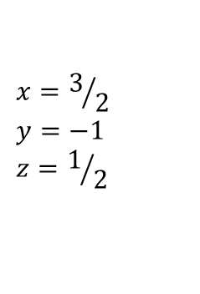









System of Linear Equations (A necessary detour before the next few topics)
Actually, we can completely solve the system using the augmented matrix:
Note how the sequence of operations turned the left side of the augmented matrix from the original A matrix (previous slide) into the identity I.
Note also that the Gaussian elimination steps only depended on the matrix A and were not at all dependent on the right-hand side vector.
This will come in handy in a moment…
$$\left[\begin{matrix}1 & 2 & 3 \\ 0 & 1 & 4/5 \\ 0 & 0 & 1\end{matrix}\left|\begin{matrix}1 \\ {−3}/5 \\ 1/2\end{matrix}\right.\right]$$
$$\left[\begin{matrix}1 & 2 & 0 \\ 0 & 1 & 0 \\ 0 & 0 & 1\end{matrix}\left|\begin{matrix}{−1}/2 \\ −1 \\ 1/2\end{matrix}\right.\right]$$
$$\left[\begin{matrix}1 & 0 & 0 \\ 0 & 1 & 0 \\ 0 & 0 & 1\end{matrix}\left|\begin{matrix}3/2 \\ −1 \\ 1/2\end{matrix}\right.\right]$$
$$x=3/2 \\ y=−1 \\ z=1/2$$
$$r_{1}→r_{1}−3r_{3}$$
$$r_{1}→r_{1}−2r_{2}$$
$$r_{2}→r_{2}−4/5r_{3}$$
$$\left[\begin{matrix}1 & −3 & 1 \\ 2 & −1 & 2 \\ 3 & 6 & 9\end{matrix}\left|\begin{matrix}5 \\ 5 \\ 3\end{matrix}\right.\right]$$
$$\left[\begin{matrix}1 & 0 & 0 \\ 0 & 1 & 0 \\ 0 & 0 & 1\end{matrix}\left|\begin{matrix}3/2 \\ −1 \\ 1/2\end{matrix}\right.\right]$$
$$x=3/2 \\ y=−1 \\ z=1/2$$

Slide 17

Matrix Inverse
Sidebar:
Invertible matrices must be square. The justification of this is a bit involved. See this thread on Quora.
Given a matrix A we would like to compute its inverse $A^{−1}$ such that
$$AA^{−1}=A^{−1}A=I$$
How can we compute $A^{−1}$ from A?
We note the following:
Assume we have such a matrix $A^{−1}$ and consider the vector $x_{0}=A^{−1}e_{0}$
$x_{0}$ will be the first column for $A^{−1}$
Multiply both side of the equation by A, we get:
$$Ax_{0}={AA}^{−1}e_{0} \\ =Ie_{0} \\ =e_{0}$$
In other words: Solving for $x_{0}$ in the $Ax_{0}=e_{0}$ gives us the first column of $A^{−1}$
Similarly: we can do the same for each column $x_{i}$ of $A^{−1}$: $Ax_{i}=e_{i}$

Slide 18





Matrix Inverse
Given that:
for each column $x_{i}$ of $A^{−1}$we have: $Ax_{i}=e_{i}$ and
Gaussian elimination only depends on A and doesn’t depend on $e_{i}$
We can therefore expand the augmented matrix notation:
$$\left[A\left|I\right.\right]\underset{⇒}{} (\text{perform} \text{Gaussian} \text{elimination}\text{)} \underset{⇒}{}\left[I\left|A^{−1}\right.\right]$$
Example: If $A=\left(\begin{matrix}2 & 0 & 4 \\ 0 & 3 & −9 \\ 0 & 0 & 1\end{matrix}\right)$ then we can compute its inverse
So $A^{−1}=\left(\begin{matrix}1/2 & 0 & −2 \\ 0 & 1/3 & 3 \\ 0 & 0 & 1\end{matrix}\right)$
$$\left[\begin{matrix}2 & 0 & 4 \\ 0 & 3 & −9 \\ 0 & 0 & 1\end{matrix}\left|\begin{matrix}1 & 0 & 0 \\ 0 & 1 & 0 \\ 0 & 0 & 1\end{matrix}\right.\right]$$
$$\left[\begin{matrix}1 & 0 & 2 \\ 0 & 1 & −3 \\ 0 & 0 & 1\end{matrix}\left|\begin{matrix}1/2 & 0 & 0 \\ 0 & 1/3 & 0 \\ 0 & 0 & 1\end{matrix}\right.\right]$$
$$\left[\begin{matrix}1 & 0 & 0 \\ 0 & 1 & 0 \\ 0 & 0 & 1\end{matrix}\left|\begin{matrix}1/2 & 0 & −2 \\ 0 & 1/3 & 3 \\ 0 & 0 & 1\end{matrix}\right.\right]$$
Note: Be sure to test that
$AA^{−1}=I$ and $A^{−1}A=I$
See also Dynamic Examples

Slide 19

Easy Matrix Inverse
Computing matrix inverses can be computationally costly in general. But there are a few cases where we can do better:
An orthogonal matrix is one where the rows and columns are orthogonal and unit length (orthonormal).
Skipping ahead: rotation matrices are always orthonormal
If A is orthogonal then $A^{−1}=A^{T}$
Proof: Consider the product ${AA}^{T}=C$
This means each component $c_{ij}= {\text{row}}_{i}\left(A\right)∙{\text{column}}_{j}\left(A^{T}\right)$
By definition of transposition, the rows of A are the same as the columns of $A^{T}$
So $c_{ij}= {\text{row}}_{i}\left(A\right)∙{\text{row}}_{j}\left(A\right)$
Since the rows of A are orthonormal, $c_{ij}=$1 whenever $i=j$, and 0 otherwise
In other word, C = I, which means $A^{T}$ is the inverse of A on the right
This argument is similar for $A^{T}A=C$
Sidebar: See also Cramer’s Method in section 3.6.4, p112. It uses determinant, which we’ll cover next.
Sidebar:
If you ask the computer for the inverse of A, it won’t know any better than to do use Gauss/Cramer. The programmer must be smart enough to request the transpose if that is sufficient.
Sidebar:
I’m including this proof here to show you how much all this notation and nomenclature can be used. You’ll encounter much the same in your research.

Slide 20

Matrix Determinant
The determinant of a square matrix A, noted by $\left|A\right| \text{or} \text{det}( A )$
is a measure of how much A changes the lengths of vectors.
A few interesting properties of determinants: Given a matrix A and vectors v and b such that $Av=b$
If $\left|A\right|=1$ then $\left\|b\right\|=\left\|v\right\|$ (i.e.: A changes the direction but not the length of v)
If $\left|A\right|>1$ then $\left\|b\right\|>\left\|v\right\|$
If $0<\left|A\right|<1$ then $\left\|b\right\|<\left\|v\right\|$
If $\left|A\right|=0$ then A has no inverse (standard test to do before computing $A^{−1}$)
If $\left|A\right|<0$ then A is a reflection transform (see next week)
$\left|A^{T}\right|=|A|$
$\left|AB\right|=\left|A\right||B|$
$\left|A^{−1}\right|=1/{\left|A\right|}$
So now let’s look how we compute this wondrous, magical operation…
Sidebar:
In a way, the matrix determinant is analogous to the magnitude of a real numbers…

Slide 21





Computing a Determinant: Minors & Cofactors
First we need to understand cofactors and minors.
For simplicity, we’ll consider a $4×4$ determinant $det\left(A\right)=\left|\begin{matrix}a_{0,0} & a_{0,1} & a_{0,2} & a_{0,3} \\ a_{1,0} & a_{1,1} & a_{1,2} & a_{1,3} \\ a_{2,0} & a_{2,2} & a_{2,2} & a_{2,3} \\ a_{3,0} & a_{3,1} & a_{3,2} & a_{3,3}\end{matrix}\right|$
Define ${\tilde{A}}_{i,j}$ to be the submatrix composed of all the elements of A but excluding all elements in row i and column j.
Example:
$${\tilde{A}}_{0,3}=\left(\begin{matrix}a_{1,0} & a_{1,1} & a_{1,2} \\ a_{2,0} & a_{2,2} & a_{2,2} \\ a_{3,0} & a_{3,1} & a_{3,2}\end{matrix}\right)$$
$${\tilde{A}}_{1,2}=\left(\begin{matrix}a_{0,0} & a_{0,1} & a_{0,3} \\ a_{2,0} & a_{2,2} & a_{2,3} \\ a_{3,0} & a_{3,1} & a_{3,3}\end{matrix}\right)$$
$$\left|\begin{matrix}a_{0,0} & a_{0,1} & a_{0,2} & a_{0,3} \\ a_{1,0} & a_{1,1} & a_{1,2} & a_{1,3} \\ a_{2,0} & a_{2,2} & a_{2,2} & a_{2,3} \\ a_{3,0} & a_{3,1} & a_{3,2} & a_{3,3}\end{matrix}\right|$$
$$\left|\begin{matrix}a_{0,0} & a_{0,1} & a_{0,2} & a_{0,3} \\ a_{1,0} & a_{1,1} & a_{1,2} & a_{1,3} \\ a_{2,0} & a_{2,2} & a_{2,2} & a_{2,3} \\ a_{3,0} & a_{3,1} & a_{3,2} & a_{3,3}\end{matrix}\right|$$

Slide 22

Computing a Determinant: Minors & Cofactors
First we need to understand cofactors and minors.
For simplicity, we’ll consider a $4×4$ determinant $det\left(A\right)=\left|\begin{matrix}a_{0,0} & a_{0,1} & a_{0,2} & a_{0,3} \\ a_{1,0} & a_{1,1} & a_{1,2} & a_{1,3} \\ a_{2,0} & a_{2,2} & a_{2,2} & a_{2,3} \\ a_{3,0} & a_{3,1} & a_{3,2} & a_{3,3}\end{matrix}\right|$
Define ${\tilde{A}}_{i,j}$ to be the submatrix composed of all the elements of A but excluding all elements in row i and column j.
The minor(i,j) is defined as $\left|{\tilde{A}}_{i,j}\right|$
The cofactor(i,j) is the term ${(−1)}^{i+j}\left|{\tilde{A}}_{i,j}\right|$
Don’t be put off by ${(−1)}^{i+j}$: this is just and alternating +1/-1 that follows this pattern:
$$\left|\begin{matrix}+ & − & + & − \\ − & + & − & + \\ + & − & + & − \\ − & + & − & +\end{matrix}\right|$$
Now we’re are in a position to compute the full determinant for A.

Slide 23






Computing a Determinant
The standard algorithm to compute the determinant of a matrix A is Laplace’s recursive algorithm:
If A is an $n×n$ matrix then
n = 1 and $A=(a)$ then $\left|A\right|=a$
If n > 1, then select one row (or column) vector of A: ${row}_{i}\left(A\right)=\left(\begin{matrix}a_{i,0} & … & a_{i,n−1}\end{matrix}\right)$
Then we compute the determinant using the following recursive expression:
$$\left|A\right|=\sum_{j=0}^{n−1}{a_{i,j }⁡{\left(−1\right)}^{i+j}\left|{\tilde{A}}_{i,j}\right|}$$
Example 1: Compute the determinant of matrix $A=\left(\begin{matrix}2 & −3 \\ 1 & 3\end{matrix}\right)$
Choosing the top row (2 -3):
Try using other rows and column: make sure you get the same answer…
See also Dynamic Examples
$$\left|A\right|=\left|\begin{matrix}2 & −3 \\ 1 & 3\end{matrix}\right|$$
$$=2 {\left(−1\right)}^{0+0}\left|3\right| + −3 {\left(−1\right)}^{0+1} |1|$$
$$\left|\begin{matrix}+ & − \\ − & +\end{matrix}\right|$$
Signs of cofactors on a 2x2
$$=2 \left|3\right| + −3(−1) |1|$$
$$=6+3=9$$
Hint: This is a good way to quickly test your answer on an exam…

Slide 24






Computing a Determinant: Example:
Example 2: Compute the determinant of matrix $A=\left(\begin{matrix}−2 & 2 & −3 \\ −1 & 1 & 3 \\ 2 & 0 & −1\end{matrix}\right)$
Ex 1: Choosing the top row: ( -2 2 -3)
$$\left|\begin{matrix}+ & − & + \\ − & + & − \\ + & − & +\end{matrix}\right|$$
Signs of cofactors on a 3x3
$$\left|A\right|=\left|\begin{matrix}−2 & 2 & −3 \\ −1 & 1 & 3 \\ 2 & 0 & −1\end{matrix}\right|$$
$$=−2 \left|\begin{matrix}1 & 3 \\ 0 & −1\end{matrix}\right|+2 \left(−1\right)\left|\begin{matrix}−1 & 3 \\ 2 & −1\end{matrix}\right|+−3\left|\begin{matrix}−1 & 1 \\ 2 & 0\end{matrix}\right|$$
$$\left|\begin{matrix}+ & − \\ − & +\end{matrix}\right|$$
Signs of cofactors on a 2x2
$$=−2 \left(−1\right) +2 \left(−1\right) \left(−5\right) +−3 (−2)$$
$$=2 +10+6 \\ =18$$
See also Dynamic Examples

Slide 25



Computing a Determinant: Example:
Example 2: Compute the determinant of matrix $A=\left(\begin{matrix}−2 & 2 & −3 \\ −1 & 1 & 3 \\ 2 & 0 & −1\end{matrix}\right)$
Ex 2: Choosing the second column: ( 2 1 0)
$$\left|\begin{matrix}+ & − & + \\ − & + & − \\ + & − & +\end{matrix}\right|$$
Signs of cofactors on a 3x3
$$\left|A\right|=\left|\begin{matrix}−2 & 2 & −3 \\ −1 & 1 & 3 \\ 2 & 0 & −1\end{matrix}\right|$$
$$=2(−1) \left|\begin{matrix}−1 & 3 \\ 2 & −1\end{matrix}\right|+1 \left|\begin{matrix}−2 & −3 \\ 2 & −1\end{matrix}\right|+0$$
$$\left|\begin{matrix}+ & − \\ − & +\end{matrix}\right|$$
Signs of cofactors on a 2x2
$$=2\left(−1\right) \left(−5\right) +1 \left(8\right)$$
$$=10+8 \\ =18$$
Lesson: Choosing the row/column with the most 0’s and ‘easy’ numbers will simplify the computation
Sidebar:
This algorithm for computing the determinant is fine for small matrices but gets too inefficient on very high dimension matrices. But since we’ll only be dealing with 4x4 or smaller, this will suffice
See also Dynamic Examples

Slide 26

Computing a Determinant: Complexity
Laplace’s algorithm for computing the determinant has a runtime of $O(n!)$
Fine with very small matrices, but unusable as n grows large
For the most part, we only use n=3 or 4, but other scientific fields will regularly have n=1000 or even 1,000,000
Other determinant algorithms exist with much better performance
The LU decomposition method is closely related to Gaussian elimination and is also used in the computation of matrix inverse.
We won’t cover LU decomposition here, but we’ll review how Gaussian Elimination can be applied to compute the determinant.

Slide 27

Computing Determinant: Using Gaussian Elimination
If A is a triangular matrix, |A| is the product of elements on the main diagonal
Ex: $\left|\begin{matrix}a_{0,0} & a_{0,1} & a_{0,2} & a_{0,3} \\ 0 & a_{1,1} & a_{1,2} & a_{1,3} \\ 0 & 0 & a_{2,2} & a_{2,3} \\ 0 & 0 & 0 & a_{3,3}\end{matrix}\right|$ $=a_{0,0}\left|\begin{matrix}a_{1,1} & a_{1,2} & a_{1,3} \\ 0 & a_{2,2} & a_{2,3} \\ 0 & 0 & a_{3,3}\end{matrix}\right|$ $=a_{0,0}a_{1,1}\left|\begin{matrix}a_{2,2} & a_{2,3} \\ 0 & a_{3,3}\end{matrix}\right|$ $=a_{0,0}a_{1,1}a_{2,2}|a_{3,3}|$
Multiplying a row or column by k also multiplies the determinant by k
Ex: $\left|\begin{matrix} k a & k b \\ c & d\end{matrix}\right|$ $=\left(ka\right)d −\left(kb\right)c=k\left(ad−bc\right)$ $=k\left|\begin{matrix} a & b \\ c & d\end{matrix}\right|$
Adding a multiple of a row/column to another does not affect the determinant
Ex: $\left|\begin{matrix} a & b \\ c+ka & d+kb\end{matrix}\right|$ $=a\left(d+kb\right)−b(c+ka)$ $=ad+akb−bc−bka=ad−bc=\left|\begin{matrix} a & b \\ c & d\end{matrix}\right|$
Swapping rows changes the sign of the determinant
Ex: $\left|\begin{matrix} c & d \\ a & b\end{matrix}\right|=cb−ad=−\left(ad−bc\right)=−\left|\begin{matrix}a & b \\ c & d\end{matrix}\right|$
Therefore: an alternative to compute |A|:
Perform Gaussian elimination on A
Keep track of every step’s effect on the determinant
The answer will be the determinant of the final triangular matrix (easy) multiplied by the cumulative effect of the steps taken.

Slide 28














Computing Determinant: Using Gaussian Elimination
Example 1: Using the earlier example of Gaussian elimination:
$$\left[\begin{matrix}1 & −3 & 1 \\ 2 & −1 & 2 \\ 3 & 6 & 9\end{matrix}\right]$$
$\left|\begin{matrix}1 & −3 & 1 \\ 2 & −1 & 2 \\ 3 & 6 & 9\end{matrix}\right|= ?$
$$\left[\begin{matrix}3 & 6 & 9 \\ 2 & −1 & 2 \\ 1 & −3 & 1\end{matrix}\right]$$
$$=−1\left|\begin{matrix}3 & 6 & 9 \\ 2 & −1 & 2 \\ 1 & −3 & 1\end{matrix}\right|$$
Swap row 1 & 3
Change sign
$$\left[\begin{matrix}1 & 2 & 3 \\ 2 & −1 & 2 \\ 1 & −3 & 1\end{matrix}\right]$$
$$=−3\left|\begin{matrix}1 & 2 & 3 \\ 2 & −1 & 2 \\ 1 & −3 & 1\end{matrix}\right|$$
Mult. row 1 by 1/3
Mult. det by 3
$$\left[\begin{matrix}1 & 2 & 3 \\ 0 & −5 & −4 \\ 0 & −5 & −2\end{matrix}\right]$$
No change
$$=−3\left|\begin{matrix}1 & 2 & 3 \\ 0 & −5 & −4 \\ 0 & −5 & −2\end{matrix}\right|$$
Add mult. of row 1
$$\left[\begin{matrix}1 & 2 & 3 \\ 0 & 1 & 4/5 \\ 0 & −5 & −2\end{matrix}\right]$$
$$=15\left|\begin{matrix}1 & 2 & 3 \\ 0 & 1 & 4/5 \\ 0 & −5 & −2\end{matrix}\right|$$
Mult. row 2 by -1/5
Mult. det by -5
$$\left[\begin{matrix}1 & 2 & 3 \\ 0 & 1 & 4/5 \\ 0 & 0 & 2\end{matrix}\right]$$
$$=15\left|\begin{matrix}1 & 2 & 3 \\ 0 & 1 & 4/5 \\ 0 & 0 & 2\end{matrix}\right|$$
Add mult. of row 2
No change
$$\left[\begin{matrix}1 & 2 & 3 \\ 0 & 1 & 4/5 \\ 0 & 0 & 1\end{matrix}\right]$$
$$=30\left|\begin{matrix}1 & 2 & 3 \\ 0 & 1 & 4/5 \\ 0 & 0 & 1\end{matrix}\right|=30$$
Mult. row 3 by 1/2
Mult. det 3 by 2

Slide 29







Computing Determinant: Gaussian Elimination
Example 2: From a few slides ago: $A=\left(\begin{matrix}−2 & 2 & −3 \\ −1 & 1 & 3 \\ 2 & 0 & −1\end{matrix}\right)$ and |A| = 18
Using Gaussian elimination
$$=−2\left|\begin{matrix}1 & −1 & −3/2 \\ 1 & −1 & 3 \\ 0 & 2 & −1\end{matrix}\right|$$
$$=−2\left|\begin{matrix}1 & −1 & −3/2 \\ 0 & 0 & 9/2 \\ 0 & 2 & −1\end{matrix}\right|$$
$$\left|\begin{matrix}−2 & 2 & −3 \\ −1 & 1 & 3 \\ 2 & 0 & −1\end{matrix}\right|$$
$$=−\left|\begin{matrix}2 & −2 & −3 \\ 1 & −1 & 3 \\ 0 & 2 & −1\end{matrix}\right|$$
$$=2\left|\begin{matrix}1 & −1 & −3/2 \\ 0 & 2 & −1 \\ 0 & 0 & 9/2\end{matrix}\right|$$
$$=2(1×2×9/2)=18$$
See also Dynamic Examples

