Slide 1
GAM 325/425: Applied 3D Geometry
Lecture 3:
Affine Transformations

Slide 2
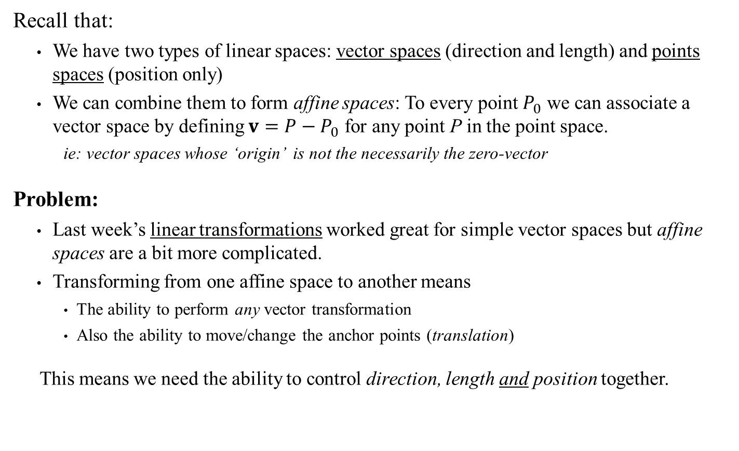
Space Transformations
Recall that:
We have two types of linear spaces: vector spaces (direction and length) and points spaces (position only)
We can combine them to form affine spaces: To every point $P_{0}$ we can associate a vector space by defining $v=P−P_{0}$ for any point P in the point space.
ie: vector spaces whose ‘origin’ is not the necessarily the zero-vector
Problem:
Last week’s linear transformations worked great for simple vector spaces but affine spaces are a bit more complicated.
Transforming from one affine space to another means
The ability to perform any vector transformation
Also the ability to move/change the anchor points (translation)
This means we need the ability to control direction, length and position together.

Slide 3


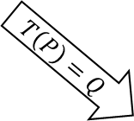



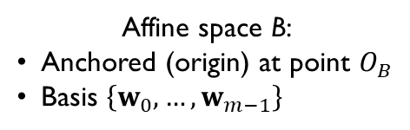


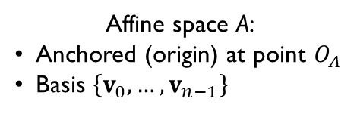




Affine Transformation: Formally
Affine space A:
Anchored (origin) at point $O_{A}$
Basis $\left\{v_{0},…,v_{n−1}\right\}$
Affine space B:
Anchored (origin) at point $O_{B}$
Basis $\left\{w_{0},…,w_{m−1}\right\}$
Example:
Consider a transform from one 2D affine plane to another
P
$$T\left(P\right)=Q$$
Q
$A$(n dimension)
$B$ (m dimension)
$$v_{0}$$
P
y
$$T\left(P\right)=Q$$
$$O_{A}$$
$$v_{1}$$
Affine space A
Q
$$w_{0}$$
x
$$w_{1}$$
$$O_{B}$$
Affine space B
z

Slide 4
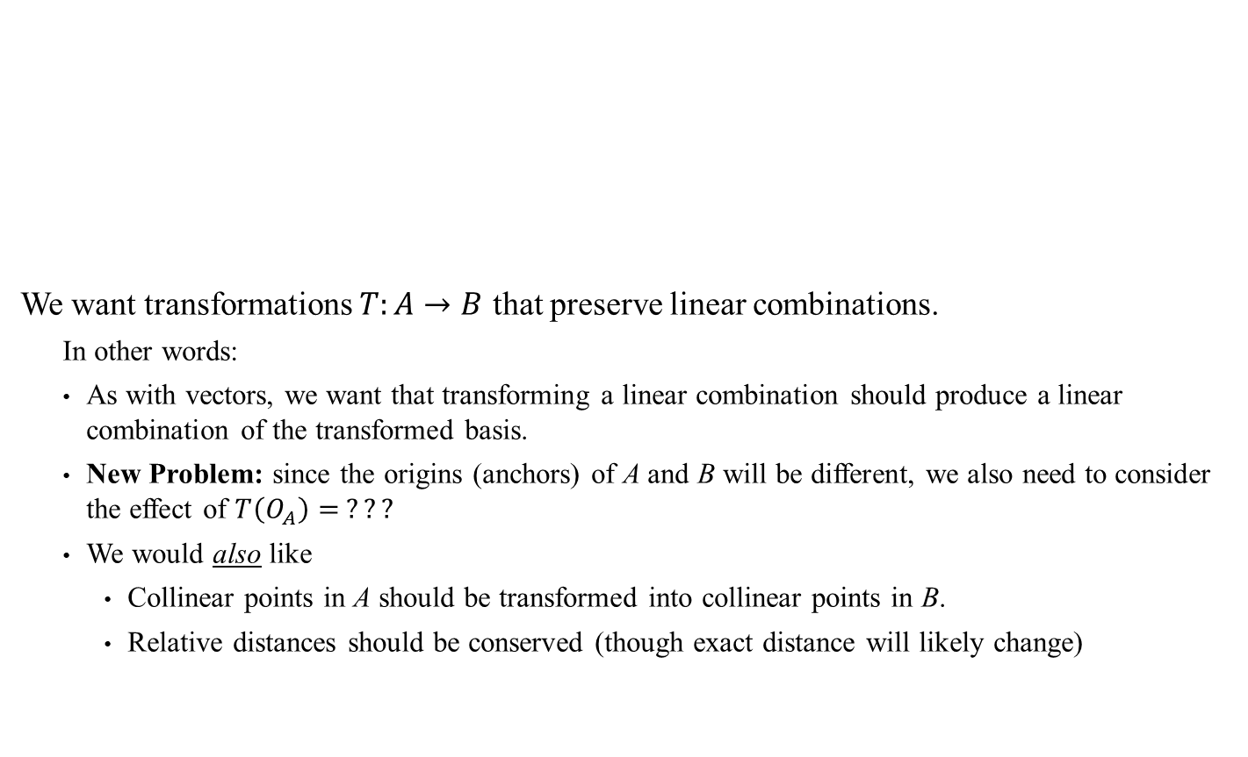
Affine Transformation: Formally
Affine space A:
Anchored (origin) at point $O_{A}$
Basis $\left\{v_{0},…,v_{n−1}\right\}$
Affine space B:
Anchored (origin) at point $O_{B}$
Basis $\left\{w_{0},…,w_{m−1}\right\}$
We want transformations $T:A→B$ that preserve linear combinations.
In other words:
As with vectors, we want that transforming a linear combination should produce a linear combination of the transformed basis.
New Problem: since the origins (anchors) of A and B will be different, we also need to consider the effect of $T\left(O_{A}\right)= ???$
We would also like
Collinear points in A should be transformed into collinear points in B.
Relative distances should be conserved (though exact distance will likely change)
P
$$T\left(P\right)=Q$$
Q
$A$(n dimension)
$B$ (m dimension)
Sidebar:
Why? Short answer: better math properties and conveniently, it works nicely for our purposes

Slide 5
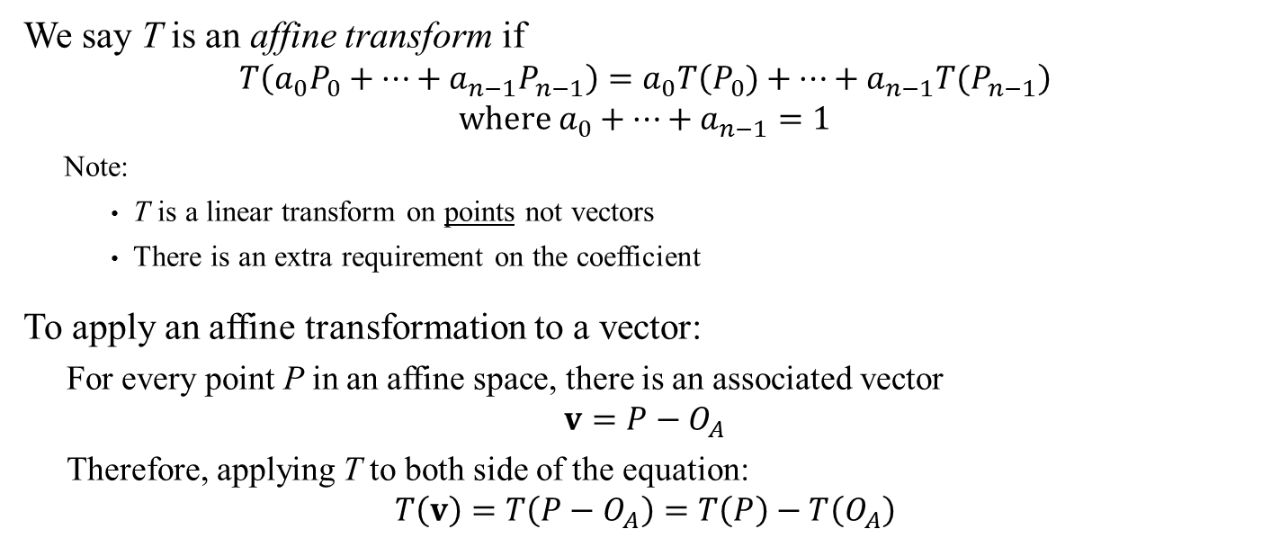

Affine Transformation: Formally
Affine space A:
Anchored (origin) at point $O_{A}$
Basis $\left\{v_{0},…,v_{n−1}\right\}$
Affine space B:
Anchored (origin) at point $O_{B}$
Basis $\left\{w_{0},…,w_{m−1}\right\}$
P
$$T\left(P\right)=Q$$
Q
$A$(n dimension)
$B$ (m dimension)
We say T is an affine transform if
$$T\left(a_{0}P_{0}+⋯+a_{n−1}P_{n−1}\right)=a_{0}T\left(P_{0})+⋯+a_{n−1}T(P_{n−1}\right) \\ \text{where} a_{0}+⋯+a_{n−1}=1$$
Note:
T is a linear transform on points not vectors
There is an extra requirement on the coefficient
To apply an affine transformation to a vector:
For every point P in an affine space, there is an associated vector
$$v=P−O_{A}$$
Therefore, applying T to both side of the equation:
$$T\left(v\right)=T\left(P−O_{A}\right)=T\left(P\right)−T\left(O_{A}\right)$$
Sidebar:
The extra requirement ensures consistency of vector operations between affine spaces. See also Affine Space – Informal Description
Using $v=P−P_{0}$ where $P_{0}=O_{A}$

Slide 6
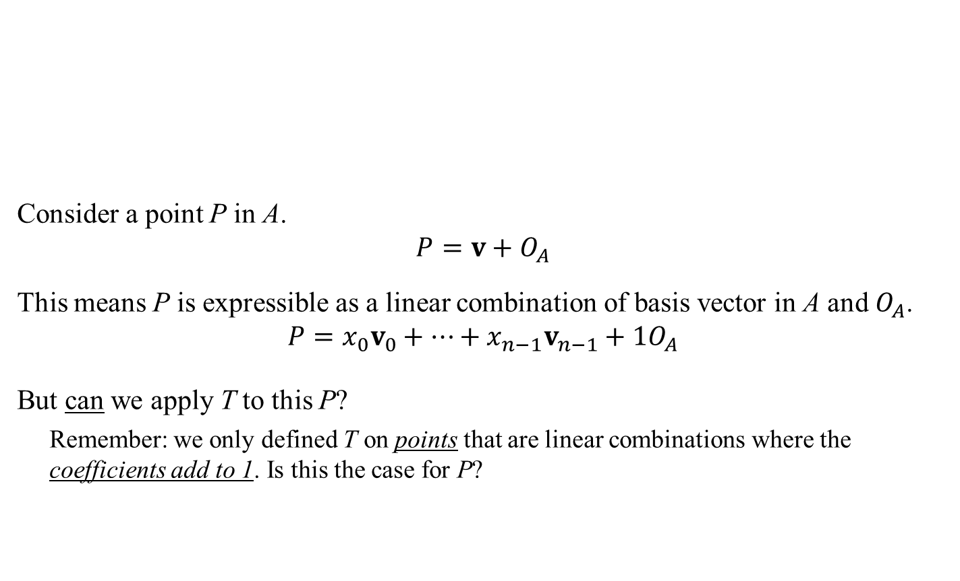
Affine Transformation: Formally
Affine space A:
Anchored (origin) at point $O_{A}$
Basis $\left\{v_{0},…,v_{n−1}\right\}$
Affine space B:
Anchored (origin) at point $O_{B}$
Basis $\left\{w_{0},…,w_{m−1}\right\}$
Consider a point P in A.
$$P=v+O_{A}$$
This means P is expressible as a linear combination of basis vector in A and $O_{A}$.
$$P=x_{0}v_{0}+…+x_{n−1}v_{n−1}+1O_{A}$$
But can we apply T to this P?
Remember: we only defined T on points that are linear combinations where the coefficients add to 1. Is this the case for P?
P
$$T\left(P\right)=Q$$
Q
$A$(n dimension)
$B$ (m dimension)
i.e.: All points can also be expressed using a vector relative to the origin of A (see this slide again)

Slide 7
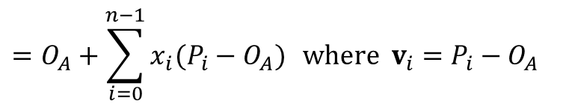

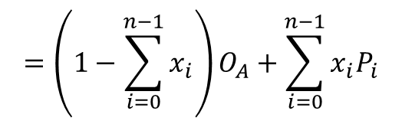
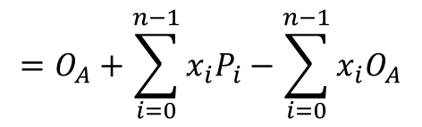

Affine Transformation: Formally
We have $P=x_{0}v_{0}+…+x_{n−1}v_{n−1}+O_{A}$. But what is P in terms of points?
So P is now expressed as a linear combination of points (Namely, $O_{A}$ and all $P_{i}$’s)
But does the sum of all these coefficients equal 1?
$$\left(1−\sum_{i=0}^{n−1}{x_{i}}\right)+\sum_{i=0}^{n−1}{x_{i}}=1$$
Therefore, we can safely apply the affine transform T to the point P
$$P=O_{A}+\sum_{i=0}^{n−1}{x_{i}v_{i}}$$
$$=O_{A}+\sum_{i=0}^{n−1}{x_{i}(P_{i}−O_{A})} \text{where} v_{i}=P_{i}−O_{A}$$
$$=O_{A}+\sum_{i=0}^{n−1}{x_{i}P_{i}}−\sum_{i=0}^{n−1}{x_{i}O_{A}}$$
$$=\left(1−\sum_{i=0}^{n−1}{x_{i}}\right)O_{A}+\sum_{i=0}^{n−1}{x_{i}P_{i}}$$

Slide 8
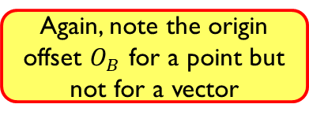
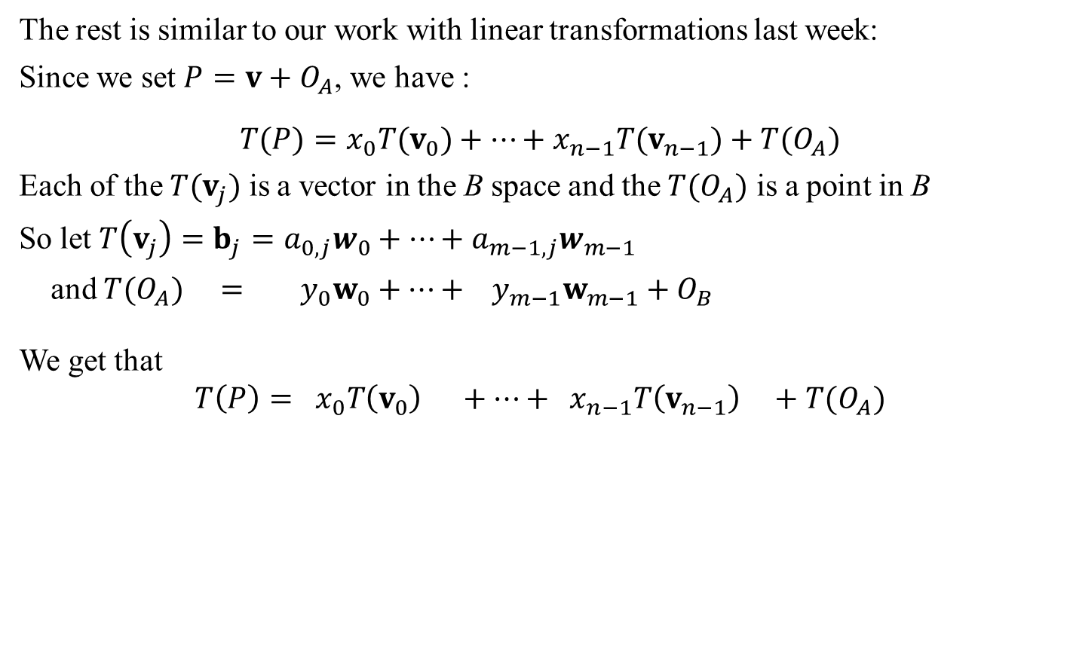
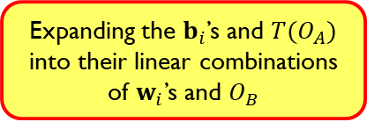
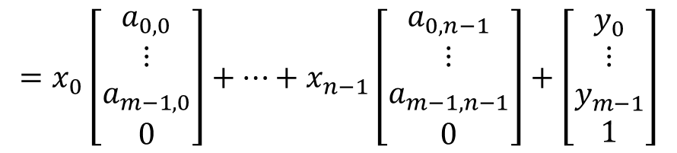
Affine Transformation: Formally
The rest is similar to our work with linear transformations last week:
Since we set $P=v+O_{A}$, we have :
$$T(P)=x_{0}T(v_{0})+…+x_{n−1}T(v_{n−1})+T(O_{A})$$
Each of the $T(v_{j})$ is a vector in the B space and the ${T(O}_{A})$ is a point in B
So let $T\left(v_{j}\right)=b_{j}=a_{0,j}w_{0}+…+a_{m−1,j}w_{m−1}$
and ${T(O}_{A}) = y_{0}w_{0}+…+ y_{m−1}w_{m−1}+O_{B}$
We get that
$$T\left(P\right)= x_{0}T\left(v_{0}\right) +…+ x_{n−1}T\left(v_{n−1}\right) +{T(O}_{A})$$
Again, note the origin offset $O_{B}$ for a point but not for a vector
$$= x_{0}b_{0} +…+ x_{n−1}b_{n−1} +{T(O}_{A})$$
Expanding the $b_{i}$’s and ${T(O}_{A})$ into their linear combinations of $w_{i}$’s and $O_{B}$
$$=x_{0}\left[\begin{matrix}a_{0,0} \\ ⋮ \\ a_{m−1,0} \\ 0\end{matrix}\right]+…+x_{n−1}\left[\begin{matrix}a_{0,n−1} \\ ⋮ \\ a_{m−1,n−1} \\ 0\end{matrix}\right]+\left[\begin{matrix}y_{0} \\ ⋮ \\ y_{m−1} \\ 1\end{matrix}\right]$$

Slide 9

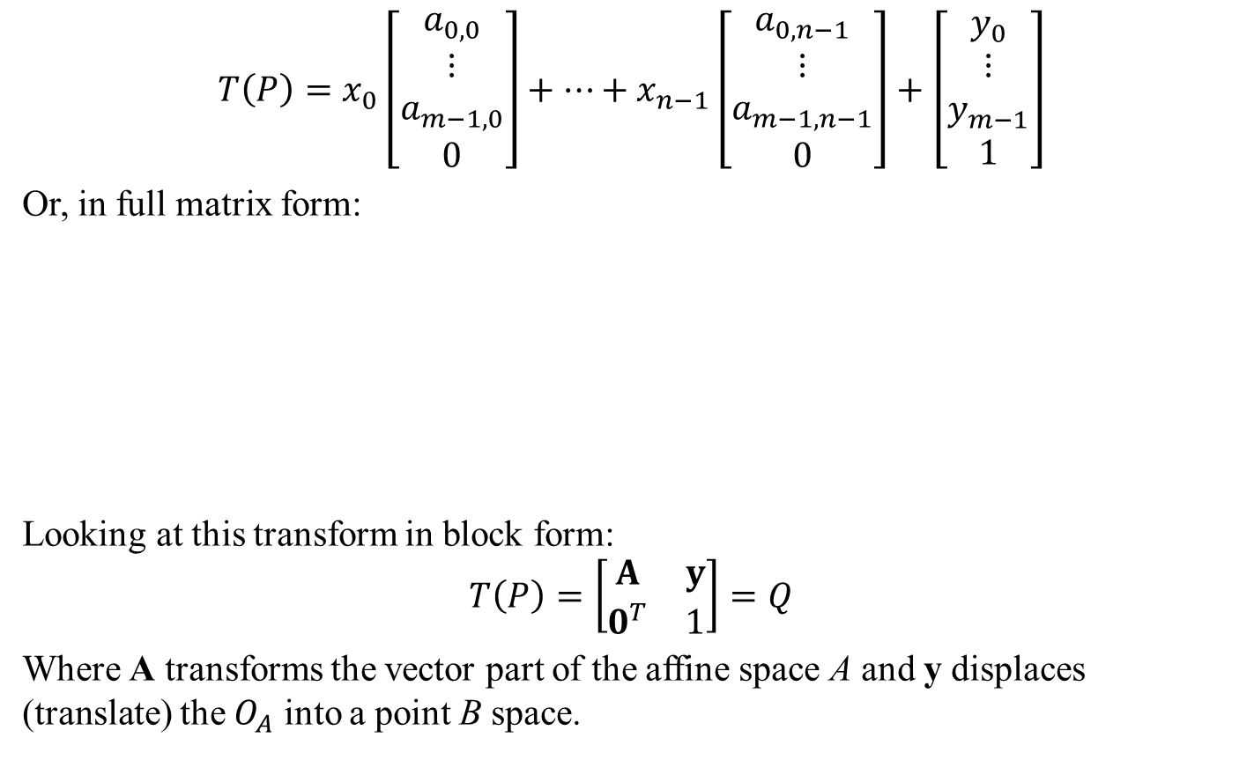

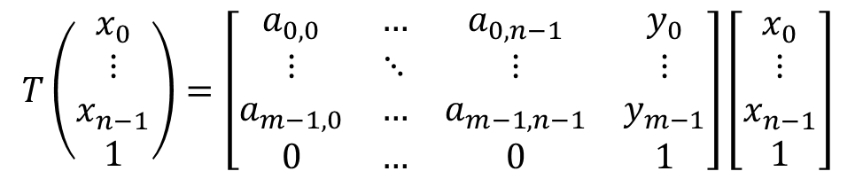
Affine Transformation: Formally
$$T\left(P\right)=x_{0}\left[\begin{matrix}a_{0,0} \\ ⋮ \\ a_{m−1,0} \\ 0\end{matrix}\right]+…+x_{n−1}\left[\begin{matrix}a_{0,n−1} \\ ⋮ \\ a_{m−1,n−1} \\ 0\end{matrix}\right]+\left[\begin{matrix}y_{0} \\ ⋮ \\ y_{m−1} \\ 1\end{matrix}\right]$$
Or, in full matrix form:
Looking at this transform in block form:
$$T\left(P\right)=\left[\begin{matrix}A & y \\ 0^{T} & 1\end{matrix}\right]=Q$$
Where A transforms the vector part of the affine space A and y displaces (translate) the $O_{A}$ into a point B space.
$$T\left(\begin{matrix}x_{0} \\ ⋮ \\ x_{n−1} \\ 1\end{matrix}\right)=\left[\begin{matrix}a_{0,0} & … & a_{0,n−1} & y_{0} \\ ⋮ & ⋱ & ⋮ & ⋮ \\ a_{m−1,0} & … & a_{m−1,n−1} & y_{m−1} \\ 0 & … & 0 & 1\end{matrix}\right]\left[\begin{matrix}x_{0} \\ ⋮ \\ x_{n−1} \\ 1\end{matrix}\right]$$
$$P=x_{0}v_{0}+…+x_{n−1}v_{n−1}+O_{A}$$
Transformed basis vectors from A into vectors in B.
Transformed $O_{A}$ into a point in B space.

Slide 10
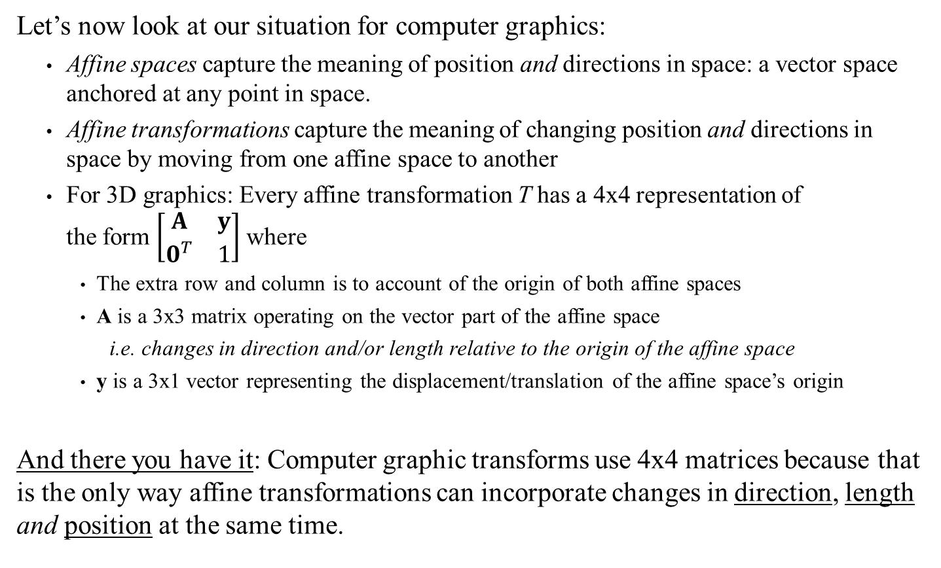
Transforming Points and Directions
Let’s now look at our situation for computer graphics:
Affine spaces capture the meaning of position and directions in space: a vector space anchored at any point in space.
Affine transformations capture the meaning of changing position and directions in space by moving from one affine space to another
For 3D graphics: Every affine transformation T has a 4x4 representation of the form $\left[\begin{matrix}A & y \\ 0^{T} & 1\end{matrix}\right]$ where
The extra row and column is to account of the origin of both affine spaces
A is a 3x3 matrix operating on the vector part of the affine space
i.e. changes in direction and/or length relative to the origin of the affine space
y is a 3x1 vector representing the displacement/translation of the affine space’s origin
And there you have it: Computer graphic transforms use 4x4 matrices because that is the only way affine transformations can incorporate changes in direction, length and position at the same time.

Slide 11
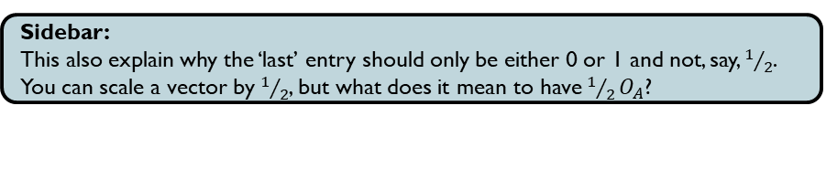
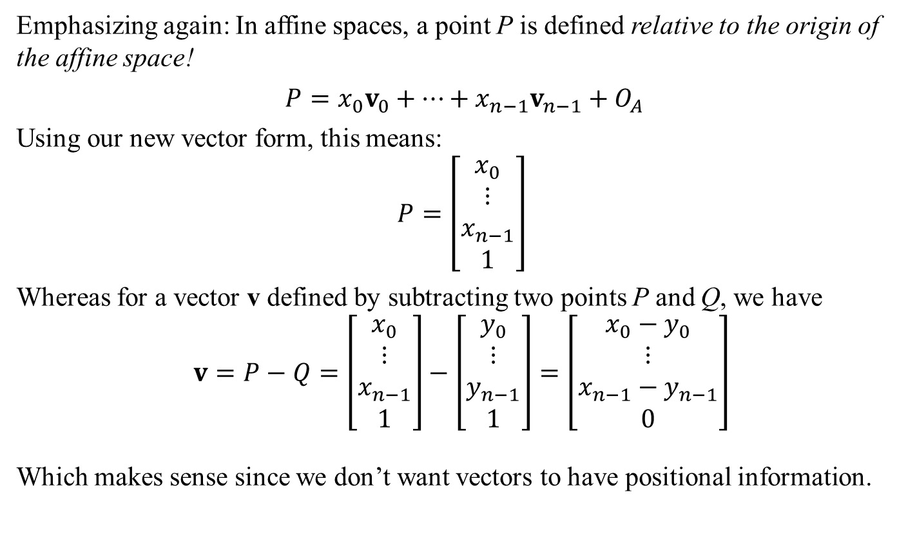
Points and Vectors
Sidebar:
This also explain why the ‘last’ entry should only be either 0 or 1 and not, say, $1/2$. You can scale a vector by $1/2$, but what does it mean to have $1/2O_{A}$?
Emphasizing again: In affine spaces, a point P is defined relative to the origin of the affine space!
$P=x_{0}v_{0}+…+x_{n−1}v_{n−1}+O_{A}$
Using our new vector form, this means:
$$P=\left[\begin{matrix}x_{0} \\ ⋮ \\ x_{n−1} \\ 1\end{matrix}\right]$$
Whereas for a vector v defined by subtracting two points P and Q, we have
$$v=P−Q=\left[\begin{matrix}x_{0} \\ ⋮ \\ x_{n−1} \\ 1\end{matrix}\right]−\left[\begin{matrix}y_{0} \\ ⋮ \\ y_{n−1} \\ 1\end{matrix}\right]=\left[\begin{matrix}x_{0}−y_{0} \\ ⋮ \\ x_{n−1}−y_{n−1} \\ 0\end{matrix}\right]$$
Which makes sense since we don’t want vectors to have positional information.
Relative to the origin of A
NOT Relative to the origin of A
In general: when given a column array, whether the last entry is a 1 or 0 determines whether we are dealing with a point or a vector.

Slide 12
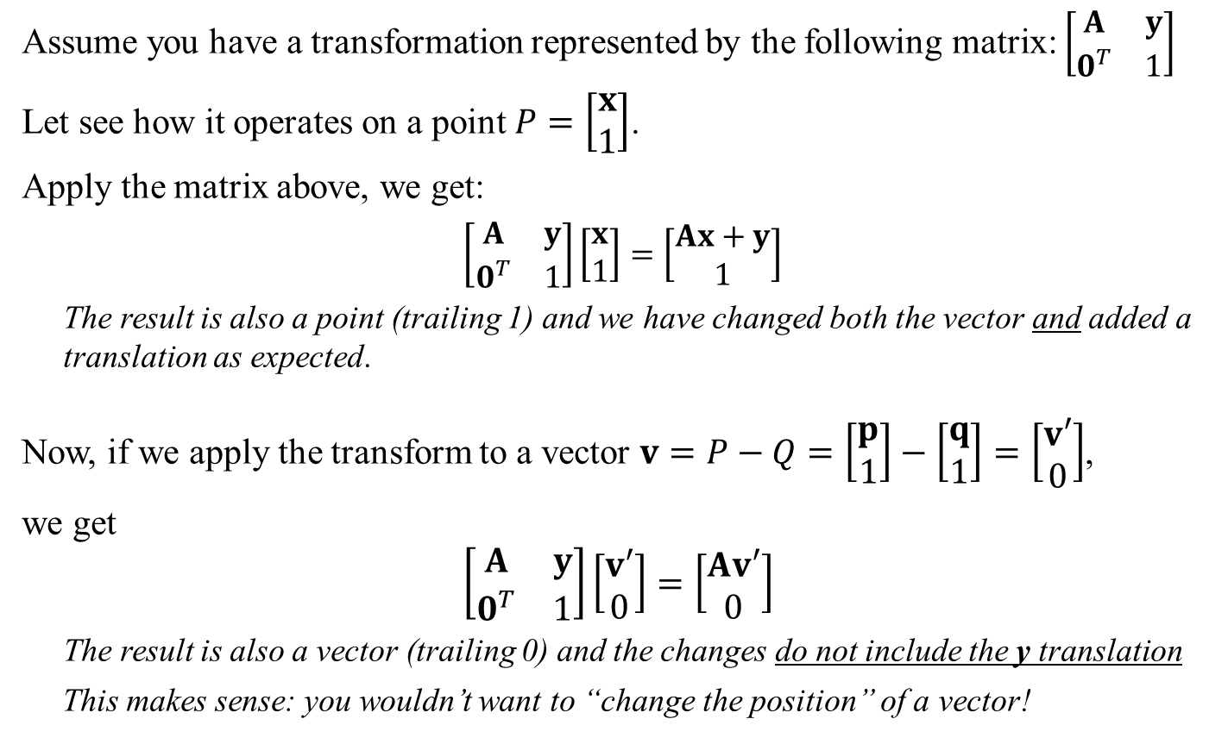
Transforming Points vs Vectors
Assume you have a transformation represented by the following matrix: $\left[\begin{matrix}A & y \\ 0^{T} & 1\end{matrix}\right]$
Let see how it operates on a point $P=\left[\begin{matrix}x \\ 1\end{matrix}\right]$.
Apply the matrix above, we get:
$\left[\begin{matrix}A & y \\ 0^{T} & 1\end{matrix}\right]\left[\begin{matrix}x \\ 1\end{matrix}\right]=\left[\begin{matrix}Ax+y \\ 1\end{matrix}\right]$
The result is also a point (trailing 1) and we have changed both the vector and added a translation as expected.
Now, if we apply the transform to a vector $v=P−Q=\left[\begin{matrix}p \\ 1\end{matrix}\right]−\left[\begin{matrix}q \\ 1\end{matrix}\right]=\left[\begin{matrix}v′ \\ 0\end{matrix}\right]$,
we get
$$\left[\begin{matrix}A & y \\ 0^{T} & 1\end{matrix}\right]\left[\begin{matrix}v′ \\ 0\end{matrix}\right]=\left[\begin{matrix}Av′ \\ 0\end{matrix}\right]$$
The result is also a vector (trailing 0) and the changes do not include the y translation
This makes sense: you wouldn’t want to “change the position” of a vector!

Slide 13


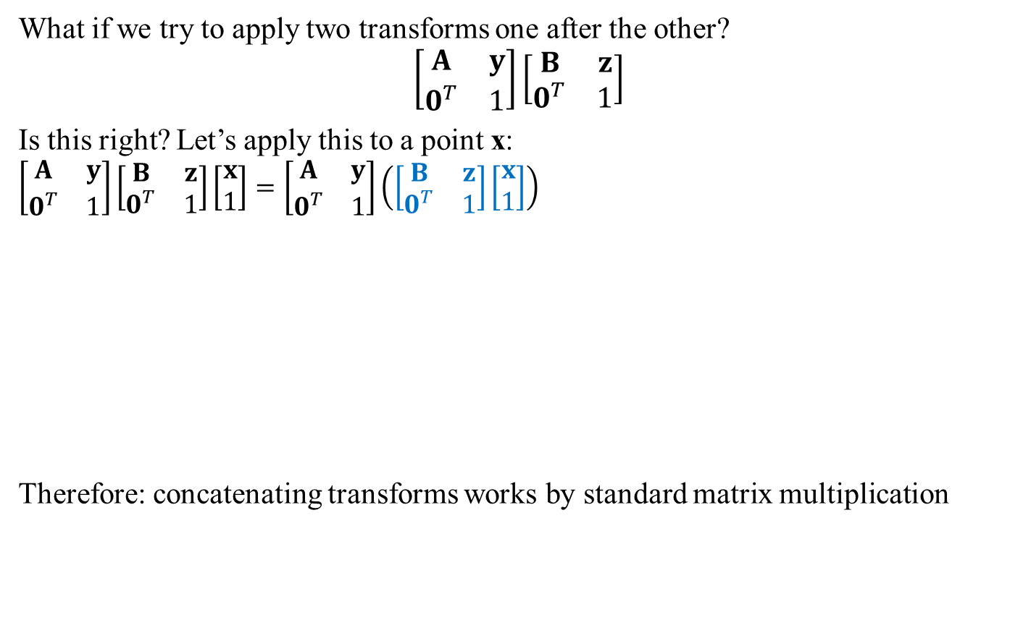



Transforming Points in Space: Concatenating Transforms
What if we try to apply two transforms one after the other?
$$\left[\begin{matrix}A & y \\ 0^{T} & 1\end{matrix}\right]\left[\begin{matrix}B & z \\ 0^{T} & 1\end{matrix}\right]$$
Is this right? Let’s apply this to a point x:
$$\left[\begin{matrix}A & y \\ 0^{T} & 1\end{matrix}\right]\left[\begin{matrix}B & z \\ 0^{T} & 1\end{matrix}\right]\left[\begin{matrix}x \\ 1\end{matrix}\right]=\left[\begin{matrix}A & y \\ 0^{T} & 1\end{matrix}\right]\left(\left[\begin{matrix}B & z \\ 0^{T} & 1\end{matrix}\right]\left[\begin{matrix}x \\ 1\end{matrix}\right]\right)$$
Therefore: concatenating transforms works by standard matrix multiplication
$$=\left[\begin{matrix}AB & Az+y \\ 0^{T} & 1\end{matrix}\right]$$
$$=\left[\begin{matrix}A & y \\ 0^{T} & 1\end{matrix}\right]\left[\begin{matrix}Bx+z \\ 1\end{matrix}\right]$$
Since B introduces a z offset first, this offset will also be affected when A is applied.
In other words:
Applying transform B followed by transform A is the same as applying the transform (AB)
$$=\left[\begin{matrix}ABx+Az+y \\ 1\end{matrix}\right]$$
$$=\left[\begin{matrix}AB & Az+y \\ 0^{T} & 1\end{matrix}\right]\left[\begin{matrix}x \\ 1\end{matrix}\right]$$
$$=\left(\left[\begin{matrix}A & y \\ 0^{T} & 1\end{matrix}\right]\left[\begin{matrix}B & z \\ 0^{T} & 1\end{matrix}\right]\right)\left[\begin{matrix}x \\ 1\end{matrix}\right]$$

Slide 14



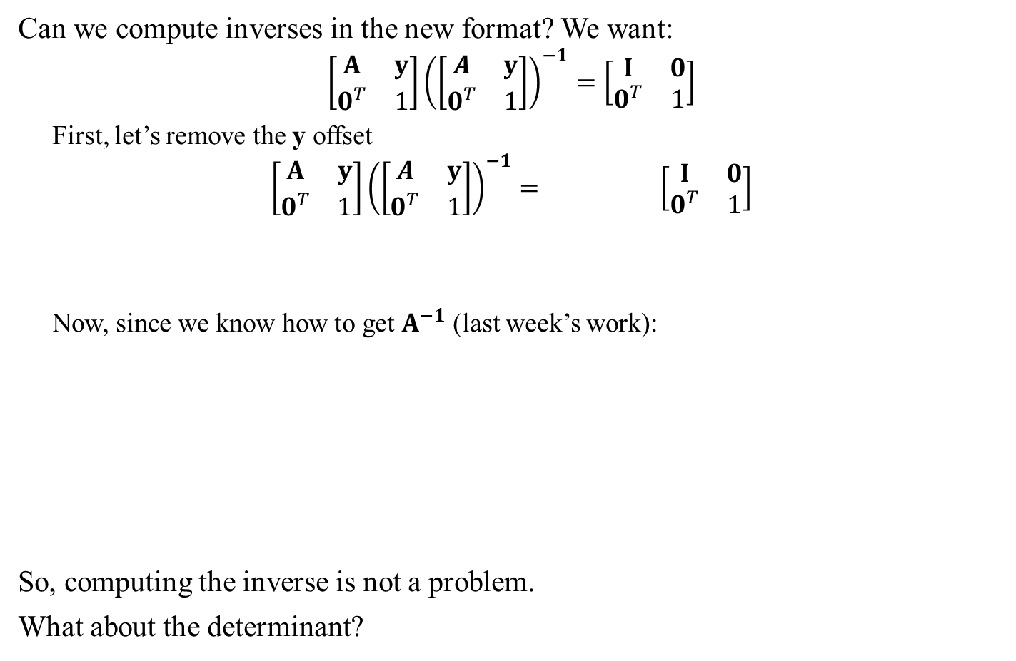
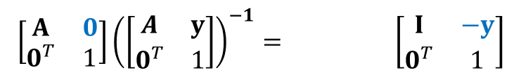
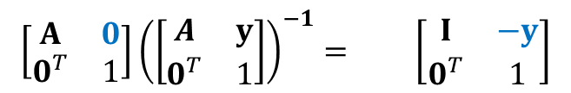
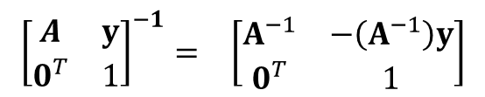

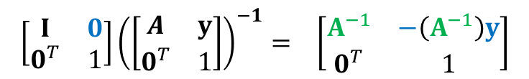
Transforming Points in Space: Inverting a Transform
Can we compute inverses in the new format? We want:
$$\left[\begin{matrix}A & y \\ 0^{T} & 1\end{matrix}\right]{\left(\left[\begin{matrix}A & y \\ 0^{T} & 1\end{matrix}\right]\right)}^{−1}=\left[\begin{matrix}I & 0 \\ 0^{T} & 1\end{matrix}\right]$$
First, let’s remove the y offset
$$\left[\begin{matrix}A & y \\ 0^{T} & 1\end{matrix}\right]{\left(\left[\begin{matrix}A & y \\ 0^{T} & 1\end{matrix}\right]\right)}^{−1}= \left[\begin{matrix}I & 0 \\ 0^{T} & 1\end{matrix}\right]$$
Now, since we know how to get $A^{−1}$ (last week’s work):
So, computing the inverse is not a problem.
What about the determinant?
NB: we need from both sides, but the argument is similar
$$\left[\begin{matrix}I & −y \\ 0^{T} & 1\end{matrix}\right]$$
$$\left[\begin{matrix}I & −y \\ 0^{T} & 1\end{matrix}\right]$$
$$\left[\begin{matrix}A & 0 \\ 0^{T} & 1\end{matrix}\right]{\left(\left[\begin{matrix}A & y \\ 0^{T} & 1\end{matrix}\right]\right)}^{−1}= \left[\begin{matrix}I & −y \\ 0^{T} & 1\end{matrix}\right]$$
$$\left[\begin{matrix}A & 0 \\ 0^{T} & 1\end{matrix}\right]{\left(\left[\begin{matrix}A & y \\ 0^{T} & 1\end{matrix}\right]\right)}^{−1}= \left[\begin{matrix}I & −y \\ 0^{T} & 1\end{matrix}\right]$$
$$\left[\begin{matrix}A^{−1} & 0 \\ 0^{T} & 1\end{matrix}\right]$$
$$\left[\begin{matrix}A^{−1} & 0 \\ 0^{T} & 1\end{matrix}\right]$$
$$\left[\begin{matrix}I & 0 \\ 0^{T} & 1\end{matrix}\right]{\left(\left[\begin{matrix}A & y \\ 0^{T} & 1\end{matrix}\right]\right)}^{−1}= \left[\begin{matrix}A^{−1} & −\left(A^{−1}\right)y \\ 0^{T} & 1\end{matrix}\right]$$
$${\left[\begin{matrix}A & y \\ 0^{T} & 1\end{matrix}\right]}^{−1}= \left[\begin{matrix}A^{−1} & −\left(A^{−1}\right)y \\ 0^{T} & 1\end{matrix}\right]$$

Slide 15


Transforming Points in Space: Determinant of a Transform
Computing the determinant of a transform in the 4x4 form is easy.
$$\left|\begin{matrix}A & y \\ 0^{T} & 1\end{matrix}\right|=$$
This can be seen by using the bottom row to compute the determinant
$$\left|A\right|$$

Slide 16
GAM 325/425: Applied 3D Geometry
Standard Affine Transforms

Slide 17
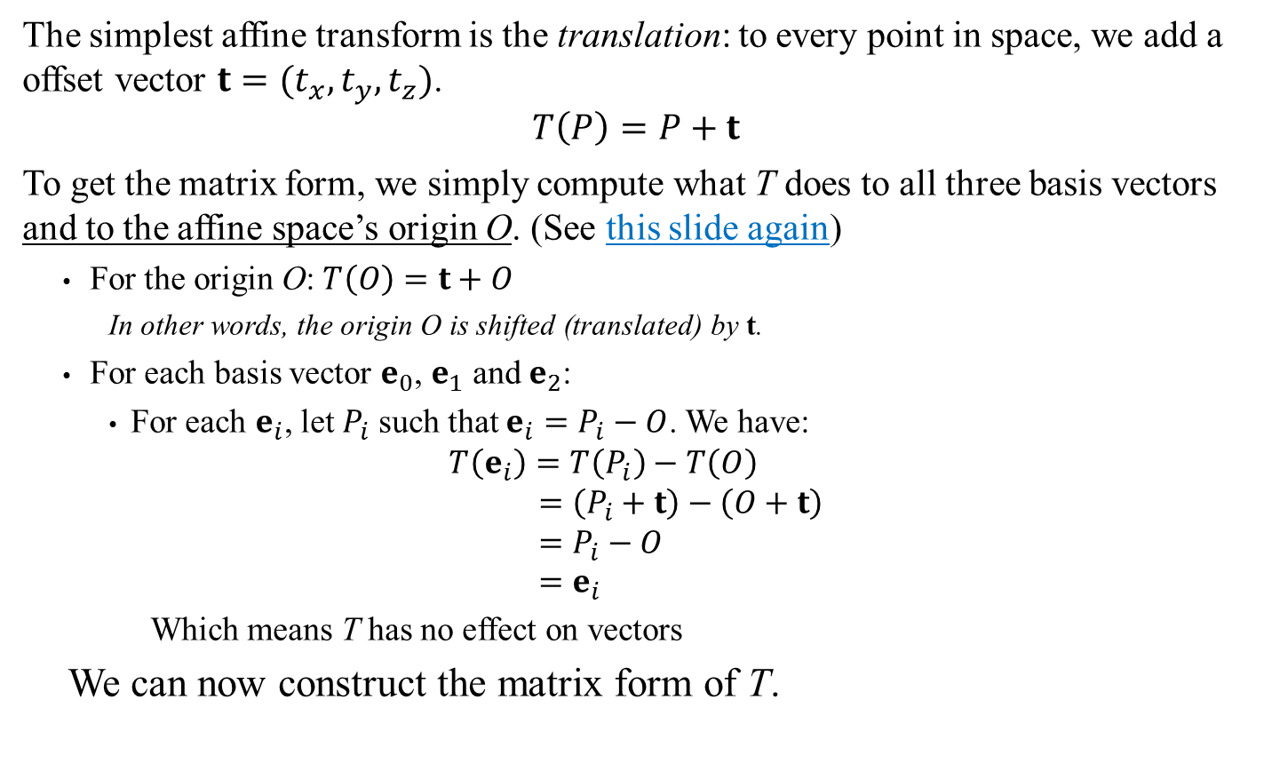
Standard Affine Transforms: Translation
The simplest affine transform is the translation: to every point in space, we add a offset vector $t=(t_{x},t_{y},t_{z})$.
$$T\left(P\right)=P+t$$
To get the matrix form, we simply compute what T does to all three basis vectors and to the affine space’s origin O. (See this slide again)
For the origin O: $T\left(O\right)=t+O$
In other words, the origin O is shifted (translated) by t.
For each basis vector $e_{0}$, $e_{1}$ and $e_{2}$:
For each $e_{i}$, let $P_{i}$ such that $e_{i}=P_{i}−O$. We have:
$$T\left(e_{i}\right)=T\left(P_{i}\right)−T\left(O\right) \\ =\left(P_{i}+t\right)−\left(O+t\right) \\ =P_{i}−O \\ =e_{i}$$
Which means T has no effect on vectors
We can now construct the matrix form of T.
This is the letter ‘O’, not the number zero.

Slide 18
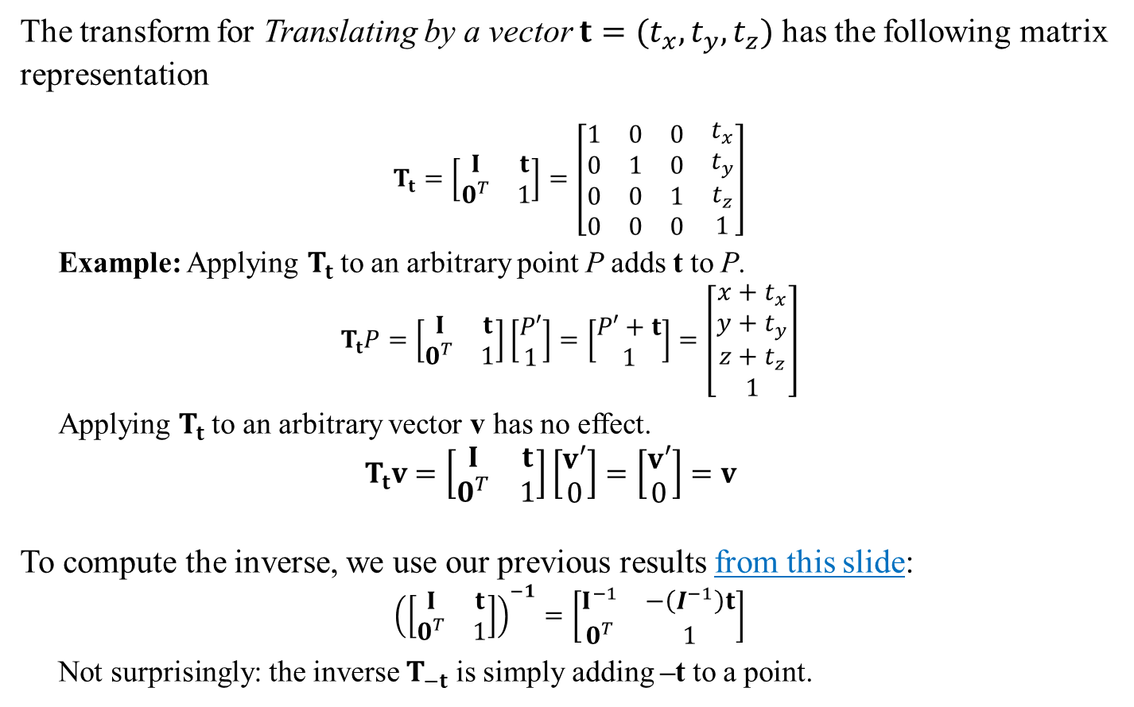



Standard Affine Transforms: Translation
The transform for Translating by a vector $t=(t_{x},t_{y},t_{z})$ has the following matrix representation
$$T_{t}=\left[\begin{matrix}I & t \\ 0^{T} & 1\end{matrix}\right]=\left[\begin{matrix}\begin{matrix}1 & 0 & 0 \\ 0 & 1 & 0 \\ 0 & 0 & 1\end{matrix} & \begin{matrix}t_{x} \\ t_{y} \\ t_{z}\end{matrix} \\ \begin{matrix}0 & 0 & 0\end{matrix} & 1\end{matrix}\right]$$
Example: Applying $T_{t}$ to an arbitrary point P adds t to P.
$$T_{t}P=\left[\begin{matrix}I & t \\ 0^{T} & 1\end{matrix}\right]\left[\begin{matrix}P′ \\ 1\end{matrix}\right]=\left[\begin{matrix}P′+t \\ 1\end{matrix}\right]=\left[\begin{matrix}\begin{matrix}{x+t}_{x} \\ y+t_{y} \\ {z+t}_{z}\end{matrix} \\ 1\end{matrix}\right]$$
Applying $T_{t}$ to an arbitrary vector v has no effect.
$$T_{t}v=\left[\begin{matrix}I & t \\ 0^{T} & 1\end{matrix}\right]\left[\begin{matrix}v′ \\ 0\end{matrix}\right]=\left[\begin{matrix}v′ \\ 0\end{matrix}\right]=v$$
To compute the inverse, we use our previous results from this slide:
$${\left(\left[\begin{matrix}I & t \\ 0^{T} & 1\end{matrix}\right]\right)}^{−1}=\left[\begin{matrix}I^{−1} & −\left(I^{−1}\right)t \\ 0^{T} & 1\end{matrix}\right]$$
Not surprisingly: the inverse $T_{−t}$ is simply adding –t to a point.
$$T\left(e_{i}\right)$$
$$T\left(O\right)$$
$$=\left[\begin{matrix}I & −t \\ 0^{T} & 1\end{matrix}\right]=T_{−t}$$
See also Dynamic Examples

Slide 19
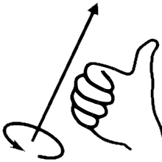
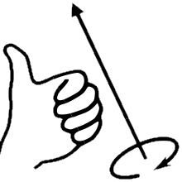
Standard Affine Transforms: Rotations
In general, to rotate a point in space, you need:
A center of rotation
An axis about which to rotate
An amount (angle) to rotate.
Note: direction of positive determined by space handedness
Angles are usually given in radians (0..2π), not degrees.
It doesn’t make any difference mathematically, but you should get used to radians.
We will approach rotations as follow:
Pure Rotations are rotations about an axis passing by the origin.
No translation and no scaling. These transformations are a bit easier, so we’ll start with them
Rotating about the three world axes are easier and surprisingly common.
A good place to start.
Rotating about an arbitrary axis (still passing by the origin) will be next
A bit more complicated.
Rotations combined with other transforms will be covered later.

Slide 20
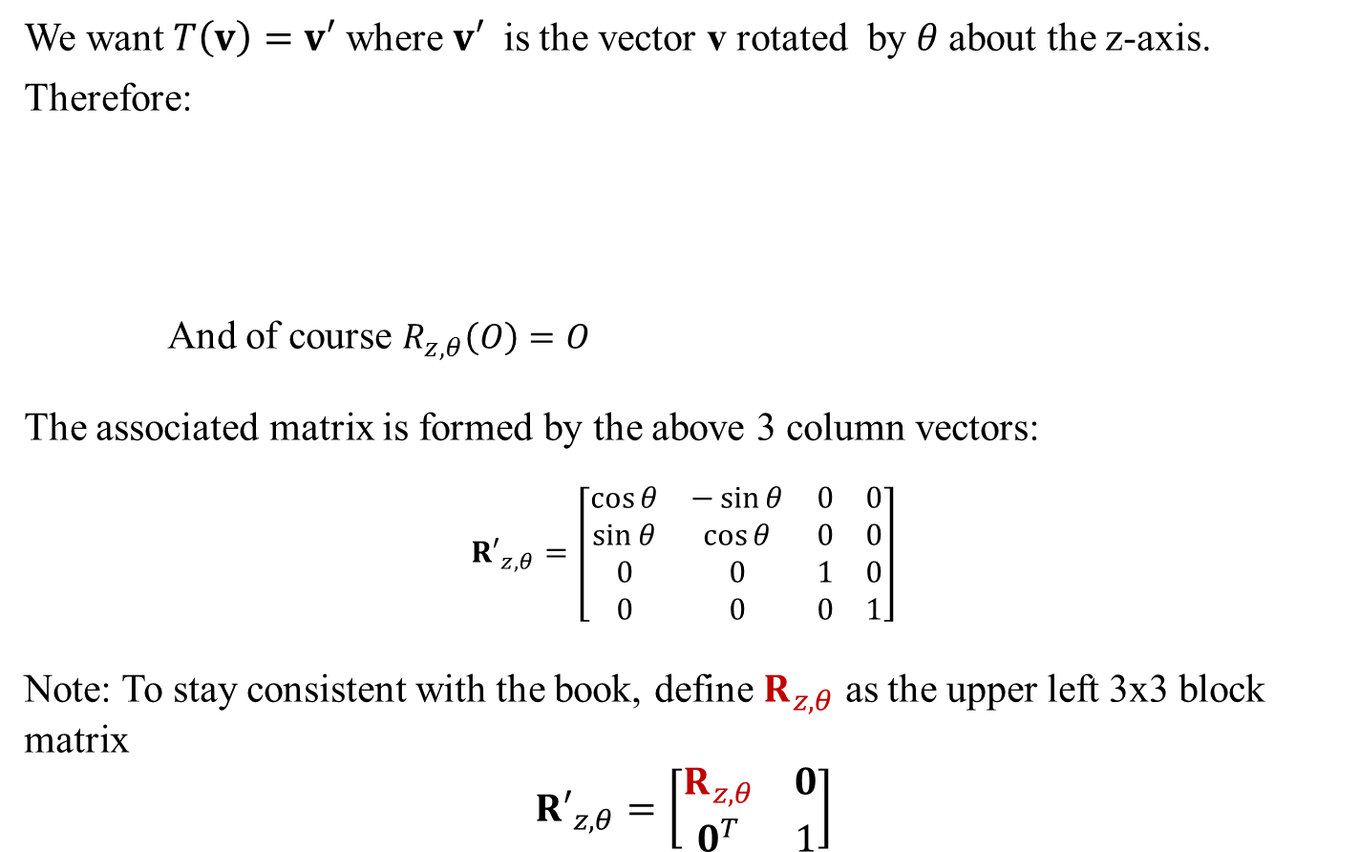




Standard Affine Transforms: Rotation About z axis
We want $T\left(v\right)=v′$ where $v′$ is the vector v rotated by $θ$about the z-axis.
Therefore:
And of course $R_{z,θ}\left(O\right)=O$
The associated matrix is formed by the above 3 column vectors:
$${R′}_{z,θ}=\left[\begin{matrix}\cos{θ} & −\sin{θ} & 0 & 0 \\ \sin{θ} & \cos{θ} & 0 & 0 \\ 0 & 0 & 1 & 0 \\ 0 & 0 & 0 & 1\end{matrix}\right]$$
Note: To stay consistent with the book, define $R_{z,θ}$ as the upper left 3x3 block matrix
$${R′}_{z,θ}=\left[\begin{matrix}R_{z,θ} & 0 \\ 0^{T} & 1\end{matrix}\right]$$
y
NB: Right hand space with z axis towards you.
y’
θ
$$R_{z,θ}\left(e_{0}\right)=\left[\begin{matrix}\cos{θ} \\ \sin{θ} \\ 0 \\ 0\end{matrix}\right]$$
$$R_{z,θ}\left(e_{1}\right)=\left[\begin{matrix}−\sin{θ} \\ \cos{θ} \\ 0 \\ 0\end{matrix}\right]$$
$$R_{z,θ}\left(e_{2}\right)=\left[\begin{matrix}0 \\ 0 \\ 1 \\ 0\end{matrix}\right]$$
x’
θ
$$x$$

Slide 21




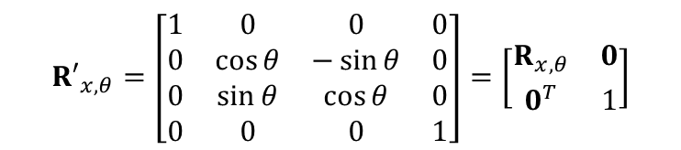

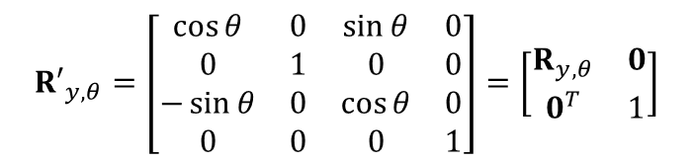


Standard Affine Transforms: Rotation About x and y axes
Applying the same reasoning to rotation about the x axis:
And of course $R_{z,θ}\left(O\right)=O$
Giving:
The y axis has a small catch: positive rotations look different
And of course $R_{z,θ}\left(O\right)=O$
Giving:
z
NB: Right hand space with x axis towards you.
$$R_{x,θ}\left(e_{0}\right)=\left[\begin{matrix}1 \\ 0 \\ 0 \\ 0\end{matrix}\right]$$
$$R_{x,θ}\left(e_{1}\right)=\left[\begin{matrix}0 \\ \cos{θ} \\ \sin{θ} \\ 0\end{matrix}\right]$$
$$R_{x,θ}\left(e_{1}\right)=\left[\begin{matrix}0 \\ −\sin{θ} \\ \cos{θ} \\ 0\end{matrix}\right]$$
z’
θ
y’
θ
y
$${R′}_{x,θ}=\left[\begin{matrix}1 & 0 & 0 & 0 \\ 0 & \cos{θ} & −\sin{θ} & 0 \\ 0 & \sin{θ} & \cos{θ} & 0 \\ 0 & 0 & 0 & 1\end{matrix}\right]=\left[\begin{matrix}R_{x,θ} & 0 \\ 0^{T} & 1\end{matrix}\right]$$
z
z’
NB: Right hand space with y axis away from you.
$$R_{y,θ}\left(e_{0}\right)=\left[\begin{matrix}\cos{θ} \\ 0 \\ −\sin{θ} \\ 0\end{matrix}\right]$$
$$R_{y,θ}\left(e_{1}\right)=\left[\begin{matrix}0 \\ 1 \\ 0 \\ 0\end{matrix}\right]$$
$$R_{y,θ}\left(e_{1}\right)=\left[\begin{matrix}\sin{θ} \\ 0 \\ \cos{θ} \\ 0\end{matrix}\right]$$
θ
θ
x
$${R′}_{y,θ}=\left[\begin{matrix}\cos{θ} & 0 & \sin{θ} & 0 \\ 0 & 1 & 0 & 0 \\ −\sin{θ} & 0 & \cos{θ} & 0 \\ 0 & 0 & 0 & 1\end{matrix}\right]=\left[\begin{matrix}R_{y,θ} & 0 \\ 0^{T} & 1\end{matrix}\right]$$
x’
See also Dynamic Examples

Slide 22
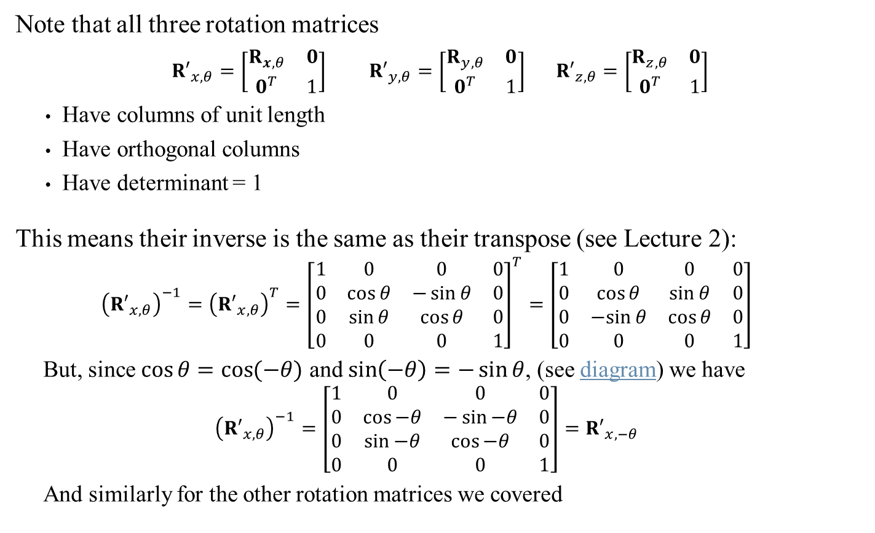
Standard Affine Transforms: Rotation Composition and Inverse
Note that all three rotation matrices
${R′}_{x,θ}=\left[\begin{matrix}R_{x,θ} & 0 \\ 0^{T} & 1\end{matrix}\right]$ ${R′}_{y,θ}=\left[\begin{matrix}R_{y,θ} & 0 \\ 0^{T} & 1\end{matrix}\right]$ ${R′}_{z,θ}=\left[\begin{matrix}R_{z,θ} & 0 \\ 0^{T} & 1\end{matrix}\right]$
Have columns of unit length
Have orthogonal columns
Have determinant = 1
This means their inverse is the same as their transpose (see Lecture 2):
$${\left({R′}_{x,θ}\right)}^{−1}={\left({R′}_{x,θ}\right)}^{T}={\left[\begin{matrix}1 & 0 & 0 & 0 \\ 0 & \cos{θ} & −\sin{θ} & 0 \\ 0 & \sin{θ} & \cos{θ} & 0 \\ 0 & 0 & 0 & 1\end{matrix}\right]}^{T}=\left[\begin{matrix}1 & 0 & 0 & 0 \\ 0 & \cos{θ} & \sin{θ} & 0 \\ 0 & −sin{θ} & \cos{θ} & 0 \\ 0 & 0 & 0 & 1\end{matrix}\right]$$
But, since $\cos{θ=\cos{(−θ)}}$ and $\sin\left(−θ\right)=−\sin{θ}$, (see diagram) we have
$${\left({R′}_{x,θ}\right)}^{−1}=\left[\begin{matrix}1 & 0 & 0 & 0 \\ 0 & \cos{−θ} & −\sin{−θ} & 0 \\ 0 & \sin{−θ} & \cos{−θ} & 0 \\ 0 & 0 & 0 & 1\end{matrix}\right]={R′}_{x,−θ}$$
And similarly for the other rotation matrices we covered
Implies they are all orthogonal matrices

Slide 23

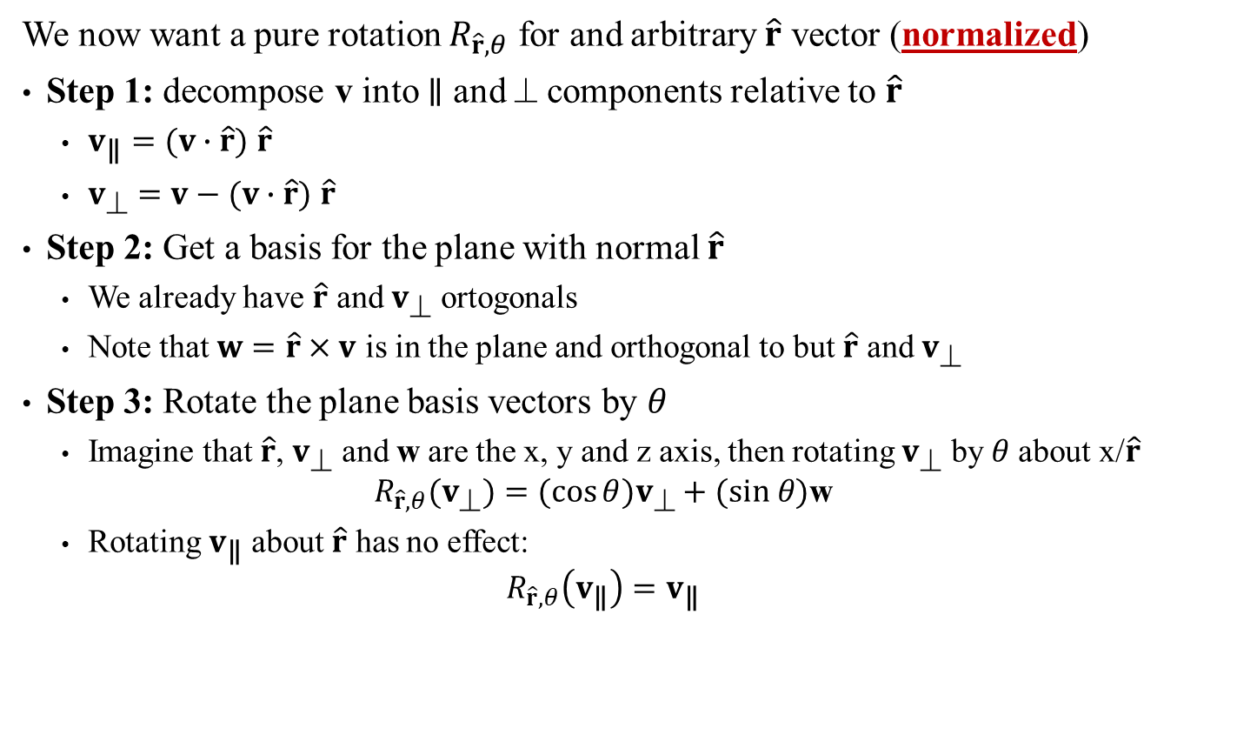



Standard Affine Transforms: Rotation About Arbitrary Axis
We now want a pure rotation $R_{\hat{r},θ}$ for and arbitrary $\hat{r}$ vector (normalized)
Step 1: decompose v into ∥ and ⊥ components relative to $\hat{r}$
$v_{\text{∥}}=(v∙\hat{r})$ $\hat{r}$
$v_{\text{⊥}}=v−(v∙\hat{r})$ $\hat{r}$
Step 2: Get a basis for the plane with normal $\hat{r}$
We already have $\hat{r}$ and $v_{\text{⊥}}$ ortogonals
Note that $w=\hat{r}×v$ is in the plane and orthogonal to but $\hat{r}$ and $v_{\text{⊥}}$
Step 3: Rotate the plane basis vectors by $θ$
Imagine that $\hat{r}$, $v_{\text{⊥}}$ and w are the x, y and z axis, then rotating $v_{\text{⊥}}$ by $θ$ about x/$\hat{r}$
$$R_{\hat{r},θ}(v_{\text{⊥}})=(cos{θ})v_{\text{⊥}}+(sin θ)\text{w}$$
Rotating $v_{\text{∥}}$ about $\hat{r}$ has no effect:
$$R_{\hat{r},θ}\left(v_{\text{∥}}\right)=v_{\text{∥}}$$
v
$$v_{∥}$$
Note: true only because $\hat{r}$ is normalized
v’
$$\hat{r}$$
$$v_{\text{⊥}}$$
θ
w

Slide 24
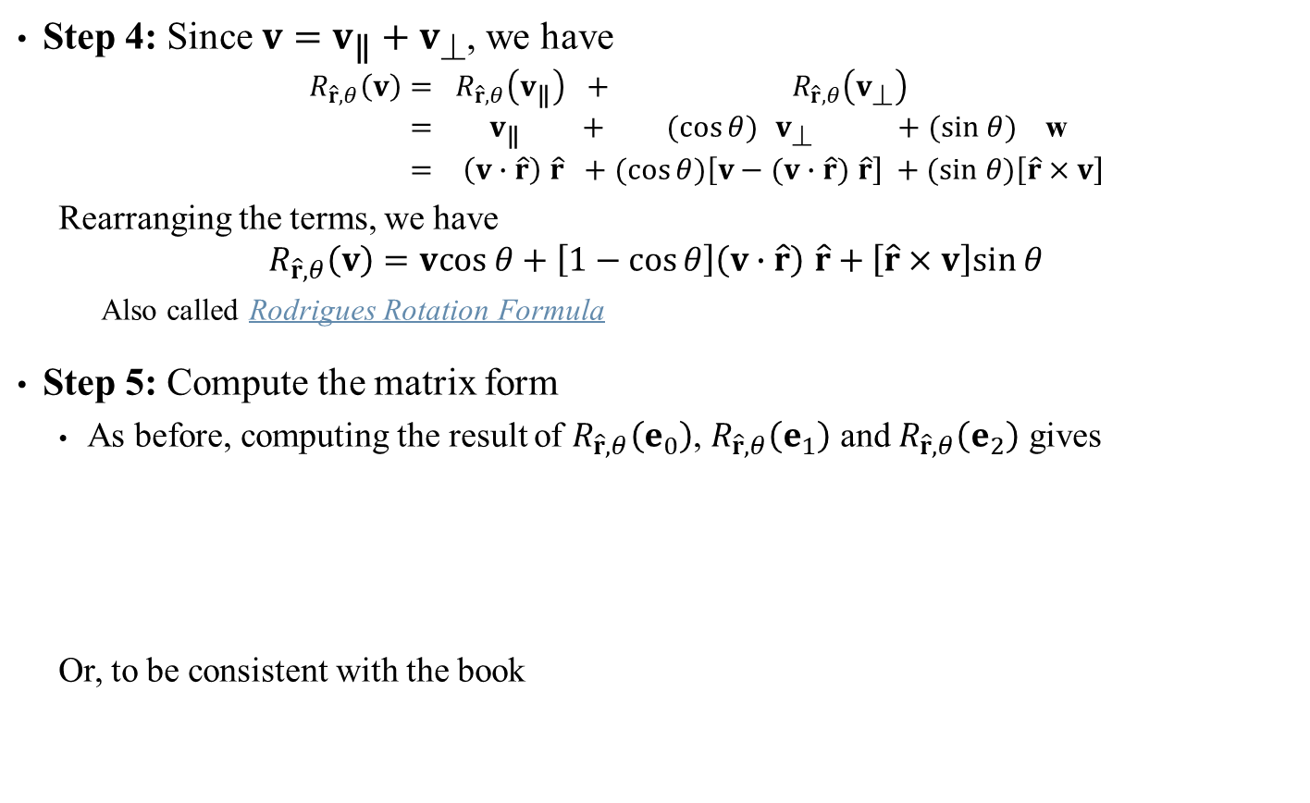
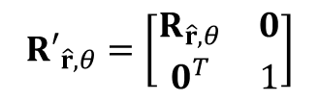

Standard Affine Transforms: Rotation About Arbitrary Axis
Step 4: Since $v=v_{\text{∥}}+v_{\text{⊥}}$, we have
$$R_{\hat{r},θ}\left(v\right)= R_{\hat{r},θ}\left(v_{\text{∥}}\right) + R_{\hat{r},θ}\left(v_{\text{⊥}}\right) \\ = v_{\text{∥}} + (cos{θ}){ v}_{\text{⊥}} +(sin θ) \text{w} \\ = \left(v∙\hat{r}\right) \hat{r} +(cos{θ})\left[v−(v∙\hat{r}) \hat{r}\right] +(sin θ)\left[\hat{r}×v\right]$$
Rearranging the terms, we have
$$R_{\hat{r},θ}\left(v\right)=vcos θ+\left[1−\cos{θ}\right]\left(v∙\hat{r}\right) \hat{r}+\left[\hat{r}×v\right]sin θ$$
Also called Rodrigues Rotation Formula
Step 5: Compute the matrix form
As before, computing the result of $R_{\hat{r},θ}\left(e_{0}\right)$, $R_{\hat{r},θ}\left(e_{1}\right)$ and $R_{\hat{r},θ}\left(e_{2}\right)$ gives
Or, to be consistent with the book
Sidebar:
At this point, the book obfuscates everything by introducing tensor operators which are completely unnecessary here. Just ignore it.
${R′}_{\hat{r},θ}=\left[\begin{matrix}tx^{2}+c & txy−sz & txz+sy & 0 \\ txy+sz & ty^{2}+c & tyz−sx & 0 \\ txz−sy & tyz+sx & tz^{2}+c & 0 \\ 0 & 0 & 0 & 1\end{matrix}\right]$ where $\begin{matrix}\hat{r}=(x,y,z) \\ c=\cos{θ} \\ s=\sin{θ} \\ t=1−\cos{θ}\end{matrix}$
$${R′}_{\hat{r},θ}=\left[\begin{matrix}R_{\hat{r},θ} & 0 \\ 0^{T} & 1\end{matrix}\right]$$
Sidebar:
When to use the formula and when to use the matrix depends on the number of vectors to transform.
See also Dynamic Examples

Slide 25


Standard Affine Transforms: Rotation About Arbitrary Axis
A few points to note:
Setting $\hat{r}$ to any of the base axes yields the previous matrices ${R′}_{x,θ}$, ${R′}_{y,θ}$ or ${R′}_{z,θ}$
As with previous rotation matrices, ${R′}_{\hat{r},θ}$ is an orthogonal matrix, so the inverse is also the transpose and equal to a rotation by $−θ$.
$${\left({R′}_{\hat{r},θ}\right)}^{−1}={\left({R′}_{\hat{r},θ}\right)}^{T}={R′}_{\hat{r},−θ}$$
While the matrix form is more useful from a computational point of view, it really doesn’t convey any idea about what the transforms actually does.
Compare the matrix above with either forms below:
Basic formula: $R_{\hat{r},θ}\left(v\right)=R_{\hat{r},θ}\left(v_{\text{∥}}\right)+R_{\hat{r},θ}\left(v_{\text{⊥}}\right)$
Rodrigues’ form: $R_{\hat{r},θ}\left(v\right)=vcos θ+\left[1−\cos{θ}\right]\left(v∙\hat{r}\right) \hat{r}+\left[\hat{r}×v\right]sin θ$
${R′}_{\hat{r},θ}=\left[\begin{matrix}tx^{2}+c & txy−sz & txz+sy & 0 \\ txy+sz & ty^{2}+c & tyz−sx & 0 \\ txz−sy & tyz+sx & tz^{2}+c & 0 \\ 0 & 0 & 0 & 1\end{matrix}\right]$ where $\begin{matrix}\hat{r}=(x,y,z) \\ c=\cos{θ} \\ s=\sin{θ} \\ t=1−\cos{θ}\end{matrix}$
There is little value in memorizing the matrix form. It’s much better to understand how the formula is derived and then reconstruct the matrix as needed

Slide 26



Standard Affine Transforms: Rotation About Arbitrary Axis
One last thing about using Rodriguez’s formula.
Whether you use it as a transform:
$$R_{\hat{r},θ}\left(v\right)=vcos θ+\left[1−\cos{θ}\right]\left(v∙\hat{r}\right) \hat{r}+\left[\hat{r}×v\right]sin θ$$
Or in matrix form:
Remember that …
${R′}_{\hat{r},θ}=\left[\begin{matrix}tx^{2}+c & txy−sz & txz+sy & 0 \\ txy+sz & ty^{2}+c & tyz−sx & 0 \\ txz−sy & tyz+sx & tz^{2}+c & 0 \\ 0 & 0 & 0 & 1\end{matrix}\right]$ where $\begin{matrix}\hat{r}=(x,y,z) \\ c=\cos{θ} \\ s=\sin{θ} \\ t=1−\cos{θ}\end{matrix}$
When using Rodriguez’s formula,
the axis vector $\hat{r}$
MUST BE NORMALIZED!!!

Slide 27
Transformation Types: Rigid vs Deformation
Transformations are classified into two groups:
Rigid Transformations are those that
Preserve angles
Preserve distances
Deformations are everything else.
Translations and rotations are rigid.
By far the most commonly used.
Needed in specific instances.
Includes:
Scaling
Projections
Reflection
Shear (see book)

Slide 28

Standard Affine Transforms: Scaling
For values a, b, c > 0, scaling transform $S_{abc}$ multiplying each component by a, b, c respectively.
$$S_{abc}\left(v\right)= S_{abc}\left(\begin{matrix}x \\ y \\ z\end{matrix}\right)=\left(\begin{matrix}ax \\ by \\ cz\end{matrix}\right)$$
In matrix form form:
$$S_{abc}=\left[\begin{matrix}a & 0 & 0 & 0 \\ 0 & b & 0 & 0 \\ 0 & 0 & c & 0 \\ 0 & 0 & 0 & 1\end{matrix}\right]$$
The inverse is very easy to compute:
$${\left(S_{abc}\right)}^{−1}=\left[\begin{matrix}1/a & 0 & 0 & 0 \\ 0 & 1/b & 0 & 0 \\ 0 & 0 & 1/c & 0 \\ 0 & 0 & 0 & 1\end{matrix}\right]=S_{1/a,1/b,1/c}$$
Sidebar:
If any of a, b or c are negative, then the scaling is combined with some reflection (next)
See also Dynamic Examples

Slide 29







Standard Affine Transforms: Plane Reflection
Reflection through the plane axis are easy. For example:
Reflecting though the yz-plane means negating the x component
Reflecting through a general plane (at the origin):
Similar reasoning as with rotation about a general axis
Given a plane normal $\hat{n}$ (normalized) and a vector v, we compute the ∥ and ⊥ components relative to $\hat{n}$
$$v=v_{\text{⊥}}+v_{\text{∥}}$$
Applying the reflection transform ${Rf}_{\hat{n}}$ to v won’t affect the $v_{\text{⊥}}$but will flip $v_{\text{∥}}$
$${Rf}_{\hat{n}}\left(v\right)={ Rf}_{\hat{n}}\left(v_{\text{⊥}}\right) + {Rf}_{\hat{n}}(v_{\text{∥}}) \\ = v_{\text{⊥}} −v_{\text{∥}} \\ = v−v_{\text{∥}} − v_{\text{∥}} \\ = v−2v_{\text{∥}} \\ = v−2(v∙\hat{n})\hat{n}$$
Important: $v_{\text{∥}}$ and $v_{\text{⊥}}$ are relative to the plane normal $\hat{n}$, not to the plane itself.
v
$$\hat{n}$$
$$v_{∥}$$
$$v_{\text{⊥}}$$
$${Rf}_{\hat{n}}\left(v\right)$$
See also Dynamic Examples

Slide 30

Standard Affine Transforms: Plane Reflection
As usual, we apply the transform to each of the base vector and origin to get the matrix from:
for $\hat{n}=\left(\begin{matrix}x \\ y \\ z\end{matrix}\right)$ define ${Rf}_{\hat{n}}(v)= v−2(v∙\hat{n})\hat{n}$
$${Rf}_{\hat{n}}=\left[\begin{matrix}1−2x^{2} & −2xy & −2xz & 0 \\ −2xy & 1−2y^{2} & −2yz & 0 \\ −2xz & −2yz & 1−2z^{2} & 0 \\ 0 & 0 & 0 & 1\end{matrix}\right]$$
Note again that the while the matrix form is very useful for computation, it loses all intuitive meaning when compared with the functional version
Sidebar:
Again, there is no value in remembering the final matrix form. Understanding the derivation is far more important!
See also Dynamic Examples

Slide 31
Standard Affine Transforms: Shear and Mirroring
Read on your own: Book

Slide 32


Standard Affine Transforms: When Not at the Origin
The transforms we covered for rotation, scaling and reflection were specifically limited to work relative to the origin:
Rotation: rotated all point around an axis passing by the origin
Scaling: change the position closer to/away from the origin
Reflection: flipped position relative to a plane passing through the origin
Question: How can we use these transforms relative to other points C ?
Answer: three steps
Translate everything by $−C$ (shift the C center to the origin)
Perform origin-centric transform
Translate everything back by C (shift the C back initial position)
Example: To apply transform M composed of $R_{\hat{r},θ}$ about an about C, then
$$M=\left[\begin{matrix}I & C \\ 0^{T} & 1\end{matrix}\right]\left[\begin{matrix}R_{\hat{r},θ} & 0 \\ 0^{T} & 1\end{matrix}\right]\left[\begin{matrix}I & −C \\ 0^{T} & 1\end{matrix}\right]$$
Sidebar:
Most 3D graphic environment will give you tools & functions to create origin-centric transforms for scaling/rotations/translation. The transform M here would be created using those tools
$$=\left[\begin{matrix}R_{\hat{r},θ} & (I−R_{\hat{r},θ})C \\ 0^{T} & 1\end{matrix}\right]$$

Slide 33







Standard Affine Transforms: At the Origin
Example: Let $P=\left(0,0,10\right)$ and we want to compute $P′$, the result of applying ${R′}_{y,π/2}$to P
$$\left[\begin{matrix}R_{y,π/2} & 0 \\ 0^{T} & 1\end{matrix}\right]\left[\begin{matrix}P \\ 1\end{matrix}\right]=\left[\begin{matrix}\cos{θ} & 0 & \sin{θ} & 0 \\ 0 & 1 & 0 & 0 \\ −\sin{θ} & 0 & \cos{θ} & 0 \\ 0 & 0 & 0 & 1\end{matrix}\right]\left[\begin{matrix}0 \\ 0 \\ 10 \\ 1\end{matrix}\right]$$
x
$$=\left[\begin{matrix}0 & 0 & 1 & 0 \\ 0 & 1 & 0 & 0 \\ −1 & 0 & 0 & 0 \\ 0 & 0 & 0 & 1\end{matrix}\right]\left[\begin{matrix}0 \\ 0 \\ 10 \\ 1\end{matrix}\right]$$
P’
$${R′}_{y,π/2}$$
$$=\left[\begin{matrix}10 \\ 0 \\ 0 \\ 1\end{matrix}\right]$$
z
P
Clearly, ${R′}_{y,π/2}$ is rotating about the origin
What if we wanted to rotate P about another point?

Slide 34









Standard Affine Transforms: Not at the Origin
Example: Let $P=\left(0,0,10\right)$ and we want to compute $P′$, the result of applying a rotation of $π/2$ about the y-axis but relative to the point $C=(5,0,10)$
$$\left[\begin{matrix}I & C \\ 0^{T} & 1\end{matrix}\right]\left[\begin{matrix}R_{y,π/2} & 0 \\ 0^{T} & 1\end{matrix}\right]\left[\begin{matrix}I & −C \\ 0^{T} & 1\end{matrix}\right]\left[\begin{matrix}P \\ 1\end{matrix}\right]$$
$$=\left[\begin{matrix}I & C \\ 0^{T} & 1\end{matrix}\right]\left[\begin{matrix}R_{y,π/2} & 0 \\ 0^{T} & 1\end{matrix}\right]\left[\begin{matrix}P−C \\ 1\end{matrix}\right]$$
x
$$=\left[\begin{matrix}I & C \\ 0^{T} & 1\end{matrix}\right]\left[\begin{matrix}R_{y,π/2} & 0 \\ 0^{T} & 1\end{matrix}\right]\left[\begin{matrix}−5 \\ 0 \\ 0 \\ 1\end{matrix}\right]$$
$$=\left[\begin{matrix}I & C \\ 0^{T} & 1\end{matrix}\right]\left[\begin{matrix}0 & 0 & 1 & 0 \\ 0 & 1 & 0 & 0 \\ −1 & 0 & 0 & 0 \\ 0 & 0 & 0 & 1\end{matrix}\right]\left[\begin{matrix}−5 \\ 0 \\ 0 \\ 1\end{matrix}\right]$$
C
P’
z
P
$$=\left[\begin{matrix}I & C \\ 0^{T} & 1\end{matrix}\right]\left[\begin{matrix}0 \\ 0 \\ 5 \\ 1\end{matrix}\right]$$
$$R_{y,π/2}$$
P - C
$$=\left[\begin{matrix}0+5 \\ 0+0 \\ 5+10 \\ 1\end{matrix}\right]=\left[\begin{matrix}5 \\ 0 \\ 15 \\ 1\end{matrix}\right]$$

