Slide 1
GAM 325/425: Applied 3D Geometry
Lecture 3B:
Using Affine Transformations

Slide 2
Coordinate Frames
There are 3 important coordinate frames:
World Space:
Fixed origin & axes
Reference for relative position and orientation between objects
Object (Local) Space:
Origin sets for the ‘center’ of the model geometry
Sets the up/forward orientation of the model
Camera Space:
More on this in a future lecture
Problem: There are no conventions or standards for any of these spaces.
Which is the up axis? Which is the forward one?
World space axis are often determined by the graphics library but object space is influenced by the 3D modelling software
Getting artists and programmers to stick to specific conventions is crucial!
If the origin for the 3D model isn’t right, turning or positioning in game will be incorrect
If the ‘forward’ and ‘up’ alignment of the model is wrong, game motion will be incorrect

Slide 3


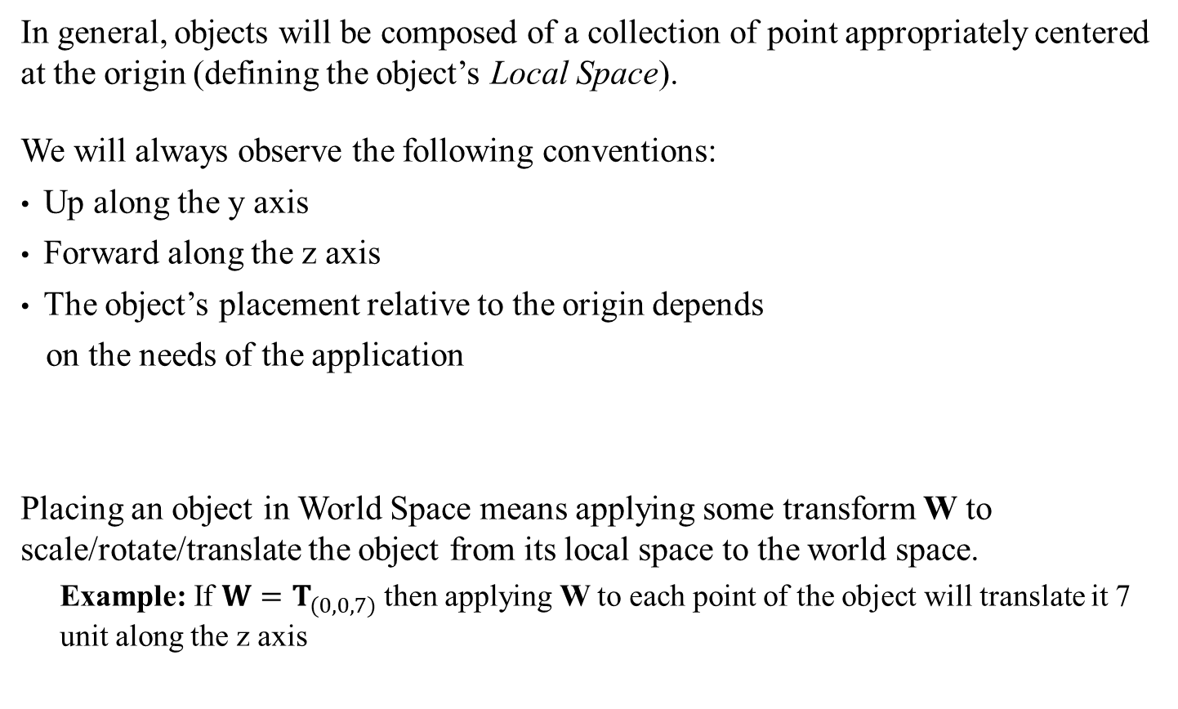




Local (Object) Space
Sidebar:
We’ll keep our example in the xz-plane for simplicity, but the principle applies to the full 3D space
In general, objects will be composed of a collection of point appropriately centered at the origin (defining the object’s Local Space).
We will always observe the following conventions:
Up along the y axis
Forward along the z axis
The object’s placement relative to the origin depends
on the needs of the application
Placing an object in World Space means applying some transform W to scale/rotate/translate the object from its local space to the world space.
Example: If $W=T_{(0,0,7)}$ then applying W to each point of the object will translate it 7 unit along the z axis
x
$$T_{(0,0,7)}$$
$$P_{3}$$
$$P_{3}$$
z
$$P_{1}$$
$$P_{2}$$
$$P_{1}$$
$$P_{2}$$

Slide 4









World Matrix: Order of Operations
In most cases (for us!), W will be a combination of scale, rotation and translation. But the order of operation is important.
Example: Compare $W_{1}=T_{(0,0,7)}R_{y,π/2}$ versus $W_{2}=R_{y,π/2}T_{(0,0,7)}$
$W_{1}$ works as expected, but $W_{2}$ induces an unexpected translation
In general, some order of operations have unwanted side effects…
x
x
$$P_{3}$$
$$P_{1}$$
$$P_{2}$$
$$P_{3}$$
$$P_{3}$$
z
$$P_{3}$$
$$P_{3}$$
z
$$P_{2}$$
$$P_{2}$$
$$P_{2}$$
$$P_{2}$$
$$P_{1}$$
$$P_{1}$$
$$P_{1}$$
$$P_{1}$$

Slide 5
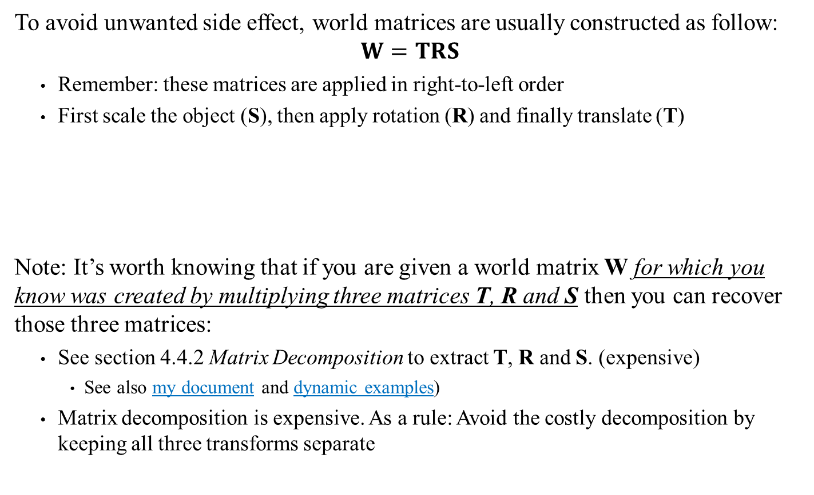
World Matrix: Order of Operations
To avoid unwanted side effect, world matrices are usually constructed as follow:
$$W=TRS$$
Remember: these matrices are applied in right-to-left order
First scale the object (S), then apply rotation (R) and finally translate (T)
Note: It’s worth knowing that if you are given a world matrix W for which you know was created by multiplying three matrices T, R and S then you can recover those three matrices:
See section 4.4.2 Matrix Decomposition to extract T, R and S. (expensive)
See also my document and dynamic examples)
Matrix decomposition is expensive. As a rule: Avoid the costly decomposition by keeping all three transforms separate
Warning: When using row vectors, we reverse the order as W = SRT. See LASR page

Slide 6


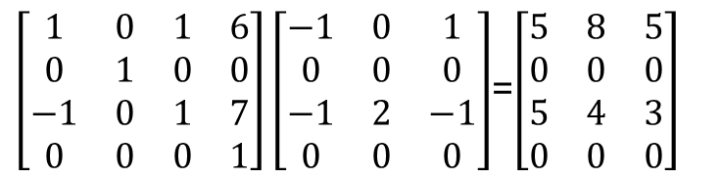
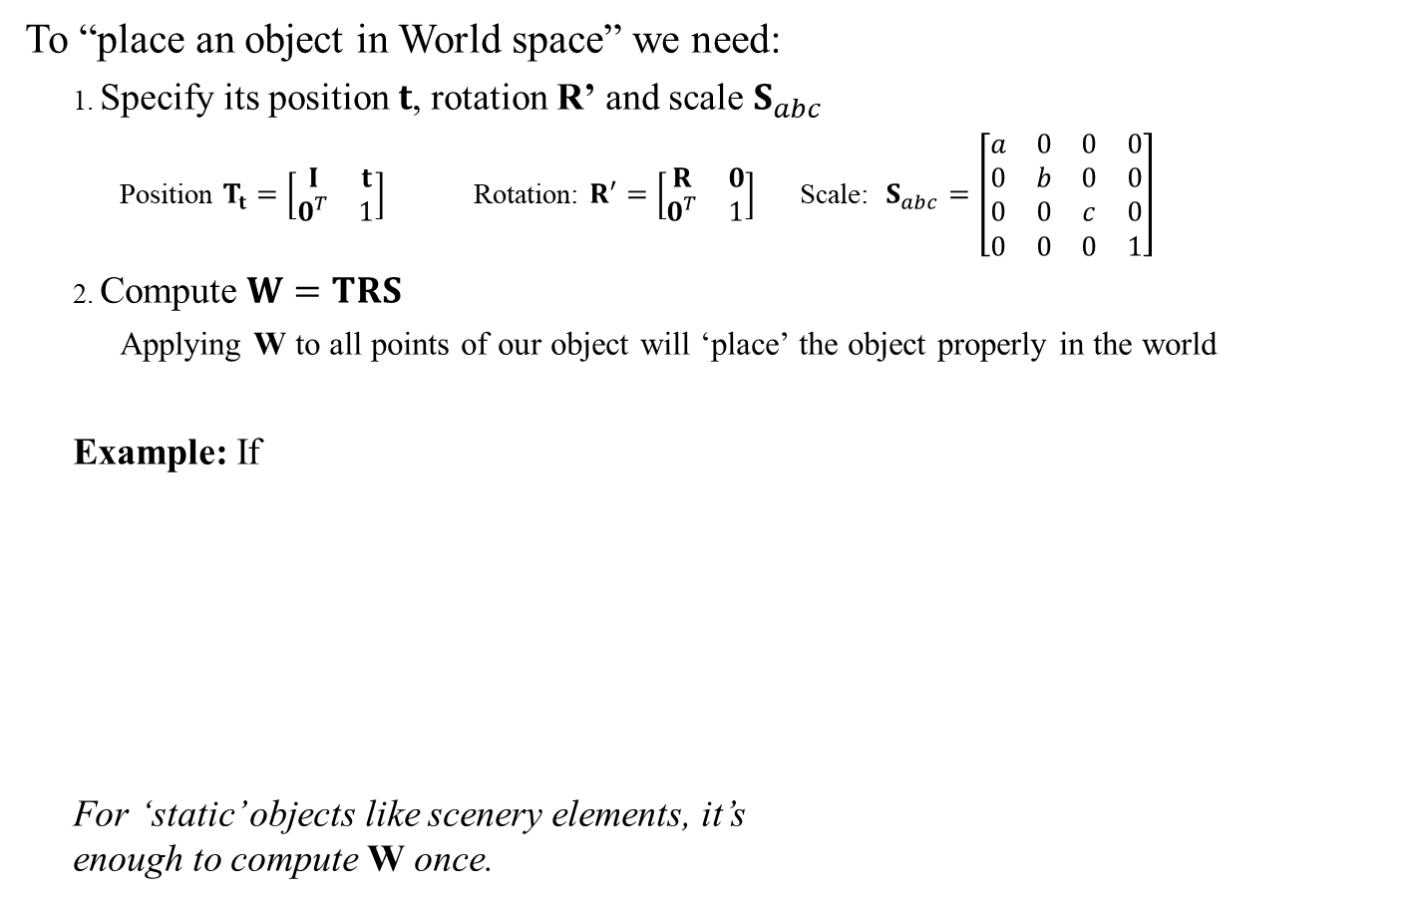
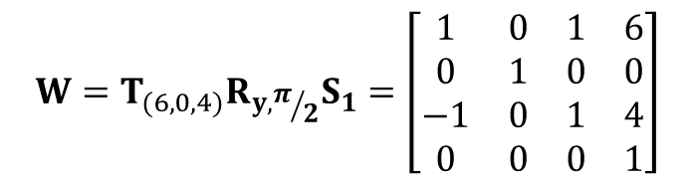


World Matrix: Placing Static Objects
To “place an object in World space” we need:
Specify its position $t$, rotation R’ and scale $S_{abc}$
Position $T_{t}=\left[\begin{matrix}I & t \\ 0^{T} & 1\end{matrix}\right]$ Rotation: $R^{′}=\left[\begin{matrix}R & 0 \\ 0^{T} & 1\end{matrix}\right]$ Scale: $S_{abc}=\left[\begin{matrix}a & 0 & 0 & 0 \\ 0 & b & 0 & 0 \\ 0 & 0 & c & 0 \\ 0 & 0 & 0 & 1\end{matrix}\right]$
Compute $W=TRS$
Applying W to all points of our object will ‘place’ the object properly in the world
Example: If
For ‘static’ objects like scenery elements, it’s enough to compute W once.
$$W=T_{(6,0,4)}R_{y,π/2}S_{1}=\left[\begin{matrix}1 & 0 & 1 & 6 \\ 0 & 1 & 0 & 0 \\ −1 & 0 & 1 & 4 \\ 0 & 0 & 0 & 1\end{matrix}\right]$$
x
$$P_{3}$$
$$W$$
$$P_{1}$$
$$P_{2}$$
$$P_{3}$$
$$P_{1}$$
$$P_{2}$$
$\left[\begin{matrix}1 & 0 & 1 & 6 \\ 0 & 1 & 0 & 0 \\ −1 & 0 & 1 & 7 \\ 0 & 0 & 0 & 1\end{matrix}\right]\left[\begin{matrix}−1 & 0 & 1 \\ 0 & 0 & 0 \\ −1 & 2 & −1 \\ 0 & 0 & 0\end{matrix}\right]$=$\left[\begin{matrix}5 & 8 & 5 \\ 0 & 0 & 0 \\ 5 & 4 & 3 \\ 0 & 0 & 0\end{matrix}\right]$
$$P_{3}$$
z
$$P_{1}$$
$$P_{2}$$
See also Dynamic Examples

Slide 7
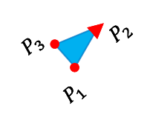

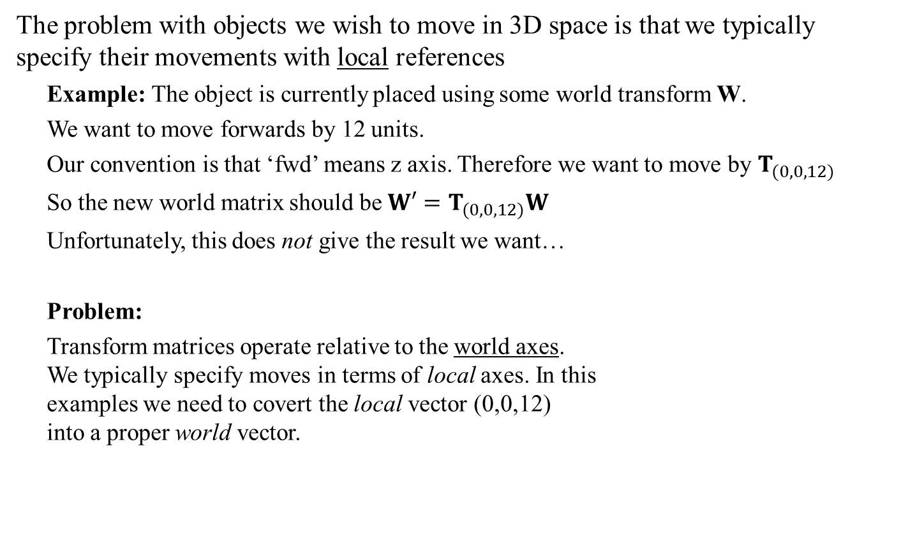
World Matrix: Placing ‘Moving’ Objects
The problem with objects we wish to move in 3D space is that we typically specify their movements with local references
Example: The object is currently placed using some world transform W.
We want to move forwards by 12 units.
Our convention is that ‘fwd’ means z axis. Therefore we want to move by $T_{(0,0,12)}$
So the new world matrix should be $W′=T_{(0,0,12)}W$
Unfortunately, this does not give the result we want…
Problem:
Transform matrices operate relative to the world axes. We typically specify moves in terms of local axes. In this examples we need to covert the local vector (0,0,12) into a proper world vector.
x
desired
z
$$P_{3}$$
$$P_{1}$$
$$P_{2}$$
Actual

Slide 8
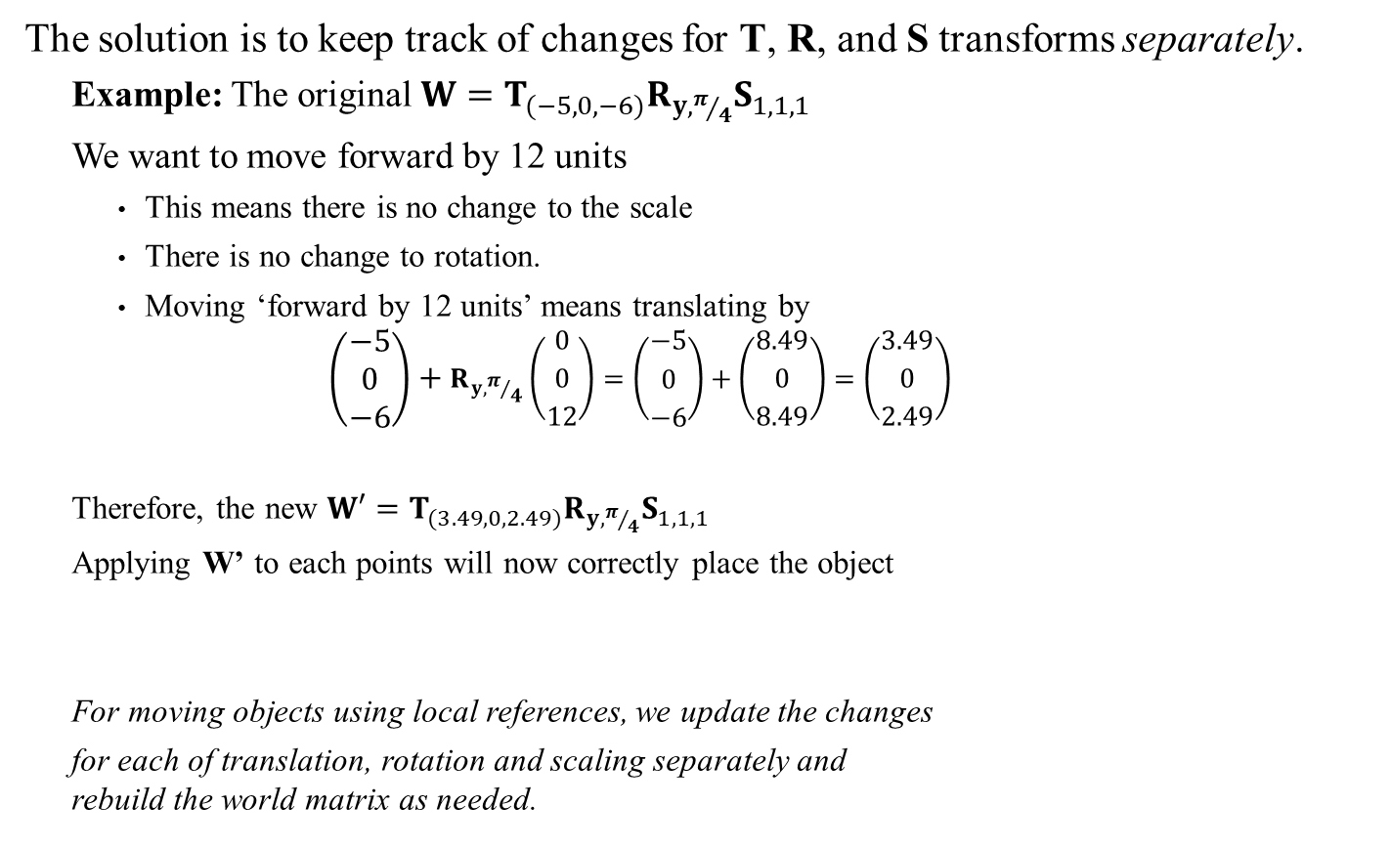
World Matrix: Local to World Updates
The solution is to keep track of changes for T, R, and S transforms separately.
Example: The original $W=T_{(−5,0,−6)}R_{y,π/4}S_{1,1,1}$
We want to move forward by 12 units
This means there is no change to the scale
There is no change to rotation.
Moving ‘forward by 12 units’ means translating by $\left(\begin{matrix}−5 \\ 0 \\ −6\end{matrix}\right)+R_{y,π/4}\left(\begin{matrix}0 \\ 0 \\ 12\end{matrix}\right)=\left(\begin{matrix}−5 \\ 0 \\ −6\end{matrix}\right)+\left(\begin{matrix}8.49 \\ 0 \\ 8.49\end{matrix}\right)=\left(\begin{matrix}3.49 \\ 0 \\ 2.49\end{matrix}\right)$
Therefore, the new $W′=T_{(3.49,0,2.49)}R_{y,π/4}S_{1,1,1}$
Applying W’ to each points will now correctly place the object
For moving objects using local references, we update the changes
for each of translation, rotation and scaling separately and rebuild the world matrix as needed.
x
desired
See also Dynamic Examples
z
$$P_{3}$$
$$P_{1}$$
$$P_{2}$$

Slide 9
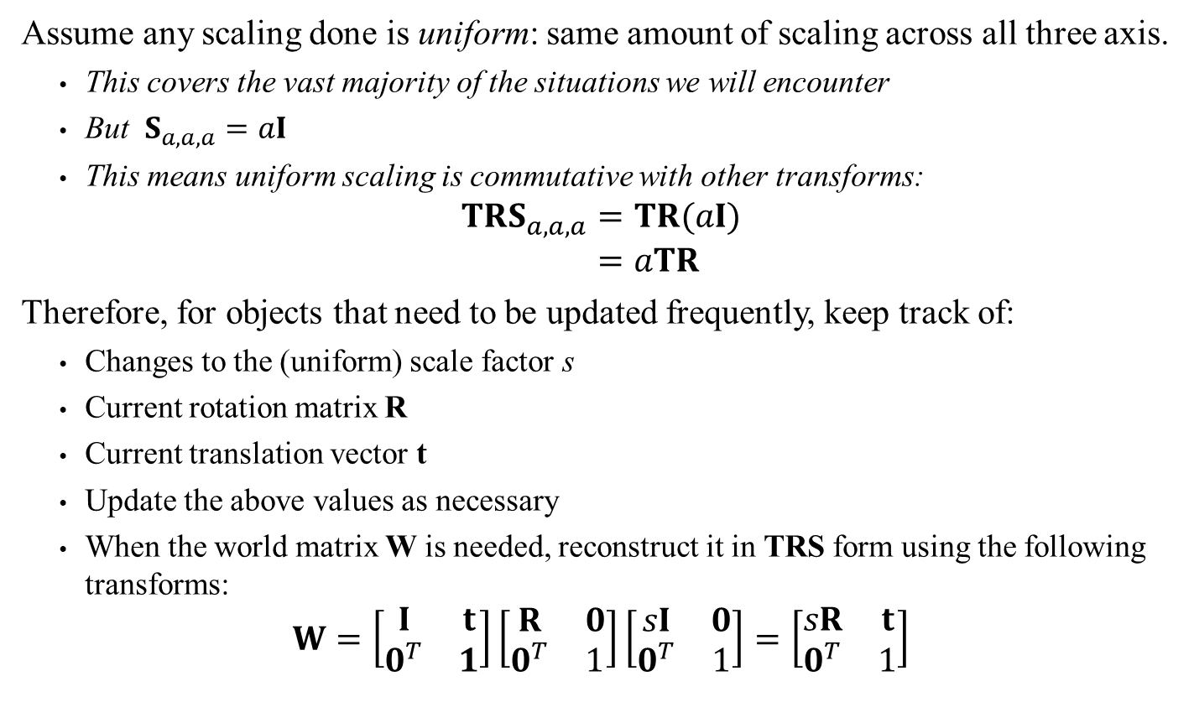
Transform Data
Assume any scaling done is uniform: same amount of scaling across all three axis.
This covers the vast majority of the situations we will encounter
But $S_{a,a,a}=aI$
This means uniform scaling is commutative with other transforms:
$$TRS_{a,a,a}=TR(aI) \\ =aTR$$
Therefore, for objects that need to be updated frequently, keep track of:
Changes to the (uniform) scale factor s
Current rotation matrix R
Current translation vector t
Update the above values as necessary
When the world matrix W is needed, reconstruct it in TRS form using the following transforms:
$$W=\left[\begin{matrix}I & t \\ 0^{T} & 1\end{matrix}\right]\left[\begin{matrix}R & 0 \\ 0^{T} & 1\end{matrix}\right]\left[\begin{matrix}sI & 0 \\ 0^{T} & 1\end{matrix}\right]=\left[\begin{matrix}sR & t \\ 0^{T} & 1\end{matrix}\right]$$

Slide 10






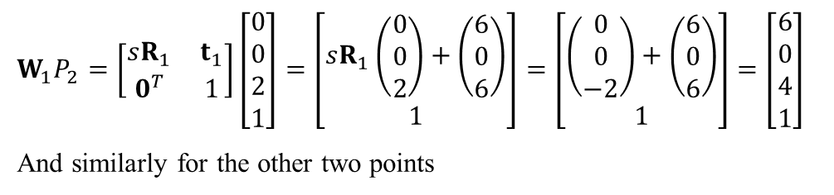


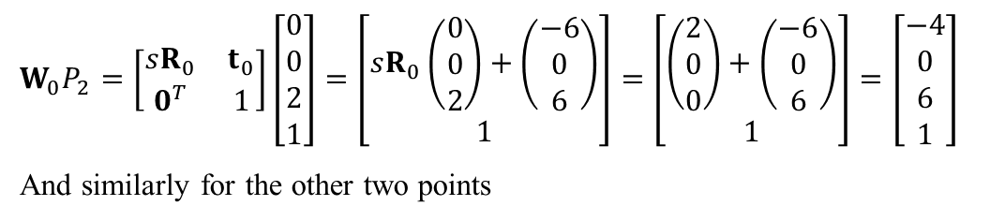
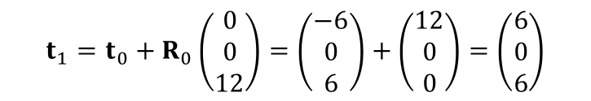


Moving Object: Example
x
Step 0: initial placement:
$s_{0}=1 R_{0}=R_{y,π/2} t_{0}=(−6,0,6)$
Step 1: Moving fwd by 12 then rotate by $R_{y,π/2}$:
$s_{1}=s_{0}, R_{1}=R_{0}R_{y,π/2}=R_{y,π }$
What about $t_{1}$?
$$W_{0}P_{2}=\left[\begin{matrix}sR_{0} & t_{0} \\ 0^{T} & 1\end{matrix}\right]\left[\begin{matrix}0 \\ 0 \\ 2 \\ 1\end{matrix}\right]=\left[\begin{matrix}sR_{0}\left(\begin{matrix}0 \\ 0 \\ 2\end{matrix}\right)+\left(\begin{matrix}−6 \\ 0 \\ 6\end{matrix}\right) \\ 1\end{matrix}\right]=\left[\begin{matrix}\left(\begin{matrix}2 \\ 0 \\ 0\end{matrix}\right)+\left(\begin{matrix}−6 \\ 0 \\ 6\end{matrix}\right) \\ 1\end{matrix}\right]=\left[\begin{matrix}−4 \\ 0 \\ 6 \\ 1\end{matrix}\right]$$
And similarly for the other two points
$$P_{3}$$
z
$$P_{1}$$
$$P_{2}$$
$$P_{3}$$
$$P_{1}$$
$$P_{2}$$
x
$$P_{2}$$
$$P_{1}$$
$$t_{1}=t_{0}+R_{0}\left(\begin{matrix}0 \\ 0 \\ 12\end{matrix}\right)=\left(\begin{matrix}−6 \\ 0 \\ 6\end{matrix}\right)+\left(\begin{matrix}12 \\ 0 \\ 0\end{matrix}\right)=\left(\begin{matrix}6 \\ 0 \\ 6\end{matrix}\right)$$
$$P_{3}$$
$$P_{3}$$
z
$$W_{1}P_{2}=\left[\begin{matrix}sR_{1} & t_{1} \\ 0^{T} & 1\end{matrix}\right]\left[\begin{matrix}0 \\ 0 \\ 2 \\ 1\end{matrix}\right]=\left[\begin{matrix}sR_{1}\left(\begin{matrix}0 \\ 0 \\ 2\end{matrix}\right)+\left(\begin{matrix}6 \\ 0 \\ 6\end{matrix}\right) \\ 1\end{matrix}\right]=\left[\begin{matrix}\left(\begin{matrix}0 \\ 0 \\ −2\end{matrix}\right)+\left(\begin{matrix}6 \\ 0 \\ 6\end{matrix}\right) \\ 1\end{matrix}\right]=\left[\begin{matrix}6 \\ 0 \\ 4 \\ 1\end{matrix}\right]$$
And similarly for the other two points
$$P_{2}$$
$$P_{1}$$
$$P_{2}$$
$$P_{3}$$
$$P_{1}$$

Slide 11




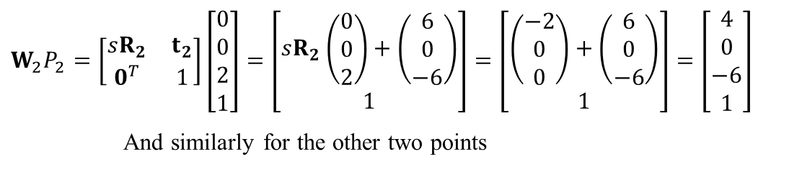



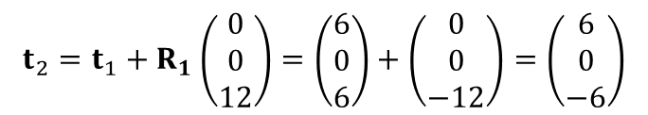

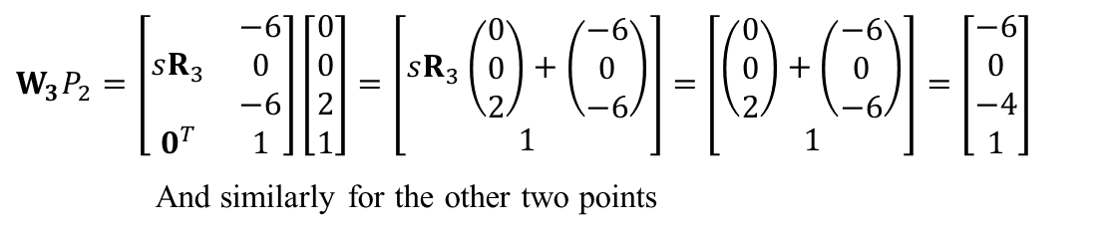


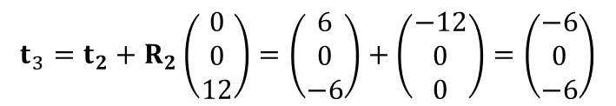



Moving Object: Example
x
Step 2: Again fwd by 12 then rotate by $R_{y,π/2}$:
$s_{2}=s_{1}, R_{2}=R_{1}R_{y,π/2}=R_{y,{3π}/2}$
Step 3: Again fwd by 12 then rotate by $R_{y,π/2}$:
$s_{3}=s_{2}, R_{3}=R_{2}R_{y,π/2}=R_{y,2π }$
$$P_{3}$$
$$P_{3}$$
$$t_{2}=t_{1}+R_{1}\left(\begin{matrix}0 \\ 0 \\ 12\end{matrix}\right)=\left(\begin{matrix}6 \\ 0 \\ 6\end{matrix}\right)+\left(\begin{matrix}0 \\ 0 \\ −12\end{matrix}\right)=\left(\begin{matrix}6 \\ 0 \\ −6\end{matrix}\right)$$
$$P_{2}$$
$$P_{1}$$
$$P_{2}$$
$$P_{1}$$
$$P_{3}$$
z
$$W_{2}P_{2}=\left[\begin{matrix}sR_{2} & t_{2} \\ 0^{T} & 1\end{matrix}\right]\left[\begin{matrix}0 \\ 0 \\ 2 \\ 1\end{matrix}\right]=\left[\begin{matrix}sR_{2}\left(\begin{matrix}0 \\ 0 \\ 2\end{matrix}\right)+\left(\begin{matrix}6 \\ 0 \\ −6\end{matrix}\right) \\ 1\end{matrix}\right]=\left[\begin{matrix}\left(\begin{matrix}−2 \\ 0 \\ 0\end{matrix}\right)+\left(\begin{matrix}6 \\ 0 \\ −6\end{matrix}\right) \\ 1\end{matrix}\right]=\left[\begin{matrix}4 \\ 0 \\ −6 \\ 1\end{matrix}\right]$$
And similarly for the other two points
$$P_{2}$$
$$P_{1}$$
$$P_{3}$$
$$P_{1}$$
$$P_{2}$$
x
11
$$P_{3}$$
$$P_{3}$$
$$t_{3}=t_{2}+R_{2}\left(\begin{matrix}0 \\ 0 \\ 12\end{matrix}\right)=\left(\begin{matrix}6 \\ 0 \\ −6\end{matrix}\right)+\left(\begin{matrix}−12 \\ 0 \\ 0\end{matrix}\right)=\left(\begin{matrix}−6 \\ 0 \\ −6\end{matrix}\right)$$
$$P_{2}$$
$$P_{1}$$
$$P_{2}$$
$$P_{1}$$
$$P_{3}$$
z
$$W_{3}P_{2}=\left[\begin{matrix}sR_{3} & \begin{matrix}−6 \\ 0 \\ −6\end{matrix} \\ 0^{T} & 1\end{matrix}\right]\left[\begin{matrix}0 \\ 0 \\ 2 \\ 1\end{matrix}\right]=\left[\begin{matrix}sR_{3}\left(\begin{matrix}0 \\ 0 \\ 2\end{matrix}\right)+\left(\begin{matrix}−6 \\ 0 \\ −6\end{matrix}\right) \\ 1\end{matrix}\right]=\left[\begin{matrix}\left(\begin{matrix}0 \\ 0 \\ 2\end{matrix}\right)+\left(\begin{matrix}−6 \\ 0 \\ −6\end{matrix}\right) \\ 1\end{matrix}\right]=\left[\begin{matrix}−6 \\ 0 \\ −4 \\ 1\end{matrix}\right]$$
And similarly for the other two points
$$P_{2}$$
$$P_{1}$$
$$P_{3}$$
$$P_{3}$$
$$P_{2}$$
$$P_{1}$$
$$P_{2}$$
$$P_{1}$$
See also Dynamic Examples

