Slide 1
GAM 325/425: Applied 3D Geometry
Lecture 4, Part A: (Extra Topics)
Matrix Information and Coordinate Change

Slide 2

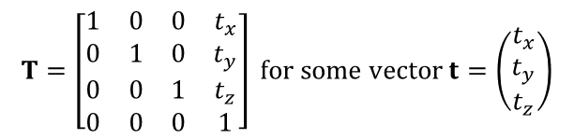
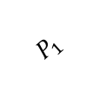
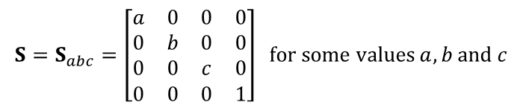



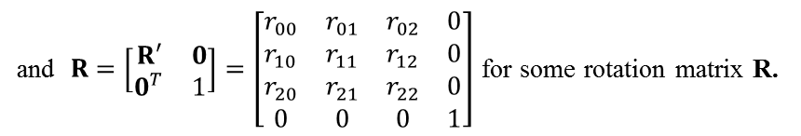
World Matrix Information
x
$$P_{2}$$
Consider our friendly TGO again placed in world space.
Assume its current position/orientation is given by W
which, in turn was created in TRS form.
Looking at W, what do we know?
Specifically: Without the picture and just W, what could you tell about the TGO ?
Actually: quite a bit…
If W was created from an unknown set of TRS matrices, then we can assume
$$P_{1}$$
$$P_{3}$$
$$W=\left[\begin{matrix}w_{00} & w_{01} & w_{02} & w_{03} \\ w_{10} & w_{11} & w_{12} & w_{13} \\ w_{20} & w_{21} & w_{22} & w_{23} \\ w_{30} & w_{31} & w_{32} & w_{33}\end{matrix}\right]$$
z
$$S=S_{abc}=\left[\begin{matrix}a & 0 & 0 & 0 \\ 0 & b & 0 & 0 \\ 0 & 0 & c & 0 \\ 0 & 0 & 0 & 1\end{matrix}\right] \text{for} \text{some} \text{values} a, b \text{and} c$$
$$T=\left[\begin{matrix}1 & 0 & 0 & t_{x} \\ 0 & 1 & 0 & t_{y} \\ 0 & 0 & 1 & t_{z} \\ 0 & 0 & 0 & 1\end{matrix}\right] \text{for} \text{some} \text{vector} t=\left(\begin{matrix}t_{x} \\ t_{y} \\ t_{z}\end{matrix}\right)$$
and $R=\left[\begin{matrix}R′ & 0 \\ 0^{T} & 1\end{matrix}\right]=\left[\begin{matrix}r_{00} & r_{01} & r_{02} & 0 \\ r_{10} & r_{11} & r_{12} & 0 \\ r_{20} & r_{21} & r_{22} & 0 \\ 0 & 0 & 0 & 1\end{matrix}\right]$ for some rotation matrix R.

Slide 3
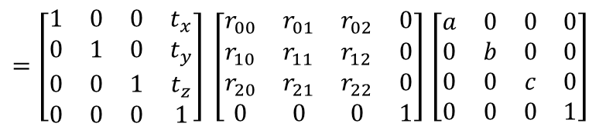

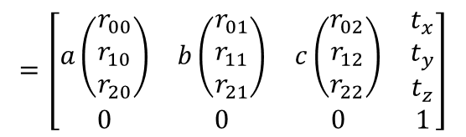
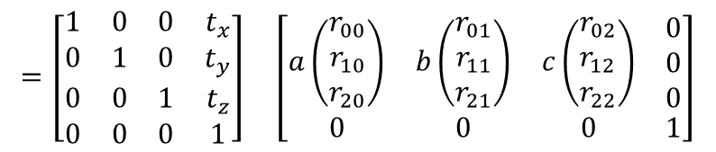
World Matrix Information
Therefore
So W actually has a lot of structures for us to exploit.
Let’s looks at these structures more closely
$$W=\left[\begin{matrix}w_{00} & w_{01} & w_{02} & w_{03} \\ w_{10} & w_{11} & w_{12} & w_{13} \\ w_{20} & w_{21} & w_{22} & w_{23} \\ w_{30} & w_{31} & w_{32} & w_{33}\end{matrix}\right]$$
$=\left[\begin{matrix}1 & 0 & 0 & t_{x} \\ 0 & 1 & 0 & t_{y} \\ 0 & 0 & 1 & t_{z} \\ 0 & 0 & 0 & 1\end{matrix}\right] \left[\begin{matrix}r_{00} & r_{01} & r_{02} & 0 \\ r_{10} & r_{11} & r_{12} & 0 \\ r_{20} & r_{21} & r_{22} & 0 \\ 0 & 0 & 0 & 1\end{matrix}\right]$ $\left[\begin{matrix}a & 0 & 0 & 0 \\ 0 & b & 0 & 0 \\ 0 & 0 & c & 0 \\ 0 & 0 & 0 & 1\end{matrix}\right]$
$$=\left[\begin{matrix}1 & 0 & 0 & t_{x} \\ 0 & 1 & 0 & t_{y} \\ 0 & 0 & 1 & t_{z} \\ 0 & 0 & 0 & 1\end{matrix}\right] \left[\begin{matrix}a\left(\begin{matrix}r_{00} \\ r_{10} \\ r_{20}\end{matrix}\right) & b\left(\begin{matrix}r_{01} \\ r_{11} \\ r_{21}\end{matrix}\right) & c\left(\begin{matrix}r_{02} \\ r_{12} \\ r_{22}\end{matrix}\right) & \begin{matrix}0 \\ 0 \\ 0\end{matrix} \\ 0 & 0 & 0 & 1\end{matrix}\right]$$
$$=\left[\begin{matrix}a\left(\begin{matrix}r_{00} \\ r_{10} \\ r_{20}\end{matrix}\right) & b\left(\begin{matrix}r_{01} \\ r_{11} \\ r_{21}\end{matrix}\right) & c\left(\begin{matrix}r_{02} \\ r_{12} \\ r_{22}\end{matrix}\right) & \begin{matrix}t_{x} \\ t_{y} \\ t_{z}\end{matrix} \\ 0 & 0 & 0 & 1\end{matrix}\right]$$

Slide 4
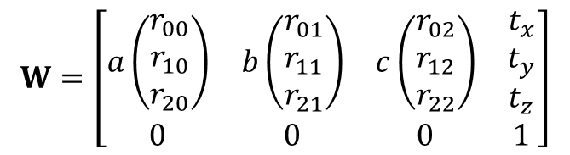
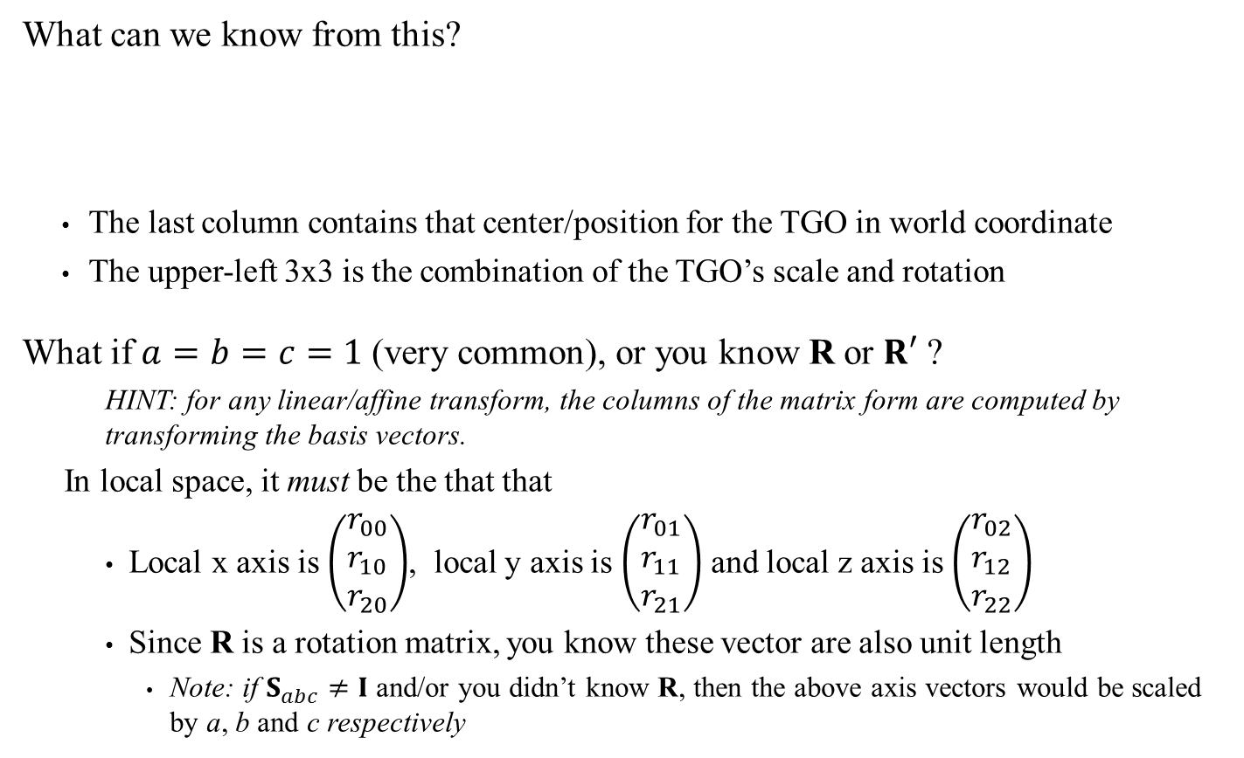
World Matrix Information
What can we know from this?
The last column contains that center/position for the TGO in world coordinate
The upper-left 3x3 is the combination of the TGO’s scale and rotation
What if $a=b=c=1$(very common), or you know R or $R′$ ?
HINT: for any linear/affine transform, the columns of the matrix form are computed by transforming the basis vectors.
In local space, it must be the that that
Local x axis is $\left(\begin{matrix}r_{00} \\ r_{10} \\ r_{20}\end{matrix}\right)$, local y axis is $\left(\begin{matrix}r_{01} \\ r_{11} \\ r_{21}\end{matrix}\right)$ and local z axis is $\left(\begin{matrix}r_{02} \\ r_{12} \\ r_{22}\end{matrix}\right)$
Since R is a rotation matrix, you know these vector are also unit length
Note: if $S_{abc}≠I$ and/or you didn’t know R, then the above axis vectors would be scaled by a, b and c respectively
$$W=\left[\begin{matrix}a\left(\begin{matrix}r_{00} \\ r_{10} \\ r_{20}\end{matrix}\right) & b\left(\begin{matrix}r_{01} \\ r_{11} \\ r_{21}\end{matrix}\right) & c\left(\begin{matrix}r_{02} \\ r_{12} \\ r_{22}\end{matrix}\right) & \begin{matrix}t_{x} \\ t_{y} \\ t_{z}\end{matrix} \\ 0 & 0 & 0 & 1\end{matrix}\right]$$

Slide 5
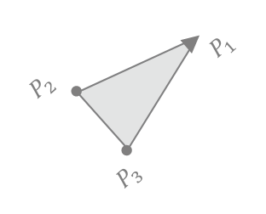
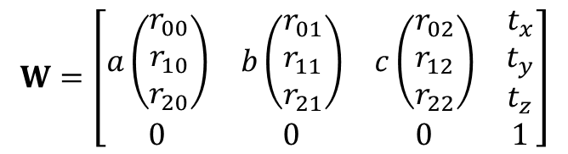
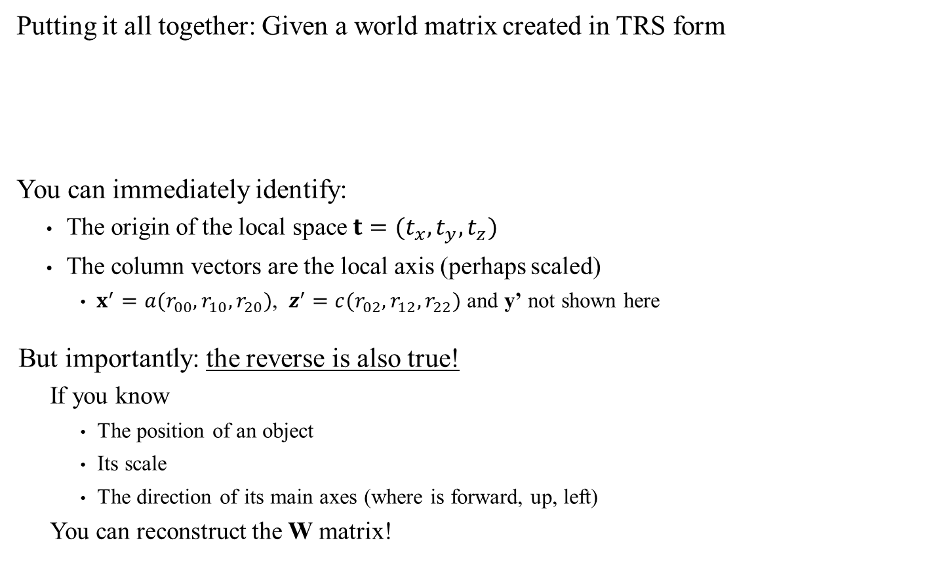

World Matrix Information
Putting it all together: Given a world matrix created in TRS form
You can immediately identify:
The origin of the local space $t=(t_{x},t_{y},t_{z})$
The column vectors are the local axis (perhaps scaled)
$x^{′}=a(r_{00},r_{10},r_{20})$, $z^{′}=c(r_{02},r_{12},r_{22})$ and y’ not shown here
But importantly: the reverse is also true!
If you know
The position of an object
Its scale
The direction of its main axes (where is forward, up, left)
You can reconstruct the W matrix!
$$W=\left[\begin{matrix}a\left(\begin{matrix}r_{00} \\ r_{10} \\ r_{20}\end{matrix}\right) & b\left(\begin{matrix}r_{01} \\ r_{11} \\ r_{21}\end{matrix}\right) & c\left(\begin{matrix}r_{02} \\ r_{12} \\ r_{22}\end{matrix}\right) & \begin{matrix}t_{x} \\ t_{y} \\ t_{z}\end{matrix} \\ 0 & 0 & 0 & 1\end{matrix}\right]$$
x
x’
z'
$$t$$
z

Slide 6

World Matrix Information
Example: If you know that the TGO is:
At position (14, 0, 10)
Has its forward axis along (1, 0, 1)
Has it’s up axis along (0, 1, 0)
Has scale (2, 2, 2)
Then we can recover W.
Step 1: Normalize the axes. Up is ok, but normalized forward is (0.707, 0, 0.707)
Step 2: Get the Left axis = Up x Fwd = (0.707, 0, -0.707)
(order matters!)
$$W=\left[\begin{matrix}a\left(\begin{matrix}r_{00} \\ r_{10} \\ r_{20}\end{matrix}\right) & b\left(\begin{matrix}r_{01} \\ r_{11} \\ r_{21}\end{matrix}\right) & c\left(\begin{matrix}r_{02} \\ r_{12} \\ r_{22}\end{matrix}\right) & \begin{matrix}t_{x} \\ t_{y} \\ t_{z}\end{matrix} \\ 0 & 0 & 0 & 1\end{matrix}\right] \\ =\left[\begin{matrix}1.414 & 0 & 1.414 & 14 \\ 0 & 2 & 0 & 0 \\ −1.414 & 0 & 1.414 & 10 \\ 0 & 0 & 0 & 1\end{matrix}\right]$$
x
x’
z'
$$t$$
z
See also Dynamic Examples

Slide 7
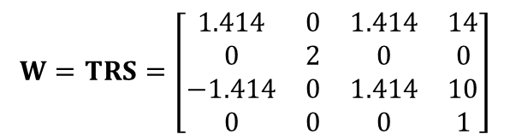


World Matrix Information
Similarly: If you know that the TGO was placed in world with this matrix:
Then you can recover the scale, rotation and translation:
From the last column $T=T_{(14,0,10)}$
Taking the length of each of the first 3 columns, we have $S=S_{(2,2,2)}$
Dividing each of the first 3 columns by its associated length, we get R
$$W=TRS=\left[\begin{matrix}1.414 & 0 & 1.414 & 14 \\ 0 & 2 & 0 & 0 \\ −1.414 & 0 & 1.414 & 10 \\ 0 & 0 & 0 & 1\end{matrix}\right]$$
x
$$R=\left[\begin{matrix}\text{0.707} & 0 & \text{0.707} & 0 \\ 0 & 1 & 0 & 0 \\ −\text{0.707} & 0 & \text{0.707} & 0 \\ 0 & 0 & 0 & 1\end{matrix}\right]$$
x’
z'
$$t$$
z

Slide 8


Coordinate Change (a.k.a Change of Basis)
A change of basis allows you to compute what the world looks like from a specific point and orientation in space.
Neither Blue nor Purple are moved here!!!
We’re only expressing position and orientation relative to different spaces, namely World, Local-to-Blue and Local-to-Purple
x
x
x
z
z
z
World Space:
Blue: (5,0,5), Rot-y π/4
Purple: (12,0,16), Rot-y 3π/4
Blue Object Space:
Blue: (0,0,0) and no rotation
Purple: (-2.83,0, 12.73), Rot-y π/2
Purple Object Space:
Blue: (12.72,0, 2.83), Rot-y –π/2
Purple: (0,0,0) and no rotation

Slide 9
Coordinate Change
Coordinate changes are very useful because they can simplify some operations
Example: Last week, we saw that rotations about a point C other than the origin was accomplished by first applying a translation by –C. This was, in effect, a simplified coordinate change
Two places where these coordinate change will come in handy (future topics):
Camera projection/processing
Collision detection
So let’s see how we can compute there coordinate changes

Slide 10







Coordinate Change: Translation Only
Let’s consider a simple case: A coordinate change involving only a translation.
How does the world look from Blue’s perspective?
Visually: you need to shift every point in space by (minus) Blue’s translation.
Or, in other words: apply the transform ${\left(W_{Blue}\right)}^{−1}= T_{−B}$ to everything in the world
IMPORTANT:
Neither Blue nor Purple are moved in this process!!!
The relative positions would likely be used by some algorithm/process
x
x
World Space:
$t_{B}$= (5,0,5)
$t_{P}$= (12,0,16)
Blue Object Space:
Blue Object Space:
Blue’s position:
$$T_{−B}\left[\begin{matrix}t_{B} \\ 1\end{matrix}\right]=\left[\begin{matrix}t_{B}−t_{B} \\ 1\end{matrix}\right]=\left[\begin{matrix}0 \\ 1\end{matrix}\right]$$
Purple’s position:
$$T_{−B}\left[\begin{matrix}t_{P} \\ 1\end{matrix}\right]=\left[\begin{matrix}t_{P}−t_{B} \\ 1\end{matrix}\right]=\left[\begin{matrix}7 \\ 0 \\ 11 \\ 1\end{matrix}\right]$$
$$T_{−B}$$
$$W_{Purp}= T_{P}$$
$$T_{−B}$$
$$W_{Blue}= T_{B}$$
z
z

Slide 11


Coordinate Change: Translation Only
See also Dynamic Examples
Let’s consider a simple case: A coordinate change involving only a translation.
How does the world look from Purple’s perspective?
Visually: apply the transform ${\left(W_{Purp}\right)}^{−1}= T_{−P}$
As you can see: in both cases we ‘undid’ whatever translation that had been applied to the object for which we want the ‘local space’
x
x
World Space:
$t_{B}$= (5,0,5)
$t_{P}$= (12,0,16)
Purple Object Space:
Purple Object Space:
Blue’s position:
$$T_{−P}\left[\begin{matrix}t_{B} \\ 1\end{matrix}\right]=\left[\begin{matrix}t_{B}−t_{P} \\ 1\end{matrix}\right]=\left[\begin{matrix}−7 \\ 0 \\ −11 \\ 1\end{matrix}\right]$$
Purple’s position:
$$T_{−P}\left[\begin{matrix}t_{P} \\ 1\end{matrix}\right]=\left[\begin{matrix}t_{P}−t_{P} \\ 1\end{matrix}\right]=\left[\begin{matrix}0 \\ 1\end{matrix}\right]$$
z
$$W_{Purp}= T_{P}$$
$$W_{Blue}= T_{B}$$
z

Slide 12

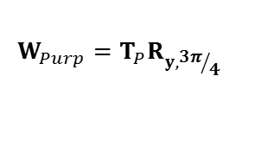


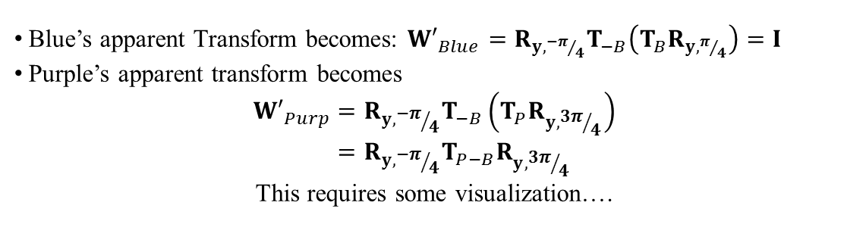
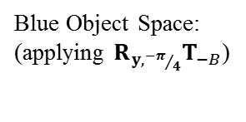
Coordinate Change: Translation & Rotation
Let’s add the rotation element now: what are the relative position and rotations?
We already know how to correct for the translation using $T_{−B}$
To correct for the rotation, we need to ‘undo’ Blue’s rotation: ${\left(R_{y,π/4}\right)}^{−1}=R_{y,{−π}/4}$
Blue’s apparent Transform becomes: ${W′}_{Blue}=R_{y,{−π}/4}T_{−B}\left(T_{B}R_{y,π/4}\right)=I$
Purple’s apparent transform becomes
$${W′}_{Purp}=R_{y,{−π}/4}T_{−B}\left(T_{P}R_{y,{3π}/4}\right) \\ =R_{y,{−π}/4}T_{P−B}R_{y,{3π}/4}$$
This requires some visualization….
x
x
x
World Space:
$t_{B}$= (5,0,5)
$t_{P}$= (12,0,16)
Blue Object Space:
(applying $T_{−B}$)
Blue Object Space:
(applying $R_{y,{−π}/4}T_{−B}$)
z
$$W_{Purp}=T_{P}R_{y,{3π}/4}$$
$$W_{Blue}=T_{B}R_{y,π/4}$$
z
z

Slide 13
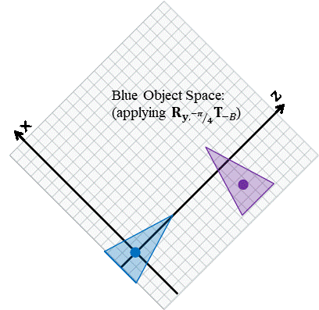
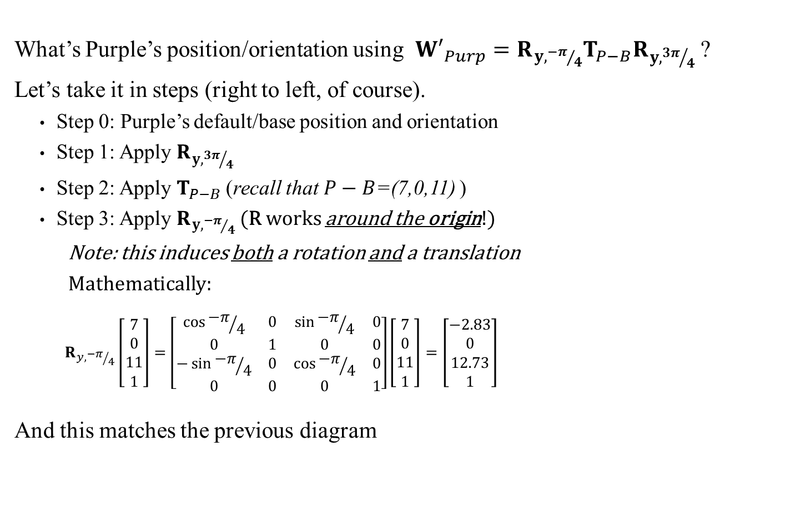
Coordinate Change: Translation & Rotation
What’s Purple’s position/orientation using ${W′}_{Purp}=R_{y,{−π}/4}T_{P−B}R_{y,{3π}/4}$ ?
Let’s take it in steps (right to left, of course).
Step 0: Purple’s default/base position and orientation
Step 1: Apply $R_{y,{3π}/4}$
Step 2: Apply $T_{P−B}$ (recall that $P−B$=(7,0,11) )
Step 3: Apply $R_{y,{−π}/4}$ (R works around the origin!)
Note: this induces both a rotation and a translation
Mathematically:
$$R_{y,{−π}/4}\left[\begin{matrix}7 \\ 0 \\ 11 \\ 1\end{matrix}\right]=\left[\begin{matrix}\cos{{−π}/4} & 0 & \sin{{−π}/4} & 0 \\ 0 & 1 & 0 & 0 \\ −\sin{{−π}/4} & 0 & \cos{{−π}/4} & 0 \\ 0 & 0 & 0 & 1\end{matrix}\right]\left[\begin{matrix}7 \\ 0 \\ 11 \\ 1\end{matrix}\right]=\left[\begin{matrix}−2.83 \\ 0 \\ 12.73 \\ 1\end{matrix}\right]$$
And this matches the previous diagram
x
Blue Object Space:
Step 2
Step 1
Step 0
z
Step 3
See also Dynamic Examples

Slide 14
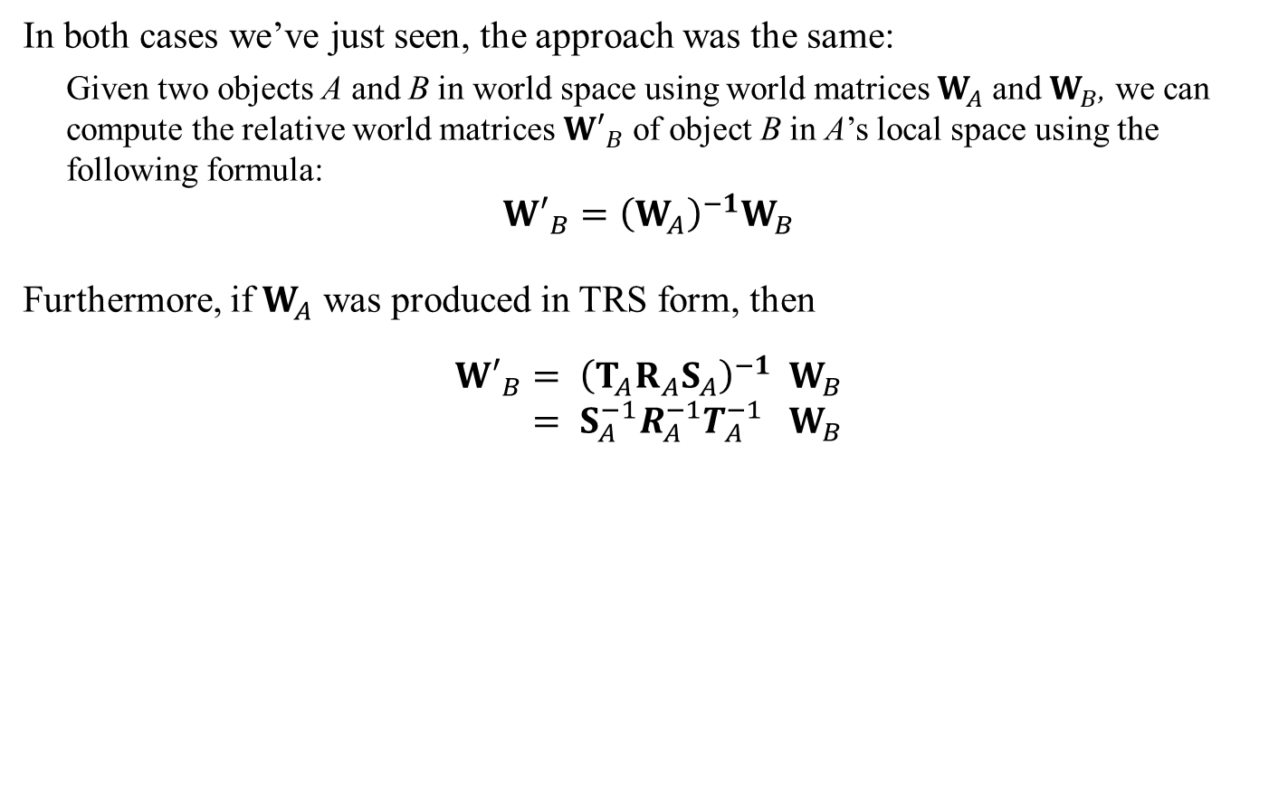
Coordinate Change: Technique:
In both cases we’ve just seen, the approach was the same:
Given two objects A and B in world space using world matrices $W_{A}$ and $W_{B}$, we can compute the relative world matrices ${W′}_{B}$ of object B in A’s local space using the following formula:
$${W′}_{B}={\left(W_{A}\right)}^{−1}W_{B}$$
Furthermore, if $W_{A}$ was produced in TRS form, then
$${W′}_{B}= {\left(T_{A}R_{A}S_{A}\right)}^{−1} W_{B} \\ = S_{A}^{−1}R_{A}^{−1}T_{A}^{−1} W_{B}$$
Now you see why matrix inverses are so important!
Remember:
The inverse of a product is the REVERSE product of inverses

Slide 15

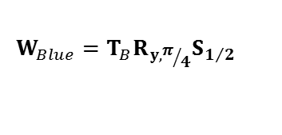
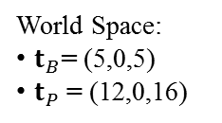
Coordinate Change: Translation, Rotation & Scaling
The technique used so far also works in general (even without TRS forms).
However, showing it in action using two objects each changing rotation, translation and scaling gets to be a bit hard to visualize.
To simplify a bit, let’s assume that
Only the Blue object changes its scale
Blue’s scale is changed by a uniform $S_{1/2}$
x
World Space:
$t_{B}$= (5,0,5)
$t_{P}$= (12,0,16)
$$W_{Purp}=T_{P}R_{y,{3π}/4}$$
$$W_{Blue}=T_{B}R_{y,π/4}S_{1/2}$$
z

Slide 16


Coordinate Change: Translation, Rotation & Scaling
Given this set up: Clearly the relative orientations will be the same as before.
But surprisingly, the position information will not be the same.
Let’s compute Purple’s matrix in Blue’s local space:
$${W′}_{Purp}={\left(T_{B}R_{y,π/4}S_{1/2}\right)}^{−1}W_{Purp} \\ =S_{2} R_{y,{−π}/4} T_{−B} W_{Purp}$$
But what’s the effect of that final $S_{2}$?
x
x
World Space:
$t_{B}$= (5,0,5)
$t_{P}$= (12,0,16)
Blue Object Space:
z
$$W_{Purp}=T_{P}R_{y,{3π}/4}$$
$$W_{Blue}=T_{B}R_{y,π/4}S_{1/2}$$
z
Note:
in local space, Blue is not scaled

Slide 17
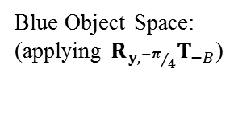

Coordinate Change: Translation, Rotation & Scaling
See also Dynamic Examples
Given this set up: Clearly the relative orientations will be the same as before.
But surprisingly, the position information will not be the same.
Let’s compute Purple’s matrix in Blue’s local space:
$${W′}_{Purp}={\left(T_{B}R_{y,π/4}S_{1/2}\right)}^{−1}W_{Purp} \\ =S_{2} R_{y,{−π}/4} T_{−B} W_{Purp}$$
Sidebar:
This is why uniform scaling is so desirable: Non-uniform scaling distorts objects in local space. For example: collision systems relying on bounding spheres don’t work with non-uniform scaling is since the radius becomes meaningless in local space.
x
x
World Space:
$t_{B}$= (5,0,5)
$t_{P}$= (12,0,16)
Blue Object Space:
(applying $R_{y,{−π}/4}T_{−B}$)
z
$$W_{Purp}=T_{P}R_{y,{3π}/4}$$
$$S_{2}\left[\begin{matrix}−2.83 \\ 0 \\ 12.73 \\ 1\end{matrix}\right]=\left[\begin{matrix}−5.66 \\ 0 \\ 25.46 \\ 1\end{matrix}\right]$$
Scale changes affect both size & distance in local space
Ex: To Ant-man, things look bigger and he has to run ‘relatively farther’…
$$W_{Blue}=T_{B}R_{y,π/4}S_{1/2}$$
z

Slide 18
World Matrix and Coordinate Change
We’ve covered:
Reconstructing a world matrix from an object’s position and direction information
Extracting position/direction from a world matrix in TRS form
Converting between world space and local space
Taken together, these techniques will be extremely useful for manipulating 3D scenes and objects.

