Slide 1
GAM 325/425: Applied 3D Geometry
Lecture 4, Part B:
Orientation Representation

Slide 2
Rotation Representation
We saw that for computer graphics/games, the three most commonly used transforms are: translation, rotation and scaling. For each of these we have used a standardized matrix representation which worked fine so far.
However, as far as rotations/orientations are concerned, there are a few alternatives to the matrix form:
Euler angles
Axis-Angles
Quaternions
All three of these can represent rotation/orientation and may prove to be more advantageous depending on context. We will review them and evaluate them according to 3 criteria:
Number of required values (small memory footprint is always desirable)
Efficient concatenation of rotations (very important for animation)
Efficient processing when rotating points and vectors (very important for rendering)
Spoiler! Matrices will win!
But these other representations have their place in specific context. We need to understand how they work and how to convert between them.

Slide 3
GAM 325/425: Applied 3D Geometry
Orientation Representation #1:
Matrices

Slide 4
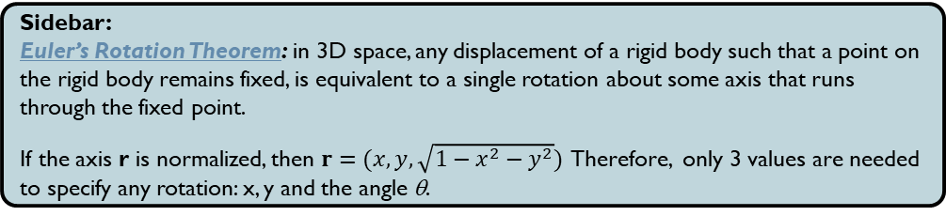
Rotation Matrices
How good are rotation matrices based on our criteria?
Small Footprint: Not so much…
At minimum, a general 3x3 rotation matrix needs 9 values.
Efficient Concatenation:
Done through matrix multiplication (efficient enough on modern CPU)
Efficient Rotation:
Extremely efficient, particularly when the same matrix is use for multiple points/vectors. Parallel/Multicore GPUs are specifically designed for this case
Sidebar:
Euler’s Rotation Theorem: in 3D space, any displacement of a rigid body such that a point on the rigid body remains fixed, is equivalent to a single rotation about some axis that runs through the fixed point.
If the axis r is normalized, then $r=(x,y, \sqrt{{1−x}^{2}−y^{2}})$ Therefore, only 3 values are needed to specify any rotation: x, y and the angle θ.

Slide 5
GAM 325/425: Applied 3D Geometry
Orientation Representation #2:
Euler Angles

Slide 6
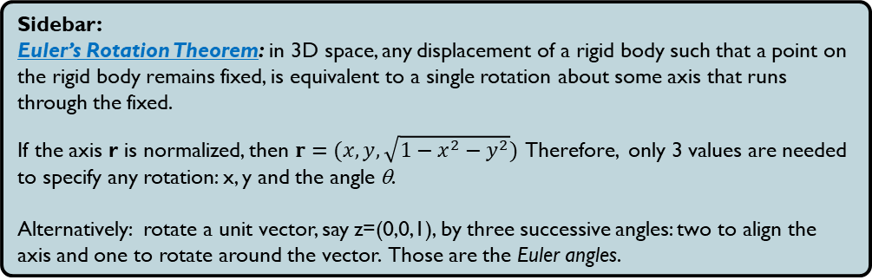
Euler Angles
Going Back to Euler’s Rotation theorem:
Problems:
Which axes do we use?
Local/object axes (as in the sidebar above). These are called intrinsic rotations
World axes. These are called extrinsic rotations.
Whether using intrinsic or extrinsic: what axis order do we use?
yxz? xyz? yzx? Allow repeated axes (classic Euler Angles) or not (Tait-Bryan Angles)?
In general, different orders give very different final rotations (see also Wikipedia)
The dreaded gimbal lock
More on this soon…
Sidebar:
Euler’s Rotation Theorem: in 3D space, any displacement of a rigid body such that a point on the rigid body remains fixed, is equivalent to a single rotation about some axis that runs through the fixed.
If the axis r is normalized, then $r=(x,y, \sqrt{{1−x}^{2}−y^{2}})$ Therefore, only 3 values are needed to specify any rotation: x, y and the angle θ.
Alternatively: rotate a unit vector, say z=(0,0,1), by three successive angles: two to align the axis and one to rotate around the vector. Those are the Euler angles.

Slide 7
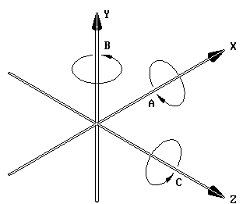

Euler Angles: Extrinsic Rotation
Easiest to implement:
Create the three axes rotation matrices $R_{x}$, $R_{y}$ and $R_{z}$ (see lecture 3 for details)
Determine the needed order (depends on context). For example: y-z-x
Meaning: rotate around y first, then around z, and finally around x
In Matrix form: Don’t forget the right-to-left arrangement:
$R=R_{x}R_{z}R_{y}$
Sidebar:
Yes, this means that while the representation of Euler angles only require 3 angles, actually working with these angles (usually) means using standard matrix operations. (admittedly, these are limited to the simpler rotation matrices)

Slide 8
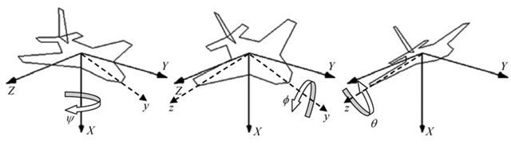
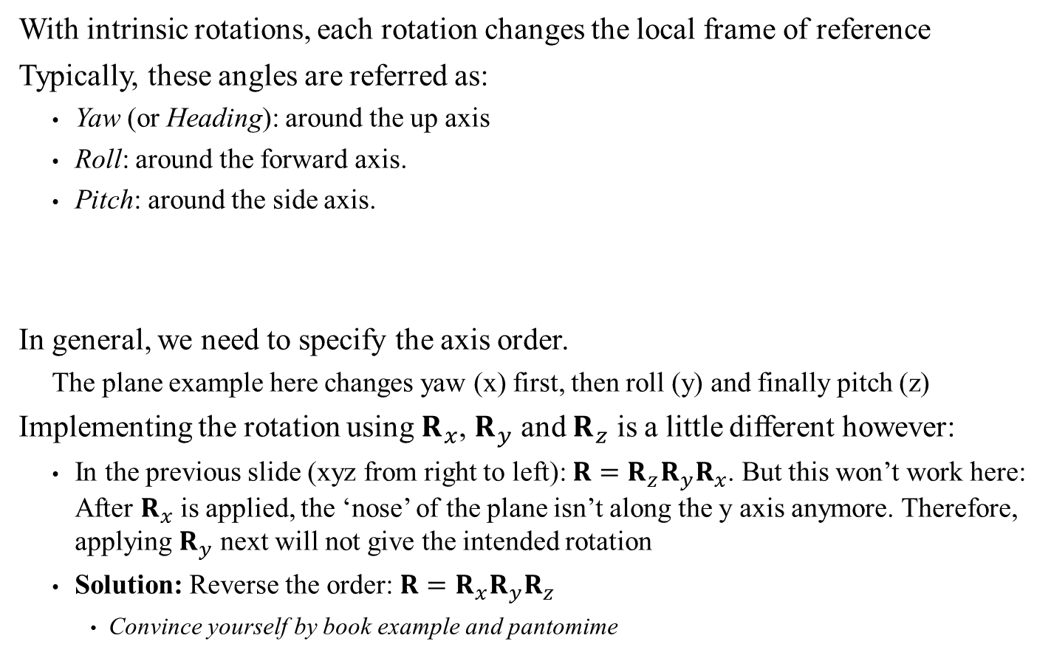
Euler Angles: Intrinsic Rotations
With intrinsic rotations, each rotation changes the local frame of reference
Typically, these angles are referred as:
Yaw (or Heading): around the up axis
Roll: around the forward axis.
Pitch: around the side axis.
In general, we need to specify the axis order.
The plane example here changes yaw (x) first, then roll (y) and finally pitch (z)
Implementing the rotation using $R_{x}$, $R_{y}$ and $R_{z}$ is a little different however:
In the previous slide (xyz from right to left): $R=R_{z}R_{y}R_{x}$. But this won’t work here: After $R_{x}$ is applied, the ‘nose’ of the plane isn’t along the y axis anymore. Therefore, applying $R_{y}$ next will not give the intended rotation
Solution: Reverse the order: $R=R_{x}R_{y}R_{z}$
Convince yourself by book example and pantomime
WARNING! Suspicious image…
Right-hand space: Check…
Model’s forward/up alignment: Not our standard
Intrinsic and extrinsic orders:
Use same set of rotation matrices.
Only the order differs

Slide 9
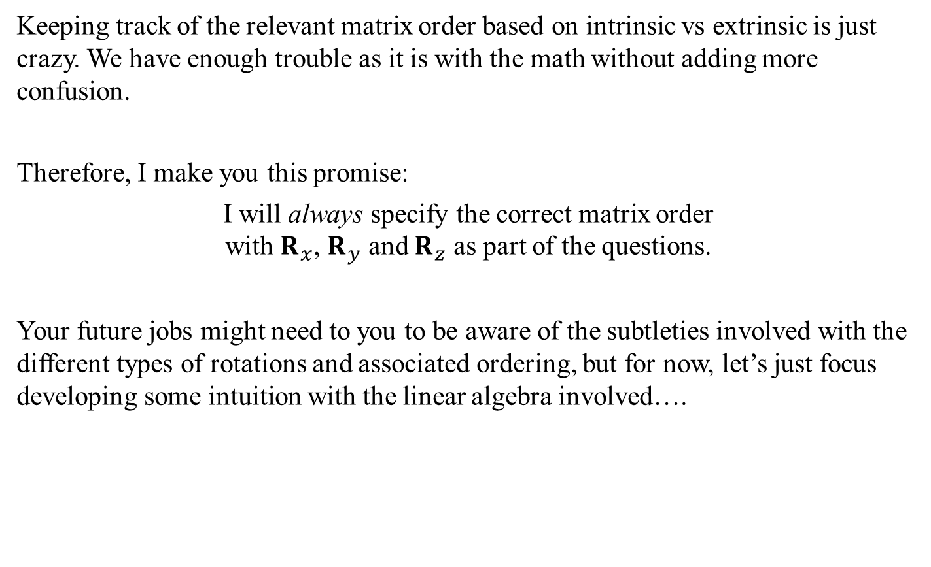
Euler Angles: A Promise
Keeping track of the relevant matrix order based on intrinsic vs extrinsic is just crazy. We have enough trouble as it is with the math without adding more confusion.
Therefore, I make you this promise:
I will always specify the correct matrix order with $R_{x}$, $R_{y}$ and $R_{z}$ as part of the questions.
Your future jobs might need to you to be aware of the subtleties involved with the different types of rotations and associated ordering, but for now, let’s just focus developing some intuition with the linear algebra involved….

Slide 10
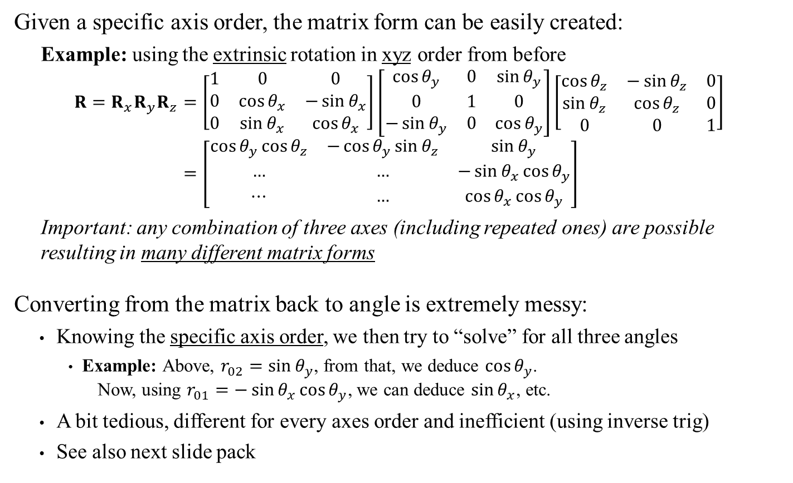
Converting Between Matrix Format and Angles
Given a specific axis order, the matrix form can be easily created:
Example: using the extrinsic rotation in xyz order from before
$$R=R_{x}R_{y}R_{z}=\left[\begin{matrix}1 & 0 & 0 \\ 0 & \cos{θ_{x}} & −\sin{θ_{x}} \\ 0 & \sin{θ_{x}} & \cos{θ_{x}}\end{matrix}\right]\left[\begin{matrix}\cos{θ_{y}} & 0 & \sin{θ_{y}} \\ 0 & 1 & 0 \\ −\sin{θ_{y}} & 0 & \cos{θ_{y}}\end{matrix}\right]\left[\begin{matrix}\cos{θ_{z}} & −\sin{θ_{z}} & 0 \\ \sin{θ_{z}} & \cos{θ_{z}} & 0 \\ 0 & 0 & 1\end{matrix}\right] \\ =\left[\begin{matrix}\cos{θ_{y}}\cos{θ_{z}} & −\cos{θ_{y}}\sin{θ_{z}} & \sin{θ_{y}} \\ … & … & −\sin{θ_{x}}\cos{θ_{y}} \\ ⋯ & … & \cos{θ_{x}}\cos{θ_{y}}\end{matrix}\right]$$
Important: any combination of three axes (including repeated ones) are possible resulting in many different matrix forms
Converting from the matrix back to angle is extremely messy:
Knowing the specific axis order, we then try to “solve” for all three angles
Example: Above, $r_{02}=\sin{θ_{y}}$, from that, we deduce $\cos{θ_{y}}$. Now, using $r_{01}=−\sin{θ_{x}}\cos{θ_{y}}$, we can deduce $\sin{θ_{x}}$, etc.
A bit tedious, different for every axes order and inefficient (using inverse trig)
See also next slide pack

Slide 11
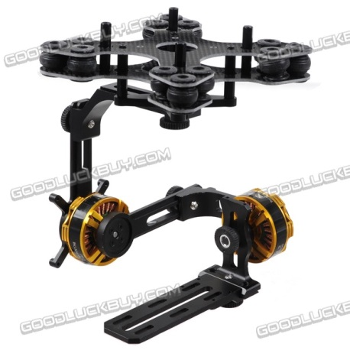
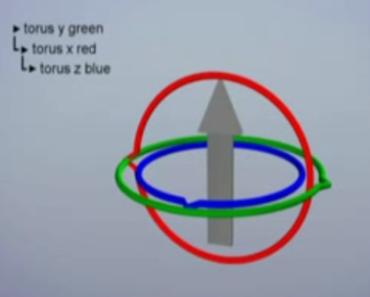
Euler Angles: Gimbal Lock
Gimbal: Mechanical mounting device that allow rotations around multiple axes (Typically 3 axes, sometimes only 2)
As an aside: software control for these is likely using Euler angles
Gimbal lock:
Originally: when one of the rotation axis reached its physical limit, ‘locking up’
3D Graphics: what happens when one axis lines up with another
Example: blue and green on the image below. At that point, rotation along the green axis cancels out whatever the blue axis has done.
The practical effect of Gimbal lock in 3D graphics is that it prevents smooth rotations between two position: If any intermediate position has a gimbal lock, the transition gets stuck in that position (see video, also Apollo Program Gimbal Lock)

Slide 12
Euler Angles: Assessment
Small Footprint:
Only 3 values… IF you don’t count specifying which axis order you use at every step. For example: Joints in 3D models often use Euler angles but do not have consistent order even within a single model!!!! (see this page)
Efficient concatenation:
No!!!! Best approach is to convert to matrix form (seriously! See book…)
Costly and error prone due to vagaries with inverse trig functions (see next slide deck)
Efficient rotation.
Uses matrix rotation, but not without a lot of back and forth conversions
Overall: a pretty bad representation….
So why the did we spend 20 minutes on these?!?!?
Because sadly, they are intuitive for people to specify orientation
Often used in 3D GUIs and get stored in models (parsing model file, you’ll see them)
Avoid at all cost!!!! But you will need to deal with them on occasion, if only for loading/setting up 3D animations…

Slide 13
GAM 325/425: Applied 3D Geometry
Orientation Representation #3:
Axis-Angle

Slide 14

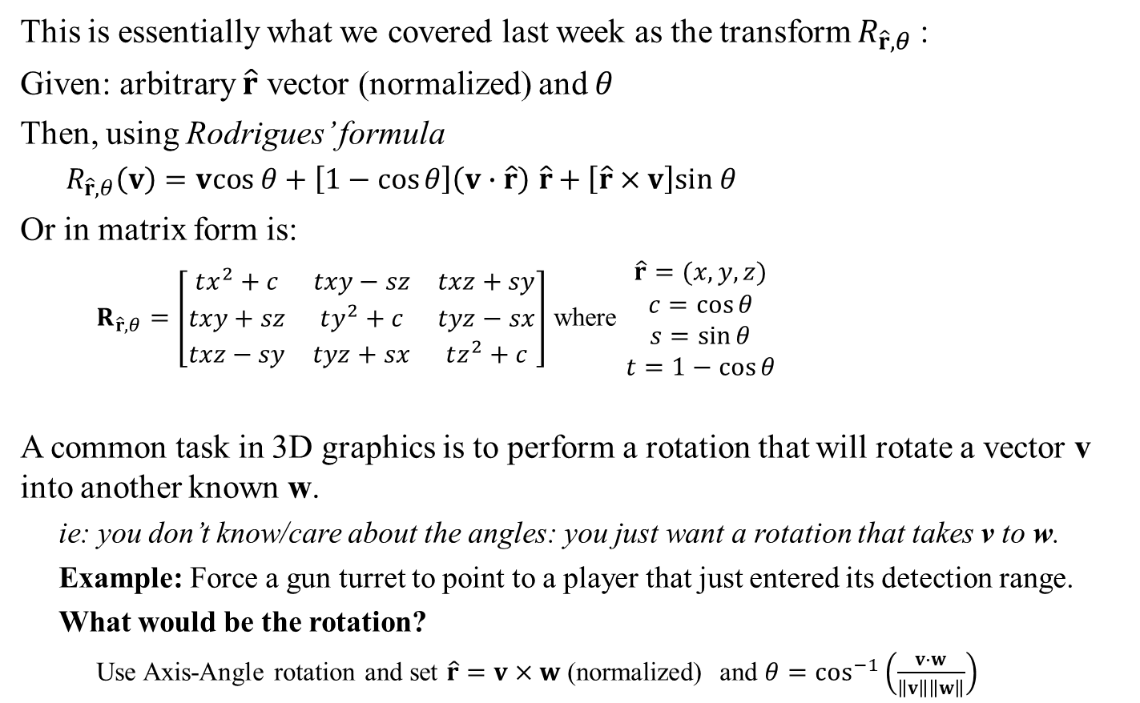
Axis-Angle
v
This is essentially what we covered last week as the transform $R_{\hat{r},θ}$:
Given: arbitrary $\hat{r}$ vector (normalized) and $θ$
Then, using Rodrigues’ formula
$R_{\hat{r},θ}\left(v\right)=vcos θ+\left[1−\cos{θ}\right]\left(v∙\hat{r}\right) \hat{r}+\left[\hat{r}×v\right]sin θ$
Or in matrix form is:
$R_{\hat{r},θ}=\left[\begin{matrix}tx^{2}+c & txy−sz & txz+sy \\ txy+sz & ty^{2}+c & tyz−sx \\ txz−sy & tyz+sx & tz^{2}+c\end{matrix}\right]$ where $\begin{matrix}\hat{r}=(x,y,z) \\ c=\cos{θ} \\ s=\sin{θ} \\ t=1−\cos{θ}\end{matrix}$
A common task in 3D graphics is to perform a rotation that will rotate a vector v into another known w.
ie: you don’t know/care about the angles: you just want a rotation that takes v to w.
Example: Force a gun turret to point to a player that just entered its detection range.
What would be the rotation?
Use Axis-Angle rotation and set $\hat{r}=v×w$ (normalized) and $θ=\cos^{−1}\left(\frac{v∙w}{\left\|v\right\|\left\|w\right\|}\right)$
v’
$$\hat{r}$$
θ
See also Dynamic Examples

Slide 15


Conversion From Matrix to Axis-Angle
Problem: Rotation around $\hat{r}$ by $θ$ is the same as a rotation around $−\hat{r}$ by $−θ$.
This means that any conversion algorithm will need to chose between two possible solutions. The selected one may not be the original…
v
v
v’
v’
$$\hat{r}$$
θ
-θ
$$−\hat{r}$$

Slide 16
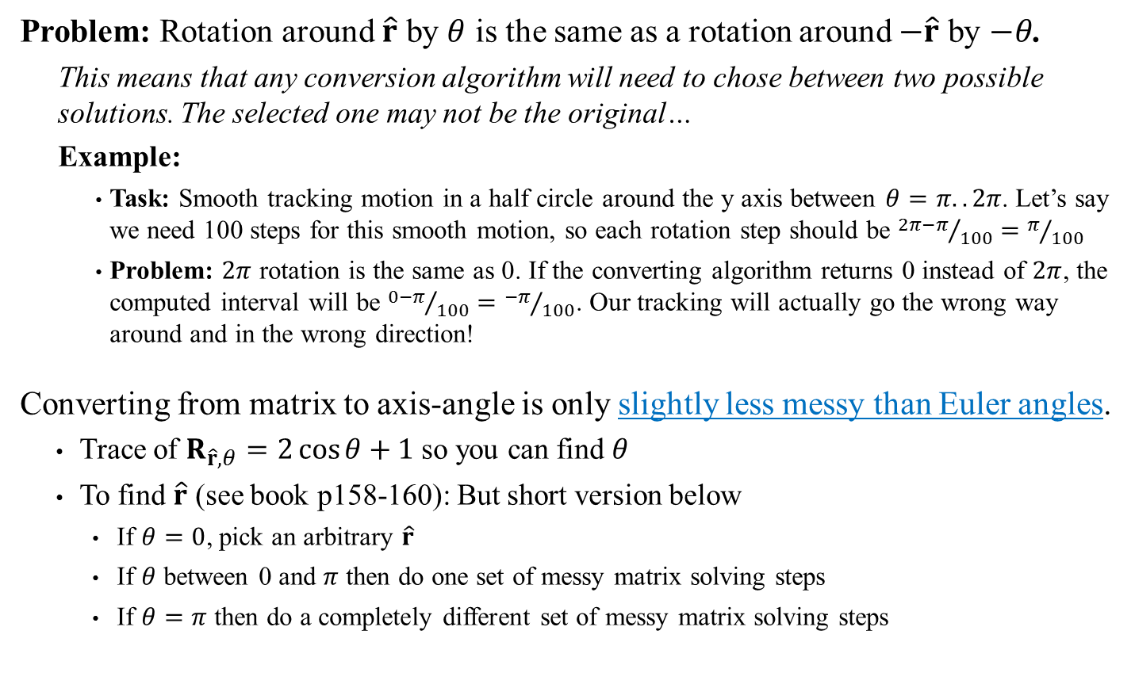
Conversion From Matrix to Axis-Angle
Problem: Rotation around $\hat{r}$ by $θ$ is the same as a rotation around $−\hat{r}$ by $−θ$.
This means that any conversion algorithm will need to chose between two possible solutions. The selected one may not be the original…
Example:
Task: Smooth tracking motion in a half circle around the y axis between $θ=π..2π$. Let’s say we need 100 steps for this smooth motion, so each rotation step should be ${2π−π}/{100}=π/{100}$
Problem: $2π$ rotation is the same as 0. If the converting algorithm returns 0 instead of $2π$, the computed interval will be ${0−π}/{100}={−π}/{100}$. Our tracking will actually go the wrong way around and in the wrong direction!
Converting from matrix to axis-angle is only slightly less messy than Euler angles.
Trace of $R_{\hat{r},θ}=2\cos{θ}+1$ so you can find $θ$
To find $\hat{r}$ (see book p158-160): But short version below
If $θ=0$, pick an arbitrary $\hat{r}$
If $θ$ between 0 and $π$ then do one set of messy matrix solving steps
If $θ=π$ then do a completely different set of messy matrix solving steps
At least there are only two clear solution options and not 6 (or more for repeated axis) as with Euler angles

Slide 17

Axis-Angle Rotations: Concatenation and Vector Rotation
Concatenation: Again, concatenation isn't really possible unless you convert to matrix form and back again (with the stated inherent possible conversion errors)
Vector Rotation: This is done through Rodrigues’ rotation formula
$$R_{\hat{r},θ}\left(v\right)=vcos θ+\left[1−\cos{θ}\right]\left(v∙\hat{r}\right) \hat{r}+\left[\hat{r}×v\right]sin θ$$
The need for trigonometric function makes it a bit costly for large volume
Precomputing/caching the trig values helps a bit, but matrix form still more efficient even when very few vector rotations are required.

Slide 18
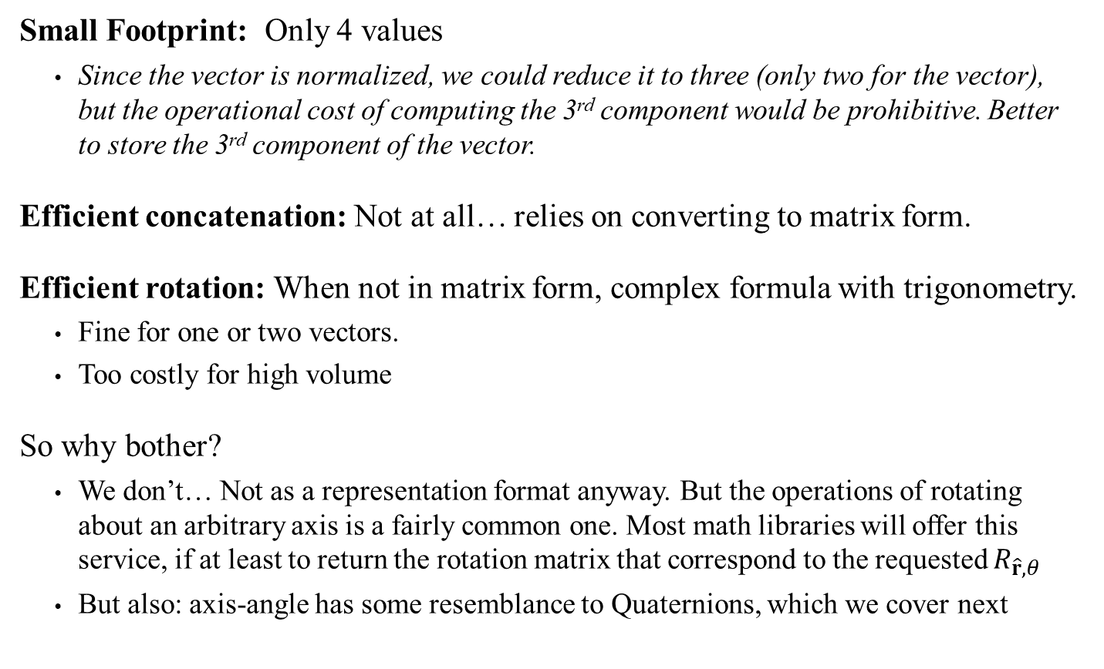
Axis-Angle: Assessment
Small Footprint: Only 4 values
Since the vector is normalized, we could reduce it to three (only two for the vector), but the operational cost of computing the 3rd component would be prohibitive. Better to store the 3rd component of the vector.
Efficient concatenation: Not at all… relies on converting to matrix form.
Efficient rotation: When not in matrix form, complex formula with trigonometry.
Fine for one or two vectors.
Too costly for high volume
So why bother?
We don’t… Not as a representation format anyway. But the operations of rotating about an arbitrary axis is a fairly common one. Most math libraries will offer this service, if at least to return the rotation matrix that correspond to the requested $R_{\hat{r},θ}$
But also: axis-angle has some resemblance to Quaternions, which we cover next

Slide 19
GAM 325/425: Applied 3D Geometry
Orientation Representation #4:
Quaternions

Slide 20

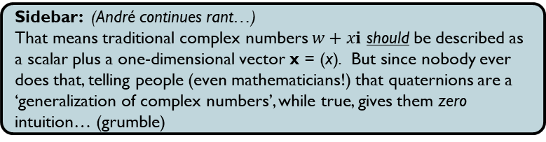
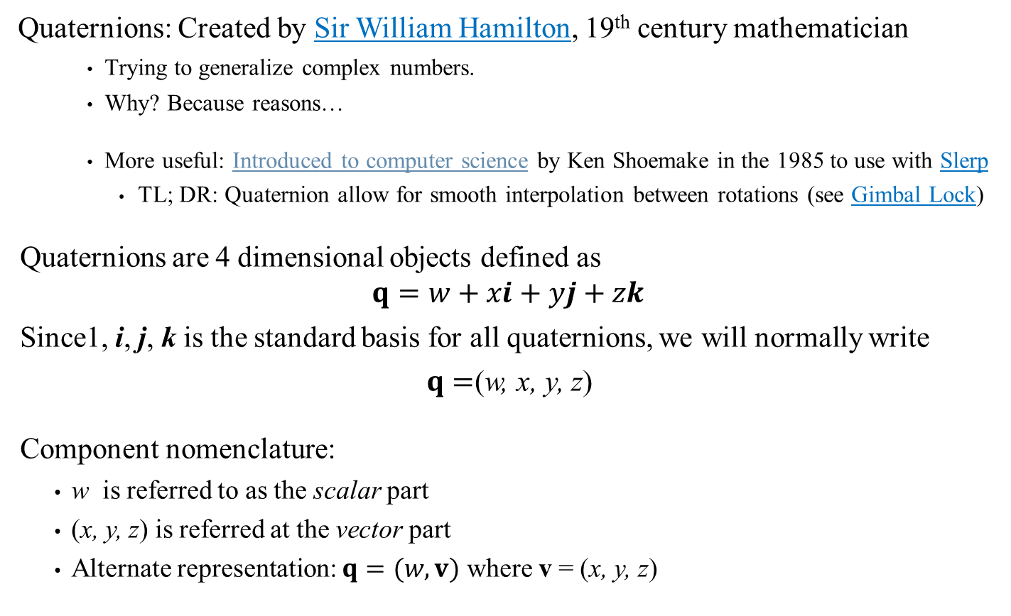
Quaternions
Quaternions: Created by Sir William Hamilton, 19th century mathematician
Trying to generalize complex numbers.
Why? Because reasons…
More useful: Introduced to computer science by Ken Shoemake in the 1985 to use with Slerp
TL; DR: Quaternion allow for smooth interpolation between rotations (see Gimbal Lock)
Quaternions are 4 dimensional objects defined as
$$q=w+xi+yj+zk$$
Since1, i, j, k is the standard basis for all quaternions, we will normally write
$q=$(w, x, y, z)
Component nomenclature:
w is referred to as the scalar part
(x, y, z) is referred at the vector part
Alternate representation: $q=(w,v)$ where v = (x, y, z)
Sidebar: (André rants) Everyone teaching quaternions in CS always states this factoid despite the fact that it clarifies nothing and gives no intuition whatsoever…
Warning: some authors write quats as $q=$(x, y, z,w)
Sidebar: (André continues rant…)
That means traditional complex numbers $w+xi$ should be described as a scalar plus a one-dimensional vector x = (x). But since nobody ever does that, telling people (even mathematicians!) that quaternions are a ‘generalization of complex numbers’, while true, gives them zero intuition… (grumble)

Slide 21
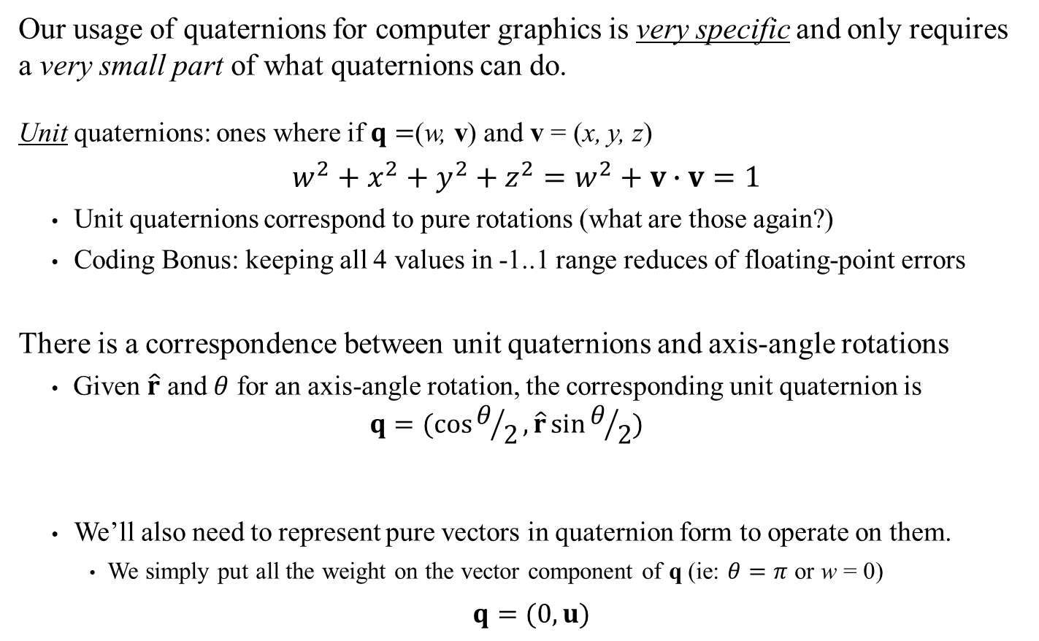
Quaternions: Limited Usage
Our usage of quaternions for computer graphics is very specific and only requires a very small part of what quaternions can do.
Unit quaternions: ones where if $q=$(w, v) and v = (x, y, z)
$w^{2}+x^{2}+y^{2}+z^{2}=w^{2}+v∙v=1$
Unit quaternions correspond to pure rotations (what are those again?)
Coding Bonus: keeping all 4 values in -1..1 range reduces of floating-point errors
There is a correspondence between unit quaternions and axis-angle rotations
Given $\hat{r}$ and $θ$ for an axis-angle rotation, the corresponding unit quaternion is
$$q=(\cos{θ/2},\hat{r}\sin{θ/2})$$
We’ll also need to represent pure vectors in quaternion form to operate on them.
We simply put all the weight on the vector component of q (ie: $θ=π$ or w = 0)
$q=(0, u)$
Sidebar:
Why the half angle? It’s an integral part of how quaternions work, but the intuition involves thinking in 4D…
See also Dynamic Examples

Slide 22
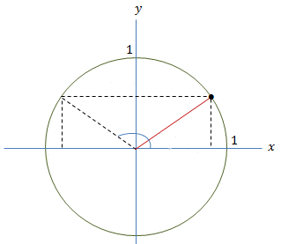
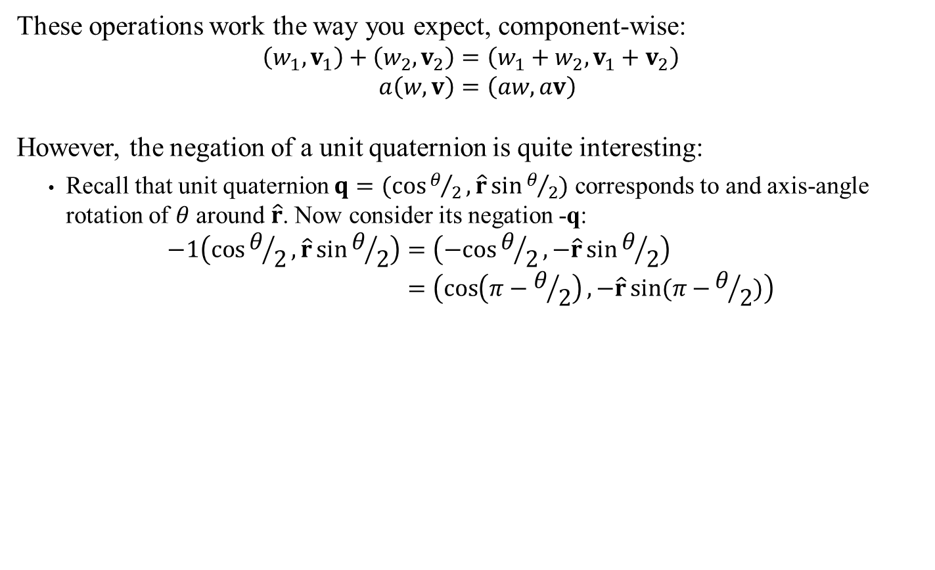
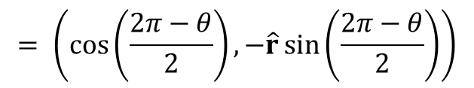
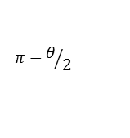
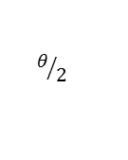
Quaternion Operations: Addition and Scalar
These operations work the way you expect, component-wise:
$$\left(w_{1},v_{1}\right)+\left(w_{2},v_{2}\right)=\left(w_{1}+w_{2},v_{1}+v_{2}\right) \\ a\left(w,v\right)=\left(aw,av\right)$$
However, the negation of a unit quaternion is quite interesting:
Recall that unit quaternion $q=(\cos{θ/2},\hat{r}\sin{θ/2})$ corresponds to and axis-angle rotation of $θ$ around $\hat{r}$. Now consider its negation -q:
$$−1\left(\cos{θ/2},\hat{r}\sin{θ/2}\right)=\left(−cos{θ/2},−\hat{r}\sin{θ/2}\right) \\ =\left(\cos\left(π−θ/2\right),−\hat{r}sin⁡(π−{θ/2)}\right)$$
$$= \left(\cos\left(\frac{2π−θ}{2}\right),−\hat{r}\sin\left(\frac{2π−θ}{2}\right)\right)$$
$$π−θ/2$$
$$θ/2$$

Slide 23

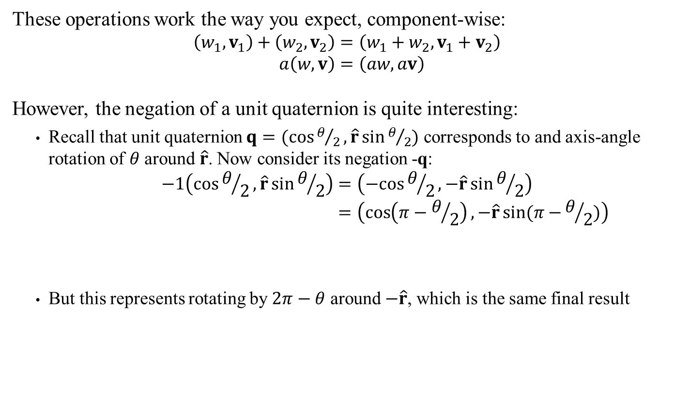







Quaternion Operations: Addition and Scalar
These operations work the way you expect, component-wise:
$$\left(w_{1},v_{1}\right)+\left(w_{2},v_{2}\right)=\left(w_{1}+w_{2},v_{1}+v_{2}\right) \\ a\left(w,v\right)=\left(aw,av\right)$$
However, the negation of a unit quaternion is quite interesting:
Recall that unit quaternion $q=(\cos{θ/2},\hat{r}\sin{θ/2})$ corresponds to and axis-angle rotation of $θ$ around $\hat{r}$. Now consider its negation -q:
$$−1\left(\cos{θ/2},\hat{r}\sin{θ/2}\right)=\left(−cos{θ/2},−\hat{r}\sin{θ/2}\right) \\ =\left(\cos\left(π−θ/2\right),−\hat{r}sin⁡(π−{θ/2)}\right)$$
But this represents rotating by $2π−θ$ around $−\hat{r}$, which is the same final result
$$= \left(\cos\left(\frac{2π−θ}{2}\right),−\hat{r}\sin\left(\frac{2π−θ}{2}\right)\right)$$
In other words: negating a quaternion doesn’t affect the associated rotation
$$\hat{r}$$
$$2π−θ$$
$$v′$$
$$v′$$
$$v$$
$$θ$$
$$v$$
$$−\hat{r}$$
Sidebar:
Interpolation between quaternions needs to be careful with this aspect, but we won’t worry about it for now

Slide 24
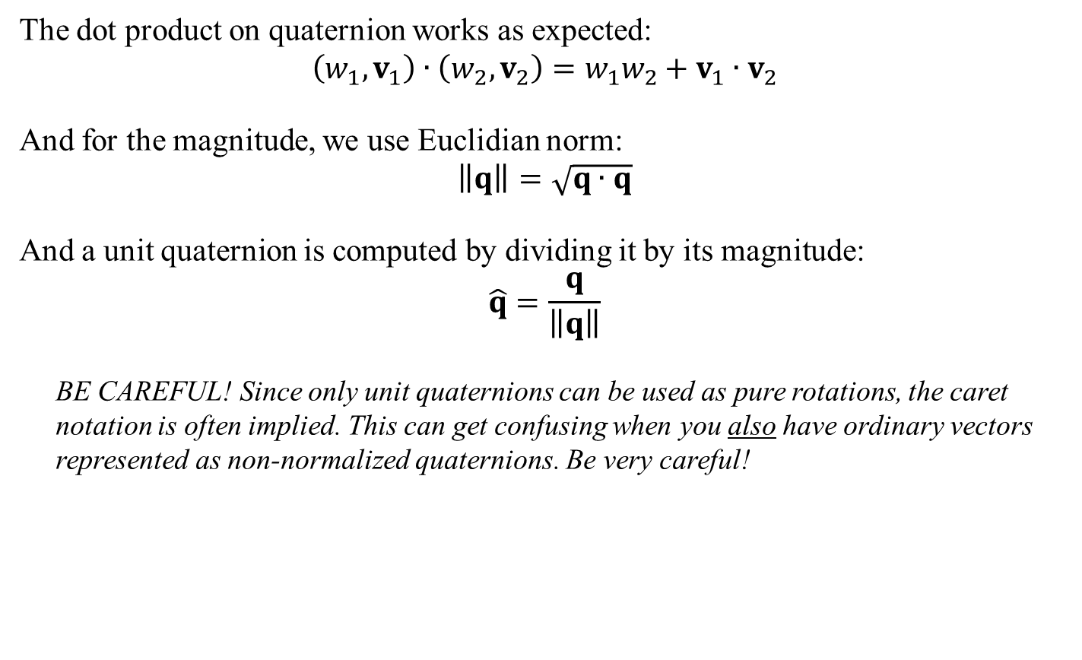
Quaternion Operations: Dot Product and Magnitude
The dot product on quaternion works as expected:
$$\left(w_{1},v_{1}\right)∙\left(w_{2},v_{2}\right)=w_{1}w_{2}+v_{1}∙v_{2}$$
And for the magnitude, we use Euclidian norm:
$$\left\|q\right\|=\sqrt{q∙q}$$
And a unit quaternion is computed by dividing it by its magnitude:
$$\hat{q}=\frac{q}{\left\|q\right\|}$$
BE CAREFUL! Since only unit quaternions can be used as pure rotations, the caret notation is often implied. This can get confusing when you also have ordinary vectors represented as non-normalized quaternions. Be very careful!

Slide 25
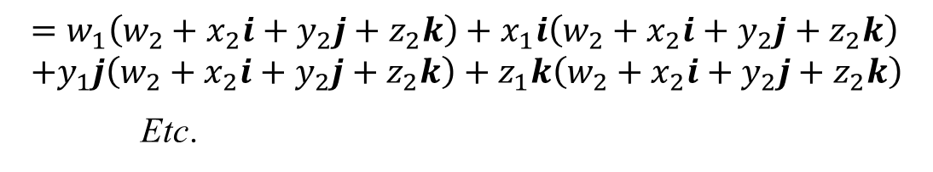
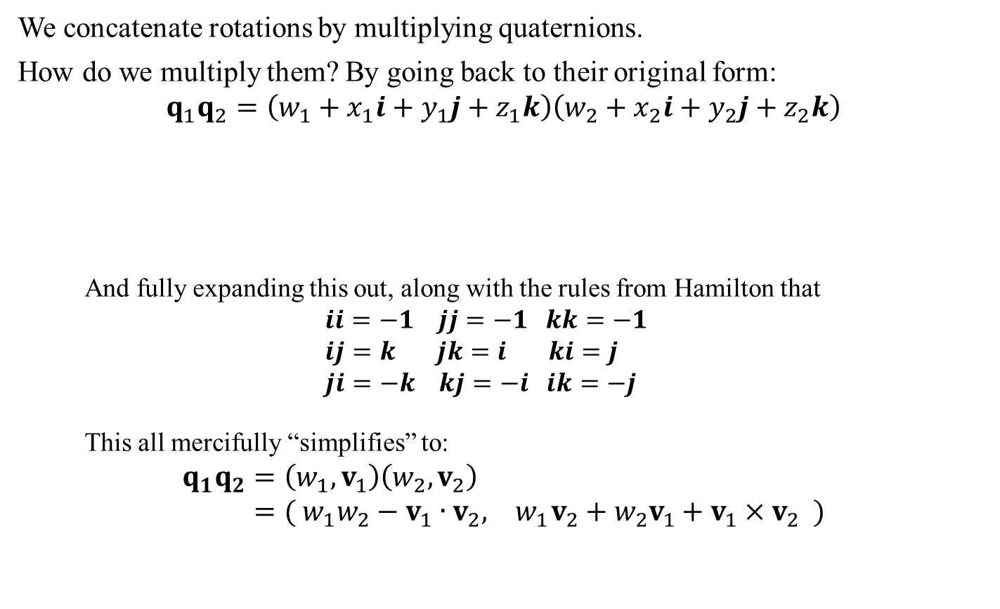
Concatenating Quaternions: Multiplication
We concatenate rotations by multiplying quaternions.
How do we multiply them? By going back to their original form:
$$q_{1}q_{2}=\left(w_{1}+x_{1}i+y_{1}j+z_{1}k\right)\left(w_{2}+x_{2}i+y_{2}j+z_{2}k\right)$$
And fully expanding this out, along with the rules from Hamilton that
$$ii=−1 jj=−1 kk=−1 \\ ij=k jk=i ki=j \\ ji=−k kj=−i ik=−j$$
This all mercifully “simplifies” to:
$$q_{1}q_{2}=\left(w_{1},v_{1}\right)\left(w_{2},v_{2}\right) \\ =( w_{1}w_{2}−v_{1}∙v_{2}, { w}_{1}v_{2}+w_{2}v_{1}+v_{1}×v_{2} )$$
$$=w_{1}\left(w_{2}+x_{2}i+y_{2}j+z_{2}k\right)+x_{1}i\left(w_{2}+x_{2}i+y_{2}j+z_{2}k\right) \\ +y_{1}j\left(w_{2}+x_{2}i+y_{2}j+z_{2}k\right)+z_{1}k\left(w_{2}+x_{2}i+y_{2}j+z_{2}k\right)$$
Etc.
Sidebar:
The product of two normalized quaternions should also be a normalized quaternion. Unfortunately, in reality round-off errors can accumulate so most implementations will renormalize after each multiplications.
See also Dynamic Examples

Slide 26



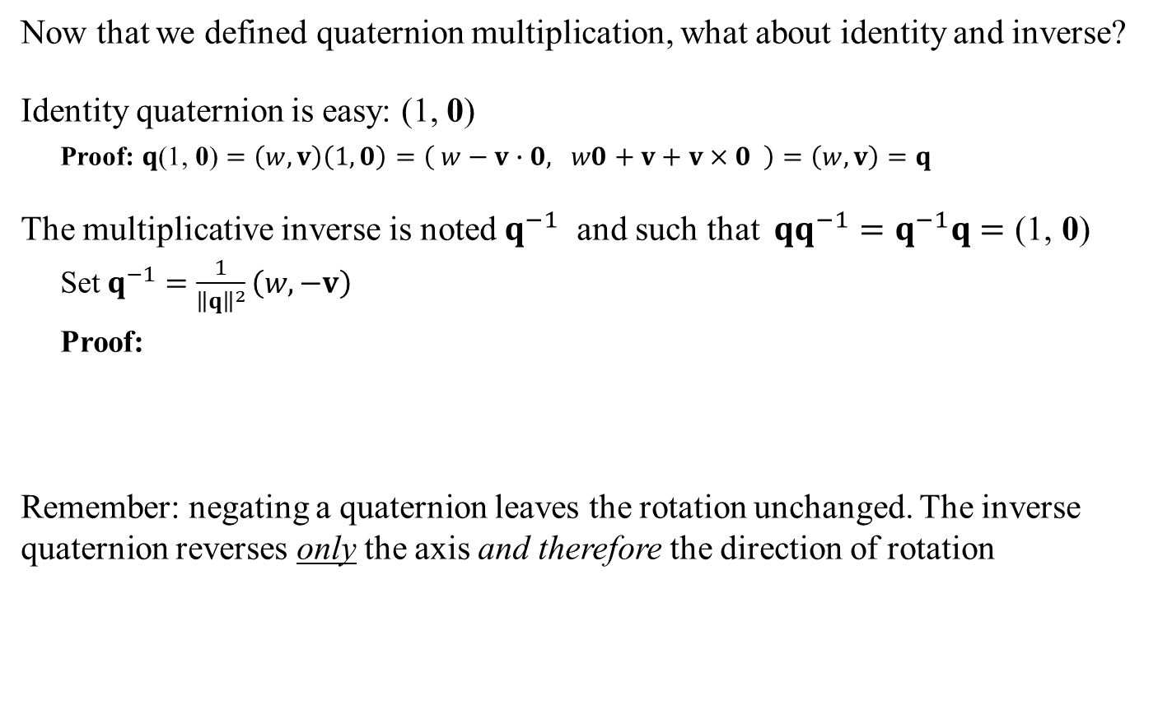




Quaternion Identity and Inverse
Now that we defined quaternion multiplication, what about identity and inverse?
Identity quaternion is easy: (1, 0)
Proof: $q\text{(1, }\text{0}\text{)}=\left(w,v\right)\left(1,0\right)=\left( w−v∙0, w0+v+v×0 \right)=\left(w,v\right)=q$
The multiplicative inverse is noted $q^{−1}$ and such that $qq^{−1}=q^{−1}q=\text{(1, }\text{0}\text{)}$
Set $q^{−1}=\frac{1}{{\left\|q\right\|}^{2}}\left(w,−v\right)$
Proof:
Remember: negating a quaternion leaves the rotation unchanged. The inverse quaternion reverses only the axis and therefore the direction of rotation
See also Dynamic Examples
$$qq^{−1}=\frac{1}{{\left\|q\right\|}^{2}}\left(w,v\right)\left(w,−v\right)$$
$$=\frac{1}{{\left\|q\right\|}^{2}}\left(w^{2}+v∙v, wv −wv−v×v\right)$$
$$=\frac{1}{{\left\|q\right\|}^{2}}\left({\left\|q\right\|}^{2}, 0\right)=(1,0)$$
Sidebar: Other side is similar, obviously
$$2π−θ$$
$$θ$$
$$θ$$
$q$ $=\left(w,v\right)$
$$−q=\left(−w,−v\right)$$
$$q^{−1}=\left(w,−v\right)$$

Slide 27
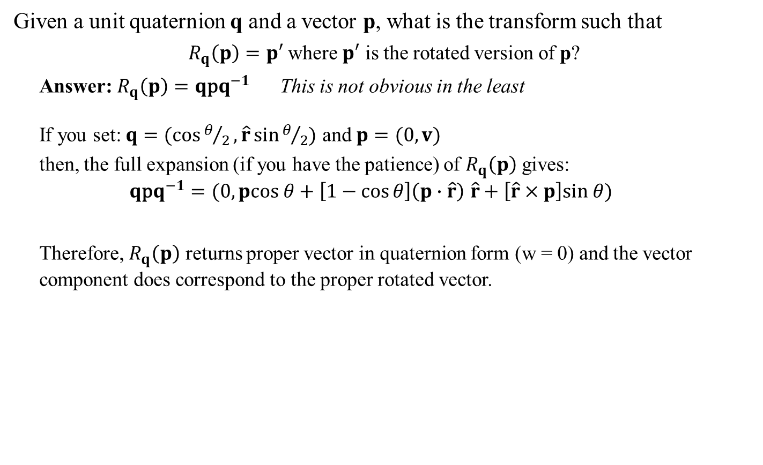
Rotating Vectors Using Quaternions
Given a unit quaternion q and a vector p, what is the transform such that
$R_{q}\left(p\right)=p′$ where $p′$ is the rotated version of p?
Answer: $R_{q}\left(p\right)=q\text{p}q^{−1}$ This is not obvious in the least
If you set: $q=(\cos{θ/2},\hat{r}\sin{θ/2})$ and $p=(0,v)$
then, the full expansion (if you have the patience) of $R_{q}\left(p\right)$ gives:
$$q\text{p}q^{−1}=(0,pcos θ+\left[1−\cos{θ}\right]\left(p∙\hat{r}\right) \hat{r}+\left[\hat{r}×p\right]sin θ)$$
Therefore, $R_{q}\left(p\right)$ returns proper vector in quaternion form (w = 0) and the vector component does correspond to the proper rotated vector.
See also Dynamic Examples
$$=(0,\text{< }\text{Rodrigues}\text{’ }\text{formula} \text{for} \text{axis}\text{−}\text{angle} \text{>} )$$
Sidebar:
The book (p172-173) tries to explain geometrically what’s going on with this odd operation. It involves imagining the rotations on two simultaneous 2D planes orthogonal in 4D where two half rotations cancels out one of the other two half rotations… Clear as mud…

Slide 28
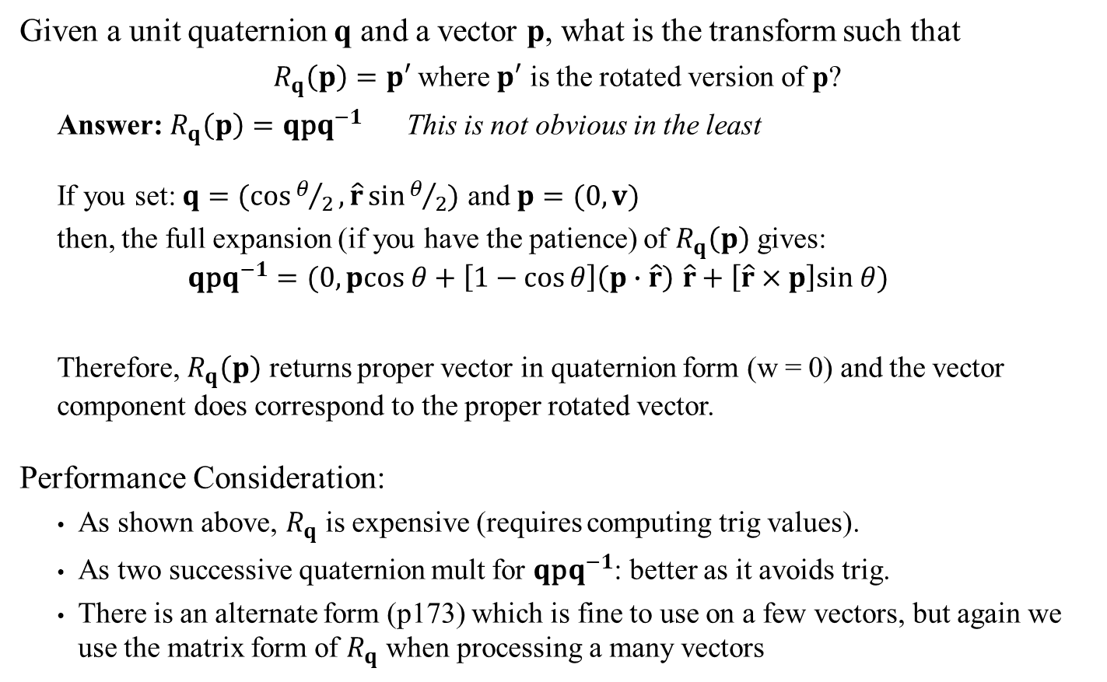
Rotating Vectors Using Quaternions
Given a unit quaternion q and a vector p, what is the transform such that
$R_{q}\left(p\right)=p′$ where $p′$ is the rotated version of p?
Answer: $R_{q}\left(p\right)=q\text{p}q^{−1}$ This is not obvious in the least
If you set: $q=(\cos{θ/2},\hat{r}\sin{θ/2})$ and $p=(0,v)$
then, the full expansion (if you have the patience) of $R_{q}\left(p\right)$ gives:
$$q\text{p}q^{−1}=(0,pcos θ+\left[1−\cos{θ}\right]\left(p∙\hat{r}\right) \hat{r}+\left[\hat{r}×p\right]sin θ)$$
Therefore, $R_{q}\left(p\right)$ returns proper vector in quaternion form (w = 0) and the vector component does correspond to the proper rotated vector.
Performance Consideration:
As shown above, $R_{q}$ is expensive (requires computing trig values).
As two successive quaternion mult for $q\text{p}q^{−1}$: better as it avoids trig.
There is an alternate form (p173) which is fine to use on a few vectors, but again we use the matrix form of $R_{q}$ when processing a many vectors
See also Dynamic Examples
$$=(0,\text{< }\text{Rodrigues}\text{’ }\text{formula} \text{for} \text{axis}\text{−}\text{angle} \text{>} )$$

Slide 29
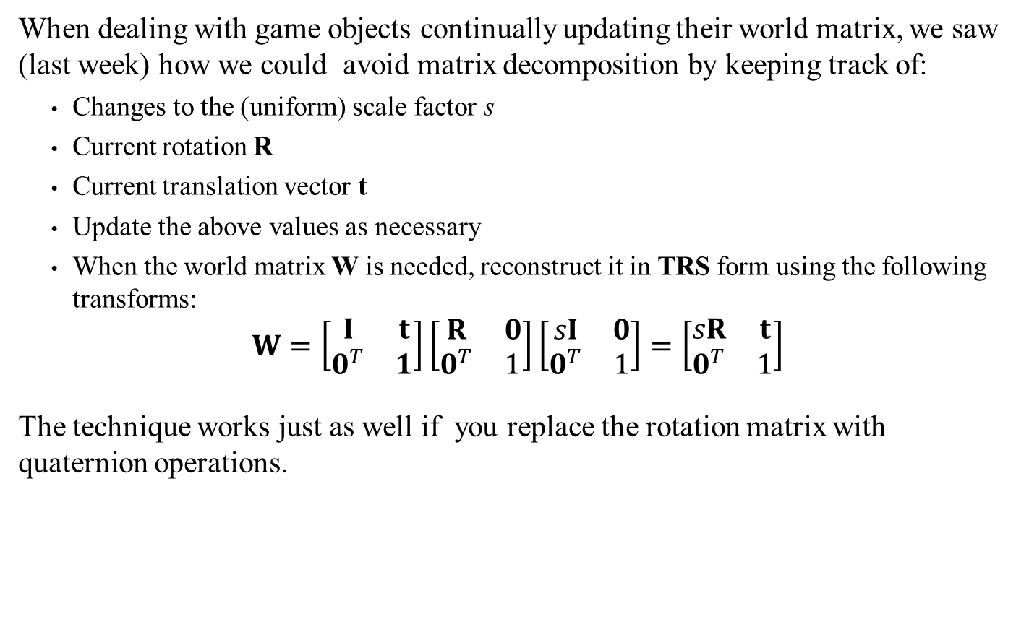
Quaternion And Transformations
When dealing with game objects continually updating their world matrix, we saw (last week) how we could avoid matrix decomposition by keeping track of:
Changes to the (uniform) scale factor s
Current rotation R
Current translation vector t
Update the above values as necessary
When the world matrix W is needed, reconstruct it in TRS form using the following transforms:
$$W=\left[\begin{matrix}I & t \\ 0^{T} & 1\end{matrix}\right]\left[\begin{matrix}R & 0 \\ 0^{T} & 1\end{matrix}\right]\left[\begin{matrix}sI & 0 \\ 0^{T} & 1\end{matrix}\right]=\left[\begin{matrix}sR & t \\ 0^{T} & 1\end{matrix}\right]$$
The technique works just as well if you replace the rotation matrix with quaternion operations.

Slide 30
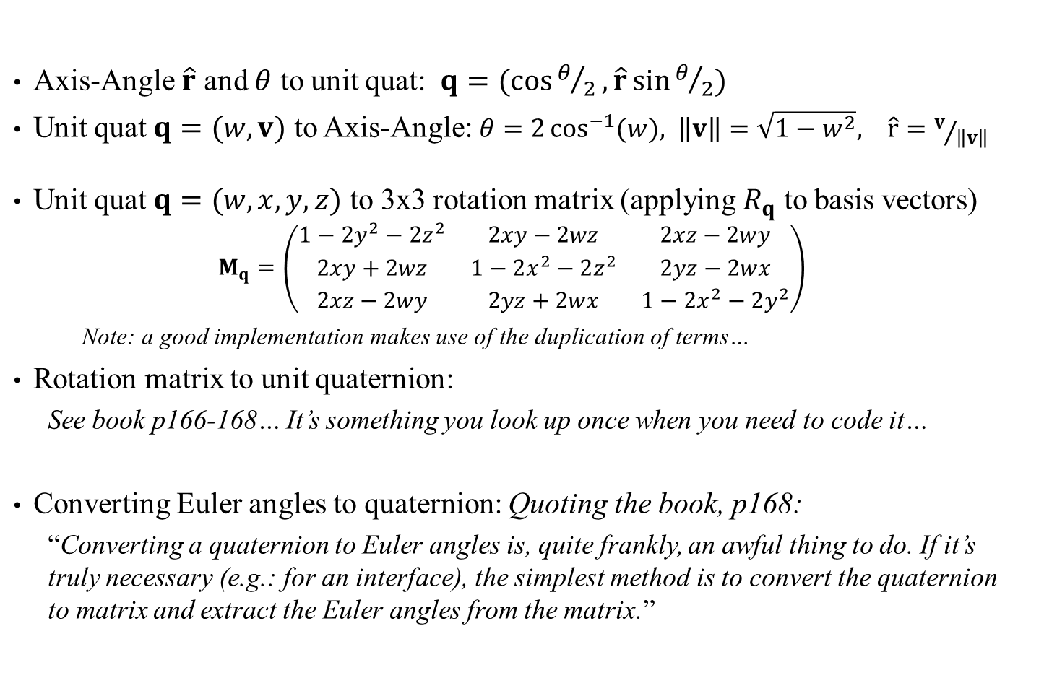
Quaternions: Converting Between Formats
Axis-Angle $\hat{r}$ and $θ$ to unit quat: $q=(\cos{θ/2},\hat{r}\sin{θ/2})$
Unit quat $q=(w,v)$ to Axis-Angle: $θ=2\cos^{−1}{(w}), \left\|v\right\|=\sqrt{1−w^{2}}, \hat{r}=v/{\left\|v\right\|}$
Unit quat $q=(w,x,y,z)$ to 3x3 rotation matrix (applying $R_{q}$ to basis vectors)
$$M_{q}=\left(\begin{matrix}1−2y^{2}−2z^{2} & 2xy−2wz & 2xz−2wy \\ 2xy+2wz & 1−2x^{2}−2z^{2} & 2yz−2wx \\ 2xz−2wy & 2yz+2wx & 1−2x^{2}−2y^{2}\end{matrix}\right)$$
Note: a good implementation makes use of the duplication of terms…
Rotation matrix to unit quaternion:
See book p166-168… It’s something you look up once when you need to code it…
Converting Euler angles to quaternion: Quoting the book, p168:
“Converting a quaternion to Euler angles is, quite frankly, an awful thing to do. If it’s truly necessary (e.g.: for an interface), the simplest method is to convert the quaternion to matrix and extract the Euler angles from the matrix.”

Slide 31
Quaternions: Assessment
So how do Quaternion fare?
Small footprint: only 4 values, like axis-angles
Efficient concatenation: Efficient. A bit better than matrix even
Efficient rotations: second only to matrix on most realistic situation.
Matrix still a better performer on high volumes
The real appeal of quaternions is their ability to smoothly interpolate between two rotations, which is absolutely crucial for good animation processing.
We’ll cover rotation interpolation later in the quarter
Note:
Animation software GUIs all use Euler angles to make it easy on artists
Euler angles in keyframe animation must be converted into quaternions for better quality
The quaternions must be converted to matrices for better performance
Such is the life of a game systems programmer…
Sidebar:
For another introduction to quaternion, I recommend 3Blue1Brown’s YouTube series. Also: video 2 and website

Slide 32
Overall Conclusions
Euler Angles are terrible as a representation but often used in GUI and model files.
You may need to deal with them occasionally, but avoid at all cost
Axis-Angle is not really suitable as a representation but the underlying math comes in handy with quaternion operations.
Quaternions are efficient at concatenation and computing rotations
Also solve many problems with interpolation, but we haven’t covered that yet
Matrix representation is a bit unwieldy on space, but since we always need to convert to it in the final stage (to send to the GPU) it’s quite serviceable as a rotation representation.
Use quaternion representation only when doing something fancy with rotation

