Slide 1
GAM 325/425: Applied 3D Geometry
Lecture 7:
Viewing and Projection

Slide 2
Part 1:
Camera Transforms

Slide 3
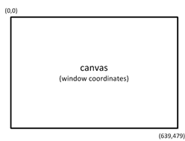
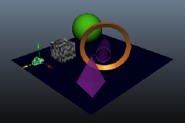
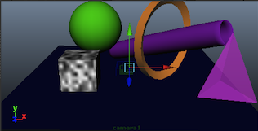
Rendering a Scene
In order to render a 3D scene to the screen:
Place objects in their world position (using transform matrices and operations)
< Something about describing the point of view >
Get a 2D image on screen
World Space
2D, width x height pixels
World Space
3D, Infinite
???
Let’s flesh out Step 2 a bit…

Slide 4
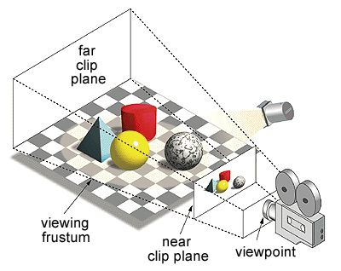
Viewing a Scene
To view a 3D scene, we need to specify two things:
Camera position and alignment in the world
The type of projection (“lens”) to be used
Generally speaking:
Game/Animation loop:
Update all scene objects’ world matrices
Draw the scene
Compute the position/orientation of all objects in camera’s frame
Perform some shader magic (outside the scope of this class)
Project the scene on a 2D plane
Repeat
Our focus will be on the math related to the camera’s position, alignment and projection.
Other classes will deal with engine and shader

Slide 5
View Frame
Just like every other object in the scene, the ‘camera’ needs a position and alignment in the 3D world.
We’ll use transform matrices, of course.
Scaling isn’t used: we only need a translation (T) and a rotation (R)
Unlike most objects however, the camera’s orientation is typically given by directional vectors
This means specifying the position, fwd direction and ‘up’ alignment of the camera.
From the camera’s position and two vectors we can reconstruct a full world matrix
More details shortly
But before, we need to talk about conventions (or lack thereof…)

Slide 6
View Frame: Handedness Strikes Again…
In View Frame space: which axes are forward, up and side?
Once again, the world of computer graphics is being...interesting…
We assume you have already selected your graphic system (OpenGL, DirectX, etc. )
Whatever team agreement we made for axes alignment in world space and/or game objects, it’s likely that the camera will have a different one.
Most cameras will have the up vector along the y axis.
Most cameras will have the side vector along the x axis
Usually the side vector will align toward the right side of the screen
This is done because the 2D screen has the x-axis going to the right
Sadly, this leads people to call this the ‘right’ vector despite the fact that this naming may conflict with handedness…
Check the camera’s handedness: (new LASR)
Some are left-handed (the books wishfully calls those ‘standard’) others are right-handed
DirectX is often LH while OpenGL often is RH (relative to World Space. The NDC may be different.)
LH cameras usually look down the z axis while RH camera look down the negative z axis
This means we have to flip the directional vector when building the world matrix for RH cameras
See next slide…

Slide 7
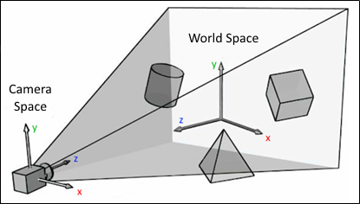
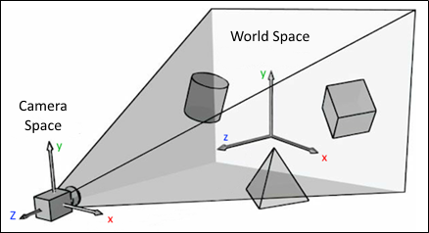



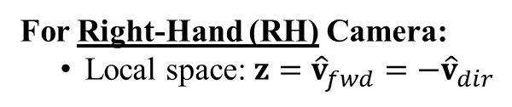
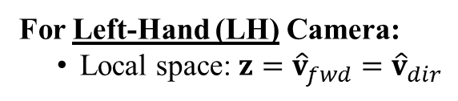
View Frame: Position/Alignment of a Camera
A camera’s position and orientation are specified as follow:
The camera’s position: $C_{pos}$
The camera’s initial ‘up’ direction (Note: not the final up vector, see next slide)
The camera’s target position: $T_{pos}$
From the above, we can compute the view direction (the direction of the ‘lens’)
${\hat{v}}_{dir}=Normalize({ T}_{pos}−C_{pos})$
This is a vector pointing from the camera towards the target
For Left-Hand (LH) Camera:
Local space: $z={\hat{v}}_{fwd}={\hat{v}}_{dir}$
For Right-Hand (RH) Camera:
Local space: $z={\hat{v}}_{fwd}=−{\hat{v}}_{dir}$
$${\hat{v}}_{dir}$$
$${−\hat{v}}_{dir}$$

Slide 8

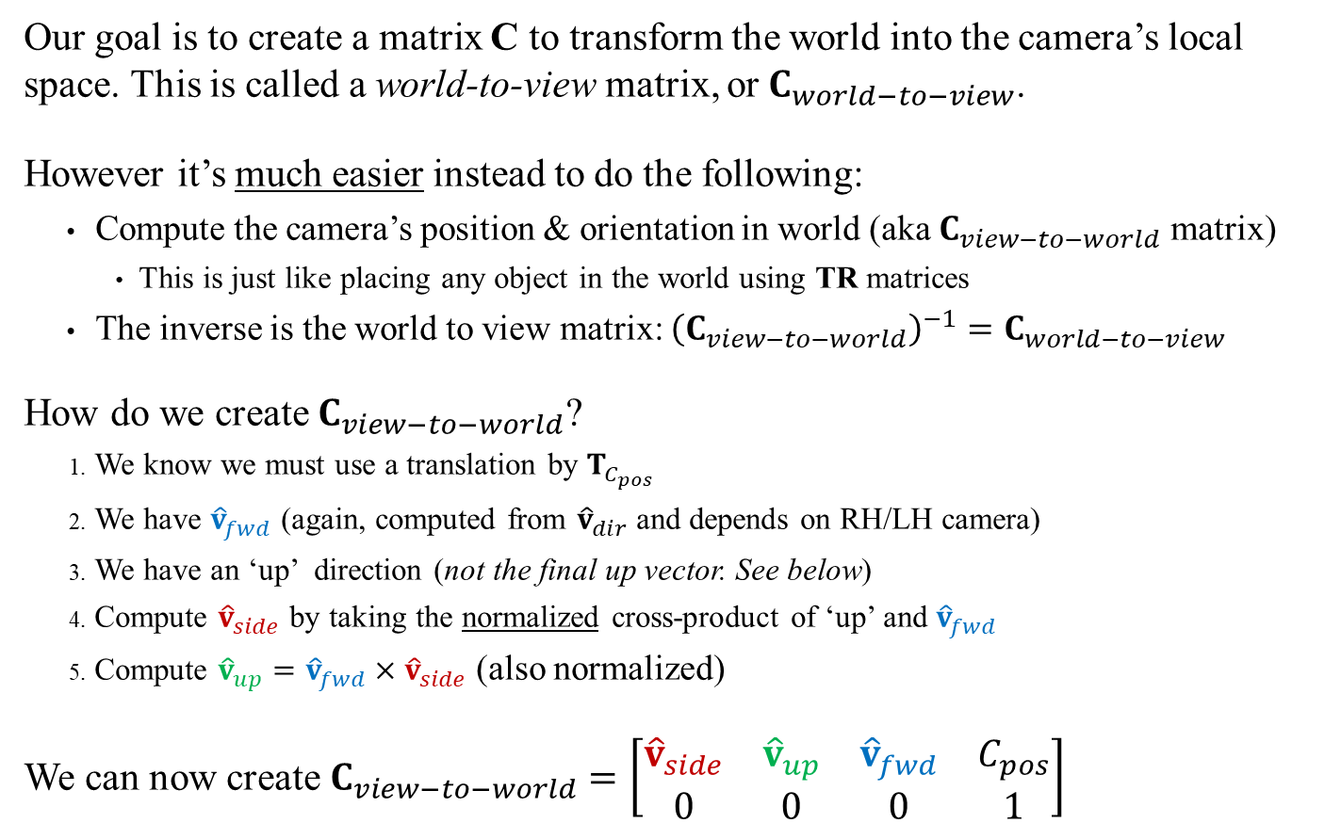



View Frame: Creating Matrix Transform
Our goal is to create a matrix C to transform the world into the camera’s local space. This is called a world-to-view matrix, or$C_{world−to−view}$.
However it’s much easier instead to do the following:
Compute the camera’s position & orientation in world (aka $C_{view−to−world}$ matrix)
This is just like placing any object in the world using TR matrices
The inverse is the world to view matrix: ${\left(C_{view−to−world}\right)}^{−1}=C_{world−to−view}$
How do we create $C_{view−to−world}$?
We know we must use a translation by $T_{C_{pos}}$
We have ${\hat{v}}_{fwd}$ (again, computed from ${\hat{v}}_{dir}$ and depends on RH/LH camera)
We have an ‘up’ direction (not the final up vector. See below)
Compute ${\hat{v}}_{side}$ by taking the normalized cross-product of ‘up’ and ${\hat{v}}_{fwd}$
Compute ${\hat{v}}_{up}={\hat{v}}_{fwd}×{\hat{v}}_{side}$ (also normalized)
We can now create $C_{view−to−world}=\left[\begin{matrix}{\hat{v}}_{side} & {\hat{v}}_{up} & {\hat{v}}_{fwd} & C_{pos} \\ 0 & 0 & 0 & 1\end{matrix}\right]$
See also Dynamic Examples
‘Up’
$${\hat{v}}_{up}$$
$$T_{C_{pos}}$$
$${\hat{v}}_{side}$$
$${\hat{v}}_{fwd}$$

Slide 9
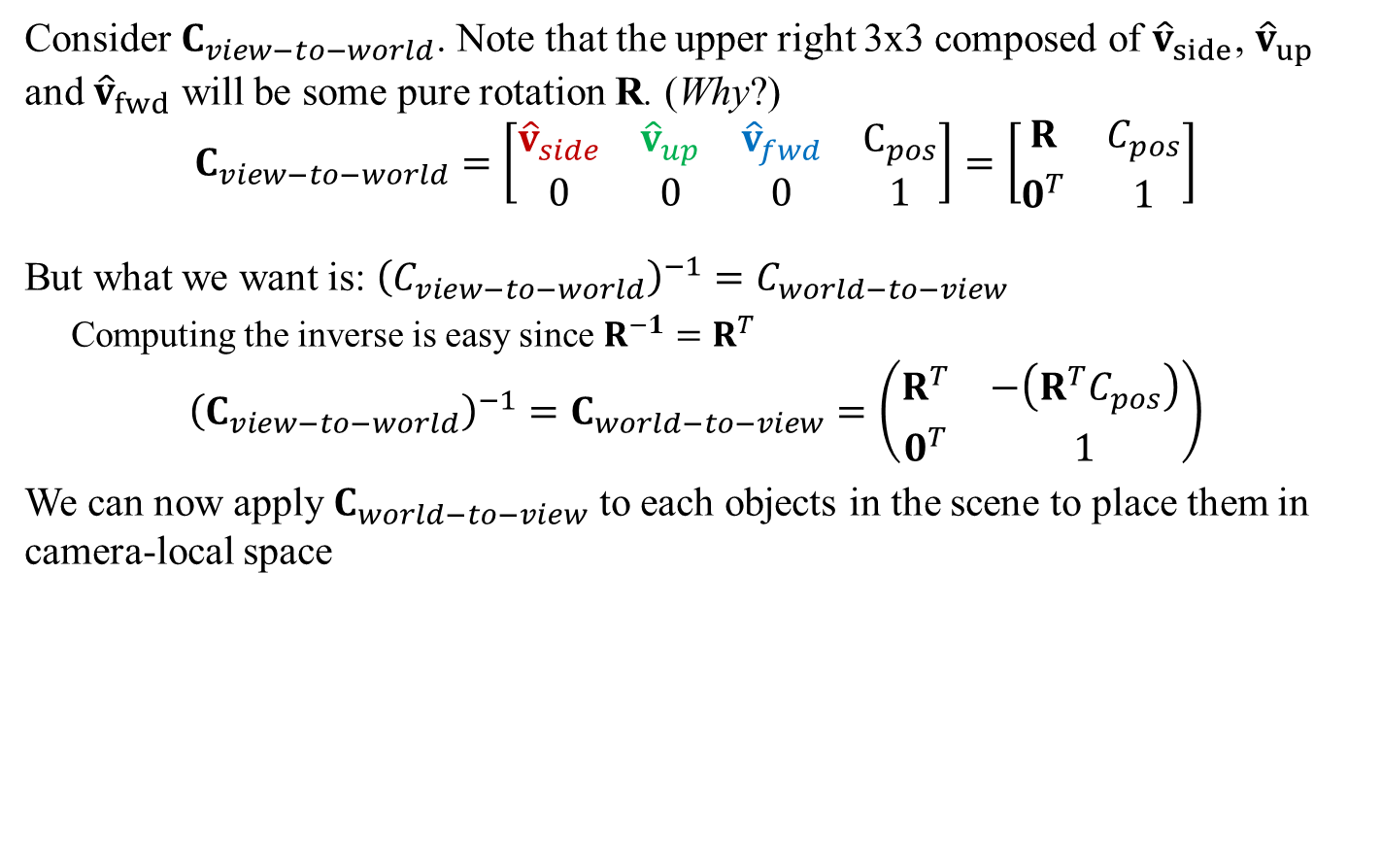
View Frame: Creating Matrix Transform
Consider $C_{view−to−world}$. Note that the upper right 3x3 composed of ${\hat{v}}_{side}$, ${\hat{v}}_{up}$ and ${\hat{v}}_{fwd}$ will be some pure rotation R. (Why?)
$$C_{view−to−world}=\left[\begin{matrix}{\hat{v}}_{side} & {\hat{v}}_{up} & {\hat{v}}_{fwd} & C_{pos} \\ 0 & 0 & 0 & 1\end{matrix}\right]=\left[\begin{matrix}R & C_{pos} \\ 0^{T} & 1\end{matrix}\right]$$
But what we want is: ${\left(C_{view−to−world}\right)}^{−1}=C_{world−to−view}$
Computing the inverse is easy since $R^{−1}=R^{T}$
$${\left(C_{view−to−world}\right)}^{−1}=C_{world−to−view}=\left(\begin{matrix}R^{T} & −\left(R^{T}C_{pos}\right) \\ 0^{T} & 1\end{matrix}\right)$$
We can now apply $C_{world−to−view}$ to each objects in the scene to place them in camera-local space
See also Dynamic Examples
See Lecture3A, slide 14
Next we must project this scene onto a 2D plane

Slide 10

Recap
In order to render a 3D scene to the screen:
World Space
2D, width x height pixels
View (Camera) Space
3D, infinite
World Space
3D, Infinite
???
Why convert everything to Camera Space?
Because it simplifies the math for the next step: projective transformation
$$C_{world−to−view}$$

Slide 11
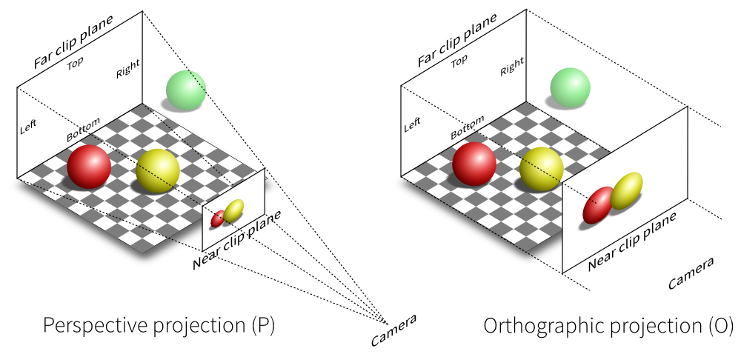
Projective Transformation
Converting the 3D scene onto a 2D plane requires a projection.
The two most commonly used projections are:
Perspective: Size changes with distance; correspond to our view of the world
Orthographic: No converging lines; great for HUD (and CAD)
The red and yellow spheres are the same size in World
Red appears smaller since its further away
Distance does not affect apparent size

Slide 12
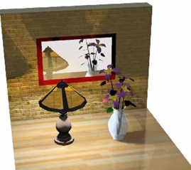
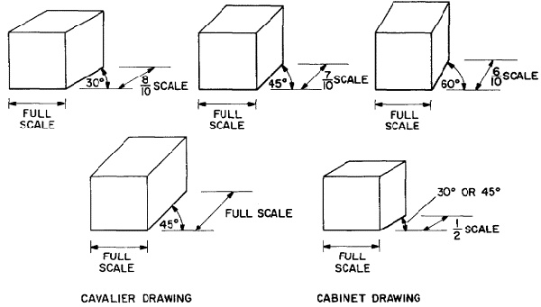
Projective Transformation
Both perspective and orthographic projections can be done either in perpendicular or oblique form:
Perpendicular: the projection plane is perpendicular to the center viewing line. This is the most common type.
Oblique: the center view line is at an angle relative to the projection plane.
Note: We’ll only cover perpendicular projections here. The book also includes some oblique ones
Oblique perspective projection can be used for mirror rendering
Oblique orthographic projection is great of isometric views, CAD plans, etc.

Slide 13
Near / Far Clip Planes and View Frustum
Near/far clip planes are planes parallel to the projection plane but near/far from it.
The presence of clip planes simplify the project math. but also:
Far clip plane: why waste computation time on objects too far away to matter
Near clip plane: visually avoids rendering from inside objects
Frustum (Wikipedia): In geometry, a frustum (plural: frusta or frustums) is the portion of a solid (normally a cone or pyramid) that lies between two parallel planes cutting it.
The view frustum is the volume of space being projected on the view plane:
Objects outside the frustum will not be visible and therefore (should not?) be rendered.

Slide 14
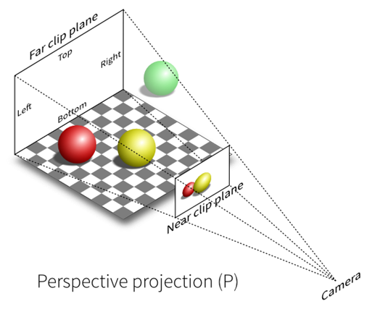
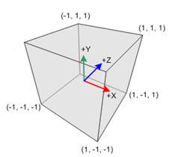
Normalized Device Coordinates: General idea
Different screens have different aspect ratios, pixel resolution, etc., all of which affects how a scene is projected on the view plane.
i.e.: Given a camera’s position, orientation and type of projection, the mathematical projection would still depend on whether the image is rendered on a small window or a 4k screen.
To simplify: we break this own into two steps:
Project the World into a standard space, the Normalized Device Coordinates (NDC).
This projection only depends on camera settings
Then convert from NDC to screen
This projection only depends on screen details.
NDC Space
2D, width x height pixels

Slide 15
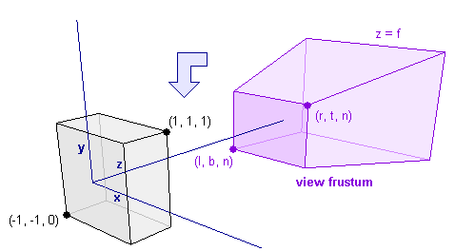
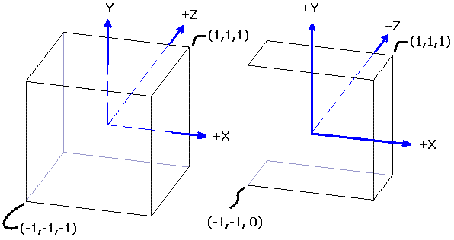
Normalized Device Coordinates
Different screens have different aspect ratios, pixel resolution, etc., all of which affects how a scene is projected on the view plane.
To simplify, most graphic systems will project all view frustum into normalized device coordinate (NDC):
A fixed volume where x and y range from -1 to 1
As for the z axis: standards are many…again…
Book: NDC is only 2D, no z axis…
OpenGL: has z axis range from -1 to 1
Direct X: has z axis range from 0 to 1
Once projected on the NDC:
Project on xy plane (drop the z coordinate)
Stretch to proper screen/window aspect ratio
Use the z coordinate for fancy layering control
Outside the scope of the lecture
WARNING: Both OpenGL and DirectX use a Left-Handed NDC space

Slide 16
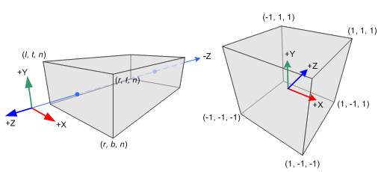
Orthographic Projection To NDC
To specify an the view volume in camera space, we need six values:
n and f along the z axis for near and far clip planes in the camera space.
t and b along the y axis for the top and bottom clip planes in the camera space.
l and r along the x axis for the left and right clip planes in the camera space.
We need to convert the view volume defined by the 6 planes into the NDC.
We only need to scale and translate a large rectangular volume into the NDC cube
We’re using a RH camera but a LH NDC so remember to flip the z axis
(See OpenGL Proj Matrix)
Let’s compute the orthographic projection transform
Camera space
NDC

Slide 17
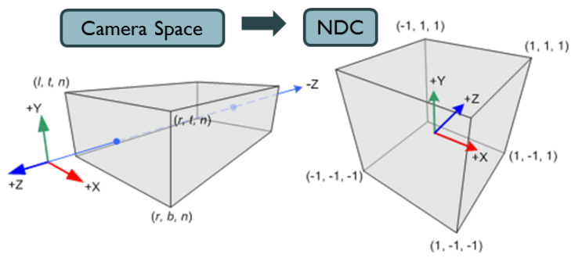
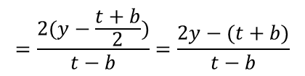
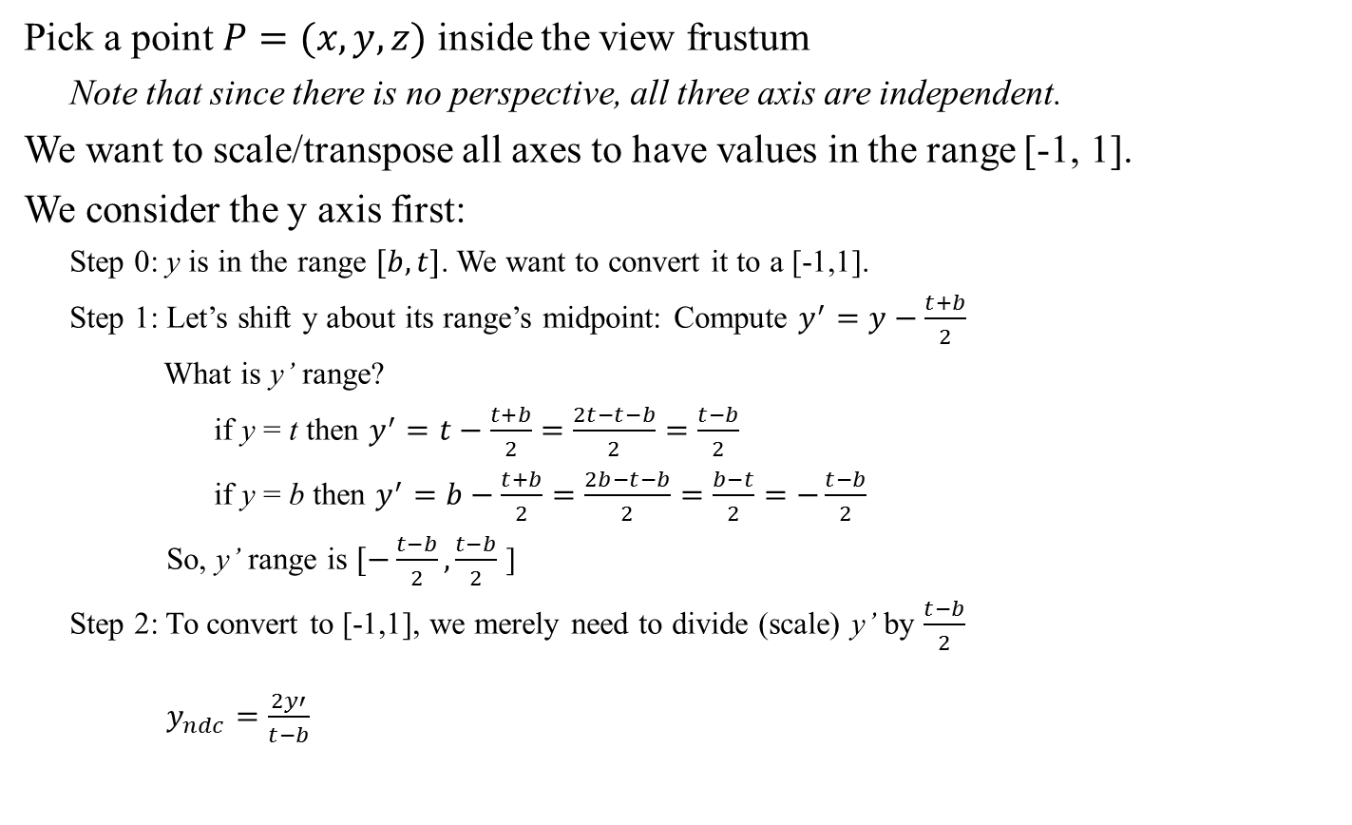

Orthographic Projection: Transform
Pick a point $P=(x,y,z)$ inside the view frustum
Note that since there is no perspective, all three axis are independent.
We want to scale/transpose all axes to have values in the range [-1, 1].
We consider the y axis first:
Step 0: y is in the range $[b,t]$. We want to convert it to a [-1,1].
Step 1: Let’s shift y about its range’s midpoint: Compute $y^{′}=y−\frac{t+b}{2}$
What is y’ range?
if y = t then $y^{′}=t−\frac{t+b}{2}=\frac{2t−t−b}{2}=\frac{t−b}{2}$
if y = b then $y^{′}=b−\frac{t+b}{2}=\frac{2b−t−b}{2}=\frac{b−t}{2}=−\frac{t−b}{2}$
So, y’ range is $[−\frac{t−b}{2},\frac{t−b}{2}$ ]
Step 2: To convert to [-1,1], we merely need to divide (scale) y’ by $\frac{t−b}{2}$
$y_{ndc}=\frac{2y′}{t−b}$
$$=\frac{2(y−\frac{t+b}{2})}{t−b}=\frac{2y−(t+b)}{t−b}$$
$$=\left(\frac{2}{t−b}\right)y−\left(\frac{t+b}{t−b}\right)$$

Slide 18
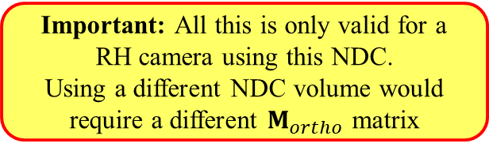
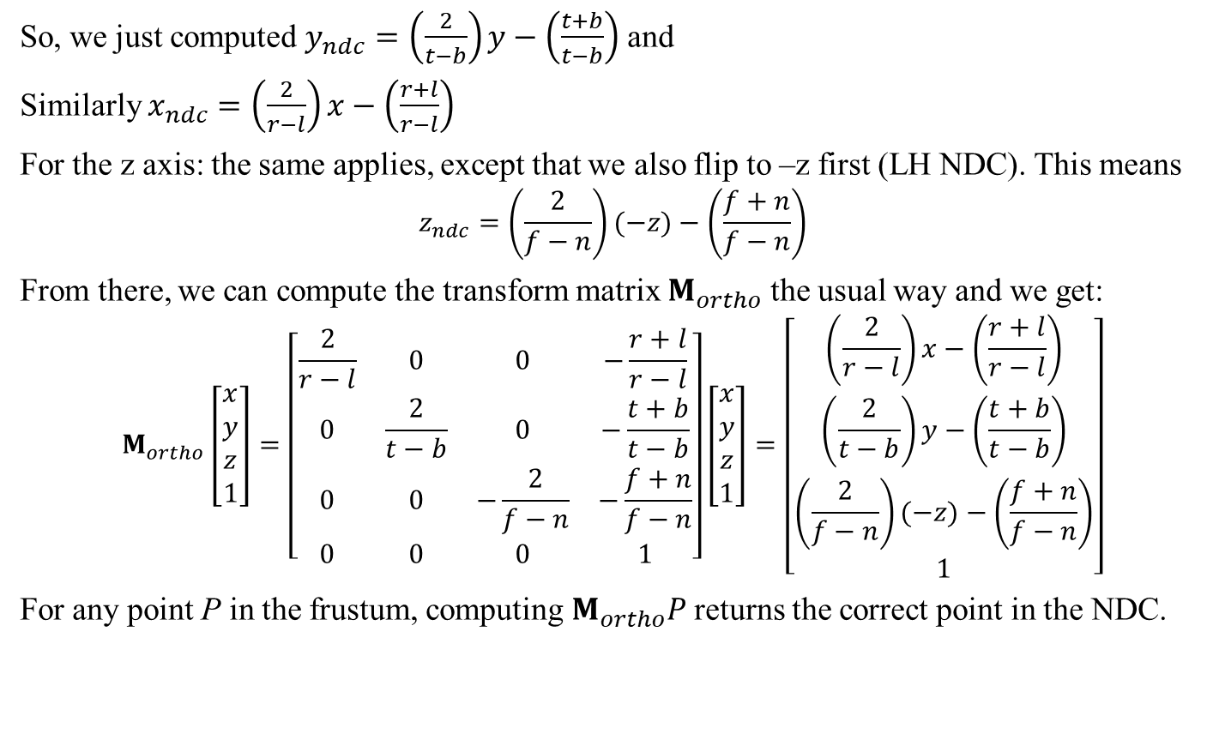
Orthographic Projection: Transform
So, we just computed $y_{ndc}=\left(\frac{2}{t−b}\right)y−\left(\frac{t+b}{t−b}\right)$ and
Similarly $x_{ndc}=\left(\frac{2}{r−l}\right)x−\left(\frac{r+l}{r−l}\right)$
For the z axis: the same applies, except that we also flip to –z first (LH NDC). This means
$$z_{ndc}=\left(\frac{2}{f−n}\right)(−z)−\left(\frac{f+n}{f−n}\right)$$
From there, we can compute the transform matrix $M_{ortho}$ the usual way and we get:
$$M_{ortho}\left[\begin{matrix}x \\ y \\ z \\ 1\end{matrix}\right]=\left[\begin{matrix}\frac{2}{r−l} & 0 & 0 & −\frac{r+l}{r−l} \\ 0 & \frac{2}{t−b} & 0 & −\frac{t+b}{t−b} \\ 0 & 0 & −\frac{2}{f−n} & −\frac{f+n}{f−n} \\ 0 & 0 & 0 & 1\end{matrix}\right]\left[\begin{matrix}x \\ y \\ z \\ 1\end{matrix}\right]=\left[\begin{matrix}\left(\frac{2}{r−l}\right)x−\left(\frac{r+l}{r−l}\right) \\ \left(\frac{2}{t−b}\right)y−\left(\frac{t+b}{t−b}\right) \\ \left(\frac{2}{f−n}\right)(−z)−\left(\frac{f+n}{f−n}\right) \\ 1\end{matrix}\right]$$
For any point P in the frustum, computing $M_{ortho}P$ returns the correct point in the NDC.
See also Dynamic Examples
Important: All this is only valid for a RH camera using this NDC.
Using a different NDC volume would require a different $M_{ortho}$ matrix

Slide 19
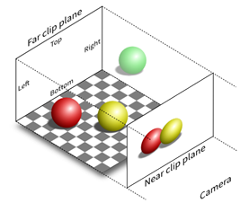

Recap
In order to render a 3D scene to the screen: Orthographic projection version
World Space
2D, width x height pixels
NDC Space
3D, Bounded
View (Camera) Space
3D, infinite
World Space
3D, Infinite
???
$$M_{ortho}$$
$$C_{world−to−view}$$
This works for an orthographic projection.
Unfortunately, a perspective projection is far more common (and more complicated)

Slide 20
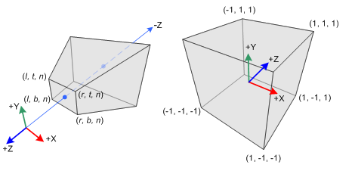
Perspective Projection
A perspective projection is usually specified using
Values for the near and far clip planes along the z axis
The aspect ratio of the viewing plane (as in width/height)
The field of view, the vertical angle between the top and bottom clip planes
We can define the 6 planes bounding the view frustum and convert into the NDC.
This time, we go from a truncated pyramid to a cube:
Problem: This is not a linear transformation… unless we do some trickery…
Again RH camera with LH NDC, so flip the z axis (See OpenGL Proj Matrix)
Let’s compute the perspective
projection transform
Side note: Most graphic systems actually request the half angle: from center line/z axis to the top plane
Camera Space
NDC

Slide 21
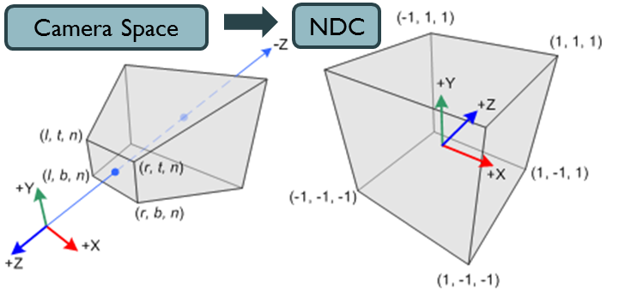




Perspective Projection: Transform
Let’s consider the y axis first:
Any point exactly on the top clip plane must have its $y_{ndc}=1$
Therefore $\frac{1}{d}=\tan\left(\frac{θ}{2}\right)$ or $d=\cot\left(\frac{θ}{2}\right)$
This gives us that $z_{ndc}=−d$ (remember to flip the axis since we have RH World but LH NDC)
Now Consider an arbitrary $P=(x,y,z)$ inside the frustum (above the z axis for simplicity)
Top clip
plane
y axis
View frustum
$$y_{ndc}=1$$
$$θ/2$$
-z axis
$$d= ?$$
Projection
plane

Slide 22





Perspective Projection: Transform
Let’s consider the y axis first:
Any point exactly on the top clip plane must have its $y_{ndc}=1$
Therefore $\frac{1}{d}=\tan\left(\frac{θ}{2}\right)$ or $d=\cot\left(\frac{θ}{2}\right)$
This gives us that $z_{ndc}=−d$ (remember to flip the axis since we have RH World but LH NDC)
Now Consider an arbitrary $P=(x,y,z)$ inside the frustum (above the z axis for simplicity)
What is the value for $y_{ndc}$ at $z_{ndc}=−d$ ?
Triangle rule: $\frac{y_{ndc}}{−d}=\frac{y}{z}$
What about $x_{ndc}$?
Similar argument as for $y_{ndc}$, but
we have to also consider the aspect ratio.
If the aspect ratio is $a={width}/{height}$
then $x_{ndc}=−\frac{dx}{az}$
or $y_{ndc}=−\frac{dy}{z}$
Top clip
plane
y axis
View frustum
P
${(y}_{ndc},−d$)
$$(y, z)$$
$$θ/2$$
$$d=\cot\left(\frac{θ}{2}\right)$$
-z axis
Projection
plane

Slide 23


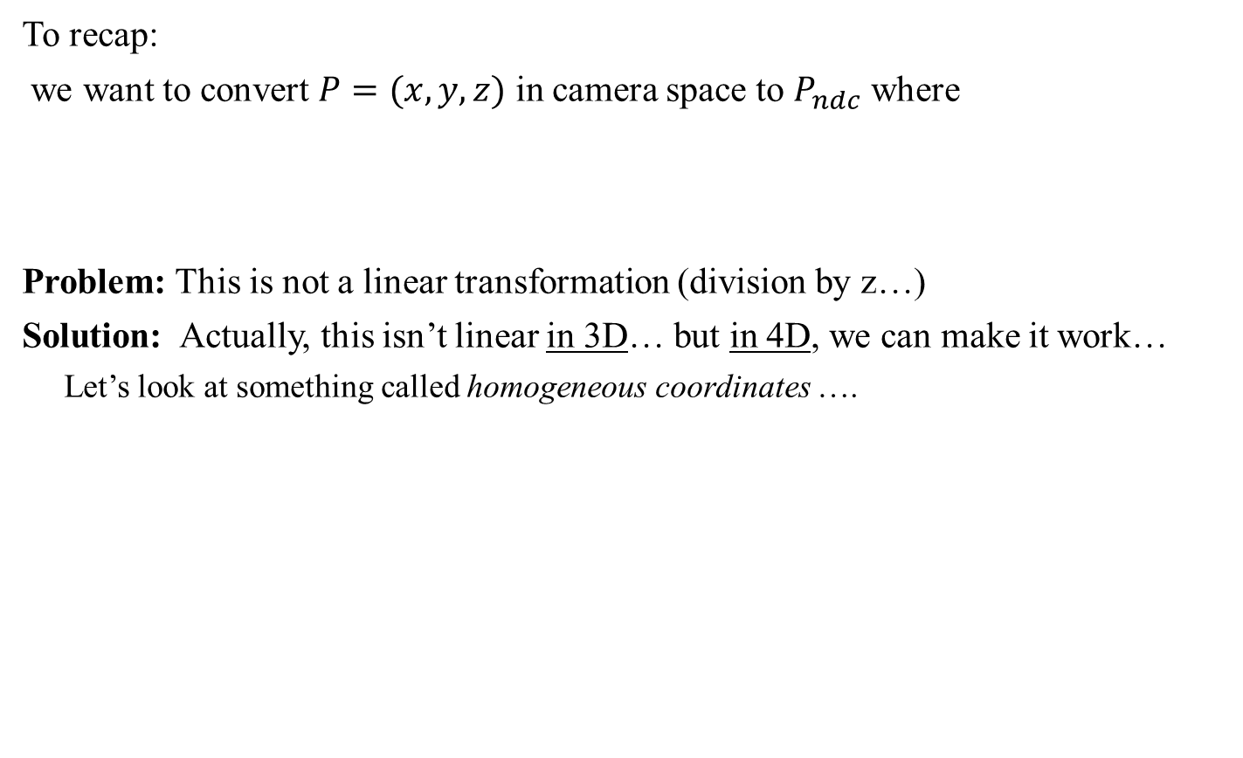


Perspective Projection: Transform
To recap:
we want to convert $P=(x,y,z)$ in camera space to $P_{ndc}$ where
Problem: This is not a linear transformation (division by z…)
Solution: Actually, this isn’t linear in 3D… but in 4D, we can make it work…
Let’s look at something called homogeneous coordinates ….
$$x_{ndc}=−\frac{dx}{az}$$
$$y_{ndc}=−\frac{dy}{z}$$
$$z_{ndc}=−d$$
where $d=\cot\left(\frac{θ}{2}\right)$

Slide 24
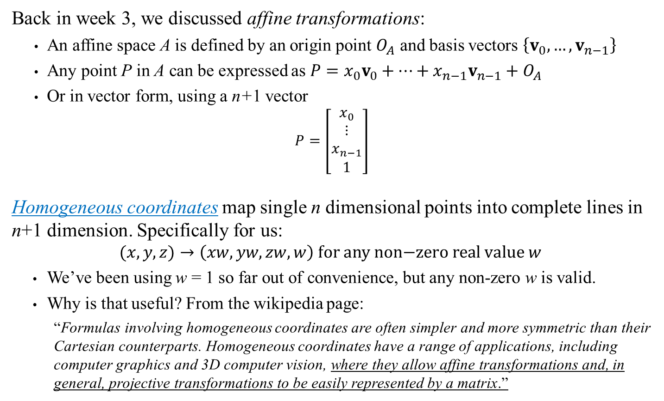
Homogeneous Coordinates
Back in week 3, we discussed affine transformations:
An affine space A is defined by an origin point $O_{A}$ and basis vectors $\left\{v_{0},…,v_{n−1}\right\}$
Any point P in A can be expressed as $P=x_{0}v_{0}+…+x_{n−1}v_{n−1}+O_{A}$
Or in vector form, using a n+1 vector
$$P=\left[\begin{matrix}x_{0} \\ ⋮ \\ x_{n−1} \\ 1\end{matrix}\right]$$
Homogeneous coordinates map single n dimensional points into complete lines in n+1 dimension. Specifically for us:
$$(x,y,z)→\left(xw, yw,zw, w\right) \text{for} \text{any} \text{non}\text{−}\text{zero} \text{real} \text{value} w$$
We’ve been using w = 1 so far out of convenience, but any non-zero w is valid.
Why is that useful? From the wikipedia page:
“Formulas involving homogeneous coordinates are often simpler and more symmetric than their Cartesian counterparts. Homogeneous coordinates have a range of applications, including computer graphics and 3D computer vision, where they allow affine transformations and, in general, projective transformations to be easily represented by a matrix.”

Slide 25

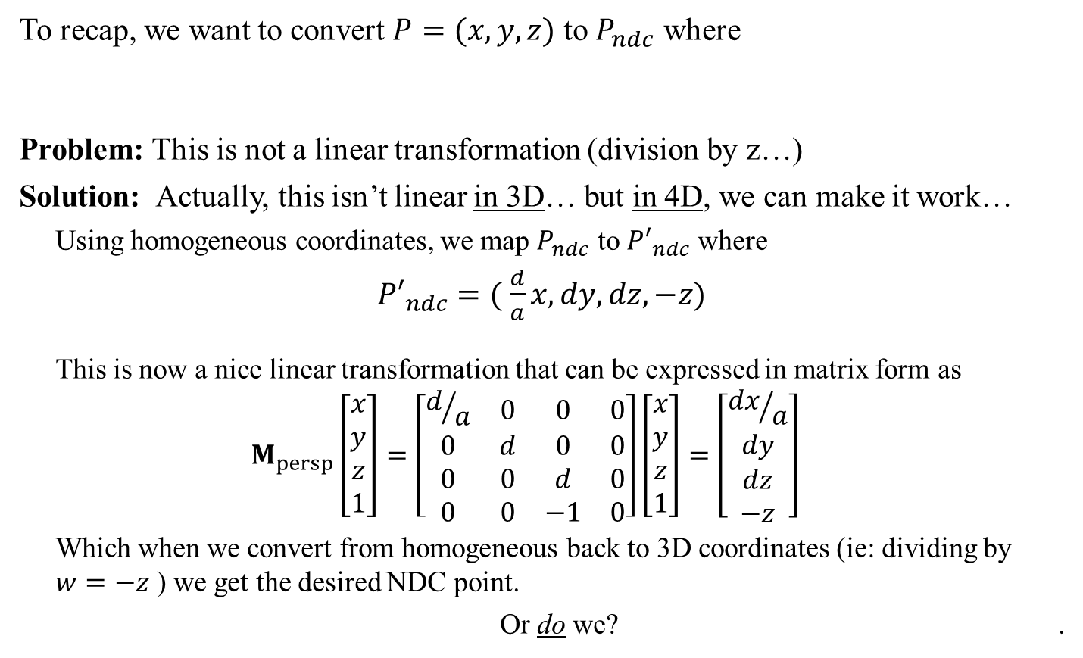



Perspective Projection: Transform w/ Homogeneous Coord.
To recap, we want to convert $P=(x,y,z)$ to $P_{ndc}$ where
Problem: This is not a linear transformation (division by z…)
Solution: Actually, this isn’t linear in 3D… but in 4D, we can make it work…
Using homogeneous coordinates, we map $P_{ndc}$ to ${P′}_{ndc}$ where
${P′}_{ndc}=( \frac{d}{a}x,dy,dz,−z)$
This is now a nice linear transformation that can be expressed in matrix form as
$$M_{persp}\left[\begin{matrix}x \\ y \\ z \\ 1\end{matrix}\right]=\left[\begin{matrix}d/a & 0 & 0 & 0 \\ 0 & d & 0 & 0 \\ 0 & 0 & d & 0 \\ 0 & 0 & −1 & 0\end{matrix}\right]\left[\begin{matrix}x \\ y \\ z \\ 1\end{matrix}\right]=\left[\begin{matrix}{dx}/a \\ dy \\ dz \\ −z\end{matrix}\right]$$
Which when we convert from homogeneous back to 3D coordinates (ie: dividing by $w=−z$ ) we get the desired NDC point.
Or do we? .
$$x_{ndc}=−\frac{dx}{az}$$
$$y_{ndc}=−\frac{dy}{z}$$
$$z_{ndc}=−d$$
where $d=\cot\left(\frac{θ}{2}\right)$

Slide 26
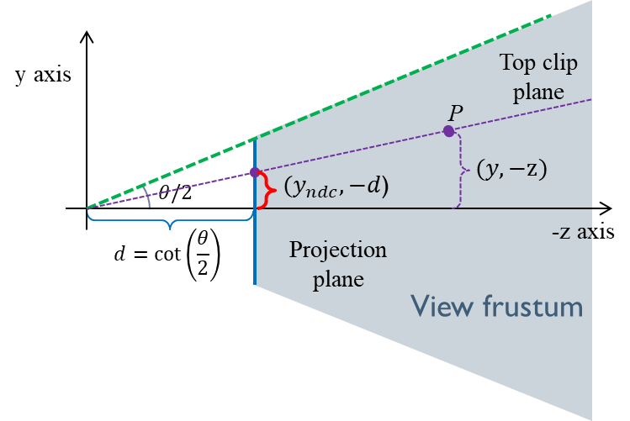
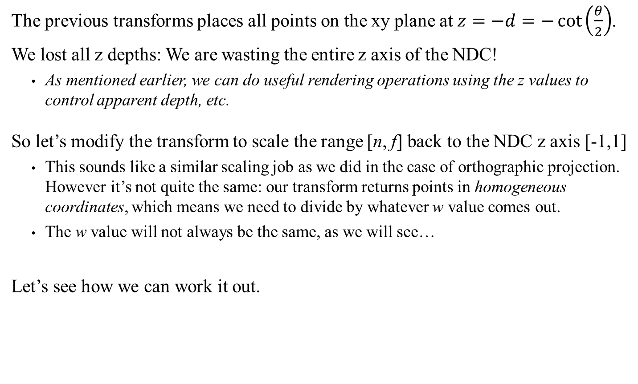
Perspective Projection: Z axis Information
The previous transforms places all points on the xy plane at $z=−d=−\cot\left(\frac{θ}{2}\right)$.
We lost all z depths: We are wasting the entire z axis of the NDC!
As mentioned earlier, we can do useful rendering operations using the z values to control apparent depth, etc.
So let’s modify the transform to scale the range [n, f] back to the NDC z axis [-1,1]
This sounds like a similar scaling job as we did in the case of orthographic projection. However it’s not quite the same: our transform returns points in homogeneous coordinates, which means we need to divide by whatever w value comes out.
The w value will not always be the same, as we will see…
Let’s see how we can work it out.

Slide 27

Perspective Projection: Z axis Information
We want a transformation that
Is linear when using the homogenous coordinates
Converts the z range [n, f] back to a normalized [-1, 1]
As with the orthographic projection, a scaling and translation along the z axis should work.
We just don’t know what scale and translation value to use.
This means our final transformation will have a form:
For some properly selected values A and B.
We also know that:
The point (0,0,-n,1) must map to NDC point (0,0,-1) and
The point (0,0,-f,1) must map to NDC point (0,0,1)
Let’s use these to solve for A and B.
$$\left[\begin{matrix}d/a & 0 & 0 & 0 \\ 0 & d & 0 & 0 \\ 0 & 0 & A & B \\ 0 & 0 & −1 & 0\end{matrix}\right]$$

Slide 28
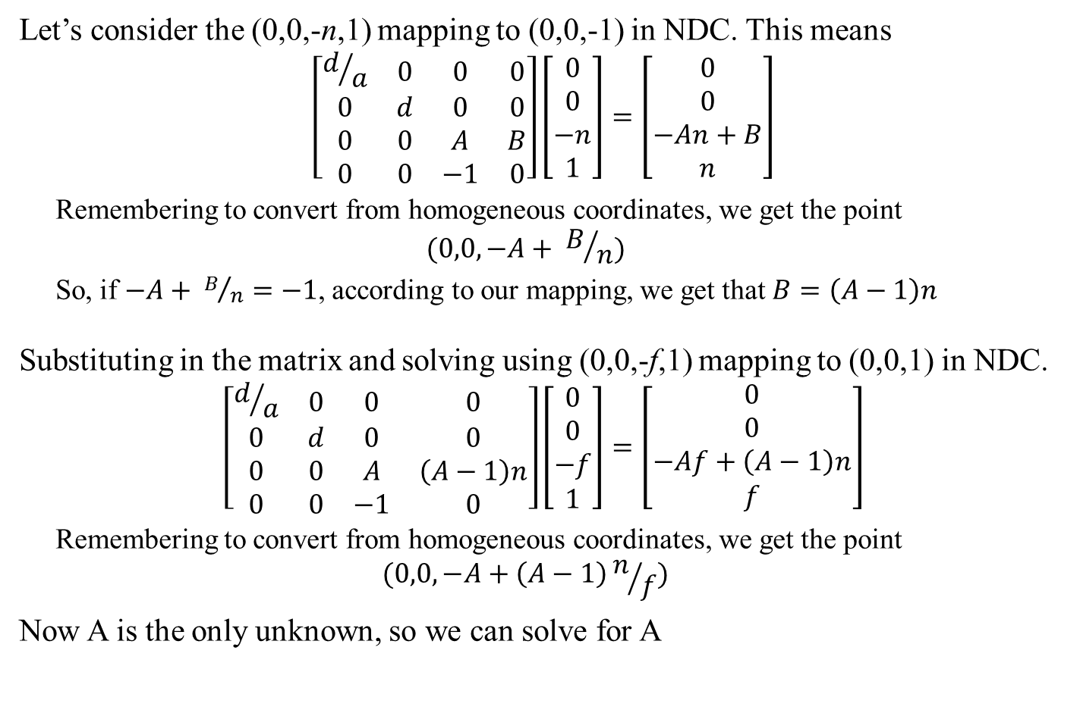
Perspective Projection: Z axis Information
Let’s consider the (0,0,-n,1) mapping to (0,0,-1) in NDC. This means
$$\left[\begin{matrix}d/a & 0 & 0 & 0 \\ 0 & d & 0 & 0 \\ 0 & 0 & A & B \\ 0 & 0 & −1 & 0\end{matrix}\right]\left[\begin{matrix}0 \\ 0 \\ −n \\ 1\end{matrix}\right]=\left[\begin{matrix}0 \\ 0 \\ −An+B \\ n\end{matrix}\right]$$
Remembering to convert from homogeneous coordinates, we get the point
$$(0,0, −A+ B/n)$$
So, if $−A+ B/n=−1$, according to our mapping, we get that $B=\left(A−1\right)n$
Substituting in the matrix and solving using (0,0,-f,1) mapping to (0,0,1) in NDC.
$$\left[\begin{matrix}d/a & 0 & 0 & 0 \\ 0 & d & 0 & 0 \\ 0 & 0 & A & \left(A−1\right)n \\ 0 & 0 & −1 & 0\end{matrix}\right]\left[\begin{matrix}0 \\ 0 \\ −f \\ 1\end{matrix}\right]=\left[\begin{matrix}0 \\ 0 \\ −Af+\left(A−1\right)n \\ f\end{matrix}\right]$$
Remembering to convert from homogeneous coordinates, we get the point
$$(0,0,−A+\left(A−1\right)n/f)$$
Now A is the only unknown, so we can solve for A

Slide 29
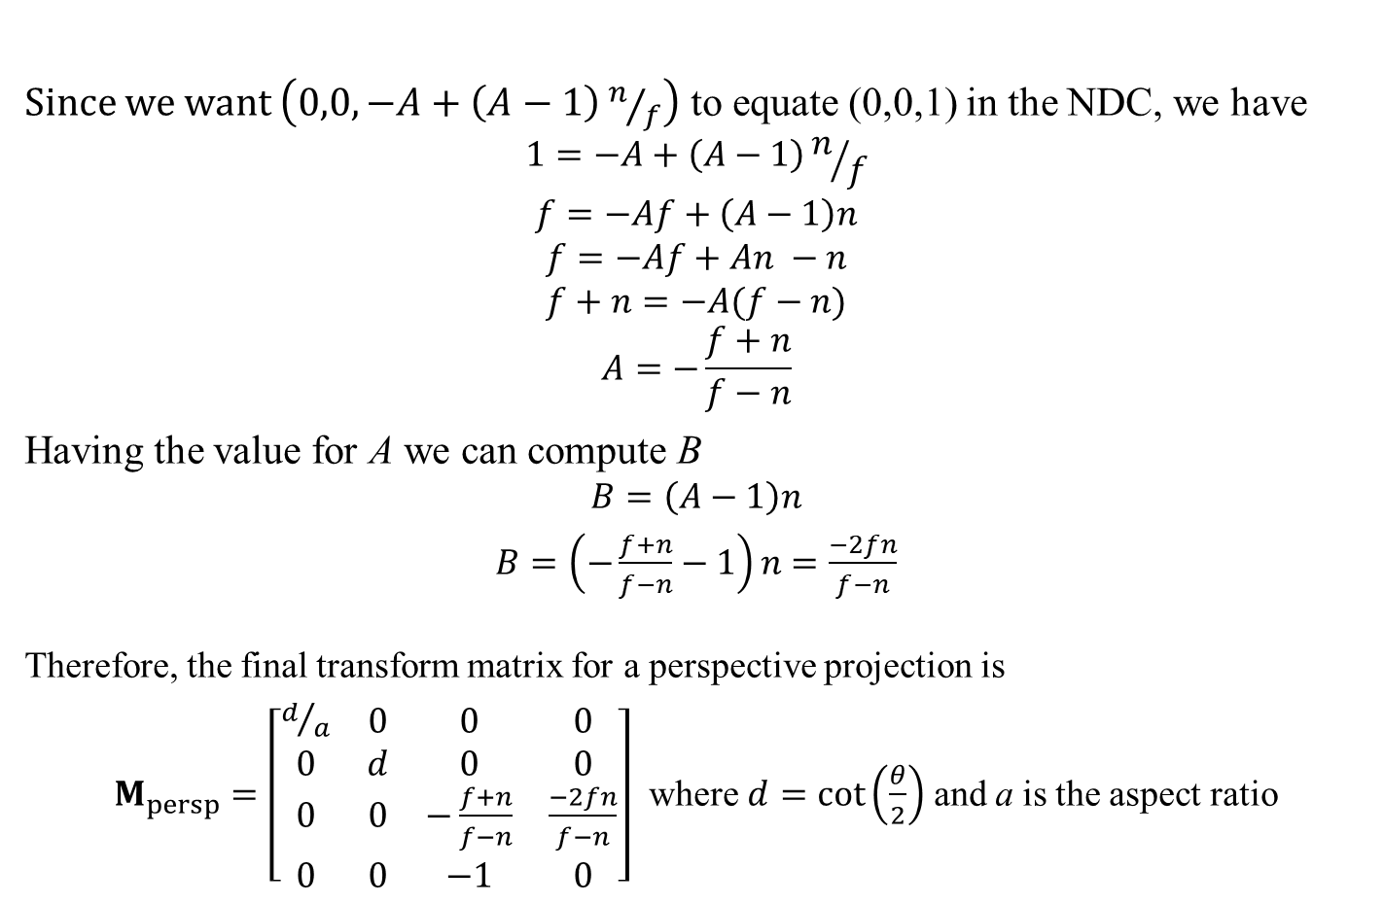
Perspective Projection: Z axis Information
Since we want $\left(0,0,−A+\left(A−1\right)n/f\right)$ to equate (0,0,1) in the NDC, we have
$$1=−A+\left(A−1\right)n/f$$
$$f=−Af+\left(A−1\right)n$$
$$f=−Af+An −n$$
$$f+n=−A(f−n)$$
$$A=−\frac{f+n}{f−n}$$
Having the value for A we can compute B
$$B=\left(A−1\right)n$$
$B=\left(−\frac{f+n}{f−n}−1\right)n$ $=\frac{−2fn}{f−n}$
Therefore, the final transform matrix for a perspective projection is
$M_{persp}=\left[\begin{matrix}d/a & 0 & 0 & 0 \\ 0 & d & 0 & 0 \\ 0 & 0 & −\frac{f+n}{f−n} & \frac{−2fn}{f−n} \\ 0 & 0 & −1 & 0\end{matrix}\right]$ where $d=\cot\left(\frac{θ}{2}\right)$ and a is the aspect ratio
Note: This is equivalent to the book, I just hate using ‘n-f’ because it hides a negative
Important: As before, this is only valid for RH camera using this specific LH NDC

Slide 30
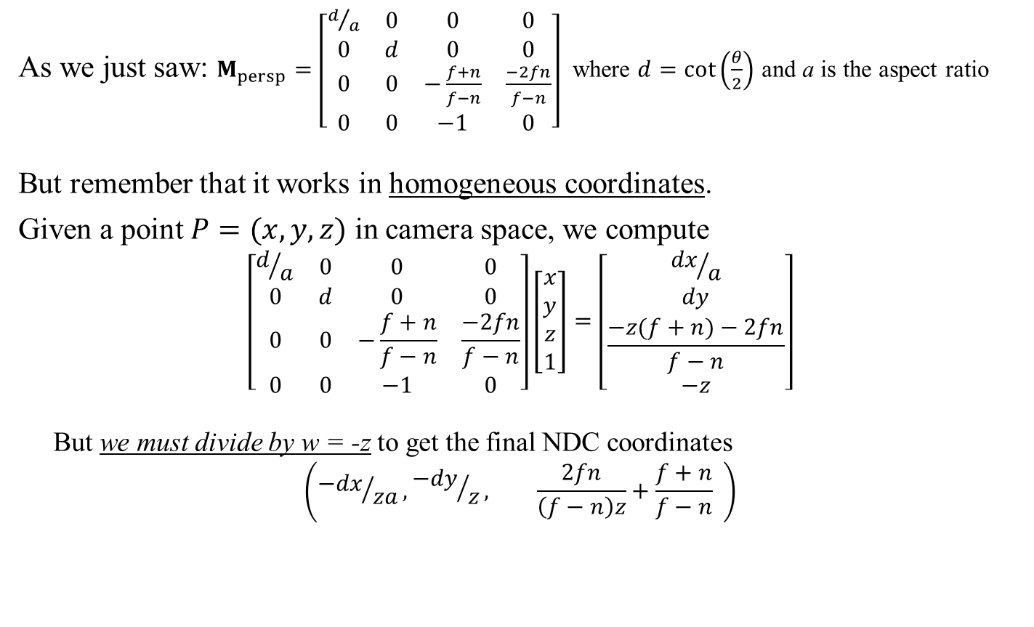
Perspective Projection: Final Transformation
As we just saw: $M_{persp}=\left[\begin{matrix}d/a & 0 & 0 & 0 \\ 0 & d & 0 & 0 \\ 0 & 0 & −\frac{f+n}{f−n} & \frac{−2fn}{f−n} \\ 0 & 0 & −1 & 0\end{matrix}\right]$ where $d=\cot\left(\frac{θ}{2}\right)$ and a is the aspect ratio
But remember that it works in homogeneous coordinates.
Given a point $P=(x,y,z)$ in camera space, we compute
$$\left[\begin{matrix}d/a & 0 & 0 & 0 \\ 0 & d & 0 & 0 \\ 0 & 0 & −\frac{f+n}{f−n} & \frac{−2fn}{f−n} \\ 0 & 0 & −1 & 0\end{matrix}\right]\left[\begin{matrix}x \\ y \\ z \\ 1\end{matrix}\right]=\left[\begin{matrix}{dx}/a \\ dy \\ \frac{−z(f+n)−2fn}{f−n} \\ −z\end{matrix}\right]$$
But we must divide by w = -z to get the final NDC coordinates
$$\left({−dx}/{za},{−dy}/z, \frac{2fn}{\left(f−n\right)z}+\frac{f+n}{f−n} \right)$$
See also Dynamic Examples
Side note: In reality, many of us will never need to implement all this math. We will likely use a graphics library which will do all this math for us. However, if you need a special projection (not all graphic library have oblique projections, for example) then you will need to derive the projection yourself.

Slide 31

Recap
In order to render a 3D scene to the screen : Perspective projection version
World Space
2D, width x height pixels
NDC Space
3D, Bounded
View (Camera) Space
3D, infinite
World Space
3D, Infinite
???
$$M_{persp}$$
$$\text{+ }$$
$$\text{Hom}\text{. }\text{Coord}\text{. }\text{div}\text{.}$$
$$C_{world−to−view}$$
The only problem left is converting from NDC Space to the screen pixels

Slide 32
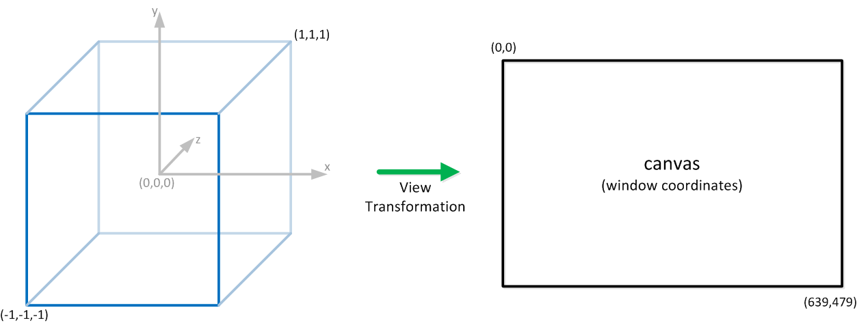

Screen Transformation
In order to visualize a point P in world space, we need
Place a camera in world using $C_{view−to−world}$
Compute it’s inverse to convert everything in camera space:
${\left(C_{view−to−world}\right)}^{−1}=C_{world−to−view}$
We then compute the position of P in camera space: $C_{world−to−view}P$
We then use the proper camera projection transform ($M_{persp}$ for example.)
$$M_{persp}C_{world−to−view}P$$
This returns points in the standardized volume of the NDC
We still need to convert the NDC into actual screen pixels…
Width = w
Height = h

Slide 33
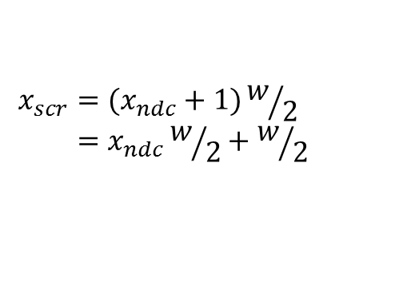
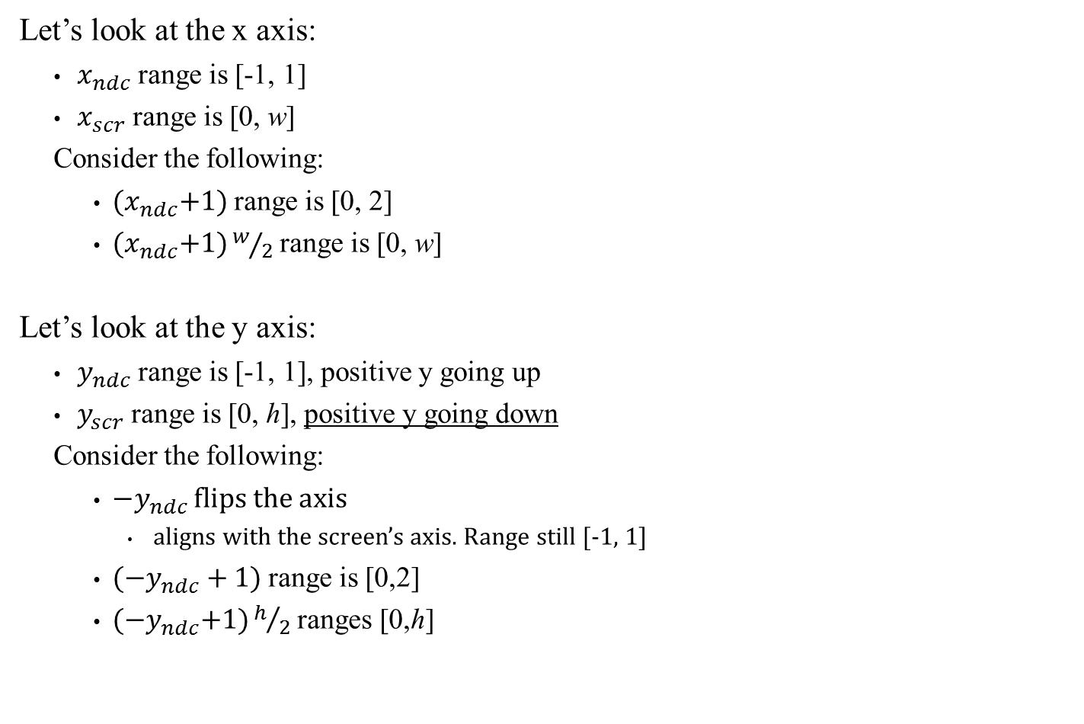
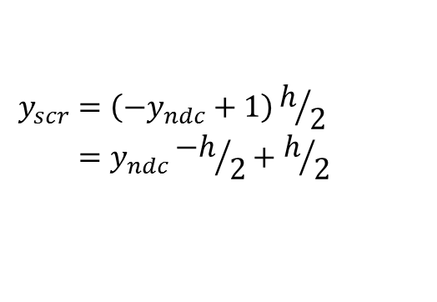
Screen Transformation: NDC to Screen Transformation
Let’s look at the x axis:
$x_{ndc}$ range is [-1, 1]
$x_{scr}$ range is [0, w]
Consider the following:
${(x}_{ndc}+1)$ range is [0, 2]
${(x}_{ndc}+1)w/2$ range is [0, w]
Let’s look at the y axis:
$y_{ndc}$ range is [-1, 1], positive y going up
$y_{scr}$ range is [0, h], positive y going down
Consider the following:
${−y}_{ndc}$ flips the axis
aligns with the screen’s axis. Range still [-1, 1]
$({−y}_{ndc}+1)$ range is [0,2]
${(−y}_{ndc}+1)h/2$ ranges [0,h]
Side note: This is only for the simple case of mapping the NDC to the entire window. If implementing some multi-view system, some slight but simple modifications are needed. See book for details
$$x_{scr}=(x_{ndc}+1)w/2 \\ =x_{ndc}w/2+w/2$$
Note: a nice linear transformation
$$y_{scr}=\left({−y}_{ndc}+1\right)h/2 \\ =y_{ndc}{−h}/2+h/2$$

Slide 34

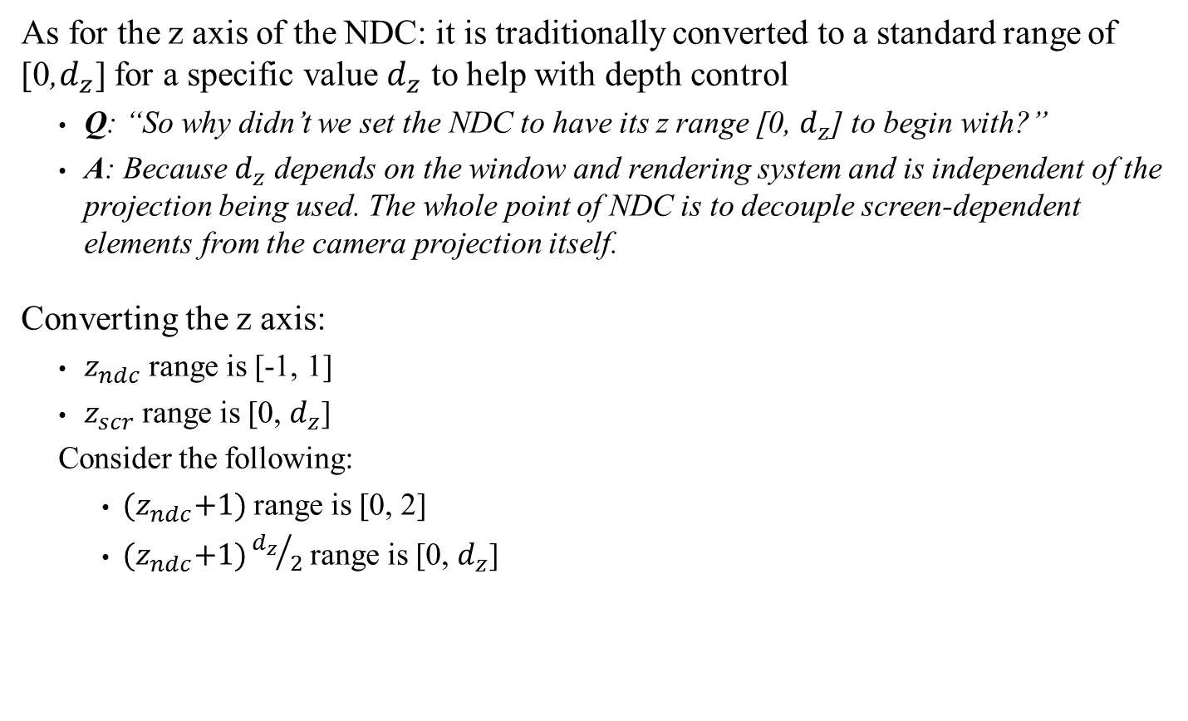
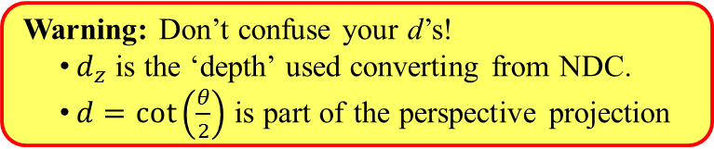
Screen Transformation: NDC to Screen Transformation
As for the z axis of the NDC: it is traditionally converted to a standard range of [0,$d_{z}$] for a specific value $d_{z}$ to help with depth control
Q: “So why didn’t we set the NDC to have its z range [0, $d_{z}$] to begin with?”
A: Because $d_{z}$ depends on the window and rendering system and is independent of the projection being used. The whole point of NDC is to decouple screen-dependent elements from the camera projection itself.
Converting the z axis:
$z_{ndc}$ range is [-1, 1]
$z_{scr}$ range is [0, $d_{z}$]
Consider the following:
${(z}_{ndc}+1)$ range is [0, 2]
${(z}_{ndc}+1){d_{z}}/2$ range is [0, $d_{z}$]
$$z_{scr}=\left(z_{ndc}+1\right){d_{z}}/2 \\ =z_{ndc}{d_{z}}/2+{d_{z}}/2$$
Warning: Don’t confuse your d’s!
$d_{z}$ is the ‘depth’ used converting from NDC.
$d=\cot\left(\frac{θ}{2}\right)$ is part of the perspective projection

Slide 35

Screen Transformation: NDC to Screen Transformation
So the final transformation:
$$M_{NDC to Screen}=\left[\begin{matrix}w/2 & 0 & 0 & w/2 \\ 0 & {−h}/2 & 0 & h/2 \\ 0 & 0 & {d_{z}}/2 & {d_{z}}/2 \\ 0 & 0 & 0 & 1\end{matrix}\right]$$
So that
$$M_{NDC to Screen}\left(\begin{matrix}x_{ndc} \\ y_{ndc} \\ z_{ndc} \\ 1\end{matrix}\right)=\left(\begin{matrix}x_{ndc}w/2+w/2 \\ y_{ndc}{−h}/2+h/2 \\ z_{ndc}{d_{z}}/2+{d_{z}}/2 \\ 1\end{matrix}\right)$$
Pixel coordinate
See also Dynamic Examples

Slide 36


Final Recap
In order to render a 3D scene to the screen:
World Space
2D, width x height pixels
NDC Space
3D, Bounded
View (Camera) Space
3D, infinite
World Space
3D, Infinite
$$M_{NDC to Screen}$$
$$M_{ortho}$$
or
$M_{persp}$+ Hom. Coord. div.
$$C_{world−to−view}$$

Slide 37


Example
Given a single point P in World space, how do you compute its position on the screen?
Compute $C_{world−to−view}$ based on camera position and orientation
Compute the projection matrix (ex: $M_{persp}$) based on various camera parameters
Compute $M_{NDC to Screen}$ based on screen dimension
Apply the entire product to P:
$M_{NDC to Screen}$ $M_{persp}C_{world−to−view}P$
See also Dynamic Examples
Convert from homogeneous
coords
Side note: Consider the rendering workload:
Each model has 100s or 1000s of points (vertices)
Each model updates it’s world matrix very often (each frame worse case)
$C_{world−to−view}$ likely changes every frame, but is the same for all models
$M_{persp}$ usually fixed once per game
$M_{NDC to Screen}$ usually fixed once per game
Except for the actual computation of world matrices, most of these multiplications take place on the GPU, thankfully.
And this does not include all the actual texturing and shader work.

Slide 38


Screen Transformation: NDC to Screen Transformation
One last detail: Note that the original picture is a bit misleading:
We did not convert the NDC to a 2D plane: we converted it to a 3D volume:
The x and y coordinate match the pixel screen we need
The z value is used for internal processing and depth control

Slide 39
Part II:
Clipping and Culling

Slide 40

Clipping and Culling
Rendering a 3D scene is typically a fairly costly operation: We want to minimize the amount of wasted work as much as possible.
Clipping and culling refer to operations/steps taken to limit the amount of work done at the rendering stage
Culling: exclude things that are not visible or not within the view frustum
Comes in two versions: object and face
Clipping: Objects that cross the viewing frustum need to be only partially rendered.
Some of their polygon will need to be clipped to within the frustum, hence the name
Side note: In my humble opinion, the book is oversimplifying the section quite a bit.
Some culling is done by the engine, some is done by the graphic system.
Clipping is mostly done by the graphic system, but it requires a bit more than just chopping polygons. And those polygons should all be triangles (not quads) for performance reasons…
As far as this class is concerned, it boils down to what math you are realistically going to use:
Coding against an existing game engine: In this case all clipping/culling will be done for you anyway.
Coding an engine from scratch: Realistically you will use OpenGL., DirectX or other library. Object culling will be your responsibility, but face culling will be done by your graphic library.
Creating a graphic library from scratch: You would need a very special reason to do that instead of using OpenGL, DirectX or other common libraries.

Slide 41
Object Culling
A key aspect of the rendering system is that it involves a very large amount of communication between the game engine/CPU and the graphics card/GPU.
For every frame, the GPU needs to know about:
What objects, models, vertices to move around, project and convert to pixels on screen
Determine what texture and lighting effect to apply to these objects
Often need to perform multiple rendering passes per frame.
This occurs when you have reflection, mirror effects, transparency, etc.
Therefore, identifying objects that are outside the frustum allows us to reduce the work sent to the GPU, which will improves rendering performance. This is object culling.
Object culling is done by the engine (not the GPU)
Typically simplified: bounding spheres per objects
Only render objects whose Bsphere is in the frustum
More on this when we cover collisions

Slide 42


Backface Culling
For object within the view frustum, there is still plenty of work to remove: all polygon faces that are facing away from the camera can be ignored.
For each face:
Get the face normal n
Do we store normals? Recompute them?
Faces have a handedness too…
Get the line of sight direction:
What is the ‘position’ of a face?
Test if $v_{los}∙n<0$
In Effect: We eliminate half the rendering work at the cost a few dot products.
Looks simple enough: so let’s see how we can get the normal and $v_{los}$.

Slide 43



Face Normals
Consider a TGO upgraded 3D:
Model: At minimum, given as two lists
List of points { p1, p2, p3, p4 }
List of triangles: { (p1, p2, p4), (p1, p4, p3), (p1, p3, p2), (p2, p4, p3) }
Face normal:
For a given triangle (a,b,c), compute the face normal as $n=(b−a)×(c−a)$
Points can be listed in clockwise or counter-clockwise order
Changing the order/winding flips the normal
Triangle points order: given by software (Maya, 3DS Max, etc)
However: the graphic system may expect a different order (LASR)
Warning: The order (winding) of the a, b and c matter!

Slide 44






Line of Sight
Computing the line of sight to a triangle face depends on many factors
Culling in World Space (Old school)
When using perspective projection
The lines of sight depend on the position of the triangle face
Ex: Both faces $T_{1}$ and $T_{2}$ below (seen almost edge-on) have the same orientation but different position in space
$T_{1}$is visible (barely) to the camera so should not be culled
$T_{2}$ is not visible to the camera and should be culled
How do we compute $v_{los}$? What is the position of a triangle?
Typically, the first point of the triangle triplet (p1, p2, p4)
Therefore $v_{los}=p1 −C_{pos}$
$$T_{1}$$
$$v_{los}$$
n
Side note: Using the first point of a triangle triplet is cheap and good for most cases. Unfortunately, very large triangle faces or ones where the first point just happen to be behind the camera position may result in improper culling behavior.
$$C_{pos}$$
$$v_{los}$$
$$T_{2}$$
n

Slide 45





Line of Sight
Culling in World Space (Old school)
When using perspective projection
The lines of sight depend on the position of the triangle face. Set $v_{los}=p1 −C_{pos}$
When using orthographic projection
All lines of sight are parallel to the camera’s view direction
Ex: Both faces $T_{1}$ and $T_{2}$ below (seen edge-on) have the same orientation in space
Both faces have normal pointing away from the camera so both should be culled
Therefore set $v_{los}={\hat{v}}_{dir}$
Note: Therefore performing backface culling in world space, using perspective projection has the added performance cost of recomputing $v_{los}$ for every triangle.
Fortunately, modern GPUs avoid incurring this cost by working in NDC space instead (next slide).
$$v_{los}$$
$$T_{1}$$
$${\hat{v}}_{dir}$$
n
$$C_{pos}$$
$$v_{los}$$
$$T_{2}$$
n

Slide 46

Line of Sight
Culling in World Space (Old school)
When using perspective projection
The lines of sight depend on the position of the triangle face. Set $v_{los}=p1 −C_{pos}$
When using orthographic projection
All lines of sight are parallel to the camera’s view direction. Set $v_{los}={\hat{v}}_{dir}$
Culling in NDC Space (Modern GPUs)
For many reasons (see GAM 370/470), GPUs delay backface culling until NDC space
The transformation from NDC to Screen is very similar to an orthographic projection
Lines of sight are parallel to the view direction.
In NDC space, the view direction is simply (0,0,1)
IMPORTANT: since the NDC is left-handed, the cross-product used for computing normal will result in them pointing in the opposite direction we want. Therefore we need to multiply the result by -1 to flip them.
Therefore set $v_{los}=(0,0,1)$ and flip the face normals!!!

Slide 47

Backface Culling
Culling in World Space (Old school)
When using perspective projection
The lines of sight depend on the position of the triangle face. Set $v_{los}=p1 −C_{pos}$
When using orthographic projection
All lines of sight are parallel to the camera’s view direction. Set $v_{los}={\hat{v}}_{dir}$
Culling in NDC Space (Modern GPUs)
Lines of sight are all parallel to (0,0,1). Set $v_{los}=(0,0,1)$ and flip the face normals
Computing triangle face visibility
Once you have the correct $v_{los}$ and n for your particular case:
If $v_{los}∙n<0$ then the triangle face is visible: proceed with rendering
If $v_{los}∙n≥0$ then the triangle face is not visible: no further processing is required,
Side note: By performing backface culling in NDC space, the GPU needs no information about the camera’s position, orientation or even which projection was used. This improves performance and streamlines GPU operations.

Slide 48


Clipping
After object culling and backface culling took place, the rendering process works on the remaining polygons.
Clipping refers to the fact that some polygons will not be fully rendered
Partially outside the view frustum
This is the only case the book addresses.
Requires replacing the original polygon with one or more new ones that ‘fit’
Partial occlusion
Also called occlusion culling, but really a clipping issue.
Much more difficult problem requiring using the z-depth
Very much outside the scope of this class.
Clipping is performed by
the graphic system
(OpenGL, DirectX, etc).
Side note: For performance reasons, models should be composed only of triangles, not quads or worse. This complicates the clipping process a bit but the book ignores that.

Slide 49

Object Picking
Picking refers to using a mouse/cursor to select some element of a 3D scene.
We have the cursor position in pixels on the screen and we need to convert this into the 3D world. In effect, we must reverse the projection process.
Without depth information, we can only convert the position into a line in 3D
Note: The book is hamstrung here:
Because it uses an NDC that is 2D only, it creates a non-invertible transformation.
We won’t have this problem since we use OpenGL style three dimension NDC

Slide 50

Object Picking: Screen to NDC
Recall our projection from NDC to screen
$$M_{NDC to Screen}=\left[\begin{matrix}w/2 & 0 & 0 & w/2 \\ 0 & {−h}/2 & 0 & h/2 \\ 0 & 0 & {d_{z}}/2 & {d_{z}}/2 \\ 0 & 0 & 0 & 1\end{matrix}\right]$$
It converted a 3D NDC point to a screen position and a z value in the range [0, $d_{z}$]
Computing it’s inverse will give us the transform from screen to NDC
$${\left(M_{NDC to Screen}\right)}^{−1}=M_{Screen to NDC}=\left[\begin{matrix}2/w & 0 & 0 & −1 \\ 0 & {−2}/h & 0 & 1 \\ 0 & 0 & 2/{d_{z}} & −1 \\ 0 & 0 & 0 & 1\end{matrix}\right]$$
Problem: To use $M_{Screen to NDC}$, we need the pixel position $x_{s}$ and $y_{s}$ (which we have) but what do we use for $z_{s}$?
$z_{s}=0$ correspond to NDC z-axis -1, which in turn corresponds to the near plane
$z_{s}=$ $d_{z}$ correspond to NDC z-axis 1, which in turn corresponds to the far plane

Slide 51

Object Picking: Screen to NDC to World
Recall that to go from world space all the way to a screen position, we applied the collection of matrices below:
$$M_{NDC to Screen}M_{persp}C_{world−to−view}$$
Our goal: based on a cursor at position $(x_{s},y_{s})$ on a screen that is $w×h$ pixels, find the points p0 (near clip) and p1 (far clip) in world coordinates.
This means we invert the process above:
$${\left(M_{NDC to Screen}M_{persp}C_{world−to−view}\right)}^{−1}=C_{view−to−world}{M_{persp}}^{−1}M_{Screen−to−NDC}$$
We just saw how to compute $M_{Screen to NDC}$
${M_{persp}}^{−1}$ can be easily computed
$C_{view−to−world}$ was created earlier
We use it to get $C_{world−to−view}$

Slide 52

Object Picking: Screen to NDC to World
Therefore:
From there, we can now compute the line
segment in world space.
Near plane: $p0=C_{view−to−world}{M_{persp}}^{−1}M_{Screen to NDC}\left[\begin{matrix}x_{s} \\ y_{s} \\ 0 \\ 1\end{matrix}\right]$
Far plane: $p1=C_{view−to−world}{M_{persp}}^{−1}M_{Screen to NDC}\left[\begin{matrix}x_{s} \\ y_{s} \\ d_{z} \\ 1\end{matrix}\right]$
Side note: Obviously, OpenGL and DirectX will give you functions to extract p0 and p1 based on the current camera settings. We are looking at the math being done under the hood.
However: To determine what, if anything, intersects with this segment, we need some collision/intersection processing which we will cover in the coming weeks.

