Slide 1
GAM 325/425: Applied 3D Geometry
Lecture 8:
Collision and Intersection Testing

Slide 2
GAM 325/425: Applied 3D Geometry
Part I:
Defining the Problem

Slide 3
Collision and Intersection Testing
Testing for collision or intersection is at the heart of many game tasks:
Collision processing: Collision events, physics, area triggers, etc.
Rendering: Object culling, clipping, picking, etc.
AI sensing: Visible area, visual field detection, line-of-sight, etc.
Together these represent a sizable chunk of processing time in every frame, and therefore great care must be taken to make sure things are done efficiently.
This means using:
Use proper math and related algorithms
Predictably, this will be our focus
Use correct software design
Outside the scope of the class however general ideas may be discussed in order to understand why we focus on certain specific math problems.

Slide 4
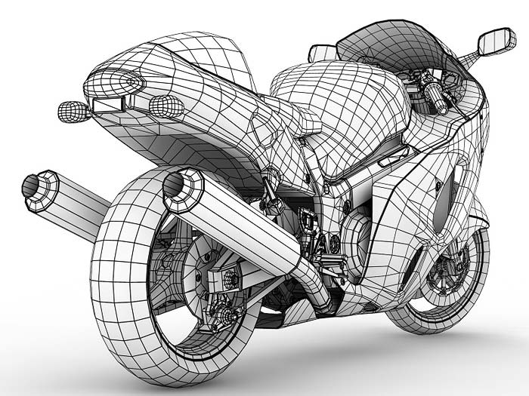
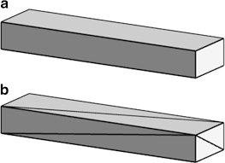
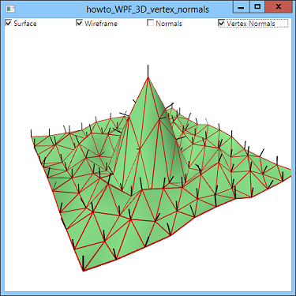
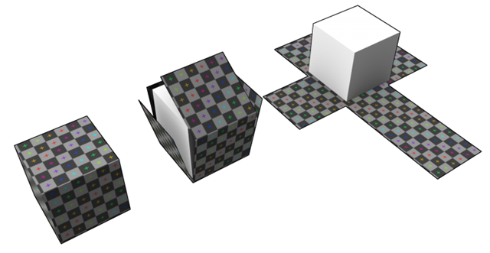

3D Models
Since so many of the collision/intersection problems have to do with models in the scene, we should look at them a bit more carefully.
We’ve been thinking of model as just a collection of vertices
But in reality, things are bit more complicated:
Models need to be triangulated: Maya/3DSMax default to quads
Vertices may not be unique: Has to do with texture & lighting
Each vertex is really a collection of (at least)
Position
Vertex normal
Texture map coordinate

Slide 5
3D Models
Even assuming you have a parser that reads in a model file (.fbx, .3dx, .blend, etc), there is still much to do with the data once you extract it:
At the very least, you need to perform triangulation (not trivial, better for rendering)
For collision support, it would be good to structure the data to offer these services:
Offer access to vertex list with unique positions
Provide fast access to face list (and vertices associated to a specific face)
The ability to determine adjacent faces would be a plus too.
The point here is that there is much preprocessing that needs to happen when a 3D model is loaded into a game. Either:
This is done for you
You set it all up yourself
You take a performance hit for rendering/collision/intersection tests

Slide 6
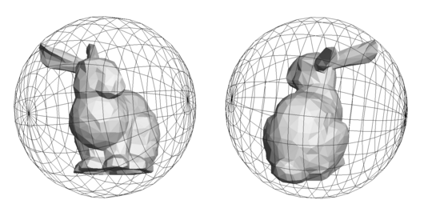
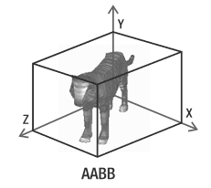
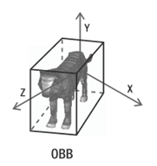
Model Collision: Coarse but Quick
Because models can be quite complex (1000s of faces, complex shapes, etc.) we rarely use exact models for collision testing. Instead, we surround the model with one or more or bounding volumes:
These are primitive volumes.
Very coarse precision
Easy math (to varying degree). (coming soon)
Excellent for early culling
Note: These volumes are mathematically defined and don’t actually exist as models/meshes
Bounding Sphere (Bsphere):
just a center and radius
Axis Aligned Bounding Box (AABB):
6 sided box, always aligned with world axes
Oriented Bounding Box (OBB):
6 sided box always aligned with the model’s axes

Slide 7
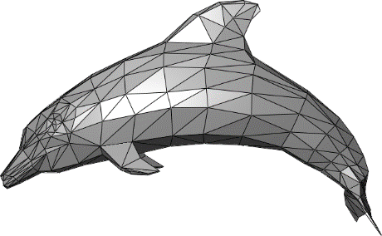
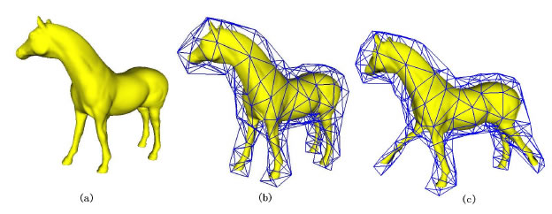
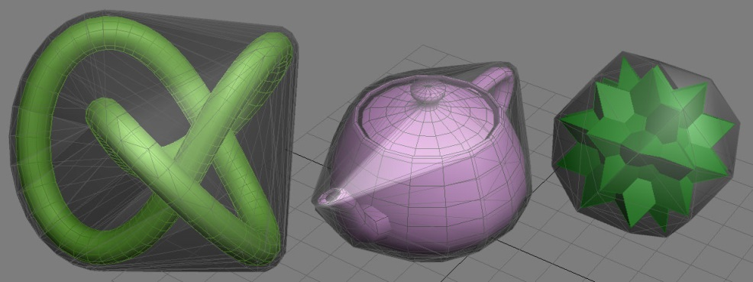
Model Collision: Precise but Slow
For best precision with collision testing, the mesh itself could be used, but in general the cost would be prohibitive
Volume is inferred from each face triangles (often 1000s of faces)
Collision test requires testing each face triangle for intersection
A possible compromise: use a loosely-fitted mesh for collision processing:
Render the only high polygon model
Use the low polygon model for tests only
How low? Time/Precision compromise…
A related concept Convex Hull
Simplifies the model by ‘removing’ cavities.
Slightly outside our scope, but many collision tests work best/only on convex volumes.

Slide 8
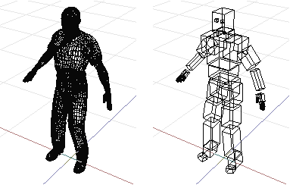
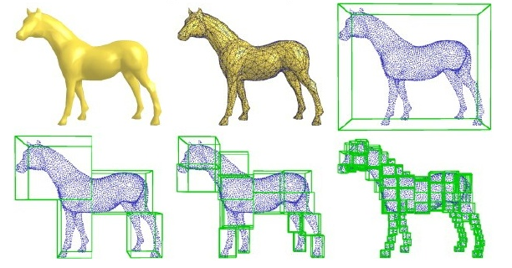
Model Collision: Multiple Volumes
Alternatively, you can compromise between precision and efficiency by using multiple primitives per models
Bounding Volume Hierarchy (BVH): Multiple simple volumes, usually articulated.
Space partitioning: recursive subdivision up to a set depth.
These have a high set up cost to ‘fit’ the original shape and their test involves a series of “simple” primitive tests with early exit.
Set-up cost can be ignored for runtime performance
The number of primitive tests is a compromise between performance and precision

Slide 9
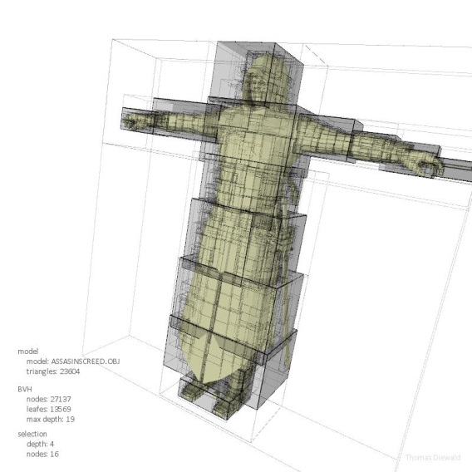
Collision System: Tiered Approach
The basic idea used in any good collision/intersection tests to use a tiered approach:
Use cheapest test (typically ill fitting) to quickly eliminate the most obvious candidates
Use a slightly more expensive test (typically better fitting) only what’s left (and repeat)
Primitive volume first: Always test against simple volumes first.
Bsphere (typical), AABB or OBB.
These tests are cheap. Many candidate pairs are quickly eliminated this way
Use higher cost tests on what’s left
Option 1: AABB or OBB (if not used yet) or BVH
These are more costly but we use them only
on the few objects that we know are in close proximity
Option 2: Use space partition on the model
High set-up cost, but use the same idea:
Test intersection on outer volume
Recurse only if intersection occurred
See also B. P. Martin’s Space Partitioning page
Side note: Section 12.4 proposes a ‘simple collision system’, but honestly it’s laughable. Even stretching the definition of ‘simple’, there is so much missing or not discussed as to be dangerously misleading.

Slide 10
Collision System: Tiered Approach
Whichever approach is selected for model collision/intersection, it will ultimately rely on a few primitive operations:
Using these basic shapes/volumes
Sphere, AABB, OBB, triangle, planes, line (segments/edges)
Compute intersection between any pair type
Sphere-OBB, Line-Triangle, Plane-AABB, etc.
Our focus will be the math surrounding these various primitive operations
The actual software system behind all of this is not relevant to us.
In particular: None of the following will be our concern here…
How the vertex data is stored or accessed.
When to do which primitive test and why.
Side note: There is much to discuss regarding implementation of all this. Collision processing one of the most complex system in a game engine. Covered in GAM 374/377 (UG) and GAM 475/575 (MS)

Slide 11
GAM 325/425: Applied 3D Geometry
Part II:
Game Object and Model Data

Slide 12
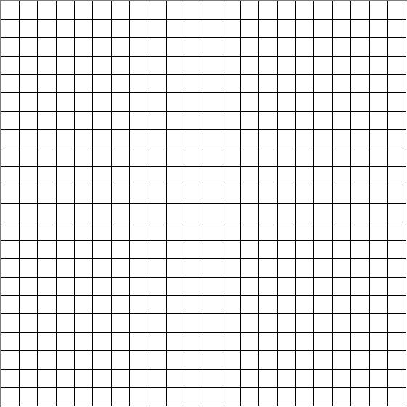



Available Data
In past weeks, we have been cavalier about using ‘game object’, models and associated matrices, etc. For what’s coming next, we need to define more carefully a few structures and relationship.
For our purposes:
Game Object:
A world matrix W
A model M
A bounding volume V (details TBD)
Model:
A list of points (vertices) defining the mesh in model space.
Side note: We will not need triangle/face info at this time.
x
x
W
z
$$P_{3}$$
z
$$P_{1}$$
$$P_{2}$$

Slide 13
Available Data
In past weeks, we have been cavalier about using ‘game object’, models and associated matrices, etc. For what’s coming next, we need to define more carefully a few structures and relationship.
For our purposes:
We also assume all necessary functions to access and/or modify this data as needed
Ex: if we need to decompose W into its TRS components, we can.
The exact details of bounding volumes will be clarified shortly
Game Object:
A world matrix W
A model M
A bounding volume V (details TBD)
Model:
A list of points (vertices) defining the mesh in model space.
Side note: We will not need triangle/face info at this time.

Slide 14
Computing Primitive Bounding Volumes
As we stated earlier, we only consider three primitive bounding volumes:
Bsphere,
AABB and
OBB
For each, we must determine the following:
Construction: Whether we are computing a bounding volume for an entire model or only some subset of a mesh, the problem is the same: Given a set of vertices, how do we construct the Bsphere/AABB/OBB?
Updating: Objects will move in world space. Therefore we must consider how to update the associated primitive volumes.
Intersection: Given a bounding volume, how do we test if a point/line/plane or another volume intersects with it?

Slide 15
GAM 325/425: Applied 3D Geometry
Part II:
Bounding Spheres

Slide 16
Bounding Sphere
A bounding sphere is a sphere with center and radius defined such that every point in the model is inside the sphere.
Defined as
C need not be the origin of the model
C is given in model space
Think of C as the sphere’s offset from the model’s origin
In principle, r should be as small as possible…
In reality, we’ll use a ‘good enough’ r for better performance
Surprisingly, there are quite a few ways to compute a Bsphere, and each have a number of problems…
Bounding Sphere
Center C (a point in model space)
Radius r (a float)
Important: the mesh sphere shown here is merely for illustration. The Bsphere itself is just the mathematical object defined by C and r.

Slide 17
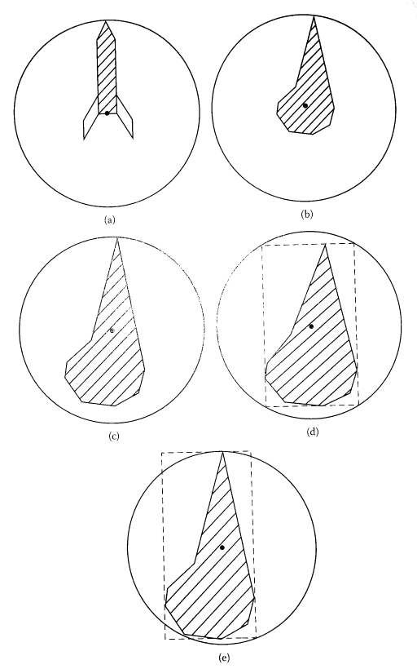

Constructing A BSphere
(using image from the book)
(a and b) Anchored at the model’s origin
How to compute radius?
Less than ideal if the model’s origin isn’t convenient
(c) Anchored at the centroid/geometric center
How?
Still subject to outlier points enlarging the radius
(d) Box center, diagonal radius
How to compute?
Better center, but the radius is usually much too big
(e) Best fit (smallest radius)
Sounds great, but most algorithms are expensive
Ultimately, none of these are ideal:
Loose fit too likely and/or too costly to compute
Side note: The center in c) doesn’t look like the geometric center to me…

Slide 18
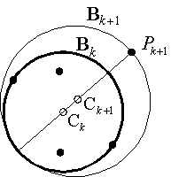

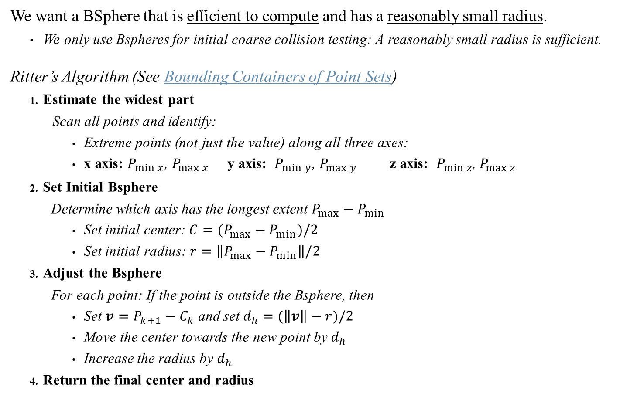


Ritter’s Algorithm
(Supporting example)
We want a BSphere that is efficient to compute and has a reasonably small radius.
We only use Bspheres for initial coarse collision testing: A reasonably small radius is sufficient.
Ritter’s Algorithm (See Bounding Containers of Point Sets)
Estimate the widest part
Scan all points and identify:
Extreme points (not just the value) along all three axes:
x axis: $P_{\min{x}}$, $P_{\max{x}}$ y axis: $P_{\min{y}}$, $P_{\max{y}}$ z axis: $P_{\min{z}}$, $P_{\max{z}}$
Set Initial Bsphere
Determine which axis has the longest extent $P_{max}−P_{min}$
Set initial center: $C=(P_{max}−P_{min})/2$
Set initial radius: $r=\left\|P_{max}−P_{min}\right\|/2$
Adjust the Bsphere
For each point: If the point is outside the Bsphere, then
Set $v=P_{k+1}−C_{k}$ and set $d_{h}=(\left\|v\right\|−r)/2$
Move the center towards the new point by $d_{h}$
Increase the radius by $d_{h}$
Return the final center and radius
Note: By construction, all points in $B_{k}$ will also be in $B_{k+1}$
$$d_{h}$$
$$d_{h}$$
See also Ritter Algo Simulator

Slide 19
Ritter’s Algorithm: Some comments
A few small problems:
A perfectly symmetric set of points may not get a perfectly centered Bsphere.
Very sensitive to the vertex order (ex: swap index #2 and #5 in the demo)
However, some very good points:
Efficient: Runs in O(n)
Returns a good-enough Bsphere:
The initial guess has the smallest possible final radius
r must be at least as big as the initial max extent!
Successive Bspheres never exclude previously processed points
By moving the center, it’s less sensitive to outlier points stretching the final radius
The returned Bsphere has (allegedly) a volume within 5% and 20% of the optimum
Side note: That figure is often quoted but I have yet to find a proof!
Because Bspheres are merely used as a coarse precision test, these problems are not particularly significant. Ritter’s algorithm is one of the most commonly use algorithm for Bsphere computation

Slide 20


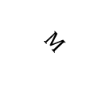

Bounding Sphere: Updating
Given a model M and a Bsphere with center C and radius r.
We apply a matrix W = TRS to M: How do we update the associated BSphere?
C’ is just like any other point: Compute C’ = WC
r isn’t affected by R or T. But S is a different story…
If S has a non uniform scaling, then nothing can be done other than recalculating the Bsphere
If S = aI, then the new radius should be r’ = ar. But: how do we know a?
Matrix decomposition would be too costly, but sometimes necessary
Best to have the game object keep track of a for later retrieval as needed
x
x
See also Dynamic Examples
M’s base position is not necessarily centered
$$M$$
Scaling is always a problem (particularly non uniform scaling)
Either avoid scaling or make sure the game engine processes scaling separately, updating data as needed
The Bsphere is likely not centered either
$$C′$$
$$M$$
$$C$$
z
z

Slide 21


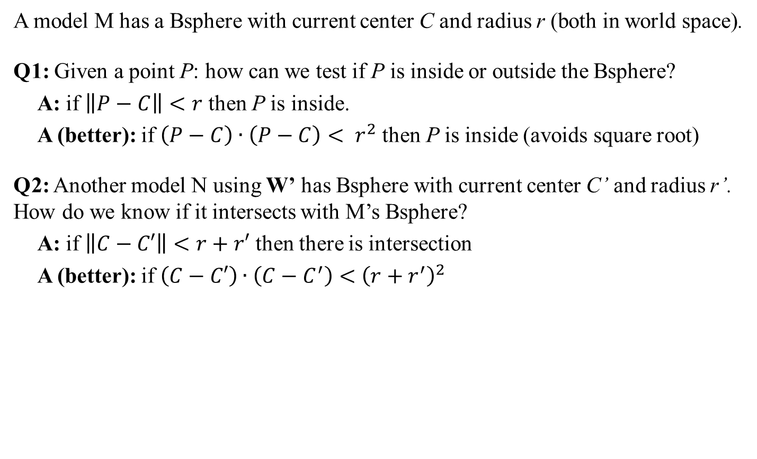


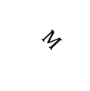
Bounding Sphere: Intersection
A model M has a Bsphere with current center C and radius r (both in world space).
Q1: Given a point P: how can we test if P is inside or outside the Bsphere?
A: if $\left\|P−C\right\|<r$ then P is inside.
A (better): if $\left(P−C\right)∙\left(P−C\right)< r^{2}$ then P is inside (avoids square root)
Q2: Another model N using W’ has Bsphere with current center C’ and radius r’. How do we know if it intersects with M’s Bsphere?
A: if $\left\|C−C′\right\|<r+r′$ then there is intersection
A (better): if $\left(C−C′\right)∙\left(C−C^{′}\right)<{\left(r+r^{′}\right)}^{2}$
x
$$N$$
$$C′$$
See also Dynamic Examples
$$M$$
$$C$$
$$P$$
As imprecise as a Bsphere is, these tests are so cheap as to make them very useful for early/rough culling
z

Slide 22
GAM 325/425: Applied 3D Geometry
Part III:
Axis Aligned Bounding Boxes

Slide 23
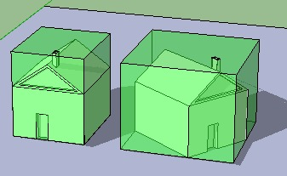
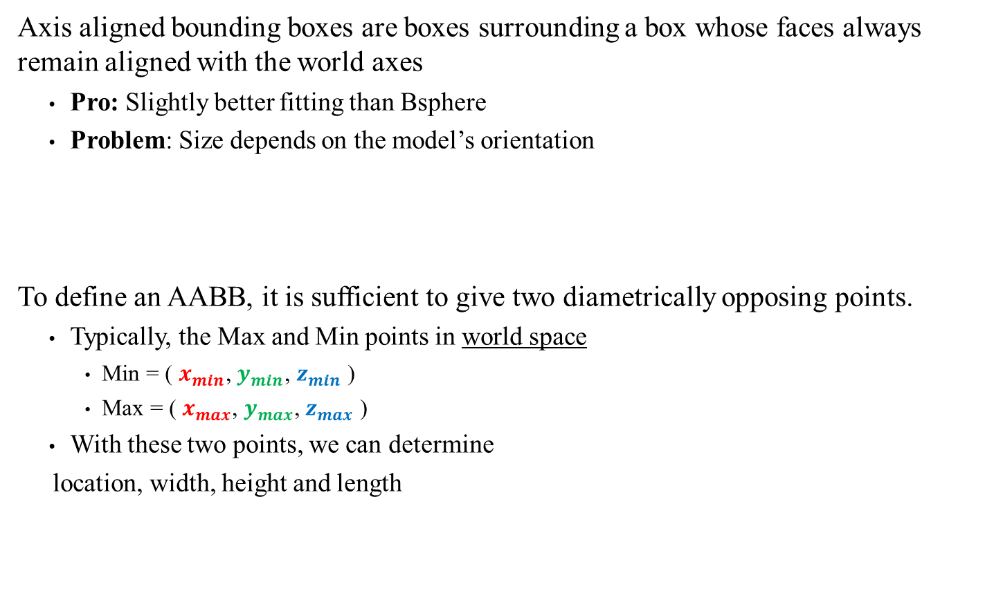
Axis Aligned Bounding Box
Axis aligned bounding boxes are boxes surrounding a box whose faces always remain aligned with the world axes
Pro: Slightly better fitting than Bsphere
Problem: Size depends on the model’s orientation
To define an AABB, it is sufficient to give two diametrically opposing points.
Typically, the Max and Min points in world space
Min = ( $x_{min}$, $y_{min}$, $z_{min}$ )
Max = ( $x_{max}$, $y_{max}$, $z_{max}$ )
With these two points, we can determine
location, width, height and length
y
x
Max
Min
z
AABB
Max and Min points (both in World space)
Side note: (with apologies to St-Exupéry….) This is only a box. The model is inside.

Slide 24
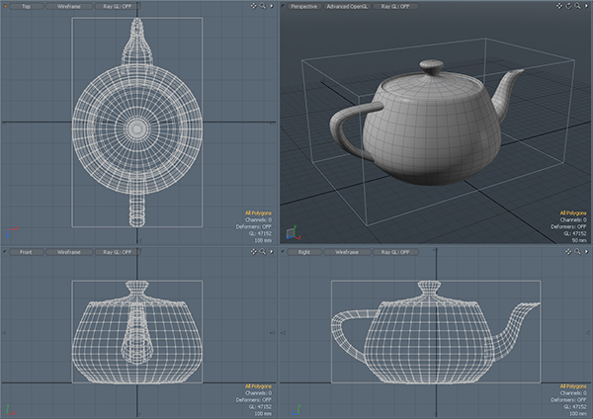
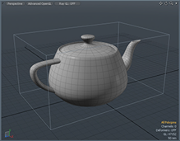









Constructing an AABB
To compute the AABB
Scan all points (in world space!) and identify:
Extreme values along each of the axes
Min = ( $x_{min}$, $y_{min}$, $z_{min}$ )
Max = ( $x_{max}$, $y_{max}$, $z_{max}$ )
Problem:
Size along each axes depends on orientation
Must be recomputed at every frame/change
$$Max$$
$$x_{max}$$
$$x_{min}$$
$$Min$$
$$y_{max}$$
$$z_{max}$$
$$z_{min}$$
$$y_{min}$$
The cost of recalculating the AABB every frame is partially offset by very easy math to test intersection.
Still: It shouldn’t be used on models with high poly count
(Ex: a low poly model (blue) wrapping the tea pot)

Slide 25
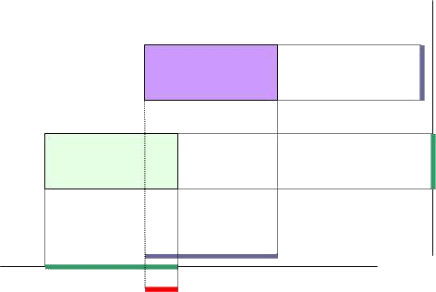

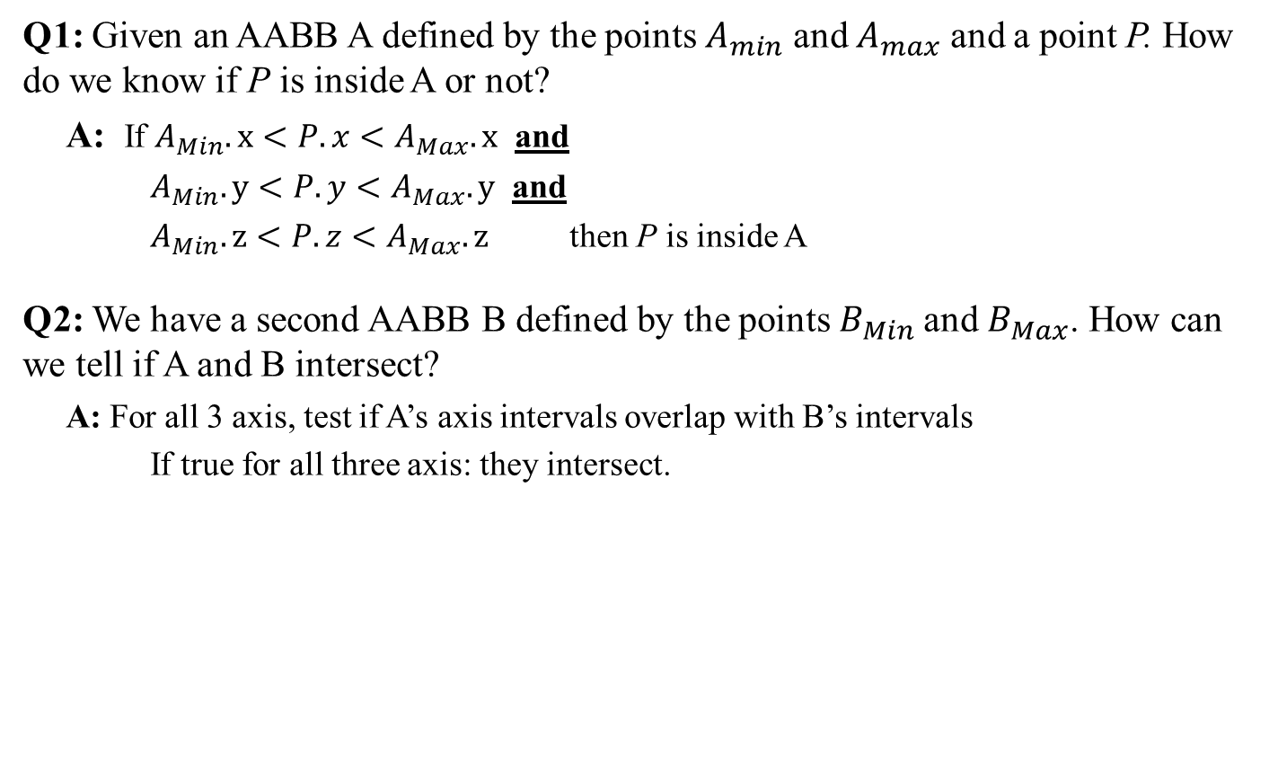


AABB Intersection
Q1: Given an AABB A defined by the points $A_{min}$ and $A_{max}$ and a point P. How do we know if P is inside A or not?
A: If $A_{Min}.x<P.x<A_{Max}.x$ and
$A_{Min}.y<P.y<A_{Max}.y$ and
$A_{Min}.z<P.z<A_{Max}.z$ then P is inside A
Q2: We have a second AABB B defined by the points $B_{Min}$and $B_{Max}$. How can we tell if A and B intersect?
A: For all 3 axis, test if A’s axis intervals overlap with B’s intervals
If true for all three axis: they intersect.
This is called axis-interval testing.
See also Collision Detection Tutorial
y
x
Max
Max
$$A$$
$$P$$
Min
z
$$B$$
Min

Slide 26
Side Track: How to do Interval Testing
You have two real intervals [a,b] and [c,d]. How do you test if they overlap?
Note: when writing an interval [x,y], it must be that x ≤ y
There are 5 cases to consider
Therefore: test the negative
No
Yes
Yes
Yes
No
a
b
c
d
a
c
b
d
Consider the two cases that do not overlap.
How do you test for those?
c
a
b
d
c
a
d
b
c
d
a
b
Test if intervals (a,b) and (c,d) overlap:
If ( b < c ) or ( d < a ) then return false (no overlap)
else return true (overlap)
See also Dynamic Examples

Slide 27



Intersection AABB vs Bounding Sphere
M is placed in world with matrix W and using an AABB as shown. Another model N using W’ has a Bsphere with current center C and radius r. How do we test if they intersect?
Clamping operation and clamping a point:
AABB-Bsphere intersection test:
Clamp the center of the sphere to the AABB (all three axes)
Test clamped point for intersection with the Bsphere.
If clamped point inside the sphere then there is a collision
Clamping c to interval [a, b]
If c < a return a
else If b < c return b
else return c
See also Dynamic Examples
Clamping p to [min, max]
compute p’ as p clamped on each axis
x
$$M$$
No
No
$$N$$
$$C$$
z
Yes
Yes
See also Dynamic Examples

Slide 28
GAM 325/425: Applied 3D Geometry
Part IV:
Oriented Bounding Boxes

Slide 29
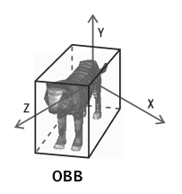
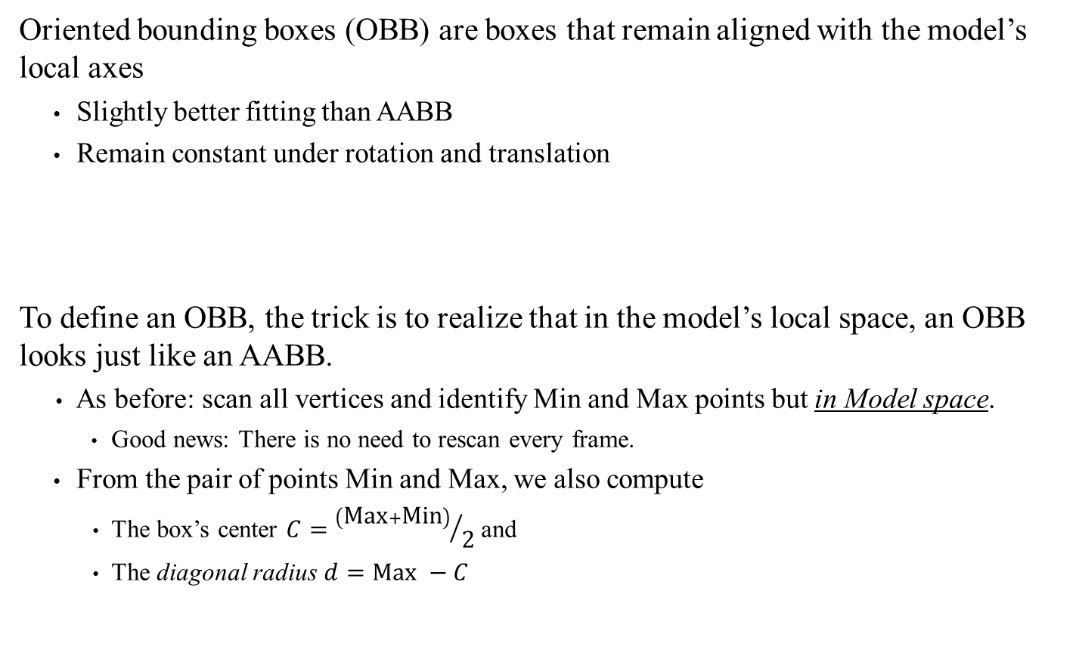
Oriented Bounding Box: Definition and Construction
Oriented bounding boxes (OBB) are boxes that remain aligned with the model’s local axes
Slightly better fitting than AABB
Remain constant under rotation and translation
To define an OBB, the trick is to realize that in the model’s local space, an OBB looks just like an AABB.
As before: scan all vertices and identify Min and Max points but in Model space.
Good news: There is no need to rescan every frame.
From the pair of points Min and Max, we also compute
The box’s center $C={\left(\text{Max}+\text{Min}\right)}/{\text{2}}$ and
The diagonal radius $d=\text{Max} −C$
Compared to AABBs, OBBs create tighter bounding volumes and are cheaper to maintain. Updating and testing intersection is more complicated, but only slightly more expensive.
OBB
Max and Min points (both in model space)
Implied:
The center C (model space)
The diagonal radius d (from C to a corner)
Why do we need C and d? You’ll see…

Slide 30
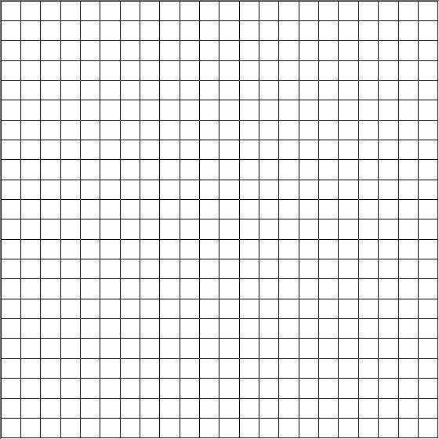



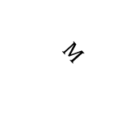
OBB: Updating
Given a model M with an OBB as shown. We apply a matrix W = TRS to M, how do we update the associated OBB?
Compute C’ = WC
Note: Max, Min and d, do not need updating
Q1: Given a point P: how can we test if P is inside or outside the OBB?
A: In Model space, OBBs are the same as AABB
Side note: Whether or not to update d is very much obfuscated in the book’s version of all this. More details shortly, but I believe not updating d is the better approach.
Test if P is in OBB using W
Compute W⁻¹ and P’ = W⁻¹P
Test P’ in OBB local space using axis interval test
x
x
$$M$$
Note: C and d are not used
C’
$$M$$
M’s Local Space
C
d
$$M$$
C
d
$$P$$
z
$$P′$$
z
See also Dynamic Examples

Slide 31
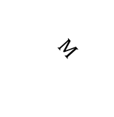
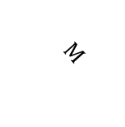


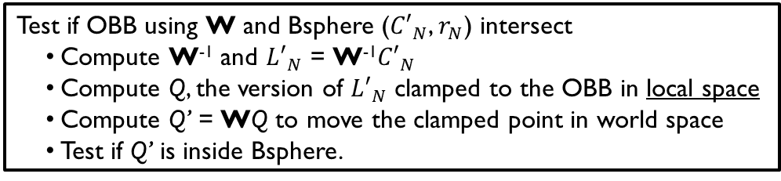


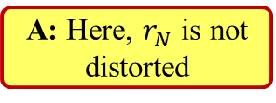


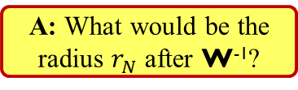
Intersection of OBB vs BSphere
Again, M is placed in world with matrix W and using an OBB as shown. Another model N using W’ has a Bsphere with current center $C_{N}$ and radius $r_{N}$.
Q: How do we test if they intersect?
A: Using the same local-space trick, but with subtleties
Test if OBB using W and Bsphere (${C′}_{N}$, $r_{N}$) intersect
Compute W⁻¹ and ${L′}_{N}$ = W⁻¹${C′}_{N}$
Compute Q, the version of ${L′}_{N}$ clamped to the OBB in local space
Compute Q’ = WQ to move the clamped point in world space
Test if Q’ is inside Bsphere.
Note: Again, C and d are not used
x
x
x
M’s Local Space
World Space
See also Dynamic Examples
$$M$$
Q: Why not test Q inside the sphere here?
$$M$$
C’
$$M$$
Q
$${L′}_{N}$$
C
$$N$$
Q’
$$N$$
C
d
$${C′}_{N}$$
$${C′}_{N}$$
z
A: What would be the radius $r_{N}$ after W⁻¹?
z
A: Here, $r_{N}$ is not distorted
z

Slide 32

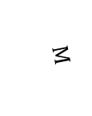




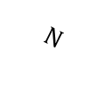
Intersection of OBB vs OBB
Testing OBB vs OBB is a bit more complicated: the local space trick isn’t enough
One possible solution: Reconstruct an AABB around N’s OBB.
Use all 8 corners of N’s OBB and build a temporary AABB
Would need to be done every frame
Problems:
Much worse ‘fit’ than using AABB from the start
More false positives than acceptable
x
x
$$N$$
$${C′}_{N}$$
M’s Local Space
$$N$$
$$M$$
$${L′}_{N}$$
$$M$$
$${C′}_{M}$$
$$C_{M}$$
z
d
z
M looks like an AABB, but not N

Slide 33
Intersection of OBB vs OBB
Testing OBB vs OBB is a bit more complicated: the local space trick isn’t enough
Another option would be to brute-force test all plane intersection
We have 6 planes from M, 6 planes from N.
That means (in world space) we need to test 36 plane-plane intersections
If we test in local-space, half the planes are axis-aligned, which simplifies the math slightly. But it still requires 36 plane-plane intersection tests…
x
x
$$N$$
$${C′}_{N}$$
M’s Local Space
$$N$$
$$M$$
$${L′}_{N}$$
$$M$$
$${C′}_{M}$$
$$C_{M}$$
z
d
z
M looks like an AABB, but not N
We need something better…

Slide 34
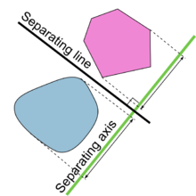
Separating Axis Theorem:
Separating Axis Theorem: “Two convex objects do not overlap if there exists a line (the axis) onto which the two objects' projections do not overlap.”
Note:
The separating axis is the green line (projection axis)
Projection: the ‘shadow’ cast by the shape along the axis.
We’ll use dot products to compute this, somehow…
We project the two objects onto the separating axis
If the intervals/shadows don’t overlap, the objects don’t collide
If the objects don’t collide, the SAT says a separating axis exist, but how can we find it?
For two objects A and B, we ‘only’ need to test the following axes:
All face normals for A
All face normals for B
All cross products of A and B’s face normals
For general models with 1000s of triangles, this could get very costly…
Fortunately for us, OBBs only have 6 faces in 3 parallel pairs (one pair for each axes)
Side note: Why only these axes? It’s related to Minkowski sums. which gets a bit complicated. However, I found an excellent and very accessible explanation of the link between Minkowski sums and the Separating Axis Theorem.

Slide 35
Using the Separating Axis Theorem
Warm up exercise: Consider two AABBs A and B. What does the SAT technique require to test if A and B collide?
Face normals for A: The 3 world axes
Face normals for B: The 3 world axes again (so, no new axes)
Cross products of face normals: The 3 world axes again (still no new axes)
We then need to test if the projection interval overlaps on the 3 world axes.
Which is exactly what we were doing back on this slide.
See also Metanet’s Collision Detection Tutorial
Now consider Two OBBs A and B: What does the SAT require?
3 face normals for A
3 face normals for B
3x3 cross products
So for OBBs, we need to test projection interval overlaps on (at most) 15 different axes.
So how exactly do we do test projection intervals on an arbitrary axis?
This is where the OBB’s center and diagonal radius finally gets used!
How do we determine the face normals of an OBB?
Hint: we know its world transform

Slide 36
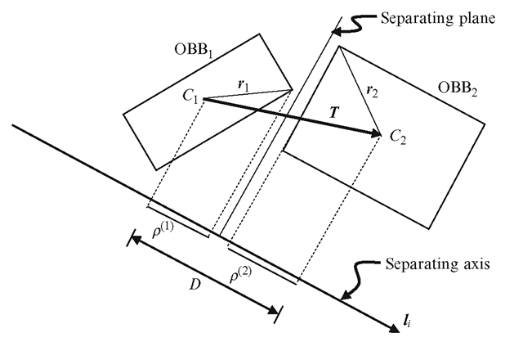

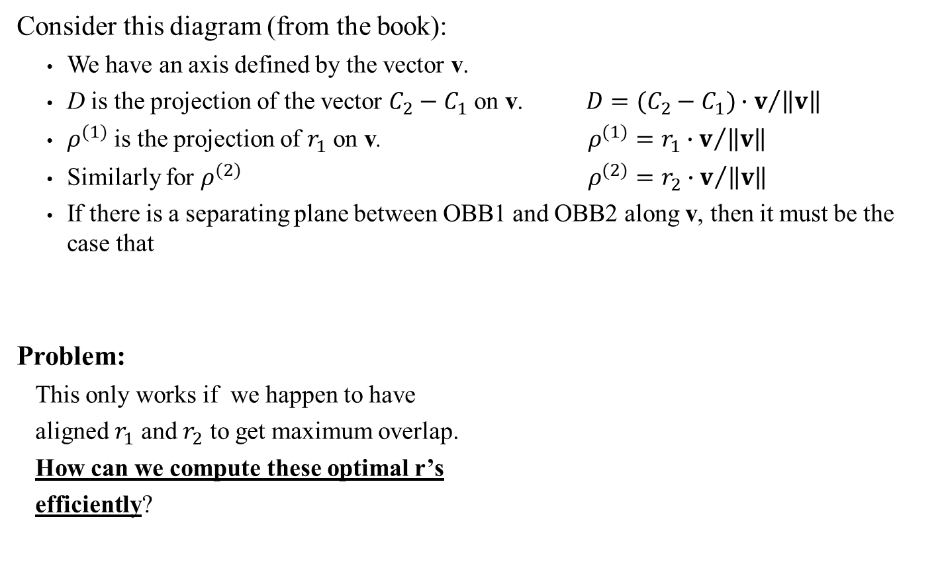
Testing OBBs Against an Axis
Consider this diagram (from the book):
We have an axis defined by the vector v.
D is the projection of the vector $C_{2}−C_{1}$ on v. $D={(C_{2}−C_{1})∙v}/{\left\|v\right\|}$
$ρ^{(1)}$ is the projection of $r_{1}$ on v. $ρ^{(1)}={r_{1}∙v}/{\left\|v\right\|}$
Similarly for $ρ^{(2)}$ $ρ^{(2)}={r_{2}∙v}/{\left\|v\right\|}$
If there is a separating plane between OBB1 and OBB2 along v, then it must be the case that
Problem:
This only works if we happen to have
aligned $r_{1}$ and $r_{2}$ to get maximum overlap.
How can we compute these optimal r’s
efficiently?
Side note: This works in local space or world space. The book’s authors claim to use the local space of one OBBs but they don’t really. More details soon.
$$\left|D\right|> \left|ρ^{(1)}\right|+\left|ρ^{(2)}\right|$$
v

Slide 37

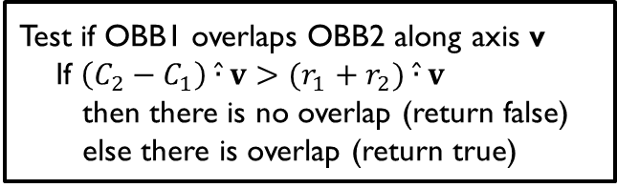
Pseudo Dot-Product
Major Book Problems!!!
Confusion!!!
The condition we want is $\left|D\right|> \left|ρ^{(1)}+ρ^{(2)}\right|$, or if we expand out the terms:
$$\left|(C_{2}−C_{1})∙v\right|> \left|r_{1}∙v +r_{2}∙v \right|=\left|(r_{1}+r_{2})∙v\right|$$
Since we’re looking for r vectors that maximize (among the 8 possible corners of their respective OBB) the overlap along v, we can use a modified dot-product that will achieve the same result:
$$a\hat{∙}b=\left|a_{x}b_{x}\right|+\left|a_{y}b_{y}\right|+\left|a_{z}b_{z}\right|$$
So, the axis interval test becomes:
Section 12.3.4.2 of the book is egregiously incorrect, confusing and very badly edited. The general idea does work, but the authors’ presentation makes absolutely no sense.
What follows here is what should have been written.
Test if OBB1 overlaps OBB2 along axis v
If $\left(C_{2}−C_{1}\right)\hat{∙}v>(r_{1}+r_{2})\hat{∙}v$
then there is no overlap (return false)
else there is overlap (return true)
B.S.!!!
Not Good!
WARNING!
The book uses the standard dot-product symbol when they mean the pseudo dot-product. Be careful how you interpret their math!

Slide 38






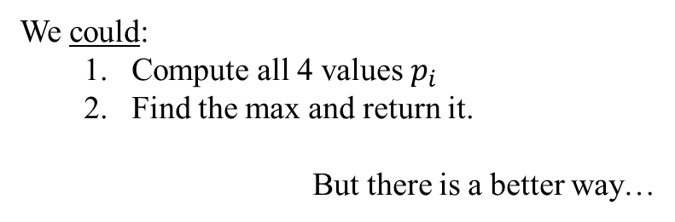


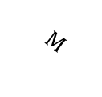
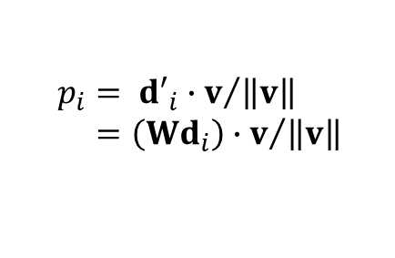



New Problem: OBB Projection on an Axis
For the moment, let’s focus on a 2D space: Consider a 2D OBB M positioned using a world matrix W and a vector v.
IMPORTANT: We assume uniform scaling, so $W= \left(\begin{matrix}sR & t \\ 0 & 1\end{matrix}\right)$ for some vector t and real value s ≥ 0.
We want to compute M’s maximum diagonal projection along v. This means:
M has 4 possible diagonals (in model space): $d_{1}$, $d_{2}$, $d_{3}$ and $d_{4}$
These diagonals are transformed by W: ${d′}_{i}=Wd_{i}$ for i = 1..4
Their projections on v are:
y
$$p_{i}= {{d′}_{i}∙v}/{\left\|v\right\|} \\ ={\left(Wd_{i}\right)∙v}/{\left\|v\right\|}$$
$$M$$
$${d′}_{2}$$
We could:
Compute all 4 values $p_{i}$
Find the max and return it.
But there is a better way…
$${d′}_{3}$$
C
$${d′}_{1}$$
$${d′}_{}$$
$${d′}_{4}$$
v
$$p_{1}$$
$$p_{3}$$
$$p_{2}$$
$$p_{4}$$
x
38

Slide 39


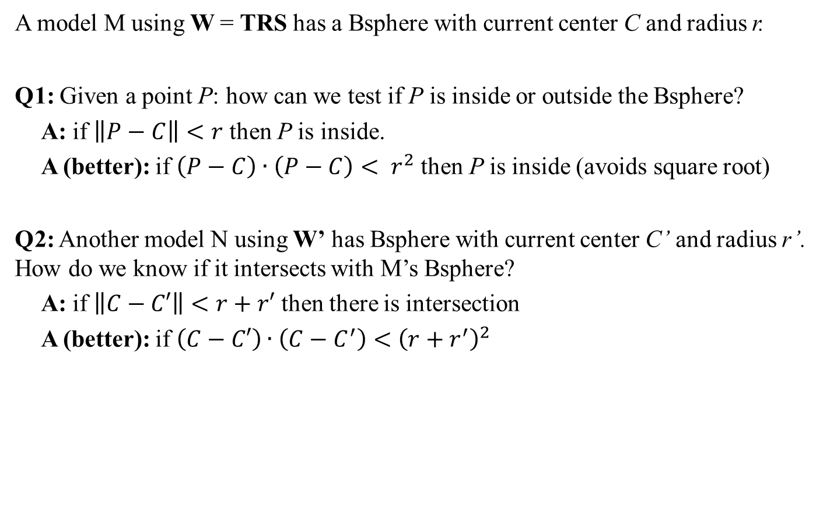
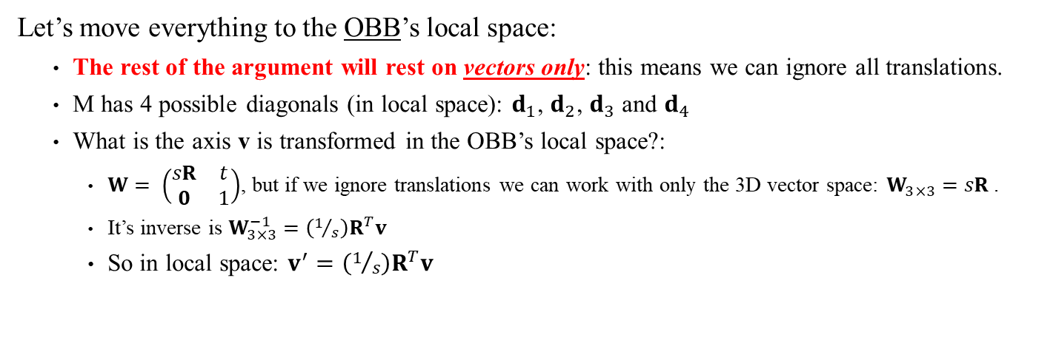



New Problem: OBB Projection on an Axis
Let’s move everything to the OBB’s local space:
The rest of the argument will rest on vectors only: this means we can ignore all translations.
M has 4 possible diagonals (in local space): $d_{1}$, $d_{2}$, $d_{3}$ and $d_{4}$
What is the axis v is transformed in the OBB’s local space?:
$W= \left(\begin{matrix}sR & t \\ 0 & 1\end{matrix}\right)$, but if we ignore translations we can work with only the 3D vector space: $W_{3×3}=sR$.
It’s inverse is $W_{3×3}^{−1}=\left(1/s\right)R^{T}v$
So in local space: $v^{′}=\left(1/s\right)R^{T}v$
We are only considering vectors not points, so we can ignore the model’s C offset
y
y
OBB’s
Local Space
$$M$$
$${d′}_{2}$$
$$M$$
$${d′}_{3}$$
C
$${d′}_{1}$$
$$d_{2}$$
$$d_{1}$$
$${d′}_{}$$
x
$${d′}_{4}$$
v
v'
$$d_{3}$$
$$d_{4}$$
$$p_{3}$$
$$p_{2}$$
$$p_{4}$$
$$p_{1}$$
x

Slide 40



New Problem: OBB Projection on an Axis
Let’s move everything to the OBB’s local space:
M has 4 possible diagonals (in local space): $d_{1}$, $d_{2}$, $d_{3}$ and $d_{4}$
The axis v is local space is: $v^{′}=\left(1/s\right)R^{T}v$
A few interesting facts about OBB in local space:
There is exactly 1 $d_{i}$ in each of the 4 quadrants
If we define $d_{1}=$(a, b) (both positive) then $d_{2}=(−a,b)$, $d_{3}=(−a,−b)$, $d_{4}=(a,−b)$
The $d_{best}=d_{i}$ with the largest projection on v’ is the one with the same +/- signature as v’
If $v^{′}=\left({v′}_{x},{v′}_{y}\right)$ then $d_{best}=({{v′}_{x}}/{\left|{v′}_{x}\right|} a,{{v′}_{y}}/{\left|{v′}_{y}\right|}b)$ will be the $d_{i}$ that matches v’ signature
We are only considering vectors not points, so we can ignore translations and work in 3D vector space only.
y
y
OBB’s
Local Space
(-,+)
(+,+)
Great! We’re done!
Compute $v^{′}=\left(1/s\right)R^{T}v$
Construct $d_{best}$ as above
Return the ${v′∙d_{best}}/{\left\|v′\right\|}$
Not so fast…
We can do better.
Also: this projection is in M’s local space. We need the projection in World Space.
$$M$$
$${d′}_{2}$$
$$M$$
$${d′}_{3}$$
C
$${d′}_{1}$$
$$(a,b)$$
$$d_{2}$$
$$d_{1}$$
$${d′}_{}$$
x
$${d′}_{4}$$
v
v'
$$d_{3}$$
$$d_{4}$$
$$p_{3}$$
$$p_{2}$$
$$p_{4}$$
$$p_{1}$$
x
(-,-)
(+,-)

Slide 41




Getting +/- Signature is Not Needed:
$$v^{′}∙d_{best}={v′}_{x}\left({{v′}_{x}}/{\left|{v′}_{x}\right|}a\right)+{v′}_{y}\left({{v′}_{y}}/{\left|{v′}_{y}\right|}b\right)$$
Consider the terms in $v^{′}∙d_{best}$
Therefore no need to compute the ratios: just use the fact that $v^{′}∙d_{best}=\left|{v′}_{x}a\right|+\left|{v′}_{y}b\right|$
$$=\left({v′}_{x}{{v′}_{x}}/{\left|{v′}_{x}\right|}\right)a+\left({v′}_{y}{{v′}_{y}}/{\left|{v′}_{y}\right|}\right)b$$
$$=\left({{{v′}_{x}}^{2}}/{\left|{v′}_{x}\right|}\right)a+\left({{{v′}_{y}}^{2}}/{\left|{v′}_{y}\right|}\right)b$$
Side note: This is what the book means by ‘pseudo dot-product’. But there is nothing ‘pseudo’ about it: it’s merely consequence of maximizing a projection in an OBB’s local space. A rather important caveat that the book completely glosses over…
$$=\left|{v′}_{x}\right|a+\left|{v′}_{y}\right|b$$
We set a and b to be positive (see this slide)
$$=\left|{v′}_{x}a\right|+\left|{v′}_{y}b\right|$$
y
y
OBB’s
Local Space
(-,+)
(+,+)
This was 2D: What about 3D?
A similar argument works in 3D.
There are 8 $d_{i}$’s. One per octant
Use +/- signature to get $d_{best}$
The absolute value trick still applies to compute ${v^{′}∙d_{best}}/{\left\|v′\right\|}$
$$M$$
$${d′}_{2}$$
$$M$$
$${d′}_{3}$$
C
$${d′}_{1}$$
$$d_{2}$$
$$d_{1}$$
$${d′}_{}$$
x
$${d′}_{4}$$
v
v'
$$d_{3}$$
$$d_{4}$$
$$p_{3}$$
$$p_{2}$$
$$p_{4}$$
$$p_{1}$$
We still need to correct for scaling relative to World space
x
(-,-)
(+,-)

Slide 42






Correcting for Scaling
W’s scale factor affects the magnitude of the projection between world and local space.
In WORLD space we have:
${d′}_{best}=W_{3×3}d_{best}=\text{s}\text{R}d_{best}$
${v∙{d^{′}}_{best}}/{\left\|v\right\|}=\left\|{d^{′}}_{best}\right\|\cos{θ_{best}}$
$=\left\|\text{s}\text{R}d_{best}\right\|\cos{θ_{best}}$
$=s \left\|d\right\|\cos{θ_{best}}$
In LOCAL space we have:
$v^{′}=W_{3×3}^{−1}v=\left(1/s\right)R^{T}v$
${v′∙d_{best}}/{\left\|v′ \right\|}=\left\|d_{best}\right\|\cos{θ_{best}}$
${v′∙d_{best}}/{\left\|\left(1/s\right)R^{T}v\right\|}=\left\|d\right\|\cos{θ_{best}}$
${v′∙d_{best}}/{\left\|v\right\|}=\left(1/s\right) \left\|d\right\|\cos{θ_{best}}$
Clearly $v∙{d^{′}}_{best}$ must depend on the scaling factor in $W_{3×3}$: For a fixed v, larger scale will have the OBB cast a larger projection.
In local space, the scale factor works in reverse: For a fixed v, the size of $v′$ grows smaller as s increases.
y
y
Side note: Size matters! The book (Section 12.3.4.2, p499) uses an argument based on rotation alone in local space, where $v^{′}=R^{T}v$ . This can work only if the d vector is updated for scale, that is to say $\left\|d_{best}\right\|=s\left\|d\right\|$. But this isn’t M’s local space anymore: this is rather M’s “rotation-only local space”. However, yes, under these conditions, both ‘spaces’ return the same projection. But this very important detail is not clearly stated anywhere.
OBB’s
Local Space
(-,+)
(+,+)
$$M$$
$${d′}_{2}$$
$$M$$
$${d′}_{3}$$
C
$${d′}_{1}$$
$$d_{2}$$
$$d_{1}$$
$${d′}_{}$$
x
$${d′}_{4}$$
v
v'
$$d_{3}$$
$$d_{4}$$
$$p_{3}$$
$$p_{2}$$
$$p_{4}$$
$$p_{1}$$
Side note: Actually, the book never really shows how to compute $v^{′}$. They just say it’s v in A’s local space, which in light of the above is extremely misleading.
x
(-,-)
(+,-)

Slide 43



Correcting for Scaling
W’s scale factor affects the magnitude of the projection between world and local space.
In WORLD space we have:
${d′}_{best}=W_{3×3}d_{best}=\text{s}\text{R}d_{best}$
${v∙{d^{′}}_{best}}/{\left\|v\right\|}=\left\|{d^{′}}_{best}\right\|\cos{θ_{best}}$
$=\left\|\text{s}\text{R}d_{best}\right\|\cos{θ_{best}}$
$=s \left\|d\right\|\cos{θ_{best}}$
In LOCAL space we have:
$v^{′}=W_{3×3}^{−1}v=\left(1/s\right)R^{T}v$
${v′∙d_{best}}/{\left\|v′ \right\|}=\left\|d_{best}\right\|\cos{θ_{best}}$
${v′∙d_{best}}/{\left\|\left(1/s\right)R^{T}v\right\|}=\left\|d\right\|\cos{θ_{best}}$
${v′∙d_{best}}/{\left\|v\right\|}=\left(1/s\right) \left\|d\right\|\cos{θ_{best}}$
Therefore ${v∙{d^{′}}_{best}}/{\left\|v\right\|}$ = ${(s}^{2}){v′∙d_{best}}/{\left\|v\right\|}$
We want this
We can compute this easily
y
y
We want the answer for ${v∙{d^{′}}_{best}}/{\left\|v\right\|}$. Therefore:
OBB’s
Local Space
(-,+)
(+,+)
$$M$$
$${d′}_{2}$$
$$M$$
Max OBB projection on Axis v
Move v to local space: $v^{′}=W^{−1}v$
Compute the max projection
$${\text{Proj}}_{max}={\left(\left|{v′}_{x}a\right|+\left|{v′}_{y}b\right|\right)}/{\left\|v\right\|}$$
Return ${(s}^{2}){\text{Proj}}_{max}$
$${d′}_{3}$$
C
$${d′}_{1}$$
$$d_{2}$$
$$d_{1}$$
$${d′}_{}$$
x
$${d′}_{4}$$
v
v'
$$d_{3}$$
$$d_{4}$$
$$p_{3}$$
$$p_{2}$$
$$p_{4}$$
$$p_{1}$$
Again: This also works in 3D
x
(-,-)
(+,-)
See also Dynamic Examples

Slide 44







Intersection of OBB vs OBB: Using SAT
Given two models M and N with OBBs as shown below. How do we test for intersection using the SAT?
Get M’s forward, up and left (side) vectors: $f_{M}$, $u_{M}$ and $s_{M}$
Get N’s forward, up and left (side) vectors: $f_{N}$, $u_{N}$ and $s_{N}$
Compute the 9 pairwise cross-products of all of these
For each of these 15 vectors as possible axis v
apply the axis overlap test
If any axis test returns “no overlap” then no intersection
If all tests return overlap, then the OBBs intersect
See also Dynamic Examples (axes generation)
See also Dynamic Examples
(one axis only)
Max OBB projection on Axis v
Move v to local space: $v^{′}=W^{−1}v$
Compute the max projection
$${\text{Proj}}_{max}={\left(\left|{v′}_{x}a\right|+\left|{v′}_{y}b\right|+\left|{v′}_{z}c\right|\right)}/{\left\|v\right\|}$$
Return ${(s}^{2}){\text{Proj}}_{max}$
x
Test if OBB1 overlaps OBB2 along axis v
Compute:
${\text{Proj}}_{1}$ = Max OBB1 projection on Axis v
${\text{Proj}}_{2}$ = Max OBB2 projection on Axis v
$D={\left|\left(C_{2}−C_{1}\right)∙v\right|}/{\left\|v\right\|}$
If $D≤{\text{Proj}}_{1}+{\text{Proj}}_{2}$ then return true (overlap )
else return false (no overlap )
$$N$$
$$C_{2}$$
$$M$$
$$C_{1}$$
z

Slide 45

Intersection of OBB vs AABB
A model M is placed in world with matrix W and using an OBB.
Another model N using W’ has an AABB define by points Max and Min.
Q: How do we test if they intersect?
A: Treat the AABB as if it was an OBB…
Seriously… nothing more to it….
x
$$M$$
C
$$N$$
z

Slide 46
GAM 325/425: Applied 3D Geometry
Part V:
Where the Book Goes Wrong…

Slide 47


Section 12.3.4.2 p499
v appears to be normalized in the diagram, but that fact is neither used nor mentioned in the text.
Normalizing runs counter to the ‘performance’ concerns below
They correctly convert the distance between centers assuming that $C_{A}$ and $C_{B}$ are in world space which isn’t clear in the text.
B’s extant (diag radius) vector in A’s local space needs to be rotated by ${R_{a}}^{T}R_{b}^{}=R^{T}$. They got it right, but it’s confusing.
However, this still won’t work (see below)
Nothing on this page considers scaling factors, which is unrealistic/misleading
Yes, the ‘pseudo dot-product’ as stated will return the correct projection for A’s extant vectors and assuming proper scale management which isn’t done here.
It will not work for B’s extent vector since the octant trick can’t apply when B’s OBB isn’t axis-aligned in A’s space.

Slide 48
GAM 325/425: Applied 3D Geometry
Part VI:
Recap and Next Week’s Topics

Slide 49
Recap: Data, Creation and Update
Primitive Volume | Data | Creation | Update
BSphere | Center C (local space) Radius r | Ritter’s Algorithm in local space | Apply W to C Radius: track scale changes
AABB | Max and Min points (both in world space) | Scan vertices in world sp. Track Max and Min | Recreate every frame/change
OBB | Max and Min points (local space) Implied data: Center C (local space) Diagonal radius r | Scan vertices in local sp. Find Max and Min Compute C and r | Apply W to C Radius: track scale changes

Slide 50

Recap: Intersection
 | Point P | OBB Max’, Min’, C’, r’ | AABB Max’, Min’ | Bsphere C’, r’
Bsphere C, r | $\left\|P−C\right\|<r$ Or rather $$\left(P−C\right)∙\left(P−C\right)< r^{2}$$ | Move C to OBB loc. sp. Q = Clamp C to OBB Q’ = WQ Test if Q’ in Bsphere | Q = Clamp C to AABB Test if Q in Bsphere | $$\left\|C−C′\right\|<r+r^{′}$$ Or rather $\left(C−C′\right)∙\left(C−C^{′}\right)<{\left(r+r^{′}\right)}^{2}$
AABB Max, Min | Test P against axis intervals | Treat AABB as an OBB | Test overlapping intervals on world axes.
OBB Max, Min, C, r | Move P to local sp. Test against axis intervals | Use SAT Optimize axis projection with ‘special’ Local-space projections

Slide 51
What’s Missing (Next week?)
In the book but not covered yet
Intersection of primitive volumes with
Line
segments
Planes
Frustum
Line-line distance & closest point
segment distance & closet point
Triangle intersection with
Line & segment
plane
Primitive volumes
More advanced but interesting
Convex hull algorithms
Separating axis Theorem & Minkowski’s result
Other?

Slide 52
GAM 325/425: Applied 3D Geometry
Part VII:
Counter Example

Slide 53

Pseudo Dot-Product is Bullshit? (This is how I initially discovered that the book was incorrect)
y
x
x
A
B
B
A
r1
r2
z
z
C1
C2
3D view
Top-Down view
Both A and B are 1x1x1 OBBs.
OBB A just happens to be axis-aligned and at the origin, so C1 = (0,0,0) and r1 = (0.5,0.5,0.5)
OBB B is rotated 45 degree around the y axis with c2 = (0,0,1) and r2 = $(1/{\sqrt{2}},1/{\sqrt{2}}, 0)$
Axis v=(0,0,1) is a valid face normal of A and clearly A and B projection on v overlap.
Yet by the book’s pseudo dot-product trick:
$\left(C2−C1\right)\hat{∙}v=\left(0,0,1\right)\hat{∙}\left(0,0,1\right)=1$ and $\left(r1+r2\right)\hat{∙}v=\left(a,a,0.5\right)\hat{∙}\left(0,0,1\right)=0.5$
So clearly $\left(C2−C1\right)\hat{∙}v>\left(r1+r2\right)\hat{∙}v$, which mean there is a separation
But visibly there isn’t…

