Slide 1
GAM 325/425: Applied 3D Geometry
Lecture 9:
Collision and Intersection Testing, continued

Slide 2
Collision and Intersection Testing
Last week we covered the very basic aspects of the math used for collision and intersection testing.
The most common primitives are:
Volumes: Bspheres, AABB and OBB
Surfaces: Planes and triangles
Others: points and line/ray/segment
We want to test intersection problems related to any pair of the above entities
Last week covered all pairwise between points, Bsphere, AABB and OBB
This week we’ll add line/ray/segment, planes and triangles to the collection
This week

Slide 3
GAM 325/425: Applied 3D Geometry
Part I:
Warm Up

Slide 4

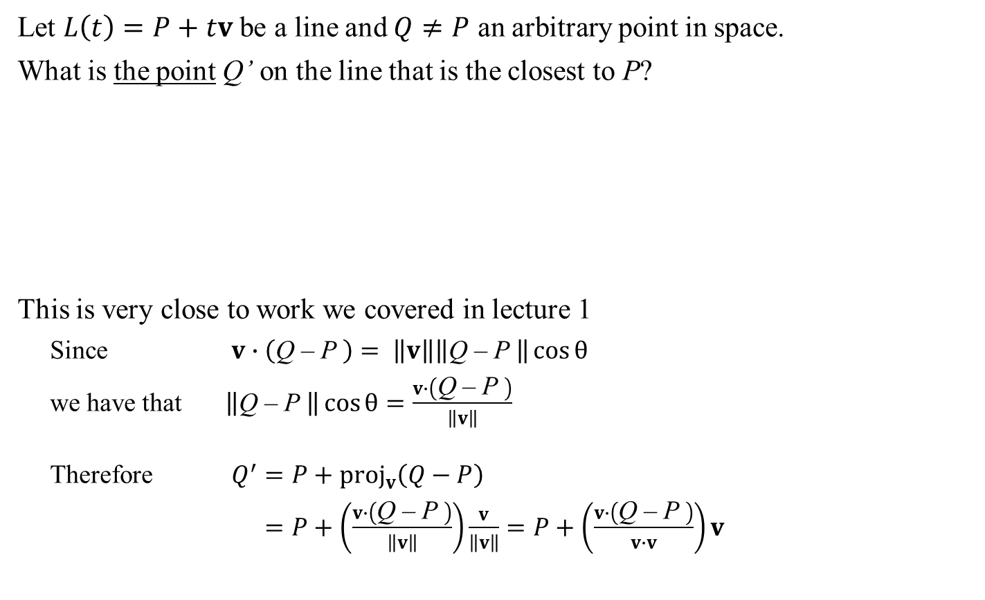
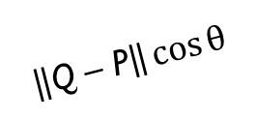
Closest Point on Line
Let $L\left(t\right)=P+tv$ be a line and $Q≠P$ an arbitrary point in space.
What is the point Q’ on the line that is the closest to P?
This is very close to work we covered in lecture 1
Since $v∙\left(\text{Q}\text{ – }\text{P} \right)= \left\|v\right\|\left\|\text{Q}\text{ – }\text{P} \right\|\cos{θ}$
we have that $\left\|\text{Q}\text{ – }\text{P} \right\|\cos{θ}=\frac{v∙\left(\text{Q}\text{ – }\text{P} \right)}{\left\|v\right\|}$
Therefore $Q^{′}=P+{\text{proj}}_{v}\left(Q−P\right)$
$=P+\left(\frac{v∙\left(\text{Q}\text{ – }\text{P} \right)}{\left\|v\right\|}\right)\frac{v}{\left\|v\right\|}=P+\left(\frac{v∙\left(\text{Q}\text{ – }\text{P} \right)}{v∙v}\right)v$
$$\left\|\text{Q}\text{ – }\text{P}\right\|\cos{θ}$$
Q’
$$v$$
L(t)
θ
Q – P
P
Q
Side note: We’ll be using this equation a lot today!
See also Dynamic Examples

Slide 5

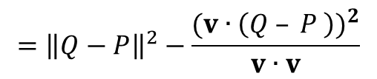

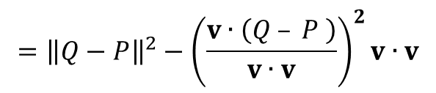
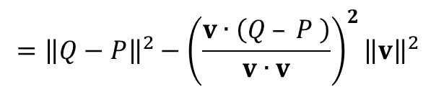

Line-Point Distance
Let $L\left(t\right)=P+tv$ be a line and $Q≠P$ an arbitrary point in space. What is the distance d between Q and the line?
We covered this on week 1, but the book offers an alternate derivation
By triangle inequality: ${\left\|{\text{perp}}_{v}\left(Q−P\right)\right\|}^{2}={\left\|Q−P\right\|}^{2}−{\left\|{\text{p}\text{roj}}_{v}\left(Q−P\right)\right\|}^{2}$
By the previous slide: $={\left\|Q−P\right\|}^{2}−{\left\|\left(\frac{v∙\left(\text{Q}\text{ – }\text{P} \right)}{v∙v}\right)v\right\|}^{2}$
$${\text{perp}}_{v}\left(Q−P\right)$$
L(t)
$$v$$
P
Q – P
Q
See also Dynamic Examples
Side note: Again, we’ll be using this equation a lot today!
$$={\left\|Q−P\right\|}^{2}−{\left(\frac{v∙\left(Q – P \right)}{v∙v}\right)}^{2}{\left\|v\right\|}^{2}$$
$$={\left\|Q−P\right\|}^{2}−{\left(\frac{v∙\left(Q – P \right)}{v∙v}\right)}^{2}v∙v$$
$$={\left\|Q−P\right\|}^{2}−\frac{{(v∙\left(Q – P \right))}^{2}}{v∙v}$$

Slide 6

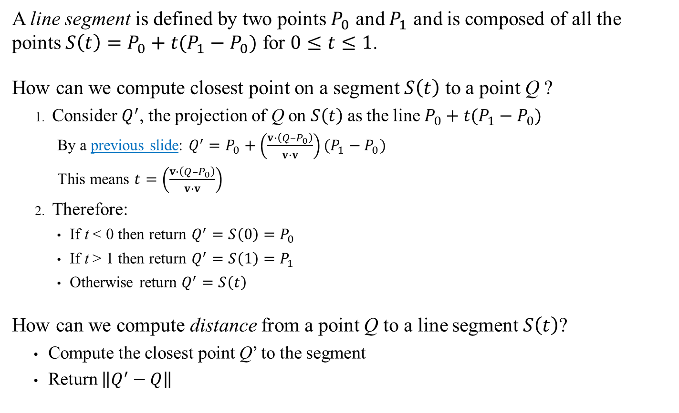






Closest Point on Segment and Distance to Segment
A line segment is defined by two points $P_{0}$ and $P_{1}$ and is composed of all the points $S\left(t\right)=P_{0}+t(P_{1}−P_{0})$ for $0≤t≤1$.
How can we compute closest point on a segment $S\left(t\right)$ to a point Q ?
Consider $Q^{′}$, the projection of Q on $S\left(t\right)$ as the line $P_{0}+t(P_{1}−P_{0})$
By a previous slide: $Q^{′}=P_{0}+\left(\frac{v∙\left(Q–P_{0}\right)}{v∙v}\right)(P_{1}−P_{0})$
This means $t=\left(\frac{v∙\left(Q–P_{0}\right)}{v∙v}\right)$
Therefore:
If t < 0 then return $Q^{′}=S\left(0\right)=P_{0}$
If t > 1 then return $Q^{′}=S\left(1\right)=P_{1}$
Otherwise return $Q^{′}=S\left(t\right)$
How can we compute distance from a point Q to a line segment $S\left(t\right)$?
Compute the closest point Q’ to the segment
Return $\left\|Q^{′}−Q\right\|$
$$P_{0}$$
S(t)
$$P_{1}$$
$$t=0$$
$$t=1$$
$$Q_{1}$$
$$Q_{2}$$
$$Q_{3}$$
In effect, we are clamping t to [0,1] and returning $S\left(t\right)$
See also Dynamic Examples

Slide 7
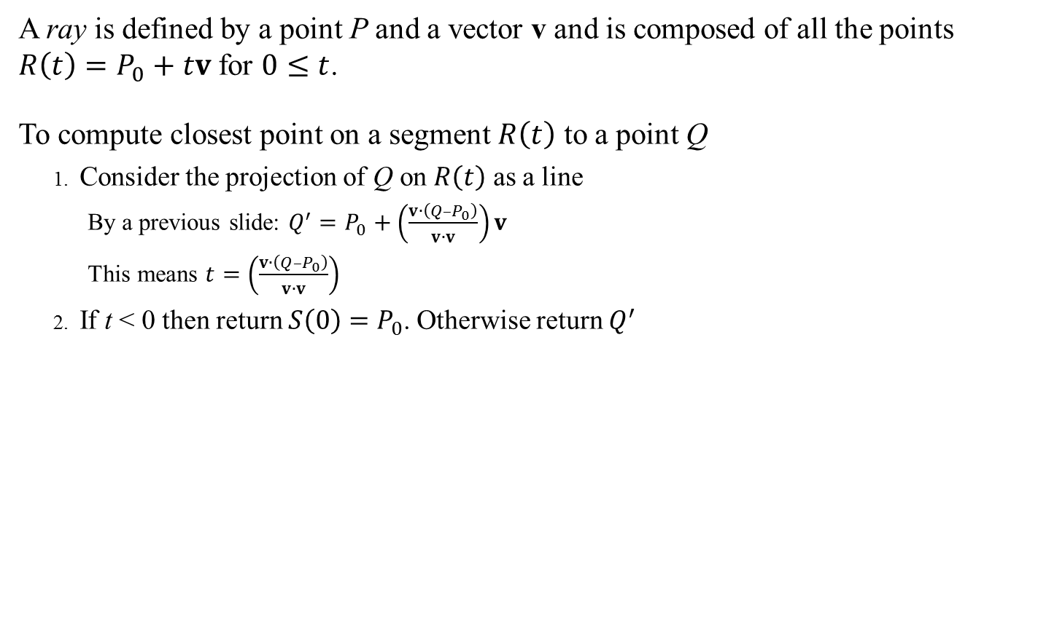



Closest Point to a Ray
A ray is defined by a point P and a vector v and is composed of all the points $R\left(t\right)=P_{0}+tv$ for $0≤t$.
To compute closest point on a segment $R\left(t\right)$ to a point Q
Consider the projection of Q on $R\left(t\right)$ as a line
By a previous slide: $Q^{′}=P_{0}+\left(\frac{v∙\left(Q–P_{0}\right)}{v∙v}\right)v$
This means $t=\left(\frac{v∙\left(Q–P_{0}\right)}{v∙v}\right)$
If t < 0 then return ${S\left(0\right)=P}_{0}$. Otherwise return $Q^{′}$
See also Dynamic Examples
$$P_{0} v$$
R(t)
$$t=0$$
$$t>0$$
$$Q_{1}$$
$$Q_{2}$$

Slide 8
GAM 325/425: Applied 3D Geometry
Part 2:
Classroom Mathematics vs
the Real World…
Wake up! We’re changing gears now…

Slide 9

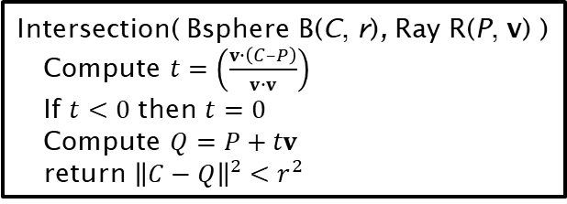
Ray-Sphere Intersection
Given a Bsphere B(C, r) and a ray R(P, v) , How can you test if they intersect?
Using the previous slides, we come up with:
But, what if you forgot all this wonderful math?
Side note: This could be used to test if an instant-bullet fired hits the Bsphere of an enemy.
Intersection( Bsphere B(C, r), Ray R(P, v) )
Compute $t=\left(\frac{v∙\left(C–P\right)}{v∙v}\right)$
If $t<0$ then $t=0$
Compute $Q=P+tv$
return ${\left\|C−Q\right\|}^{2}<r^{2}$
See also Dynamic Examples
No worries:
Engaging our best Google-Foo!

Slide 10
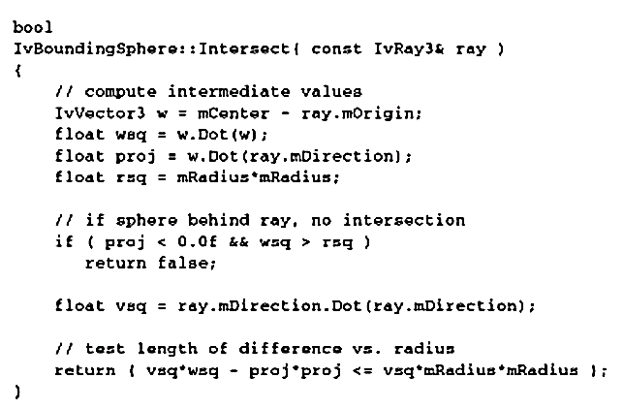

Ray-Sphere Intersection: A Case Study
Given a Bsphere B(C, r) and a ray R(P, v) , How can you test if they intersect?
After a quick google session, we find this:
Intersection( Bsphere B(C, r), Ray R(P, v) )
$$w=C−P$$
$$d=w∙w$$
$$q=w∙v$$
If $q<0$ and $d>r^{2}$ return false
$$v_{sq}=v∙v$$
return $v_{sq}d−q^{2} ≤v_{sq}r^{2}$
Translating
What’s the test for?
What is this algorithm?
When researching algorithms for intersection primitives, what you find is either:
Optimized for performance, obscuring the math logic in each step.
Or (more than likely) incorrect, BS, half work, etc.
It’s your job to prove they work correctly before you decide to use them!

Slide 11
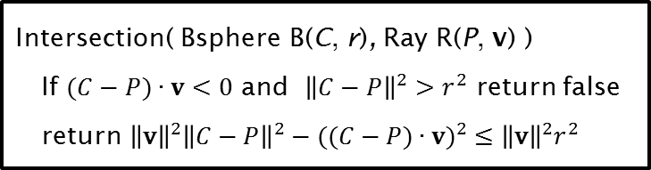
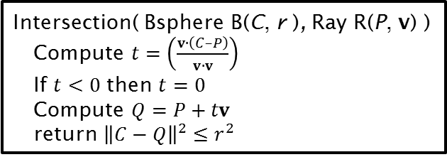

Ray-Sphere Intersection: A Case Study
So, are these two algorithms functionally the same?
First, we remove the temp variables:
We can now rewrite the algorithm as
Intersection( Bsphere B(C, r ), Ray R(P, v) )
Compute $t=\left(\frac{v∙\left(C–P\right)}{v∙v}\right)$
If $t<0$ then $t=0$
Compute $Q=P+tv$
return ${\left\|C−Q\right\|}^{2}≤r^{2}$
Intersection( Bsphere B(C, r), Ray R(P, v) )
$$w=C−P$$
$$d=w∙w$$
$$q=w∙v$$
If $q<0$ and $d>r^{2}$ return false
$$v_{sq}=v∙v$$
return $v_{sq}d−q^{2} ≤v_{sq}r^{2}$
$$={\left\|C−P\right\|}^{2}$$
$$=(C−P)∙v$$
$$={\left\|\text{v}\right\|}^{2}$$
Intersection( Bsphere B(C, r), Ray R(P, v) )
If $(C−P)∙v<0$ and ${\left\|C−P\right\|}^{2}>r^{2}$ return false
return ${\left\|\text{v}\right\|}^{2}{\left\|C−P\right\|}^{2}−{((C−P)∙v)}^{2} ≤{\left\|\text{v}\right\|}^{2}r^{2}$

Slide 12
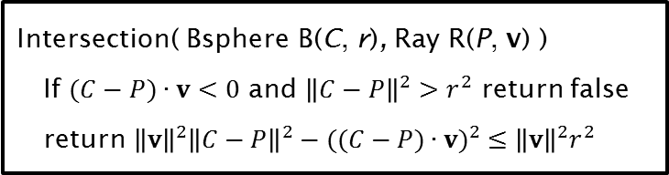
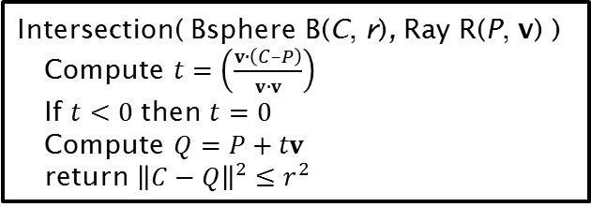


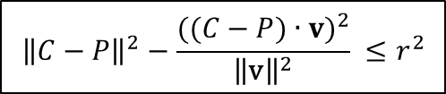

Ray-Sphere Intersection: A Case Study
Now consider the final return value:
Dividing by ${\left\|\text{v}\right\|}^{2}$ on both sides:
Which is the same as:
Intersection( Bsphere B(C, r), Ray R(P, v) )
Compute $t=\left(\frac{v∙\left(C–P\right)}{v∙v}\right)$
If $t<0$ then $t=0$
Compute $Q=P+tv$
return ${\left\|C−Q\right\|}^{2}≤r^{2}$
Intersection( Bsphere B(C, r), Ray R(P, v) )
If $(C−P)∙v<0$ and ${\left\|C−P\right\|}^{2}>r^{2}$ return false
return ${\left\|\text{v}\right\|}^{2}{\left\|C−P\right\|}^{2}−{((C−P)∙v)}^{2} ≤{\left\|\text{v}\right\|}^{2}r^{2}$
${\left\|\text{v}\right\|}^{2}{\left\|C−P\right\|}^{2}−{((C−P)∙v)}^{2} ≤{\left\|\text{v}\right\|}^{2}r^{2}$
$${\left\|C−P\right\|}^{2}−\frac{{((C−P)∙v)}^{2}}{{\left\|\text{v}\right\|}^{2}} ≤r^{2}$$
$${\left\|C−P\right\|}^{2}−\frac{{((C−P)∙v)}^{2}}{v∙v} ≤r^{2}$$
Why the original form?
Two multiplication is cheaper than one division

Slide 13
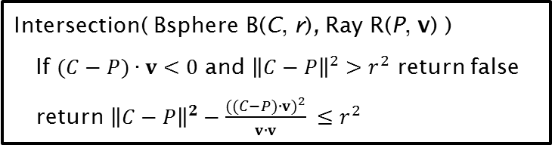

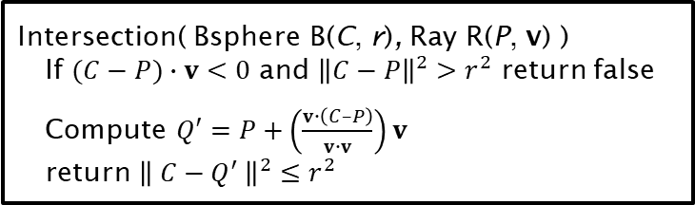


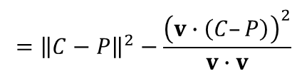

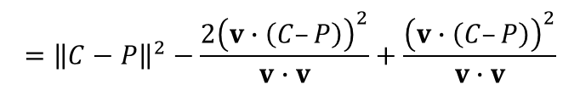
Ray-Sphere Intersection: A Case Study
Consider the left-hand side: Where did that come from?
Let $Q′=P+\left(\frac{v∙\left(C–P\right)}{v∙v}\right)v$ , the Bsphere’s center projected on the ray (possibly behind P).
Therefore, the second algorightm can be re-written as:
Intersection( Bsphere B(C, r), Ray R(P, v) )
Compute $t=\left(\frac{v∙\left(C–P\right)}{v∙v}\right)$
If $t<0$ then $t=0$
Compute $Q=P+tv$
return ${\left\|C−Q\right\|}^{2}≤r^{2}$
Intersection( Bsphere B(C, r), Ray R(P, v) )
If $(C−P)∙v<0$ and ${\left\|C−P\right\|}^{2}>r^{2}$ return false
return ${\left\|C−P\right\|}^{2}−\frac{{((C−P)∙v)}^{2}}{v∙v} ≤r^{2}$
$${\left\|C−Q′\right\|}^{2}={\left\|(C−P)−tv \right\|}^{2}$$
$$=\left((C−P)−tv\right)∙\left(\left(C−P\right)−tv\right)$$
$$=\left(C−P\right)∙\left(C−P\right)−2t(v∙\left(C−P\right))+t^{2}v∙v$$
$$={\left\|C−P\right\|}^{2}−\frac{2{\left(v∙\left(C–P\right)\right)}^{2}}{v∙v}+\frac{{\left(v∙\left(C–P\right)\right)}^{2}}{v∙v}$$
Replacing t with $\left(\frac{v∙\left(C–P\right)}{v∙v}\right)$
Sidebar: See also Slide #5
$$={\left\|C−P\right\|}^{2}−\frac{{\left(v∙\left(C–P\right)\right)}^{2}}{v∙v}$$
Intersection( Bsphere B(C, r), Ray R(P, v) )
If $(C−P)∙v<0$ and ${\left\|C−P\right\|}^{2}>r^{2}$ return false
Compute $Q′=P+\left(\frac{v∙\left(C–P\right)}{v∙v}\right)v$
return ${\left\| C−Q^{′} \right\|}^{2}≤r^{2}$

Slide 14







Ray-Sphere Intersection: A Case Study
Do these two algorithms give the same answers?
If $t≥0$ then $Q=Q′$ therefore we return the same true/false result.
Remember $v∙v$ is always positive..
If $t<0$ then we have two cases:
If ${\left\|C−P\right\|}^{2}>r^{2}$ then both algos return false
Note that $Q=P$ in our algorithm
Otherwise, if ${\left\|C−P\right\|}^{2}≤r^{2}$ then:
We have (left algo):
By triangle properties: $\left\|C−Q′\right\|<\left\|C−P\right\|$
Therefore ${\left\|C−Q′\right\|}^{2}<{\left\|C−P\right\|}^{2}={\left\|C−Q\right\|}^{2}≤r^{2}$
So both algorithms return true.
Intersection( Bsphere B(C, r), Ray R(P, v) )
Compute $t=\left(\frac{v∙\left(C–P\right)}{v∙v}\right)$
If $t<0$ then $t=0$
Compute $Q=P+tv$
return ${\left\|C−Q\right\|}^{2}≤r^{2}$
Intersection( Bsphere B(C, r), Ray R(P, v) )
If $(C−P)∙v<0$ and ${\left\|C−P\right\|}^{2}>r^{2}$ return false
Compute $Q′=P+\left(\frac{v∙\left(C–P\right)}{v∙v}\right)v$
return ${\left\| C−Q^{′} \right\|}^{2}≤r^{2}$
$$v$$
$$Q′$$
$$P=Q$$
$Q=P$,
${\left\|C−P\right\|}^{2}≤r^{2}$ and
$Q′$ is ‘behind’ the ray ($t<0$).
$$C$$

Slide 15
Ray-Sphere Intersection: A Case Study
.
Intersection( Bsphere B(C, r), Ray R(P, v) )
Compute $t=\left(\frac{v∙\left(C–P\right)}{v∙v}\right)$
If $t<0$ then $t=0$
Compute $Q=P+tv$
return ${\left\|C−Q\right\|}^{2}≤r^{2}$
Intersection( Bsphere B(C, r), Ray R(P, v) )
If $(C−P)∙v<0$ and ${\left\|C−P\right\|}^{2}>r^{2}$ return false
Compute $Q′=P+\left(\frac{v∙\left(C–P\right)}{v∙v}\right)v$
return ${\left\| C−Q^{′} \right\|}^{2}≤r^{2}$
All three of these algorithms are functionally the same, differing only in efficiency and clarity
When researching algorithms for intersection primitives, it’s not easy to distinguish those written for efficiency from those that are just garbage.
You must develop the skills to tell which is which.

Slide 16
GAM 325/425: Applied 3D Geometry
Part 3:
More Line Intersections

Slide 17
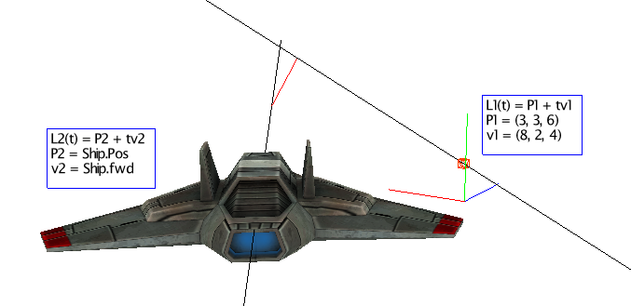




Line-Line “Intersection” (3D) (Distance, Closest Pts, Intersection)
$L_{1}\left(t\right)=P_{1}+tv_{1}$
$L_{2}\left(t\right)=P_{2}+tv_{2}$
y
$$L_{1}$$
Given two lines in 3D,
And consider their spatial relationship. Either:
The lines are parallel but separated
The lines are parallel and are coincident (same line)
The line are skew (they don’t have any common plane)
The lines intersect at exactly one point
x
z
$$L_{1}\left(t\right)=P_{1}+tv_{1}$$
$$L_{2}\left(t\right)=P_{2}+tv_{2}$$
$$L_{2}$$
Side note: This could be used by some AI to predict if a collision is imminent between two objects

Slide 18

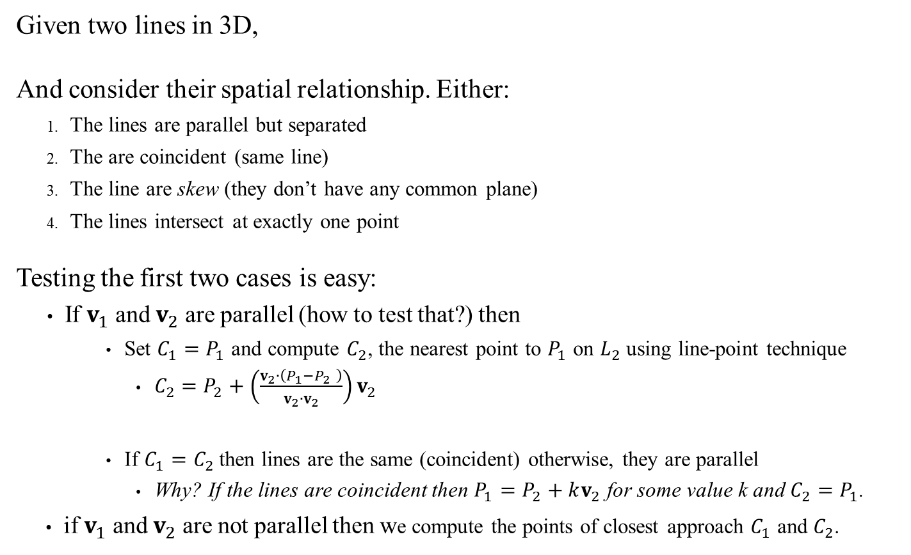


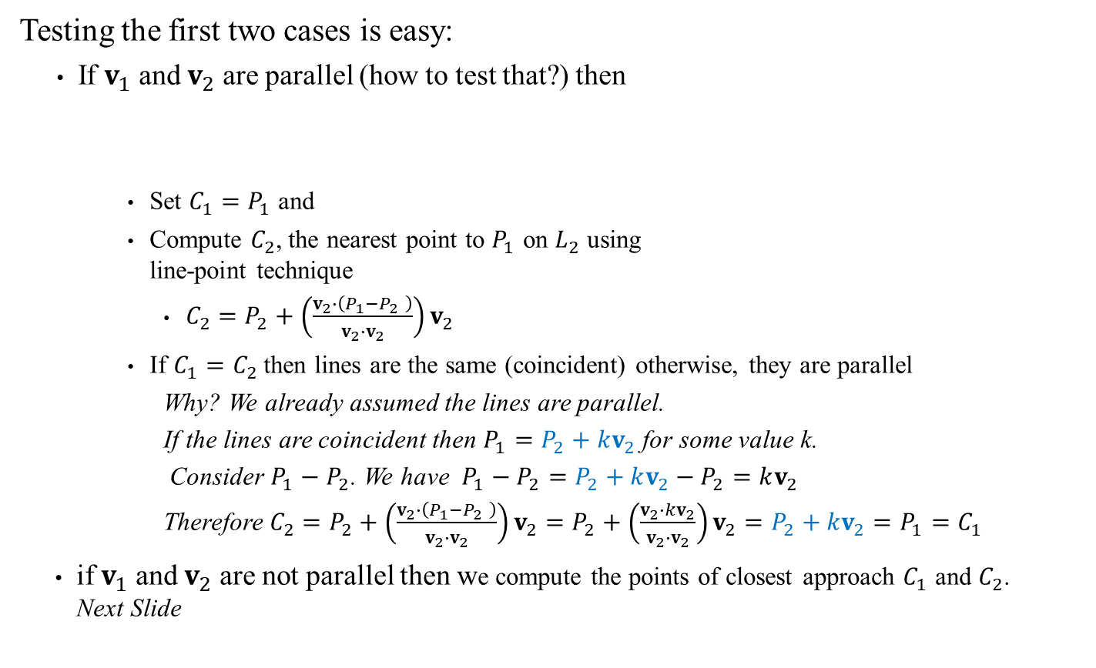




Line-Line “Intersection” (3D) (Distance, Closest Pts, Intersection)
y
$$L_{1}$$
Testing the first two cases is easy:
If $v_{1}$ and $v_{2}$ are parallel (how to test that?) then
Set $C_{1}=P_{1}$ and
Compute $C_{2}$, the nearest point to $P_{1}$ on $L_{2}$ using line-point technique
$C_{2}=P_{2}+\left(\frac{v_{2}∙\left(P_{1}−P_{2} \right)}{v_{2}∙v_{2}}\right)v_{2}$
If $C_{1}=C_{2}$ then lines are the same (coincident) otherwise, they are parallel
Why? We already assumed the lines are parallel.
If the lines are coincident then $P_{1}=P_{2}+kv_{2}$ for some value k.
Consider $P_{1}−P_{2}$. We have $P_{1}−P_{2}=P_{2}+kv_{2}−P_{2}=kv_{2}$
Therefore $C_{2}=P_{2}+\left(\frac{v_{2}∙\left(P_{1}−P_{2} \right)}{v_{2}∙v_{2}}\right)v_{2}=P_{2}+\left(\frac{v_{2}∙kv_{2}}{v_{2}∙v_{2}}\right)v_{2}=P_{2}+kv_{2}=P_{1}=C_{1}$
if $v_{1}$ and $v_{2}$ are not parallel then we compute the points of closest approach $C_{1}$ and $C_{2}$. Next Slide
$$C_{1}$$
$${C_{1}=P}_{1}$$
$$v_{1}$$
x
$$C_{2}$$
$$P_{2}$$
$$v_{2}$$
$$C_{2}$$
z
$$L_{1}\left(t\right)=P_{1}+tv_{1}$$
$$L_{2}\left(t\right)=P_{2}+tv_{2}$$
$$L_{2}$$

Slide 19




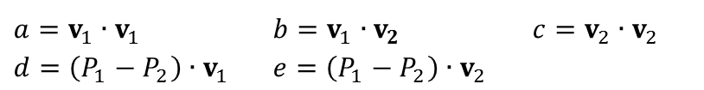



Line-Line “Intersection” (3D)
y
$$L_{1}$$
We want $t_{1}$and $t_{2}$ such that $L_{1}\left(t_{1}\right)=C_{1}$ and $L_{2}\left(t_{2}\right)=C_{2}$
Consider $w=L_{1}\left(t_{1}\right)−L_{2}\left(t_{2}\right)=C_{1}−C_{2}$
Expanding, we have
Since w must be perpendicular to both lines, we have that
Expanding, we have
Let’s clarify this a bit. Let:
Now, the two equations become:
So this is nothing more than a linear system of 2 equations, 2 unknowns
We know how to solve those!
$$C_{1}$$
$$w=(P_{1}+t_{1}v_{1})−(P_{2}+t_{2}v_{2})$$
x
$$=\left(P_{1}−P_{2}\right)+t_{1}v_{1}−t_{2}v_{2}$$
$$C_{2}$$
z
$w∙v_{1}=0$ and $w∙v_{2}=0$
$$L_{1}\left(t\right)=P_{1}+tv_{1}$$
$$L_{2}\left(t\right)=P_{2}+tv_{2}$$
$$\left(P_{1}−P_{2}\right)∙v_{1}+t_{1}v_{1}∙v_{1}−t_{2}v_{2}∙v_{1}=0$$
$$\left(P_{1}−P_{2}\right)∙v_{2}+t_{1}v_{1}∙v_{2}−t_{2}v_{2}∙v_{2}=0$$
$$L_{2}$$
$a=v_{1}∙v_{1}$ $b=v_{1}∙v_{2}$ $c=v_{2}∙v_{2}$
$d=\left(P_{1}−P_{2}\right)∙v_{1}$ $e=\left(P_{1}−P_{2}\right)∙v_{2}$
$$d+t_{1}a−t_{2}b=0$$
$$e+t_{1}b−t_{2}c=0$$
$$t_{1}a−t_{2}b=−d$$
$$t_{1}b−t_{2}c=−e$$
Note: This symbolic solving is important!
We don’t want to solve these equations every time you need to compute the line-line intersection!

Slide 20



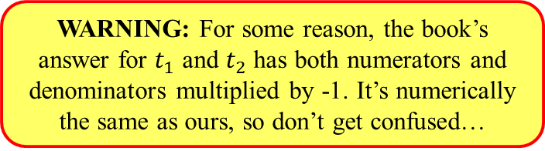

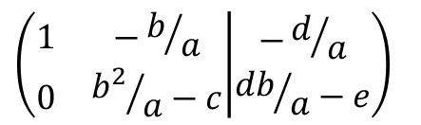





Line-Line “Intersection” (3D)
We use Gaussian elimination to solve the system
Therefore: $t_{1}=\frac{cd−be}{b^{2}−ac}$ and $t_{2}=\frac{db−ae}{b^{2}−ac}$
$t_{1}a−t_{2}b=−d$ and $t_{1}b−t_{2}c=−e$
$$\left(\begin{matrix}a & −b \\ b & −c\end{matrix} | \begin{matrix}−d \\ −e\end{matrix}\right)$$
$$\left(\begin{matrix}1 & −b/a \\ b & −c\end{matrix} | \begin{matrix}−d/a \\ −e\end{matrix}\right)$$
$$\left(\begin{matrix}1 & −b/a \\ 0 & {b^{2}}/a−c\end{matrix} | \begin{matrix}−d/a \\ {db}/a−e\end{matrix}\right)$$
$$\left(\begin{matrix}1 & 0 \\ 0 & 1\end{matrix} | \begin{matrix}−d/a+\left(b/a\right)\left(\frac{db−ae}{b^{2}−ac}\right) \\ \frac{db−ae}{b^{2}−ac}\end{matrix}\right)$$
$$\left(\begin{matrix}1 & −b/a \\ 0 & \frac{b^{2}−ac}{a}\end{matrix} | \begin{matrix}−d/a \\ \frac{db−ae}{a}\end{matrix}\right)$$
$$\left(\begin{matrix}1 & −b/a \\ 0 & 1\end{matrix} | \begin{matrix}−d/a \\ \frac{db−ae}{b^{2}−ac}\end{matrix}\right)$$
$$\left(\begin{matrix}1 & 0 \\ 0 & 1\end{matrix} | \begin{matrix}\frac{−d\left(b^{2}−ac\right)+b(db−ae)}{a(b^{2}−ac)} \\ \frac{db−ae}{b^{2}−ac}\end{matrix}\right)$$
$$\left(\begin{matrix}1 & 0 \\ 0 & 1\end{matrix} | \begin{matrix}\frac{cd−be}{b^{2}−ac} \\ \frac{db−ae}{b^{2}−ac}\end{matrix}\right)$$
WARNING: For some reason, the book’s answer for $t_{1}$ and $t_{2}$ has both numerators and denominators multiplied by -1. It’s numerically the same as ours, so don’t get confused…

Slide 21
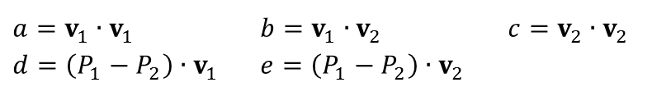
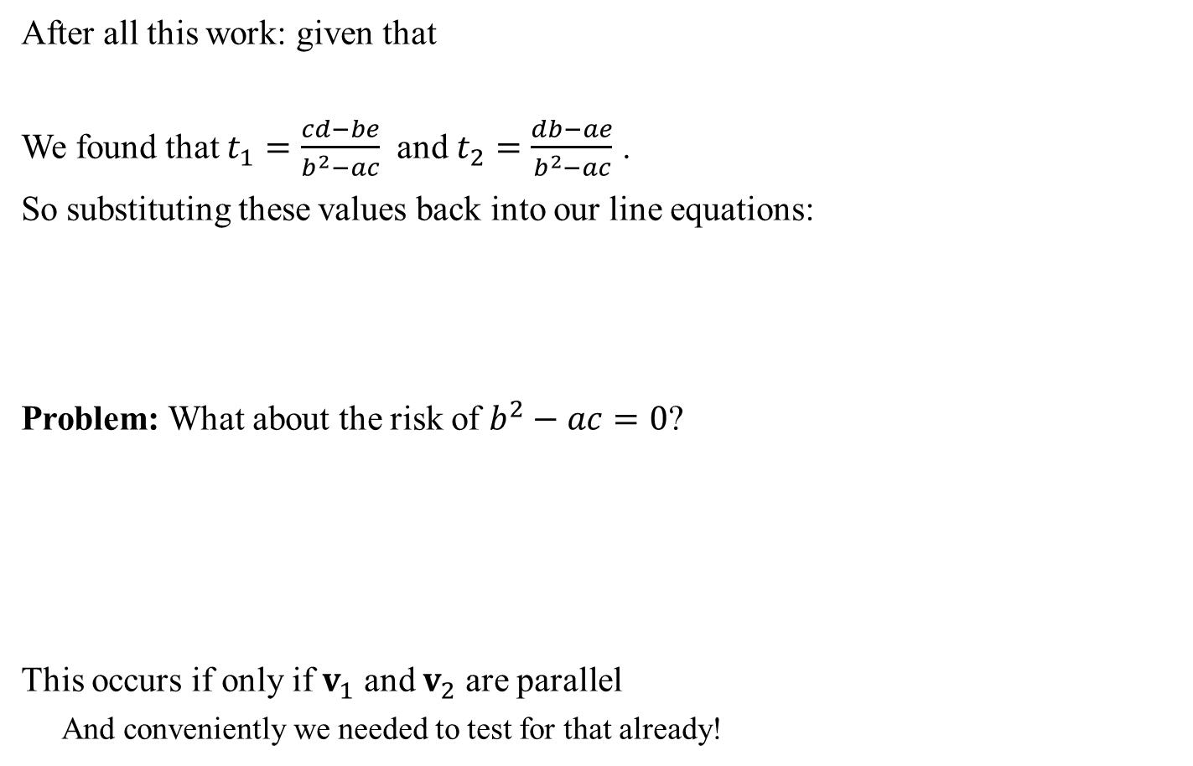
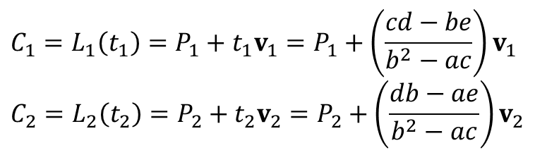

Line-Line “Intersection” (3D)
After all this work: given that
We found that $t_{1}=\frac{cd−be}{b^{2}−ac}$ and $t_{2}=\frac{db−ae}{b^{2}−ac}$ .
So substituting these values back into our line equations:
Problem: What about the risk of $b^{2}−ac=0$?
This occurs if only if $v_{1}$ and $v_{2}$ are parallel
And conveniently we needed to test for that already!
$a=v_{1}∙v_{1}$ $b=v_{1}∙v_{2}$ $c=v_{2}∙v_{2}$
$d=\left(P_{1}−P_{2}\right)∙v_{1}$ $e=\left(P_{1}−P_{2}\right)∙v_{2}$
$$C_{1}=L_{1}\left(t_{1}\right)=P_{1}+t_{1}v_{1}=P_{1}+\left(\frac{cd−be}{b^{2}−ac}\right)v_{1}$$
$${C_{2}=L}_{2}\left(t_{2}\right)=P_{2}+t_{2}v_{2}=P_{2}+\left(\frac{db−ae}{b^{2}−ac}\right)v_{2}$$
$$0=b^{2}−ac \\ ={\left(v_{1}∙v_{2}\right)}^{2}−\left(v_{1}∙v_{1}\right)\left(v_{2}∙v_{2}\right) \\ ={\left(v_{1}∙v_{2}\right)}^{2}−{\left\|v_{1}\right\|}^{2}{\left\|v_{2}\right\|}^{2}$$
or
$${ \left(v_{1}∙v_{2}\right)}^{2}={\left\|v_{1}\right\|}^{2}{\left\|v_{2}\right\|}^{2}$$
$v_{1}∙v_{2}=\left\|v_{1}\right\|\left\|v_{2}\right\|$
y
$$L_{1}$$
$$C_{1}$$
x
$$C_{2}$$
z
$$L_{2}$$

Slide 22

Line-Line “Intersection” (3D)
The final algorithm is:
Line-line test: $L_{1}\left(P_{1},v_{1}\right)$ and $L_{2}\left(P_{2},v_{2}\right)$
Set $a=v_{1}∙v_{1}$ $b=v_{1}∙v_{2}$ $c=v_{2}∙v_{2}$
$d=\left(P_{1}−P_{2}\right)∙v_{1}$ $e=\left(P_{1}−P_{2}\right)∙v_{2}$
if $b^{2}−ac=0$then (we have parallel lines)
Use $P_{1}$ and $L_{2}\left(P_{2},v_{2}\right)$ to find nearest point/distance
$$C_{1}=P_{1}$$
$$C_{2}=P_{2}+\left(\frac{e}{c}\right)v_{2}$$
Else compute
$$C_{1}=P_{1}+\left(\frac{cd−be}{b^{2}−ac}\right)v_{1}$$
$$C_{2}=P_{2}+\left(\frac{db−ae}{b^{2}−ac}\right)v_{2}$$
Distance = $\left\|C_{1}−C_{2}\right\|$
return points $C_{1}$, $C_{2}$ and distance
void PWMathTools::LineLineIntersection(
const Vect& P1, const Vect& v1,
const Vect& P2, const Vect& v2,
Vect& C1, Vect& C2)
{
float a = v1.dot(v1);
float b = v1.dot(v2);
float c = v2.dot(v2);
float det = b*b - a*c;
Vect Pv = P1 - P2;
float d = Pv.dot(v1);
float e = Pv.dot(v2);
if (det == 0)
{
C1 = P1;
C2 = P2 + (e / c)*v2;
}
else
{
C1 = P1 + ((c*d - b*e) / det)*v1;
C2 = P2 + ((d*b - a*e) / det)*v2;
}
}
Actual Implementation
See also Dynamic Examples

Slide 23
Line-Line “Intersection” (3D)
The final algorithm is:
IMPORTANT: Notice how completely unintuitive the algorithm looks!
In general, geometry algorithms rarely make sense unless you reverse-engineer the proof that lead to them.
In order to know whether algorithms you find online are any good, you have to be able to find/regenerate the mathematical reasoning that lead to them
void PWMathTools::LineLineIntersection(
const Vect& P1, const Vect& v1,
const Vect& P2, const Vect& v2,
Vect& C1, Vect& C2)
{
float a = v1.dot(v1);
float b = v1.dot(v2);
float c = v2.dot(v2);
float det = b*b - a*c;
Vect Pv = P1 - P2;
float d = Pv.dot(v1);
float e = Pv.dot(v2);
if (det == 0)
{
C1 = P1;
C2 = P2 + (e / c)*v2;
}
else
{
C1 = P1 + ((c*d - b*e) / det)*v1;
C2 = P2 + ((d*b - a*e) / det)*v2;
}
}

Slide 24



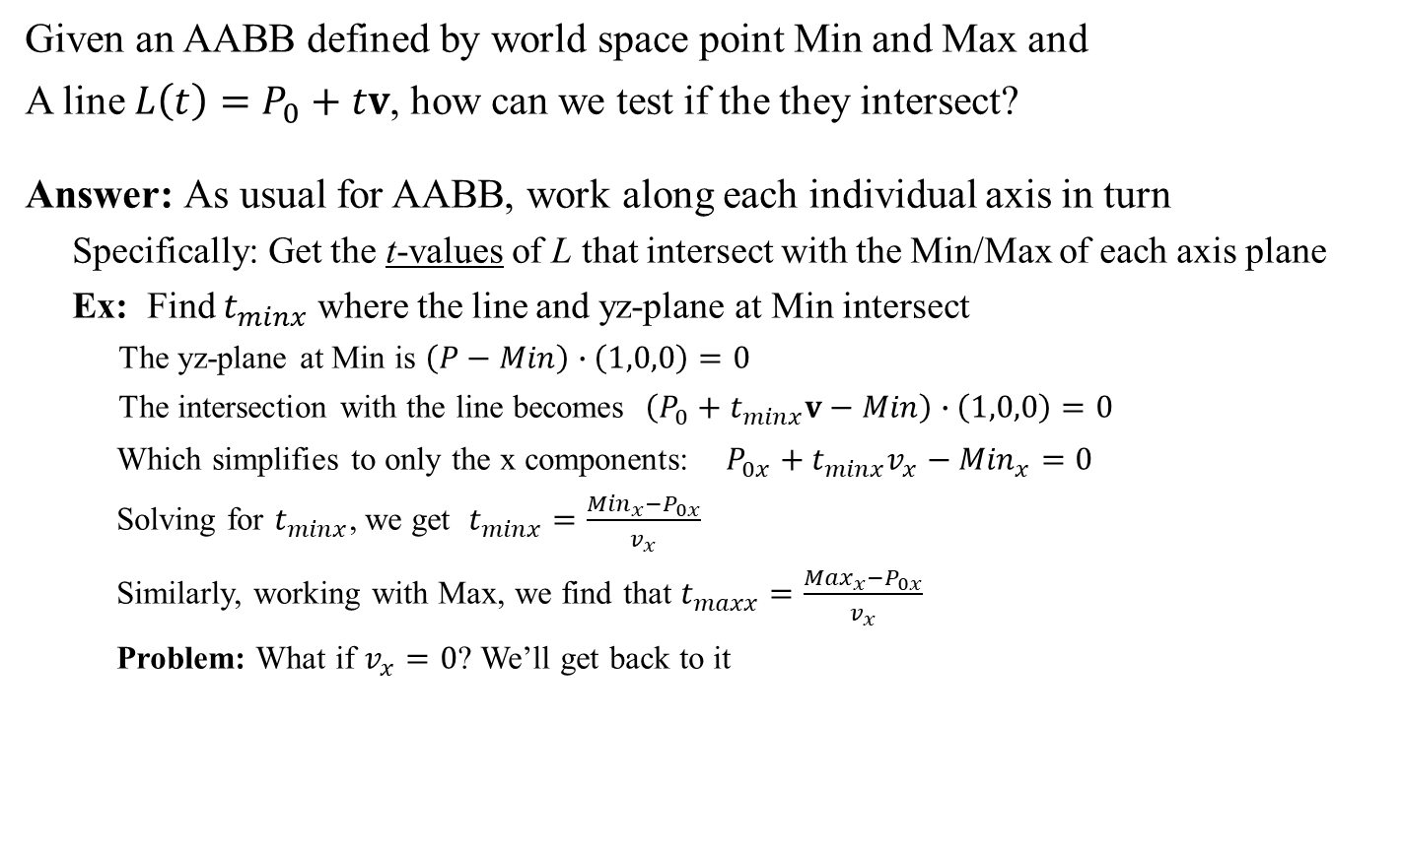



Line-AABB Intersection
Given an AABB defined by world space point Min and Max and
A line $L\left(t\right)=P_{0}+tv$, how can we test if the they intersect?
Answer: As usual for AABB, work along each individual axis in turn
Specifically: Get the t-values of L that intersect with the Min/Max of each axis plane
Ex: Find $t_{minx}$ where the line and yz-plane at Min intersect
The yz-plane at Min is $\left(P−Min\right)∙\left(1,0,0\right)=0$
The intersection with the line becomes $\left(P_{0}+t_{minx}v−Min\right)∙\left(1,0,0\right)=0$
Which simplifies to only the x components: $P_{0x}+t_{minx}v_{x}−{Min}_{x}=0$
Solving for $t_{minx}$, we get $t_{minx}=\frac{{Min}_{x}−P_{0x}}{v_{x}}$
Similarly, working with Max, we find that $t_{maxx}=\frac{{Max}_{x}−P_{0x}}{v_{x}}$
Problem: What if $v_{x}=0$? We’ll get back to it
Side note: This could be used for object picking.
$$L\left(t_{minx}\right)$$
$$L\left(t_{maxx}\right)$$
$${Max}_{y}$$
$${Min}_{y}$$
$${Max}_{x}$$
$${Min}_{x}$$

Slide 25
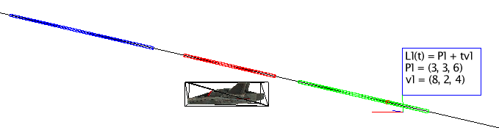
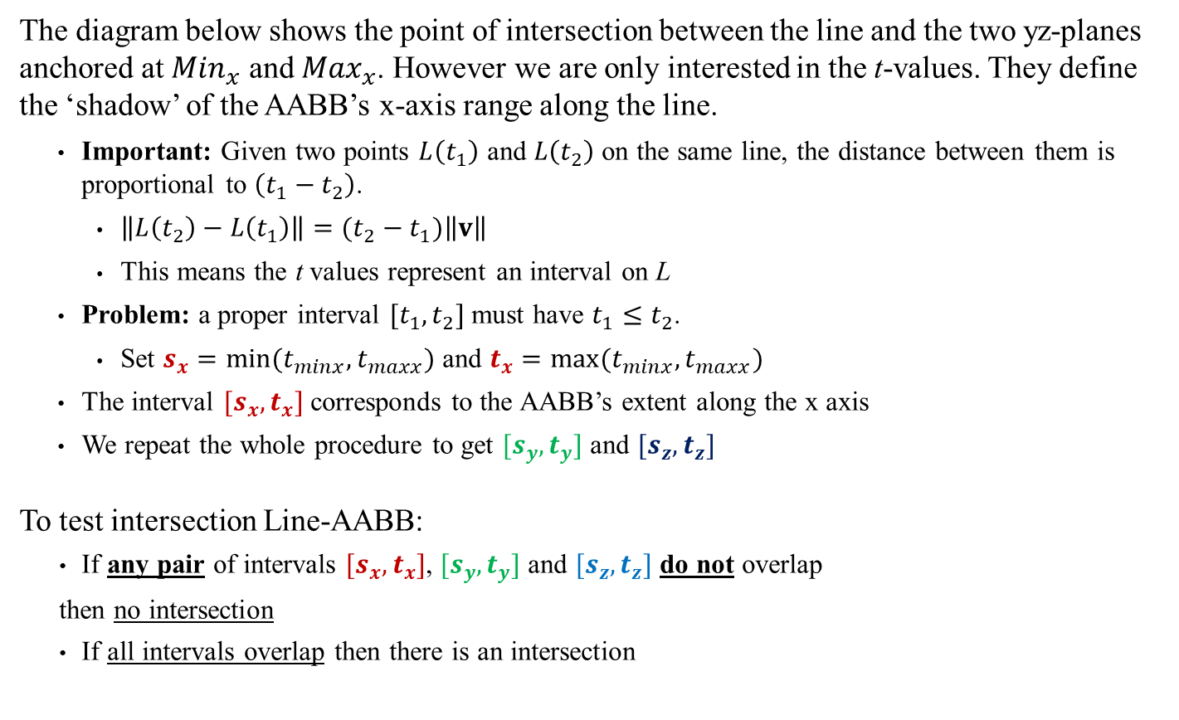


Line-AABB Intersection
The diagram below shows the point of intersection between the line and the two yz-planes anchored at ${Min}_{x}$ and ${Max}_{x}$. However we are only interested in the t-values. They define the ‘shadow’ of the AABB’s x-axis range along the line.
Important: Given two points $L\left(t_{1}\right)$ and $L\left(t_{2}\right)$ on the same line, the distance between them is proportional to $\left(t_{1}−t_{2}\right)$.
$\left\|L\left(t_{2}\right)−L\left(t_{1}\right)\right\|=(t_{2}−t_{1})\left\|v\right\|$
This means the t values represent an interval on L
Problem: a proper interval $[t_{1},t_{2}]$ must have $t_{1}≤t_{2}$.
Set $s_{x}=min(t_{minx},t_{maxx})$ and $t_{x}=max(t_{minx},t_{maxx})$
The interval $[s_{x},t_{x}]$ corresponds to the AABB’s extent along the x axis
We repeat the whole procedure to get $[s_{y},t_{y}]$ and $[s_{z},t_{z}]$
To test intersection Line-AABB:
If any pair of intervals $[s_{x},t_{x}]$, $[s_{y},t_{y}]$ and $[s_{z},t_{z}]$ do not overlap
then no intersection
If all intervals overlap then there is an intersection
$$L\left(t_{minx}\right)$$
$$L\left(t_{maxx}\right)$$
$$L\left(t_{maxy}\right)$$
$${Max}_{y}$$
$$L\left(t_{miny}\right)$$
$${Min}_{y}$$
$${Max}_{x}$$
$${Min}_{x}$$

Slide 26


Line-AABB Intersection: Visualization
Looking down at the xz-plane: Looking edge-on at the xy-plane:
Note: The alignment of the colored ‘shadows’ appears slightly off because of 3D parallax effects

Slide 27


Line-AABB Intersection: Visualization
Note: Intersection occurs only if all interval pairs overlap!
Here, green and blue don’t overlap and there is clearly no intersection,
Here, all three intervals overlap and there is intersection,

Slide 28


Line-AABB Intersection
Problem: dealing with the potential division by zero in computing the t values such as $t_{minx}=\frac{{Min}_{x}−P_{0x}}{v_{x}}$
If $v_{x}=0$ this means the line $L\left(t\right)=P_{0}+tv$ is parallel to the yz-plane.
If the line exist in outside the ${Min}_{x}$ and ${Max}_{x}$ planes (ie: $P_{0x}<{Min}_{x}$ or ${Max}_{x}<P_{0x}$) then no collision.
Otherwise, the interval is the entire line…
Similarly for $v_{y}$ and $v_{z}$
$$L\left(t\right)$$
$${Max}_{y}$$
$${Min}_{y}$$
$${Max}_{x}$$
$${Min}_{x}$$

Slide 29

Line-AABB Intersection: Final Algorithm
Line-AABB test: $L\left(P_{0},v\right)$ and AABB(Max, Min)
if $v_{x}=0$
if ($P_{0x}<{Min}_{x}$ || $P_{ox}>{Max}_{x}$) then return false
else [$s_{x}$,${ t}_{x}$] = [$−∞,∞$] // all the axis is covered
else
a = $({Min}_{x}−P_{ox})/v_{x}$
b = $({Max}_{x}−P_{ox})/v_{x}$
$s_{x}$ = smallest of (a, b)
$t_{x}$ = largest of (a, b)
(Repeat the above for y and z axis)
if [$s_{x}$,${ t}_{x}$] overlaps [$s_{y}$,${ t}_{y}$] AND
[$s_{y}$,${ t}_{y}$] overlaps [$s_{z}$,${ t}_{z}$] AND
[$s_{z}$,${ t}_{z}$] overlaps [$s_{x}$,${ t}_{x}$] then return true
See also Dynamic Examples

Slide 30

Line-OBB Intersection
Given an OBB defined by local space points Min and Max and matrix W and a line $L\left(t\right)=P+tv$, how can we test if the they intersect?
Answer: Convert the line to the OBB’s local space where the OBB is an AABB and use previous procedure.

Slide 31
GAM 325/425: Applied 3D Geometry
Part IV:
Plane Intersections

Slide 32






Plane-Bsphere Intersection
Problem: Given an affine plane defined by $P_{0}$ and n, how can we determine if a Bsphere B(C, r ) intersects with it?
Solution: Using results from lecture 1:
$${\text{proj}}_{n}\left(C−P_{0}\right)=\frac{\left(C−P_{0}\right)∙n}{{\left\|n\right\|}^{2}}n$$
Which means:
$$d=\left\|{\text{proj}}_{n}\left(C−P_{0}\right)\right\| \\ =\left|\frac{\left(C−P_{0}\right)∙n}{{\left\|n\right\|}^{2}}\right|\left\|n\right\| \\ =\left|\frac{\left(C−P_{0}\right)∙n}{\left\|n\right\|}\right|$$
The Bsphere intersects the plane if $d<r$
$$C$$
n
$$C−P_{0}$$
d = ?
$$P_{0}$$

Slide 33

Plane Distance Variations
The previous slide showed how to compute a point’s distance to a plane
$$d=\left\|{\text{proj}}_{n}\left(C−P_{0}\right)\right\|=\left|\frac{\left(C−P_{0}\right)∙n}{{\left\|n\right\|}^{2}}\right|\left\|n\right\| =\left|\frac{\left(C−P_{0}\right)∙n}{\left\|n\right\|}\right|$$
We can also compute d without using the absolute value:
If d = 0 then C is in the plane
If d > 0 then C is above the plane (same side as n)
If d < 0 then C t is below the plane (opposite side as n)
In these cases d is the signed distance from the plane.
Similarly: if the exact distance isn’t important but you only wish to know if a point is above/below the plane, we can drop the $1/{\left\|n\right\|}$
$\left(C−P_{0}\right)∙n=0$ then C is in the plane (Note: this is the standard plane equation)
$\left(C−P_{0}\right)∙n>0$ then C is above the plane
$\left(C−P_{0}\right)∙n<0$ then C is below the plane
$$C$$
n
$$C−P_{0}$$
d = ?
$$P_{0}$$
See also Dynamic Examples

Slide 34



Plane-Segment Intersection
Recall that a line segment is defined by two points $S_{1}$ and $S_{2}$ and is composed of all the points $S\left(t\right)=S_{1}+t(S_{2}−S_{1})$ for $0≤t≤1$.
Problem: Given a plane defined by $P_{0}$ and n, how can we know whether the segment from $S_{1}$ to $S_{2}$ intersects the plane?
Solution 1: We could do something similar this slide:
Note that intersection point between the line S and the given plane (see week 1 exercises)
$$S\left(t′\right)=S_{1}+t^{′}(S_{2}−S_{1})=S_{1}+\left(\frac{\left(P_{0}−S_{1}\right)∙n}{(S_{2}−S_{1})∙n}\right)(S_{2}−S_{1})$$
This means $t^{′}=\frac{\left(P_{0}−S_{1}\right)∙n}{(S_{2}−S_{1})∙n}$
If $0≤t^{′}≤1$ then there is intersection. Otherwise no intersection
See also Dynamic Examples
This works fine and a (possible) advantage of this approach is that by also returning $t^{′}$, we can judge how much of the segment is below the plane and/or get the intersection point.
Implementation downside: float division and we need to test for division by zero (line parallel to the plane)

Slide 35



Plane-Segment Intersection
Recall that a line segment is defined by two points $S_{1}$ and $S_{2}$ and is composed of all the points $S\left(t\right)=S_{1}+t(S_{2}−S_{1})$ for $0≤t≤1$.
Problem: Given a plane defined by $P_{0}$ and n, how can we know whether the segment from $S_{1}$ to $S_{2}$ intersects the plane?
Solution 2: if we only care about yes/no for the intersection, we could use one of the plane-distance variations: `
If the segment intersects the plane then $S_{1}$ and $S_{2}$ must be on opposite side of the plane
Compute $d_{1}=\left(S_{1}−P_{0}\right)∙n$ and $d_{2}=\left(S_{2}−P_{0}\right)∙n$
If either ($d_{1}<0$ and $d_{2}>0$) or ($d_{2}<0$ and $d_{1}>0$) then there is intersection.
(Alternatively: if $d_{1}d_{2}<0$ then intersection)
We get no information about how much of the segment is above/below the plane, but much faster implementation and no float division or risk of division by zero
See also Dynamic Examples

Slide 36




OBB-Plane
(Adapted from Section 12.3.2.4, P491 AABB-Plane Intersection)
Problem: Given an OBB and a plane as shown, how can we test intersection?
Solution 1: Test each the OBB’s 12 edges for Plane-Segment intersection.
Return true if any one of them test true.
Solution 2:
Note that for each face, it’s sufficient to test two diagonals.
Theorem: An edge intersect the face if and only if one of the diagonals does.
This means we can test 6x2 = 12 segments
Solution 3:
Actually, a similar reasoning shows that testing the cube’s diagonals is enough.
This brings down the number of tests to 4
$$M$$
Works, but that’s a lot of tests…
C’
$$n$$
$$P_{0}$$
That’s not better…
Better, but we can still improve on this!

Slide 37


OBB-Plane
(Adapted from Section 12.3.2.4, P491 AABB-Plane Intersection)
Consider the diagonals in relation with the plane normal
If we could identify the diagonal most closely align with n,
we could get away with only one plane-segment test!
From last week:
given an OBB and an axis v = n, we can
compute the maximum projection using:
Technically, this algorithm returns the length of the half diagonal projected on n.
Using this information, we can reconstruct the projection of the full diagonal on n.
$$n$$
$$P_{0}$$
Max OBB projection on Axis v
Move v to local space: $v^{′}=W^{−1}v$
Compute the max projection
$${\text{Proj}}_{max}={\left(\left|{v′}_{x}a\right|+\left|{v′}_{y}b\right|+\left|{v′}_{z}c\right|\right)}/{\left\|v\right\|}$$
Return ${(s}^{2}){\text{Proj}}_{max}$

Slide 38







OBB-Plane
(Adapted from Section 12.3.2.4, P491 AABB-Plane Intersection)
To get both ends of the full diagonal segment:
Let C be the OBB’s center and h the length of the half-diag proj.
$S_{1}=C−h\frac{n}{\left\|n\right\|}$ and $S_{2}=C+h\frac{n}{\left\|n\right\|}$
We now have the following situation:
The segment formed by $S_{1}$ and $S_{2}$ represents the projection of
the OBB along n.
The segment from $S_{1}$ to $S_{2}$has the same direction as n.
This allows us to simplify the plane-segment intersection in this case:
Compute $d_{1}=\left(S_{1}−P_{0}\right)∙n$ and $d_{2}=\left(S_{2}−P_{0}\right)∙n$
If $d_{1}<0$ and $d_{2}>0$ then there is intersection
$$S_{2}$$
$$C$$
$$S_{1}$$
$$n$$
$$h$$
$$h$$
By construction, the other case cannot happen

Slide 39





OBB-Plane: Final Algorithm
Problem: Given an OBB and a plane as shown, how can we test intersection?
Solution:
$$M$$
OBB[Max, Min, C, d] - Plane[$P_{0}$, n] Intersection
h = OBB half projection on n
$$S_{1}=C−h\frac{n}{\left\|n\right\|}$$
$$S_{2}=C+h\frac{n}{\left\|n\right\|}$$
$$d_{1}=\left(S_{1}−P_{0}\right)∙n$$
$$d_{2}=\left(S_{2}−P_{0}\right)∙n$$
return ($d_{1}<0$ and $d_{2}>0$)
See also Dynamic Examples
C’
Max OBB projection on Axis v
Move v to local space: $v^{′}=W^{−1}v$
Compute the max projection
$${\text{Proj}}_{max}={\left(\left|{v′}_{x}a\right|+\left|{v′}_{y}b\right|+\left|{v′}_{z}c\right|\right)}/{\left\|v\right\|}$$
Return ${(s}^{2}){\text{Proj}}_{max}$
$$n$$
$$P_{0}$$

Slide 40

OBB-Plane: Final Algorithm
Problem: Given an OBB and a plane as shown, how can we test intersection?
Solution:
$$M$$
OBB[Max, Min, C, d] - Plane[$P_{0}$, n] Intersection
h = OBB half projection on n
$$S_{1}=C−h\frac{n}{\left\|n\right\|}$$
$$S_{2}=C+h\frac{n}{\left\|n\right\|}$$
$$d_{1}=\left(S_{1}−P_{0}\right)∙n$$
$$d_{2}=\left(S_{2}−P_{0}\right)∙n$$
return ($d_{1}<0$ and $d_{2}>0$)
C’
Max OBB projection on Axis v
Move v to local space: $v^{′}=W^{−1}v$
Compute the max projection
$${\text{Proj}}_{max}={\left(\left|{v′}_{x}a\right|+\left|{v′}_{y}b\right|+\left|{v′}_{z}c\right|\right)}/{\left\|v\right\|}$$
Return ${(s}^{2}){\text{Proj}}_{max}$
$$n$$
$$P_{0}$$
In terms of performance, this is fairly efficient:
No loops or conditionals to be found!
$W^{−1}$ is likely already computed & maintained by the game engine
Computing $\left\|n\right\|$ can’t be avoided here, but the cost is worth it given the overall savings in performance

Slide 41
AABB-Plane Intersection
Problem: Given an AABB and a plane as shown, how can we test intersection?
Solution:
Once again: treat the AABB as an OBB and use the same algorithm

