Slide 1
CSC 355 Database Systems
Lecture 2
Eric J. Schwabe
School of Computing, DePaul University
Winter 2020

Slide 2
Today:
The Relational Model

Slide 3
Data Models
A data model describes three things about stored data:
  Structure of the data: How is the data organized?
  Operations on the data: What can be done with the data?
  Constraints on the data: How are the data restricted?

Slide 4
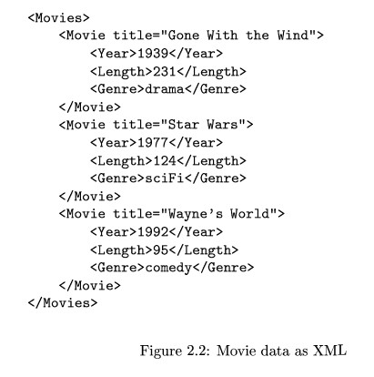
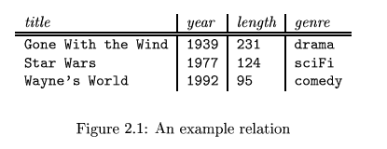
Relational vs. Semi-structured
From Ullman/Widom:

Slide 5
Relational vs. Semi-structured
Relational Model:
  Structure: Two-dimensional tables with links
  Operations: Relational algebra / SQL
  Constraints: Data domains, uniqueness,…
Semi-structured Model:
  Structure: Nested XML elements
  Operations: Element traversal, searching
  Constraints: Data domains, nesting restrictions,…

Slide 6
The Relational Model
Introduced by E.F.Codd in 1970
First model that separated the logical organization of the data from its physical implementation
Model is based on formal logic and the relational algebra

Slide 7
The Relational Model
Data is stored in two-dimensional tables called relations, each one having a name
Each row is a tuple representing one instance of the entity the table represents
Each column is an attribute, representing a property for which each instance has a value
Every component in a tuple must have a value taken from its attribute’s associated domain

Slide 8
Relation Example
Name: EMPLOYEE
Tuples: { (100, Margaret Simpson, Marketing, 48,000) ,
(140, Allen Beeton, Accounting, 52,000.00) ,
(110, Chris Lucero, Info Systems, 43,000.00) ,
…and three more… }
Attributes: ID, Name, Dept, Salary
Domains: (Three-digit) integer, string (of length at most 20), string (of length at most 12), decimal number (with at most five digits to the left of the decimal point and two to the right)
  Note that domains can be a little complicated to describe...

Slide 9
Properties of Relations
1. Each relation has a unique name (in database)
2. Each attribute has a unique name (in relation)
3. Each entry of a relation contains a single value from its attribute’s domain (or NULL)
4. The order of the records does not matter
5. The order of the attributes does not matter
6. No two records in a relation are identical

Slide 10
Relation Schema vs. Instance
The schema of a relation consists of the name of the relation followed by a list of its attributes (domains may be included also…)
  EMPLOYEE ( ID , Name , Dept , Salary ) …
  EMPLOYEE ( ID:number , Name:string , Dept:string , Salary:number ) … ?
  EMPLOYEE ( ID:integer(3) , Name:string(20) , Dept:string(12) , Salary:number(5.2) ) … ?

Slide 11
Relation Schema vs. Instance
An instance of a relation is a set of tuples, where each tuple contains a value for each attribute (from the associated domain), or perhaps NULL (indicating no value)
  DBMS enforces these “domain constraints”
Instances are often presented as tables rather than as sets, but the order of the rows in these tables is not significant

Slide 12
Candidate Keys
A candidate key is a set of attributes for which each tuple in the relation must have a unique set of values (“key constraints”), and for which no subset of the set has this property
  The book calls these just keys, but I will use the more specific term candidate keys since there are different types of keys…
This property must hold for all possible relation instances for it to be a candidate key

Slide 13
Primary Keys
One of the candidate keys can be chosen as the primary key for the relation
A relation may have many candidate keys, but can have only one primary key
The primary key will be underlined in the schema
  A primary key must have a unique set of values in each tuple, and may not contain any NULL values in any tuple (“entity integrity”)

Slide 14
Foreign Keys
We link two relations using a shared key that is the primary key in one of the relations
In the other relation, this key is called a foreign key (dotted underline in schema,
with arrow to corresponding primary key)
  Every value of the foreign key must be the value of the corresponding primary key in some tuple
  Thus the foreign key associates each tuple with exactly one tuple in the relation that it references

Slide 15
Referential Integrity
Every foreign key value must appear as the value of the primary key in some row of the table it references
This restricts the changes that can be made:
  We can add a row containing a foreign key only if the value of the foreign key appears among the values of the referenced primary key
  We can remove a row containing a primary key only if the value of the primary key does not appear among the values of any referencing foreign key

Slide 16
Constraints
All of these will be maintained by the DBMS:
  Domain constraints: In every tuple, the value of each attribute must come from its specified domain
  Key constraints: Each tuple must have a unique set of values in each of its candidate keys
  Entity integrity: Each tuple must have a unique set of values in its primary key, and not any NULLs
  Referential integrity: Every foreign key value must appear as the value of the primary key in some tuple of the relation it references

Slide 17
Database Schema vs. Instance
The schema of a relational database consists of:
  The schema of each relation in the database
    Name, list of attributes (and maybe domains)
    Primary keys and foreign keys underlined
  An arrow from each foreign key to the primary key it references

Slide 18
Database Schema vs. Instance
An instance of a relational database consists of:
  An instance of each relation in the database, where each relation instance satisfies all the required constraints:
    domain constraints, key constraints, entity integrity, referential integrity (and any user-defined constraints)
  The only changes allowed by the DBMS are those that result in another valid instance…

Slide 19
Next Time:
SQL Data Definition Language
Start SQL Queries?
(Assignment 1 will be posted after class, due 1/15…)

