Slide 1
CSC 355 Database Systems
Lecture 9
Eric J. Schwabe
School of Computing, DePaul University
Winter 2020

Slide 2
Today:
Transactions

Slide 3
Problem: Interruptions
Two SQL statements are written to transfer money from one bank account to another
One executes, then the server crashes
  What happens to the money?

Slide 4
Problem: Concurrency
Two SQLDeveloper connections query the same table
One updates it
Both query it again
  What will they see?

Slide 5
Problem: Concurrency
Two passengers both see the same open airplane seat
Both try to reserve it
  Who gets it?

Slide 6
Solution: Transactions
A transaction is a collection of SQL statements that must be executed as a unit
The Transaction manager in the DBMS must handle
  Interruptions: Logging and recovery, Buffers
  Concurrency: Concurrency control, Lock tables

Slide 7
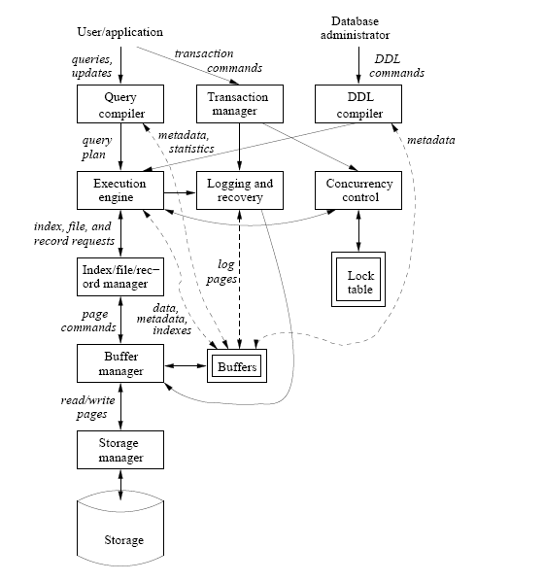
Components of a DBMS
(From Ullman/Widom)

Slide 8
ACID Properties
A transaction should satisfy the following properties:
  Atomicity: Executes completely or not at all
  Consistency: Satisfies all database constraints
  Isolation: Executes “separately” from others
  Durability: Once executed, results are permanent

Slide 9
Atomicity
Transaction operations are kept in a local store, not applied to database immediately
  Transaction can see its own changes, others can’t
When transaction is completed, results are “committed” to the database in their entirety
Partial results can be “rolled back” before completion (by user or by system)

Slide 10
Durability
Committing changes also insures durability
  Once changes are committed to the database, they are permanent, and cannot be rolled back

Slide 11
Consistency
As long as legal SQL is used, the DBMS will insure that database constraints are satisfied
  Constraints can be “deferred”, so that they are only checked when the transaction commits
    Add DEFERRABLE INITIALLY DEFERRED (or IMMEDIATE) to end of constraint definition
    Change later with SET CONSTRAINT Name DEFERRED (or IMMEDIATE)
    If constraint is violated, transaction is rolled back

Slide 12
Isolation
Must maintain separation among transactions that access data concurrently
  Several different levels of isolation
  Tradeoffs of data integrity vs. performance
  Transactions might read or modify data

Slide 13
Serializable Isolation
Transactions must behave as though they were run serially (first one, then the other)
DBMS can “lock” all tables used by a transaction (or just parts of the tables)
  Transactions using the same tables would have to wait until they were released
  Transactions using other tables could run at the same time

Slide 14
Read Committed Isolation
Not as strict as serializable
If one transaction tries to read data that was written by another, it can only see changes that have been committed
  Can’t be rolled back, but could be changed later
  Multiple queries of the same table might not yield the same results...

Slide 15
Read Committed Isolation
This isolation level allows:
  Phantoms: Tuples may be added to query results while the transaction is running
  Non-repeatable reads: Tuples may be added to or removed from query results while the transaction is running (includes phantoms)
Stricter “Repeatable Read” level allows phantoms, but not other non-repeatable reads

Slide 16
Dirty Reads
What about uncommitted changes?
Reads of uncommitted changes from another transaction are called dirty reads
  They could be rolled back later, in which case we shouldn’t even have known about them…
“Read uncommitted” level allows dirty reads
  Some are more dangerous than others!

Slide 17
Isolation Levels
SERIALIZABLE: Transactions must appear to run serially – cannot read any changes from others
REPEATABLE READ: Can read committed changes that only add data (allows phantoms)
READ COMMITTED: Can read all committed changes (allows phantoms, non-repeatable reads)
READ UNCOMMITTED: Can read all changes (allows phantoms, non-repeatable reads, dirty reads)

Slide 18
Transactions in Oracle
Supports READ COMMITTED (by default) and SERIALIZABLE isolation levels only
  (Can have READ WRITE (by default) and READ ONLY transactions…)
SET TRANSACTION to start transaction, COMMIT or ROLLBACK to end
  SQL statements that modify data start an implicit transaction; use COMMIT to end it

Slide 19
Midterm Exam Information
In class, Wednesday 2/12
Closed book, closed notes, no electronic devices
You may bring one 8.5”x11” sheet of original, handwritten notes to the exam (can use both sides)
  No typed, printed, or photocopied notes permitted
  Notes must be turned in with exam
Multiple choice, short answers, writing and/or evaluating SQL queries and transactions
Sections 1.1-1.3, 2.1-2.3, 6.1-6.6, 7.1-7.3
Review outline will be posted after class

Slide 20
Next Time:
Finish Transactions
Set Operations (finally…)
Review for Midterm Exam
Introduction to Relational Database Design
  Sections 3.1-3.3
(Assignment 4 due 2/6…)

