Slide 1
CSC 373 Spring 2019 Prof. Lytinen
Introduction to Assembly Language
Readings:
Bryant and O’Hallaron, sections 3.1-3.7; 3.10.
Notes do not cover 3.6.8

Slide 2
Machine Code
When a C program is compiled, eventually it is translated into machine code
Currently x86-64 machine code, named for historical reasons
Original developed by Advanced Micro Devices (AMD) and was named AMD64
x86-64 machine code has evolved from 16-bit processors to current 64-bit; backwards compatability has been maintained

Slide 3
Assembly Language
In essence, a (somewhat) more readable version of machine code
Translation to machine code is almost one-to-one (i.e., each assembly language instruction often translates to one machine code instruction)
Instructions' names are used; no need to memorize op code (see below)
Likewise for some operands (although hexadecimal is used to indicate addresses)
x64 Assembly

Slide 4
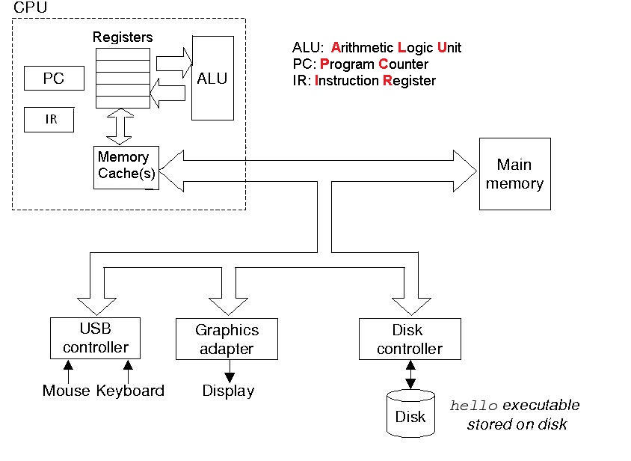
x86-64 Architecture

Slide 5
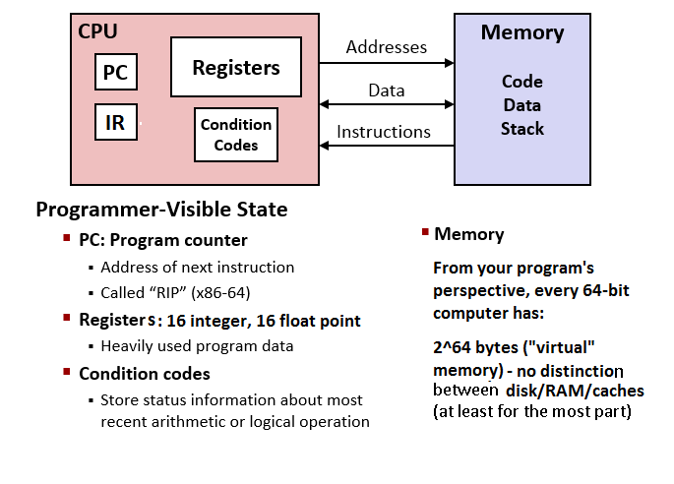
What your program sees

Slide 6
Memory from the point of view of a process
Only 3 types of memory: registers, main memory and files
Cache(s) are invisible to a process
Processes also don’t know what portions of their address space is currently in main memory and what is still on the disk.
Registers
Program counter register (called %rip in assembly language) keeps track of execution location in main memory (a 64-bit address) . No direct access to this register.
Instruction register contains the current instruction (1-15 bytes on x86-64)
16 regular 64-bit integer registers
16 64-bit floating point registers

Slide 7
Comparisons of speed
Memory Type | Latency (how many times slower)
Registers | 1
L1 Cache | 4
L2 Cache | 10
L3 Cache | 50
RAM | 200
Disk | 100,000

Slide 8
Chip history
The first commercial 8-bit processor was the Intel 8008 (1972) (Wikipedia)
chars, ints, floats(?), addresses, etc. all took up 1 byte
2⁸ bytes of addressable memory!! 0x00 – 0xff. Everything else had to be on a disc (or another computer)

Slide 9
Intel 8008: 8-bit machine
Eight 8-bit registers: A, B, C, D, SI, DI, SP, BP
First 4 were general purpose; the other 4 were for specific purposes
Naming made some sense at the time (SI = Source Index, DI = Destination Index, SP = Stack pointer, BP = Base pointer

Slide 10
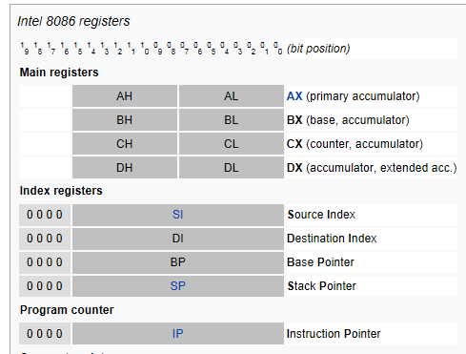
Intel 8086: 16 bit machine
H = higher, L = lower
16 bits
each

Slide 11
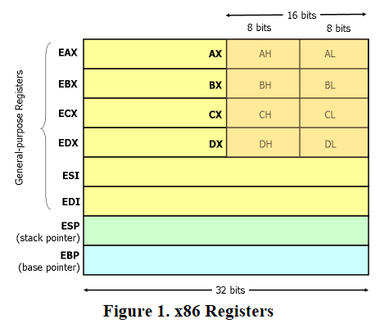
32-bit machines

Slide 12
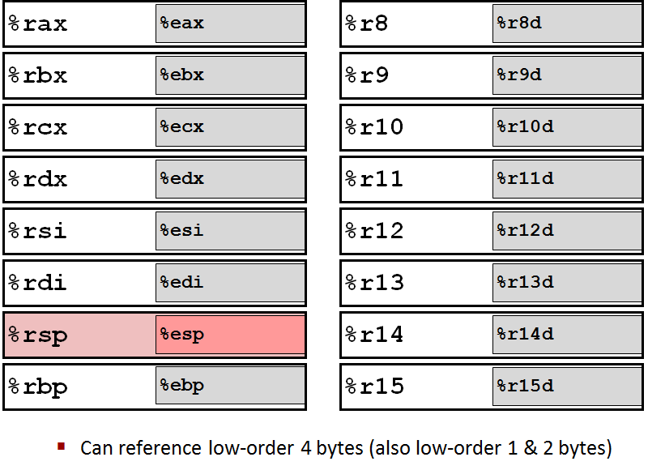
X86-64 Integer Registers
Example: %rdi, %edi, %di, %dil

Slide 13
x86-64 instructions
Machine code instructions are composed of an operation code (op code) and its operands. Of course, all are binary numbers.
The first portion of an instruction (up to 3 bytes) encodes the op code
Instructions are very low-level; e.g., 0x4889 is the op code which copies data from one 64-bit register to another
Example:
48 89 d8 means movq %rbx,%rax
Aside: why is the entire instruction 3 bytes long?
Each opcode has a fixed number of operands (1 or 2), which takes up a fixed number of bytes (or possibly bits)
Each operand specifies either a register or a (64-bit virtual) memory address
Registers can be encoded in 4 bits, since there are 16 of them.

Slide 14
Register names
General-purpose registers are legacy names for backwards compatibility
First microprocessors were 8-bit (meaning the address space of a process was 2⁸ bytes)
General purpose registers were %a, %b, %c, %d
Other registers had special purposes, and their names reflect this for historical reasons. For example, only certain registers could have pointer values (%di, %si, %bp, %sp) which we’ll talk about later
si: source index; di = destination index; bp = base pointer; sp = stack pointer

Slide 15
Register names
When 16-bit architecture was introduced, integer registers were increased to 2 bytes (as well as address spaces). To distinguish, full 16-byte registers were name %ax, %bx, %cx, and %dx. However, for backwards compatibility, the lower-order byte of the 4 general-purpose registers could still be used with the name %a, %b, %c, and %d.
32-bit architecture: %eax, %ebx, %ecx, %edx, %edi, %esi, %ebp, %esp
6 of the 8 registers became general-purpose, but retained their special-purpose names again for backwards compatibility (%ebp and %esp were still special-purpose)
To reference 8 bits, the register names changed to %al, %ah, etc.
64-bit architecture: there are now 16 integer registers, called %rax, %rbx, %rcx, %rdx, %rdi, %rsi, %rbp, %rsp, %r8…%r15

Slide 16
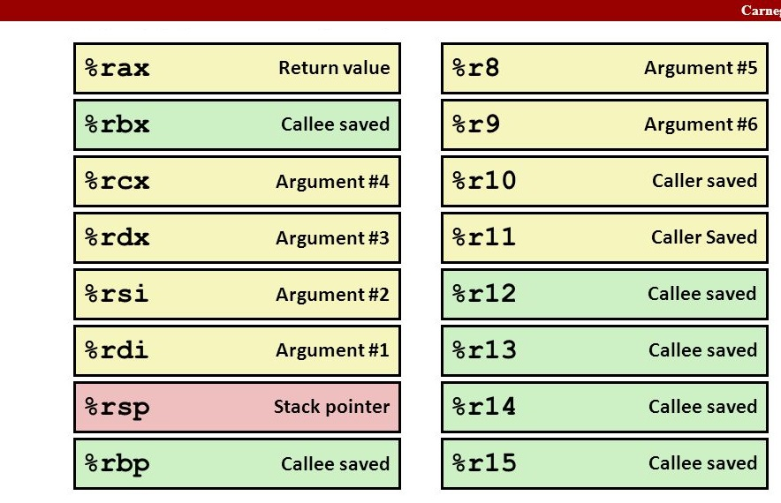
X86-64 Integer Registers: Usage Conventions
While most registers can be used for general purposes, some are still also used for special purposes

Slide 17
Example of assembly language and machine code
int main() {
printf("Hi\n");
printf("Bye\n");
}
Memory address | Machine code of instruction in that address | Corresponding assembly language
400530 | 55 | push %rbp
400531 | 48 89 e5 | mov %rsp,%rbp
400534 | bf e0 0f 40 00 | mov $0x4005e0, %edi
400539 | e9 d2 fe ff ff | callq 400410 <puts@plt>
40053e | bf 3e 0f 40 00 | mov $0x4005e3, %edi
400543 | e8 c8 fe ff ff | callq 400410 <puts@plt>
400548 | 5d | pop %rbp
400549 | c3 | retq

Slide 18
We can inspect further to see what the function does
%edi is used to pass one of the parameters to a function (in this case puts)
At 400534, the address 0x4005e0 is placed in %edi
At 40053e, the address 0x4005e3 is placed in %edi
In the debugger, we can type
(gdb) x/s 0x4005e0
0x4005e0: "Hi"
(gdb) x/s 0x4005e3
0x4005e3: "Bye“
The op code bf is
“move immediate” (also
indicated by $
Memory address | Machine code | Corresponding assembly language
400530 | 55 | push %rbp
400531 | 48 89 e5 | mov %rsp,%rbp
400534 | bf e0 05 40 00 | mov $0x4005e0, %edi
400539 | e9 d2 fe ff ff | callq 400410 <puts@plt>
40053e | bf e3 05 40 00 | mov $0x4005e3, %edi
400543 | e8 c8 fe ff ff | callq 400410 <puts@pllt>
400548 | 5d | pop %rbp
400549 | c3 | retq

Slide 19
How a program runs
./hello
A process is created
An address space is created; always 2⁶⁴ bytes on a 64-bit machine The program now thinks it has 2⁶⁴ bytes of memory
In reality, part of this address space may be on disk, in main memory, and/or in cache memory. Much of it will not be anywhere.
The starting address of the program in the address space is loaded into the CPU's program counter (%rip)
In the example above, 0x0000000000400530

Slide 20
How a program runs
Based on the contents of the PC, The first (next) instruction is copied from memory into the instruction register
First instruction: 0x55
The program counter is incremented by the appropriate number (1-15, depends on the length of the instruction)
After 1st instruction, increment %rip by 1
After 2nd instruction, increment %rip by 3
The instruction in the instruction register is executed. Some instructions modify the PC (to make loops, call other functions, etc.)
Repeat steps 4-6

Slide 21
PC
Memory address | Machine code | Corresponding assembly language
400530 | 55 | push %rbp
400531 | 48 89 e5 | mov %rsp,%rbp
400534 | bf e0 05 40 00 | mov $0x4005e0, %edi
400539 | e9 d2 fe ff ff | callq 400410 <puts@plt>
40053e | bf e3 05 40 00 | mov $0x4005e3, %edi
400543 | e8 c8 fe ff ff | callq 400410 <puts@pllt>
400548 | 5d | pop %rbp
400549 | c3 | retq
400530
IR
55

Slide 22
PC
Memory address | Machine code | Corresponding assembly language
400530 | 55 | push %rbp
400531 | 48 89 e5 | mov %rsp,%rbp
400534 | bf e0 05 40 00 | mov $0x4005e0, %edi
400539 | e9 d2 fe ff ff | callq 400410 <puts@plt>
40053e | bf e3 05 40 00 | mov $0x4005e3, %edi
400543 | e8 c8 fe ff ff | callq 400410 <puts@pllt>
400548 | 5d | pop %rbp
400549 | c3 | retq
400531
IR
48 89 e5

Slide 23
PC
Memory address | Machine code | Corresponding assembly language
400530 | 55 | push %rbp
400531 | 48 89 e5 | mov %rsp,%rbp
400534 | bf e0 05 40 00 | mov $0x4005e0, %edi
400539 | e9 d2 fe ff ff | callq 400410 <puts@plt>
40053e | bf e3 05 40 00 | mov $0x4005e3, %edi
400543 | e8 c8 fe ff ff | callq 400410 <puts@pllt>
400548 | 5d | pop %rbp
400549 | c3 | retq
400534
IR
bf e0 05 40 00
“little-endian”
%edi
e0 0e 5 40 00

Slide 24
PC
Memory address | Machine code | Corresponding assembly language
400530 | 55 | push %rbp
400531 | 48 89 e5 | mov %rsp,%rbp
400534 | bf e0 05 40 00 | mov $0x4005e0, %edi
400539 | e9 d2 fe ff ff | callq 400410 <puts@plt>
40053e | bf e3 05 40 00 | mov $0x4005e3, %edi
400543 | e8 c8 fe ff ff | callq 400410 <puts@pllt>
400548 | 5d | pop %rbp
400549 | c3 | retq
400539
IR
e9 d2 fe ff ff
%edi
e0 05 40 00

Slide 25
PC
Memory address | Machine code | Corresponding assembly language
400530 | 55 | push %rbp
400531 | 48 89 e5 | mov %rsp,%rbp
400534 | bf e0 05 40 00 | mov $0x4005e0, %edi
400539 | e9 d2 fe ff ff | callq 400410 <puts@plt>
40053e | bf e3 05 40 00 | mov $0x4005e3, %edi
400543 | e8 c8 fe ff ff | callq 400410 <puts@pllt>
400548 | 5d | pop %rbp
400549 | c3 | retq
400410 (start of puts)
IR
???
%edi
e0 05 40 00

Slide 26
PC
Memory address | Machine code | Corresponding assembly language
400530 | 55 | push %rbp
400531 | 48 89 e5 | mov %rsp,%rbp
400534 | bf e0 05 40 00 | mov $0x4005e0, %edi
400539 | e9 d2 fe ff ff | callq 400410 <puts@plt>
40053e | bf e3 05 40 00 | mov $0x4005e3, %edi
400543 | e8 c8 fe ff ff | callq 400410 <puts@pllt>
400548 | 5d | pop %rbp
400549 | c3 | retq
40053e
IR
bf e3 05 40 00
%edi
e3 05 40 00

Slide 27
PC
Memory address | Machine code | Corresponding assembly language
400530 | 55 | push %rbp
400531 | 48 89 e5 | mov %rsp,%rbp
400534 | bf e0 05 40 00 | mov $0x4005e0, %edi
400539 | e9 d2 fe ff ff | callq 400410 <puts@plt>
40053e | bf e3 05 40 00 | mov $0x4005e3, %edi
400543 | e8 c8 fe ff ff | callq 400410 <puts@pllt>
400548 | 5d | pop %rbp
400549 | c3 | retq
400549
IR
c3
Back to OS
%edi
e3 05 40 00

Slide 28
Data formats
In Intel/AMD-speak, integer types have different names than in C. Again, this is for historical reasons
C declaration | Data type | AMD64 suffix | Size (bytes)
char | Byte | b | 1
short | Word | w | 2
int | double word | l | 4
long | quad word | q | 8
All pointers | quad word | q | 8
Examples:
movq %rax,%rbx means move (copy) 64 bits from %rax to %rbx
mov1 %eax,%ebx means move (copy) the least significant 32 bits from %rax to %rbx. The most significant 32 bits are not affected.

Slide 29
Assembly Language Example
C Code: Add two signed integers
long add(long x, long y) { return x + y; }
Assembly
movq %rsi, %rax # copy y into %rax
addq %rdi, %rax # add x to $rax
ret
By convention, the first 2 parameters are passed in %rdi and %rsi. The return value is passed in %rax.
Sort of like
%rax = %rsi
%rax += %rdi
return %rax

Slide 30
Common x86-64 Instructions
In 2-operand instructions, 1st operand is source, 2nd operand is destination. In 1-operand instructions, operand is destination. Many instructions have variants, such as mov, movq, movl, movw, movb. For most of the operations, both operands may be registers, or one may be a memory address and the other a register. Almost no instructions allow 2 memory addresses as their operands.
Instruction | # of operands | Meaning
mov | 2 | copy from src to dest
add | 2 | add src to dest; store result in dest
sub | 2 | subtract src from dest; store result in dest
imul | 2 | integer multiplication; store result in dest
cmp | 2 | Compare dest with src; flags are set accordingly
inc | 1 | increment dest
dec | 1 | decrement dest
neg | 1 | negate dest (e.g., 1 becomes -1)

Slide 31
Common x86-64 Instructions
.
Instruction | # of operands | Meaning
not | 1 | bitwise not dest
and | 2 | bitwise and dest and src; store result in dest
or | 2 | bitwise or dest and src; store result in dest
xor | 2 | bitwise xor dest and src; store result in dest
sal | 2 | shift (arithmetic) left. dest is shifted by src bits.
sar | 2 | shift (arithmetic) right. dest is shifted by src bits.
shr | 2 | shift (logical) right. dest is shifted by src bits.
lea | 2 | Load effective address. To be discussed later.
push | 1 | Push a value onto the program stack. To be discussed later
pop | 1 | Pop a value from the program stack. To be discussed later.

Slide 32
X86-64 Integer Registers: Usage Conventions
While most registers can be used for general purposes, some are still also used for special purposes

Slide 33
Special registers
Some registers are still only used for special purposes. These are:
%rip: instruction register. Contains the instruction currently being executed. Almost never seen in assembly language code.
%rsp: stack pointer. Almost always used in one particular way (more later)
%rbp: base pointer. Almost always used in one particular way (more later)
Others may be used for general purposes, but by convention are used as follows:
%rdi, %rsi, %rdx, %rcx, %r8, %r9: used for parameter passing (although they may also be used for other purposes)
%rax: used to return a value from a function (although it might be used for other purposes)

Slide 34
Examples
int same(int x) {
return x; }
same: movl %edi, %eax
ret
int add(int x, int y) {
int s = x + y;
return s; }
add: movl %rsi, %eax
addl %rdi, %eax
ret
unsigned long times8(unsigned long x) {
return x * 8; }
times8:
movq %rdi, %rax
shlq $3, %rax
ret

Slide 35
Examples
int negative(int x) {
return -x; }
negative: movl %edi,%eax
negl %eax
ret
char abs (char x) {
if (x >= 0) return x;
else return -x; }
abs:
movl %edi, %edx
movl %edi, %eax
sarb $7, %dl
xorl %edx, %eax
subl %edx, %eax
ret

Slide 36
abs(1)
%rdi/%edi | %rdx/%edx | %rax%eax
0x01 | 0x01
0x01 | 0x01 | 0x01
0x01 | 0x00 | 0x01
0x01 | 0x00 | 0x01
0x01 | 0x00 | 0x01
abs:
movl %edi, %edx
movl %edi, %eax
sarb $7, %dl # why 7?
xorl %edx, %eax
subl %edx, %eax
ret
abs(1) is 1

Slide 37
abs(-3)
abs:
movl %edi, %edx
movl %edi, %eax
sarb $7, %dl
xorl %edx, %eax
subl %edx, %eax
ret
#rsi /#esi | #rdx / #edx | #rax / %eax
0xfd | 0xfd
0xfd | 0xfd | 0xfd
0xfd | 0xff | 0xfd
0xfd | 0xff | 0x02
0xfd | 0xff | 0x03
Notes:
-3₁₀ is 0xfd (in 8-bit 2s complement)
0xff ^ 0xfd is 0x02 (see next slide)
0x02 – 0xff is 0x03 (using 8-bit 2s complement)
abs(-3) = 3

Slide 38
abs:
movl %edi, %edx
movl %edi, %eax
sarb $7, %dl
xorl %edx, %eax
subl %edx, %eax
ret
abs(-3)
%rdi %rdx %rax
0xfd
0xff
0xfd -> 0x02
11111111
^
11111101
=
00000010

Slide 39
abs:
movq %rdi,%rdx # %rdx = x
sarq $63,%rdx # shift right – why 63 bits?
movq %rdx, %rax
xorq %rdi, %rax
subq %rdx, %rax
ret
abs(-3)
%rdi %rdx %rax
0xfd
0xff
0x03
2 – (-1) = 3

Slide 40
Condition codes
The CPU maintains 1-bit registers, which store information about the results of the previous instruction. Usually the instructions are a variant of cmp but other instructions also set the condition codes, such as add, subtract, shift, etc. However, there are very few instructions which allow us to directly examine these flags
Code | Meaning
CF (carry flag) | The most recent operation generated a carry out of the most significant bit. Overflow for unsigned operations, including left logical shifts.
ZF (zero flag) | The most recent operation yielded 0. Note that cmp performs a subtraction, so ZF indicates the the numbers are equal
SF (sign flag) | The most recent operation yielded a negative number.
OF (overflow flag) | The most recent operation yielded a 2s complement overflow (from positive to negative or vice versa)

Slide 41
The cmp and test instructions
Both compare numbers
cmp subtracts one from the other
e.g., cmp %edx, %eax computes %eax - %edx
test performs a bitwise-and
yields different condition codes in certain cases
Example: %eax is 8, %edx is 6
cmpl %edx, %eax sets CF and SF
testl %edx, %eax sets ZF
test is often used to see if a register contains 0 (ZF is set)

Slide 42
Set instructions
Usually follow a cmp or test instruction
Sets dest based on condition code registers
Instruction | # of operands | Meaning
sete | 1 | Dest is set to ZF
setne | 1 | Dest is set to ~ZF
setge | 1 | Dest is set to ZF | ~SF
setg | 1 | Dest is set to ~ZF & ~SF
setle | 1 | Dest is set to ZF | SF
setl | 1 | Dest is set to ~ZF & SF

Slide 43
Example
int less(x, y) {
return x < y;
}
less:
xorl %eax, %eax # %eax = 0
cmpl %esi, %edi # compare %edi with %esi (computes %edi - %esi)
setl %al # if negative (%edi < %esi) , set %al to 1
ret

Slide 44
Some (hopefully) easy ones
f:
movl %edi, %eax
shrl $31, %eax
ret
g:
movl %edi, %eax
andl $1, %eax
xorl $1, %eax
ret
h:
cmpl %esi, %edi
setl %cl
xorl %eax, %eax
cmpl %edx, %esi
setl %al
andl %ecx, %eax
ret
64-bit register | 32-bit register | Arg #
%rdi | %edi | 1
%rsi | %esi | 2
%rdx | %edx | 3

Slide 45
Some (hopefully) easy ones
We didn’t get to h on 1/30
f:
movl %edi, %eax
shrl $31, %eax
ret
g:
movl %edi, %eax
andl $1, %eax
xorl $1, %eax
ret
h:
cmpl %esi, %edi
setl %cl
xorl %eax, %eax
cmpl %edx, %esi
setl %al
andl %ecx, %eax
ret
Int f(int x) {
return x < 0;
}
int g(int x)
return x % 2 == 0;
}
64-bit register | 32-bit register | Arg #
%rdi | %edi | 1
%rsi | %esi | 2
%rdx | %edx | 3

Slide 46
The jmp instructions
Behavior depends on the condition flags
Every jmp you could possibly imagine
OP | Jump if … | Flags
jmp | always | -
je | equal | ZF
js | Sign | SF
jns | Not sign | ~SF
jg | greater | ~(SF^OF)&~ZF
jge | greater or equal | ~(SF^OF)
OP | Jump if … | Flags
jl | Less | SF ^ OF
jle | Less or equal | (SF ^ OF) | ZF
ja | Above | ~CF & ~ZF
jae | Above or equal | ~CF
jb | Below | CF
jbe | Below or equal | CF | ZF

Slide 47
The C goto statement
C x86-64
int greater(int x, int y) {
int diff = x – y;
if (diff > 0)
goto retx;
return y;
retx: return x;
}
greater:
cmpl %edi, %esi
jl .L2
movl %edi, %eax
jmp .L4
.L2:
movl %esi, %eax
.L4:
ret
64-bit register | 32-bit register | Arg #
%rdi | %edi | 1
%rsi | %esi | 2
%rdx | %edx | 3

Slide 48
The C goto statement
int power(int x, int y) {
int a = 1;
int i=0;
start: if (i == y)
goto end;
a *= x;
i++;
goto start;
end: return a;
}

Slide 49
int power(int x, int y) {
int a = 1;
int i=0;
L6: if (i == y)
return a;
a *= x;
i++;
goto L6;
}
power:
xorl %edx, %edx
testl %esi, %esi
movl $1, %eax
je .L5
.L6:
addl $1, %edx
imull %edi, %eax
cmpl %esi, %edx
jne .L6
.L5:
ret
64-bit register | 32-bit register | Arg #
%rdi | %edi | 1
%rsi | %esi | 2
%rdx | %edx | 3

Slide 50
The C goto statement: factorial function
factorial:
cmpl $1, %edi
jle .L4
addl $1, %edi
movl $2, %edx
movl $1, %eax
.L3:
imull %edx, %eax
addl $1, %edx
cmpl %edi, %edx
jne .L3
ret
.L4:
movl $1, %eax
ret

Slide 51
Flow of control
No if…else or looping constructs in assembly language
Instead, set, test, cmp, snd jmp are used to create the same effects
“Spaghetti code”

Slide 52
Another goto example in C
void print_equal(int x, int y) {
if (x != y)
printf("Not equal\n");
else printf("Equal\n");
void print_equal(int x, int y) {
if (x != y) {
printf("Not equal\n");
goto end;
printf("Equal\n");
end: return
}
print_equal:
cmpl %esi, %edi
je .L2
movl $.LC0, %edi
jmp puts
.L2:
movl $.LC1, %edi
jmp puts
print_equal_goto:
cmpl %esi, %edi
je .L5
movl $.LC0, %edi
jmp puts
.L5:
movl $.LC1, %edi
jmp puts
64-bit register | 32-bit register | Arg #
%rdi | %edi | 1
%rsi | %esi | 2
%rdx | %edx | 3

Slide 53
Memory addressing
Finite number of registers
Eventually, "main memory" must be used to store working data
Virtual address space
Difficult to demonstrate with simple C programs, unless compilation is not optimized
int mult(int x, int y) { return x * y;
}
> gcc –o mult.s mult.c –S –O2
mult:
movl %edi, %eax
imull %esi, %eax
ret

Slide 54
Memory addressing
int mult(int x, int y) { return x * y;
}
> gcc –o mult.s mult.c –S
mult:
pushq %rbp # ignore
movq %rsp, %rbp # ignore
movl %edi, -4(%rbp) # int a = x (a is in memory)
movl %esi, -8(%rbp) # int b = y (b is in memory)
movl -4(%rbp), %eax # ans = a
imull -8(%rbp), %eax # ans *= b
popq %rbp # ignore
ret # return ans

Slide 55
Operand types
Immediate: constant value in decimal or Hex; number preceded by $
Register: starts with %
Memory reference
several different ways to specify an operand's memory address
Most generally D(B,I,s)
D = displacement
B = base register
I = index register
s = scale

Slide 56
Memory Operand types
D = displacement
B = base register
I = index register
s = scale
Absolute: give memory location D (rarely used)
Indirect: specify a register; it contains the memory location (B)
Base + displacement: specify a register, add a value to its address (like pointer arithmetic) D(B)
Indexed: specify 2 registers, or 2 registers + a constant (B,I) or D(B,I)
Scaled indexed: multiply by the scale s (B,I,s) or D(B,I,s)

Slide 57
Addressing type | Syntax | Example | Result
Immediate | number preceded by $ | movq $10, %rax | %rax set to 10
Register | % before name | movq %rax,%rdx | the contents of the register %rax are copied into %rdx
Memory | D(B,I,S)
Memory operands Can have 4 components: Displacement Base Index Scale Base and index are registers Displacement and scale are integers. | Any may be left out, although the syntax varies a bit | movq %rax, (%rbx) movl 4(%rbx),%rax movl (%rbx,%rcx,4), %rdx | Assume %rax is x, %rbx is the pointer p, %rdx is y, and %rcx contains 5 *p = x x = p[1] y = p[5]

Slide 58
C examples
data is in memory, not a register lea: Load Effective Address
Loads a memory address but does not retrieve/store data from that address
leaq -4(%rbp), %rdx Store the address computed by subtracting 4 from the contents of %rbp
Can also be used for arithmetic computations
leaq (,%rdi,4), %rax # %rax = x * 4
does not access memory
Scale is dependent on datatype size
Data type | C example | Instruction example
int | int x = 3; | movq $3,-4(%rbp)
int [] | y[i] = 0; | movq $0,-32(%rbp,%rdx,4)
int * | p = &x; | leaq -4(%rbp),%rdx

Slide 59
Exercise
Assume the following values are stores in the following values and registers. Fill in the following tables.
D(B,I,S) = B + (S*I) + D
Memory Location | Value
0x100 | 0x000000ff
0x104 | 0x000000ab
0x108 | 0x00000013
0x10c | 0x00000011
Register | Value
%rax | 0x000000000000100
%rcx | 0x000000000000001
%rdx | 0x000000000000003
Operand | Value
9(%rax, %rdx)
256(%rcx,%edx)
0xfc(,%ecx,4)
(%rax,%rdx,4)
Operand | Value
%rax
$0x108
(%rax)
4(%rax)

Slide 60
Fill in the following table showing the effect of each of the instructions below. Assume the values in in memory and registers are as specified above. Assume the instructions are not sequential.
Instruction | Destination | New Value in Destination
movq %rax, (%rax)
addl 4(%rax), %ecx
subq %rdx, (%rax, %rcx, 4)
movq $-1, 4(%rax)
movzbq $0x61, 4(%rax,%rcx,4)
movsbq $-1,%rdx
Note: the numbers in red should all be 64 bits, but for brevity I have written most of them
as 16 bit numbers. This is also true of the previous slide.

Slide 61
What does this function do?
f:
movl (%rdi), %eax
movl (%rsi), %edx
movl %edx, (%rdi)
movl %eax, (%rsi)
ret
64-bit register | 32-bit register | Arg #
%rdi | %edi | 1
%rsi | %esi | 2
%rdx | %edx | 3

Slide 62
Strings as parameters
mystrlen:
cmpb $0, (%rdi)
je .L4
addq $1, %rdi
xorl %eax, %eax
.L3:
addq $1, %rdi
addl $1, %eax
cmpb $0, -1(%rdi)
jne .L3
ret
.L4:
xorl %eax, %eax
ret
int mystrlen(char *s) {
int i;
for (i=0; s[i]!='\0'; i++);
return i;
}

Slide 63
Array vs. Pointer syntax example
int strlen373(char s[]) {
int i;
for (i=0; s[i] != '\0'; i++);
return i;
}
int strlen373ptr(char *s) {
int i;
for (i=0; *s++ != '\0'; i++);
return i;
}
strlen373:
cmpb $0, (%rdi)
je .L4
addq $1, %rdi
xorl %eax, %eax
.L3:
addq $1, %rdi
addl $1, %eax
cmpb $0, -1(%rdi)
jne .L3
ret
.L4:
xorl %eax, %eax
ret
strlen373ptr:
xorl %eax, %eax
cmpb $0, (%rdi)
leaq 1(%rdi), %rdx
je .L9
.L8:
addq $1, %rdx
addl $1, %eax
cmpb $0, -1(%rdx)
jne .L8
ret
.L9:
ret
64-bit register | 32-bit register | Arg #
%rdi | %edi | 1
%rsi | %esi | 2
%rdx | %edx | 3

Slide 64
int sum_of_squares (int n) {
int ans = 0;
int i;
for (i=1; i<=n; i++)
ans += i*i;
return ans;
}
int sum_of_squares(int n) {
int ans = 0;
int i=1;
L1: if (i>n) goto L2;
ans += i*i;
i++;
goto L1;
L2: return ans;
}
The C code compiles the same in either
case
64-bit register | 32-bit register | Arg #
%rdi | %edi | 1
%rsi | %esi | 2
%rdx | %edx | 3
sum_of_squares:
testl %edi, %edi
jle .L4
addl $1, %edi
movl $1, %edx
xorl %eax, %eax
.L3:
movl %edx, %ecx
imull %edx, %ecx
addl $1, %edx
addl %ecx, %eax
cmpl %edi, %edx
jne .L3
rep ret
.L4:
xorl %eax, %eax
ret

Slide 65
// convert ‘F’ to ‘C’ and vice versa
void scale(char s1, char *s2) {
if (s1 == ‘F’)
*s2 = ‘C’;
else if (s1 == ‘C’)
*s2 = ‘F’;
}
scale:
cmpb $70, %dil # s1 == 'F'
je .L6 # Yes? Goto L6
cmpb $67, %dil # s1 == 'C'
je .L7 # Yes? Goto L7
ret
.L7: movb $70, (%rsi) # *s2 = 'F‘; indirect addressing
ret
.L6: movb $67, (%rsi) # *s2 = 'C‘; indirect addressing
ret
64-bit register | 32-bit register | 8 bits | Arg #
%rdi | %edi | %dil | 1
%rsi | %esi |  | 2
%rdx | %edx |  | 3

Slide 66
What does this function do?
f:
testl %esi, %esi
jle .L4
xorl %edx, %edx
xorl %eax, %eax
.L3:
addl (%rdi,%rdx,4), %eax
addq $1, %rdx
cmpl %edx, %esi
jg .L3
ret
.L4:
xorl %eax, %eax
ret
64-bit register | 32-bit register | Arg #
%rdi | %edi | 1
%rsi | %esi | 2
%rdx | %edx | 3
L3: memory operand base, index, scale
How many parameters?
What type of data?
Is there a loop?

Slide 67
What does this function do?
f:
testl %esi, %esi
jle .L4
xorl %edx, %edx
xorl %eax, %eax
.L3:
addl (%rdi,%rdx,4), %eax
addq $1, %rdx
cmpl %edx, %esi
jg .L3
ret
.L4:
xorl %eax, %eax
ret
parameter
64-bit register | 32-bit register | Arg #
%rdi | %edi | 1
%rsi | %esi | 2
%rdx | %edx | 3
Not parameter
parameter
L3: memory operand base, index, scale
How many parameters? 2
Is there a loop?
What types of parameters?
%rdi: pointer
%rsi: integer
Yes beginning with L3
Returns the sum of an array of integers

Slide 68
Program Stack
Programs keep track of many things in a portion of memory called the program stack
Instructions push and pop do what they sound like
%rsp contains the address of the top of the stack
When a function is called, it sets up a stack frame for itself
%rsp is a pointer to the top of the stack frame
%rbp is a pointer to the bottom of the stack frame

Slide 69
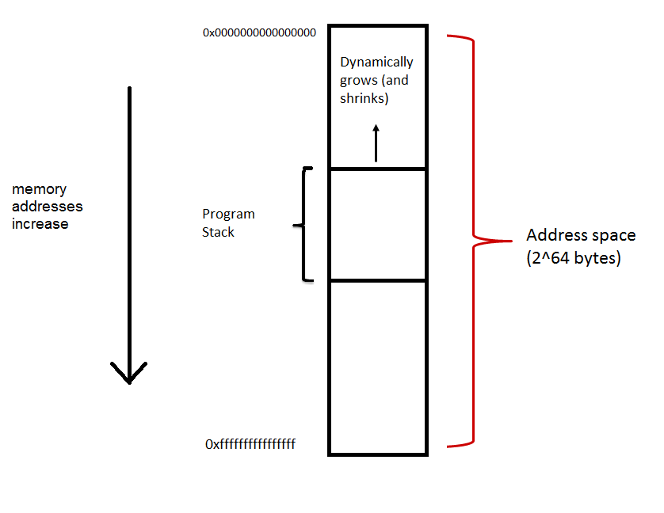

Slide 70
Or if you prefer
Dynamically
Grows (and shrinks)

Slide 71
Orientation of the Program Stack
Text. P. 90: “By convention, we draw stacks upside down, so that the “top” of the stack is shown at the bottom.”
My diagrams do not follow this convention, because it doesn’t make sense.

Slide 72
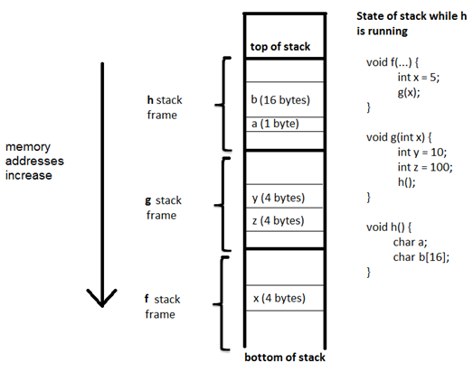
Use of the program stack
When a function is called, it allocates room on the stack for its “stack frame”
The frame contains space for local variables, register values that need to be stored away, and information needed to return to the calling function

Slide 73
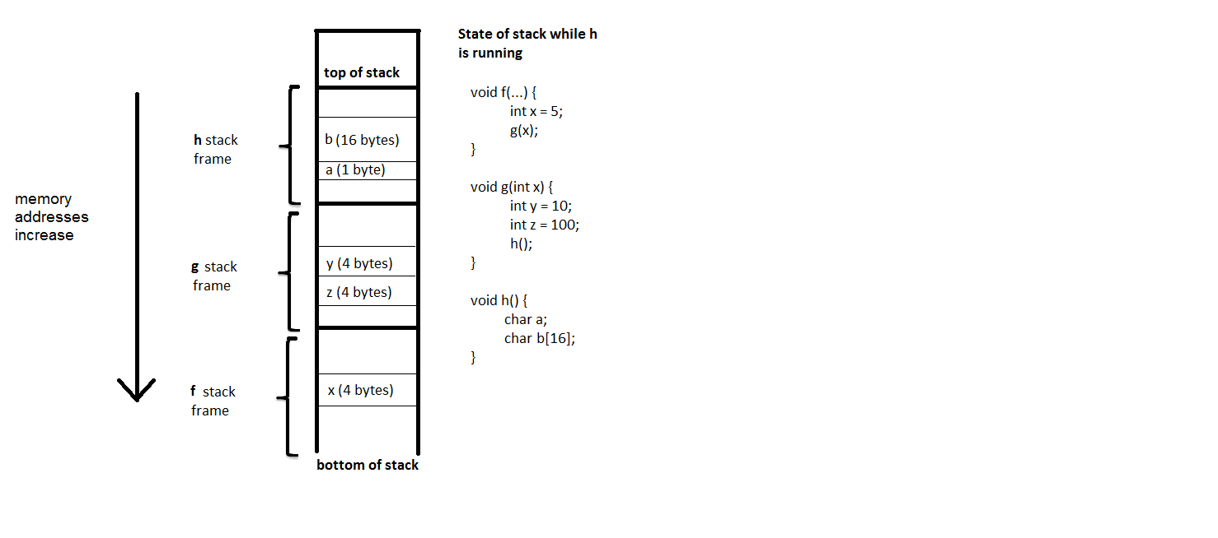
%rsp
%rbp

Slide 74
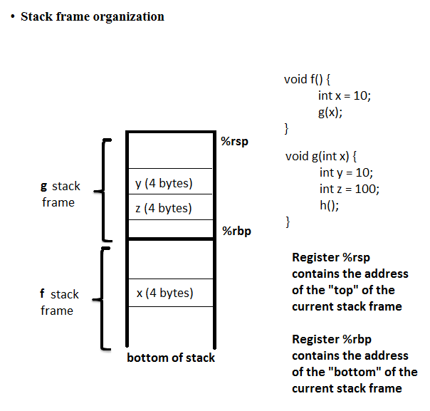

Slide 75
pushq
When a function is called, it creates its own stack frame
It also needs to store information that is required to return to the calling function
Return address
Boundaries of the calling function’s stack frame
Therefore, many functions start with
pushq %rbp
movq %rsp, %rbp
push is a “macro”, short for
subq $16, %rsp
movq %rbp, (%rsp)

Slide 76
popq
When a function returns, it restores the program stack to its previous state
Therefore, many functions end with with
popq %rbp
pop is a “macro”, short for
movq (%rsp), %rbp
addq $16, %rsp

Slide 77
Example
int f(x) {
return g(x);
}
int g(y) {
return y * 2;
}
g:
pushq %rbp
movq %rsp, %rbp
subq $-4, %rsp
movl %edi, -4(%rbp)
movl -4(%rbp), %eax
addl %eax, %eax
addq $4, %rsp
popq %rbp
ret
%rsp
f %rbp
f
stack
frame
%rbp

Slide 78
Example
int f(x) {
return g(x);
}
int g(y) {
return y * 2;
}
g:
pushq %rbp
movq %rsp, %rbp
subq $-4, %rsp
movl %edi, -4(%rbp)
movl -4(%rbp), %eax
addl %eax, %eax
addq $4, %rsp
popq %rbp
ret
%rbp
%rsp
f %rbp
f
stack
frame

Slide 79
Example
int f(x) {
return g(x);
}
int g(y) {
return y * 2;
}
g:
pushq %rbp
movq %rsp, %rbp
subq $-4, %rsp
movl %edi, -4(%rbp)
movl -4(%rbp), %eax
addl %eax, %eax
addq $4, %rsp
popq %rbp
ret
%rsp
g stack frame
%rbp
f %rbp
f
stack
frame

Slide 80
Example
int f(x) {
return g(x);
}
int g(y) {
return y * 2;
}
g:
pushq %rbp
movq %rsp, %rbp
subq $-4, %rsp
movl %edi, -4(%rbp)
movl -4(%rbp), %eax
addl %eax, %eax
addq $4, %rsp
popq %rbp
ret
%rsp
%rbp
f %rbp
f
stack
frame

Slide 81
Example
int f(x) {
return g(x);
}
int g(y) {
return y * 2;
}
g:
pushq %rbp
movq %rsp, %rbp
subq $-4, %rsp
movl %edi, -4(%rbp)
movl -4(%rbp), %eax
addl %eax, %eax
addq $4, %rsp
popq %rbp
ret
%rsp
f
stack
frame
%rbp

Slide 82
pop example
less:
pushq %rbp # save %rbp from previous stack frame
movq %rsp, %rbp # %rbp now points to the bottom of “less” stack frame
subq $16, %rsp # adjust %rsp so that the stack frame is the right size
movl %edi, -4(%rbp)
movl %esi, -8(%rbp)
movl -4(%rbp), %eax
cmpl -8(%rbp), %eax
setl %al
movzbl %al, %eax
addq $16, %rsp # make “less” stack frame disappear
popq %rbp # restore calling function’s base pointer
ret

Slide 83
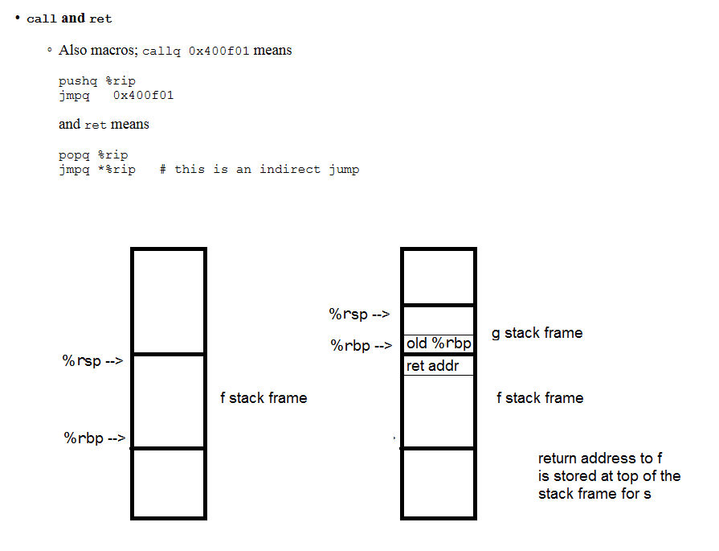

Slide 84
Recursion
Recursive code is sometimes slower than iterative, because of the need to use the program stack.
Example: factorial

Slide 85
int fact_r(int x) {
if (x <= 1)
return 1;
else return x * fact_r(x-1);
}
Where is x remembered?
First, using
gcc –o fact.s –s fact.c

Slide 86
fact_r: Each call to fact_r requires a stack frame
pushq %rbp
movq %rsp, %rbp
subq $16, %rsp
movl %edi, -4(%rbp)
cmpl $1, -4(%rbp)
jg .L2
movl $1, %eax
jmp .L3
.L2:
movl -4(%rbp), %eax
subl $1, %eax
movl %eax, %edi
call fact_r
imull -4(%rbp), %eax
.L3:
leave
ret
Current %rsp
Local variable
Used to store parameter
12 bytes
%rbp from previous frame
Current %rbp

Slide 87
fact_r: Each call to fact_r requires a stack frame
pushq %rbp
movq %rsp, %rbp
subq $16, %rsp
movl %edi, -4(%rbp)
cmpl $1, -4(%rbp)
jg .L2
movl $1, %eax
jmp .L3
.L2:
movl -4(%rbp), %eax
subl $1, %eax
movl %eax, %edi
call fact_r
imull -4(%rbp), %eax
.L3:
leave
ret
Establish stack frame
Current %rsp
Local variable
Used to store parameter
12 bytes
%rbp from previous frame
Current %rbp

Slide 88
fact_r: Each call to fact_r requires a stack frame
pushq %rbp
movq %rsp, %rbp
subq $16, %rsp
movl %edi, -4(%rbp)
cmpl $1, -4(%rbp)
jg .L2
movl $1, %eax
jmp .L3
.L2:
movl -4(%rbp), %eax
subl $1, %eax
movl %eax, %edi
call fact_r
imull -4(%rbp), %eax
.L3:
leave
ret
Store x
Current %rsp
Local variable
Used to store parameter
12 bytes
%rbp from previous frame
Current %rbp

Slide 89
fact_r: Each call to fact_r requires a stack frame
pushq %rbp
movq %rsp, %rbp
subq $16, %rsp
movl %edi, -4(%rbp)
cmpl $1, -4(%rbp)
jg .L2
movl $1, %eax
jmp .L3
.L2:
movl -4(%rbp), %eax
subl $1, %eax
movl %eax, %edi
call fact_r
imull -4(%rbp), %eax
.L3:
leave
ret
(1)! Is 1
Current %rsp
Local variable
Used to store parameter
12 bytes
%rbp from previous frame
Current %rbp

Slide 90
fact_r: Each call to fact_r requires a stack frame
pushq %rbp
movq %rsp, %rbp
subq $16, %rsp
movl %edi, -4(%rbp)
cmpl $1, -4(%rbp)
jg .L2
movl $1, %eax
jmp .L3
.L2:
movl -4(%rbp), %eax
subl $1, %eax
movl %eax, %edi
call fact_r
imull -4(%rbp), %eax
.L3:
leave
ret
(n)! Is (n)[(n-1)!]
Current %rsp
Local variable
Used to store parameter
12 bytes
%rbp from previous frame
Current %rbp

Slide 91
fact_r: Consider fact_r(4):
pushq %rbp
movq %rsp, %rbp
subq $16, %rsp
movl %edi, -4(%rbp)
cmpl $1, -4(%rbp)
jg .L2
movl $1, %eax
jmp .L3
.L2:
movl -4(%rbp), %eax
subl $1, %eax
movl %eax, %edi
call fact_r
imull -4(%rbp), %eax
.L3:
leave
ret
Current %rsp
0x00000004
12 bytes
%rbp from main
Current %rbp

Slide 92
fact_r: fact_r(3):
pushq %rbp
movq %rsp, %rbp
subq $16, %rsp
movl %edi, -4(%rbp)
cmpl $1, -4(%rbp)
jg .L2
movl $1, %eax
jmp .L3
.L2:
movl -4(%rbp), %eax
subl $1, %eax
movl %eax, %edi
call fact_r
imull -4(%rbp), %eax
.L3:
leave
ret
Current %rsp
0x00000003
%rbp from fact_r(4)
12 bytes
Current %rbp
0x00000004
12 bytes
%rbp from main

Slide 93
fact_r: fact_r(2):
pushq %rbp
movq %rsp, %rbp
subq $16, %rsp
movl %edi, -4(%rbp)
cmpl $1, -4(%rbp)
jg .L2
movl $1, %eax
jmp .L3
.L2:
movl -4(%rbp), %eax
subl $1, %eax
movl %eax, %edi
call fact_r
imull -4(%rbp), %eax
.L3:
leave
ret
Current %rsp
0x00000002
%rbp from fact_r(3)
12 bytes
Current %rbp
0x00000003
%rbp from fact_r(4)
12 bytes
0x00000004
12 bytes
%rbp from main

Slide 94
fact_r: fact_r(1):
pushq %rbp
movq %rsp, %rbp
subq $16, %rsp
movl %edi, -4(%rbp)
cmpl $1, -4(%rbp)
jg .L2
movl $1, %eax
jmp .L3
.L2:
movl -4(%rbp), %eax
subl $1, %eax
movl %eax, %edi
call fact_r
imull -4(%rbp), %eax
.L3:
leave
ret
Current %rsp
0x00000001
%rbp from fact_r(2)
12 bytes
Current %rbp
0x00000002
%rbp from fact_r(3)
12 bytes
0x00000003
%rbp from fact_r(4)
12 bytes
0x00000004
12 bytes
%rbp from main

Slide 95
int fact_r(int x) {
if (x <= 1)
return 1;
else return x * fact_r(x-1);
}
Where is x remembered?
Now, using
gcc –o fact.s –s fact.c –O2

Slide 96
fact_r:
cmpl $1, %edi
movl $1, %eax
jg .L3
jmp .L2
.L9:
movl %edx, %edi
.L3:
leal -1(%rdi), %edx
imull %edi, %eax
cmpl $1, %edx
jne .L9
.L2:
ret
This is no longer recursive!!
Compiler removes recursion whenever possible, because loops are faster

Slide 97
Function parameters and the program stack
In x86-64, parameters are usually passed through registers
In the unlikely event that more than 6 parameters are passed, then the program stack is used for the rest of the parameters
To illustrate, we will switch to IA-32, and consider this code.
int g(int x, int y) {
return x + y;
}
int f() {
int a=1, b=2;
return g(a,b);
}
int main() {
printf(“%d\n”, f());
}

Slide 98
int f() {
int a=1, b=2;
return g(a,b);
}
int main() {
printf(“%d\n”, f());
}
_f:
pushl %ebp
movl %esp, %ebp
subl $24, %esp
movl $1, -4(%ebp)
movl $2, -8(%ebp)
movl -8(%ebp), %eax
movl %eax, 4(%esp)
movl -4(%ebp), %eax
movl %eax, (%esp)
call _g
leave
ret
_main:
…
call _f
…
%esp
main $ebp
main
stack
frame
ret addr to main
Program stack

Slide 99
int f() {
int a=1, b=2;
return g(a,b);
}
int main() {
printf(“%d\n”, f());
}
_f:
pushl %ebp
movl %esp, %ebp
subl $24, %esp
movl $1, -4(%ebp)
movl $2, -8(%ebp)
movl -8(%ebp), %eax
movl %eax, 4(%esp)
movl -4(%ebp), %eax
movl %eax, (%esp)
call _g
leave
ret
$esp
f
stack
frame
24 bytes
main $ebp
$ebp
main
stack
frame
ret addr to main

Slide 100
int f() {
int a=1, b=2;
return g(a,b);
}
int main() {
printf(“%d\n”, f());
}
_f:
pushl %ebp
movl %esp, %ebp
subl $24, %esp
movl $1, -4(%ebp)
movl $2, -8(%ebp)
movl -8(%ebp), %eax
movl %eax, 4(%esp)
movl -4(%ebp), %eax
movl %eax, (%esp)
call _g
leave
ret
$esp
24 bytes
f
stack
frame
2
1
main $ebp
$ebp
main
stack
frame
ret addr to main

Slide 101
int f() {
int a=1, b=2;
return g(a,b);
}
int main() {
printf(“%d\n”, f());
}
These are parameters that will be passed to g
_f:
pushl %ebp
movl %esp, %ebp
subl $24, %esp
movl $1, -4(%ebp)
movl $2, -8(%ebp)
movl -8(%ebp), %eax
movl %eax, 4(%esp)
movl -4(%ebp), %eax
movl %eax, (%esp)
call _g
leave
ret
1
2
$esp
f
stack
frame
2
1
main $ebp
$ebp
main
stack
frame
ret addr to main

Slide 102
int g(int x, int y) {
return x + y;
}
int f() {
int a=1, b=2;
return g(a,b);
}
_f:
pushl %ebp
movl %esp, %ebp
subl $24, %esp
movl $1, -4(%ebp)
movl $2, -8(%ebp)
movl -8(%ebp), %eax # copy arg 2
movl %eax, 4(%esp)
movl -4(%ebp), %eax # copy arg 1
movl %eax, (%esp)
call _g
leave
ret
addr of leave instr
$esp
1
2
f
stack
frame
2
1
main $ebp
$ebp
main
stack
frame
ret addr to main
The call instruction pushes the
return address onto the program stack,
so that the calling function know where
to return

Slide 103
int g(int x, int y) {
return x + y;
}
int f() {
int a=1, b=2;
return g(a,b);
}
_g:
pushl %ebp
movl %esp, %ebp
movl 12(%ebp), %eax
addl 8(%ebp), %eax
popl %ebp
ret
_f:
pushl %ebp
movl %esp, %ebp
subl $24, %esp
movl $1, -4(%ebp)
movl $2, -8(%ebp)
movl -8(%ebp), %eax
movl %eax, 4(%esp)
movl -4(%ebp), %eax
movl %eax, (%esp)
call _g
leave
ret
%ebp from f’s s.f.
$esp
%ebp from f s.f.
addr of leave instr
1
2
f
stack
frame
2
1
main $ebp
$ebp
main
stack
frame
ret addr to main

Slide 104
int g(int x, int y) {
return x + y;
}
int f() {
int a=1, b=2;
return g(a,b);
}
_g:
pushl %ebp
movl %esp, %ebp
movl 12(%ebp), %eax
addl 8(%ebp), %eax
popl %ebp
ret
_f:
pushl %ebp
movl %esp, %ebp
subl $24, %esp
movl $1, -4(%ebp)
movl $2, -8(%ebp)
movl -8(%ebp), %eax
movl %eax, 4(%esp)
movl -4(%ebp), %eax
movl %eax, (%esp)
call _g
leave
ret
g
stack
frame
%ebp from f’s s.f.
%esp,
%ebp
%ebp from f s.f.
addr of leave instr
1
2
f
stack
frame
2
1
main %ebp
main
stack
frame
ret addr to main

Slide 105
int g(int x, int y) {
return x + y;
}
int f() {
int a=1, b=2;
return g(a,b);
}
_g:
pushl %ebp
movl %esp, %ebp
movl -12(%ebp), %eax
addl -8(%ebp), %eax
popl %ebp
ret
-12(%ebp) and -8(%ebp)
Are the parameters
Passed to g
_f:
pushl %ebp
movl %esp, %ebp
subl $24, %esp
movl $1, -4(%ebp)
movl $2, -8(%ebp)
movl -8(%ebp), %eax
movl %eax, 4(%esp)
movl -4(%ebp), %eax
movl %eax, (%esp)
call _g
leave
ret
g
stack
frame
%ebp from f’s s.f.
%esp,
%ebp
%ebp from f s.f.
addr of leave instr
1
2
f
stack
frame
2
1
main %ebp
main
stack
frame
ret addr to main

Slide 106
int g(int x, int y) {
return x + y;
}
int f() {
int a=1, b=2;
return g(a,b);
}
_g:
pushl %ebp
movl %esp, %ebp
movl 12(%ebp), %eax
addl 8(%ebp), %eax
popl %ebp
ret
12(%ebp) and 8(%ebp)
Are the parameters
Passed to g
_f:
pushl %ebp
movl %esp, %ebp
subl $24, %esp
movl $1, -4(%ebp)
movl $2, -8(%ebp)
movl -8(%ebp), %eax
movl %eax, 4(%esp)
movl -4(%ebp), %eax
movl %eax, (%esp)
call _g
leave
ret
%ebp from f’s s.f.
addr of leave instr
%esp
1
2
f
stack
frame
2
1
main %ebp
%ebp
main
stack
frame
ret addr to main

Slide 107
int g(int x, int y) {
return x + y;
}
int f() {
int a=1, b=2;
return g(a,b);
}
_g:
pushl %ebp
movl %esp, %ebp
movl 12(%ebp), %eax
addl 8(%ebp), %eax
popl %ebp
ret
Next instruction is
“leave” in f
_f:
pushl %ebp
movl %esp, %ebp
subl $24, %esp
movl $1, -4(%ebp)
movl $2, -8(%ebp)
movl -8(%ebp), %eax
movl %eax, 4(%esp)
movl -4(%ebp), %eax
movl %eax, (%esp)
call _g
leave
ret
%ebp from f’s s.f.
1
2
%esp
f
stack
frame
2
1
main %ebp
%ebp
main
stack
frame
ret addr to main

Slide 108
int g(int x, int y) {
return x + y;
}
int f() {
int a=1, b=2;
return g(a,b);
}
_f:
pushl %ebp
movl %esp, %ebp
subl $24, %esp
movl $1, -4(%ebp)
movl $2, -8(%ebp)
movl -8(%ebp), %eax
movl %eax, 4(%esp)
movl -4(%ebp), %eax
movl %eax, (%esp)
call _g
leave
ret
%ebp from f’s s.f.
1
2
%esp
leave is a macro for popping
into %ebp. After ret, the next instruction is back in main
f
stack
frame
2
1
main %ebp
%ebp
main
stack
frame
ret addr to main

Slide 109
int g(int x, int y) {
return x + y;
}
int f() {
int a=1, b=2;
return g(a,b);
}
_f:
pushl %ebp
movl %esp, %ebp
subl $24, %esp
movl $1, -4(%ebp)
movl $2, -8(%ebp)
movl -8(%ebp), %eax
movl %eax, 4(%esp)
movl -4(%ebp), %eax
movl %eax, (%esp)
call _g
leave
ret
main
stack
frame
$esp
$ebp

Slide 110
Example illustrating program stack
int main( ) {
int x, y, z;
printf("Type 3 numbers\n");
scanf("%d%d%d", &x, &y, &z);
printf("%d+%d+%d=%d\n", x, y,
z, sum3(x, y, z));
}
int sum3(int x, int y, int z) {
return x + sum2(y,z);
}
int sum2(int x, int y) {
int sum = x + y;
return sum;
}

Slide 111
x86-64 Example
int main( ) {
int x, y, z;
printf("Type 3 numbers\n");
scanf("%d%d%d", &x, &y, &z);
printf("%d+%d+%d=%d\n", x, y,
z, sum3(x, y, z));
}
main:
pushq %rbp
movq %rsp, %rbp
subq $16, %rsp
movl $.LC0, %edi
call puts
leaq -16(%rbp), %rcx
leaq -12(%rbp), %rdx
leaq -8(%rbp), %rsi
movl $.LC1, %edi
call __isoc99_scanf
movl -16(%rbp), %edx
movl -12(%rbp), %ecx
movl -8(%rbp), %eax
movl %ecx, %esi
movl %eax, %edi
call sum3
movl %eax, -4(%rbp)
movl -4(%rbp), %eax
movl %eax, %esi
movl $.LC2, %edi
call printf
leave
ret

Slide 112
x86-64 Example
main:
pushq %rbp
movq %rsp, %rbp
subq $16, %rsp
movl $.LC0, %edi
call puts
leaq -16(%rbp), %rcx
leaq -12(%rbp), %rdx
leaq -8(%rbp), %rsi
movl $.LC1, %edi
call __isoc99_scanf
movl -16(%rbp), %edx
movl -12(%rbp), %ecx
movl -8(%rbp), %eax
movl %ecx, %esi
movl %eax, %edi
call sum3
movl %eax, -4(%rbp)
movl -4(%rbp), %eax
movl %eax, %esi
movl $.LC2, %edi
call printf
leave
ret
z
y
24 byte
Stack frame
For main
x
%rbp from OS

Slide 113
x86-64 Example
main:
pushq %rbp
movq %rsp, %rbp
subq $16, %rsp
movl $.LC0, %edi
call puts
leaq -16(%rbp), %rcx
leaq -12(%rbp), %rdx
leaq -8(%rbp), %rsi
movl $.LC1, %edi
call __isoc99_scanf
movl -16(%rbp), %edx
movl -12(%rbp), %ecx
movl -8(%rbp), %eax
movl %ecx, %esi
movl %eax, %edi
call sum3
movl %eax, -4(%rbp)
movl -4(%rbp), %eax
movl %eax, %esi
movl $.LC2, %edi
call printf
leave
ret
%rsp
z
y
24 byte
stack frame
for main
x
%rbp
%rbp from OS

Slide 114
x86-64 Example
main:
pushq %rbp
movq %rsp, %rbp
subq $16, %rsp
Arg to movl $.LC0, %edi
puts call puts
leaq -16(%rbp), %rcx
leaq -12(%rbp), %rdx
leaq -8(%rbp), %rsi
movl $.LC1, %edi
call __isoc99_scanf
movl -16(%rbp), %edx
movl -12(%rbp), %ecx
movl -8(%rbp), %eax
movl %ecx, %esi
movl %eax, %edi
call sum3
movl %eax, -4(%rbp)
movl -4(%rbp), %eax
movl %eax, %esi
movl $.LC2, %edi
call printf
leave
ret
%rsp
Stack frame
for puts
%rbp
%rbp from main
Ret addr to main
z
y
32 byte
stack frame
for main
x
%rbp from OS

Slide 115
x86-64 Example
main:
pushq %rbp
movq %rsp, %rbp
subq $16, %rsp
movl $.LC0, %edi
call puts # prompt user
leaq -16(%rbp), %rcx # &z
leaq -12(%rbp), %rdx # &y
leaq -8(%rbp), %rsi # &x
movl $.LC1, %edi
call __isoc99_scanf
movl -16(%rbp), %edx
movl -12(%rbp), %ecx
movl -8(%rbp), %eax
movl %ecx, %esi
movl %eax, %edi
call sum3
movl %eax, -4(%rbp)
movl -4(%rbp), %eax
movl %eax, %esi
movl $.LC2, %edi
call printf
leave
ret
%rsp
z
y
24 byte
stack frame
for main
x
%rbp
%rbp from OS

Slide 116
x86-64 Example
main:
pushq %rbp
movq %rsp, %rbp
subq $16, %rsp
movl $.LC0, %edi
call puts # prompt user
leaq -16(%rbp), %rcx
leaq -12(%rbp), %rdx
leaq -8(%rbp), %rsi
movl $.LC1, %edi
call __isoc99_scanf
movl -16(%rbp), %edx
movl -12(%rbp), %ecx
movl -8(%rbp), %eax
movl %ecx, %esi
movl %eax, %edi
call sum3
movl %eax, -4(%rbp)
movl -4(%rbp), %eax
movl %eax, %esi
movl $.LC2, %edi
call printf
leave
ret
args to
scanf
Stack frame
for scanf
%rsp
%rbp
%rbp from main
Ret addr to main
z
32 byte
stack frame
for main
y
x
%rbp from OS

Slide 117
x86-64 Example
main:
pushq %rbp
movq %rsp, %rbp
subq $16, %rsp #%rbp pushed
movl $.LC0, %edi
call puts # prompt user
leaq -16(%rbp), %rcx
leaq -12(%rbp), %rdx
leaq -8(%rbp), %rsi
movl $.LC1, %edi
call __isoc99_scanf
movl -16(%rbp), %edx #z
movl -12(%rbp), %ecx
movl -8(%rbp), %eax
movl %ecx, %esi #y
movl %eax, %edi #z
call sum3
movl %eax, -4(%rbp)
movl -4(%rbp), %eax
movl %eax, %esi
movl $.LC2, %edi
call printf
leave
ret
%rsp
z
y
24 byte
Stack frame
For main
x
%rbp
%rbp from OS

Slide 118
x86-64 Example
movl -16(%rbp), %edx #z
movl -12(%rbp), %ecx
movl -8(%rbp), %eax
movl %ecx, %esi #y
movl %eax, %edi #z
call sum3
(gdb) x/x $rsp
0x7fffffffe978: 0x00400634
In main:
0x0040062f <+66>: callq 0x40064d <sum3>
0x00400634 <+71>: mov %eax,-0x4(%rbp)
When one function calls another,
The return address in the calling
function is pushed onto the program
stack
(gdb) break *sum3
Breakpoint 5 at 0x40064d
(gdb) cont
Continuing.
Breakpoint 5, 0x00000000004006 4d in sum3
%rsp
0x400634
z
y
32 byte
Stack frame
For main
x
%rbp
%rbp from OS

Slide 119
x86-64 Example
sum3:
pushq %rbp
movq %rsp, %rbp
.cfi_def_cfa_register 6
subq $32, %rsp
movl %edi, -20(%rbp)
movl %esi, -24(%rbp)
movl %edx, -28(%rbp)
movl -28(%rbp), %edx
movl -24(%rbp), %eax
movl %edx, %esi
movl %eax, %edi
call sum2
movl %eax, -4(%rbp)
movl -4(%rbp), %eax
movl -20(%rbp), %edx
addl %edx, %eax
leave
ret
z
y
sum3
Stack
Frame
32
x
%rsp
%rbp from main
0x40064d
z
Main
Stack
Frame
24 bytes
y
x
%rbp
%rbp from OS

Slide 120
x86-64 Example
sum3:
pushq %rbp
movq %rsp, %rbp
subq $32, %rsp
movl %edi, -20(%rbp)
movl %esi, -24(%rbp)
movl %edx, -28(%rbp)
movl -28(%rbp), %edx
movl -24(%rbp), %eax
movl %edx, %esi
movl %eax, %edi
call sum2
movl %eax, -4(%rbp)
movl -4(%rbp), %eax
movl -20(%rbp), %edx
addl %edx, %eax
leave
ret
%rsp
z
y
sum3
Stack
Frame
32 bytes
x
ans
%rbp from main
%rbp
0x40064d
z
Main
Stack
Frame
24 bytes
y
x
%rbp from OS

Slide 121
x86-64 Example
sum2:
0x40067f <+0>: push %rbp
0x400680 <+1>: mov %rsp,%rbp
0x400683 <+4>: mov %edi,-0x4(%rbp)
0x400686 <+7>: mov %esi,-0x8(%rbp)
0x400689 <+10>: mov -0x8(%rbp),%eax
0x40068c <+13>: mov -0x4(%rbp),%edx
0x40068f <+16>: add %edx,%eax
0x400691 <+18>: pop %rbp
0x400692 <+19>: retq
%rbp from main
%rsp
%rbp
400672
z
y
sum3
Stack
Frame
32 bytes
x
ans
%rbp from main
0x40064d
z
Main
Stack
Frame
24 bytes
y
x
%rbp from OS

Slide 122
The GNU debugger
Very low-level debugging / code inspection tool
Operates on executable files
Enables programmers to “disassemble” code, set breakpoints, inspect register and memory contents, step through code execution, etc.
We will use it for code inspection, and to help us understand what machine code is doing and how
We will also use it to understand a certain type of security vulnerability caused by the stack frame organization

Slide 123
Example gdb session
> gdb sum3
> disas sum3
(gdb) disas sum3
Dump of assembler code for function sum3:
0x0000000000400608 <+0>: push %rbp
0x0000000000400609 <+1>: mov %rsp,%rbp
0x000000000040060c <+4>: sub $0x20,%rsp
0x0000000000400610 <+8>: mov %rdi,-0x18(%rbp)
0x0000000000400614 <+12>: mov -0x18(%rbp),%rax
0x0000000000400618 <+16>: mov (%rax),%eax
0x000000000040061a <+18>: mov %eax,-0x4(%rbp)
0x000000000040061d <+21>: mov -0x18(%rbp),%rax
0x0000000000400621 <+25>: add $0x4,%rax
0x0000000000400625 <+29>: mov %rax,%rdi
0x0000000000400628 <+32>: mov $0x0,%eax
0x000000000040062d <+37>: callq 0x40063a <sum2>
0x0000000000400632 <+42>: add %eax,-0x4(%rbp)
0x0000000000400635 <+45>: mov -0x4(%rbp),%eax
0x0000000000400638 <+48>: leaveq
0x0000000000400639 <+49>: retq

Slide 124
Example gdb session
(gdb) run
Starting program: /home/DPU/slytinen/406w18/x86/sum3_slow
Type 3 integers
1 2 3
Breakpoint 1, 0x0000000000400608 in sum3 ()
Missing separate debuginfos, use: debuginfo-install glibc-2.17-106.el7_2.6.x86_64
(gdb) print/x $rdi
$1 = 0x7fffffffe960
(gdb) x/3x $rdi
0x7fffffffe960: 0x00000001 0x00000002 0x00000003
(gdb) print/x $rsp
$2 = 0x7fffffffe958
(gdb) x/x $rsp
0x7fffffffe958: 0x004005ef
(gdb) x/x 0x4005ef
0x4005ef <main+79>: 0x8bf84589
(gdb) x/i main+79
0x4005ef <main+79>: mov %eax,-0x8(%rbp)
(gdb) x/i main+74
0x4005ea <main+74>: callq 0x400608 <sum3>

Slide 125
Example gdb session
(gdb) break *sum3+48
Breakpoint 2 at 0x400638
(gdb) continue
Continuing.
Breakpoint 2, 0x0000000000400638 in sum3 ()
(gdb) print/d $rax
$3 = 6
(gdb) stepi
0x0000000000400639 in sum3 ()
(gdb) stepi
0x00000000004005ef in main ()
(gdb) disas 0x4005f2
0x00000000004005ea <+74>: callq 0x400608 <sum3>
0x00000000004005ef <+79>: mov %eax,-0x8(%rbp)
=> 0x00000000004005f2 <+82>: mov -0x8(%rbp),%eax
0x00000000004005f5 <+85>: mov %eax,%esi
0x00000000004005f7 <+87>: mov $0x400713,%edi
0x00000000004005fc <+92>: mov $0x0,%eax
0x0000000000400601 <+97>: callq 0x400470 <printf@plt>
0x0000000000400606 <+102>: leaveq
0x0000000000400607 <+103>: retq

Slide 126
Example gdb session
(gdb) break *main+97
Breakpoint 3 at 0x400601
(gdb) continue
Continuing.
Breakpoint 3, 0x0000000000400601 in main ()
(gdb) print/x $rdi
$4 = 0x400713
(gdb) x/x $rdi
0x400713: 0x20656854
(gdb) x/s $rdi
0x400713: "The sum is %d\n“
(gdb) print/d $rsi
$5 = 6
(gdb) cont
Continuing.
The sum is 6
[Inferior 1 (process 27473) exited with code 015]

Slide 127
Basic gdb commands
Start the debugger: gdb followed by the name of the executable
disas: “disassemble” a function (translate from machine code back to assembly language). Can either be followed by a function name or an address
break: set a breakpoint. Can either be followed by an address or an offset from the beginning of a function. Place an * beforehand, such as break *main
run
cont: resume execution from a breakpoint
print: print the contents of a register. Qualifiers: /d, /x, /s, /c
Example: print/d $rax
x: print the contents of a memory address. Also may use qualifiers
Example: x/x 0x400601
x/3x $rdi
x/s $rdi
stepi: execute the next instruction (step into). If the current instruction is a function call, then the first instruction of the called function is executed

