Slide 1
EPAM Diploma
Alexandr Belov 24 stream

Slide 2
Variant 2.
Variant 2. Using API https://affiliate.itunes.apple.com/resources/documentation/itunes-store-web-service-search-api/ get all data about “The Beatles" and store it into your DB: kind, collectionName, trackName, collectionPrice, trackPrice, primaryGenreName, trackCount, trackNumber, releaseDate. Output the data by collectionName (the collectionName is set) in form of a table and sort them by releaseDate in ascending order.

Slide 3
Criteria
Criteria | Description
SCM | https://github.com/abelovn/github_epam_diploma_task Github flow strategy
Quality gate | SonarQube
IaC | Terraform
Orchestration | Kubernetes/EKS
Logging | ELK Search, Kibana
Monitoring | Prometheus, Grafana
Runtime/Deployment | Runtume: production и development. Automatic deployment according to the branches of the repository by strategy GitLab Flow
Scalability/redundancy | Deployment with HPA
Cloud and Cost efficiency | AWS: EKS, EC2, DocumentDB, ALB Estimated cost calculation is given on the following slides.

Slide 4
Application
Python/Flask
uWSGI application server
Cluster: DocumentDB
The repository contains IaC, application code, application DockerFile, PipeLine, additional tools (scripts) to run in the local environment.

Slide 5
Tools
AWS
Terraform
Github
DockerHub
SonarQube
K8s

Slide 6
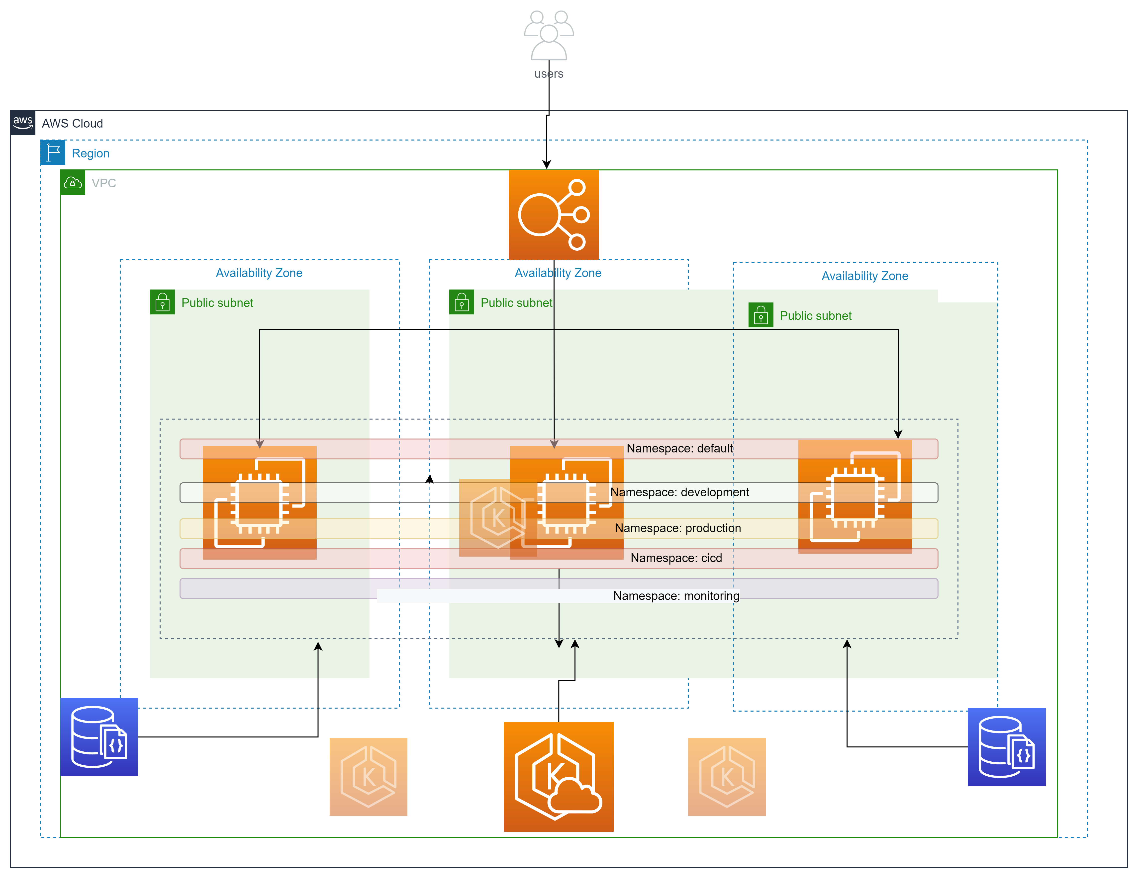
IAC

Slide 7

Pipeline

Slide 8
Coasts
Region | Service | Comments | Costs
 | It will be a little later

Slide 9
Потенциальные улучшения
Добавление тестов
Переход от EBS к EFS (требуется настройка OIDC для EFS CSI driver)
Переход от NodePort Service к Load Balancer Service (требуется настройка OIDC для AWS Load Balancer Controller add-on)

Slide 10
Thank you for your attention

