Slide 1


.
Project – Viva-Voce Even 2024-25
Title
Name of the Students and Department
Name Of the Guide and Designation

Slide 2
Abstract
Intelligent Communication – This project develops a chatbot using Natural Language
Processing (NLP) to enable human-like interactions by understanding and generating
context-aware responses.
NLP Techniques & Learning – The chatbot leverages NLP techniques like tokenization, intent
recognition, and sentiment analysis, continuously improving through machine learning and
user interactions.

Slide 3
Introduction
Brief description: A chatbot designed to provide detailed student information such as attendance, CGPA, assignment marks, fees, contact details, and feedback.
Technologies: Python, NLTK, Regex

Slide 4
Existing System
1. Manual Customer Interaction
Customers reach out via email or call for queries.
Support agents handle multiple repetitive questions manually.
Long wait times and inconsistent responses.
2. Static Information Pages
Website contains FAQ sections and product details.
Users must search manually to find relevant answers.

Slide 5
Problem Statements
Limited to predefined student data.
Cannot handle complex or ambiguous queries.
Requires internet connection for NLTK data on the first run.

Slide 6
Proposed System/objectives
Project Objectives
Efficient retrieval of student information.
NLP techniques for flexible user queries.
Structured data extraction from text inputs.

Slide 7
Key Features
Attendance Information: Display student's attendance percentage.
CGPA Details: Show semester-wise CGPA.
Assignment Marks: Fetch marks for specific subjects.
Fees Status: Provide status of semester, bus, and hostel fees.
Contact Details: Display student or parent contact information.

Slide 8
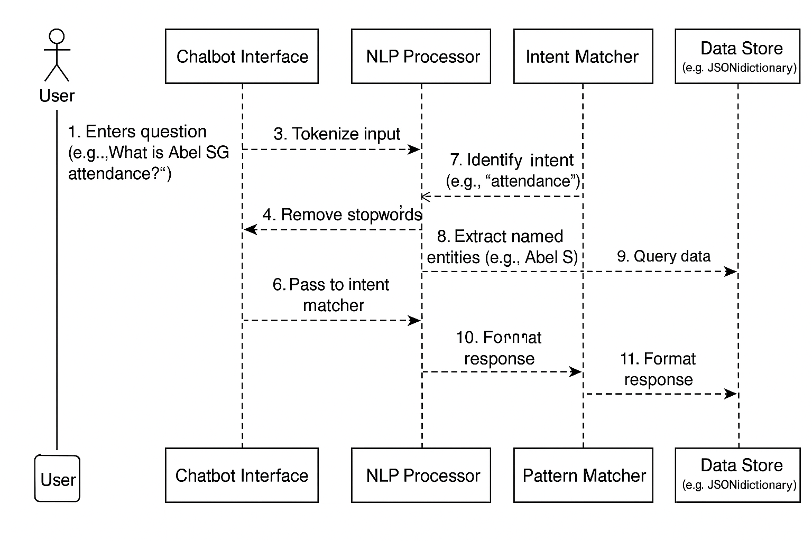
methodology

Slide 9
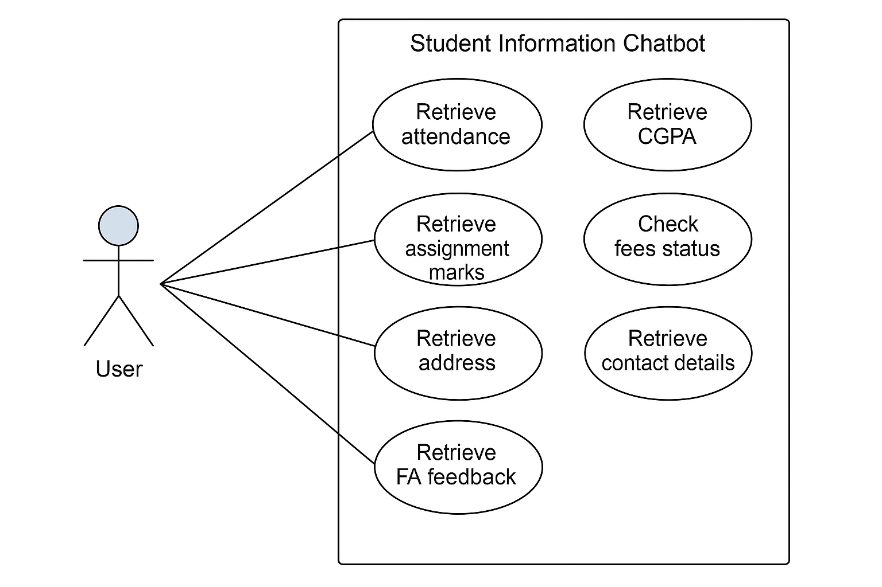

Slide 10
NLP Techniques Used
Tokenization: Splitting text into words or tokens.
Stopword Removal: Eliminating common words like 'is', 'the', etc.
Lemmatization: Reducing words to their base form.
Pattern Matching: Extracting specific patterns like names or subjects.
Intent Recognition: Identifying the purpose of the query (e.g., attendance, CGPA).

Slide 11
Implementation and sample outputs
Q: What is Abel SG's attendance percentage?
A: Abel SG's attendance percentage is 72%.
Q: Show me Jeffin M's 3rd semester CGPA.
A: Jeffin M's CGPA in the 3rd semester is 6.908.

Slide 12
General Questions:
"Hello!"
"Hi there!"
"Goodbye"
"Thanks for your help"

Slide 13
Student-Specific Questions:
About Attendance:
"What is Abel SG's attendance percentage?"
"Tell me about Safeer Bashar's attendance"
"How is Jaibin Joe's attendance?"

Slide 14
Conclusion
Summary of the chatbot's ability to simplify student data retrieval.
Future Scope: Enhancing NLP techniques for better context understanding.
Questions and Answers.

Slide 15
References
Bird, S., Klein, E., & Loper, E. (2009). Natural Language Processing with Python.
O'Reilly Media.
Chowdhary, K. R. (2020). Fundamentals of Artificial Intelligence. Springer.
NLTK Documentation. (n.d.). Retrieved from https://www.nltk.org/
Flask Documentation. (n.d.). Retrieved from https://flask.palletsprojects.com/

Slide 16
Thank You

