Slide 1
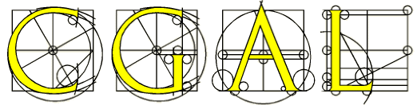
Introduction of the
Computational Geometry Algorithms Library
www.cgal.org
1393-1

Slide 2
Overview
Introduce
Structure of CGAL
Installing CGAL

Slide 3
Part 1
Introduce

Slide 4
CGAL?
CGAL = Computational Geometry Algorithms Library
A library of Geometric algorithms and data structures
Written in C++
provide easy access to efficient and reliable geometric algorithms

Slide 5
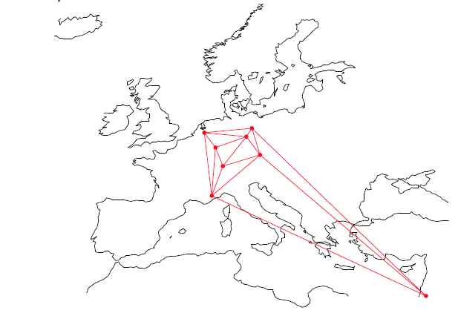
Development
Development started in 1995
ETH Zurich (Switzerland)
Freie Universität Berlin (Germany)
INRIA Sophia-Antipolis (France)
Martin-Luther-Universität Halle-Wittenberg (Germany)
Max-Planck-Institut für Informatik (Germany)
RISC Linz (Austria)
Tel Aviv University (Israel)
Utrecht University (The Netherlands)

Slide 6
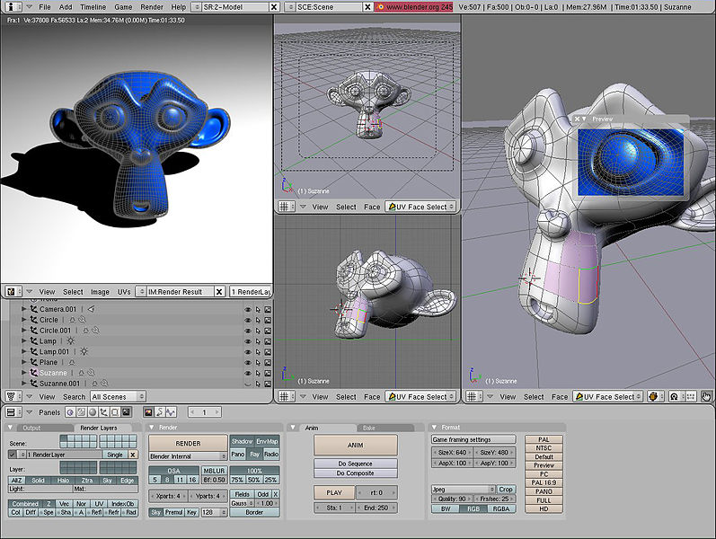
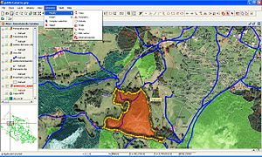
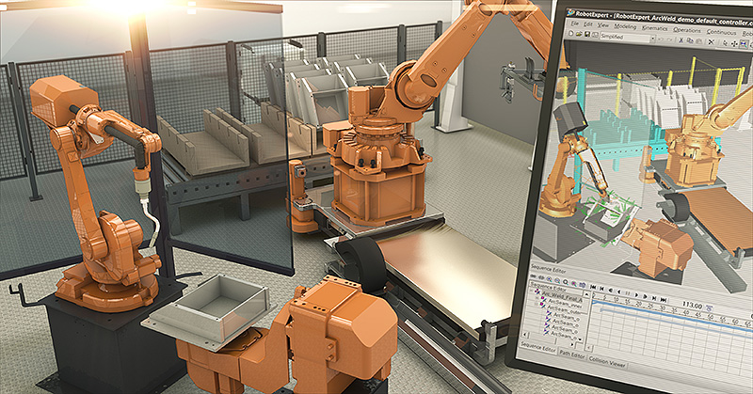
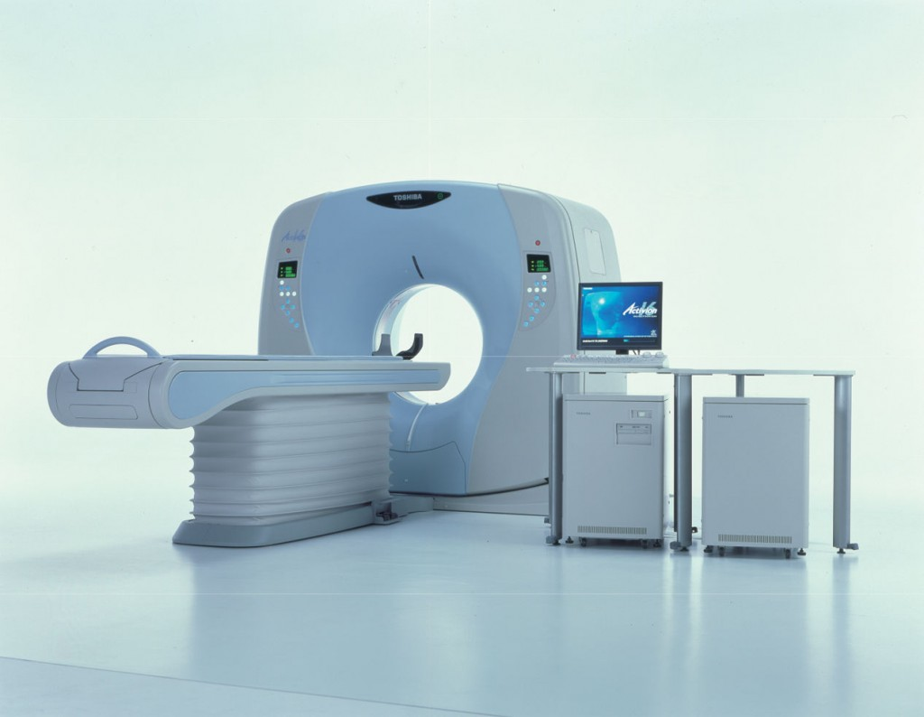
Users
CGAL is used in various areas needing geometric computation
Computer Graphics
Computer Aided Design And Modeling
Geographic Information Systems
Molecular Biology
Medical Imaging
Robotics
Motion Planning
Games
2D and 3D Modelers

Slide 7
CGAL in numbers
> 500,000 lines of C++ code
Several platforms g++ (Linux, MacOS), VC++ (Windows)
> 1,000 downloads in month
> 60 developers registered on developer list
10 people have provided reviews of CGAL Packages
latest version: CGAL-4.5 in Dec 22, 2014

Slide 8
Data Structures and Algorithms
Convex hull in 2D, 3D and dD
Triangulations triangulations in 2D and 3D and Delaunay triangulations
Voronoi diagrams for 2D and 3D points and segment Voronoi diagrams
Polygons boolean operations , offsets, straight skeleton
Polyhedral boolean operations
Search structures kd tree, and range and segment trees

Slide 9
Data Structures and Algorithms
Others:
mesh generation
geometry processing
alpha shapes
shape analysis
kinetic data structures
interpolation

Slide 10
Part 2
Structure of CGAL

Slide 11
Structure
Kernel and Number Type
Basic Library Various packages (81)
Support Library STL extensions, Visualization, I/O, Random, timers, …

Slide 12
Kernel and Number Type
Primitives 2D, 3D, dD Point, Triangle, Rectangle, Circle Line, Segment, Ray …
Predicates Comparison Orientation …
Constructions Intersection square distance ...

Slide 13
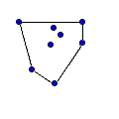

Basic Library
Convex Hull (3)
2D Convex Hulls and Extreme Points
Introduced in: CGAL 1.0
3D Convex Hulls
Introduced in: CGAL 1.1
dD Convex Hulls and Delaunay Triangulations
Introduced in: CGAL 2.3

Slide 14
2D Convex Hull Algorithms
Function | Algorithm | Speed | Discovered By
convex_hull_2() | Bykat or Akl and Toussaint | Min( O(nh), O(n log n) )
ch_bykat() | Bykat | O(nh) | [A. Bykat, 1978]
ch_akl_toussaint() | Akl and Toussaint | O(n log n) | [S. G. Akl and G. T. Toussaint, 1978]
ch_graham_andrew() | Andrew | O(n log n) | [A. M. Andrew, 1979]
ch_jarvis() | Jarvis | O(nh) | [R. A. Jarvis, 1973]
ch_eddy() | Eddy's | O(nh) | [W. F. Eddy, 1977]
ch_melkman() | Melkman (for simple polygonal chains) | O(n)
n: number of points
h: number of points on the boundary of convex hull

Slide 15
2D Convex Hulls Function
OutputIterator CGAL::convex_hull_2 ( InputIterator first,
InputIterator last,
OutputIterator result
)
It generates the counterclockwise sequence of extreme points of the points in the range [first, last]
The resulting sequence is placed starting at position result and the past-the-end iterator for the resulting sequence is returned

Slide 16
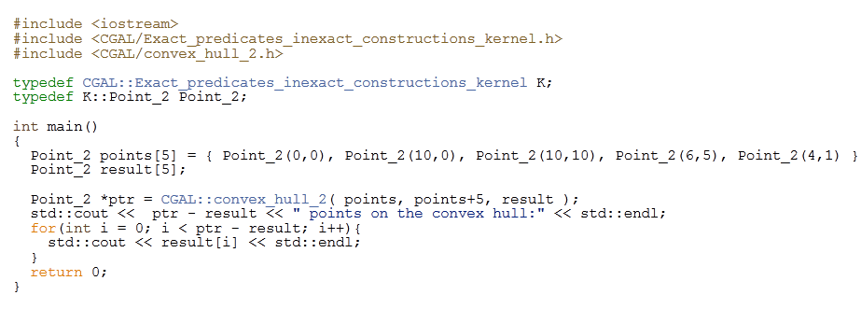
Hello World

Slide 17
Other
Function | Speed
lower_hull_points_2() | O(n log n)
upper_hull_points_2() | O(n log n)
is_cw_strongly_convex_2() | O(n)
is_ccw_strongly_convex_2() | O(n)
ch_nswe_point() | O(n)
ch_ns_point() , ch_we_point() | O(n)
ch_n_point(), ch_s_point(), ch_w_point(), ch_e_point() | O(n)

Slide 18
3D Convex Hulls
This package provides:
functions for computing convex hulls in 3D
using a static algorithm
using an incremental construction algorithm
using a triangulation to get a fully dynamic computation
functions for checking if sets of points are strongly convex or not
(1.63s)
(9.50s)
(11.54s)
To compute the convex hull of a million of random points in a unit ball

Slide 19
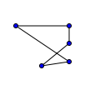
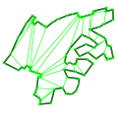


Basic Library
Polygons (7)
2D Polygons
Introduced in: CGAL 0.9
2D Polygon Partitioning
Introduced in: CGAL 2.3
2D Minkowski Sums
Introduced in: CGAL 3.3
2D Regularized Boolean Set-Operations
Introduced in: CGAL 3.2

Slide 20
2D Polygons
This package provides the following algorithms:
find the leftmost, rightmost, topmost and bottommost vertex
compute the (signed) area
check if a polygon is simple
check if a polygon is convex
check if a point lies inside a polygon
…

Slide 21
2D Polygon Partitioning
This package provides:
functions for partitioning polygons in monotone
functions for partitioning polygons in convex polygons
The algorithms can produce results with the minimal number of polygons

Slide 22
2D Minkowski Sums
This package provides:
functions for computing the Minkowski sum of two polygons
functions for computing the Minkowski sum of a polygon and a disc (an operation also known as offsetting or dilating a polygon)

Slide 23
2D Regularized Boolean Set-Operations
This package consists of the implementation of Boolean set-operations
intersection
join
difference
symmetric Difference
complement
…

Slide 24
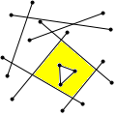
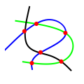
Basic Library
Arrangements (5)
2D Arrangements
Introduced in: CGAL 2.1
2D Intersection of Curves
Introduced in: CGAL 2.4

Slide 25
2D Arrangements
this package can be used to maintain, alter, and display arrangements in the plane
the package can be used to obtain results of various queries on the arrangement, such as point location
Computing the overlay of two arrangements
…

Slide 26
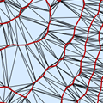
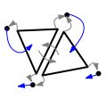
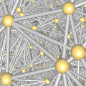
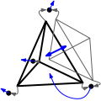
Basic Library
Triangulations and Delaunay Triangulations(7)
2D Triangulation
Introduced in: CGAL 0.9
2D Triangulation Data Structure
Introduced in: CGAL 2.2
3D Triangulations
Introduced in: CGAL 2.1
3D Triangulation Data Structure
Introduced in: CGAL 2.1

Slide 27
2D Triangulation
This package allows to build various triangulations for point sets two dimensions
Any CGAL triangulation covers the convex hull of its vertices
Triangulations are built incrementally and can be modified by insertion or removal of vertices
…

Slide 28
2D Triangulation Data Structure
This package provides a data structure to store a two-dimensional triangulation
Data Structure Based on Faces and Vertices
visit all the vertices, edges and faces incident to a given vertex
addition of a new vertex splitting a given face or a given edge
removal of a vertex incident to three faces
flip edges
…

Slide 29
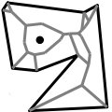
Basic Library
Voronoi Diagrams(3)
2D Segment Delaunay Graphs
Introduced in: CGAL 0.9
An algorithm for computing the dual graph of a Voronoi diagram of a set of segments

Slide 30
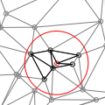
Basic Library
Spatial Searching and Sorting (7)
2D Range and Neighbor Search
Introduced in: CGAL 2.1
circular range search
triangular range search
isorectangular range search
(k) nearest neighbor(s)

Slide 31
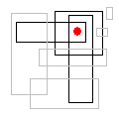
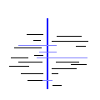
Basic Library
Spatial Searching and Sorting
dD Range and Segment Trees
Introduced in: CGAL 0.9
Interval Skip List
Introduced in: CGAL 3.0

Slide 32
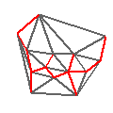
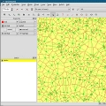

Support Library (10)
CGAL and the Boost Graph Library
Introduced in: CGAL 3.3
CGAL Ipelets
Introduced in: CGAL 3.5
Profiling tools, Hash Map, Union-find, Modifiers
Introduced in: CGAL 3.2

Slide 33
Part 3
CGAL LiveCD

Slide 34
CGAL LiveCD
Optimal as a Demo CD -contains all the demos of CGAL compiled.
Test CGAL or Solve applied computational geometry exercises easily.
Enables you to Run and Compile CGAL programs without installing any software and without changing anything on you hard drive.
Easy operation- Just put the CD in the computer and reboot (of course you can always use a virtual machine to do that)
Based on CGAL 3.5

Slide 35
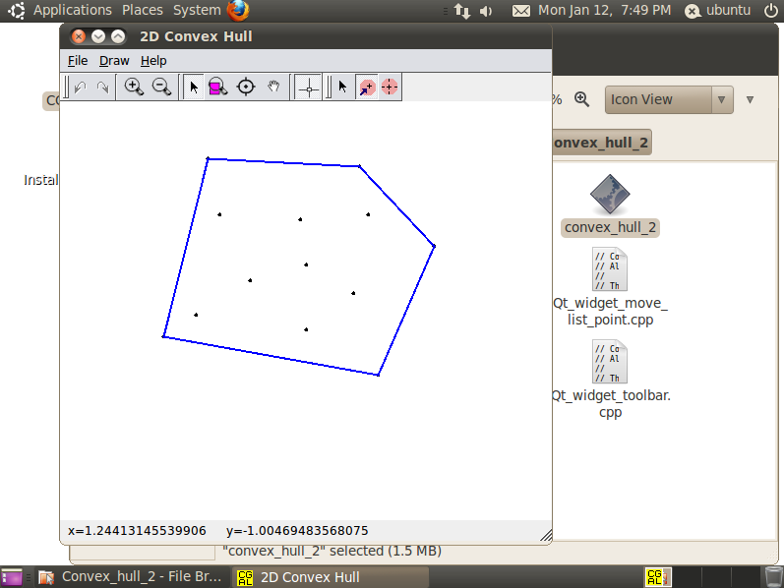
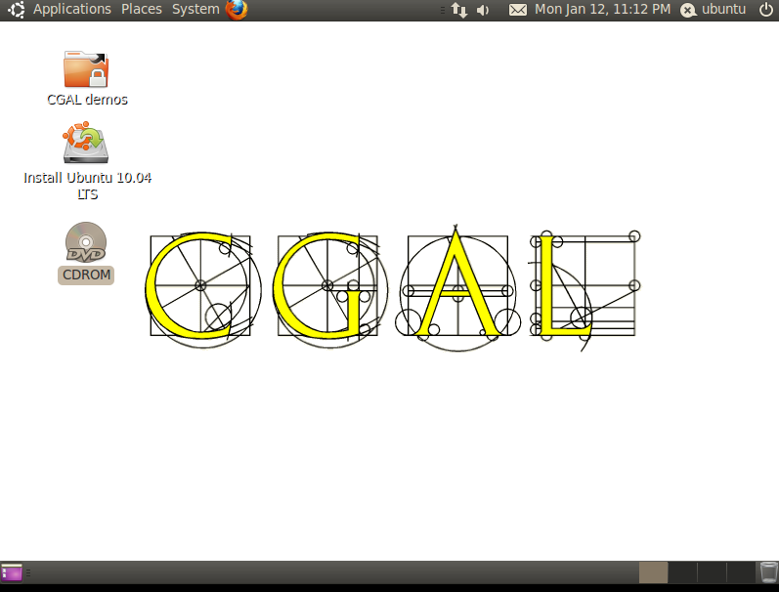

Slide 36
Compiling a CGAL example
By default the source code for the CGAL example programs is installed as a compressed archive in a documentation directory.
Unpack tar --gzip -xf /usr/share/doc/libcgal-demo/examples.tar.gz
Go to subdirectory cd examples/Convex_hull_2
compile an example program g++ -lCGAL array_convex_hull_2.cpp
Run program ./a.out

Slide 37
Part 4
Installing CGAL on Linux

Slide 38
Prerequisites
Install CMake sudo apt-get install cmake cmake-gui
Install Boost Libraries sudo apt-get install libboost-all-dev
Qt4 is only needed if you want to run CGAL demos
libQGLViewer is only needed for 3D CGAL demos

Slide 39
Installing libQGLViewer
Downloading libQGLViewer downloaded the file libQGLViewer-2-6-0.tar.gz from www.libqglviewer.com/src/libQGLViewer-2.6.0.tar.gz
Unpack tar libQGLViewer-2-6-0.tar.gz
Configure cd libQGLViewer-2-6-0/QGLViewer qmake –spec mack-g++ make

Slide 40
Installing CGAL on Linux
Downloading CGAL downloaded the file CGAL-4.5.tar.gz from http://www.cgal.org/download.html
Unpack tar xzf CGAL-4.5.tar.gz
the directory CGAL-4.5 will be created

Slide 41
Installing CGAL on Linux
This directory contains the following subdirectories
Directory | Contents
auxiliary | Precompiled GMP and Mpfr for windows
demo | demo programs
cmake/modules | modules for finding and using libraries
config | configuration files for install script
doc_html | documentation (HTML)
examples | example programs
include | header files
scripts | some useful scripts
src | source files

Slide 42
Building CGAL on Linux
Configuring CGAL with the cmake Command-Line Tool cd CGAL-4.5 # go to CGAL directory cmake . # configure CGAL make # build the CGAL libraries

Slide 43
Configuring an Example/Demo/Program
Configuring and Building cd CGAL-4.5/examples/Convex_hull_2 # go to Convex_hull_2 directory cmake –DCGAL_DIR=$HOME/CGAL-4.5 . # configure make # build
Run ./array_convex_hull_2 # sample program
Examples need neither Qt4, nor libQGLViewer

Slide 44
Reference
www.CGAL.org
www.acg.cs.tau.ac.il

Slide 45
The end.

