Slide 1
Doctorado en ciencias de la Computación
Estructuras de Datos y Algoritmos
Yalmar Ponce

Slide 2
Topics
C++ Review
  Programming Techniques
  STL
  Templates
C++ 11/14
  New Features
  Auto
  Lambda
  Variadic templates

Slide 3
Topics
Use cases
  BOOST libraries
  CGAL
  Other own implementations of TDAs
Aplications
  Image processing
  Computer graphics
  Simulation
    Physical
    Others
  Parallel computing
  IC

Slide 4
Bibliografia C++
C++ In Depth
  Tour of C++
  C++ Templates: The Complete Guide
  Modern C++ Design
  C++ Template Metaprogramming
  Exceptional C++ Style
  Exceptional C++
  More Exceptional C++
  Accelerated C++
  Applied C++
  Essential C++

Slide 5
Bibliografia C++
The C++ Programming Languaje 4ed
Programming: Principles and Practice Using C++
The C++ Standard Library
A tour of C++
Effective C++
More Effective C++
Modern Effective C++
Omong much others …

Slide 6
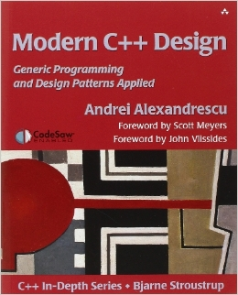
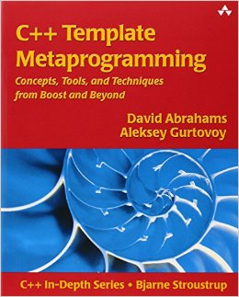
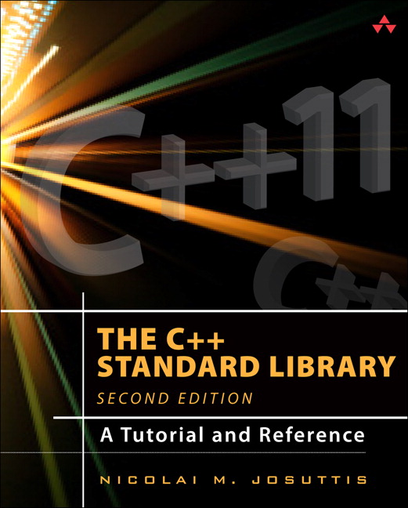
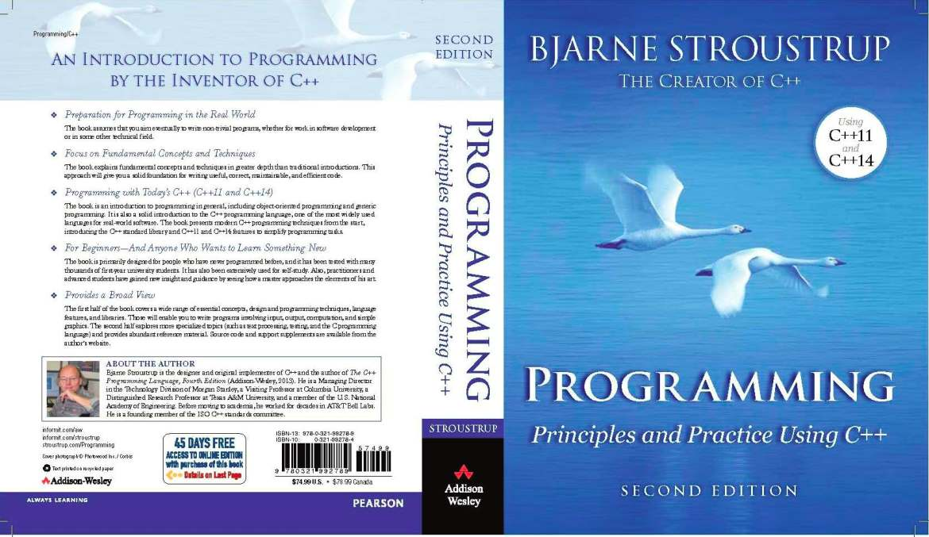
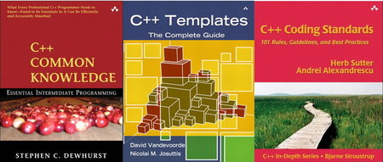
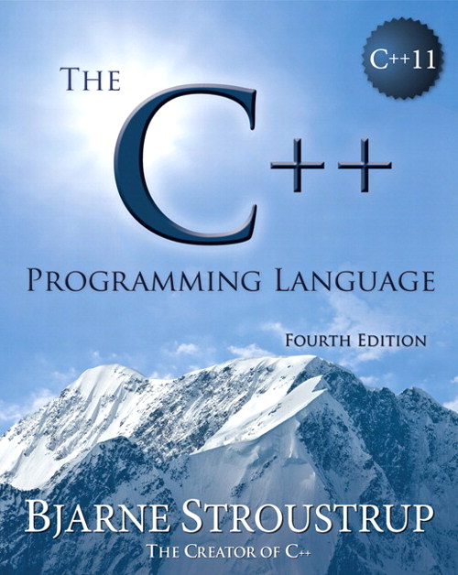

Slide 7
Bibliografia ED
HandBook of Data Structures and Applications
Data Structures and Algorithms in C++
Data Structures and Algorithms Analysis in C++
Foundations of Multidimensional and Metric Data Structures

Slide 8
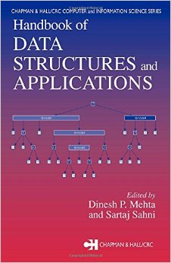
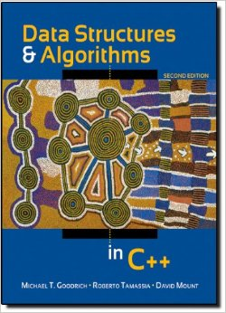
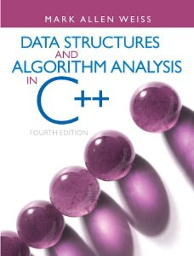
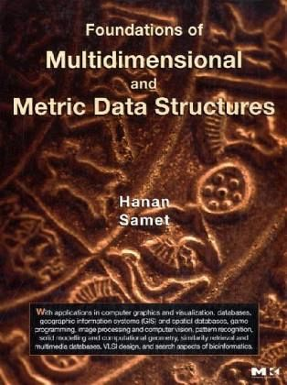
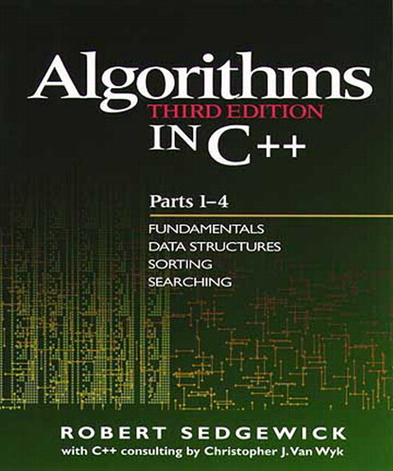
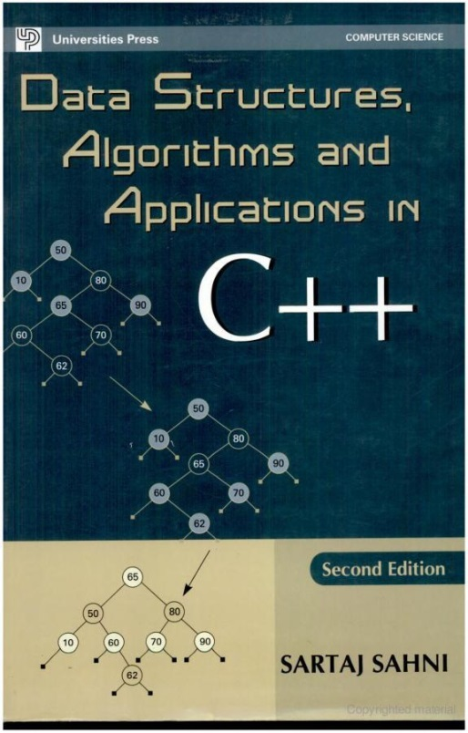
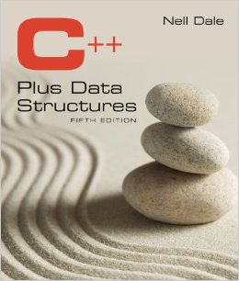

Slide 9
Caso de Uso
BOOST y CGAL

