Slide 1
Mesh Generation

Slide 2
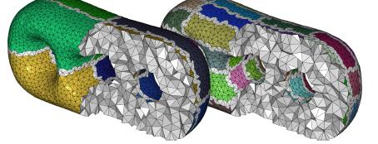
Introduction to Meshes
The Mesh Generation is the discretization of a given domain into simpler elements such as triangles or quadrilaterals (2D) and tetrahedra or hexahedra (3D).
Source: http://www.cse.ohio-state.edu/~tamaldey/LocDel.html

Slide 3
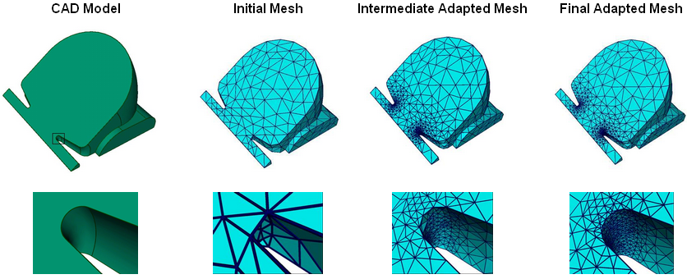
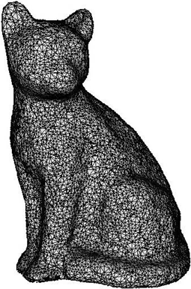
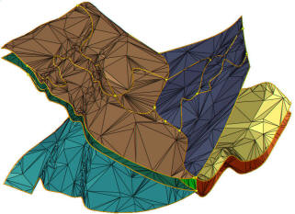
CAD Model
http://www.itaps.org/tools/services/adaptive-loops.html
Curved Surface
Non-manifold
Kazhdan M. et al. “Poisson surface reconstruction,” 2006.
http://www-ljk.imag.fr/Publications/Basilic/com.lmc.publi.PUBLI_Article@117681e94b6_1fc082a/index_en.html

Slide 4
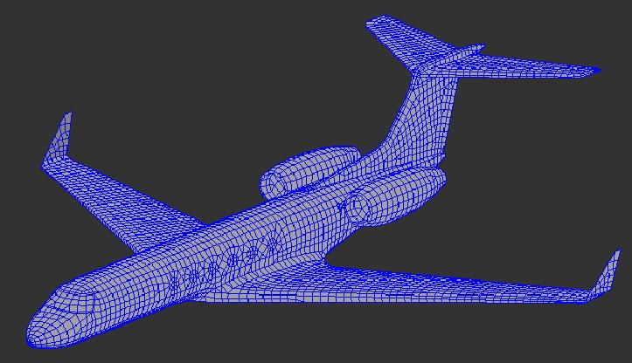
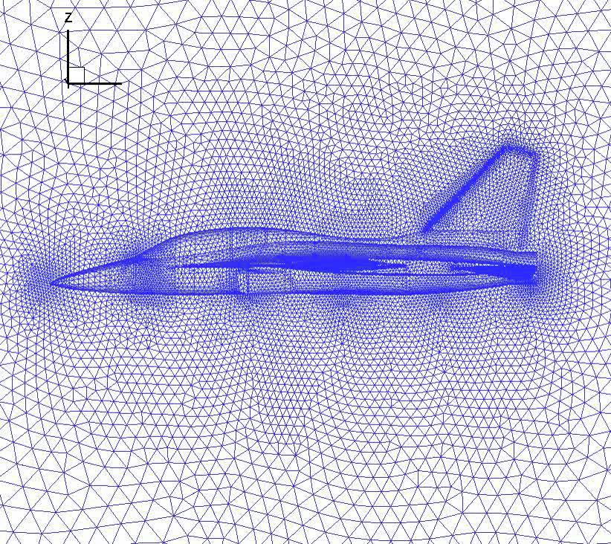
Aeronautical Engineering
Aircraft Designing: Fuselage and hull design, Wing type and Size design, Engine Design, Structure Design
www.thermoanalytics.com
http://www.youtube.com/watch?v=6zIb0pcjdEY

Slide 5
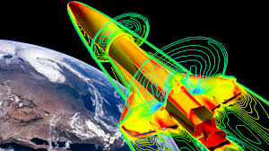
Mechanical Engineering
While deforming sheet metal for manufacturing special care is required to avoid cracking or over thinness. So, detailed stress analysis is required which require a good quality mesh.
Thermodynamics and Fluid Flow (heat sink for CPU or air conditioning system, turbine and motor boat)
www.cd-adapco.com

Slide 6
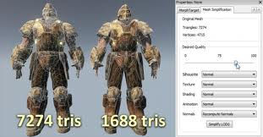
Computer Graphics
Computer Games
2. CAD/Solid Modelling
3. Movie production
http://www.unrealengine.com/news/epic_games_releases_july_2011_unreal_development_kit_beta/

Slide 7
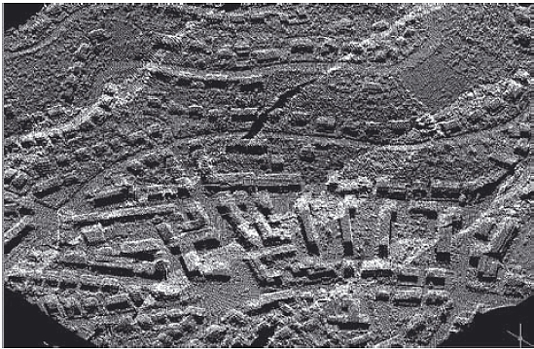
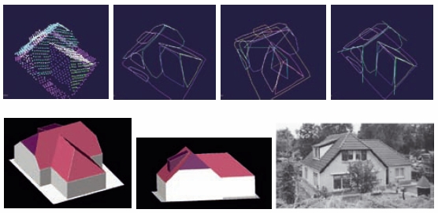
LIDAR
http://www.fig.net/pub/figpub/pub48/figpub48.htm
Sample of LiDAR data – a 3D view of urban neighborhood.
Steps in automatic extraction process of 3D building from LiDAR data – segmentation → segments handling → topological analysis → line and vertices extraction (top from left to right); the extracted 3D building and results verification (bottom from left to right). (Abo Akel et al., 2006)

Slide 8
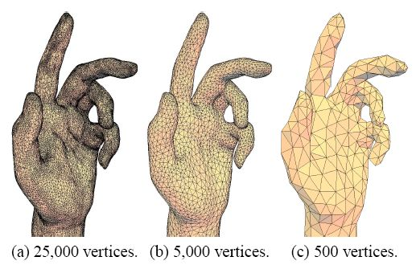
Mesh Simplification
Surface mesh simplification is the process of reducing the number of faces used in the surface while keeping the overall shape, volume and boundaries preserved as much as possible. It is the opposite of subdivision
http://doc.cgal.org/latest/Surface_mesh_simplification/index.html
www.cs.sfu.ca

Slide 9
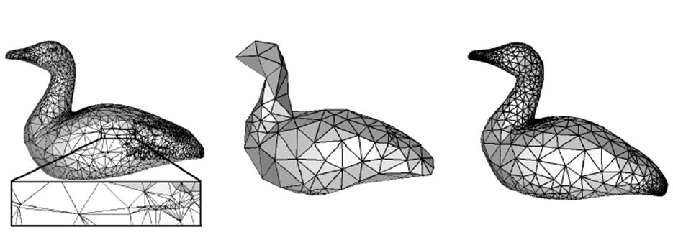
Remeshing
Scanning an object, especially automated results in raw meshing as objects are oversampled and contains redundant vertices. Remeshing is done to improve the mesh quality in terms of vertex sampling, regularity and triangle quality.
http://www.cs.utah.edu/~csilva/courses/cpsc7960/pdf/remeshing.pdf
www.cse.ohio-state.edu/~tamaldey/paper/remesh/remesh-not-journal.pdf

Slide 10
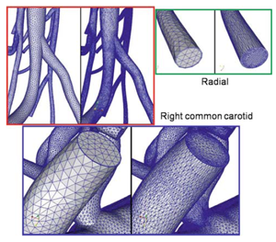
Mesh Adaption
Mesh adapt works with large scale problems and focuses on carefully selected local mesh operators, such as refinement, coarsening, swapping and node repositioning, to increase the quality of the mesh while satisfying the desired size field.
http://www.itaps.org/tools/services/adaptServ.html

Slide 11
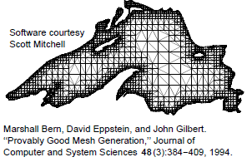
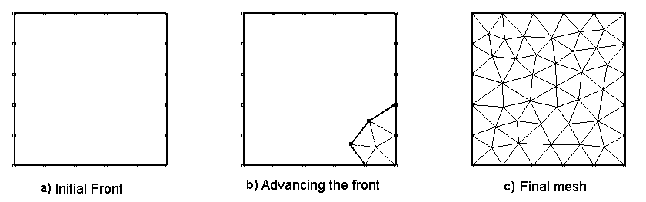
Meshing Techniques
Octree Based
Advancing front
Delaunay based
http://www.ae.metu.edu.tr/~cengiz/thesis/afm.html

Slide 12
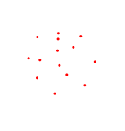
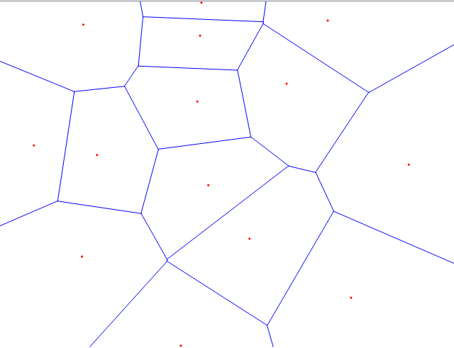
Voronoi Diagram
VD(S) is a covering of the plane by n regions V_{p}, p ϵ S, where
V_{p} = {x|d(p, x) ≤ d(q, x), p ≠ q ϵ S}.

Slide 13
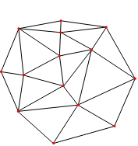
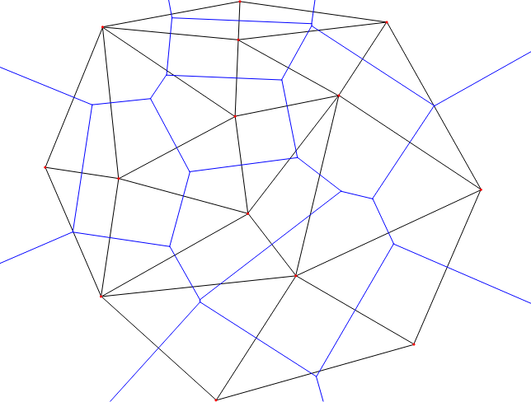
Delaunay Triangulation
DT(S) is a straight line dual of VD(S), i.e. there is a straight line edge between p and q if they are the closest point in Voronoi diagram.
Delaunay Triangulation has an empty circle property, according to which no triangle has a circumscribing circle that encloses any point in point set V.
Point Set
Delaunay Triangulation
Voronoi-Delaunay
Duality

Slide 14
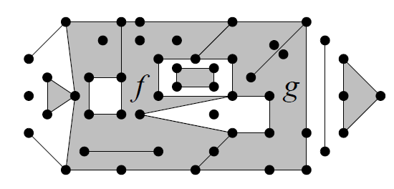
Piecewise linear complex (P)
P contains both vertices of every edge in P
Relative interior of an edge in P intersects no vertex in P nor any other edge in P
For each Polygon f in P, the boundary of f is a union of edges in P
If two polygons in P intersect, their intersection is a union of edges and vertices in P.
A PLC
NOT a PLC

Slide 15
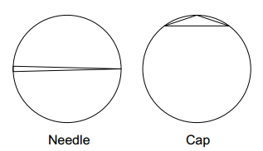

Bad quality triangles
$$Aspect ratio= ρ=\frac{circum−radius}{shortest edge length}$$

Slide 16
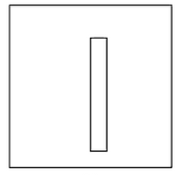
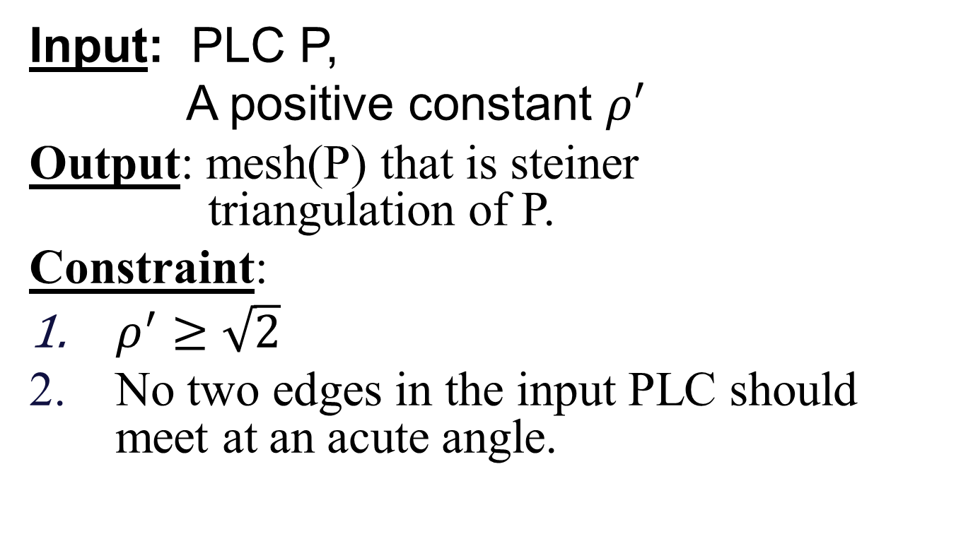
Ruppert’s algorithm
Input: PLC P,
A positive constant $ρ′$
Output: mesh(P) that is steiner triangulation of P.
Constraint:
$ρ^{′}≥\sqrt{2}$
No two edges in the input PLC should meet at an acute angle.

Slide 17
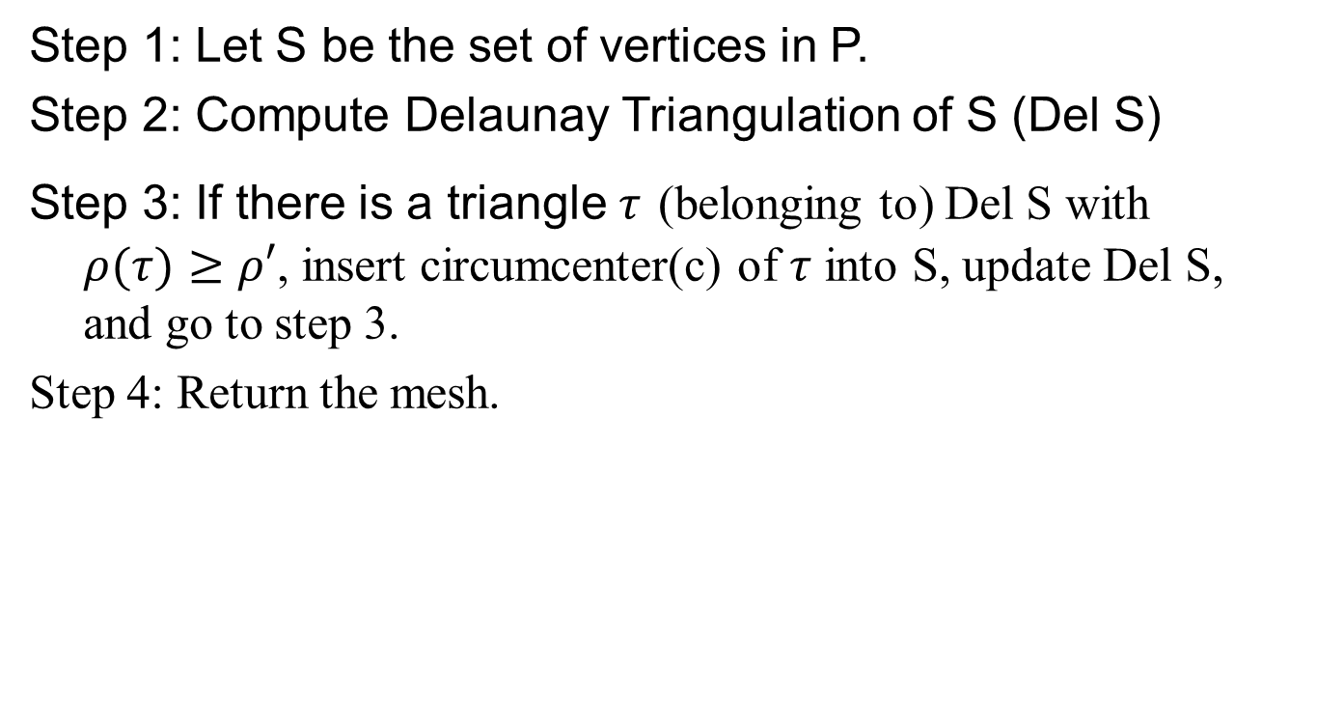
General refinement approach
Step 1: Let S be the set of vertices in P.
Step 2: Compute Delaunay Triangulation of S (Del S)
Step 3: If there is a triangle $τ$ (belonging to) Del S with $ρ(τ)≥ρ′$, insert circumcenter(c) of $τ$ into S, update Del S, and go to step 3.
Step 4: Return the mesh.

Slide 18
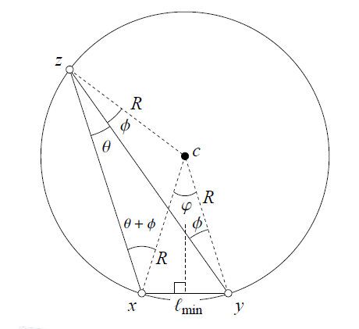

Termination?
Let λ be the shortest distance
between any two points in S
before c is inserted.
2. $ρ\left(τ\right)=\frac{R}{l_{min}}$
3. Since $τ$ is Delaunay
=>it does not contain any vertex
from S

Slide 19
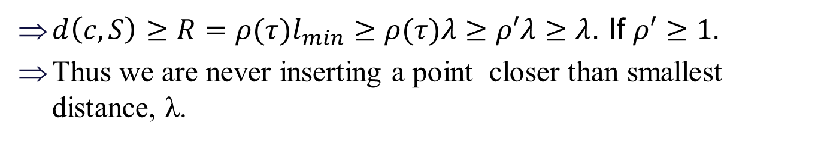
Proof Sketch
$d\left(c,S\right)≥R=ρ(τ)l_{min}≥$ $ρ(τ)λ≥ρ′λ$ $≥$ $λ$. If $ρ′≥1.$
Thus we are never inserting a point closer than smallest distance, λ.
Hence, using Packing Lemma, we conclude that the algorithm terminates

Slide 20
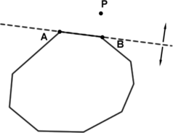
Domain Conformity
Because some of the new vertices might lie outside the domain, |P|.
What is the fix?
Let’s have a look at the complete algorithm given by Ruppert

Slide 21
DelTriPLC(P, ῤ)
Let S be the set of vertices in P. Let E be the set of edges in P.
Compute Del S
While some subsegment e (belonging to) E is encroached upon by a vertex in S, call SPLIT SUBSEGMENT(e,S,E), update Del S, and repeat Step 3.
If Del S contains a triangle |P| for which ρ(τ) > ῤ, call SPLITTRIANGLE(τ,S,E), update Del S, goto step 3.
Return the mesh {σ ∈ Del S :σ ⊆ |P|}

Slide 22
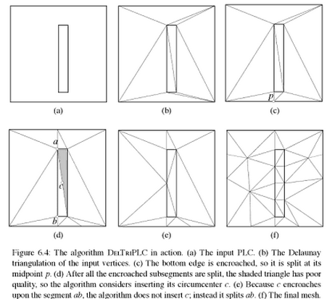

Slide 23
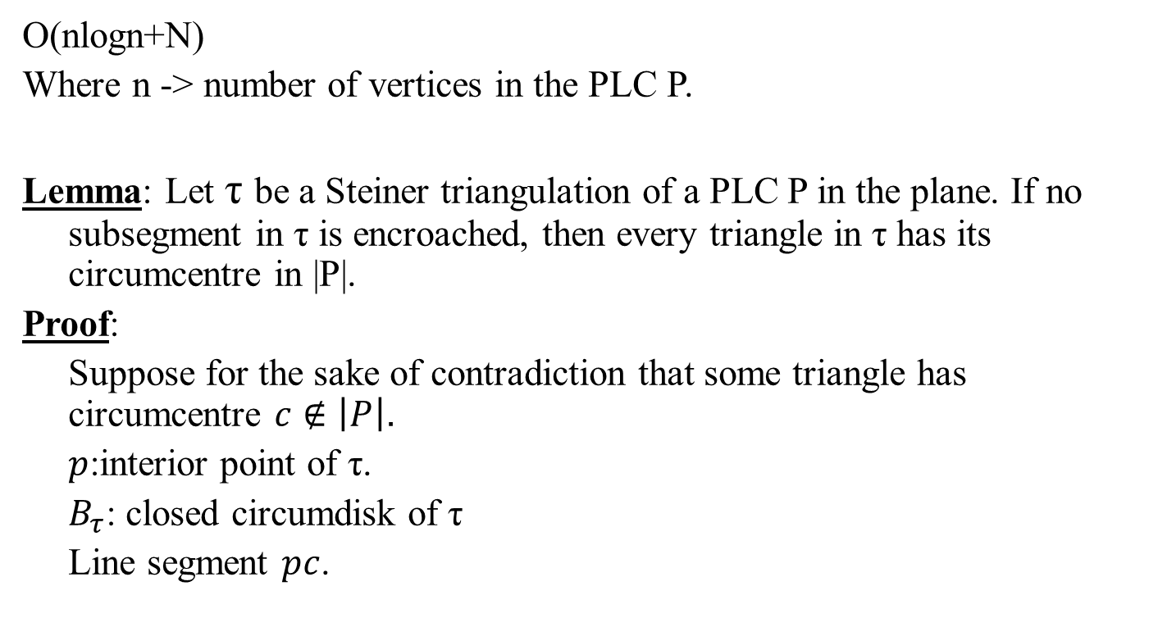
Running Time
O(nlogn+N)
Where n -> number of vertices in the PLC P.
Lemma: Let τ be a Steiner triangulation of a PLC P in the plane. If no subsegment in τ is encroached, then every triangle in τ has its circumcentre in |P|.
Proof:
Suppose for the sake of contradiction that some triangle has circumcentre $c∉\left|P\right|$.
$p$:interior point of τ.
$B_{τ}$: closed circumdisk of τ
Line segment $pc$.

Slide 24
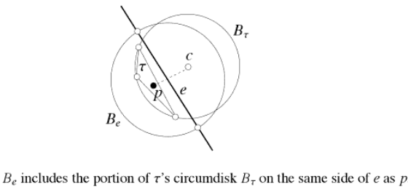

Line segment $pc$crosses from interior of $\left|P\right|$to its exterior.
Therefore, must cross some subsegment $e$ on boundary.
Claim: $e$is encroached.
Interior of PLC(H)

Slide 25
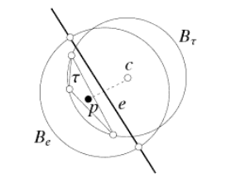
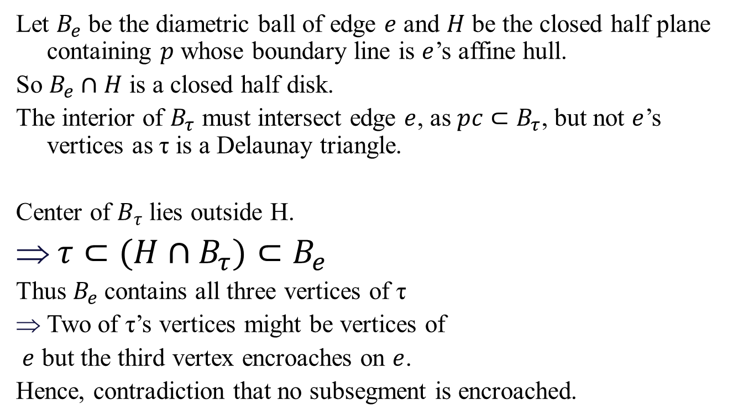
Let $B_{e}$ be the diametric ball of edge $e$ and $H$ be the closed half plane containing $p$ whose boundary line is $e$’s affine hull.
So $B_{e}∩H$ is a closed half disk.
The interior of $B_{τ}$ must intersect edge $e$, as $pc⊂B_{τ}$, but not $e$’s vertices as τ is a Delaunay triangle.
Center of $B_{τ}$lies outside H.
$τ⊂(H∩B_{τ})⊂B_{e}$
Thus $B_{e}$contains all three vertices of τ
Two of τ’s vertices might be vertices of
$e$ but the third vertex encroaches on $e$.
Hence, contradiction that no subsegment is encroached.

Slide 26
Thanks

Slide 27
Packing Lemma
BACK
Packing Lemma: Let D (subset of) R² be a bounded domain. Let S ⊂ D be a point set and λ>0 a scalar constant such that every two distinct points u and v in S, d(u,v) ≥λ.
Then, there is a constant ξ depending solely on D and λ such that |S| < ξ.

Slide 28
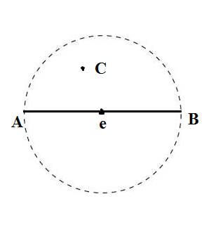
Encroachment
Encroachment: A vertex, C that lies in the closed diametric ball of a subsegment e but is not a vertex of e is said to be encroaching upon e
Back to DelTriPLC

Slide 29
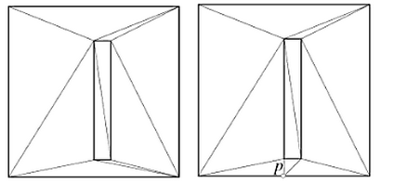
SPLIT SUBSEGMENT
1. Insert the midpoint of e into S
2. Remove e from E and add its two halves to E
Back to DelTriPLC
e
e1
e2

Slide 30
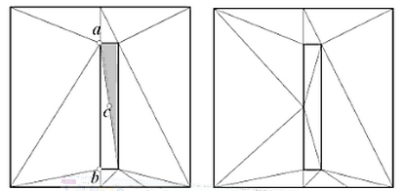
SPLIT TRIANGLE
Let c be the circumcentre of τ
If c encroaches upon some subsegment c (belonging to) E, call SPLITSUBSEGMENT(e,S,E). Otherwise, insert c into S.
Back to DelTriPLC

Slide 31
References
Siu-Wing Cheng, Tamal K. Dey, J. R. Shewchuk. Delaunay Mesh Generation. CRC Press, Boca Raton, Florida, December 2012.

