Slide 1
Spring 2019 48721 Instructions for Assignment 3-Part 1

Slide 2
Starter Package
Baseline control logic code
Baseline building operation data
xremote.py (client tool to run virtual control test remotely)
requirements.txt (environment requirements file)

Slide 3
Control Logic
The control logic should be implemented in Python 3
Allowed external python package:
Numpy
Scipy
A starter code (baseline logic) is provided. Your control logic can be very similar to the baseline logic, and should not be too complicated (the grade is not related to the complexity of the control logic)
Spend your time in data analysis

Slide 4
Simulator
The simulator is implemented based on OpenAI Gym interface
Action @ t+1
Your Code
Simulator (EnergyPlus)
Observations, Terminal Flag @ t

Slide 5
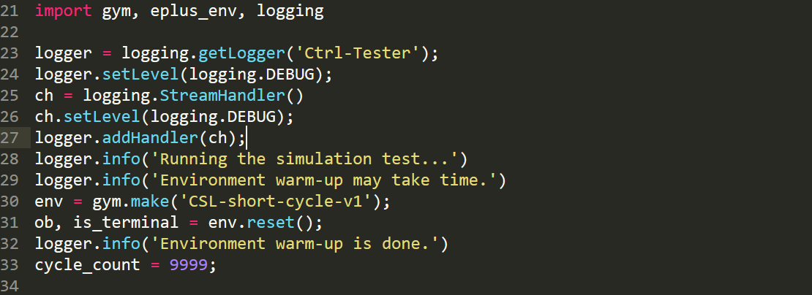
Control Logic
The header part sets up some dependent variables and objects, and obtain the initial “ob” from the simulator (it may take some time)
You can add new variables, but should not delete anything

Slide 6
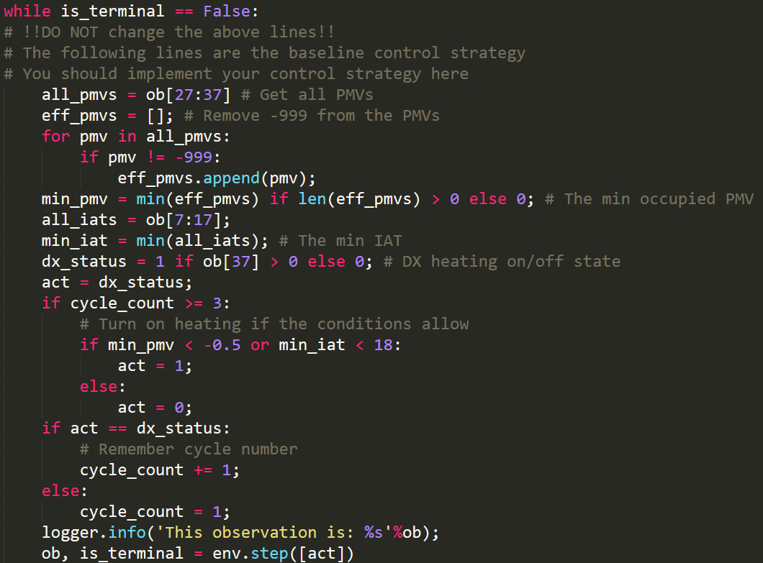
Control Logic
Write your control logic inside the while loop
“ob” is a Python list [item0, item1,…,itemN], the physical meaning of each item can be found in Appendix of your handout

Slide 7
Control Logic
Your logic should determine a control action based on the information in “ob”
Send the control actions back to the simulator at the end of each while loop cycle using “env.step([act])” (DONOT change this line except “act”)

Slide 8
Control Logic
The control action should be wrapped inside a Python list [act]
The available actions you can choose can be found in Appendix of the handout

Slide 9
Control Logic
DO NOT use print (it will block your code)
Use logger.info()

Slide 10
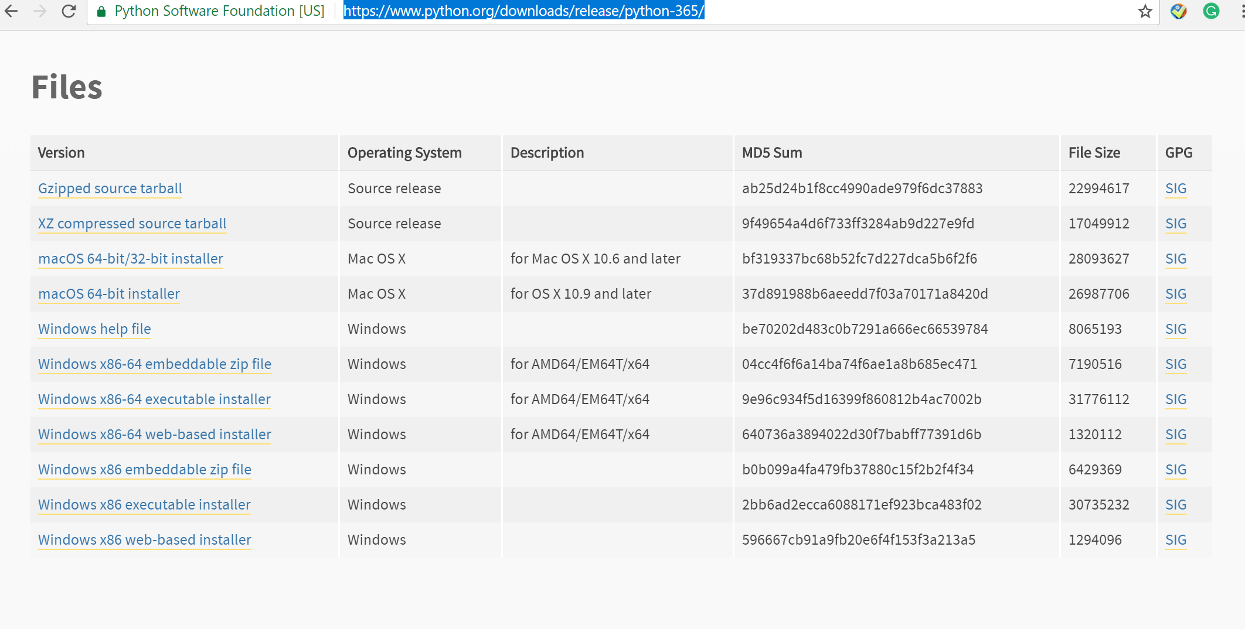
Environment Setup (windows)
Download Python 3 (latest version is 3.6.5) from https://www.python.org/downloads/release/python-365/
64 bit
32 bit

Slide 11
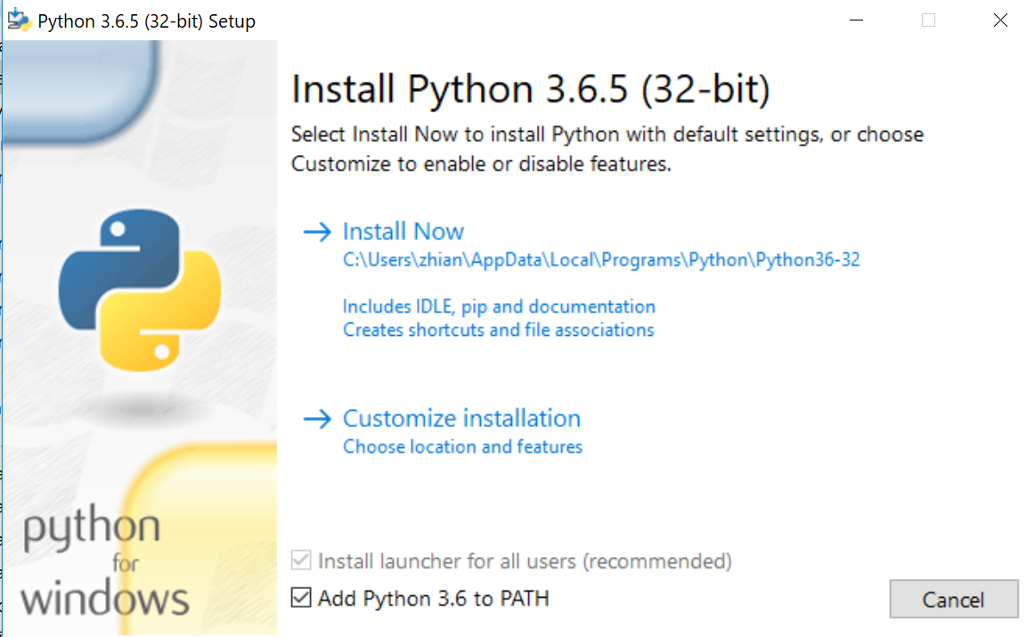
Environment Setup (windows)
Install

Slide 12
Environment Setup (windows)
Open “Command Prompt” or “PowerShell” of windows by administrator (right click run as administrator)
pip install virtualenv
Set the execution policy to “bypass” only for this session if you use PowerShell
Set-ExecutionPolicy –Scope Process –ExecutionPolicy Bypass
Go to your working directory, create a virtual environment
virtualenv virtualEnvName
Enter the virtual environment
.\virtualEnvName\Scripts\activate
Leave the virtual environment
Deactivate
Install dependencies
pip install -r requirements.txt

Slide 13
Run the Control Test
xremote.py is a client script that sends your code to the server, and gets the results from the server
python xremote.py --ip 128.2.111.196 --port 48721 --key KEY --path pathToYourCode
The keys can be found in keys.txt

Slide 14
Run the Control Test
xremote can stream the real-time logging to your terminal for your debug
If successful, xremote downloads the results to xremote_res.zip

Slide 15
Results
Simulation results are stored in Eplus-env-run{X}/Eplus-env-{environment name}-res{X}/Eplus-env-sub_run1/output/
You can view the eplusout.eso file using DesignBuilder Results Viewer (https://designbuilder.co.uk/download)
Or you can view eplusout.csv using Excel

Slide 16
Errors
This is our in-house brewed code
Copy me all the error messages
I will fix it ASAP
WeChat: zhangzhizza

