Slide 1
Grand Challenge 1 CMPE -275
Hardik ghori (016452059)
Abraham Mathew (016018990)
Varun raj (015918006)

Slide 2
Introduction
Develop a low-level socket-based multi-threaded server client communication model utilizing various technologies including gRPC, Protobuf, Java, and Python.
Client request are distributed to the servers one by one in a cyclic manner.

Slide 3
Technologies used
Protobuf
gRPC framework
Python
Java

Slide 4
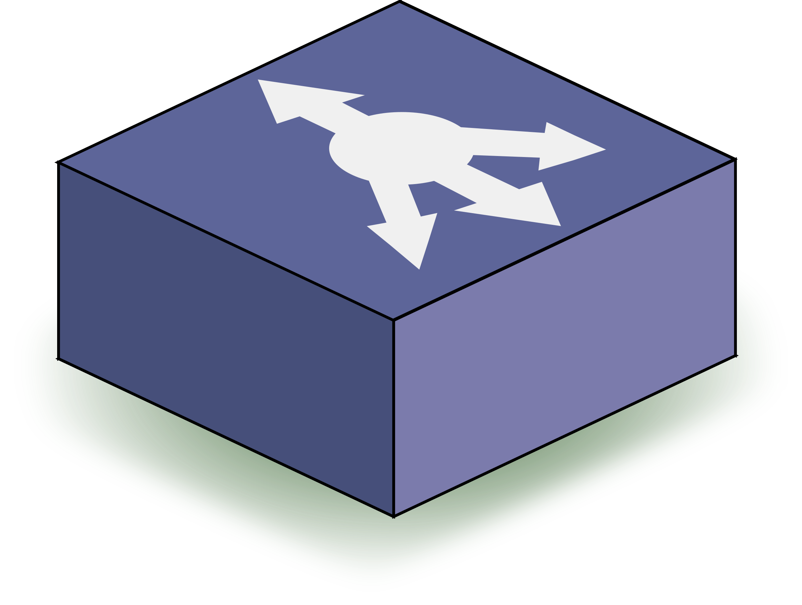
Outline-Model
end
Communication Channel
Client requests
Neutral data form
Server A
Server B
Server C
Server D
Server E
java
python
Load balancer

Slide 5
Design
Unlike centralized architecture because of failure(leader), we took a 50-50 approach.
Traffic distribution is in dynamic manner by passing it to the next server in case if storage is not available.
And the same goes on.
server A
Full capacity

Slide 6
Results
Requests

Slide 7
Difficulties
Lots of possibilities to execute but difficult to analyze them in a quick manner
Condition where some servers fail and other all servers are full, this will fail
Selection of leader in a dynamic way

