Slide 1


Smart Hospital Management System
Bahir Dar University 2018E.C
ABEMELEK MESFIN,YONAS ALEBEL,TSION TESFAYE

Slide 2


BACKGROUND OF THE STUDY
Hospitals handle complex clinical and administrative processes
Multiple departments must work together for patient care
Digital systems improve efficiency, accuracy, and coordination
Integrated hospital systems are essential in modern healthcare

Slide 3





PROBLEM STATEMENT
Difficulty on patient visits from start to finish Hospitals use partial systems and manual processes together.
Patient data is fragmented and hard to retrieve. Billing is manual, slow, and error-prone.
Reporting and decision-making are difficult due to inconsistent data.

Slide 4
General Objective
THE GENERAL OBJECTIVE OF THIS PROJECT IS TO DESIGN AND DEVELOP AN INTEGRATED HOSPITAL MANAGEMENT SYSTEM.

Slide 5

Specific Objectives
Gather requirements for a digital hospital management system based on research. Implement a visit lifecycle management system (create, update status, close).
Develop automated billing and payment processing with accurate bill generation. Integrate a digital laboratory module for test requests and result processing.
Integrate clinical, diagnostic, and pharmacy workflows into a unified system.

Slide 6
Methodology
Requirement gathering through interviews with hospital system administrators
Analysis using object oriented approach System design using UML diagrams
Web based system using role based modules and centralized database.

Slide 7





FEASIBILITY STUDY
1
Technical Feasibility
Users can operate the system easily; it supports role- based workflows and secure access.
3
Operational Feasibility
Supports existing hospital workflows and improves efficiency through digital integration.
2
Economic Feasibility
Uses free/open-source tools; no cost to users or hospital during the academic phase.
4
Schedule Feasibility
Scope is limited to essential modules to meet the academic timeline.

Slide 8




BENEFICIARY
Hospital administrators and managers Doctors and nurses
Receptionists and cashiers Laboratory and pharmacy staff Patients (indirectly through improved workflow and service delivery)

Slide 9




SCOPE AND LIMITATION
Scope
Patient triage and registration Visit monitoring and medical checkups
Laboratory and pharmacy management
Billing and payment processing Role based access control
Limitations
Designed for a single hospital Uses simulated (non-real) data
No advanced analytics or AI support Limited emergency scenario handling
Can not handle operations for big hospitals

Slide 10
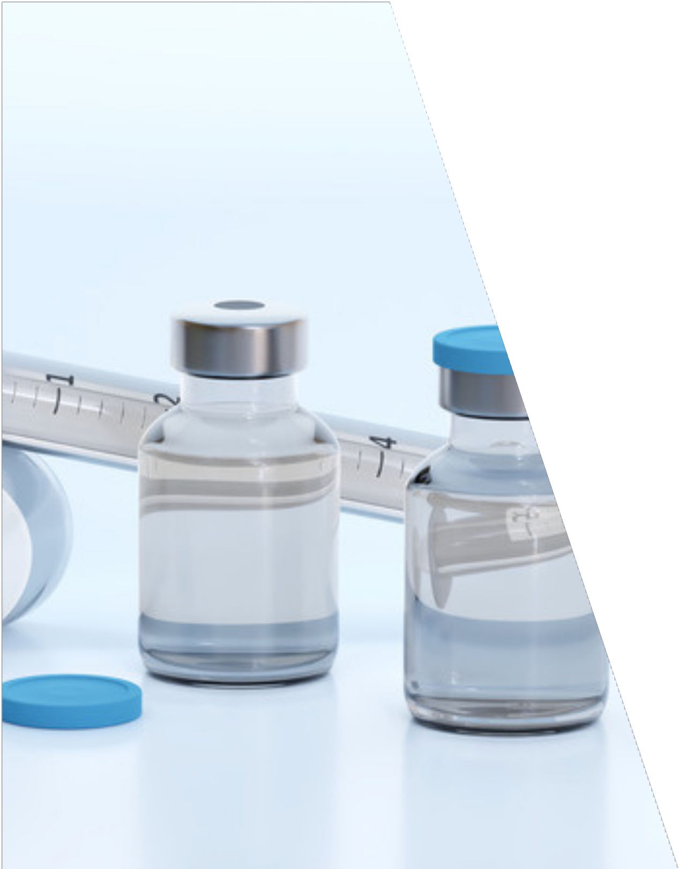

EXISTING SYSTEM
Hospitals already use digital systems
Systems are role-based with separate modules Core services are supported digitally
Used as a reference for system design

Slide 11




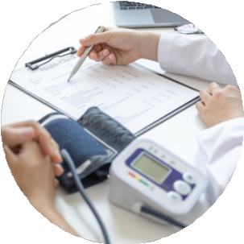


PROPOSED SYSTEM
Modeled system similar to existing hospital systems
Integrated workflow across all departments
Centralized data storage
Secure and role-based system access Integrated digital billing system

Slide 12








1
FUNCTIONAL REQUIREMENT
2
User authentication and role-based access Patient registration and visit creation Triage recording and vital sign updates
Clinical examination and diagnosis recording Lab request and result processing
Pharmacy dispensing and inventory management Billing and payment processing
3

Slide 13



NON-FUNCTIONAL REQUIREMENT
Security and data confidentiality System reliability and availability Ease of use and usability Performance and responsiveness Scalability for future expansion
Medical c ieve ent

Slide 14
System Actors
Administrator Receptionist Triage
Doctor Nurse
Laboratory Technician Pharmacist
Cashier

Slide 15
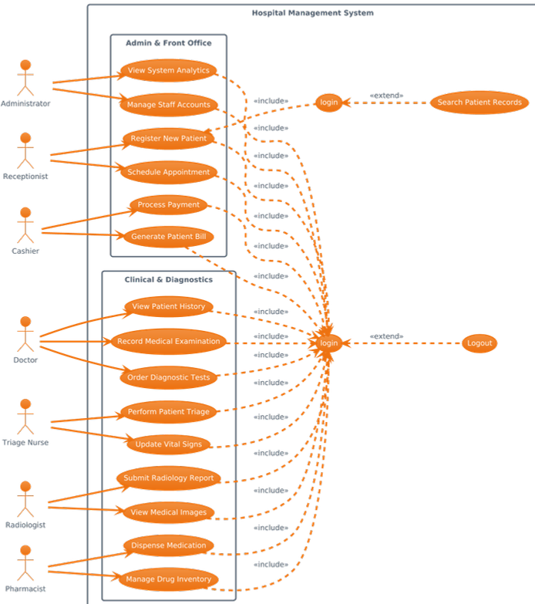
GENERAL USE CASE DIAGRAM
High-level interaction between users and system Focuses on authentication and role access Represents general system functionality

Slide 16
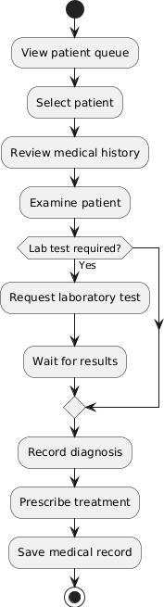
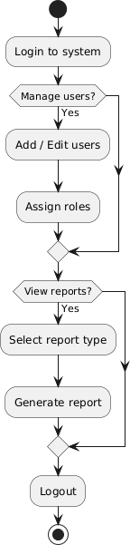
ACTIVITY DIAGRAMS
Show workflow of hospital processes Include decision points and task flow Represent department-level operations
Doctor Activity Diagram
Admin Activity Diagram

Slide 17
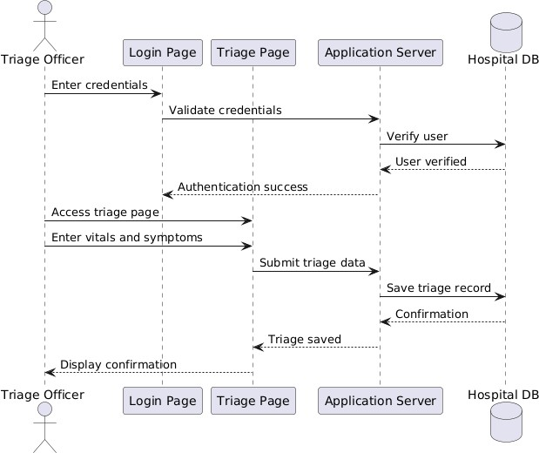
SEQUENCE DIAGRAMS
Show interaction order between actors and system
Include user pages, server, and database Represent time-based system behavior
Triage Sequence Diagram

Slide 18
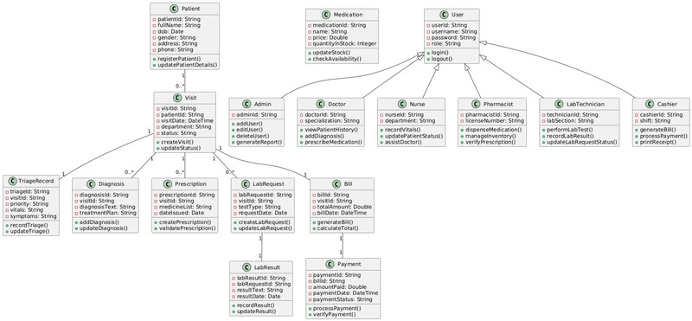
CLASS MODEL DIAGRAM
Shows system entities, attributes, and relationships
Includes User roles (Doctor, Nurse, Admin, etc.) Represents key modules: Patient, Visit, Billing, Lab, Pharmacy

Slide 19
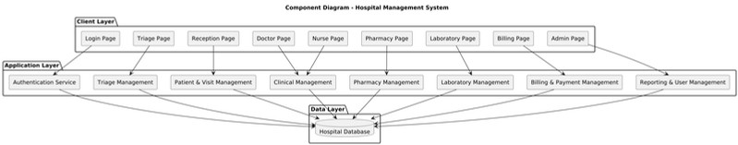
COMPONENT MODEL
Represents major system components Shows how modules interact
Helps understand system structure

Slide 20
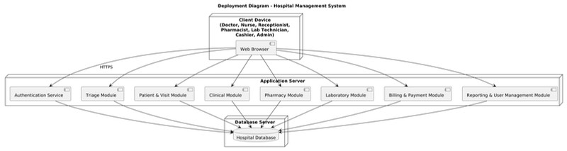
DEPLOYMENT MODEL
Client-server architecture
User devices connect to application server
Centralized database for data storage

Slide 21
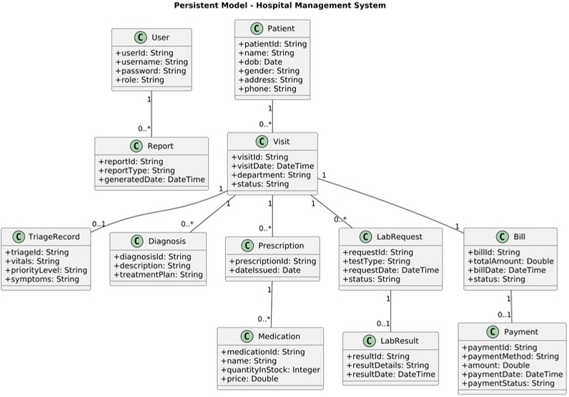
PERSISTENT MODEL
Identifies data stored permanently Includes patient, visit, billing, and user data
Ensures data consistency and integrity

Slide 22
Conclusion
The system models a fully integrated digital hospital workflow Uses UML diagrams to document system behavior and structure Ensures secure access through role-based authentication
Supports essential hospital operations with scope-limited implementation Provides a foundation for future expansion and real-world use

Slide 23
Thank You
Questions and Comments?
Bahir Dar Institute of Technology | Faculty of Computing

