Slide 1

SCSJ3343 - Software Quality and Testing
7b - Test Design Techniques: Part II

Slide 2
Decision Table Testing
Applicable for system requirements or specifications, which contain logical conditions and complex business rules that a system is to implement.
Check specifications and define input conditions and actions of the system and state them in a way, that they can be either “true” or “false”
Decision table contains combinations of “true” and “false” for all input conditions and the resulting actions.

Slide 3
Decision Table (cont.)
Each column of the table corresponds to a rule in the business process, which defines a unique combination of conditions, which again results in the execution of the action, which is associated with this rule.
For decision table testing usually used standard-coverage:
  At least one test case per column (includes the coverage of all combinations of triggering conditions).

Slide 4
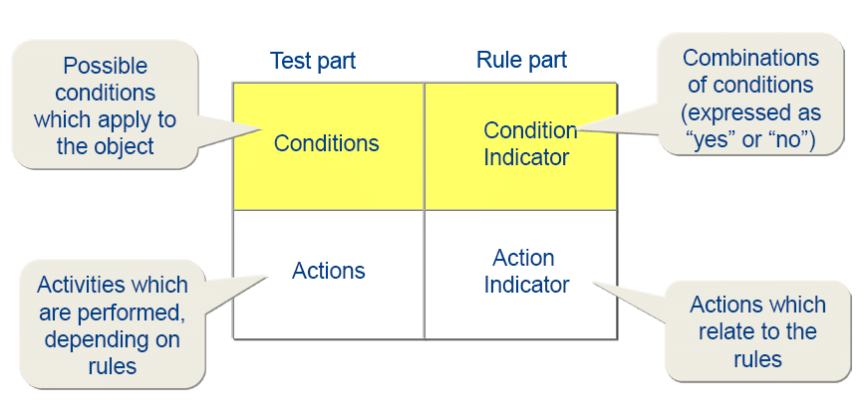
Decision Table Testing (cont.)
The four quadrants of the decision table:

Slide 5
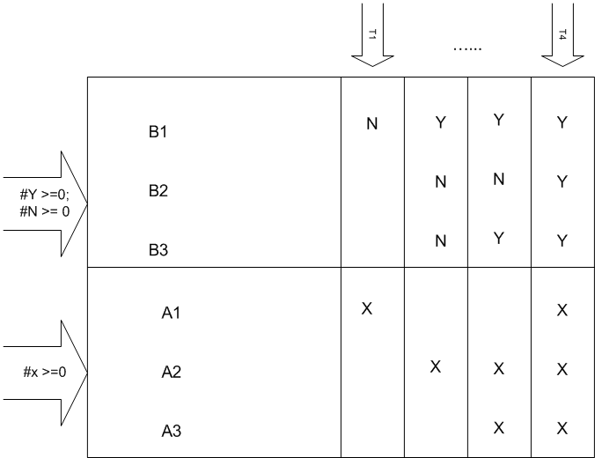
Decision Table
Each column responds to a test case (rule)
Coverage Criteria:
  All conditions at least once N and Y
  All actions at least once x.
  All condition-combinations.

Slide 6
A Simple Example
Scenario: A marketing company wishes to construct a decision table to decide how to treat clients according to three characteristics:
  Gender,
  City Dweller, and
  age group: A (under 30), B (between 30 and 60), C (over 60).
The company has four products (W, X, Y and Z) to test market.
  Product W will appeal to male city dwellers.
  Product X will appeal to young males.
  Product Y will appeal to Female middle aged shoppers who do not live in cities.
  Product Z will appeal to all but older males.

Slide 7
Identify Conditions & Values
The three data attributes tested by the conditions in this problem are
  gender, with values M and F;
  city dweller, with value Y and N; and
  age group, with values A, B, and C
as stated in the problem.

Slide 8
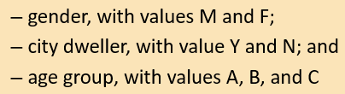
2. Compute Maximum Number of Rules
The maximum number of rules is 2 x 2 x 3 = 12

Slide 9
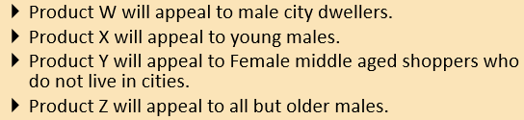
3. Identify Possible Actions
The four actions are:
  market product W,
  market product X,
  market product Y,
  market product Z.

Slide 10
4. Enter All Possible Conditions
RULES
 | 1 | 2 | 3 | 4 | 5 | 6 | 7 | 8 | 9 | 10 | 11 | 12
Sex | m | f | m | f | m | f | m | f | m | f | m | f
City | y | y | n | n | y | y | n | n | y | Y | n | n
Age | a | a | a | a | b | b | b | b | c | c | c | c

Slide 11
5. Define Actions for each Rule
Actions
Market | 1 | 2 | 3 | 4 | 5 | 6 | 7 | 8 | 9 | 10 | 11 | 12
W | X |  |  |  | X |  |  |  | X
X | X |  | X
Y |  |  |  |  |  |  |  | X
Z | X | X | X | X | X | X | X | X |  | X |  | X

Slide 12
Full table
RULES
 | 1 | 2 | 3 | 4 | 5 | 6 | 7 | 8 | 9 | 10 | 11 | 12
Sex | m | f | m | f | m | f | m | f | m | f | m | f
City | y | y | n | n | y | y | n | n | y | Y | n | n
Age | a | a | a | a | b | b | b | b | c | c | c | c
Actions
Market | 1 | 2 | 3 | 4 | 5 | 6 | 7 | 8 | 9 | 10 | 11 | 12
W | X |  |  |  | X |  |  |  | X
X | X |  | X
Y |  |  |  |  |  |  |  | X
Z | X | X | X | X | X | X | X | X |  | X |  | X

Slide 13
6. Verify the Policy
Let us assume that the client agreed with our decision table.

Slide 14
7. Simplify the Table
There appear to be no impossible rules.
Note that rules 2, 4, 6, 7, 10, 12 have the same action pattern.
Rules 2, 6 and 10 have
  two of the three condition values (gender and city dweller) identical and
  all three of the values of the non- identical value (age) are covered,
so they can be condensed into a single column 2.
The rules 4 and 12 have identical action pattern, but they cannot be combined because the indifferent attribute "Age" does not have all its values covered in these two columns.
Age group B is missing.

Slide 15
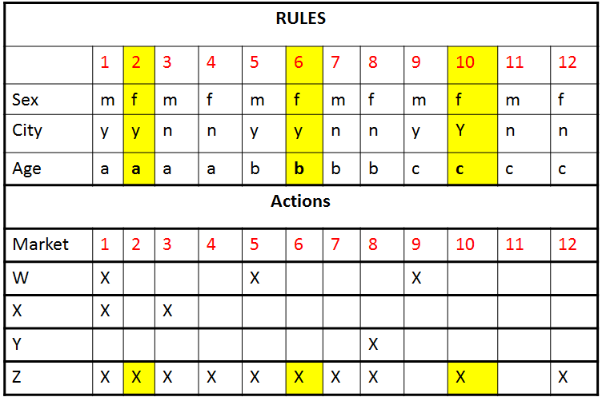

Simplify the Table
  two of the three condition values (gender and city dweller) identical and
  all three of the values of the non- identical value (age) are covered,
  so they can be condensed into a single column 2

Slide 16
The revised table is as follows:
RULES
 | 1 | 2 | 3 | 4 | 5 | 6 | 7 | 8 | 9 | 10
Sex | M | F | M | F | M | M | F | M | M | F
City | Y | Y | N | N | Y | N | N | Y | N | N
Age | A | - | A | A | B | B | B | C | C | C
Actions
Market | 1 | 2 | 3 | 4 | 5 | 6 | 7 | 8 | 9 | 10
W |  |  |  |  | X |  |  | X
X | X |  | X
Y |  |  |  |  |  |  | X
Z | X | X | X | X | X | X | X |  |  | X

Slide 17
Test Cases
Test Case ID | Condition 1 | Condition 2 | Condition 3 | Expected Output | Actual Output | Pass/Fail
TC1 | M | Dweller | 29 | Market X & Z
:
TC10

Slide 18
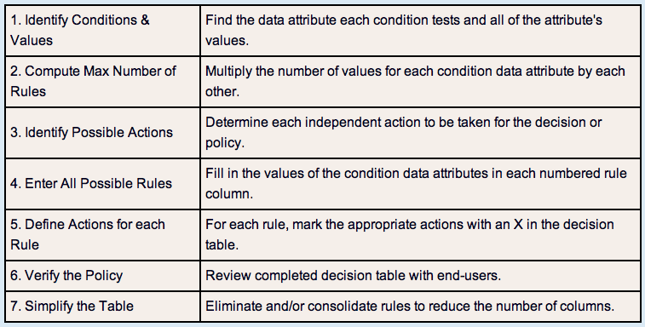
Decision Table Methodology

Slide 19
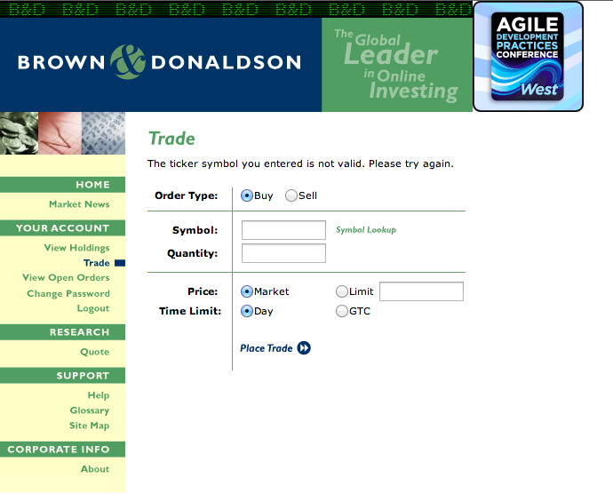
Referring to the Trade Web page of the Brown & Donaldson Web site, consider the rules for Buy order.
  Only when a valid symbol, valid quantity, and sufficient funds are available should the Buy order be placed.

Slide 20
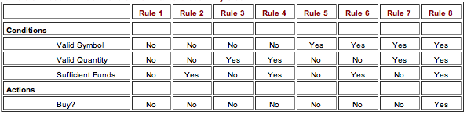
Non-Collapsed Decision Table
2x2x2= 8 rules
Simplification #1
Simplification #2

Slide 21
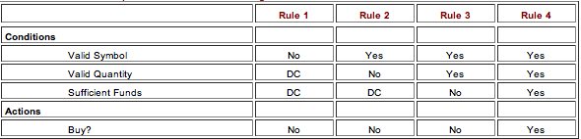
Revised Decision Table
*DC – Don’t Care
Condensed #1
Condensed #2

Slide 22
A More Complex Decision Table
Some police departments have handheld computers that take action for moving violations (excess speeds).

Slide 23
A Police System Decision Table
Condition | 1 | 2 | 3 | 4 | 5 | 6 | 7 | 8
License ok | N
Warrant |  | Y
Registration OK |  |  | N
Vehicle OK |  |  |  | N
Excess Speed |  |  |  |  | 1-10 | 11-20 | 21-25 | >25
Action
Arrest | X | X
Warning |  |  |  |  | Y
Fine | +250 | +250 | +25 | +25 | +0 | +75 | +150 | +250

Slide 24
Evaluation of Decision Table
Benefits
  It derives tests for combinations of conditions, which might otherwise not be executed
  The decision table testing technique can be applied generally for problem solving in all situations, in which the execution of the software depends on several logical decisions.
  Logical connections can be formulated systematically.
  Decision tables can easily be checked for redundancy, absence of contradictions and completeness
Disadvantages
  Confusing if too many conditions exist (2n combinations must be shown in the table)
  Connections between separate conditions can only be expressed implicitly (compare Cause and Effect graph)

Slide 25
State Transition Testing
Finite-state models are used to understand the various states the system has, including any which are initial and final
Transitions, events, conditions and actions in each state are identified
Graph or table are used to model the system and serve as an oracle – state diagram
For each event and condition, verify action and next state

Slide 26
State transition diagram
Has four basic parts:
  the states that the software may occupy;
  the transitions from one state to another;
  the events that cause a transition;
  the actions that result from a transition.

Slide 27
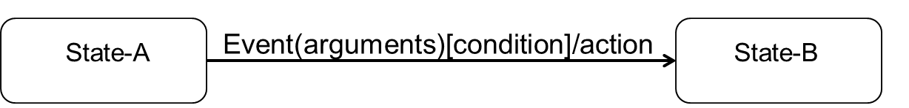
Transition notation
Event:
  triggers the transition
Guard condition:
    Transition only eligible to fire when guard evaluates to true
    Guards of transition exiting one state are mutually exclusive
Action:
  executable atomic computation
  May include operation calls, the creation or destruction of another objects, or the sending of a signal to an object.

Slide 28
State Transition – Example for a Theatre Show reservation
Black Box Test Techniques
Request Show Options
Choose Show
Reserve Show
Show Options
provided
Show selected
Show
Reservation
Made
Pay for Show
Change Mind/
Return to Options
Cancel reservation
Show
Reservation
Paid For
Cancelled
Reservation
Cancel reservation/ Issue Refund
Issue
Ticket
Ticket
Received
Cancel reservation (return ticket)/Issue Refund
Notes:
This is a simple example covering reserving and then paying for theatre tickets for a Show at a local Theatre. It also covers the possibility if the customer cancelling the reservation and depending on when cancelled, money being refunded by the system.
Note that some Transitions here have just an Event, others have an Event and an Action. This is typical for these type of diagrams.
Some Transition diagrams also show a Transition flowing from a State back into the same State.
The tester could trace several test paths in this diagram.

Slide 29
State coverage (SC)
Start with a positive flow path. We identify this path as ‘smooth transaction’
  Positive: excludes negative flows / states, such as, cancel, no, fail, etc.
If possible, try to identify if the positive flow path is able to cover all states
If this is not possible, try to identify other flow path that could cover the remaining states
Minimum 100% state coverage (SC) is 1 – when you only require ONE flow path to cover all states at one time

Slide 30
Transition coverage (TC)
Emphasise on the transition(s)
Try to re-use the results of State Coverage
State Coverage is always <= Transition Coverage
STEPS:
  Start with positive flow path / smooth transaction
  If there are still uncovered transactions, followed by negative flow path– with 1 error per transaction, either SS-SS, or ST-ES
  Count the number of path(s)

Slide 31
POS system
Password [invalid]/
error
Scanning [invalid]/
check
Pay [invalid] /
error
Customer
Logging in
Waiting
Scanning
Scan [last item]/
display total
Charging
Logging out
Password [valid]/
open register
Shift end /
close register
Scan [more items]/
display subtotal
Pay [valid] /
Issue receipt

Slide 32
State Transition Example Simplified Car Gears
Black Box Test Techniques
Change Down/
Move Back
Neutral
Reverse
Change Up/
Accelerate
Change Up/
Accelerate
Change Down/
Decelerate
1st. Gear
Change Up/
Accelerate
Change Down/
Decelerate
2nd. Gear
Change Up/
Accelerate
Change Down/
Decelerate
3rd. Gear
Notes:
START – and now an example for a car transmission system
So when we move from Neutral to 1st Gear:
Starting Sate – Neutral
Transition - is shown by the arrow to 1st Gear
(transition) Event - is Change Up
(transition) Action is Accelerate
End State – 1st Gear
Same for the move from 1st Gear down to Neutral and so on

Slide 33

State Based Transition: Exit Criteria and Coverage Measuring
Minimal criteria: Each state is captured at least once
Further criteria: Each state transition was executed at least once
All transitions were exercised which violate the specification
Each action (function) was executed at least once

Slide 34
Deriving Test Case
Understand the various state and transition and mark each valid and invalid state
Defining a sequence of an event that leads to an allowed test ending state
Each one of those visited state and traversed transition should be noted down
Steps 2 and 3 should be repeated until all states have been visited and all transitions traversed
For test cases to have a good coverage, actual input values and the actual output values have to be generated

Slide 35
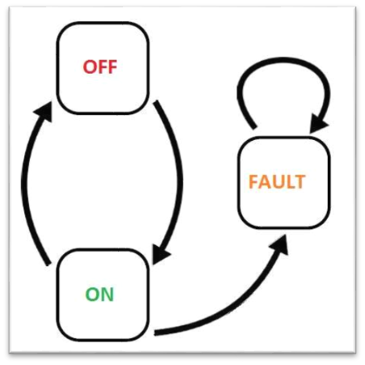
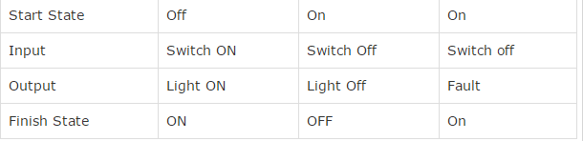
Example: Deriving Test Case
A System's transition is represented as shown in the below diagram:
Steps:
1. Write all start states
2. Identify the end state for each start state
3. For each start state and its corresponding finish state, write down the input and output condition
Fault
Light On
Fault

Slide 36
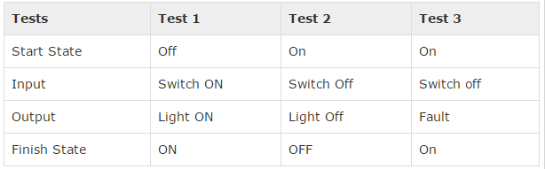
Example: Deriving Test Case
A System's transition is represented as shown in the below diagram:
Steps:
4. Next, add the test case ID (The tests are derived from the above
state and transition and below are the possible scenarios that
need to be tested)
Light On
Fault

Slide 37
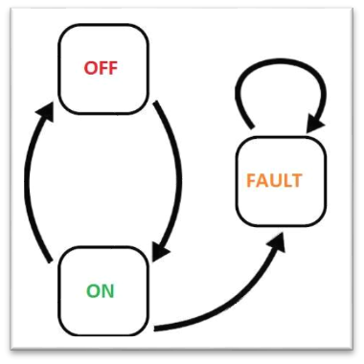
Example: Deriving Test Case
A System's transition is represented as shown in the below diagram:
Steps:
5. Next, transform into formal test cases (below table shows sample only)
TC ID | Description | Steps | Expected Result
Test 1 | Validate that the system is able to perform from Off light to ON light with output the light is ON. | 1. Switch ON | The light should be ON as the final state is ON.
Test 2 | Validate that the system is able to perform from ON light to Off light with output the light is Off. | 1. Switch Off | The light should be Off as the final state is OFF.
*Note:
Additional info like preconditions, severity, priority, environment and other quality are also can be included in the test case.

Slide 38




