Slide 1

SCSJ3343 - Software Quality and Testing
10a – Tool Support for Testing

Slide 2
Type of Test Tools (1)
Based on the idea of Computer Assisted Software Engineering (CASE) tools, test tools are also called CAST-Tools (Computer Aided Software Testing).
Different classifications are possible according to:
  The supported activity or phase of the test process.
  The supported test level
  The supported type of test
  The supported test role
  The supported technology
  Commercial / open-source software/shareware
  …….

Slide 3
Types of Test Tools (2): Classification according to supported activities
Test tools according to the supported activity or phase of test process
  Test planning and control
  Test analysis and test design
  Test implementation and execution
  ….
Separate test tools support mostly only a small part of the test process.
Test tool families or test tools suites cover many activities of the test process, or even all activities and can be viewed as an integrated unit.

Slide 4
Types of Test Tools (3): Classification according to main objective group or main user of the tool
Who should use the tool?
  Tester?
  Test manager?
  Developer, to support the component / integration test?
Several tools support the software development process
  Tools especially for the support of the tester.
  Tools, which are not only used by testers. These tools can also support other activities in the software development process e.g. requirements management.

Slide 5
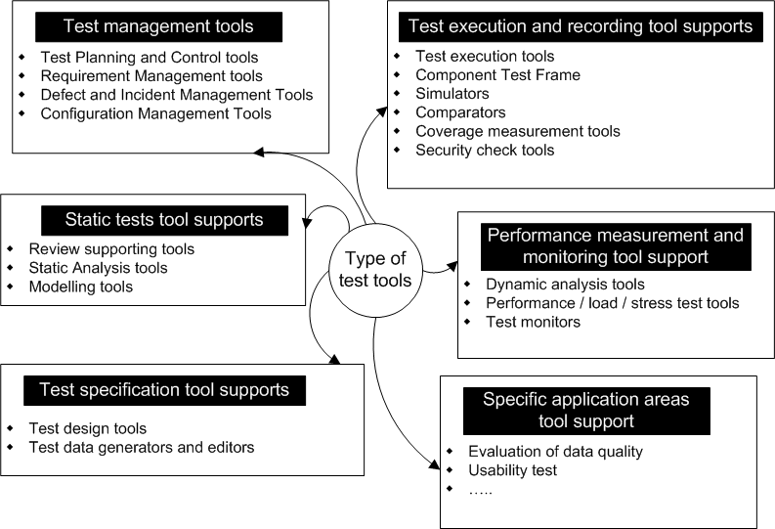
Types of test tools (3)

Slide 6
Types of test tools (4)

Slide 7
Test Management: Tools for Test Planning and Control
Planning tools are used for gathering, cataloging, administration and prioritization test cases.
Advanced functionality:
  Import of system requirements
  Traceability of test, test results and incidents
  Test case status (e.g: how often executed )
  Recording of test results and producing of progress reports.
  Time and resource planning

Slide 8
Requirements Management Tools
Complexity and high number of requirements
  Need tools for gathering, cataloging, structured storage, change management and prioritizing requirements.
Advanced functionality:
  Testing for consistency as well as missing or undefined requirements
  Traceability of separate test for requirements, functions and/or features
  Measuring of the degree of requirements coverage, functions, and/or quantity of tests.

Slide 9
Defect and Incident Management Tools
Many of defect reports require defect and incident management tools for gathering, administration, sorting and tracking of deviations (e.g. status, change request.)
Enable the tracking of defects over time.
Advanced functionality:
  Parameterizable defect status models (eg. Open, closed)
  Workflow functionality for the bug fixing process (eg allocation of tasks to determine responsibility for bug fixing )

Slide 10
Configuration Management Tools
Not really test tools, but can be appropriately called “test supporting tools”.
Identification, administration, storing of information about versioning, and the configuration of the software and testware.
Allow traceability between the software product components, the variants and the testware.
Especially appropriate for the administration of several configurations of hardware and software environments (eg for differenct OS, libraries, browsers)

Slide 11
Types of test tools

Slide 12
Tools for the Review Process
Administration of documents (data handling)
  Administration of reviews and checklists
  Distribution of review comments and review results
  Administration and version control of the review documents.
Supporting the reviewer
Evaluation (data collection)
  Supporting the collection and evaluation of review results by means of metrics.
Supporting the review examination (meeting support)

Slide 13
Tools to support for Static Analysis
Analyse different characteristics of program code.
Structural characteristics (e.g. cyclomatic number, depth of inheritance etc)
  Data flow anomalies
  Adherence of coding conventions.
Advanced functionality
  Clone detection
  Cycle detection (cyclic dependencies between the elements in the source code)

Slide 14
Modeling Tools
Support the specifications as well as the validation and verification of models of the software.
Starting point for the generating test data and test cases from the model.
Advanced functionality:
  Code generation
  Test data and test cases generation
Main use of static analysis and modeling tools:
  Effective detection of defects in the development process

Slide 15
Type of test tools

Slide 16
Test Design Tools
Generating test cases or test input data (test data generators) from different models and sources, e.g. from
  Requirements
  GUI
  Design model
  Code
Generating test oracle
  Expected responses
  Expected post state
No guarantee for “good” test cases.

Slide 17
Type of test tools

Slide 18
Test Execution and Recording
Automated and partially automated versions of test cases:
  Providing the test object with test data.
  Recording the response of the test object.
  Recording the test run.
The tool must be capable of accessing the test objet, which depends on the test level (component, integration or system test).
Different types:
  Test execution tools
  Simulators
  Comparators
  Tools for coverage measurement
  Security testing tools.

Slide 19
Test Execution and Recording (2)
Automating functional tests.
Uses the external interface of the test object, for example the user interface.
Different approaches can be used for the automation of test executions.
  Capture and replay
  Script-based testing
  Data-driven approach
  Keyword-driven approach

Slide 20
Capture & Replay
Capture of user actions, like mouse movement, mouse clicks and keyboard strokes and saving these actions in scripts.
Defining and setting of points where expected values will be compared to actual values.
Replay of the scripts with the check points.
Test data can often be imported from external sources.
Testers need to know the specific script language used by the tool, so as to modify the test scripts.
Capturing can also be a useful support for explorative tests, so that the tester knows the steps executed if a defect is discovered.

Slide 21
Comparators
Enable the comparison between expected and actual results to be made easily.
Can handle different file and database formats.
Test execution tools have comparators for
  GUI Objects
  Screen content (eg comparing two screen shots and highlighting the differences)
  Console content.
Configuration management tools have comparators for highlighting the difference between two versions of a program.

Slide 22
Type of test tools

Slide 23
Dynamic Analysis Tools
Provide additional information which can only be gathered when the program runs:
  Storage use
  Pointer allocation
  Pointer arithmetic
  Memory leaks
Application: Component and integration test as well as tests for middleware.

Slide 24
Performance/Load/Stress Test Tools
Test of performance-related non-functional requirements.
Tools for performance tests measure the response time of a system under different simulated usage conditions
  Number of parallel users.
  Run-up/ramp-up system behaviour
  Frequency of transactions.
A large quantity of virtual users can be simulated to generate the required load.
A load can be for example:
  Database queries
  User transactions, Network traffic

Slide 25
Type of test tools

Slide 26
Tool Support for Specific Application Areas
Tool support exists for specific types of applications, eg:
  Performance tools, specifically for web-based applications.
  Test tools for examining network protocols.
  Static analysis tools for specific development platforms.
  Commercial tool suites for embedded or security critical systems
  Tools for usability tests
  Cyclomatic Complexity Tool (latest version of JUnit)
  Debugger

Slide 27
Effective Use of Tools: Potential Benefits and Risks

Slide 28
Benefits of Using Testing Tools (1)
Saving of resources by means of efficient processing of tasks.
Standardisation of the test documentation.
Simple statistical and graphical evaluation about executed tests eg.:
  Test process
  Defect rates
  Performance
Unattended

Slide 29
Benefits of Using Testing Tools(2)
A higher degree of automation brings:
  Consistency and repeatability
  Traceability of tests
  More depth of tests
  Faster execution of large amounts of test possible
  Relieving the test team from repetitive tasks.
  Test can be conducted, which would be very difficult or impossible if executed manually.
  High reliability of test, for example, by means of automated comparison of high data volume.

Slide 30
Risks of Testing Tools (1)
Unrealistic expectations towards automation and tool.
Underestimation of time, costs and effort.
  From initial implementation of the tool (including training and consultancy).
  To adjust existing processes.
  For the maintenance of the artefacts, which have been created by the tool.
Blind trust into the tool
  Neglect or even replacement of test design.
  Replacement of tests that were actually much more adequate as manual tests.

Slide 31
Risks of Testing Tools (2)
The tool vendor changes
Risks of insufficient support from the vendor
Neglect of the complexity of interfaces to other tools.

Slide 32
Choice and Introduction of Test Tools into an Organization

Slide 33
Costs of Tool Implementation
When implementing a tool, costs (mostly) arise from:
  Selection
  Purchase
  Maintenance
  Hardware
  Staff training

Slide 34
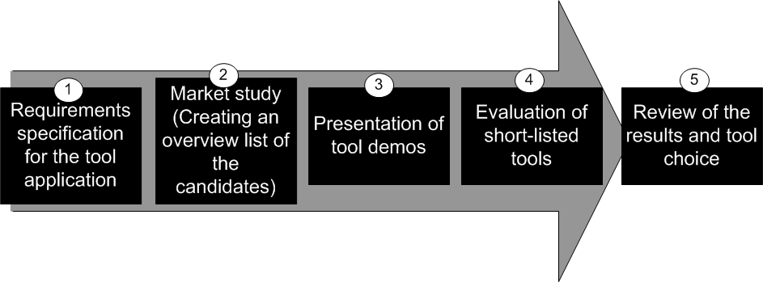
Process of Tool Selection

Slide 35
Criteria for Requirements Specification
How well the tool communicates with the potential test object
Know-how of the tester about tools and methods
Possibility for integration into the existing development environment.
Possibility for integration with other testing tools to be used.
Platform on which the tool should run.
Service, training offered, reliability and market position of the vendor.
License conditions, price, maintenance costs.

Slide 36
Market Study and Tool Demos
Creating a list of available tools in a specific category.
Limitation to a short-listed of candidates based on the criteria catalogue and requested information about the tools or internet research.
Tool demonstration of the vendor of short-listed products.

Slide 37
Evaluation and Tool Selection
After tool demo, the following main points are to be verified in the final evaluation round:
  Does the tool work with the test objects and the development environment?
  Were other performance characteristics can be achieved in practice?
  Can the vendor deliver support for non-standard questionss?

Slide 38
Selecting a Tool
Select the right tool to succeed at test automation
Perform a realistic assessment
Define clear requirements and objective criteria
Do at least one proof-of-concept
Evaluate vendor
Evaluate training
Plan for coaching and mentoring
Understand the business case
Copyright © RBCS 1996-2911

Slide 39
Objectives of an Automation Pilot Project
Learn more about the tool and how to use it
Adapt the tool and/or processes and practices to fit organisation and systems
Standardise ways of using, managing, storing and maintaining the tool and the test assets
Assess the ROI (return of investment)
  For e.g. cost benefit analysis compared with manual testing
Copyright © RBCS 1996-2911

Slide 40
Success Factors for Tool Deployment
Deploy the tool to the rest of the organisation incrementally (repeat cost benefit analysis at every cycle, and produce lessons learned document)
Adapt and improve the test processes to fit use of the tool
Provide training, coaching and mentoring for new users
Define tool usage guidelines
Learn ways to improve use of the tool continuously
Provide support, coaching and mentoring
Gather lessons learned
Monitor tool use and benefits
Copyright © RBCS 1996-2011

Slide 41




