Slide 1
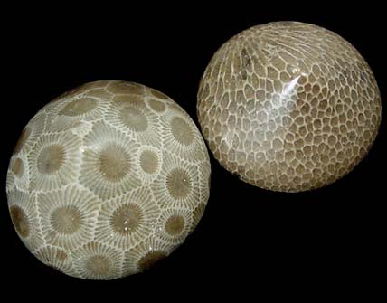
Science Olympiad
Fossils
Division B
2010
.

Slide 2
Science Olympiad
A journey into the study of science!

Slide 3
Not limited to the exceptional student!
The purpose is to introduce students to new areas of interest in science.

Slide 4
Community Partnership!
Local Rock, Mineral and Gem Societies

Slide 5
Community Partnership!
Local Rock, Mineral and Gem Societies
Community and Park Nature Centers

Slide 6
Community Partnership!
Local Rock, Mineral and Gem Societies
Community and Park Nature Centers
Science Museums

Slide 7
Contents
Event description
Topics
Outline
Coaching tips
Making tests
Putting together a team
Test-taking strategies
Resources

Slide 8
Contents
Event description
Topics
Outline
Coaching tips
Making tests
Putting together a team
Test-taking strategies
Resources

Slide 9
Contents
Event description
Topics
Outline
Coaching tips
Making tests
Putting together a team
Test-taking strategies
Resources

Slide 10
EVENT DESCRIPTION
A team of up to 2 will demonstrate knowledge of fossils
Writing implements, hand lenses, and resources are allowed
National Test Div B format will be 20 stations,
100 questions
Samples will be taken from the official NSO list, unless otherwise noted

Slide 11
EVENT TOPICS
Specimen identification

Slide 12
EVENT TOPICS
Specimen identification
Clues to past environments

Slide 13
EVENT TOPICS
Specimen identification
Clues to past environments
With the ability to answer questions about classification, habitat, ecologic relationships, behaviors and the use of fossils to date and correlate rock units

Slide 14
2010 Official Science Olympiad Fossil List
Specimens for identification must be taken from this list
Event supervisors are free to substitute similar species, however participants will not be required to identify those substitute species by species name.
Fossil list can be found at: http://soinc.org

Slide 15
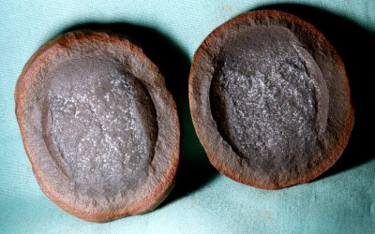
Addition to list for 2010
Phylum Cnidaria
Class Scyphozoa (Jellyfish)

Slide 16
Phylum Cnidaria
Class Scyphozoa (Jellyfish)
Horn & Colonial Corals
Genus – Heliophyllum
Genus – Favosites
Genus – Haxagonara
Genus –Halysites
Genus - Septastraea

Slide 17
Rule Clarifications
Check the National Science Olympiad web site often for rule clarifications.
Also look at FAQs
http://soinc.org

Slide 18
Fossils
Invertebrate and vertebrate Fossils
Conditions required for a plant or an animal to become fossilized
Common modes of preservation: permineralization, petrifaction/petrification, mineral replacement, cast/mold, imprint, actual remains. Uncommon modes of preservation include encased in amber, mummification, freezing, trapped in tar/asphalt

Slide 19
Fossils
Invertebrate and vertebrate Fossils
Conditions required for a plant or an animal to become fossilized
Common modes of preservation: permineralization, petrifaction/petrification, mineral replacement, cast/mold, imprint, actual remains. Uncommon modes of preservation include encased in amber, mummification, freezing, trapped in tar/asphalt

Slide 20
Fossils
Invertebrate and vertebrate Fossils
Conditions required for a plant or an animal to become fossilized
Common modes of preservation: permineralization, petrifaction/petrification, mineral replacement, cast/mold, imprint, actual remains. Uncommon modes of preservation include encased in amber, mummification, freezing, trapped in tar/asphalt

Slide 21
Fossils Cont.
Geologic Time Scale

Slide 22
Fossils Cont.
Geologic Time Scale
Index Fossils

Slide 23
Fossils Cont.
Geologic Time Scale
Index Fossils
Fossil bearing sedimentary rocks: limestone, shale, sandstone, mudstone, coquina, etc
Modes of life: filter feeder, predator, scavenger, deposit feeder, benthic, pelagic, etc.

Slide 24
Fossils Cont.
Geologic Time Scale
Index Fossils
Fossil bearing sedimentary rocks: limestone, shale, sandstone, mudstone, coquina, etc
Modes of life: filter feeder, predator, scavenger, deposit feeder, benthic, pelagic, etc.

Slide 25
Fossils Cont.
Environments: marine, terrestrial, fresh water, etc.
Mineral and organic components of skeletons, shells, etc: calcite, aragonite, silica, chiton
Important paleontological events & discoveries and their significance, Ediacaran fossils, Burgess Shale, Permian extinction, Dinosaurs with feathers from China, Cretaceous extinction, Pleistocene Ice Age.

Slide 26
Fossils Cont.
Environments: marine, terrestrial, fresh water, etc.
Mineral and organic components of skeletons, shells, etc: calcite, aragonite, silica, chiton
Important paleontological events & discoveries and their significance, Ediacaran fossils, Burgess Shale, Permian extinction, Dinosaurs with feathers from China, Cretaceous extinction, Pleistocene Ice Age.

Slide 27
Fossils Cont.
Environments: marine, terrestrial, fresh water, etc.
Mineral and organic components of skeletons, shells, etc: calcite, aragonite, silica, chiton
Important paleontological events & discoveries and their significance, Ediacaran fossils, Burgess Shale, Permian extinction, Dinosaurs with feathers from China, Cretaceous extinction, Pleistocene Ice Age.

Slide 28
Fossils Cont.
Taxonomic hierarchy: kingdom, phylum, class, order, family, genus, species
Adaptations and morphologic features of major fossils groups (ie. Trilobites – compound eye on Phacops; lack of eyes on Cryptolithus; body parts – cephalon, thorax, pygidium)
Relative dating: law of superposition, original horizontality, cross cutting relationships, unconformities (buried erosion surfaces).
Absolute dating: radiometric dating, half life, volcanic ash layers.
.

Slide 29
Fossils Cont.
Taxonomic hierarchy: kingdom, phylum, class, order, family, genus, species
Adaptations and morphologic features of major fossils groups (ie. Trilobites – compound eye on Phacops; lack of eyes on Cryptolithus; body parts – cephalon, thorax, pygidium)
Relative dating: law of superposition, original horizontality, cross cutting relationships, unconformities (buried erosion surfaces).
Absolute dating: radiometric dating, half life, volcanic ash layers.
.

Slide 30
Fossils Cont.
Taxonomic hierarchy: kingdom, phylum, class, order, family, genus, species
Adaptations and morphologic features of major fossils groups (ie. Trilobites – compound eye on Phacops; lack of eyes on Cryptolithus; body parts – cephalon, thorax, pygidium)
Relative dating: law of superposition, original horizontality, cross cutting relationships, unconformities (buried erosion surfaces).
Absolute dating: radiometric dating, half life, volcanic ash layers.
.

Slide 31
Fossils Cont.
Taxonomic hierarchy: kingdom, phylum, class, order, family, genus, species
Adaptations and morphologic features of major fossils groups (ie. Trilobites – compound eye on Phacops; lack of eyes on Cryptolithus; body parts – cephalon, thorax, pygidium)
Relative dating: law of superposition, original horizontality, cross cutting relationships, unconformities (buried erosion surfaces).
Absolute dating: radiometric dating, half life, volcanic ash layers.
.

Slide 32
Be Reasonable!
Middle school students mostly have not had biology so the emphases in Div B should be on common names and the ability to recognize the species names that are on the list
In Div C all the rules should apply.

Slide 33
Characteristics of Animal Movement
Fast Slow
Longer elongated ankle bones Shorter elongated ankle Walks on the tips of their toes Walks more flat footed
Flexed knees Straighter knees

Slide 34
Characteristics of Animal Movement
Fast Slow
Longer elongated ankle bones Shorter elongated ankle Walks on the tips of their toes Walks more flat footed
Flexed knees Straighter knees
For meat eaters consider:
Does it need to run fast to kill it's prey?
Can it get meat another way?

Slide 35
Characteristics of Animal Movement
Fast Slow
Longer elongated ankle bones Shorter elongated ankle Walks on the tips of their toes Walks more flat footed
Flexed knees Straighter knees
For meat eaters consider:
Does it need to run fast to kill it's prey?
Can it get meat another way?
For plant eaters consider:
Was their only defense speed?
Could it defend itself in another way?

Slide 36
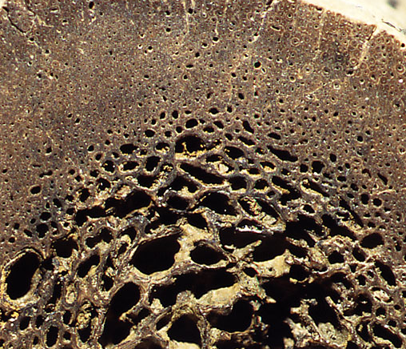
Were dinosaurs Warm Blooded?
Consider: Does a cold blooded creature need to heat the bone with blood vessels through out the whole bone?
Search: Haversian canals

Slide 37
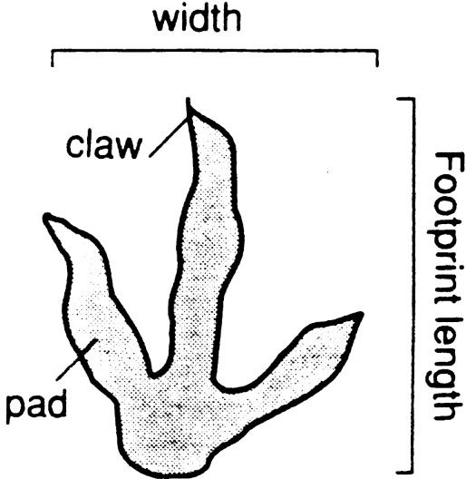
From the length of the dinosaur footprint, using the supplied Formula deternin the hip height and overall length of the dinosaur.
___________ cm. X 4 = ___________ cm.
Length of Foot Hip height
_______ cm. X 14 = __________ cm. Length of Foot Total Body Length

Slide 38
OUTLINE
Find what works for your group

Slide 39
OUTLINE
Find what works for your group
Look in texts, on internet, find syllabi from fellow teachers or online

Slide 40
OUTLINE
Find what works for your group
Look in texts, on internet, find syllabi from fellow teachers or online
Make sure all of the topics are covered

Slide 41
COACHING TIPS
Practice! A lot!

Slide 42
COACHING TIPS
Practice! A lot!
Weekly quizzes and work on:

Slide 43
COACHING TIPS
Practice! A lot!
Weekly quizzes and work on:
Arranging specimens in groups

Slide 44
COACHING TIPS
Practice! A lot!
Weekly quizzes and work on:
Arranging specimens in groups
Charts
Diagrams

Slide 45
COACHING TIPS
Practice! A lot!
Weekly quizzes and work on:
Arranging specimens in groups
Charts
Diagrams
Create a “Binder”

Slide 46
COACHING TIPS
Practice! A lot!
Weekly quizzes and work on:
Arranging specimens in groups
Charts
Diagrams
Create a “Binder”
Choose the resources wisely

Slide 47
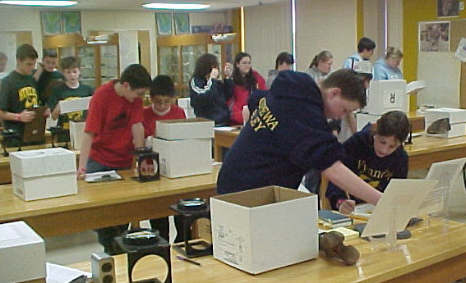
National Div. B Test
20 Stations in covered boxes A-T
Time the boxes are open is controlled

Slide 48
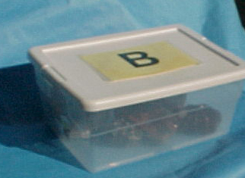
Letters on top of the boxes
Movement ascending the alphabet A - T then T - A

Slide 49
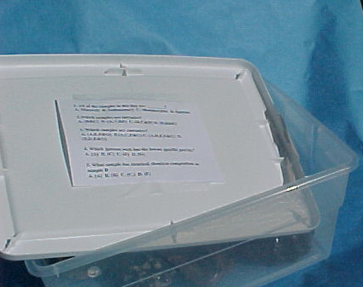
Questions & Answers are Found in the box tops

Slide 50
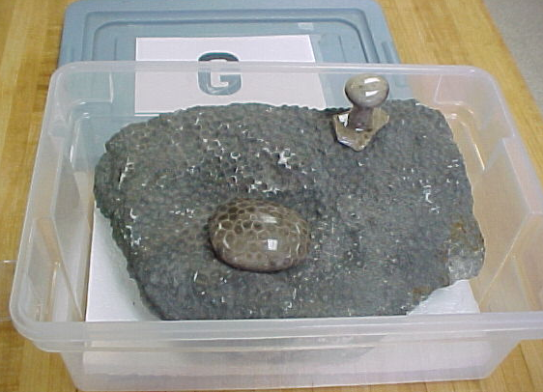
Samples are found in and around the boxes

Slide 51
Answers are recorded on an Answer Sheet
1. A B C D 50. A B C D
2. A B C D 51. A B C D
3. A B C D 52 A B C D
4. A B C D 53 A B C D
5. A B C D 54 A B C D
6 A B C D 55. A B C D
Block out the correct answer with a pencil.

Slide 52
Practicing
Give lots of quizzes – even if they’re only 5 samples!
Have kids make quizzes
Use flash cards
Have samples available at every practice and whenever kids want to study (study hall?)
Have kids quiz each other and ask associated questions
Play pictionary, hangman, charades, anything

Slide 53
Practicing
Give lots of quizzes – even if they’re only 5 samples!
Have kids make quizzes
Use flash cards
Have samples available at every practice and whenever kids want to study (study hall?)
Have kids quiz each other and ask associated questions
Play pictionary, hangman, charades, anything

Slide 54
Practicing
Give lots of quizzes – even if they’re only 5 samples!
Have kids make quizzes
Use flash cards
Have samples available at every practice and whenever kids want to study (study hall?)
Have kids quiz each other and ask associated questions
Play pictionary, hangman, charades, anything

Slide 55
Practicing
Give lots of quizzes – even if they’re only 5 samples!
Have kids make quizzes
Use flash cards
Have samples available at every practice and whenever kids want to study (study hall?)
Have kids quiz each other and ask associated questions
Play pictionary, hangman, charades, anything

Slide 56
Practicing
Give lots of quizzes – even if they’re only 5 samples!
Have kids make quizzes
Use flash cards
Have samples available at every practice and whenever kids want to study (study hall?)
Have kids quiz each other and ask associated questions
Play pictionary, hangman, charades, anything

Slide 57
Practicing
Give lots of quizzes – even if they’re only 5 samples!
Have kids make quizzes
Use flash cards
Have samples available at every practice and whenever kids want to study (study hall?)
Have kids quiz each other and ask associated questions
Play pictionary, hangman, charades, anything

Slide 58
Arranging Specimens
By Periods
By Era
By mode of preservation
In groups
  By index fossils
  By ages of (Sea life, fish, amphibians, reptiles, mammals and man)
  By Invertebrate and vertebrate Fossils

Slide 59
Arranging Specimens
By Periods
By Era
By mode of preservation
In groups
  By index fossils
  By ages of (Sea life, fish, amphibians, reptiles, mammals and man)
  By Invertebrate and vertebrate Fossils

Slide 60
Charts
Have the team make charts for anything you or they can think of!
Physical properties, origins
Excel is good for these
Combine charts
Color code
Laminate

Slide 61
Charts
Have the team make charts for anything you or they can think of!
Physical properties, origins
Excel is good for these
Combine charts
Color code
Laminate

Slide 62
Diagrams
Index Fossils

Slide 63
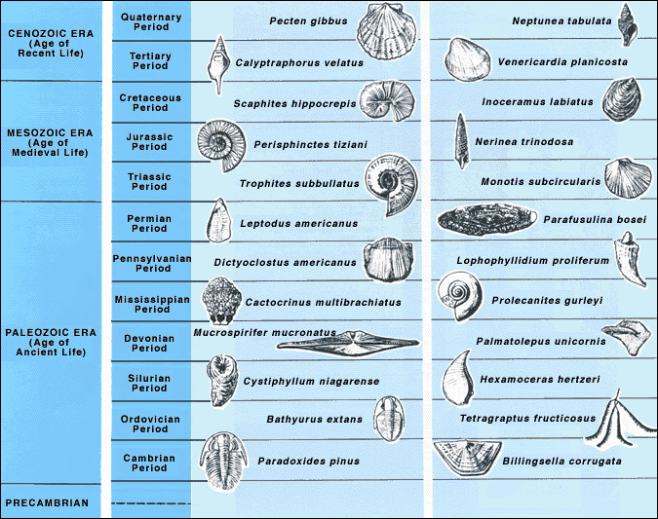

Slide 64
Diagrams
Index Fossils
The ages of geological Time

Slide 65
Ages of Geological Time
Era Period or Epoch Age
Cenozoic Pleistocene Age of Man
Pliocene
Miocene
Oligocene Age of Mammals
Eocene
Paleocene
Mesozoic Cretaceous
Jurassic Age of Reptiles
Triassic
Paleozoic Permian
Carboniferous Age of Amphibians
Devonian
Silurian Age of Fishes
Ordovician
Cambrian Age of Sea Life

Slide 66
Diagrams
Index Fossils
The ages of geological Time
Era

Slide 67
Era
Cenozoic Recent
Mesozoic
Paleozoic Old

Slide 68
Diagrams
Index Fossils
The ages of geological Time
Era
Periods

Slide 69
Periods : Cambrian Old
Ordovician
Silurian
Devonian
Carboniferous
Pennsylvanian Epoch
Mississippian Epoch.
Permian
Triassic
Jurassic
Cretaceous Recent

Slide 70
Periods : Tertiary Paleocene Epoch
Eocene Epoch
Oligocene Epoch
Miocene Epoch
Pliocene Epoch
Quaternary Pleistocene Epoch
Holocene Epoch

Slide 71
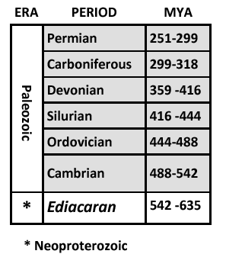
NEW GEOLOGICAL PERIOD ADDED

Slide 72
NEW GEOLOGICAL PERIOD ADDED
On May 13, 2004, the International Union of Geological Sciences (IUGS) announced the first new geological period declared in 120 years—the Ediacaran Period. The IUGS is an international non-governmental organization devoted to international cooperation in the field of geology. One of its daughter groups, the International Commission on Stratigraphy, is the generally accepted authority on the names and starting/ending dates of the various subdivision of the geological time scale. The Ediacaran Period takes its name from the Ediacara Hills, located in the Flinders Ranges of South Australia, the location of the type site or Global Boundary Stratification and Selection Point (GSSP). The Ediacaran is the last geological period of the Neoproterozoic Era, just preceding the Cambrian Period of the Paleozoic Era. Its assigned time range is 635 to 542 million years ago.
Since animals with hard shells (exoskeletons) did not appear until the Cambrian Period, the fossil record for the new period is sparse. However, the Ediacaran biota include the oldest definite multicellular organisms with tissues, the most common types resembling segmented worms, fronds, disks, or immobile bags. They bear little resemblance to modern lifeforms, and their relationship even with the later lifeforms of the Cambrian explosion is difficult to interpret. More than 100 genera have been described, and well known forms include Arkarua, Charnia, Dickinsonia, Ediacaria, Marywadea, Onega, Pteridinium, and Yorgia.

Slide 73
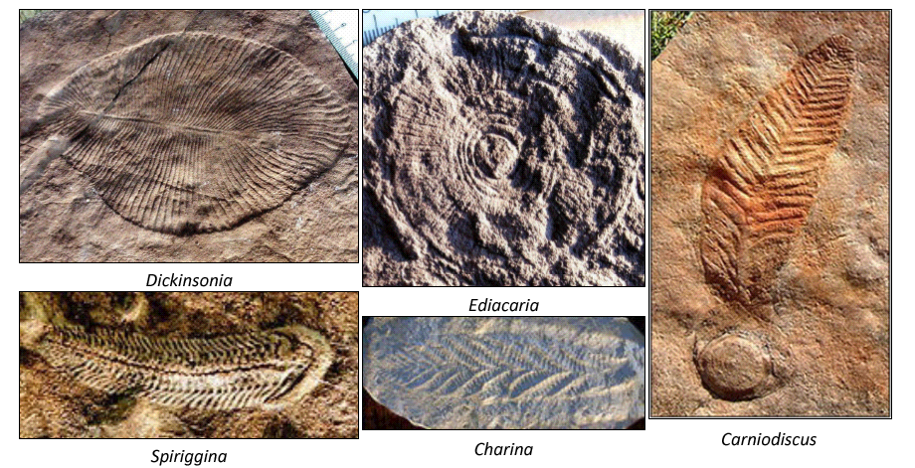
NEW GEOLOGICAL PERIOD ADDED
Although the Ediacaran Period does contain soft bodied fossils, it is unusual in comparison to later periods because its beginning is not defined by a change in the fossil record. Rather, the beginning is defined at the base of a chemically distinctive carbonate (a salt or ester of carbonic acid) layer, referred to as a "cap carbonate," because it caps glacial deposits and indicates a sudden climatic change at the end of an ice age. This bed is characterized by an unusual depletion of C-13, and is considered by many scientists to be of global extent.

Slide 74
NEW GEOLOGICAL PERIOD ADDED
No dating has been possible at the type section. The age range of 635 to 542 MYA is based on correlations to other countries where dating has been possible. The base age of approximately 635 million years ago is based on U-Pb (uranium-lead) isochron dating from Namibia. Applying this age to the base of the Ediacaran assumes that individual cap carbonates are synchronous around the world and that the correct cap carbonate layers have been correlated between Australia and Namibia.

Slide 75
Also the event may cover:
Important paleontological events and discoveries and their significance,
Examples may include: Burgess Shale, Permian extinction, Dinosaurs with feathers from China, Cretaceous extinction, Pleistocene Ice Age. Fossil concepts appearing in the news.
a.

Slide 76
Diagrams
Index Fossils
The ages of geological Time
Era
Periods
Geologic time scale

Slide 77
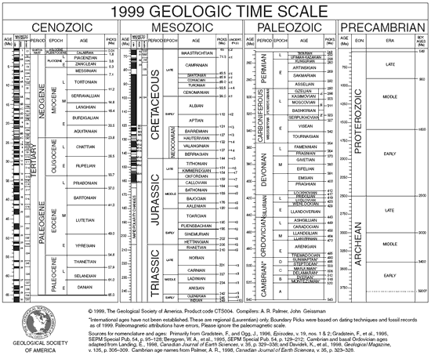
Geologic time scale
http://www.geosociety.org/science/timescale/timescl.pdf

Slide 78
Diagrams
Index Fossils
The ages of geological Time
Era
Periods
Geologic time scale
Taxonomic Hierarchy

Slide 79
Taxonomic hierarchy:
Kingdom
Phylum
Class
Order
Family
Genus
Species

Slide 80
Reference Material
(RECORDING THE JOURNEY)
Each team may bring only one magnifying glass; one published field guide that they may tab, write in or attach Post-It or other notes; and one 3-ring binder (any size) containing information in any form from any source. The materials must be 3-hole punched and inserted into the rings (sheet protectors are allowed).
Have students make his/her own
They must be familiar with it and be speedy
Organization is key

Slide 81
Additional RESOURCES to study from
A guidebook with which the students have practiced
Text of your choice
Additional miscellaneous resources
  Fossil list, colored and laminated
  Charts and diagrams

Slide 82
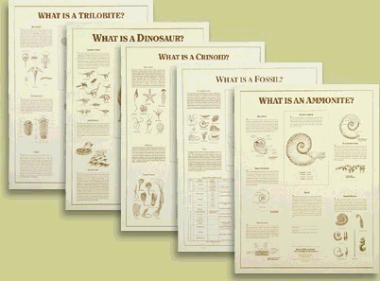
Black Hills Institute of Geological Research, Inc.
PO Box 643
Hill City, SD 57745 (505) 574-4289
http://www.bhigr.com
Posters: $3.00@ Laminated: $6:00 @
What is a Fossil?
What is a Ammonite?
What is a Trilobite?
What is a Crinoid?
What is a Dinosaur?

Slide 83
MAKING TESTS
Choose specimens that have typical characteristics
Put one or more specimens per station
Pair supplemental questions with specimens
Provide information if necessary (Formula)
Provide equipment if necessary (hand lens)

Slide 84
MAKING TESTS
Choose specimens that have typical characteristics
Put one or more specimens per station
Pair supplemental questions with specimens
Provide information if necessary (Formula)
Provide equipment if necessary (hand lens)

Slide 85
MAKING TESTS
Choose specimens that have typical characteristics
Put one or more specimens per station
Pair supplemental questions with specimens
Provide information if necessary (Formula)
Provide equipment if necessary (hand lens)

Slide 86
MAKING TESTS
Choose specimens that have typical characteristics
Put one or more specimens per station
Pair supplemental questions with specimens
Provide information if necessary (Formula)
Provide equipment if necessary (hand lens)

Slide 87
MAKING TESTS
Choose specimens that have typical characteristics
Put one or more specimens per station
Pair supplemental questions with specimens
Provide information if necessary (Formula)
Provide equipment if necessary (hand lens)
Label so specimens can’t be mixed up!

Slide 88
MAKING TESTS CONT.
Try to cover all topics reasonably evenly

Slide 89
MAKING TESTS CONT.
Try to cover all topics reasonably evenly
Work out the traffic pattern and label it

Slide 90
MAKING TESTS CONT.
Try to cover all topics reasonably evenly
Work out the traffic pattern and label it
Indicate tiebreakers, but include them in the regular score

Slide 91
MAKING TESTS CONT.
Try to cover all topics reasonably evenly
Work out the traffic pattern and label it
Indicate tiebreakers, but include them in the regular score
Optional – include a section students can work on without being at a station

Slide 92
MAKING TESTS CONT.
Try to cover all topics reasonably evenly
Work out the traffic pattern and label it
Indicate tiebreakers, but include them in the regular score
Optional – include a section students can work on without being at a station
Clearly convey expectations at beginning of test

Slide 93
Science Olympiad RESOURCES
FOSSILS CD Includes lessons and sample tests on fossils to help you prepare for the event. (Rev. 09)
FOCD $16
Science Olympiad
2 Trans Am Plaza Drive
Suite 415, Oakbrook Terrace, Illinois 60181
Tel: 630-792-1251, FAX: 630-792-1287

Slide 94
PUTTING TOGETHER A TEAM
Have more than 2 students per team practicing
Pair your strengths (both identification and concepts)
Have students practice together
Choose which resources will be used
Be sure the students will support each other
  Both students should contribute
  If one is more dominant in the event, he/she should be a mentor, not just take over

Slide 95
PUTTING TOGETHER A TEAM
Have more than 2 students per team practicing
Pair your strengths (both identification and concepts)
Have students practice together
Choose which resources will be used
Be sure the students will support each other
  Both students should contribute
  If one is more dominant in the event, he/she should be a mentor, not just take over

Slide 96
PUTTING TOGETHER A TEAM
Have more than 2 students per team practicing
Pair your strengths (both identification and concepts)
Have students practice together
Choose which resources will be used
Be sure the students will support each other
  Both students should contribute
  If one is more dominant in the event, he/she should be a mentor, not just take over

Slide 97
PUTTING TOGETHER A TEAM
Have more than 2 students per team practicing
Pair your strengths (both identification and concepts)
Have students practice together
Choose which resources will be used
Be sure the students will support each other
  Both students should contribute
  If one is more dominant in the event, he/she should be a mentor, not just take over

Slide 98
PUTTING TOGETHER A TEAM
Have more than 2 students per team practicing
Pair your strengths (both identification and concepts)
Have students practice together
Choose which resources will be used
Be sure the students will support each other
  Both students should contribute
  If one is more dominant in the event, he/she should be a mentor, not just take over

Slide 99
TEST-TAKING STRATEGIES
For Students

Slide 100
TEST-TAKING STRATEGIES
Know the event! (rules and format)
Know the subject! (concepts and identification skills)
Talk quietly (the competition may be listening)
Don’t mix up the specimens
Don’t leave your resources behind
Don’t panic if a station is left unfinished
  Take notes and try to finish while at another station

Slide 101
TEST-TAKING STRATEGIES
Know the event! (rules and format)
Know the subject! (concepts and identification skills)
Talk quietly (the competition may be listening)
Don’t mix up the specimens
Don’t leave your resources behind
Don’t panic if a station is left unfinished
  Take notes and try to finish while at another station

Slide 102
TEST-TAKING STRATEGIES
Know the event! (rules and format)
Know the subject! (concepts and identification skills)
Talk quietly (the competition may be listening)
Don’t mix up the specimens
Don’t leave your resources behind
Don’t panic if a station is left unfinished
  Take notes and try to finish while at another station

Slide 103
TEST-TAKING STRATEGIES
Know the event! (rules and format)
Know the subject! (concepts and identification skills)
Talk quietly (the competition may be listening)
Don’t mix up the specimens
Don’t leave your resources behind
Don’t panic if a station is left unfinished
  Take notes and try to finish while at another station

Slide 104
TEST-TAKING STRATEGIES
Know the event! (rules and format)
Know the subject! (concepts and identification skills)
Talk quietly (the competition may be listening)
Don’t mix up the specimens
Don’t leave your resources behind
Don’t panic if a station is left unfinished
  Take notes and try to finish while at another station

Slide 105
TEST-TAKING STRATEGIES
Know the event! (rules and format)
Know the subject! (concepts and identification skills)
Talk quietly (the competition may be listening)
Don’t mix up the specimens
Don’t leave your resources behind
Don’t panic if a station is left unfinished
  Take notes and try to finish while at another station

Slide 106
RESOURCES
Fossil Guides
  Try several to see what the students like
Suggestions:
National Audubon Society Field Guide to Fossils
Smithsonian Handbooks: Fossils by Chris Pellant (also called Eyewitness Handbook or DK)
A Field Guide to Fossils by Frederick
  H. Pough (Peterson Field Guides)

Slide 107
RESOURCES
Places to find samples to study:
  High school geology classes

Slide 108
RESOURCES
Places to find samples to study:
  High school geology classes
  Local colleges or universities (geology or education departments)

Slide 109
RESOURCES
Places to find samples to study:
  High school geology classes
  Local colleges or universities (geology or education departments)
  Local rockhound societies or individuals

Slide 110
RESOURCES
Places to find samples to study:
  High school geology classes
  Local colleges or universities (geology or education departments)
  Local rockhound societies or individuals
  State Geological Surveys

Slide 111
RESOURCES
Places to find samples to study:
  High school geology classes
  Local colleges or universities (geology or education departments)
  Local rockhound societies or individuals
  State Geological Surveys
  Swap sets with other schools to vary samples

Slide 112
Fossil Samples
Earth Science Educator’s Supply
P.O. Box 503,
Lee's Summit, MO 64063
(No Credit Cards or Phone Orders-PH 816-524-5635; FAX 816-525-4263) item FOLY 24 at $18.00. Price quoted includes shipping and handling.

Slide 113
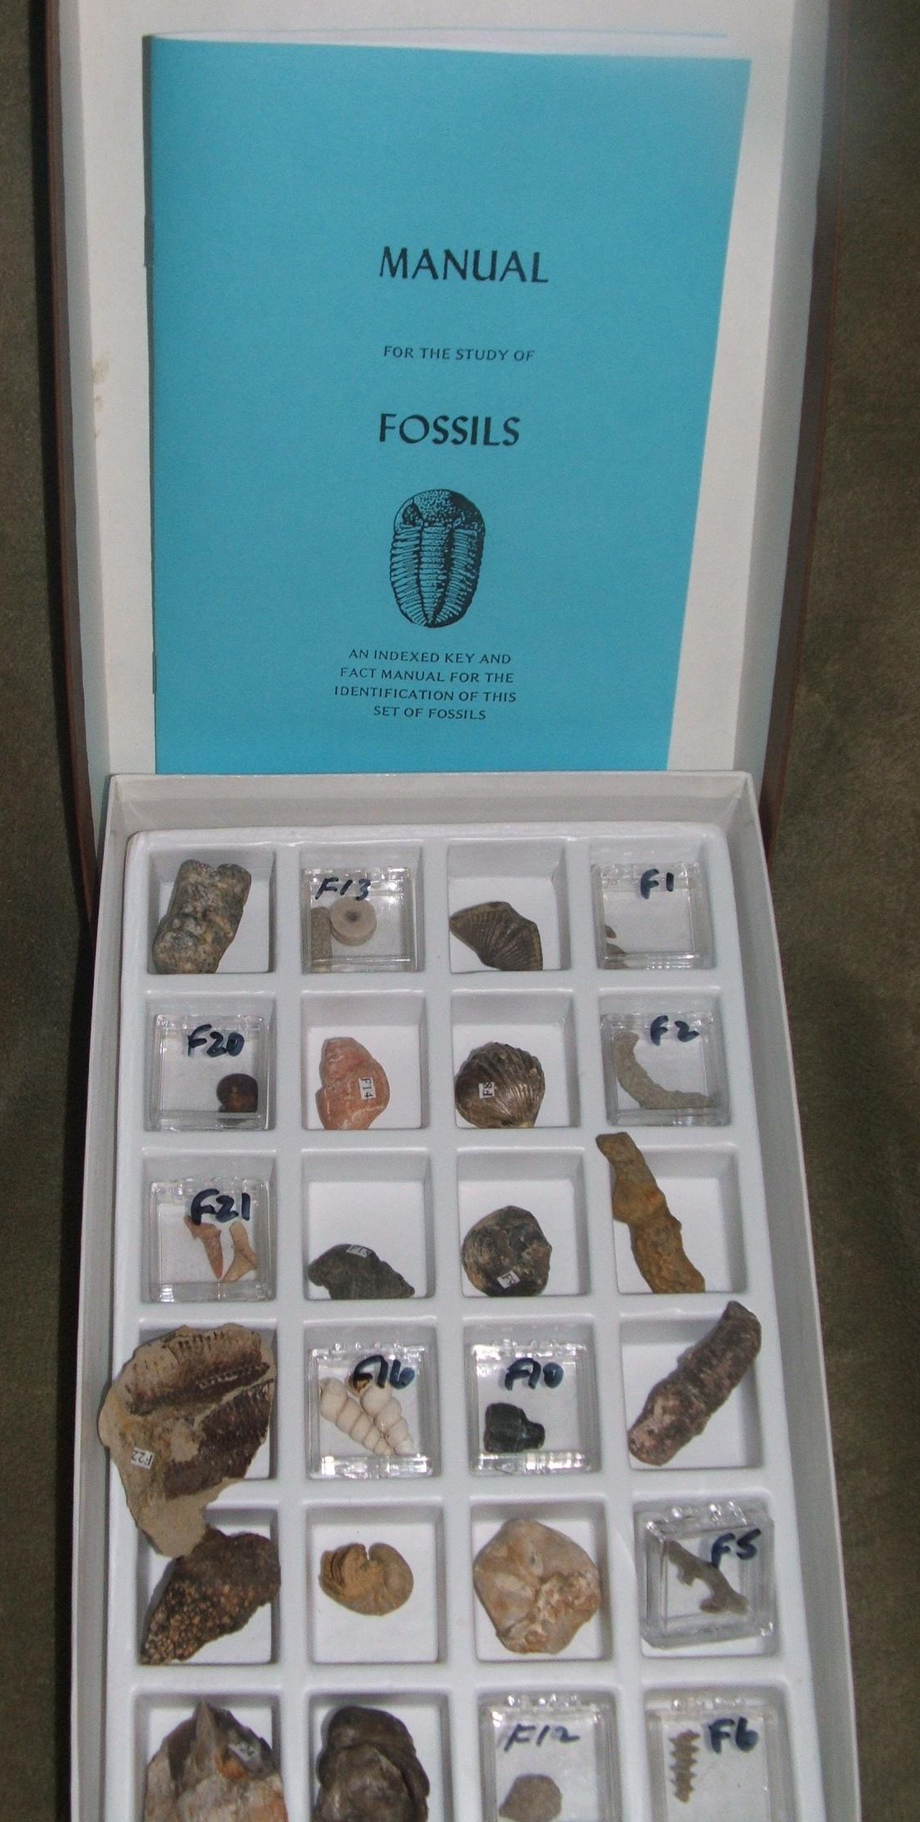

Slide 114
Protozoan-Fusulinda
Porifera- Sponge
Coelenterata-Thannpora coral
Coelenterata-Horn coral
Bryozoan- Branching
Bryozoan- Screw
Brachiopoda- Mucrospirifier
Brachiopoda- Rhynchonella
Brachiopoda- Atrypa
Arthropoda-Trilobite
Echinodermata-Echinoid
Echinodermata-Blastoid
Echinodermata- Crinoid Stem
Gastropod- Snail
Gastropod- Worthenia
Gastropod-Turritella
Pelecypod- Exogyra
Pelecypod- Gryphaea
Cephalopod- Orthoceras
Cephalopod- Ammonite
Chondrichthyes- Shark Tooth
Osteichthyes- Fossil Fish
Reptile- Dinosaur bone piece
Plant- Petrified wood

Slide 115
SIF Student Investigative Pack
1 pound bag contains fifteen fossils within a sand mixture for the students to pick out and identify. A sheet listing the fossils to be found is included.
Sold in groups of 10.
A beginning to identify fossil shapes!

Slide 116
SIF Includes:
COELENTERA
HORN CORAL or TABULATE or COLONIAL CORALS
BEYOZOA BRANCHING TYPE OR MASSIVE
BRACHIOPOD COMPOSITA or ZYGOSPIRA or ATRYPA or SPIRFER
ARTHROPOD TRILOBITE
ECHINODERMATA CRINOID STEM or ECHINOID
MOLLUSCA PELECYPOD, EXOGYRA or GRAPHAEA
GASTROPOD, WORTHENIA or TRURITELLA
CEPHALOPOD, BELEMNITE or BACULITES or ORTHOCERAS or AMMONITE
VERTEBRATA CHONDRICHTHYES, SHARK TEETH
REPTILES, DINOSAUR BONE
FOSSIL PLANT ALGAE & PETRIFIED WOOD

Slide 117
SUMMARY
Assemble and get to know the resources

Slide 118
SUMMARY
Assemble and get to know the resources
Practice identification

Slide 119
SUMMARY
Assemble and get to know the resources
Practice identification
Assemble teams that can work together

Slide 120
SUMMARY
Assemble and get to know the resources
Practice identification
Assemble teams that can work together
Keep a sense of humor

Slide 121
SUMMARY
Assemble and get to know the resources
Practice identification
Assemble teams that can work together
Keep a sense of humor
Have FUN! Rock and Roll !!!
Best Luck to all.

Slide 122
The END

Slide 123
PowerPoint
Created by
Richard Brzozowski
Vice President
Mt. Clemens-Macomb County Gem & Lapidary Society

