Slide 1
Template by Kevin Dufendach
Updates at http://sites.google.com/site/dufmedical/jeopardy
JEOPARDY!
JEOPARDY!
Instructions
Board
not in any way endorsed or affiliated with the Jeopardy Game Show

Slide 2
Instructions
Reset
To start a new game, click the “reset” button on the board slide. This will reset the board, set each player’s score to 0, and randomly move the Daily Double.
Click “Adj Scores” from the board to manually change scores.
Click on the lights at the bottom to start a countdown (click below to change).
Incorrect response: Click the “incorrect” button if the player responds incorrectly, and their score will subtract.
Correct response: Press the “correct” button if the player responds correctly, and the correct response will then be shown.
  To skip viewing the correct response, check the box below
If no one gets the question correct, press the arrow to go to the next slide (or return to the board if the checkbox below is checked).
Troubleshooting:
  Do not delete the value shape (e.g. $400) from any slide. If you don’t like it, you can move it off the screen, but DON’T DELETE IT, and don’t change its text!!!
  Do not delete question slides and copy them in from somewhere else. You can do this to replace “answer” slides, but just not question slides (unless you re-apply the hyperlinks to the board)
  If none of the functions are working, see “Macro Troubleshooting”
Adjust Countdown Timer
Import from Excel Template
(Template available online)
Template by Kevin Dufendach. Updates at http://sites.google.com/site/dufmedical/jeopardy
Please send questions and comments to krd.public+Jeopardy@gmail.com

Slide 3
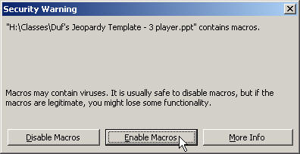
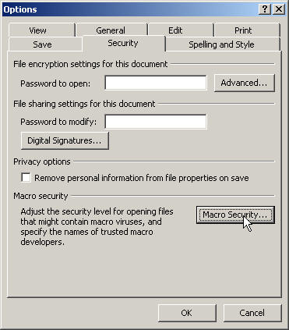
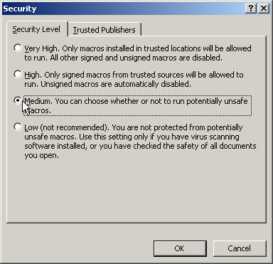
Macro Troubleshooting
If you’re having trouble getting this PowerPoint to work, be sure to “Enable Macros” when opening the file.
If you don’t see this box when you open PowerPoint, your security settings may be set too high. In this case, go to the “Tools” menu and select “Options.” Click on [Macro Security…] and then select “Medium.” Press OK until you return to the show. Now save this file and then re-open it. You should now receive the dialog shown above. Click “Enable Macros”
Note: some of the functions may not work with versions of PowerPoint other than PowerPoint 2010 for Windows

Slide 4
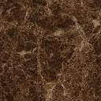
Board
The Daily Double is located at:
Move to
reveal location
E3
Instructions
Adj Scores
Reset
Double
Species Interactions
Insects
Soil Biology
Ecosystems
Costa Rica
Living Organisms
$100
$100
$100
$100
$100
$100
$200
$200
$200
$200
$200
$200
$300
$300
$300
$300
$300
$300
$400
$400
$400
$400
$400
$400
$500
$500
$500
$500
$500
$500

Slide 5
Competition between animals of the same species.
$100

Slide 6
What is intraspecific competition.
$100

Slide 7
Competition between organisms that are from different species.
$200

Slide 8
What is interspecific competition.
$200

Slide 9
The interaction when an organism eats plants.
$300

Slide 10
What is herbivory.
$300

Slide 11
The interaction between cattle egret birds and horses.
$400

Slide 12
What is commensalism
$400
Cattle egret birds eat insects that horses accidentally disturb

Slide 13
The interaction that harms one species and doesn't affect the other.
$500

Slide 14
What is ammensalism.
$500

Slide 15
Insects are found in this Domain.
$100

Slide 16
What is eukaryotes.
$100

Slide 17
Insects have this many legs.
$200

Slide 18
What is 6.
$200

Slide 19
This lifecycle has 4 distinct stages.
$300

Slide 20
What is complete metamorphosis.
$300

Slide 21
Insects breathe through these.
$400

Slide 22
What is spiracles.
$400

Slide 23
This is the percentage of animals which are insects on this earth.
$500

Slide 24
What is 75%.
$500

Slide 25
Besides mud, what 4 other ingredients were added to the soil column.
$100

Slide 26
What are water, newspaper, chalk and yolk
$100

Slide 27
This is the name of the column we prepared.
$200

Slide 28
What is winogradsky.
$200

Slide 29
Elements are recycled in the column by these two processes.
$300

Slide 30
Respiration and photosynthesis
$300

Slide 31
The column is an open system. True of False.
$400

Slide 32
False
$400

Slide 33
Oxygen flows in this direction in the column.
$500

Slide 34
What is downwards.
$500

Slide 35
Abiotic components are classified as living organisms. True or False.
$100

Slide 36
False
$100

Slide 37
Ecosystems are largely determined by this element.
$200

Slide 38
What is climate.
$200

Slide 39
This is constantly being recycled in an ecosystem to exist.
$300

Slide 40
What are nutrients.
$300

Slide 41
Nitrate is converted to dinitrogen through this process.
$400

Slide 42
What is denitrification.
$400

Slide 43
Carbon, nitrogen, oxygen, and water are what type of cycles.
$500

Slide 44
What are gaseous cycles.
$500

Slide 45
We will be visiting this volcano in San Jose.
$100

Slide 46
What is the Poas volcano.
$100

Slide 47
We will be visiting this waterfall in the Arenal region.
$200

Slide 48
What is La Fortuna.
$200

Slide 49
On the first day, we will take a guided walking tour of this city.
$300

Slide 50
What is Granada.
$300

Slide 51
This is the place where we will do a canopy tour.
$400

Slide 52
What is Guanacaste.
$400

Slide 53
This is the name of the crater we will take a tour of.
$500

Slide 54
What is Masaya.
$500

Slide 55
Living organisms need to be composed of one or more cells. True or False.
$100

Slide 56
True
$100

Slide 57
Viruses are living organisms. True or False.
$200

Slide 58
False
$200

Slide 59
Not all living organisms adapt to their environment. True or False.
$300

Slide 60
False
$300

Slide 61
Slime molds are living organisms. True or False.
$400

Slide 62
True
$400

Slide 63
All living organisms' cell walls are composed of peptidoglycan.
$500

Slide 64
False
$500
Eukaryotic and Archeae cell walls do not contain peptidoglycan.

Slide 65
DAILY
DOUBLE
Enter your wager:
$
Go!

Slide 66
Board
Move to
reveal location
D2
B4
The Daily Doubles are located at:
Move to
reveal location
Instructions
Adj Scores
Single
Final
Life Cycles
Adaptations
Geography
Nicaragua
Our Tour
Animals
$200
$200
$200
$200
$200
$200
$400
$400
$400
$400
$400
$400
$600
$600
$600
$600
$600
$600
$800
$800
$800
$800
$800
$800
$1000
$1000
$1000
$1000
$1000
$1000

Slide 67
This is the lifecycle in which the young resembles the adult.
$200

Slide 68
What is incomplete metamorphosis (ametabolous)
$200

Slide 69
Every lifecycle has this stage.
$400

Slide 70
What is egg.
$400

Slide 71
This is the third stage in complete metamorphosis.
$600

Slide 72
What is pupa.
$600

Slide 73
This is a synonym for incomplete metamorphosis.
$800

Slide 74
What is hemimetabolous.
$800

Slide 75
Under incomplete metamorphosis the adult is able to do this that the nymphs are not able to.
$1000

Slide 76
What is reproduce.
$1000

Slide 77
The moths were able to survive in the polluted environment due to changing this feature.
$200

Slide 78
What is their color.
$200

Slide 79
This insect is able to fly from California to North Carolina.
$400

Slide 80
What is the monarch butterfly.
$400

Slide 81
This insect has the shortest generation time.
$600

Slide 82
What is the aphid.
$600

Slide 83
This is the loudest insect.
$800

Slide 84
What is the cicada.
$800

Slide 85
This insect is able to live up to 28.7 years.
$1000

Slide 86
What is Lasius niger (an ant)
$1000

Slide 87
This is the line which Costa Rica lies on.
$200

Slide 88
What is the equator.
$200

Slide 89
The region where we will visit hot springs.
$400

Slide 90
What is the Arenal region.
$400

Slide 91
The capitol of Costa Rica.
$600

Slide 92
What is San Jose.
$600

Slide 93
The size of Costa Rica.
$800

Slide 94
What is 19,730 sq miles.
$800

Slide 95
These two countries border Costa Rica.
$1000

Slide 96
What are Panama and Nicaragua.
$1000

Slide 97
Ocean boarding Nicaragua.
$200

Slide 98
What is the Pacific Ocean.
$200

Slide 99
The capital of Nicaragua.
$400

Slide 100
What is Managua.
$400

Slide 101
Besides Costa Rica, this country also boarders Nicaragua.
$600

Slide 102
What is Honduras.
$600

Slide 103
Name of the currency used in Nicaragua.
$800

Slide 104
What is cordoba.
$800

Slide 105
Name of the current president of Nicaragua.
$1000

Slide 106
Who is Daniel Ortega.
$1000

Slide 107
We will fly into this city.
$200

Slide 108
What is Managua.
$200

Slide 109
We will fly out of this city.
$400

Slide 110
What is San Jose.
$400

Slide 111
The Rincon de la Vieja National Park is in this city.
$600

Slide 112
What is Guanacaste.
$600

Slide 113
We are in this city on day 3.
$800

Slide 114
What is Granada.
$800

Slide 115
This is the name of our tour guide.
$1000

Slide 116
What is Uncle Walter.
$1000

Slide 117
This taxonomic level is the most specific.
$200

Slide 118
What is species.
$200

Slide 119
This term is used to describe the maximum of indiviudals in a population.
$400

Slide 120
What is carrying capacity.
$400

Slide 121
This is the shape of the Exponential Growth Rate.
$600

Slide 122
What is J.
$600

Slide 123
Animals have cell walls. True or False.
$800

Slide 124
What is false.
$800

Slide 125
Insects are animals. True of False.
$1000

Slide 126
What is true.
$1000

Slide 127
DAILY
DOUBLE
Enter your wager:
$
Go!

Slide 128
DAILY
DOUBLE
Enter your wager:
$
Go!

Slide 129
Final Jeopardy Category
Final Jeopardy Prompt
Final
Jeopardy
Reveal Prompt
Reveal Response

Slide 130
Final Jeopardy Response
Incorrect
Correct
Incorrect
Correct
Incorrect
Correct
Incorrect
Correct

