Slide 1
Access Modifiers

Slide 2
The access modifiers in java specifies accessibility (scope) of a data member, method, constructor or class.
There are 4 types of java access modifiers:
private
default
protected
public
Note: There are many non-access modifiers such as static, abstract, synchronized, native, volatile, transient, etc

Slide 3
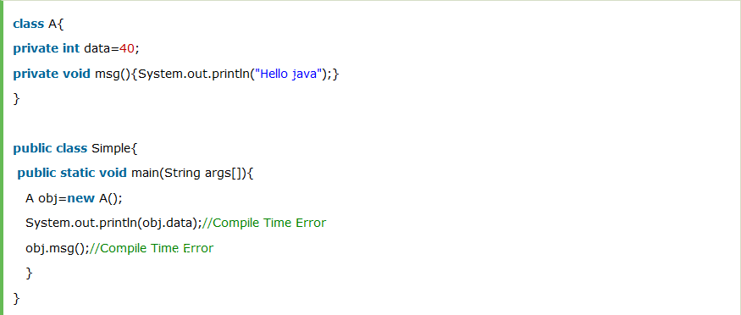
Private access modifier Two classes A and Simple. A class contains private data member and private method. We are accessing these private members from outside the class

Slide 4
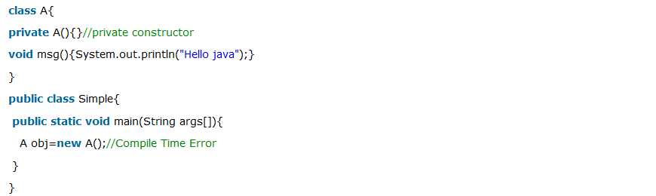
Role of Private Constructor you cannot create the instance of that class from outside the class

Slide 5
Default access modifier
If you don't use any modifier, it is treated as default bydefault. The default modifier is accessible only within package.
Create two packages pack and mypack. We are accessing the A class from outside its package, since A class is not public, so it cannot be accessed from outside the package.

Slide 6
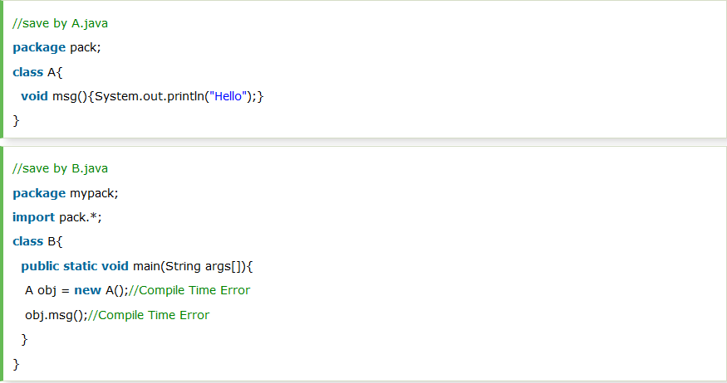

Slide 7
Protected access modifier
The protected access modifier is accessible within package and outside the package but through inheritance only.
The protected access modifier can be applied on the data member, method and constructor. It can't be applied on the class.

Slide 8
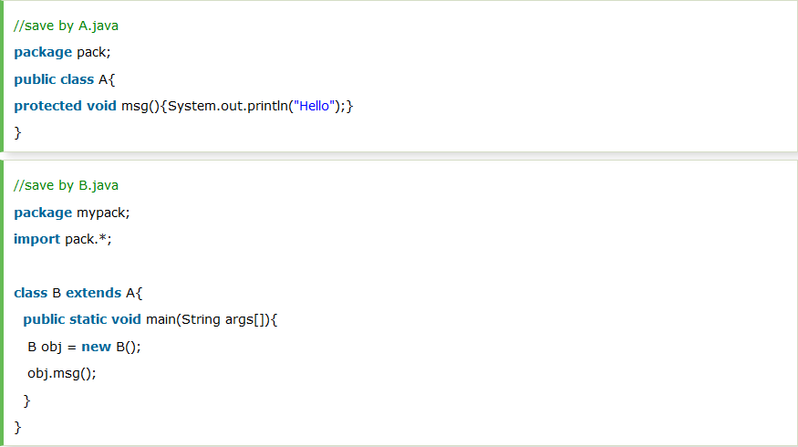

Slide 9
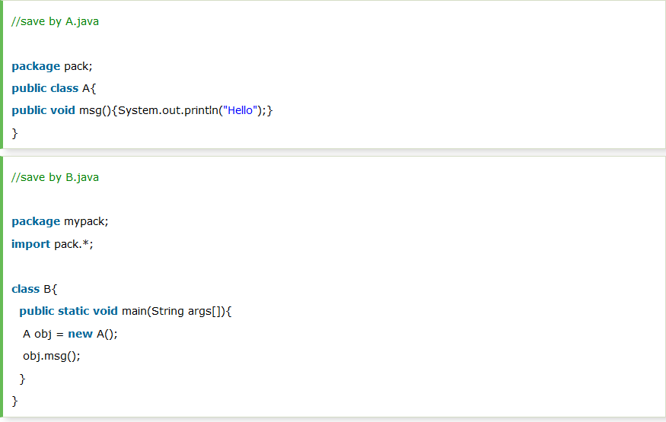
Public access modifier

Slide 10
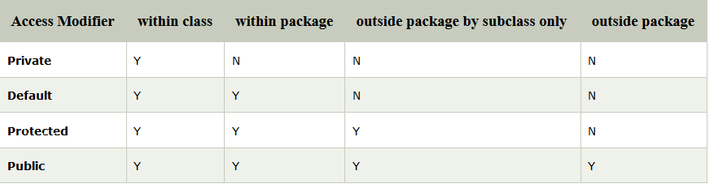

Slide 11
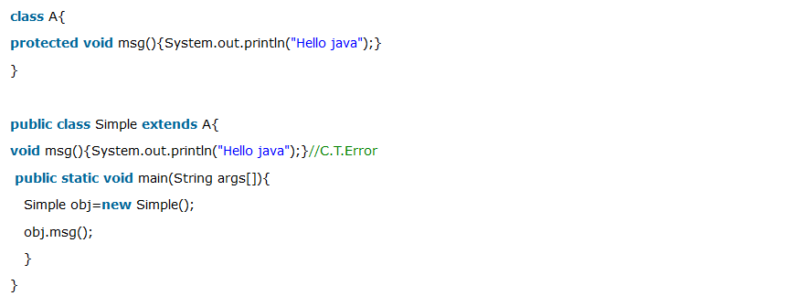
order of access modifiers from the least restrictive to the most restrictive
public > protected > default > private

Slide 12
Generics

Slide 13
Generics means parameterized types. The idea is to allow type (Integer, String, … etc., and user-defined types) to be a parameter to methods, classes, and interfaces. Using Generics, it is possible to create classes that work with different data types. An entity such as class, interface, or method that operates on a parameterized type is a generic entity.
Why Generics?
The Object is the superclass of all other classes, and Object reference can refer to any object. These features lack type safety. Generics add that type of safety feature.
Type safety means that the compiler will validate types while compiling, and throw an error if you try to assign the wrong type to a variable (Trying to put an integer in a string String one = 1)
Classes like HashSet, ArrayList, HashMap, etc., use generics very well.

Slide 14
Types of Generics
Generic Method: Generic Java method takes a parameter and returns some value after performing a task. It is exactly like a normal function, however, a generic method has type parameters that are cited by actual type. This allows the generic method to be used in a more general way. The compiler takes care of the type of safety which enables programmers to code easily since they do not have to perform long, individual type castings.
Generic Classes: A generic class is implemented exactly like a non-generic class. The only difference is that it contains a type parameter section. There can be more than one type of parameter, separated by a comma. The classes, which accept one or more parameters, ​are known as parameterized classes or parameterized types.

Slide 15
Mainly Introduced to deal with type-safe objects. It makes the code stable by detecting the bugs at compile time.
3 advantages of generics.
Type-safety
Type casting is not required
Compile-Time checking

Slide 16
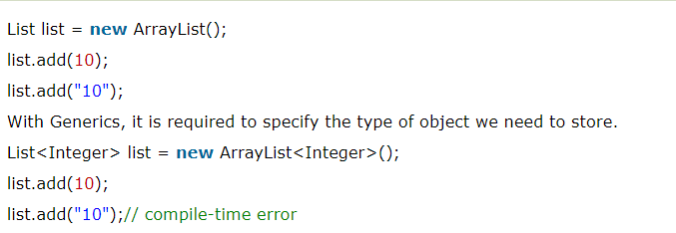
Type-safety

Slide 17
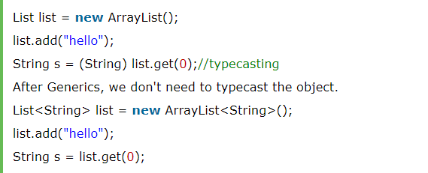
Type casting is not required

Slide 18

Compile – Time checking

Slide 19
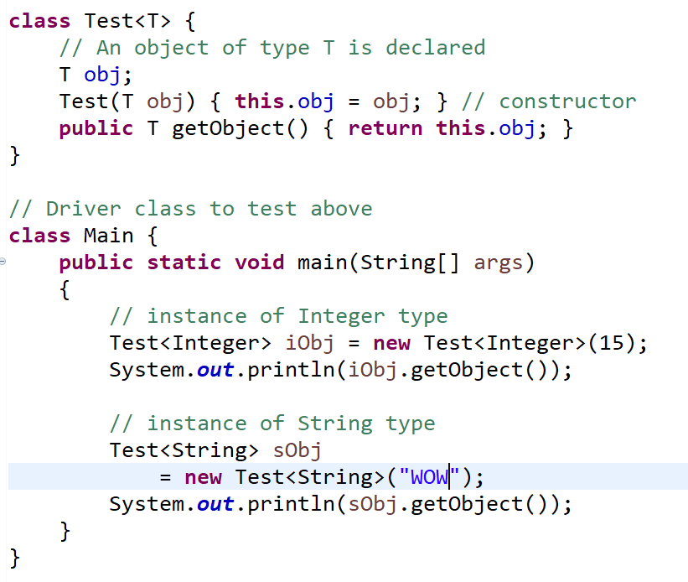

Slide 20
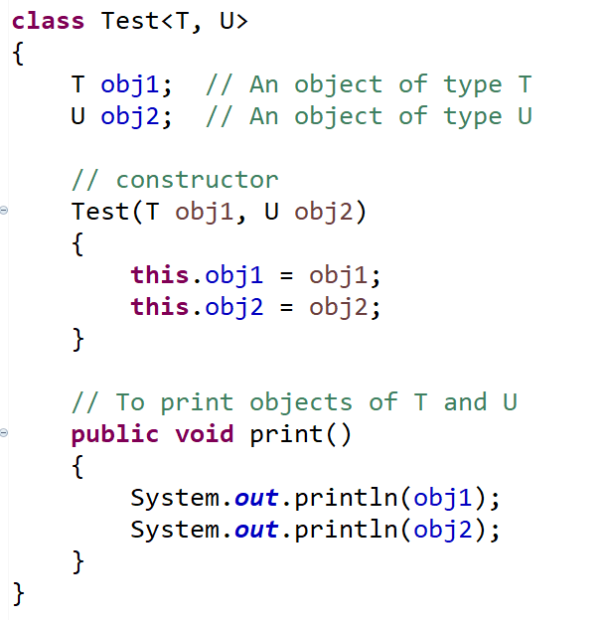
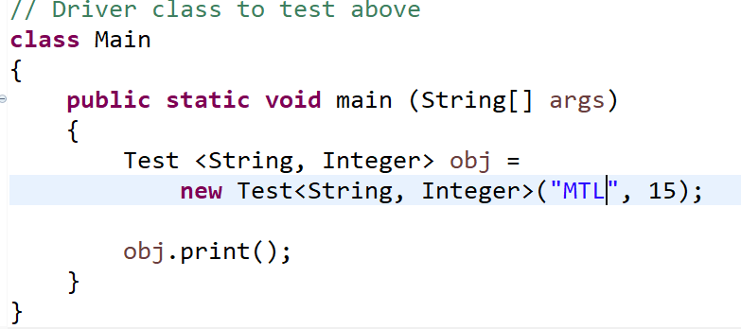
Multiple Type parameters in Generic classes.

Slide 21
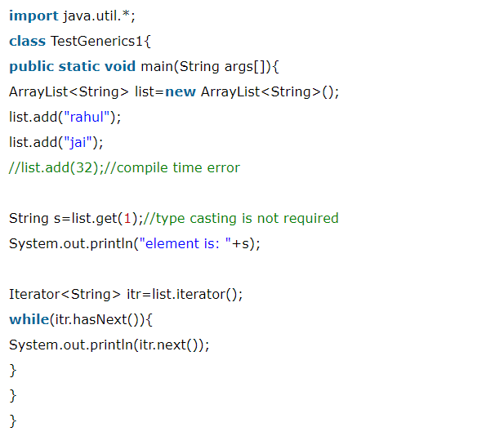
Example

Slide 22
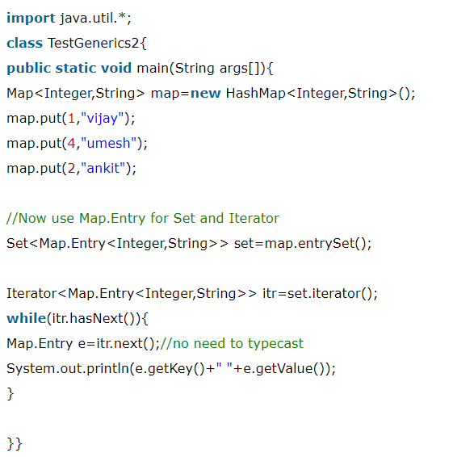
Java Generics using Map

Slide 23
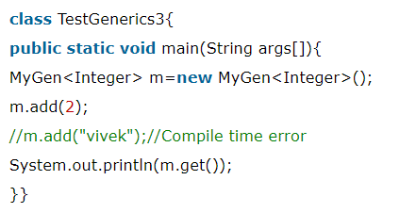
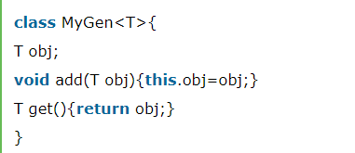
Generic class
A class that can refer to any type is known as a generic class. Here, we are using the T type parameter to create the generic class of specific type.

Slide 24
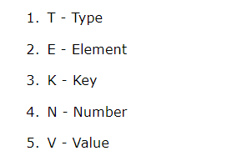
Generic Method
we can create a generic method that can accept any type of arguments.
Here, the scope of arguments is limited to the method where it is declared. It allows static as well as non-static methods.

Slide 25
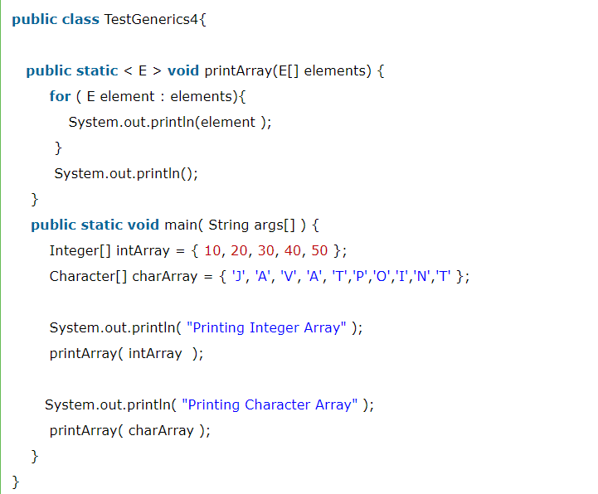
Generic method to print array elements. E to denote the element.

Slide 26
Wildcard in Java Generics
The ? (question mark) symbol represents the wildcard element. It means any type. If we write <? extends Number>, it means any child class of Number, e.g., Integer, Float, and double. Now we can call the method of Number class through any child class object.

Slide 27
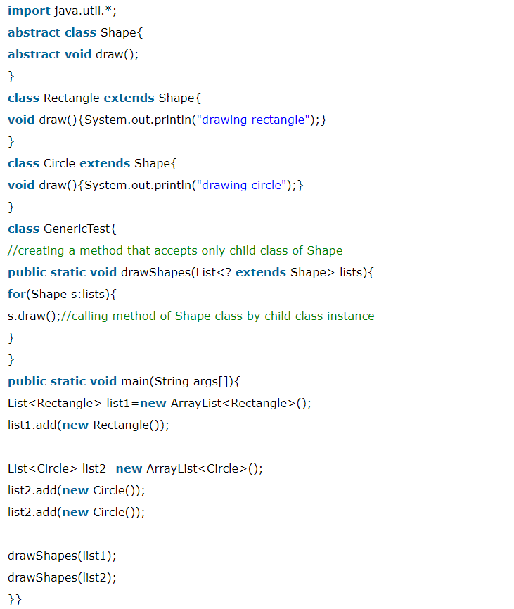

Slide 28
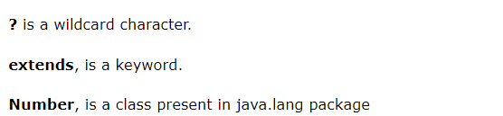
Upper Bounded Wildcards
The purpose of upper bounded wildcards is to decrease the restrictions on a variable. It restricts the unknown type to be a specific type or a subtype of that type.
It is used by declaring wildcard character ("?") followed by the extends (in case of, class) or implements (in case of, interface) keyword, followed by its upper bound.
List<? extends Number>

Slide 29
we want to write the method for the list of Number and its subtypes (like Integer, Double).
Using List<? extends Number> is suitable for a list of type Number or any of its subclasses whereas List<Number> works with the list of type Number only.
So, List<? extends Number> is less restrictive than List<Number>.

Slide 30
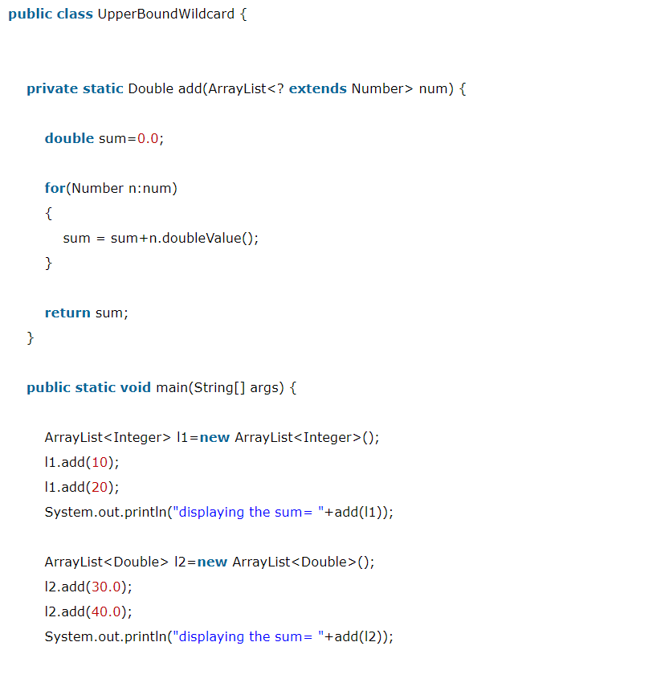

Slide 31
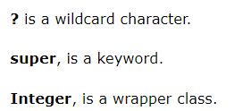
Lower Bounded Wildcards
The purpose of lower bounded wildcards is to restrict the unknown type to be a specific type or a supertype of that type.
It is used by declaring wildcard character ("?") followed by the super keyword, followed by its lower bound.
List<? super Integer>

Slide 32
we want to write the method for the list of Integer and its supertype (like Number, Object).
Using List<? super Integer> is suitable for a list of type Integer or any of its superclasses whereas List<Integer> works with the list of type Integer only.
So, List<? super Integer> is less restrictive than List<Integer>.

Slide 33
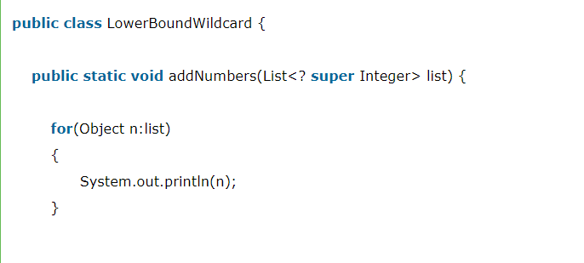
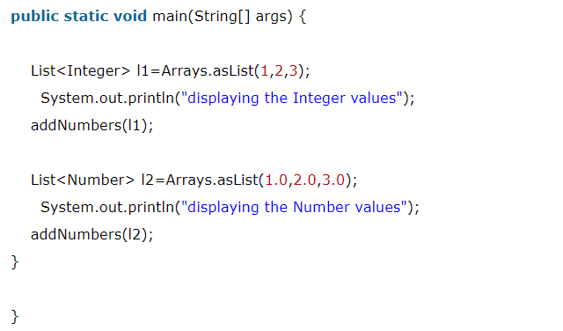

Slide 34
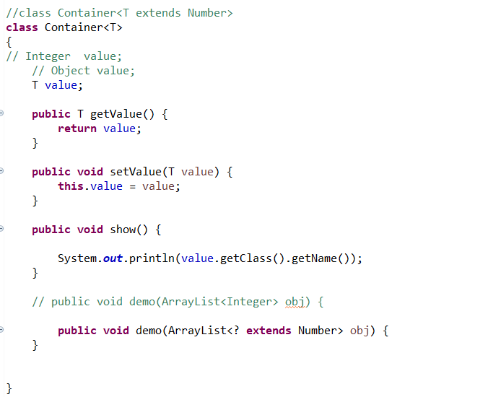

Slide 35
