Slide 1
The Queue ADT

Slide 2
Objectives
Examine queue processing
Define a queue abstract data type
Demonstrate how a queue can be used to solve problems
Examine various queue implementations
Compare queue implementations

Slide 3
Queues
Queue: a collection whose elements are added at one end (the rear or tail of the queue) and removed from the other end (the front or head of the queue)
A queue is a FIFO (first in, first out) data structure
Any waiting line is a queue:
The check-out line at a grocery store
The cars at a stop light
An assembly line

Slide 4
Conceptual View of a Queue
Adding an element
Front of queue
New element is added to the rear of the queue

Slide 5
Conceptual View of a Queue
Removing an element
New front element of queue
Element is removed from the front of the queue

Slide 6
Uses of Queues in Computing
For any kind of problem involving FIFO data
Printer queue (e.g. printer in MC 235)
Keyboard input buffer
GUI event queue (click on buttons, menu items)
To encode messages (more on this later)

Slide 7
Uses of Queues in Computing
In simulation studies, where the goal is to reduce waiting times:
Optimize the flow of traffic at a traffic light
Determine number of cashiers to have on duty at a grocery store at different times of day
Other examples?
Notes:
Ticket counter simulation

Slide 8
Queue Operations
enqueue : add an element to the tail of a queue
dequeue : remove an element from the head of a queue
first : examine the element at the head of the queue (“peek”)
Other useful operations (e.g. is the queue empty)
It is not legal to access the elements in the middle of the queue!

Slide 9
Operations on a Queue
Operation | Description
dequeue | Removes an element from the front of the queue
enqueue | Adds an element to the rear of the queue
first | Examines the element at the front of the queue
isEmpty | Determines whether the queue is empty
size | Determines the number of elements in the queue
toString | Returns a string representation of the queue

Slide 10
Interface to a Queue in Java
public interface QueueADT<T> {
// Adds one element to the rear of the queue
public void enqueue (T element);
// Removes and returns the element at the front of the queue
public T dequeue( );
// Returns without removing the element at the front of the queue
public T first( );
// Returns true if the queue contains no elements
public boolean isEmpty( );
// Returns the number of elements in the queue
public int size( );
// Returns a string representation of the queue
public String toString( );
}

Slide 11
Using Queues: Coded Messages
A Caesar cipher is a substitution code that encodes a message by shifting each letter in a message by a constant amount k
If k is 5, a becomes f, b becomes g, etc.
Used by Julius Caesar to encode military messages for his generals (around 50 BC)
This code is fairly easy to break!

Slide 12
Using Queues: Coded Messages
Modern version: ROT13
Each letter is shifted by 13
“used in online forums as a means of hiding spoilers, punchlines, puzzle solutions, and offensive materials from the casual glance” (Wikipedia)

Slide 13
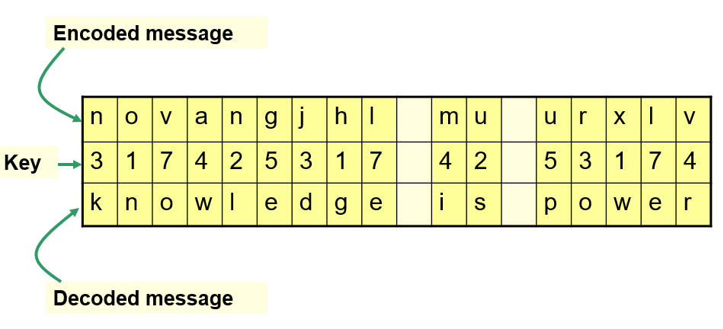
Using Queues: Coded Messages
An improvement: change how much a letter is shifted depending on where the letter is in the message

Slide 14
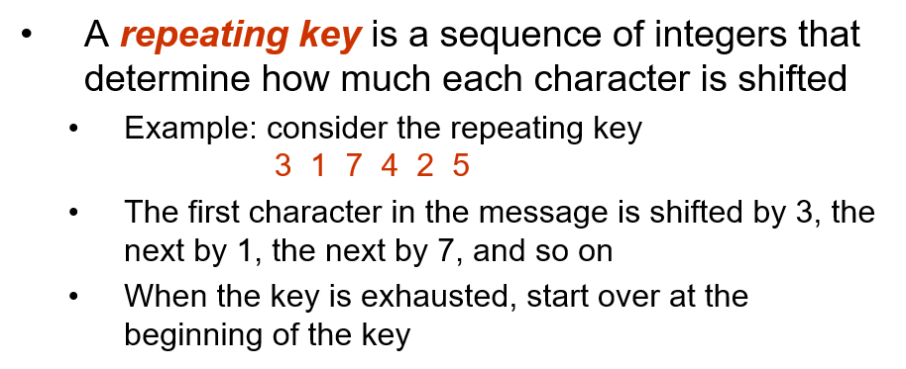

Slide 15
Using Queues: Coded Messages
We can use a queue to store the values of the key
dequeue a key value when needed
After using it, enqueue it back onto the end of the queue
So, the queue represents the constantly cycling values in the key

Slide 16
Using Queues: Ticket Counter Simulation
Simulate the waiting line at a movie theatre:
Determine how many cashiers are needed to keep the customer wait time under 7 minutes
Assume:
Customers arrive on average every 15 seconds
Processing a request takes two minutes once a customer reaches a cashier

Slide 17
Results of Ticket Counter Simulation
Number of Cashiers
1 | 2 | 3 | 4 | 5 | 6 | 7 | 8 | 9 | 10
5317 | 2325 | 1332 | 840 | 547 | 355 | 219 | 120 | 120 | 120
Average time (in seconds)

Slide 18
Array Implementation of a Queue
First Approach:
Use an array in which index 0 represents one end of the queue (the front)
Integer value count represents the number of elements in the array (so the element at the rear of the queue is in position count - 1)
Discussion: What is the challenge with this approach?

Slide 19
An Array Implementation of a Queue
A queue aq containing four elements
front
0
1
2
3
4
…
queue
aq
4
count

Slide 20
Queue After Adding an Element
The element is added at the array location given by the value of count and then count is increased by 1.
0
1
2
3
4
…
queue
aq
5
count

Slide 21
Queue After Removing an Element
Element is removed from array location 0, remaining elements are shifted forward one position in the array, and then count is decremented.
0
1
2
3
4
…
queue
aq
4
count

Slide 22
public class ArrayQueue<T> implements QueueADT<T> {
private final int DEFAULT_CAPACITY = 100;
private int count;
private T[] queue;
public ArrayQueue() {
count = 0;
queue = (T[])(new Object[DEFAULT_CAPACITY]);
}
public ArrayQueue (int initialCapacity) {
count = 0;
queue = (T[])(new Object[initialCapacity]);
}

Slide 23
//-----------------------------------------------------------------
// Adds the specified element to the rear of the queue,
// expanding the capacity of the queue array if
// necessary.
//-----------------------------------------------------------------
public void enqueue (T element) {
if (size() == queue.length)
expandCapacity( );
queue[count] = element;
count++;
}

Slide 24
//-----------------------------------------------------------------
// Removes the element at the front of the queue and returns
// a reference to it. Throws anEmptyCollectionException if the
// queue is empty.
//-----------------------------------------------------------------
public T dequeue ( ) throws EmptyCollectionException {
if (isEmpty( ))
throw new EmptyCollectionException (“Empty queue");
T result = queue[0];
count--;
// shift the elements
for (int i = 0; i < count; i++)
queue[i] = queue[i+1];
queue[count] = null;
return result;
}

Slide 25
Second Approach: Queue as a Circular Array
If we don't fix one end of the queue at index 0, we won't have to shift elements
Circular array is an array that conceptually loops around on itself
The last index is thought to “precede” index 0
In an array whose last index is n, the location “before” index 0 is index n; the location “after” index n is index 0
Need to keep track of where the front as well as the rear of the queue are at any given time

Slide 26
Conceptual Example of a Circular Queue
front
After 5 dequeues
1
After 7 enqueues
1
0
0
front
12
12
11
11
rear
rear
10
10
rear
1
0
front
12
11
After 8 more enqueues
10

Slide 27
Circular Array Implementation of a Queue
3
2
3
1
4
front
queue
5
cq
0
8
5
n-1
6
rear
count
n-2
7
n-3
8
.
9
.
.
10

Slide 28
A Queue Straddling the End of a Circular Array
98
2
3
1
4
front
queue
5
cq
0
2
4
99
6
rear
count
98
7
97
8
.
9
.
.
10

Slide 29
Circular Queue Drawn Linearly
Queue from previous slide
98
cq
front
queue
0
1
2
3
4
…
96
97
98
99
2
4
rear
count

Slide 30
Circular Array Implementation
When an element is enqueued, the value of rear is incremented
But it must take into account the need to loop back to index 0:
rear = (rear+1) % queue.length;
Can this array implementation also reach capacity?
Notes:
Yes, so it may need enlarging

Slide 31
Example: array of length 4 What happens?
0
1
2
3
2
front
queue
cq
Suppose we try to add one more item to a queue implemented by an array of length 4
1
3
rear
count
0
1
2
3
2
The queue is now full. How can you tell?
front
queue
cq
2
4
rear
count

Slide 32
Add another item! Need to expand capacity…
0
1
2
3
We can’t just double the size of the array and copy values to the same positions as before: circular properties of the queue will be lost
2
front
queue
cq
2
4
rear
count
0
1
2
3
4
5
6
7
2
front
queue
cq
2
4
These locations should be in use
rear
count

Slide 33
We could build the new array, and copy the queue elements into contiguous locations beginning at location front:
0
1
2
3
4
5
6
7
2
front
queue
cq
6
4
rear
count

Slide 34
Better: copy the queue elements in order to the beginning of the new array
0
1
2
3
4
5
6
7
0
front
queue
cq
4
4
rear
count

Slide 35
New element is added at rear = (rear+1) % queue.length
0
1
2
3
4
5
6
7
0
front
queue
cq
5
5
rear
count

