Slide 1


Object Detection in low light
Sunku Abenay Krishna
21BAI1402

Slide 2
Introduction
Zero-Reference Deep Curve Estimation (Zero-DCE) is a method for enhancing low-light images. It uses a deep network, DCE-Net, to estimate tonal curves for dynamic range adjustment. The output is an enhanced image with preserved contrast and maintained range. On the other hand, YOLOv8 is the latest in the YOLO series for real-time object detection and classification. It’s efficient and processes the entire image in a single pass. When combined, Zero-DCE can enhance low-light images, which are then processed by YOLOv8 for object detection. This combination could potentially improve object detection in low-light conditions. However, the effectiveness of this combination would need to be validated through experimentation.

Slide 3
Zero-dce
In the methodology of Zero-Reference Deep Curve Estimation (Zero-DCE), low-light image enhancement is formulated as the task of estimating an image-specific tonal curve with a deep neural network. A lightweight deep network, DCE-Net, is trained to estimate pixel-wise and high-order tonal curves for dynamic range adjustment of a given image. The input to Zero-DCE is a low-light image, and it produces high-order tonal curves as its output. These curves are then used for pixel-wise adjustment on the dynamic range of the input, resulting in an enhanced image. The curve estimation process is designed to maintain the range of the enhanced image and preserve the contrast of neighboring pixels.
The LoL Dataset is utilized for training and testing. It provides 485 images for training and 15 for testing. Each image pair in the dataset consists of a low-light input image and its corresponding well-exposed reference image.
The output of this methodology is an enhanced image. The enhancement is achieved by applying the high-order tonal curves produced by the DCE-Net to the input low-light image. The enhanced image maintains the range of the original image and preserves the contrast of neighboring pixels. This approach demonstrates the potential of Zero-DCE for low-light image enhancement, providing a valuable contribution to the field of computer vision.

Slide 4
yolo8
Object detection is the process of identifying, classifying, and localizing objects within a given image. This is often thought of as an extension of classification, but instead of one class label for the image, you must detect and localize an arbitrary number of classes. Since the inception of You Only Look Once (YOLO), object detection has primarily been solved using deep learning. Most deep learning architectures do this by cleverly framing the object detection problem as a combination of many small classification problems and many regression problems. More specifically, this is done by generating many anchor boxes of varying shapes and sizes across the input images and assigning them each a class label, as well as x, y, width, and height offsets. The model is trained to predict the class labels of each box, as well as the x, y, width, and height offsets of each box that is predicted to be an object.

Slide 5
MOdel
Pros:
Improved Accuracy: Zero-DCE, when integrated with a lightweight YOLOv5, has been shown to accurately detect objects in poorly lit road scenes at night1. The same could be expected when using YOLOv8, which is an advanced version of YOLOv5.
Image Enhancement: Zero-DCE takes a low-light image as input and produces high-order tonal curves as its output. These curves are then used for pixel-wise adjustment on the dynamic range of the input to obtain an enhanced image2.
Preservation of Contrast: The curve estimation process of Zero-DCE is done in such a way that it maintains the range of the enhanced image and preserves the contrast of neighboring pixels2.
Cons:
Complexity: The integration of Zero-DCE with YOLOv8 might increase the complexity of the model, which could potentially lead to longer training and inference times.
Dependency on Quality of Input Images: The performance of Zero-DCE and YOLOv8 might be affected by the quality of the input images. Low-light images often suffer from issues such as low brightness, low contrast, and high noise, which can degrade the performance of the model3.
Need for Large Datasets: For effective training and performance, these models might require large datasets of low-light images, which might not always be readily available.

Slide 6
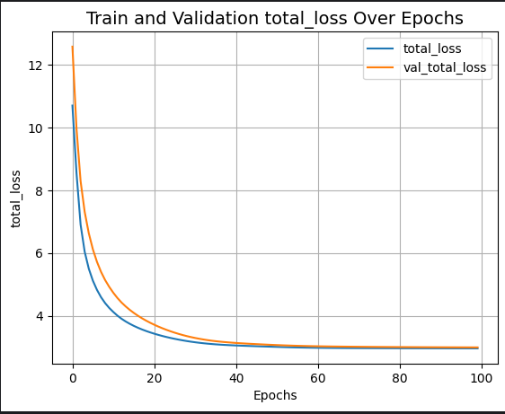
Image enhancement
Total Loss: This is the overall loss that the model tries to minimize during training. It’s usually a combination of several other loss functions, each measuring a different aspect of the discrepancy between the model’s predictions and the actual data. Minimizing the total loss leads to better model performance.
Illumination Smoothness Loss: This loss function ensures that changes in illumination remain consistent among neighboring pixel locations. It helps to maintain the smoothness and continuity of the illumination map, which is crucial for preserving the naturalness of the enhanced image.

Slide 7
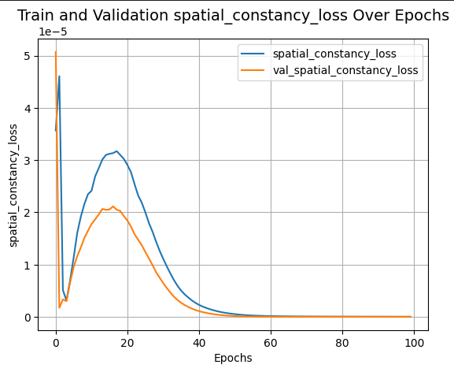
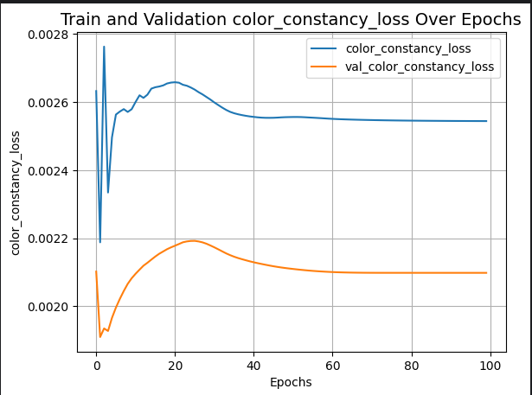
Image enhancement
Spatial Constancy Loss: This loss function ensures that the enhanced image maintains the spatial consistency of the original image. It helps to preserve the contrast between neighboring pixels and the overall structure of the image.
Color Constancy Loss: This loss function ensures that the colors in the enhanced image are consistent with the colors in the original image. It helps to maintain the color balance and prevent color distortions in the enhanced image.

Slide 8
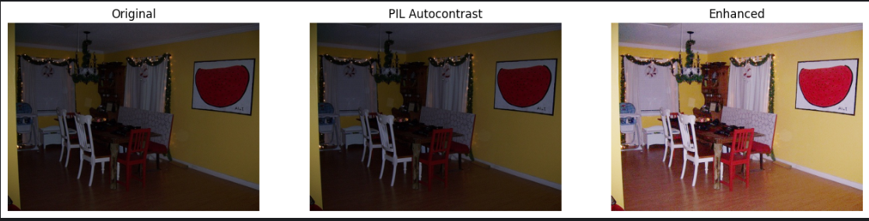
Image enhancement
PIL Autoconstrast
Vs
Enhanced Zero-DCE

Slide 9
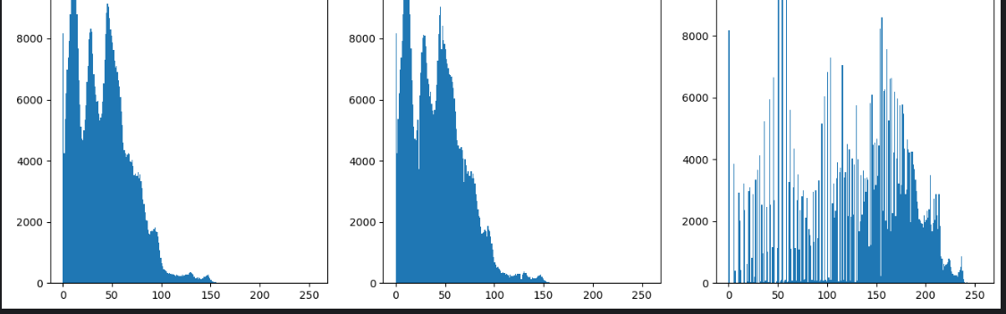
Image enhancement
Histogram

Slide 10
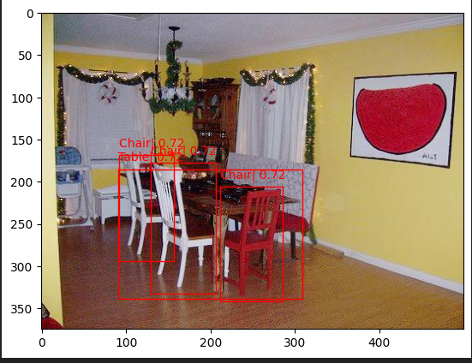
Object detection
YOLO8

Slide 11
Thank you

