Slide 1


Predicting International Happiness Scores
Alex Bender
Model
Prepare
Evaluate
Understand
Envision

Slide 2
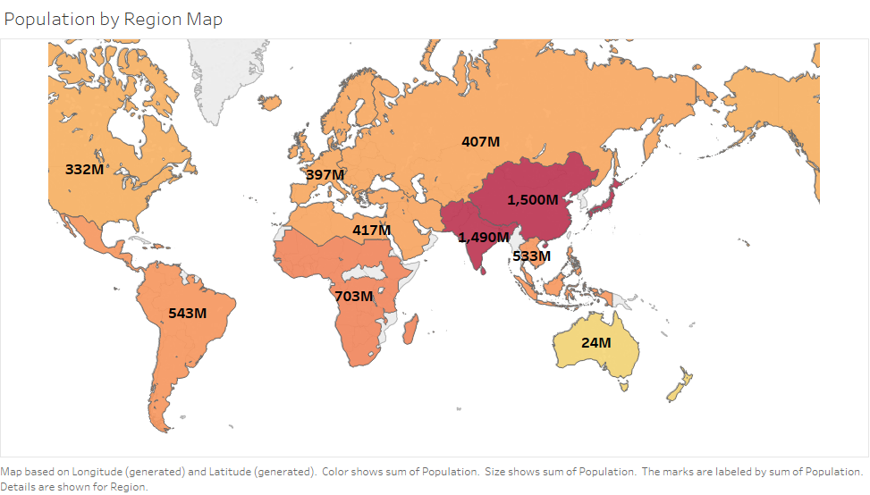


Predicting International Happiness Scores
Alex Bender
Understand
Prepare
Envision
Model
Evaluate

Slide 3
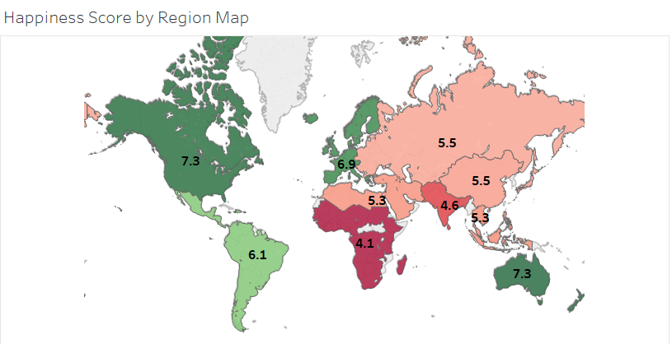
Understand
Prepare
Envision
Evaluate
Model

Slide 4
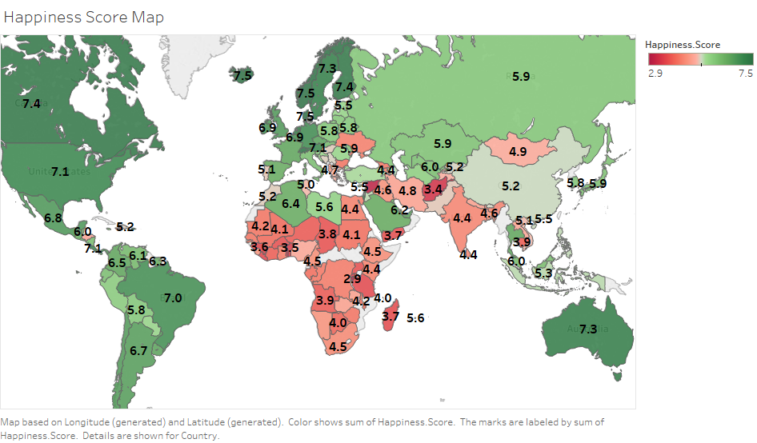
Understand
Prepare
Envision
Evaluate
Model

Slide 5
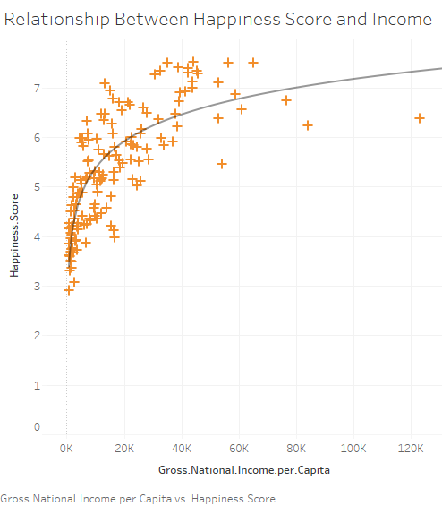
Understand
Prepare
Envision
Evaluate
Model

Slide 6
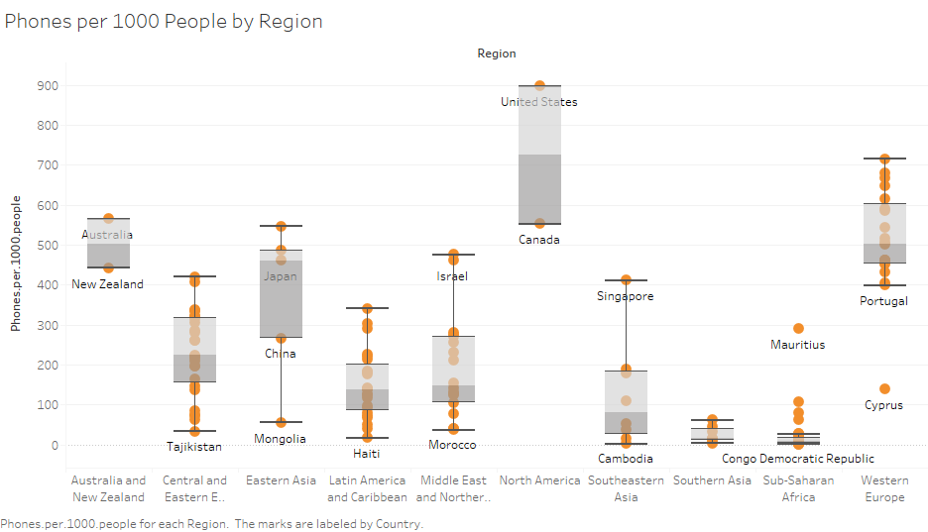
Understand
Prepare
Envision
Evaluate
Model

Slide 7
Understand
Prepare
Envision
Evaluate
Model

Slide 8
Understand
Standardize country names
Impute missing values using central tendency
Detecting outliers
Normalization/standardization
Feature selection - multicollinearity
VIF, PCA, P-value
Prepare
Envision
Model
Evaluate

Slide 9
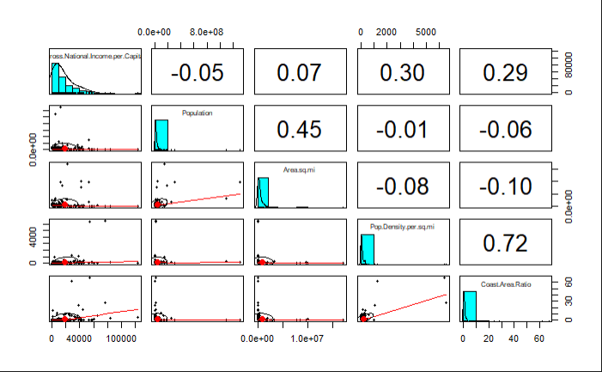
Prepare
Standardize country names
Impute missing values using central tendency
Detecting outliers
Normalization/standardization
Feature selection - multicollinearity
VIF, PCA, P-value
Envision
Model
Evaluate

Slide 10
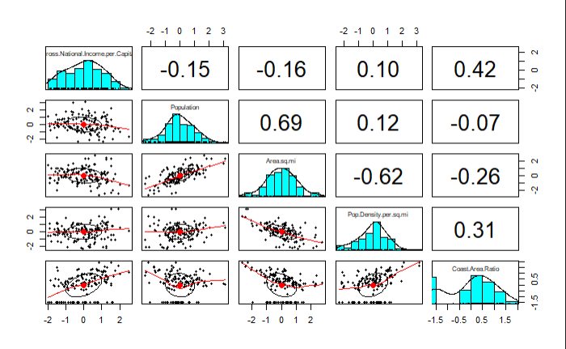
Prepare
Standardize country names
Impute missing values using central tendency
Detecting outliers
Normalization/standardization
Feature selection - multicollinearity
VIF, PCA, P-value
Envision
Model
Evaluate

Slide 11
Prepare
Envision
Model
Evaluate

Slide 12
Prepare
Many factors go into a nation’s development and happiness
If we are able to predict important factors, we can provide governments a playbook
Objectives: understand most important factors affecting a nation’s average happiness
Which model will achieve the best results? How close can I get?
Envision
Model
Evaluate

Slide 13
Envision
Many factors go into a nation’s development and happiness
If we are able to predict important factors, we can provide governments a playbook
Objectives: understand most important factors affecting a nation’s average happiness
Which model will achieve the best results? How close can I get?
Model
Evaluate

Slide 14
Envision
Many factors go into a nation’s development and happiness
If we are able to predict important factors, we can provide governments a playbook
Objectives: understand most important factors affecting a nation’s average happiness
Which model will achieve the best results? How close can I get?
Multiple Linear Regression
Regression Trees
Neural Networks
k-NN
Simple Ensemble
Stacked Ensemble
Model
Evaluate

Slide 15
Model
Multiple Linear Regression
Regression Trees
Neural Networks
k-NN
Simple Ensemble
Stacked Ensemble
Evaluate

Slide 16
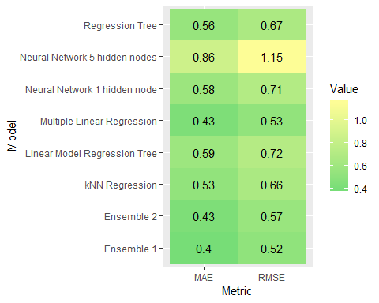
Model
Multiple Linear Regression
Regression Trees
Neural Networks
k-NN
Simple Ensemble
Stacked Ensemble
Evaluate

Slide 17
Understand
Prepare
Envision
Model
Evaluate

Slide 18
Key Takeaways
Most important factors:
Region of the world
Infant mortality
Life expectancy
Gross national income
Best model:
Simple ensemble
Understand
Prepare
Envision
Model
Evaluate

Slide 19

Key Takeaways
Most important factors:
Region of the world
Infant mortality
Life expectancy
Gross national income
Best model:
Simple ensemble
Thank you!
Model
Prepare
Evaluate
Understand
Envision

Slide 20
Key Takeaways
Most important factors:
Region of the world
Infant mortality
Life expectancy
Gross national income
Best model:
Simple ensemble
Thank you!
Understand
Prepare
Envision
Model
Evaluate

