Slide 1
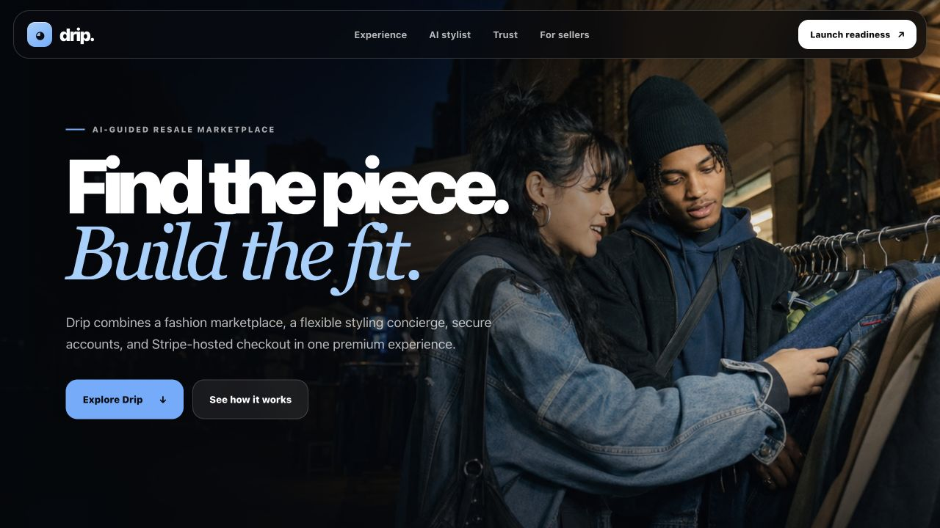
DRIP / PRODUCT PITCH
AI-GUIDED FASHION MARKETPLACE
Notes:
Open on the customer promise: Drip helps people move from inspiration to a complete fit and a protected purchase.
[Sources]
- Internal Drip website capture: deliverables/website-hero.png
- Internal Drip editorial asset: assets/editorial/drip_night_market_editorial_v3.jpg

Slide 2
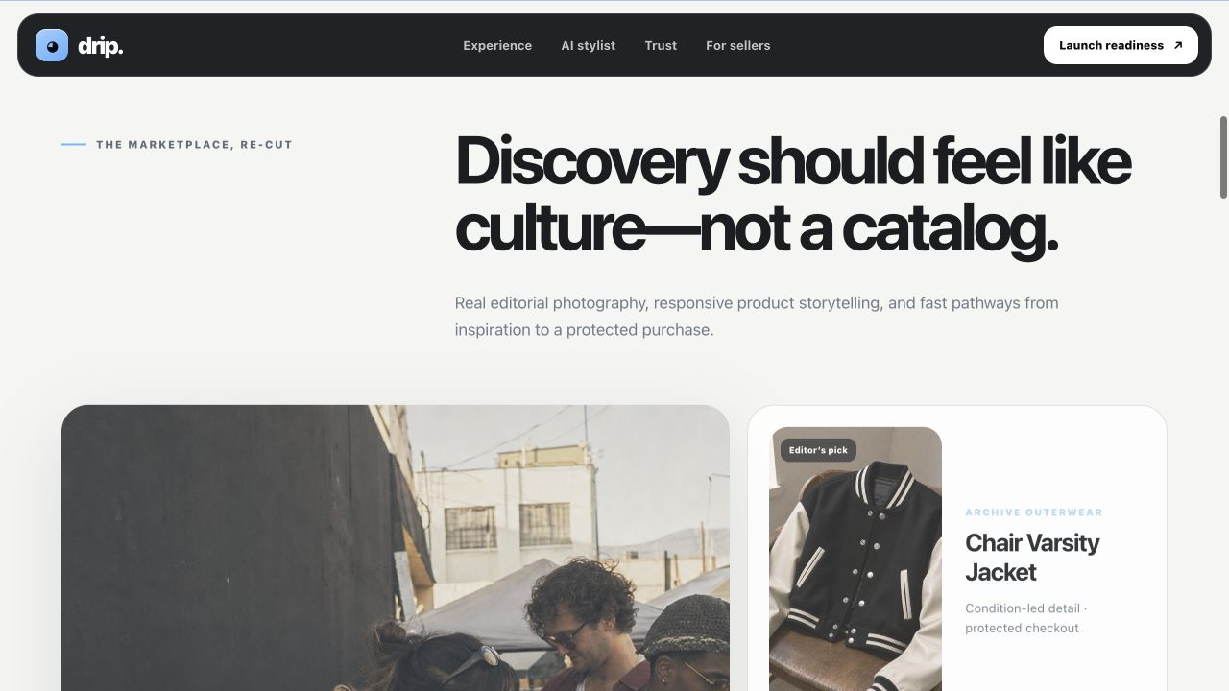
THE CUSTOMER GAP
Products are easy.
Decisions are personal.
Resale discovery is visual, but the decision is personal: budget, fit, occasion, confidence, trust, and payment all happen in the same moment.
DISCOVER
Editorial context, not a generic feed
Context earns attention.
Advice earns confidence.
ASK
Professional answers to flexible style questions
BUY
Server-verified totals and Stripe-hosted payment
02
CUSTOMER VALUE
Notes:
Frame the gap as decision support. Drip connects discovery, advice, and commerce instead of treating them as separate tools.
[Sources]
- Internal Drip product experience capture: deliverables/website-experience.png
- Internal product requirements and UX: README.md

Slide 3
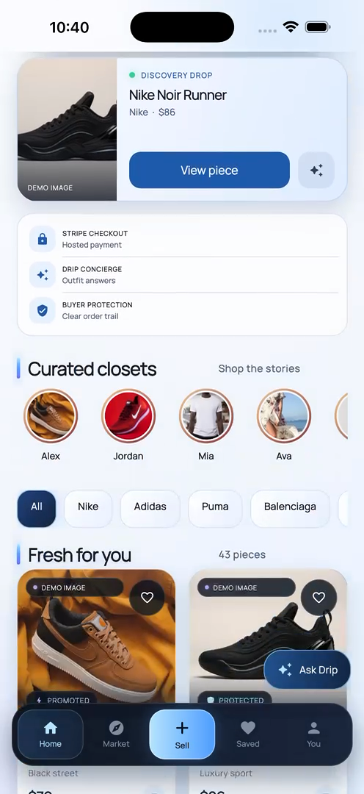
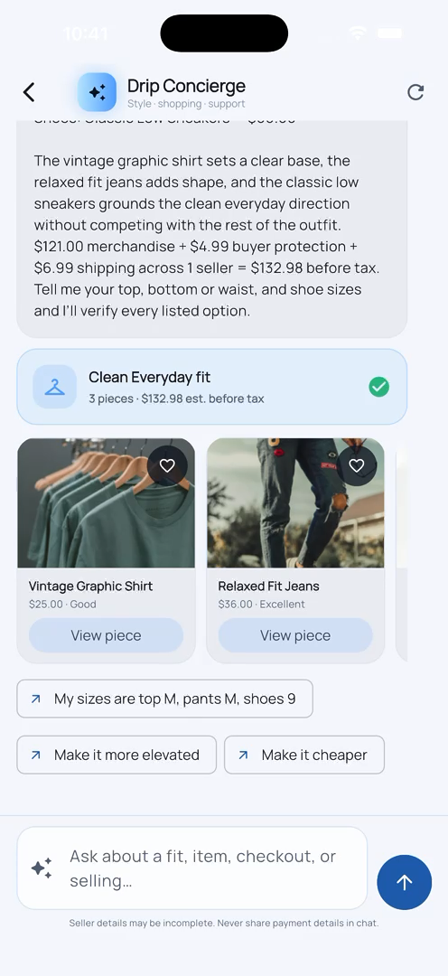
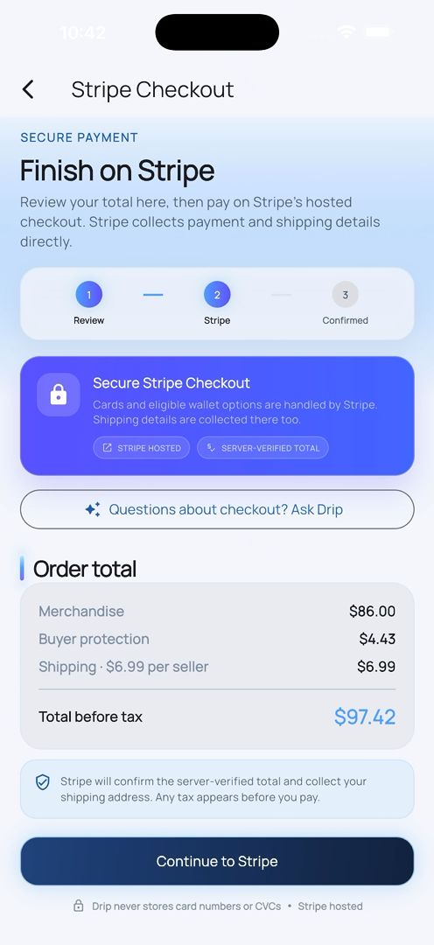
ONE CONNECTED EXPERIENCE
Inspiration becomes confidence—then checkout.
01 / DISCOVER
02 / STYLE
03 / CHECKOUT
Editorial + trust signals
Budget-aware outfit guidance
Verified Stripe totals
Notes:
Walk left to right. The value is the continuity: discovery context informs the stylist, and the selected product moves into a transparent checkout.
[Sources]
- Internal two-minute walkthrough frames: deliverables/video_frames/frame-5.png, frame-25.png, frame-105.png
- Internal AI and checkout behavior: docs/TECHNICAL_DOCUMENTATION.md

Slide 4
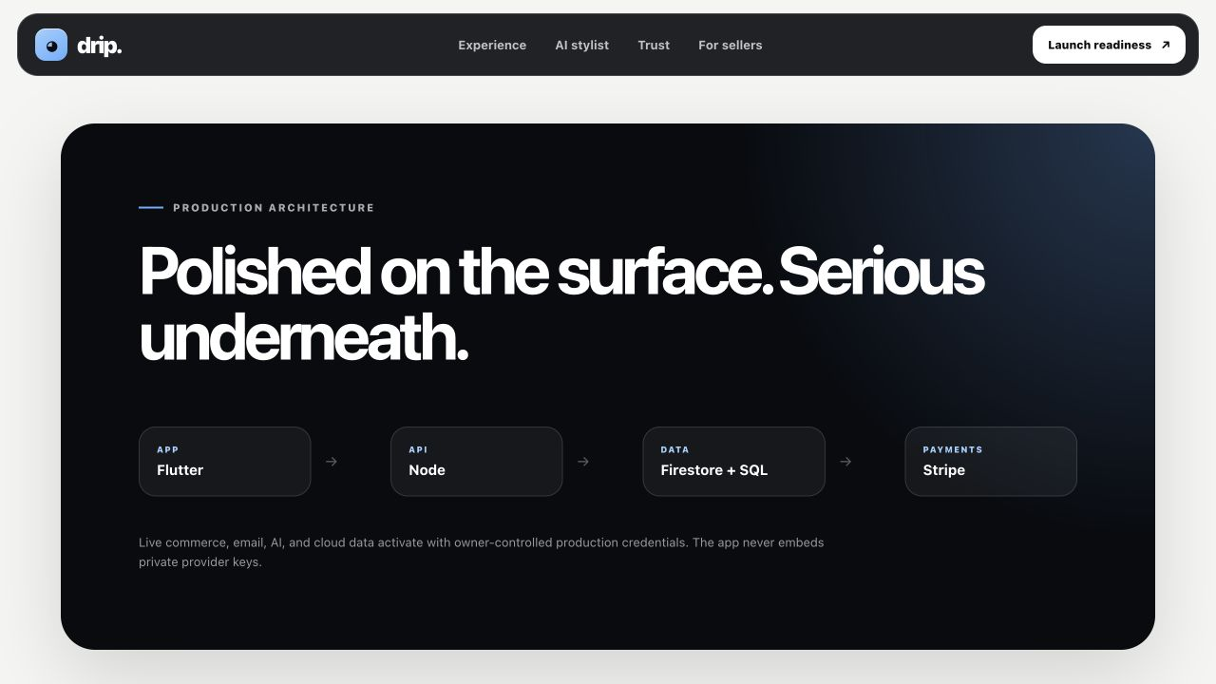
TRUST IS THE ARCHITECTURE
Private data stays private.
Payment authority stays off the client.
01
EMAIL VERIFIED
Confirmation codes before account activation
02
SPLIT DATA AUTHORITY
Firestore catalog; SQL for transactional truth
03
STRIPE HOSTED
No raw card details enter Drip
04
WEBHOOK CONFIRMED
Redirects never declare an order paid
04
TRUST & ARCHITECTURE
Notes:
Emphasize the split authority. Firestore serves marketplace catalog documents, while SQL preserves atomic identity, inventory, order, and payment invariants.
[Sources]
- Internal architecture capture: deliverables/website-launch.png
- Internal technical documentation: docs/TECHNICAL_DOCUMENTATION.md
- Internal backend setup and security boundaries: server/README.md

Slide 5
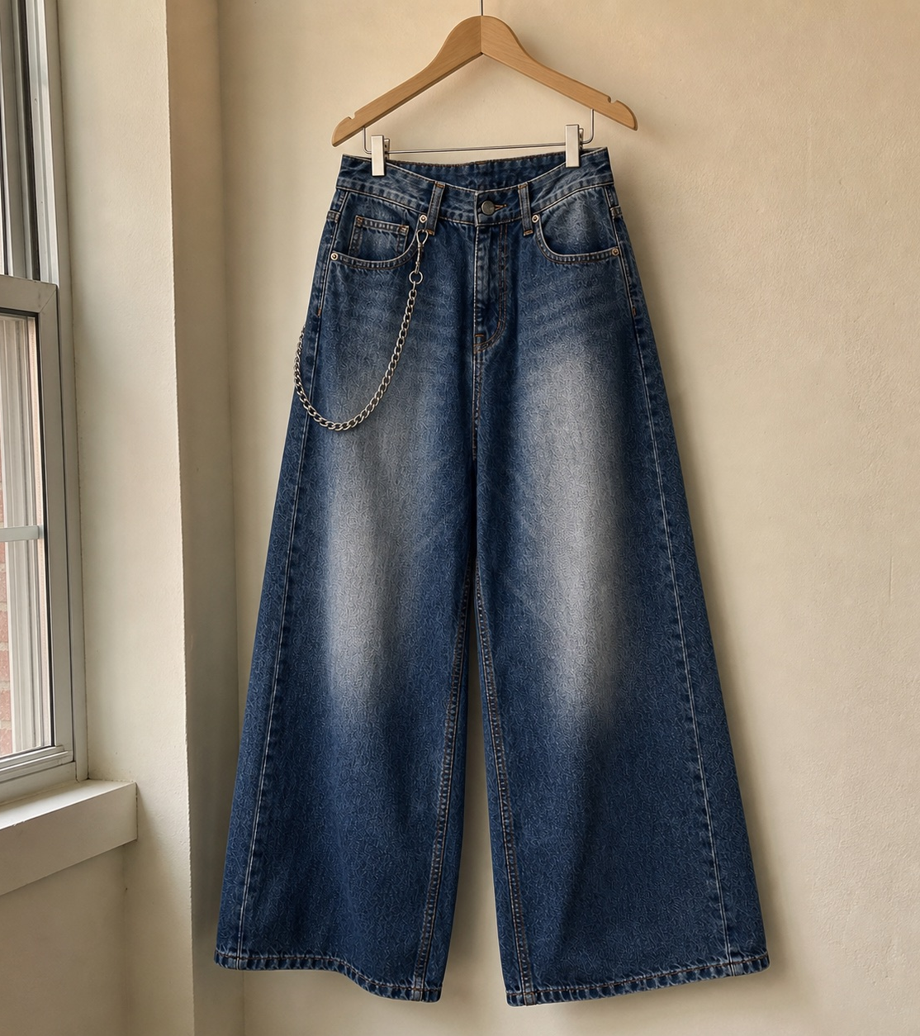
BUSINESS MODEL
Four revenue paths grow with marketplace activity.
4
MONETIZATION LAYERS
Transaction fee
Buyer protection
Listing boosts
Drip Pro subscription
No invented traction figures. The model is designed and instrumented; launch validation comes next.
Notes:
Keep the claim disciplined: the product contains four monetization mechanisms, but no market traction or revenue is claimed before a real pilot.
[Sources]
- Internal seller experience capture: deliverables/website-seller.png
- Internal business model: docs/BUSINESS_MODEL.md
- Internal commerce policy implementation: lib/commerce_model.dart

Slide 6
THE LAUNCH PATH
The product is built.
Production credentials unlock the market.
Seeking a launch partner and a focused beta community of sellers and style-conscious shoppers.
01
02
03
CONNECT
DEPLOY
PILOT
Owner Firebase, Stripe, Resend, and OpenAI production credentials
Backend API, webhooks, real inventory, monitoring, and support
Invite sellers, observe conversion, and validate the revenue model
TWO-MINUTE NARRATED PRODUCT WALKTHROUGH INCLUDED WITH THIS SUBMISSION
Notes:
Close with the concrete next decision: provide the owner credentials, deploy the backend, and run a measured pilot with a narrow customer segment.
[Sources]
- Internal production roadmap: docs/PRODUCTION_ROADMAP.md
- Internal requirement mapping: docs/REQUIREMENTS_CHECKLIST.md
- Internal narrated demo: deliverables/drip_demo_2min.mp4

