Slide 1

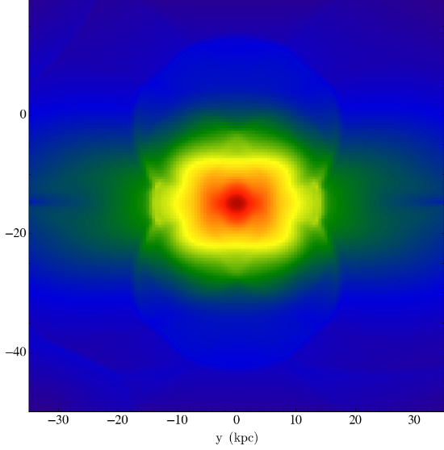
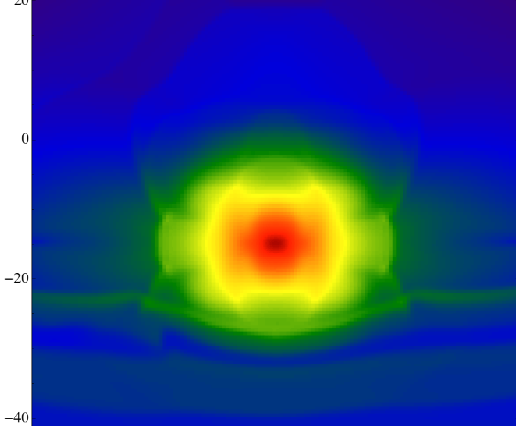
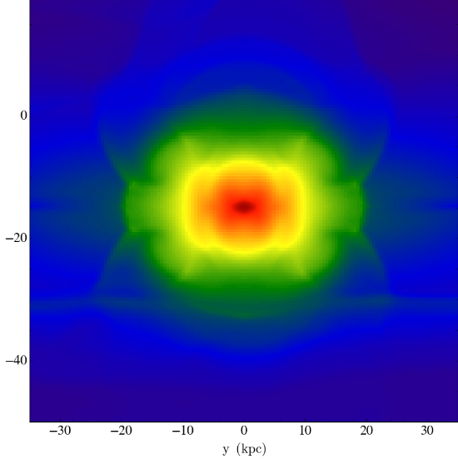
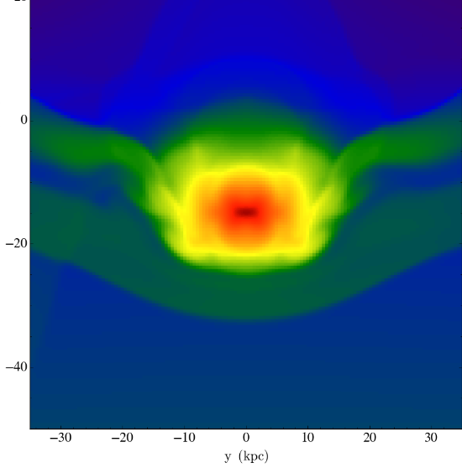
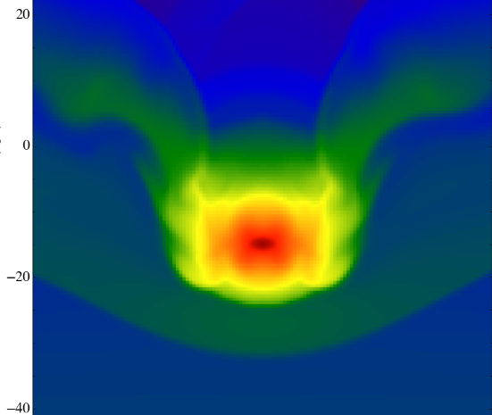
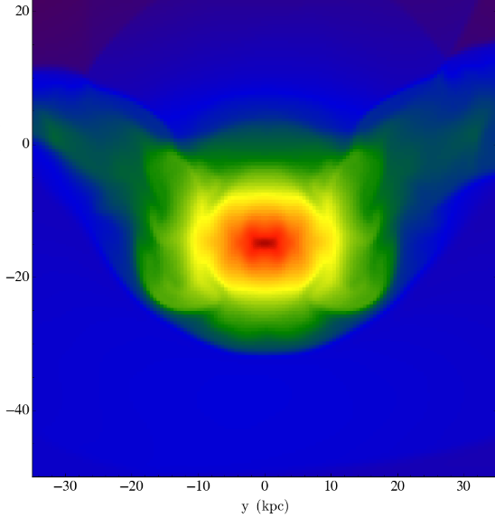
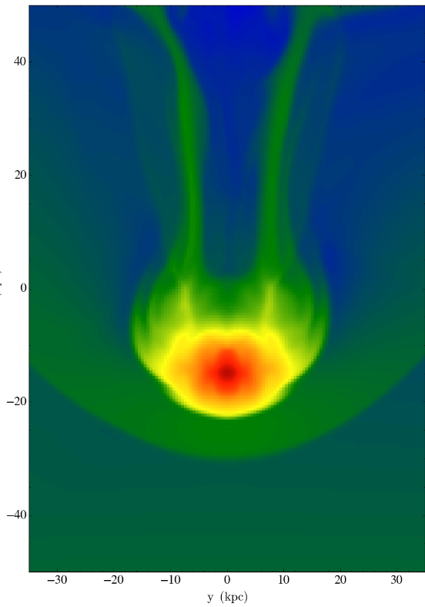
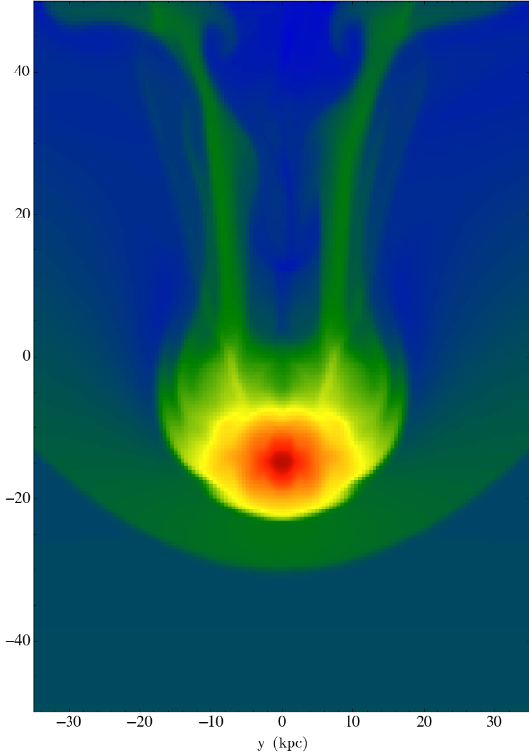
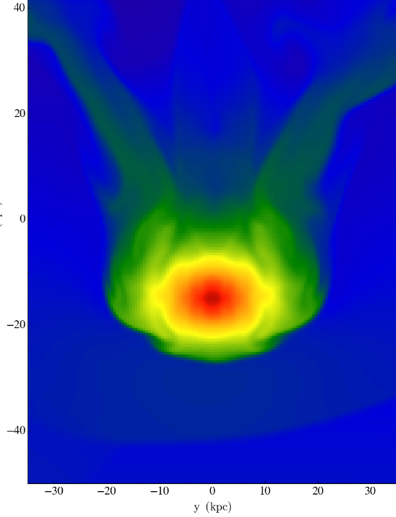
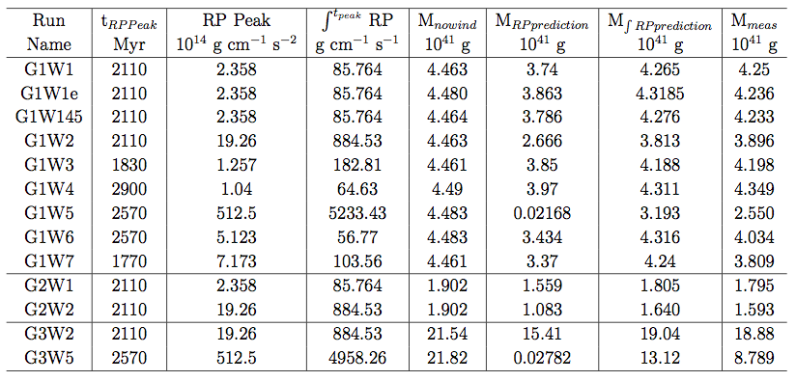
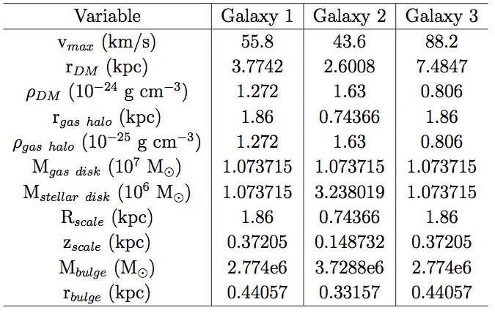
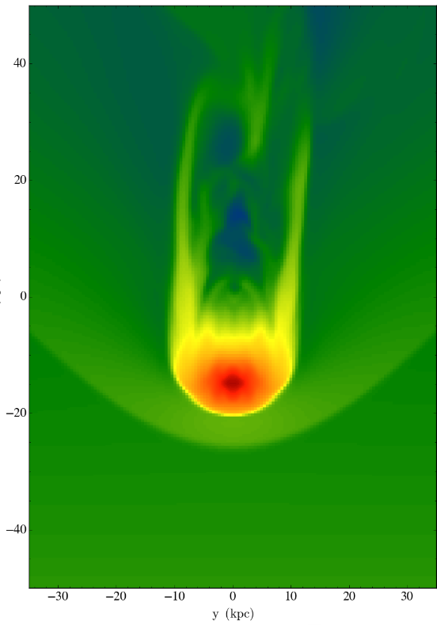
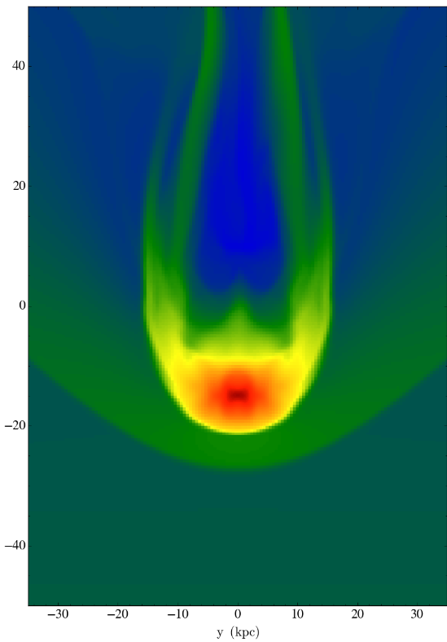
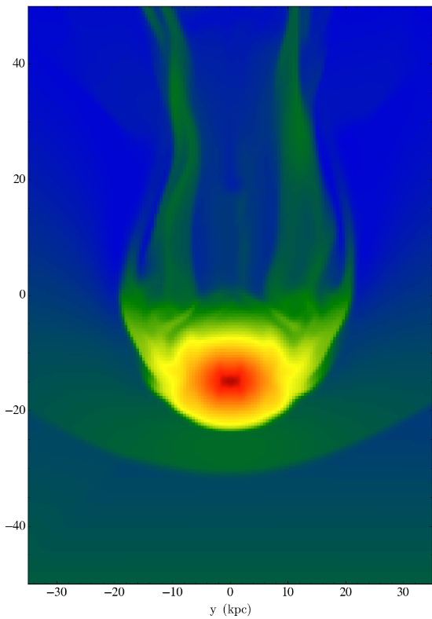

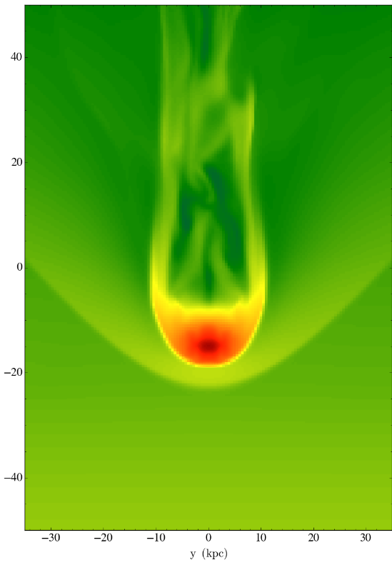
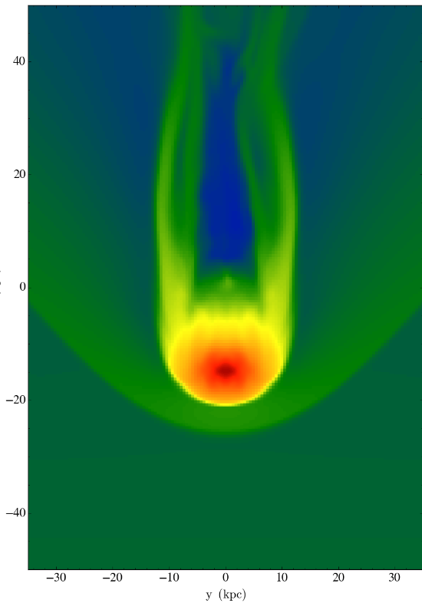
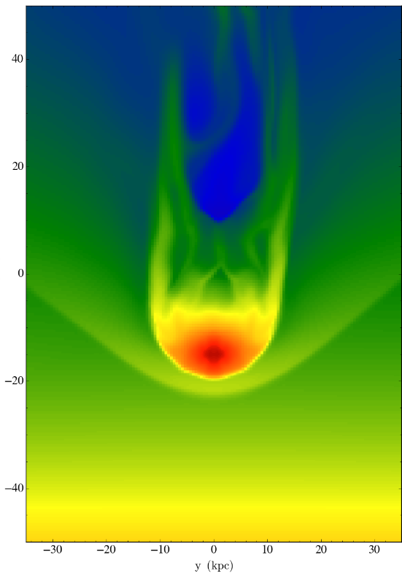
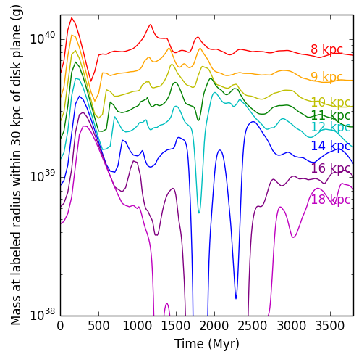
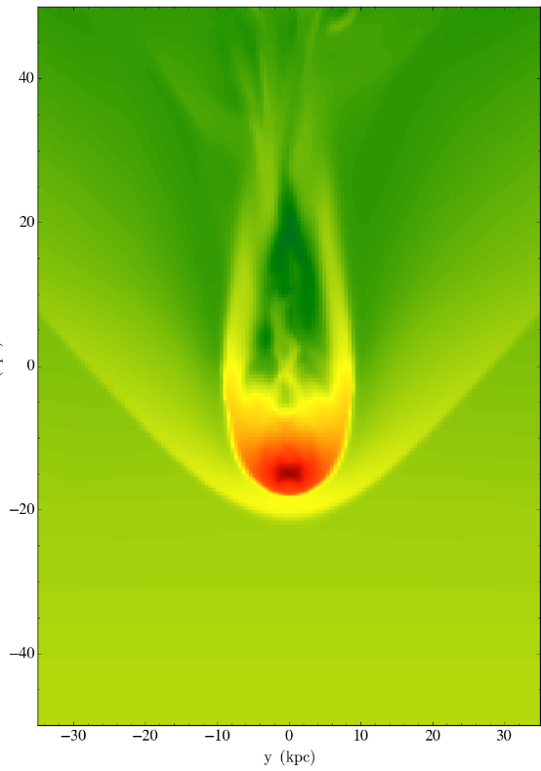
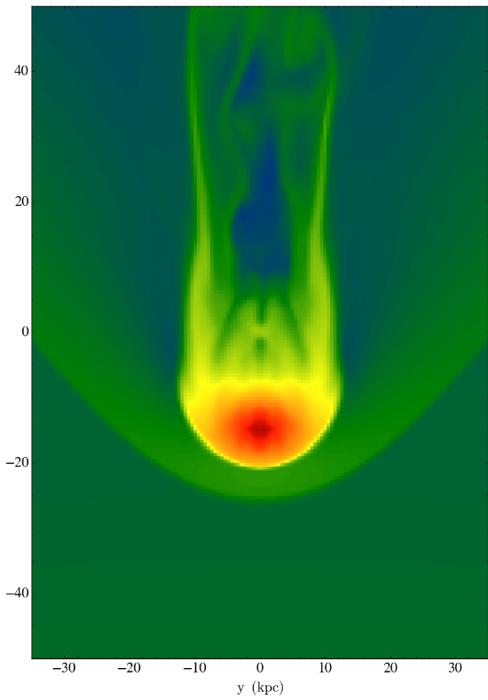
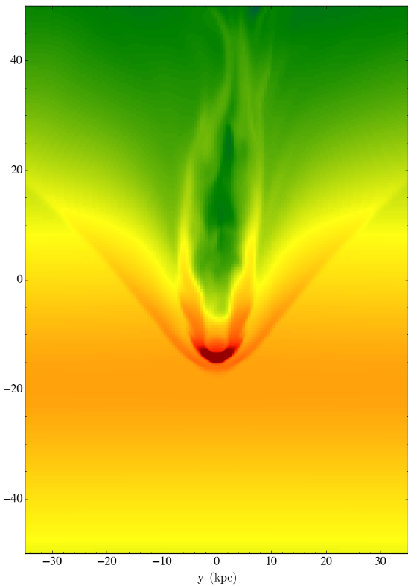
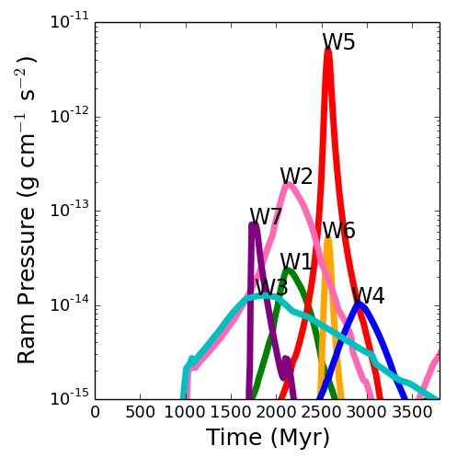
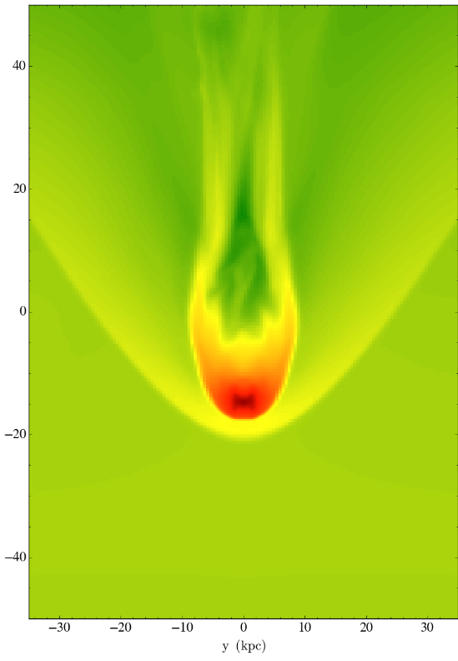
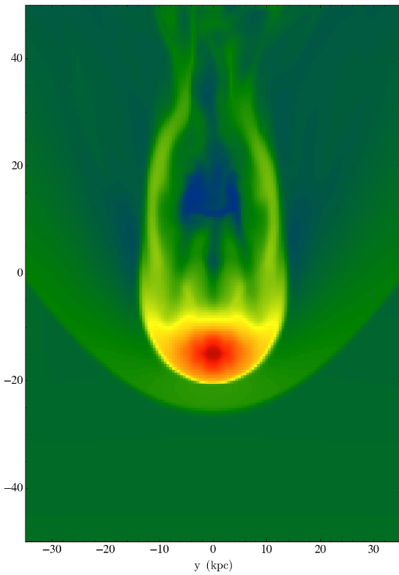
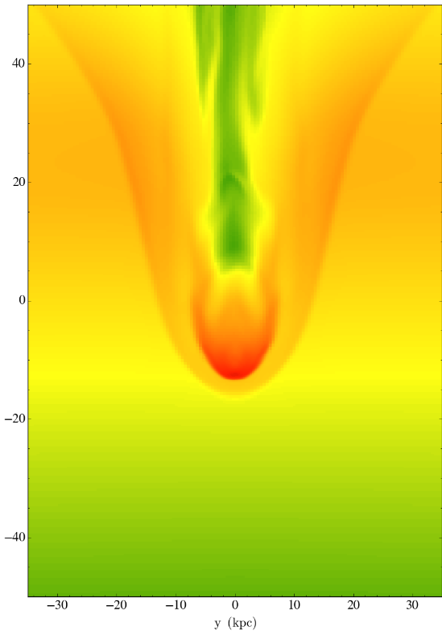
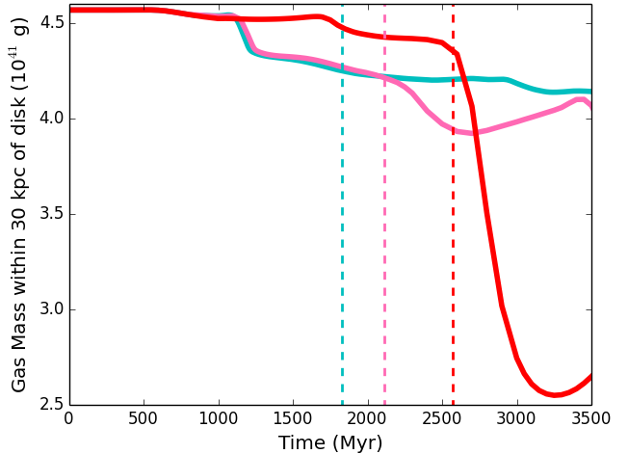
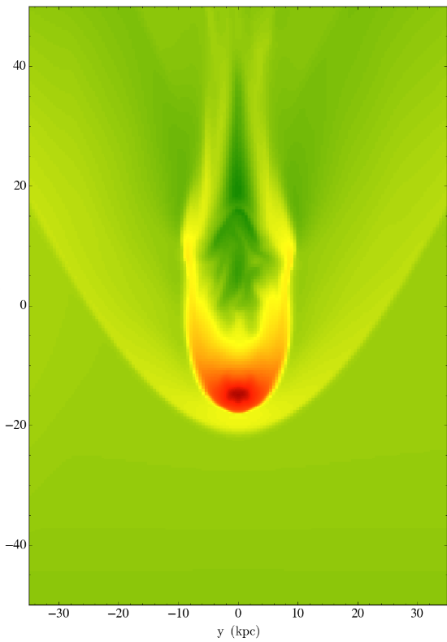
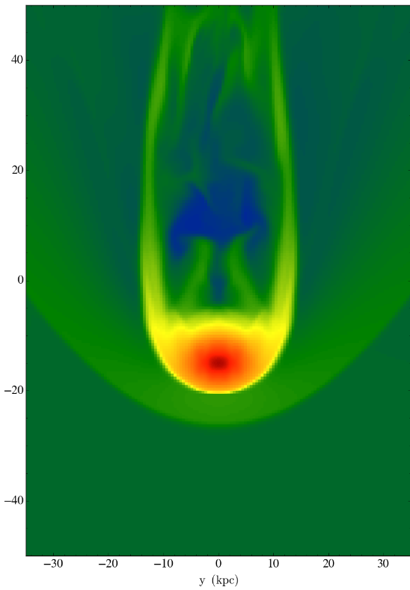
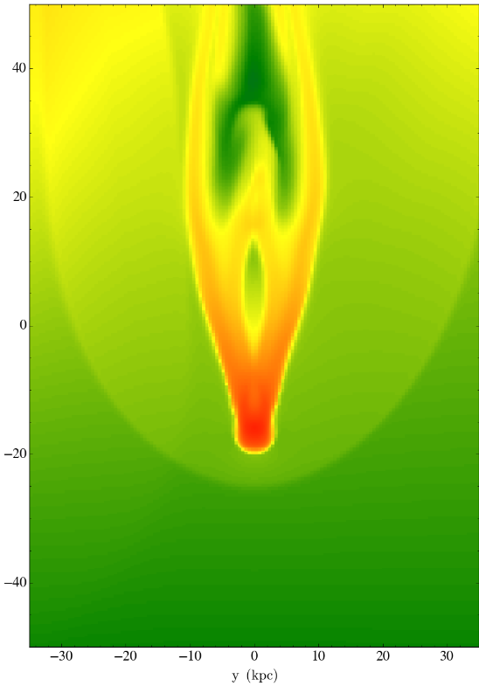
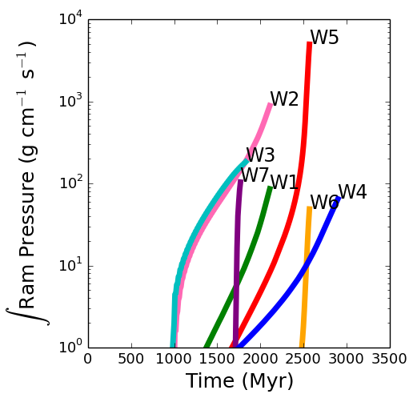
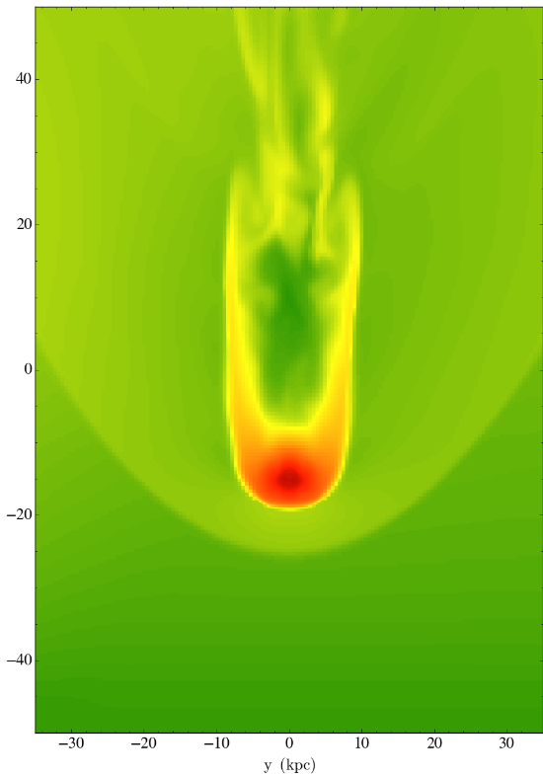
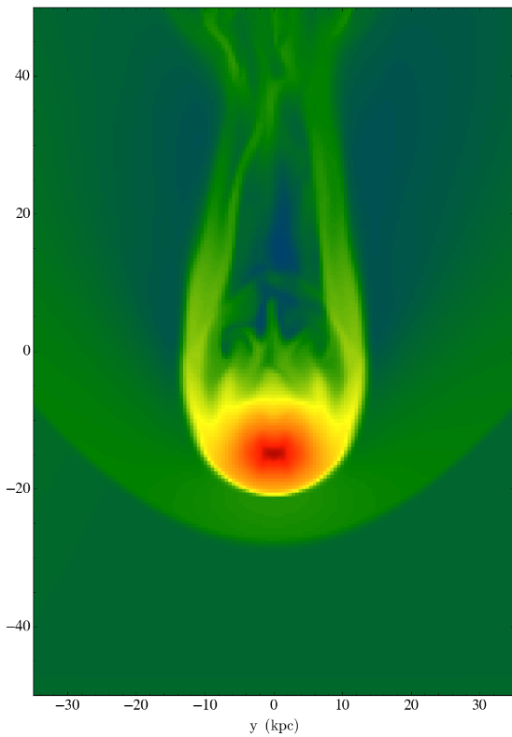
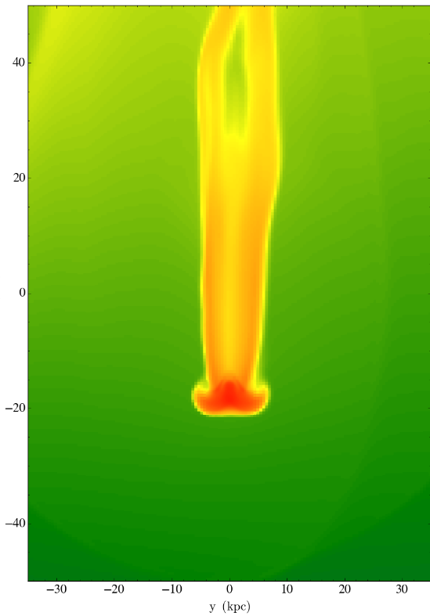
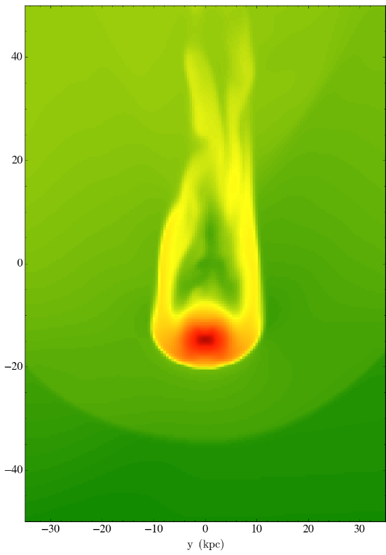
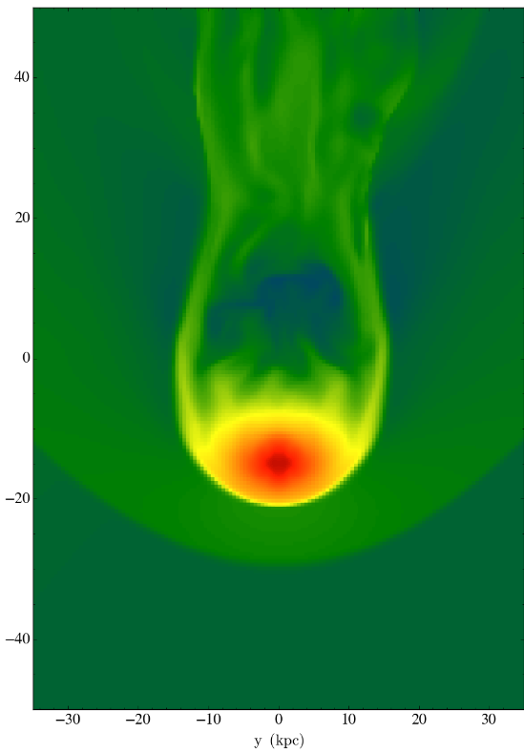
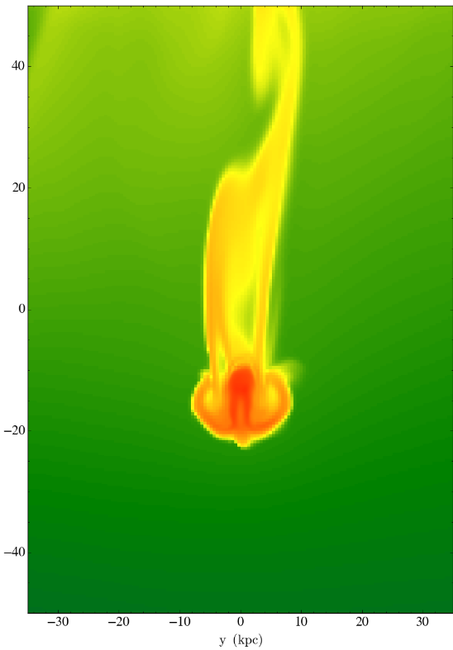
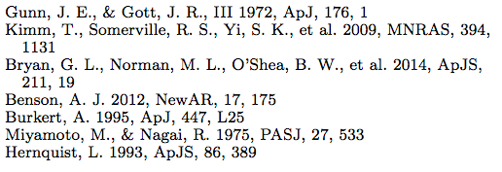
Ram Pressure Stripping:
The Long Goodbye
Stephanie Tonnesen¹; Yu Lu¹; Andrew Benson¹; Annika Peter²; Michael Boylan-Kolchin⁵; Andrew Wetzel^{1,3}; Daniel Weisz⁴
1. Carnegie Observatories, Pasadena, CA, United States. 2. Ohio State University, Columbus, OH, United States. 3. California Institute of Technology, Pasadena, CA, United States. 4. University of Washington, Seattle, WA, United States. 5. University of Texas at Austin, Austin, TX, United States.
stonnes@obs.carnegiescience.edu
What turns off star formation in satellite galaxies? Ram pressure stripping^{[1]}, the removal of a galaxy’s gas through direct interaction with the gas halo in which it orbits, is an attractive quenching mechanism, particularly in the Milky Way halo where the radial distribution of quenching is dramatic. However, many implementations of this process in semi-analytic models result in overly-rapid gas removal^{[2]}. We use high resolution hydrodynamical simulations run with Enzo^{[3]} to parameterize the stripping of disk and halo gas from an orbiting satellite galaxy for use in the semi-analytic modeling code Galacticus^{[4]}. We find that using the instantaneous ram pressure overestimates the amount of gas that is stripped, and present a physically-motivated module for including ram pressure stripping in semi-analytic models that uses the integral of the ram pressure experienced by a satellite galaxy. We will compare our results to observations of the Milky Way satellites.
We run a set of ~130 pc resolution simulations (using the AMR code Enzo) to calculate an analytic prescription to describe ram pressure stripping in semi-analytic models (SAMs).
2 Gyr in the Life of G1W2
2 Gyr in the Life of G1W3
2 Gyr in the Life of G1W5
We implement 3 critical updates to parameterize ram pressure stripping:
The wind is coming from the bottom of the box
kpc
0
0
0
Ram pressure stripping is not instantaneous and cannot be modeled as such. We use the integral of the ram pressure up to the peak ram pressure.
The gas halo and disk cannot be treated separately, as the stripping wind does not discriminate in how gas in different components is stripped
The gravitational restoring force is determined by the acceleration in the wind direction.
We derive a physically-motivated prescription that can be implemented into SAMs.
-20
-1.3 Gyr
-20
-900 Myr
-20
-1.4 Gyr
-40
-40
-40
kpc
20
20
We find that ram pressure stripping is determined by a galaxy’s orbit near pericenter, not just the peak ram pressure
0
110
0
0
Our stripping timescales will be compared to observational quenching timescales of satellite galaxies
-20
-1 Gyr
-20
-700 Myr
-20
-900 Myr
*We color-code the points that support these updates
-40
-40
-40
The Galaxies
40
40
40
Measured in the cylinder shown
We model three different galaxies with different masses
The dark matter and stellar components are static gravitational potentials
The gas is followed with adaptive mesh refinement (AMR)
We do not include radiative cooling or star formation
20
20
20
+30 kpc
The Predicted and Measured Amount of Galactic Gas after Ram Pressure Stripping within 30 kpc of our Simulated Galaxies
kpc
0
0
0
-20
-30 kpc
Note: the cylinder is aligned in the wind direction
Low density gas (like the halo) survives behind the galaxy at small radii
The halo is not entirely stripped
-20
-700 Myr
-20
-500 Myr
-40
-600 Myr
-40
-40
40
40
40
Burkert DM profile^{[5]}
20
20
20
0
0
0
kpc
-20
-300 Myr
-20
-300 Myr
-20
-300 Myr
Miyamoto-Nagai gas and stellar disks^{[6]}
-40
-40
-40
The integrated prediction is much closer to the measured minimum than the instantaneous prediction
40
40
40
Hernquist
Bulge^{[7]}
The lack of flaring indicates that all the gas at a certain radius either survives or is removed
20
20
20
We see that at any cylindrical radius around the galaxy, the gas mass is flat or almost entirely stripped. This indicates that gas is stripped in both the halo and disk.
It also indicates that gas is mainly stripped in the wind direction, as also shown by the lack of flaring in the tail. Thus the gravitational acceleration in the wind direction should determine whether gas can be stripped.
t_{peak}
G1W3
kpc
0
0
0
-20
-100 Myr
-20
-100 Myr
-20
-100 Myr
-40
-40
-40
Determining the Stripping Radius
The Winds
40
40
40
Ram pressure is measured in the plane of the disk at the edge of the simulation box
20
20
20
Instantaneous: Compare the peak ram pressure to the gravitational restoring force from the galaxy
(restoring force = the peak acceleration in the wind direction from the galaxy potential times the gas column density)
a_{peak,wind-dir} Σ_{gas} ~ ρ v²
Integrated:
Compare the integrated (up to the time of peak ram pressure) ram pressure a galaxy has experienced to the restoring force from the galaxy times the reaction time of the galaxy
kpc
0
0
0
-20
t_{peak}
-20
t_{peak}
-20
t_{peak}
-40
-40
-40
40
40
40
20
20
20
The Anatomy of Gas Stripping
kpc
0
0
0
Disk settling
First gas mass minimum is from ram pressure stripping (it takes some time for gas to actually be pushed more than 30 kpc from the disk)
-20
+100 Myr
-20
+100 Myr
-20
+100 Myr
-40
-40
-40
More gas is stripped in the steeply peaked runs (W5, W6, and W7) than in the other runs. Note also the different morphology of the gas tail
After ram pressure stripping, there is continuous stripping
40
40
40
Initial onslaught of wind (both W2 and W3 have initial ram pressure jumps that result in quick initial stripping but end up not being critically important to the total amount stripping)
20
20
20
kpc
0
0
0
G1W2 t_{peak}
Fallback (we would not see fallback from beyond the tidal radius if we included the gravitational potential of a central galaxy)
-20
+200 Myr
-20
+200 Myr
-20
+300 Myr
G1W2 t_{peak}
-40
-40
-40
G1W3 t_{peak}
40
40
40
20
20
20
kpc
0
0
0
Breaking the system
a_{peak,z-dir} Σ_{gas}t_{sound} ~ Σ(ρ v² Δt)
-20
+400 Myr
-20
+400 Myr
-20
+500 Myr
Our predictions for the mass remaining after ram pressure stripping are extremely close to the measured amount of gas. This is true for several wind profiles, for tilted disks, and for all three different galaxy masses. This is true when we measure the mass within 30 kpc of the disk plane, 10 kpc of the disk plane, or how much mass that begins within 5 kpc of the disk plane is stripped to above 30 kpc of the disk plane (considering different tidal radii).
-40
-40
-40
40
270
40
40
[1]
20
20
20
[2]
kpc
0
0
0
But, if the wind peaks too quickly—as in W5, W6, and W7, we underpredict the amount of gas that is stripped. This may be because with a fast increase in ram pressure strength, using the sound crossing time is no longer appropriate and a correction factor will need to be applied. We note that our integrated prediction is still closer than the instantaneous prediction.
[3]
-20
-20
-20
[4]
[5]
-40
+600 Myr
-40
+600 Myr
+700 Myr
[6]
-40
[7]
-30
-10
0
-10
-30
-30
-10
0
-10
-30
-30
-10
0
-10
-30
kpc
kpc
kpc

