Slide 1
CST 499 – Final Project Student Portal
Anders Berg
University of Arizona Global (Formally Ashford University)
CST 499–Capstone for Computer Software Technology
Amjad Alkilani
11/11/2021

Slide 2
Project Scope
The scope of this development is to create a system for user and course registration for learning institutions.
The system will need to be able to register users that are new and provide the ability for them to create an account.
User profiles need to include name, phone, and email. Once a user completes a registration, they need to be able to login with their unique id and password that they created.
Users will need to be able to register for course in spring/summer/fall semesters.
Courses will need to be listed out and available for registration per semester.

Slide 3
Product Functions
Functional
Able to register new users
Users need to be assigned a unique id and password that they can login with
User profiles need to include name, phone, and email
Users will need to be able to register for course in spring/summer/fall semesters
Users able to register for course based on semester
Course have a cap for max registration and allow users to be waitlisted
Allow users to cancel course registration and automatically allow for waitlisted users to register
Non-functional
Website availability need to be 24 hours a day.
Website needs to be authenticated with an SSL certificate
Build using modern web languages like HTML, CSS, JavaScript and PHP.
Website that supports all devices including mobile, tablet and Traditional PC’s
Database design will be constructed with a user table
Website needs to be handled a variety of traffic loads, including high traffic during peak hours or during promotional phases.
Built on AWS cloud architecture

Slide 4
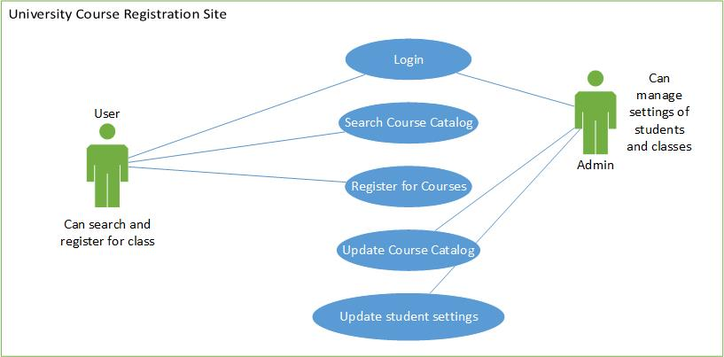
Use Case Diagram

Slide 5
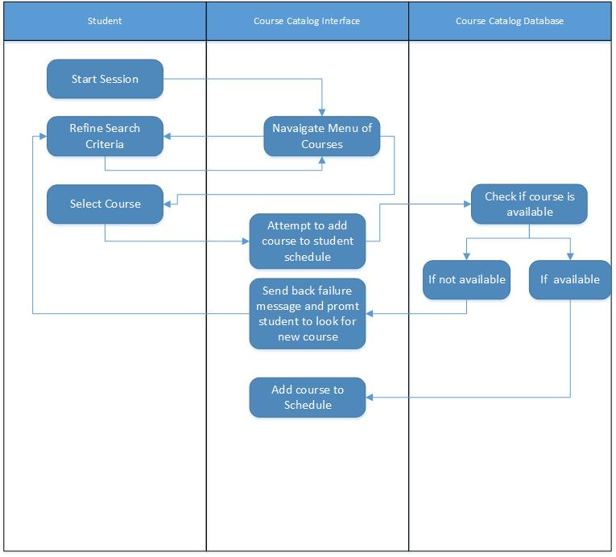
Sequence Diagram

Slide 6
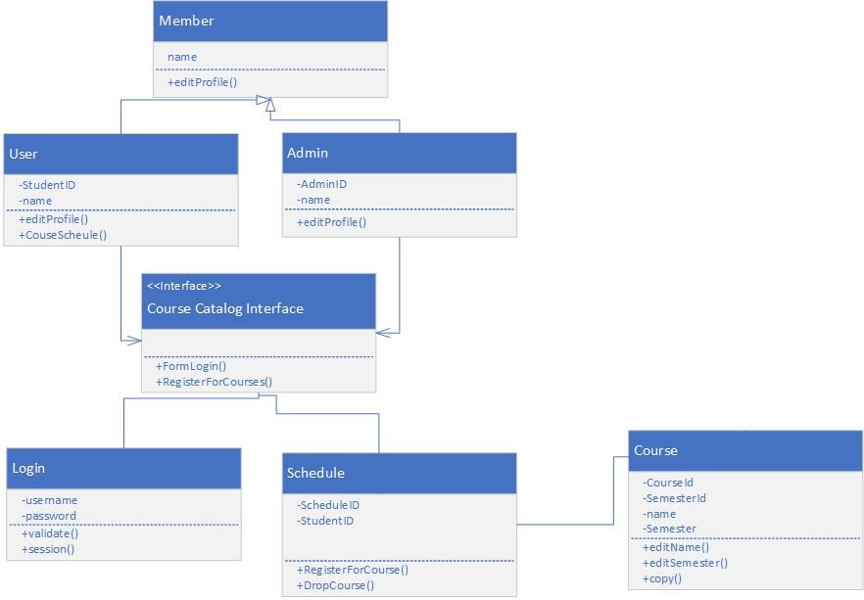
Structural Model

Slide 7
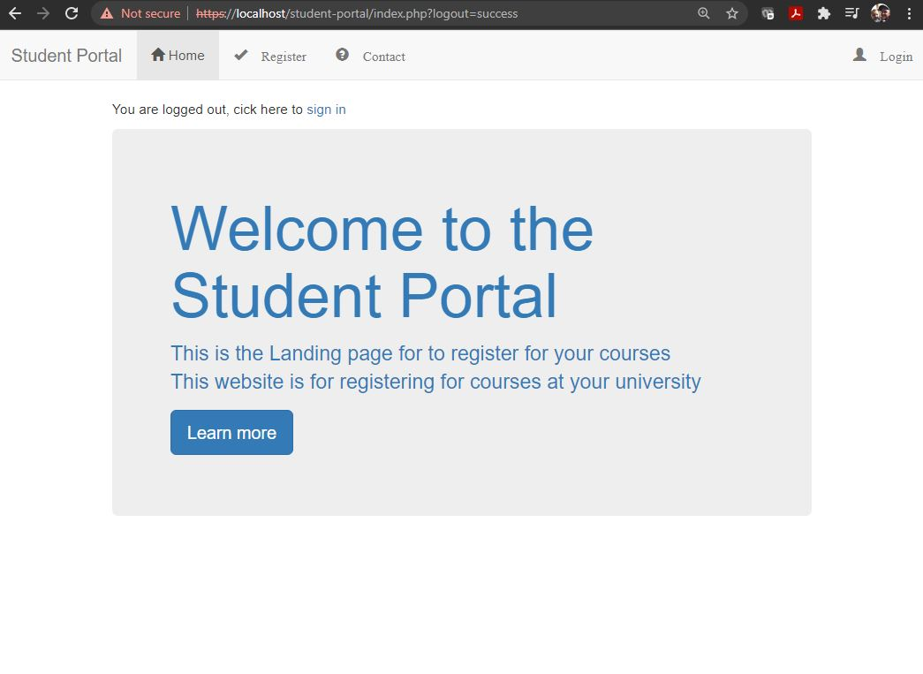
Student Portal Demo
Website created using HTML, bootstrap and PHP
Hosted Using XAMPP and MySQL

Slide 8
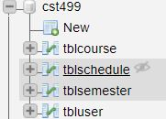
MySQL Database
Database for this registration website is built with four tables: tbluser, tblcourse, tblschulde and tblsemester.
Respectively they keep track of user, course, schedule and semester data.

Slide 9
GitHub Repo
https://github.com/aberg08/CST499_Student_Portal

Slide 10
References
American Society for Quality. (2021). What is Software Quality? ASQ. https://asq.org/quality-resources/software-quality.
Coronel, C., & Morris, S. (2019). Database systems: Design, implementation, and management (13th ed.). Retrieved from https://www.vitalsource.com
Pressman, R. S. (1992). Software engineering: A practitioner's approach (8th ed.). Nueva York: McGrawHill.
Sommerville, I. (2018). Software Engineering. Hallbergmoos/Germany: Pearson.
Spillner, A., & Linz, T. (2021). Software Testing Foundations, 4th Edition: A Study Guide for the Certified Tester Exam (5th ed.)
VMWare. (2021). Apache Friends. Apache Friends RSS. Retrieved November 1, 2021, from https://www.apachefriends.org/index.html.

