Slide 1
Set Up GitHub
Sign up, new repository, init, push, and clone

Slide 2
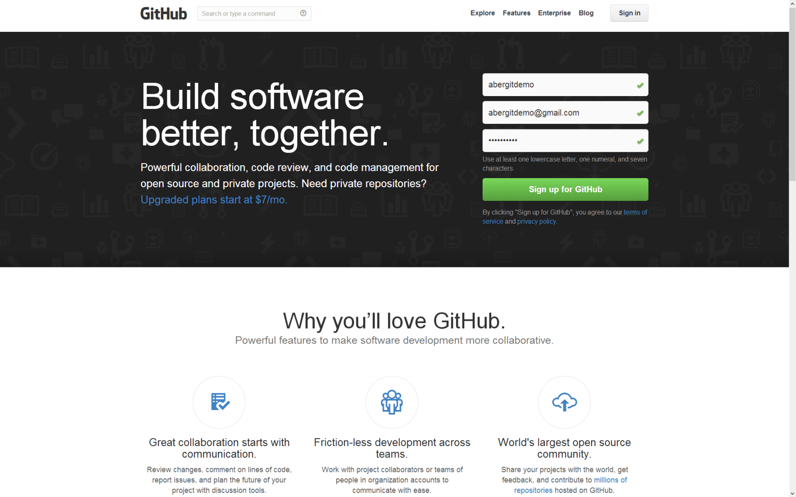
Sign Up (https://github.com/)

Slide 3
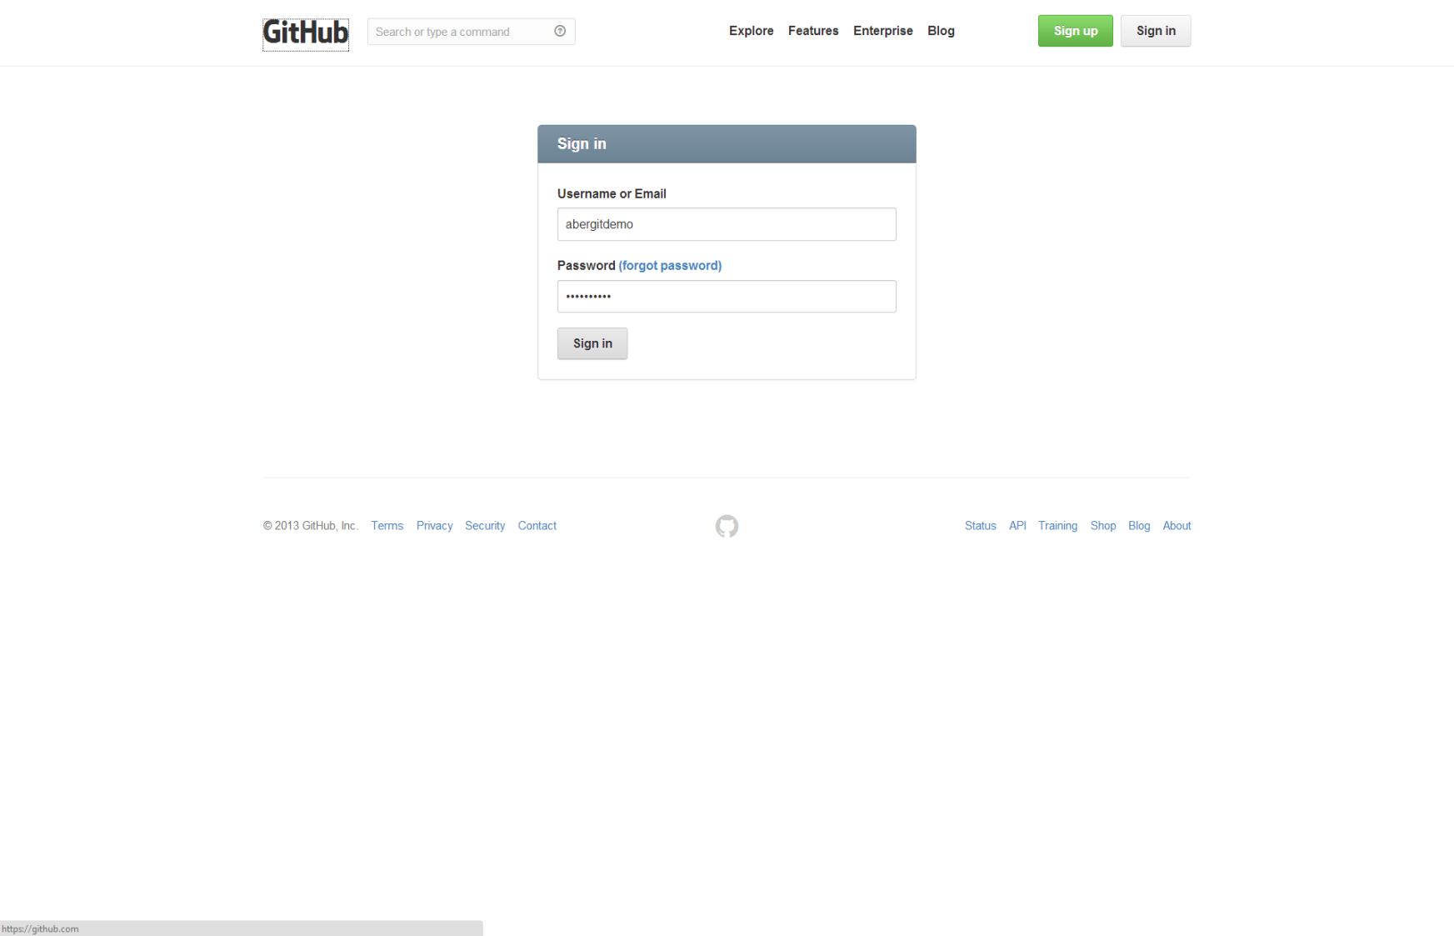
Sign In (https://github.com/login)

Slide 4
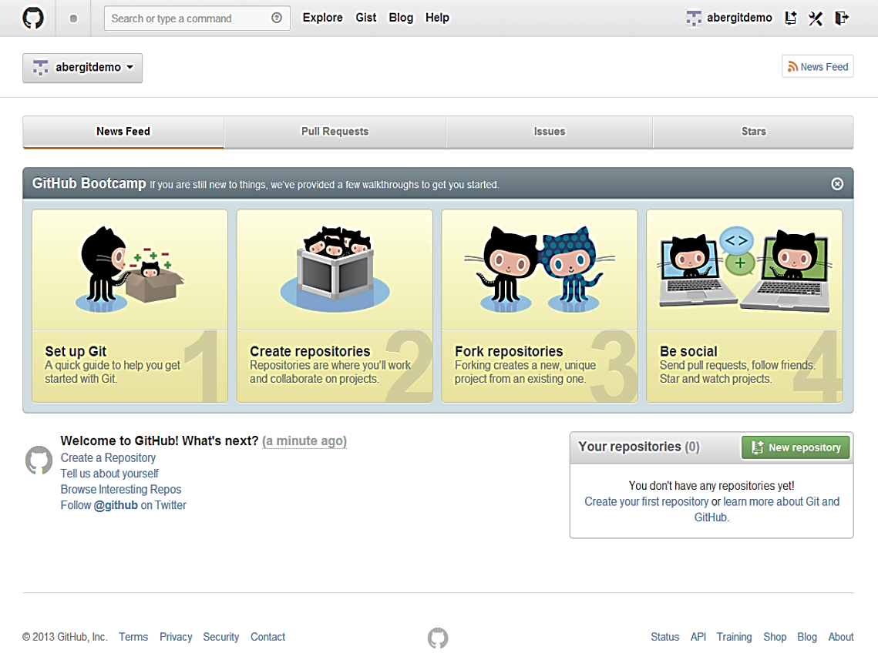
New Empty Repository (https://github.com/new)

Slide 5
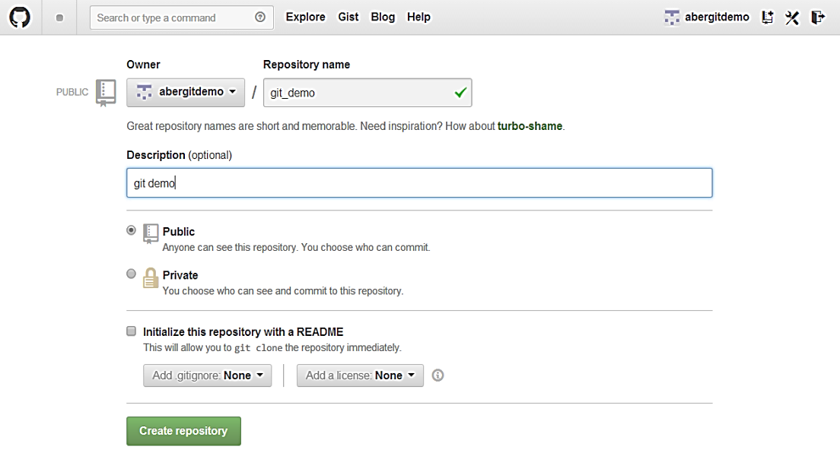
New Empty Repository (https://github.com/new)

Slide 6
Link and Push to Remote Repository (git push)
$ mkdir git_demo
$ cd git_demo
$ echo new file >> newfile
$ echo another new file >> newfiletwo
$ git init
Initialized empty Git repository in c:/Users/rrd09/Documents/git_demo/.git/
$ git add .
$ git status
# On branch master
# Initial commit
# Changes to be committed:
# new file: newfile
# new file: newfiletwo
$ git commit -m 'initial commit'
[master (root-commit) 10c29dd] initial commit
2 files changed, 2 insertions(+)
create mode 100644 newfile
create mode 100644 newfiletwo
$ git remote add origin https://github.com/abergitdemo/git_demo.git
$ git push -u origin master
Username for 'https://github.com': abergitdemo
Password for 'https://abergitdemo@github.com':
Counting objects: 4, done.
Delta compression using up to 4 threads.
Compressing objects: 100% (2/2), done.
Writing objects: 100% (4/4), 270 bytes | 0 bytes/s, done.
Total 4 (delta 0), reused 0 (delta 0)
To https://github.com/abergitdemo/git_demo.git
* [new branch] master -> master
Branch master set up to track remote branch master from origin. $ git status
# On branch master
nothing to commit, working directory clean

Slide 7
Key Git Commands
git init
Initialise an empty Git repository
git add <file>
Take a snapshot of (‘stage’) a file to be committed
git commit –m <message>
Commit the ‘staged’ changes. You must provide a commit message!

Slide 8
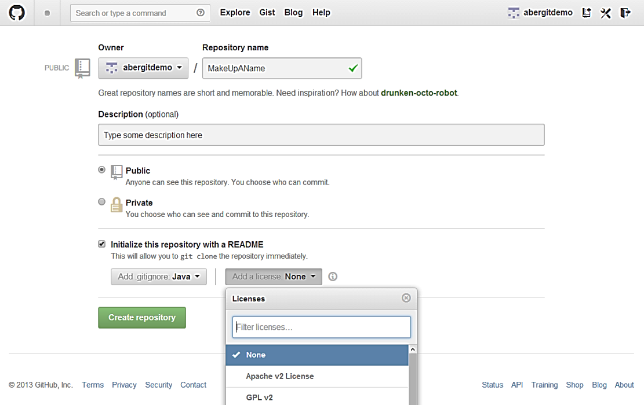
Alternatively ... Initialise Repository with a README and/or .gitignore

Slide 9
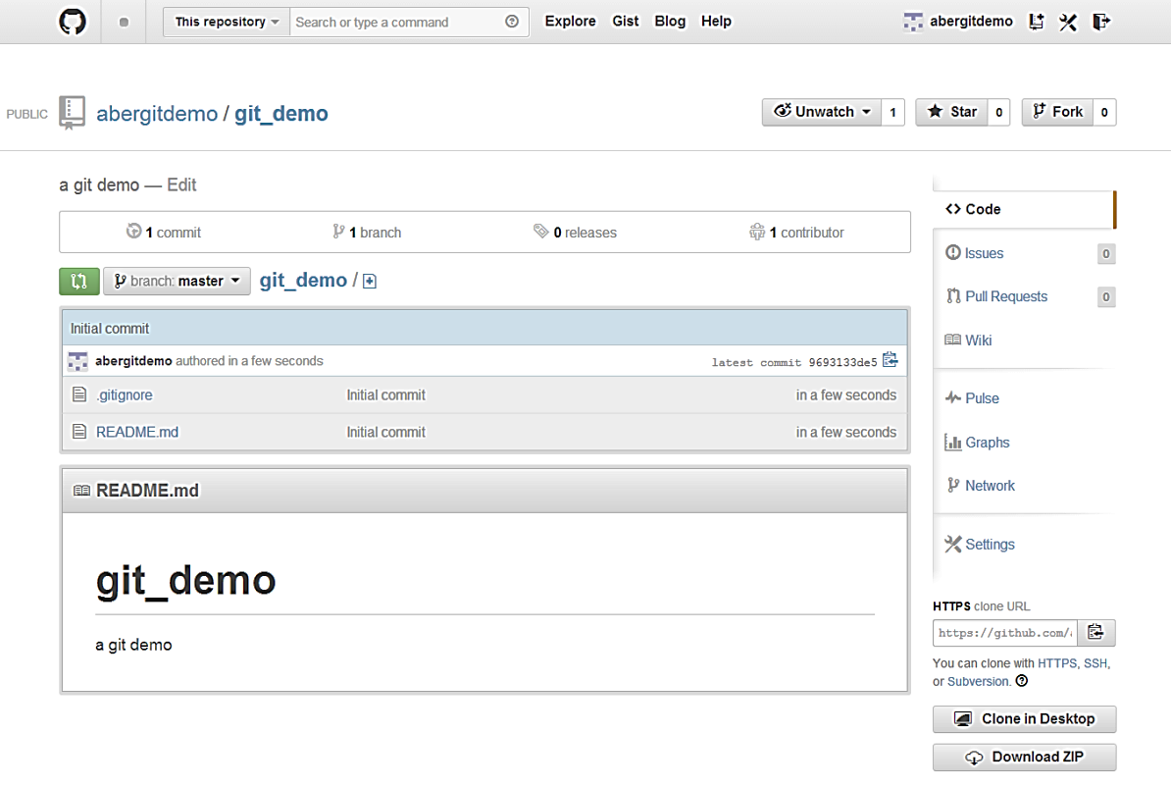
Initialised Repository

Slide 10
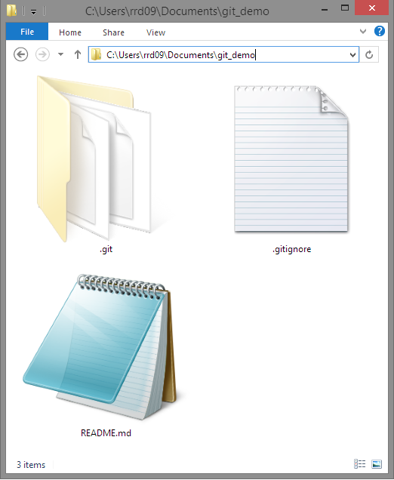
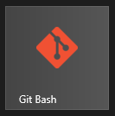
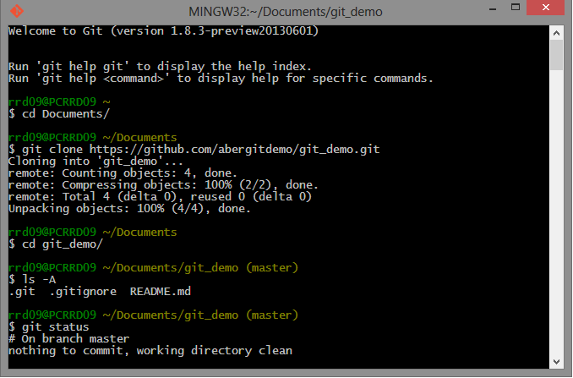
Clone from Remote Repository (git clone)

Slide 11
Further Reading
http://git-scm.com/book/en/Git-Basics-Getting-a-Git-Repository
https://www.atlassian.com/git/tutorial/git-basics
http://gitimmersion.com/lab_03.html

