Slide 1
Source Management using Git and GitHub
A walk through

Slide 2
Overview
Git Install
GitHub Sign Up

Slide 3

Git Install (In Progress)

Slide 4

GitHub Sign Up
https://github.com/

Slide 5
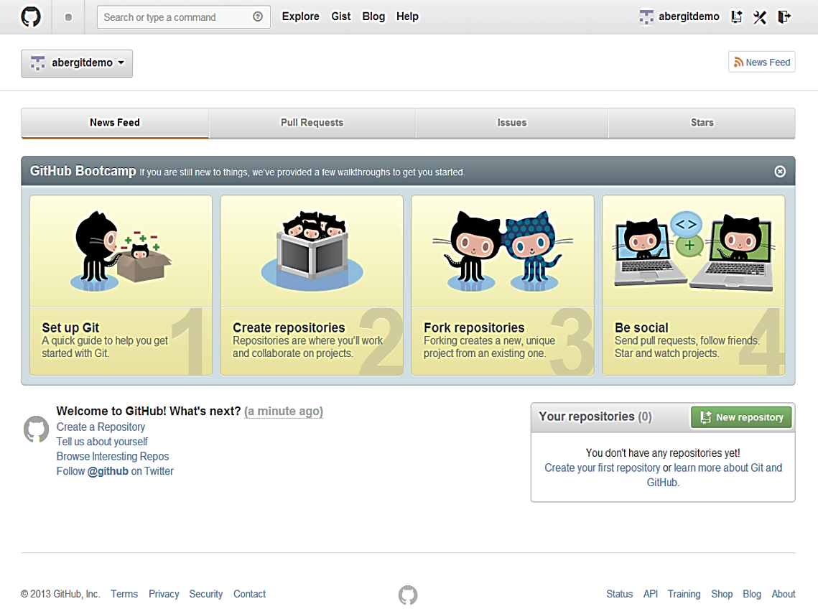
New Empty Repository

Slide 6
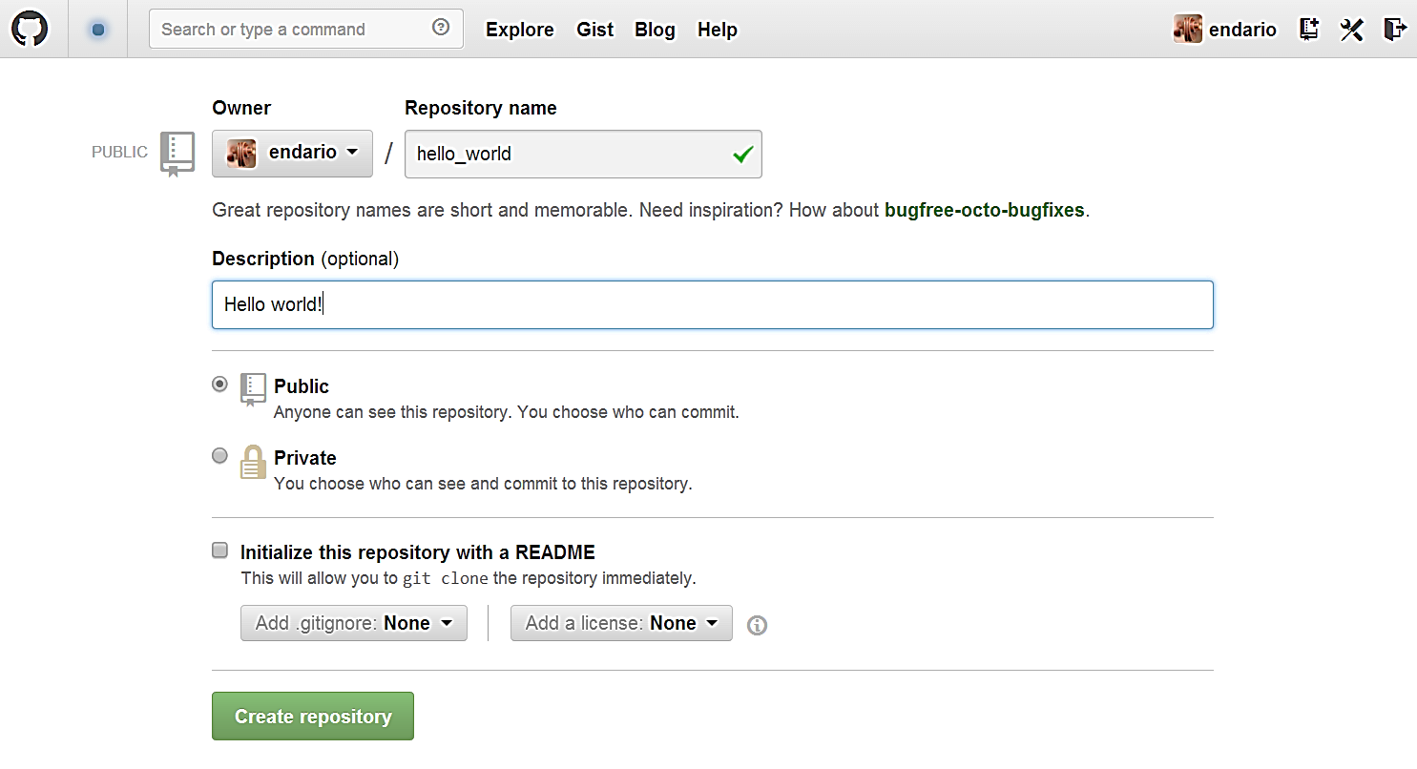
Configure New Repository

Slide 7
Link and Push to Remote Origin
$ mkdir hello_world
$ cd hello_world
$ git init
Initialized empty Git repository in c:/Users/rrd09/Documents/hello_world/.git/
$ mkdir src lib
$ touch src/Main.java
$ mv ../commons-math-2.1.jar lib/
$ git add .
$ git status
# On branch master
# Initial commit
# Changes to be committed:
# new file: lib/commons-math-2.1.jar
# new file: src/Main.java $ git commit -m 'initial commit'
[master (root-commit) 56b4a6d] initial commit
2 files changed, 0 insertions(+), 0 deletions(-)
create mode 100644 lib/commons-math-2.1.jar
create mode 100644 src/Main.java
$ git remote add origin https://github.com/endario/hello_world.git
$ git push -u origin master
Username for 'https://github.com': endario
Password for 'https://endario@github.com':
Counting objects: 6, done.
Delta compression using up to 4 threads.
Compressing objects: 100% (3/3), done.
Writing objects: 100% (6/6), 725.22 KiB | 0 bytes/s, done.
Total 6 (delta 0), reused 0 (delta 0)
To https://github.com/endario/hello_world.git
* [new branch] master -> master
Branch master set up to track remote branch master from origin.
rrd09@PCRRD09 ~/Documents/hello_world (master) $ git status
# On branch master
nothing to commit, working directory clean

Slide 8
Track and Un-Track Files
Write some code, add and commit changes
$ git add .
$ git commit -m 'Hello World print using Alphabet class'
[master 34f0cfa] Hello World print using Alphabet class
13 files changed, 455 insertions(+)
create mode 100644 .idea/.name
...
create mode 100644 .idea/workspace.xml
create mode 100644 hello_world.iml
create mode 100644 out/production/hello_world/Alphabet.class
create mode 100644 out/production/hello_world/Main.class
create mode 100644 src/Alphabet.java
Oops, added unnecessary files.
$ git rm –r –cached .idea/ out/ hello_world.iml
$ git status
# On branch master
# Your branch is ahead of 'origin/master' by 1 commit.
# Changes to be committed:
# deleted: .idea/.name
# ...
# deleted: .idea/workspace.xml
# deleted: hello_world.iml
# deleted: out/production/hello_world/Alphabet.class
# deleted: out/production/hello_world/Main.class
# Untracked files:
# .idea/
# hello_world.iml
# out/

Slide 9
Ignore Files
Edit .gitignore
.idea/
out/
*.iml
Commit again
$ git add .
$ git commit -m 'removed compile and IDE files, added gitignore'
[master 5248588] removed compile and IDE files, added gitignore
12 files changed, 3 insertions(+), 412 deletions(-)
create mode 100644 .gitignore
delete mode 100644 .idea/.name
...
delete mode 100644 .idea/workspace.xml
delete mode 100644 hello_world.iml
delete mode 100644 out/production/hello_world/Alphabet.class
delete mode 100644 out/production/hello_world/Main.class

Slide 10
Ignore Files
Edit .gitignore
.idea/
out/
*.iml
Commit again
$ git add .
$ git commit -m 'removed compile and IDE files, added gitignore'
[master 5248588] removed compile and IDE files, added gitignore
12 files changed, 3 insertions(+), 412 deletions(-)
create mode 100644 .gitignore
delete mode 100644 .idea/.name
...
delete mode 100644 .idea/workspace.xml
delete mode 100644 hello_world.iml
delete mode 100644 out/production/hello_world/Alphabet.class
delete mode 100644 out/production/hello_world/Main.class

Slide 11
Branching and Merging
New branch
$ git checkout -b 'hellogithub'
M src/Main.java
Switched to a new branch 'hellogithub'
Commit changes
$ git add .
$ git commit -m 'hello to GitHub instead'
[hellogithub 9d54dd0] hello to GitHub instead
1 file changed, 6 insertions(+), 6 deletions(-)
$ git branch -v
* hellogithub 9d54dd0 hello to GitHub instead
master 5248588 [ahead 2] removed compile and IDE files, added gitignore
Fast-forward merge
$ git checkout master
Switched to branch 'master'
Your branch is ahead of 'origin/master' by 2 commits.
(use "git push" to publish your local commits)
$ git merge hellogithub
Updating 5248588..9d54dd0
Fast-forward
src/Main.java | 12 ++++++------
1 file changed, 6 insertions(+), 6 deletions(-)

Slide 12
Branching and Merging, Again
New branch
$ git checkout -b 'hellogithub'
M src/Main.java
Switched to a new branch 'hellogithub'
Commit changes
$ git add .
$ git commit -m 'hello to GitHub instead'
[hellogithub 9d54dd0] hello to GitHub instead
1 file changed, 6 insertions(+), 6 deletions(-)
$ git branch -v
* hellogithub 9d54dd0 hello to GitHub instead
master 5248588 [ahead 2] removed compile and IDE files, added gitignore
Fast-forward merge
$ git checkout master
Switched to branch 'master'
Your branch is ahead of 'origin/master' by 2 commits.
(use "git push" to publish your local commits)
$ git merge hellogithub
Updating 5248588..9d54dd0
Fast-forward
src/Main.java | 12 ++++++------
1 file changed, 6 insertions(+), 6 deletions(-)

Slide 13
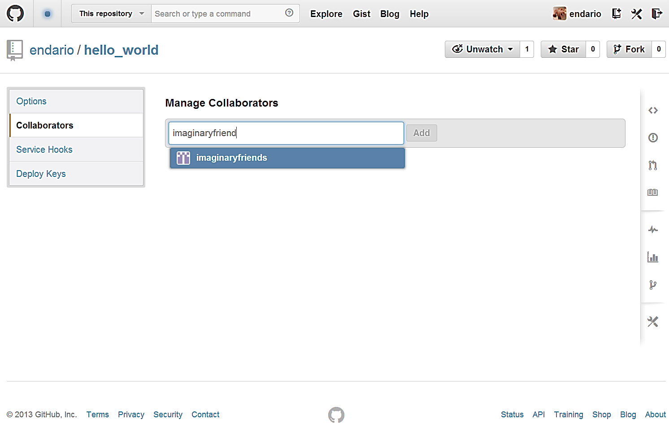
Collaborate!

