Slide 1
GitHub Features
Issues, milestones, fork, and pull requests

Slide 2
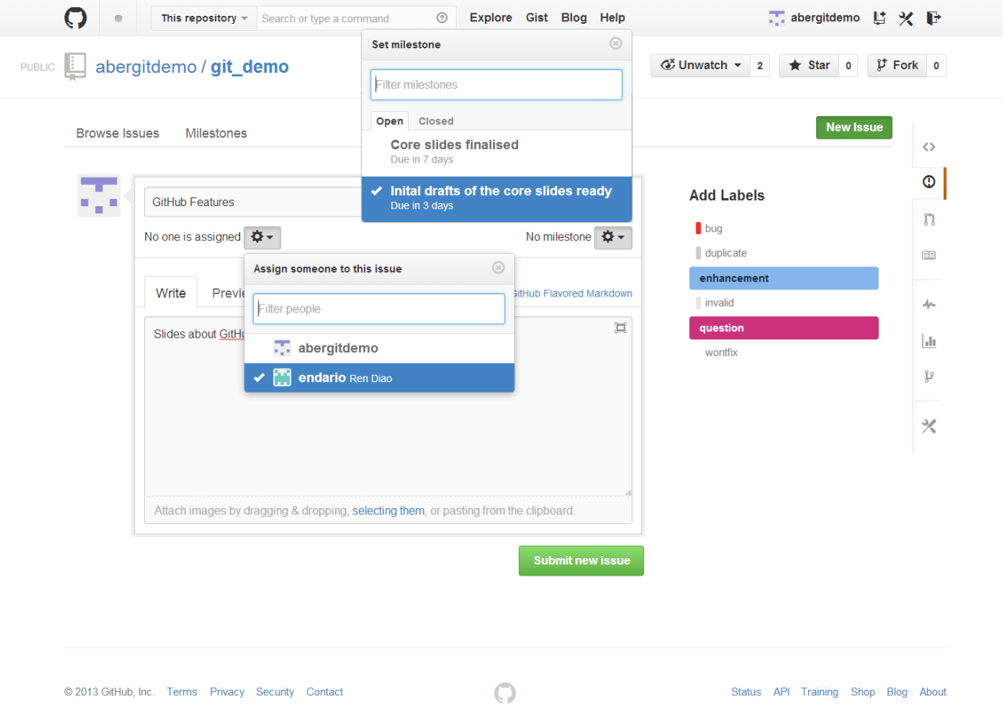
Open a New Issues
Notes:
Points to be made:
assign people
assign milestone (more later)
add labels (customisable)
people get email notifications so long being related to a given issue or @mentions.
you can mute the notifications

Slide 3
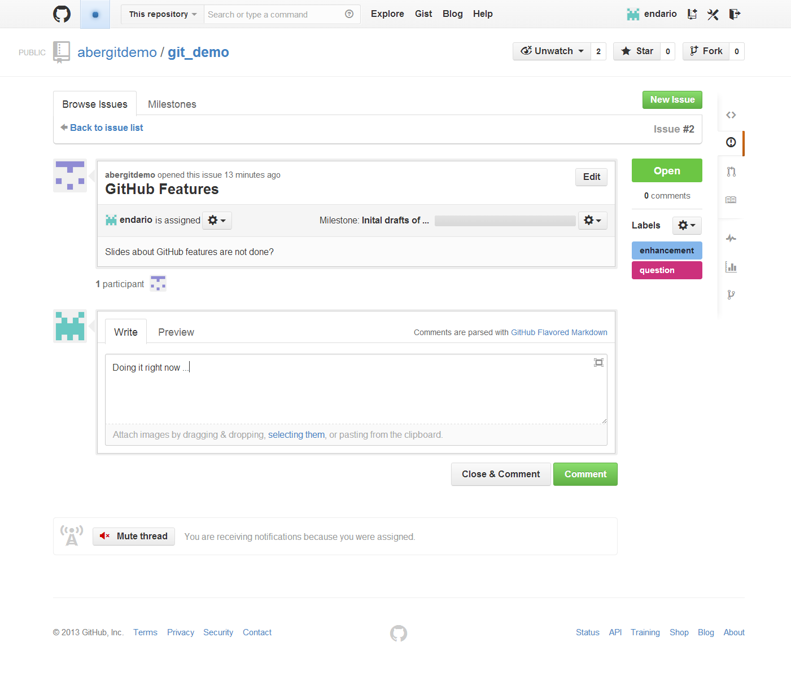
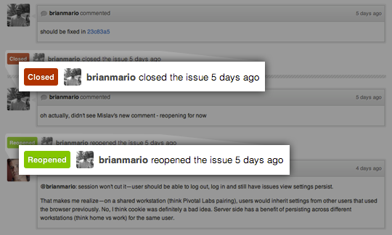
Closing & Re-Opening an Issue

Slide 4
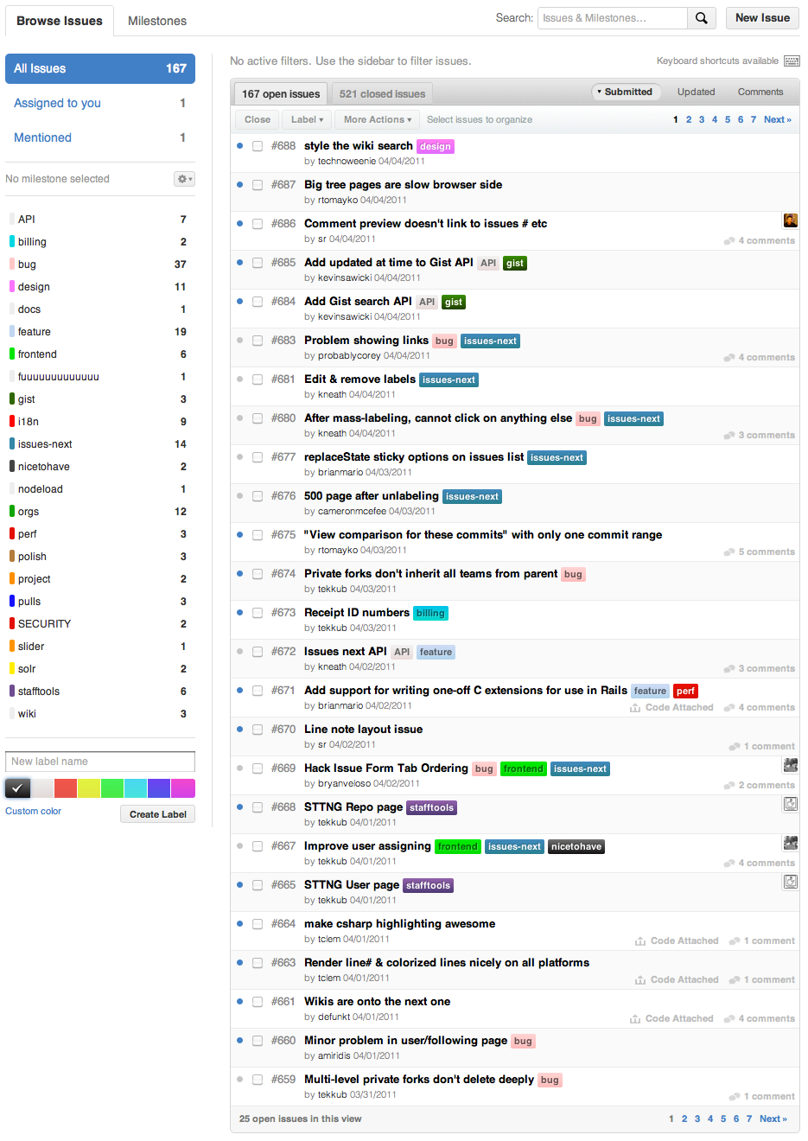
Navigating Issues

Slide 5
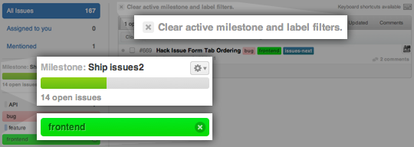
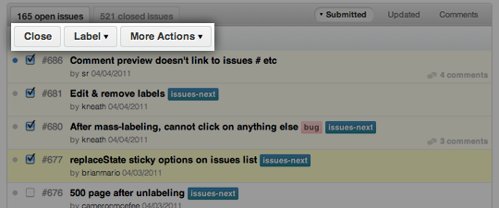
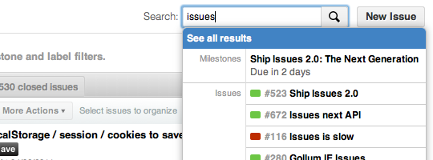
Working with Issues (1)
Filter by labels, milestones, etc.
Mass-editing: close, reopen, add labels, assign to users, etc.
Quick-search as you type, or open full search.

Slide 6
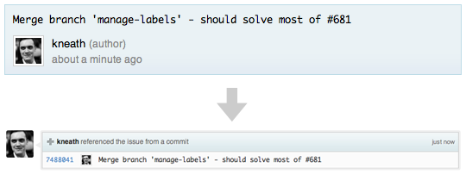
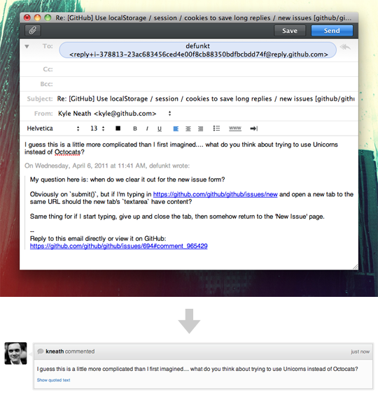
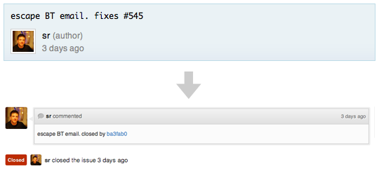
Working with Issues (2)
reference an issue from a commit message
close issue using commit
Reply by email

Slide 7
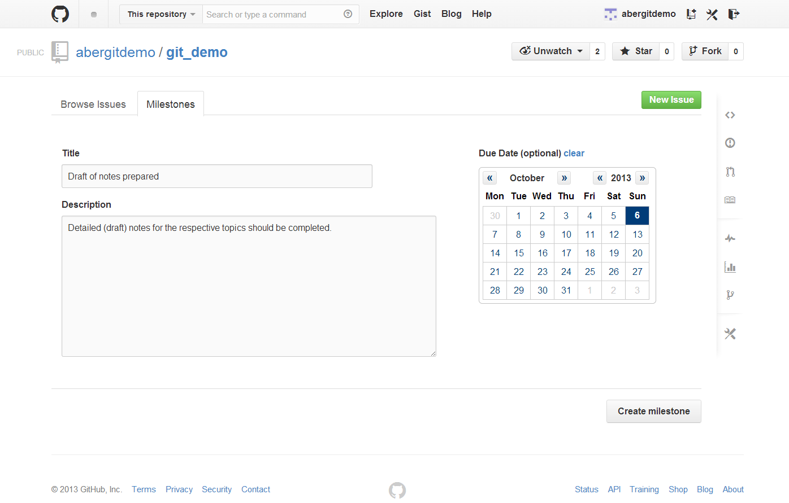
Create a New Milestone

Slide 8
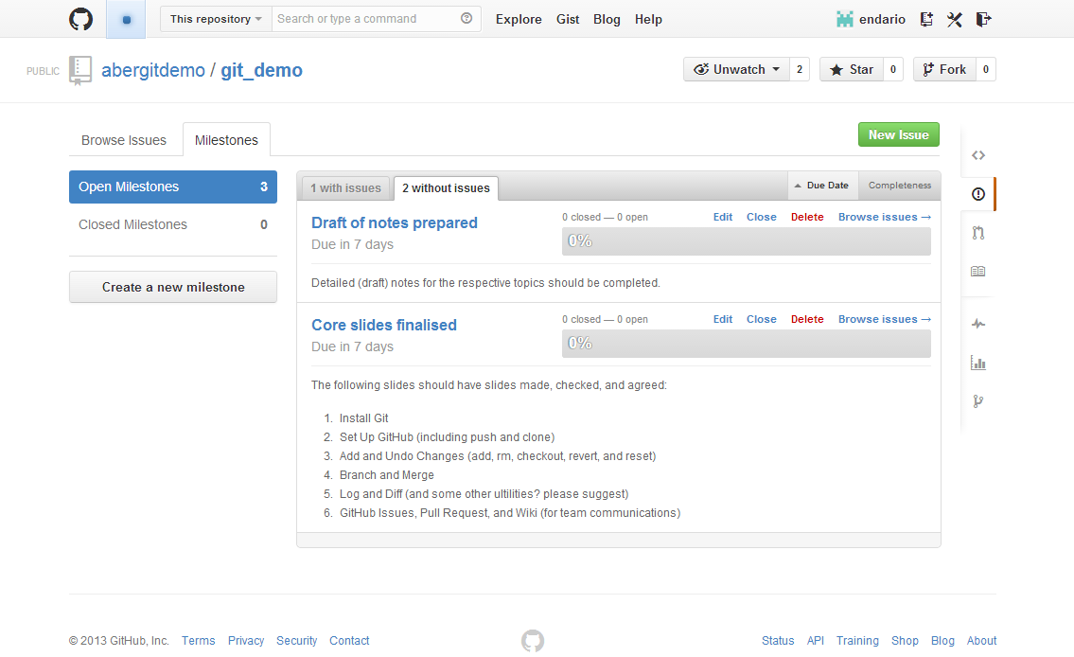
View Milestones

Slide 9
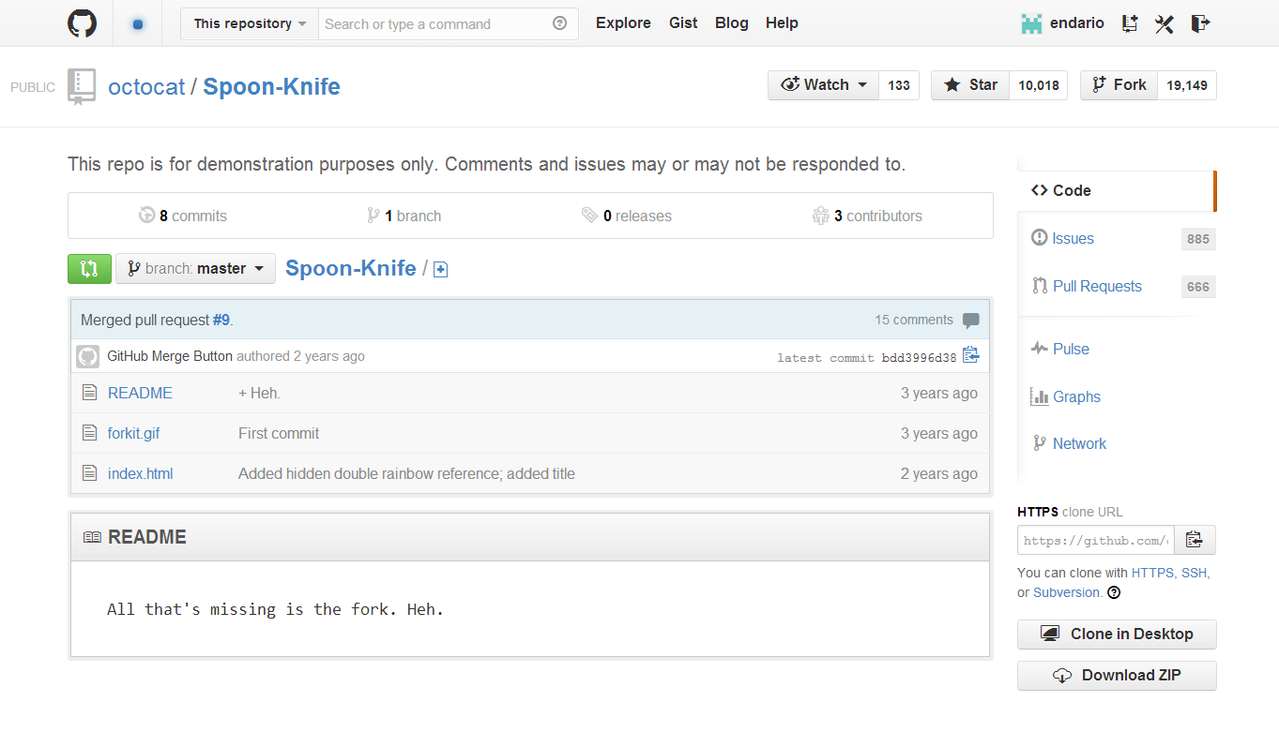
Fork A Repository (1)
Forks are higher level ‘branches’ allowing isolated development on a collaborative project.

Slide 10
Fork A Repository (2)
Clone your fork
Configure remotes
Pull in upstream changes
$ git clone https://github.com/endario/Spoon-Knife.git
Cloning into 'Spoon-Knife'...
remote: Counting objects: 24, done.
remote: Compressing objects: 100% (21/21), done.
remote: Total 24 (delta 7), reused 15 (delta 1)
Unpacking objects: 100% (24/24), done.
$ git remote add upstream https://github.com/octocat/Spoon-Knife.git
$ git fetch upstream
From https://github.com/octocat/Spoon-Knife
* [new branch] master -> upstream/master
$ git fetch upstream
# Fetches any new changes from the original repository
$ git merge upstream/master
# Merges any changes fetched into your working files

Slide 11
Fork A Repository (3)
Create branches
Push your commits
$ git checkout –b colour
Switched to a new branch ‘colour’
$ git commit -a -m 'modified index page with some colour and boldness'
[master d5a7377] modified index page with some colour and boldness
1 file changed, 7 insertions(+), 1 deletion(-)
$ git push origin colour
Username for 'https://github.com': endario
Password for 'https://endario@github.com':
Counting objects: 5, done.
Delta compression using up to 4 threads.
Compressing objects: 100% (3/3), done.
Writing objects: 100% (3/3), 396 bytes | 0 bytes/s, done.
Total 3 (delta 2), reused 0 (delta 0)
To https://github.com/endario/Spoon-Knife.git
bdd3996..d5a7377 colour -> colour

Slide 12
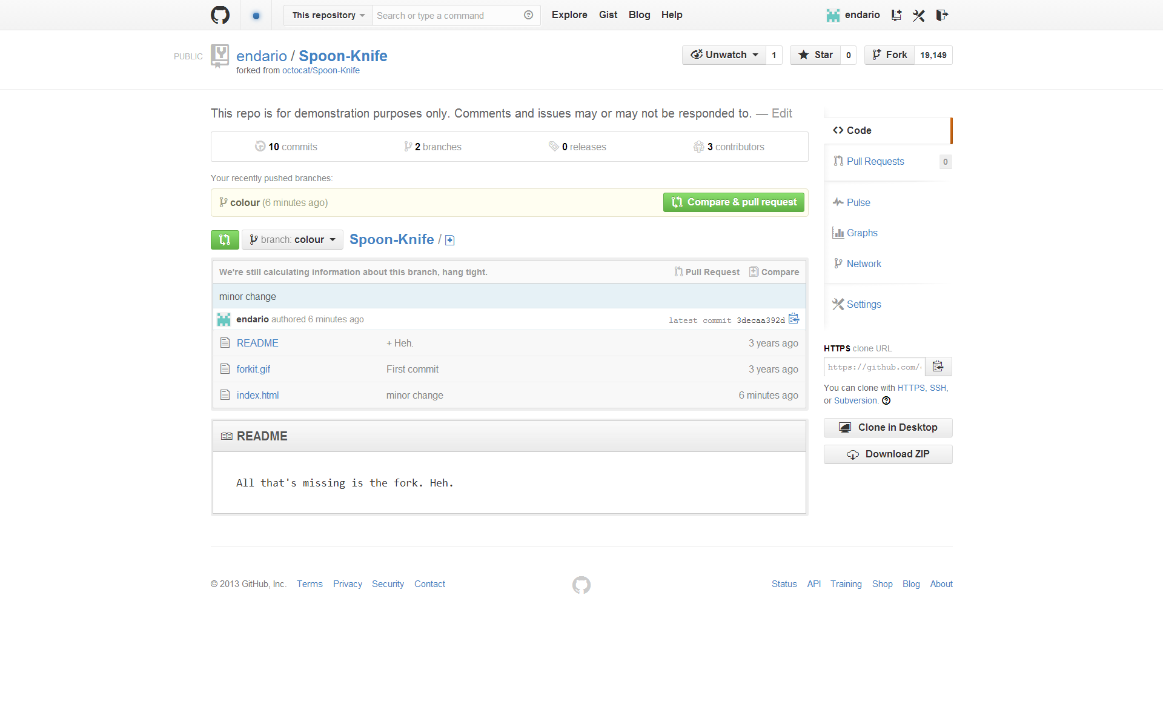
Initiate a Pull Request
Once you’ve made a few commits, you would like someone to review and merge. Navigate to your repository with the changes you want someone else to pull and press the Pull Request button.

Slide 13
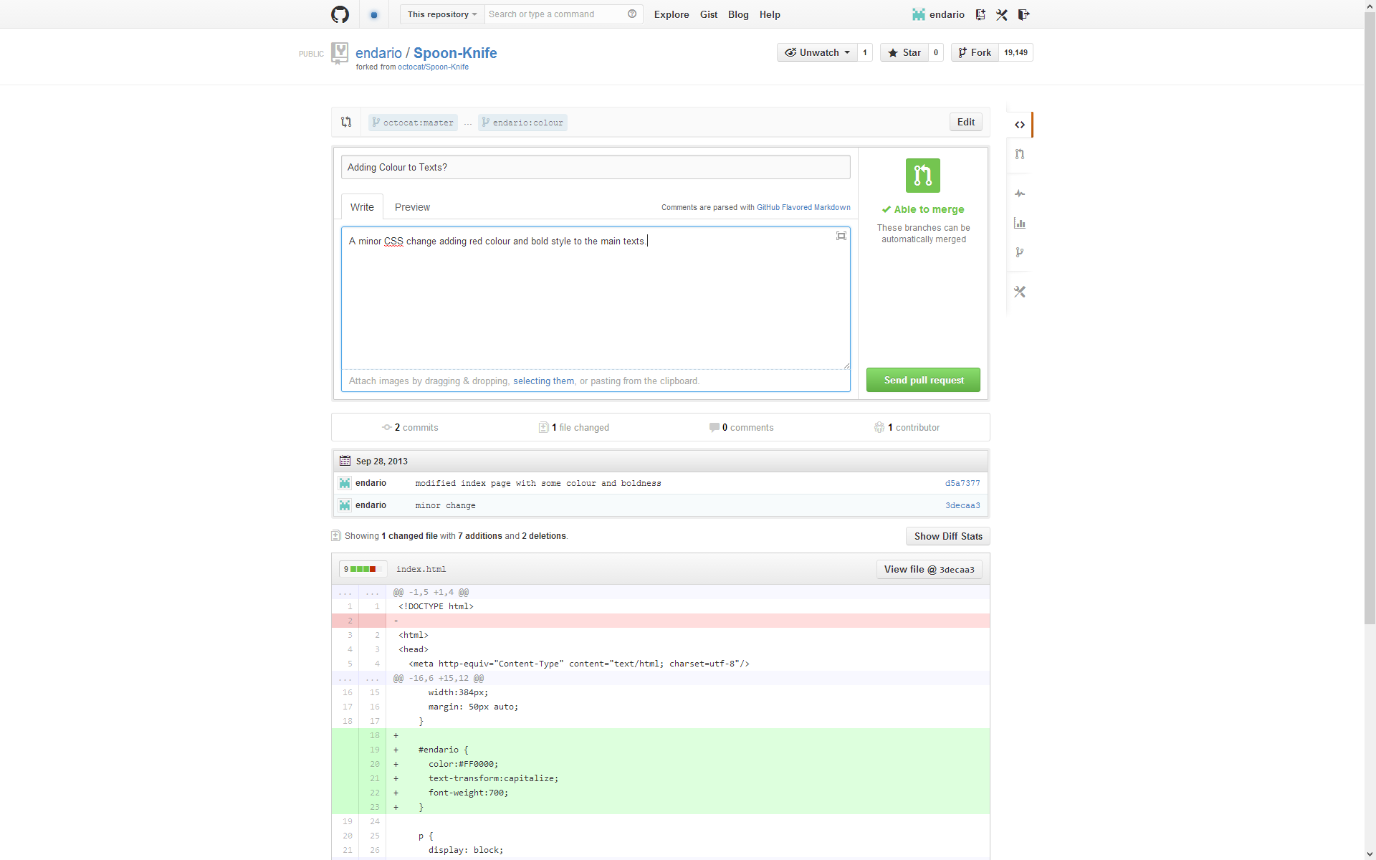
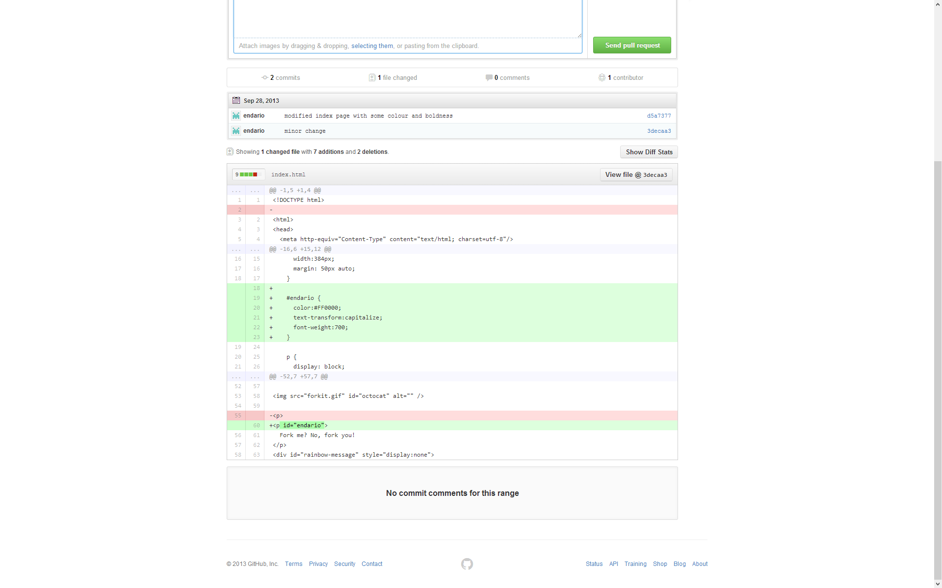
Review a Pull Request
You are then presented with a review page where you can get a high-level overview of what exactly has changed between your branch and the repository's master branch.

Slide 14
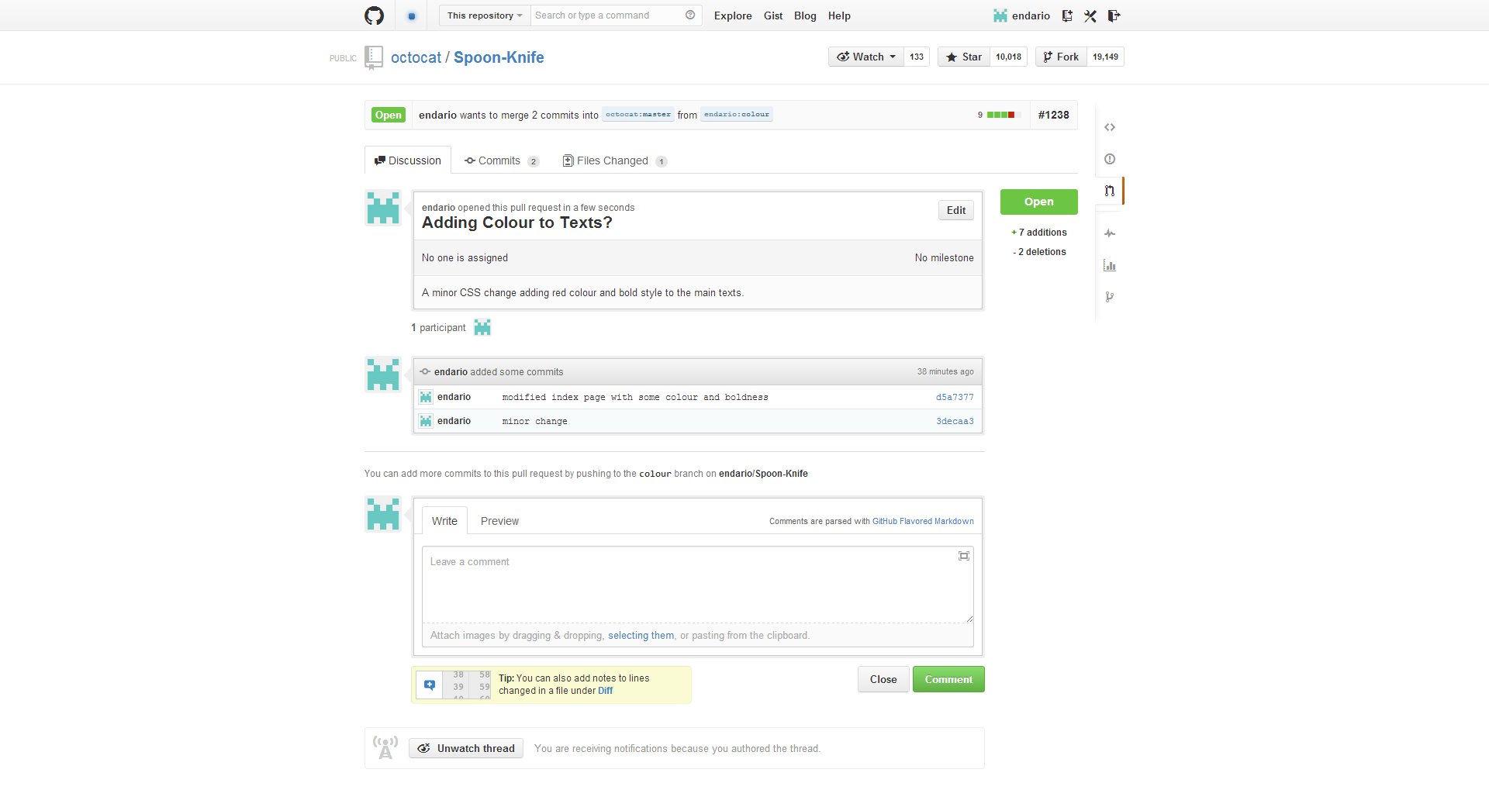
Send a Pull Request
You are then presented with a review page where you can get a high-level overview of what exactly has changed between your branch and the repository's master branch.

Slide 15
Recommended Readings
https://github.com/blog/831-issues-2-0-the-next-generation
https://help.github.com/articles/using-pull-requests
https://help.github.com/articles/fork-a-repo

