Slide 1
Branching and Merging

Slide 2
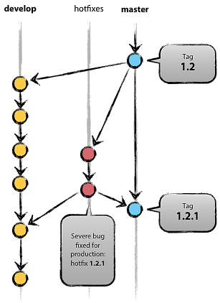
Branching
Diverge from a single line of development
Work without disturbing other lines
Team members may work on sub-components independently

Slide 3
Branching
git branch -v
list the local branches
git branch <branch>
create a new branch
git checkout <branch>
switch to a branch
git branch –d <branch>
delete a branch
$ git branch
* crazy 3b74ddf best feature ever?
master 90cd414 added GUI
stable 3b74ddf feature A included
test 62a557a updated test code
$ git checkout master
Switched to branch 'master'
$ git branch -d crazy
Deleted branch crazy (was 3b74ddf).

Slide 4
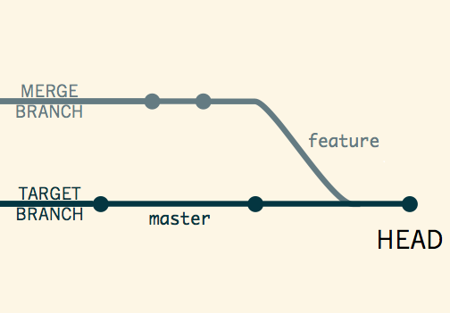
Merging
git merge <branch>
Putting a forked history back together.
Integrate independent lines of development into a single branch.

Slide 5
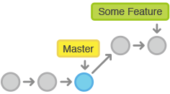
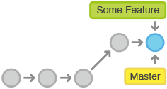
Fast-Forward Merge
Before
After
There’s a linear path from the current branch tip to the target branch.
Git simply moves the current branch tip up to that of the target.
Useful for small features or bug fixes.

Slide 6
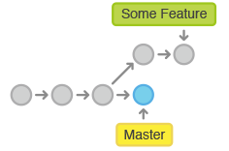
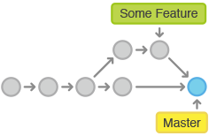
3-Way Merge (1)
Before
After
The branches have diverged, i.e., no linear path to the target branch.
3-way merges use a dedicated commit to tie together the two histories.

Slide 7
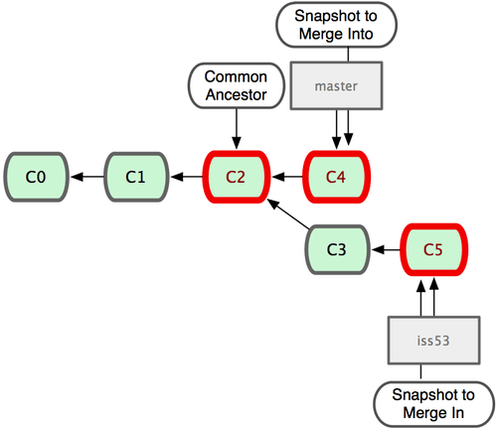
3-Way Merge (2)
Git automatically identifies the best common-ancestor.

Slide 8
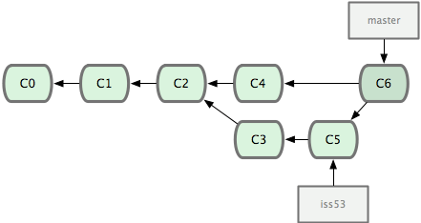
3-Way Merge (3)
A ‘merge commit’ created this way has more than one parent.

Slide 9
Resolving Conflicts
branch master HEAD
unmerged state
This is
the new file
content that is
in the file,
refined as part of the update to master.
This is
<<<<<<< HEAD
the new file
content that is
in the file,
refined as part of the update to master.
=======
the
content of file
after implementing a new feature.
>>>>>>> feature
branch feature
This is
the
content of file
after implementing a new feature.
Resolve the conflicts, and run git add <file> to mark it resolved, then use git status to verify.

Slide 10
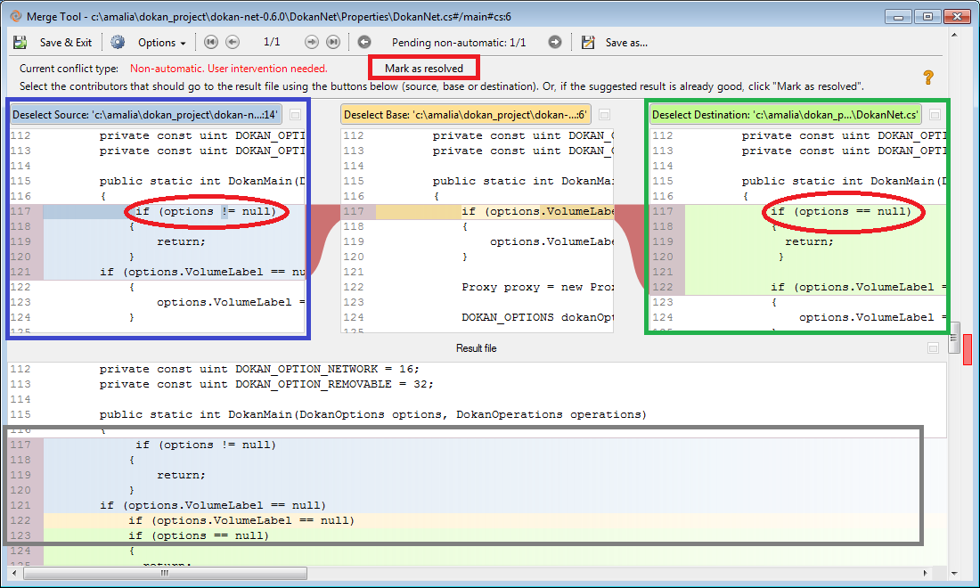
Merge Tools
Various merge tools exist that compare and merge multiple files, and provide graphic views of the conflicts.

Slide 11
Recommended Readings
https://www.atlassian.com/git/tutorial/git-branches
http://nvie.com/posts/a-successful-git-branching-model/
http://git-scm.com/book/en/Git-Branching

