Slide 1
GitHub Features
Issues, milestones, pull requests,
and wiki

Slide 2
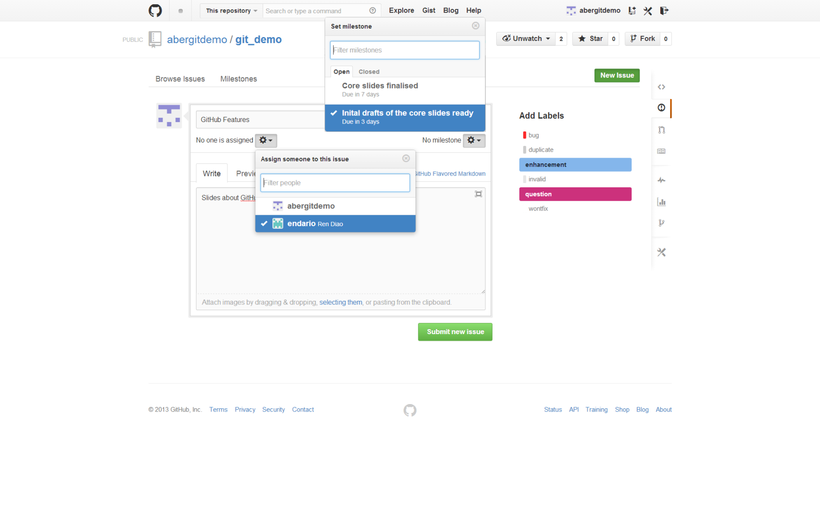
Issues

