Slide 1

EmotionLayer : A Multimodal Architecture for Empathic Voice Assistants
EmotionLayer
A Multimodal Architecture for Empathic Voice Assistants based on Speech Emotion Recognition and Large Language Models
Based on Speech Emotion Recognition and Large Language Models
Alessio Bernardini
Alessio Bernardini
Department of Computer Science, University of Milan, Italy
Department of Computer Science, University of Milan, Italy
alessio.bernardini@studenti.unimi.it
alessio.bernardini@studenti.unimi.it

Slide 2




The Empathic Gap
Vocal Agent Pipeline
The Current Paradigm: Traditional voice systems (ASR → LLM → TTS) and newer Speech-to-Speech (STS) models process speech mainly as text, ignoring its prosodic and emotional components.
ASR
SPEECH-TO-TEXT
The Missing Link: Valuable paralinguistic information such as tone, rhythm, hesitations, and intensity is completely lost during transcription.
The consequence: The system “hears” the words but fails to “listen” to the emotional state.
LLM
Real Impact: In contexts where understanding the customer’s emotional state is essential, such as customer support, the lack of proper prosodic context leads to standardized, tone-deaf responses, which can cause frustration and dissatisfaction.
TEXT-TO-SPEECH
TTS

Slide 3


Questions & Contributions
Research Questions (RQs)
Key Contributions
RQ1: How effectively can LLMs detect and respond to complex emotions using multimodal input (text + emotional & audio context)?
Italian SER Models: Fine-tuning of Wav2Vec 2.0 for discrete emotion classification and continuous PAD regression.
RQ2: Which LLM architectures offer optimal trade-offs between emotional intelligence, latency, and cost for production?
EmotionLayer Architecture: Fuses text and prosody into a JSON payload ready for downstream LLMs.
Systematic Benchmark: Evaluated 18 LLMs on 40 gold-standard scenarios via LLM-as-a-Judge to detect the correct user emotion and take the right decision.

Slide 4
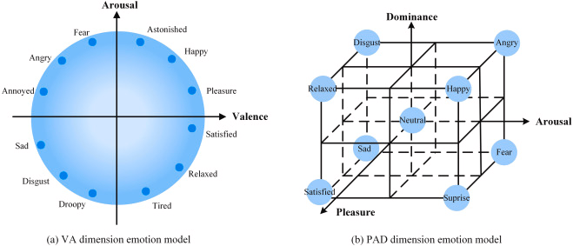
Background Emotional Models
Ekman's Categorical Model
PAD Dimensional Model
Identifies 6 basic emotions:
anger, disgust, fear, joy, sadness, and surprise
Valence (V): Negative (-1) ↔ Positive (+1)
Arousal (A): Calm (-1) ↔ Excited (+1)
Dominance (D): Submissive (-1) ↔ Dominant (+1)

Slide 5








State of the Art
Architectures
Italian Datasets
Empathic Benchmarks
Wav2Vec 2.0 represents the state-of-the-art for self-supervised representations of the speech signal, utilizing advanced Transformer-based architectures.
Resources are limited. We utilize:
EMOVO (professional actors), Emozionalmente (crowdsourced, 6,902 samples)
AI4SER (the only Italian dataset with native PAD annotations).
Frameworks like EQ-Bench and EmotionQueen evaluate emotional intelligence, empathy generation, and the comprehension of complex dynamics in LLMs.

Slide 6
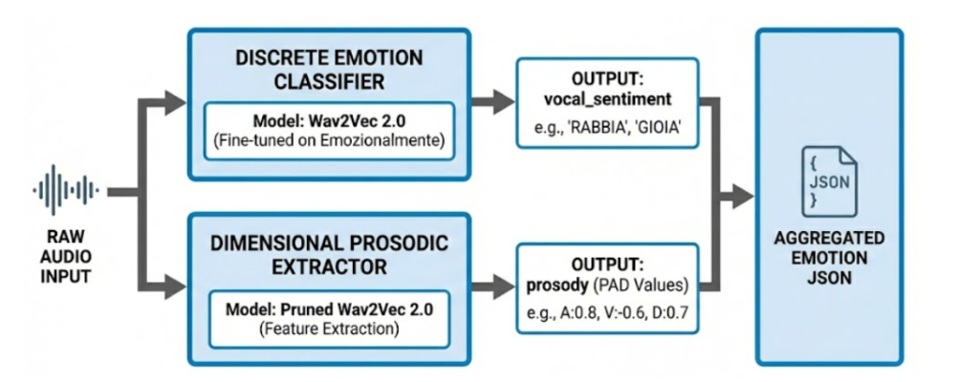
System Architecture
Parallel Audio Processing: The system analyzes raw audio streams simultaneously to extract distinct emotional vectors.
1. Discrete Emotion Classifier
2. PAD Prosodic Regressor
Fine-tuned Wav2Vec 2.0 outputs a categorical label (e.g., "Anger: 96%") across 7 primary emotion classes.
Pruned Wav2Vec 2.0 outputs continuous dimensional values (e.g., Arousal: 0.95, Valence: 0.05, Dominance: 0.90).

Slide 7




Emotion Taxonomy
Emotion | Status | Valence | Arousal | Dominance | Composition
Enthusiasm |  | >0.6 | >0.6 | ≈0.5 | Joy + Surprise
Satisfaction |  | >0.6 | ≈0.5 | ≈0.5 | Joy + Good Text
Uncertainty |  | <0.5 | ≈0.5 | <0.5 | Fear + Surprise
Frustration |  | <0.4 | >0.6 | <0.5 | Anger + Sadness
Sarcasm |  | ≈0.5 | ≈0.5 | ≈0.5 | Discrepancy: Text vs Audio
Urgency |  | <0.4 | >0.8 | <0.5 | Fear + Anger
Insecurity |  | <0.4 | <0.4 | <0.3 | Fear + Sadness

Slide 8
Strategy Taxonomy
Target Strategy | Emotion Target | Speed | Tone | Pitch
Rapid Resolution | Urgency | 1.25x | Professional | default
Assertive Neutrality | Sarcasm | 1.00x | Professional | low
Active De-escalation | Anger, Frustration, Disgust | 0.80x | Apologetic | low
Empathic Validation | Uncertainty, Insecurity, Sadness | 0.85x | Empathetic | low
Positive Mirroring | Enthusiasm, Satisfaction, Joy | 1.10x | Cheerful | high
Direct Efficiency | Neutral | 1.00 | Informative | balance

Slide 9
Evaluation Framework
Model | Provider
Gpt-5-mini | OpenAI
Gpt-5.2 | OpenAI
Gpt-4.1-mini | OpenAI
Gpt-4.1 | OpenAI
Qwen2.5-7B | HuggingFace
Qwen2.5-72B | HuggingFace
Mistral-7B | HuggingFace
Gpt-oss-120b | Groq
Gpt-oss-20b | Groq
LLama-3.1-8b | Groq
LLama-3.3-70b | Groq
Qwen3-32b | Groq
Claude-sonnet-4-5 | Anthropic
Claude-haiku-4-5 | Anthropic
Claude-opus-4-5 | Anthropic
Gemini-2.5-flash | Google
Gemini-2.5-pro | Google
Gemini-2.5-flash-lite | Google
We evaluated 18 candidate LLMs over 40 gold-standard scenarios using an automated LLM-as-a-Judge methodology (by Claude Opus 4.6).
Binary Metrics (40% Weight)
Emotion Match (0/1): Correctly identifying the emotion from multimodal JSON.
Strategy Match (0/1): Selecting the appropriate strategy.
Continuous Metrics (60% Weight, Scale 1-5)
Relevance: Technical accuracy of the response.
TTS Alignment: Consistency of TTS parameters (speed/pitch).
Voice Suitability: Conciseness and conversational naturalness.
Empathic Response: Overall quality of empathy expressed.

Slide 10
Model Performance Results
Provider | Models | Score | Latenza (s) | Costo ($)
Gemini | gemini-2.5-flash |  | 4.328 | 0.001000
Gemini | gemini-2.5-pro | 90.50 | 10.617 | 0.003944
OpenAI | gpt-4.1-2025-04-14 | 90.30 | 3.769 | 0.004647
Anthropic | claude-sonnet-4-5 | 89.46 | 8.475 | 0.010305
Anthropic | claude-opus-4-5 | 87.64 | 8.270 | 0.016995
Groq | openai/gpt-oss-120b | 87.10 | 1.594 | 0.000633
Groq | qwen/qwen3-32b | 86.20 | 1.623 | 0.000819
HuggingFace | Qwen2.5-72B-Instruct | 85.60 | 8.927 | 0.000647
Gemini | gemini-2.5-flash-lite | 85.40 | 1.494 | 0.000235
Groq | openai/gpt-oss-20b | 84.00 | 1.041 | 0.000364
OpenAI | gpt-4.1-mini | 82.75 | 3.362 | 0.000909
Groq | llama-3.3-70b-versatile | 82.60 | 0.758 | 0.001051
OpenAI | gpt-5-mini-2025-08-07 | 80.30 | 19.667 | 0.003060
Anthropic | claude-haiku-4-5 | 80.06 | 3.909 | 0.003355
91.70

Slide 11









Model Performance Results
Leadership Gemini
Extreme Speed
Cost Efficiency
Gemini 2.5 Flash-Preview (91.70) and Pro (90.50) dominate in terms of quality, achieving the highest overall scores and even outperforming OpenAI solutions.
The Groq infrastructure remains unrivalled in terms of latency. The llama-3.1-8b-instant model achieves record-breaking minimum response times of just 0.511 seconds.
Gemini 2.5 Flash-Lite stands out for its exceptional value for money: a solid score (85.40) combined with extremely low operating costs ($0.000235).

Slide 12


Conclusions & Future Work
Key Conclusions
Future Work
Bridging the Gap: Solving the "Empathic Gap" in voice assistants is technically viable in production by injecting paralinguistic data pre-LLM.
SER Improvements: Enhance the current Speech Emotion Recognition accuracy (66.81%) by fine-tuning on spontaneous, non-acted speech datasets.
Voice Suitability Matters: LLMs optimized purely for complex reasoning (e.g., GPT-5) often generate overly verbose text that ruins conversational TTS naturalness.
Human Evaluation: Expand the LLM benchmark with multi-rater human evaluations on live interactions.
E2E Systems: Transition towards End-to-End Speech-to-Speech models capable of natively and directly controlling prosodic output parameters.

Slide 13
Thank you for your attention !
Alessio Bernardini
alessio.bernardini@studenti.unimi.it

