Slide 1
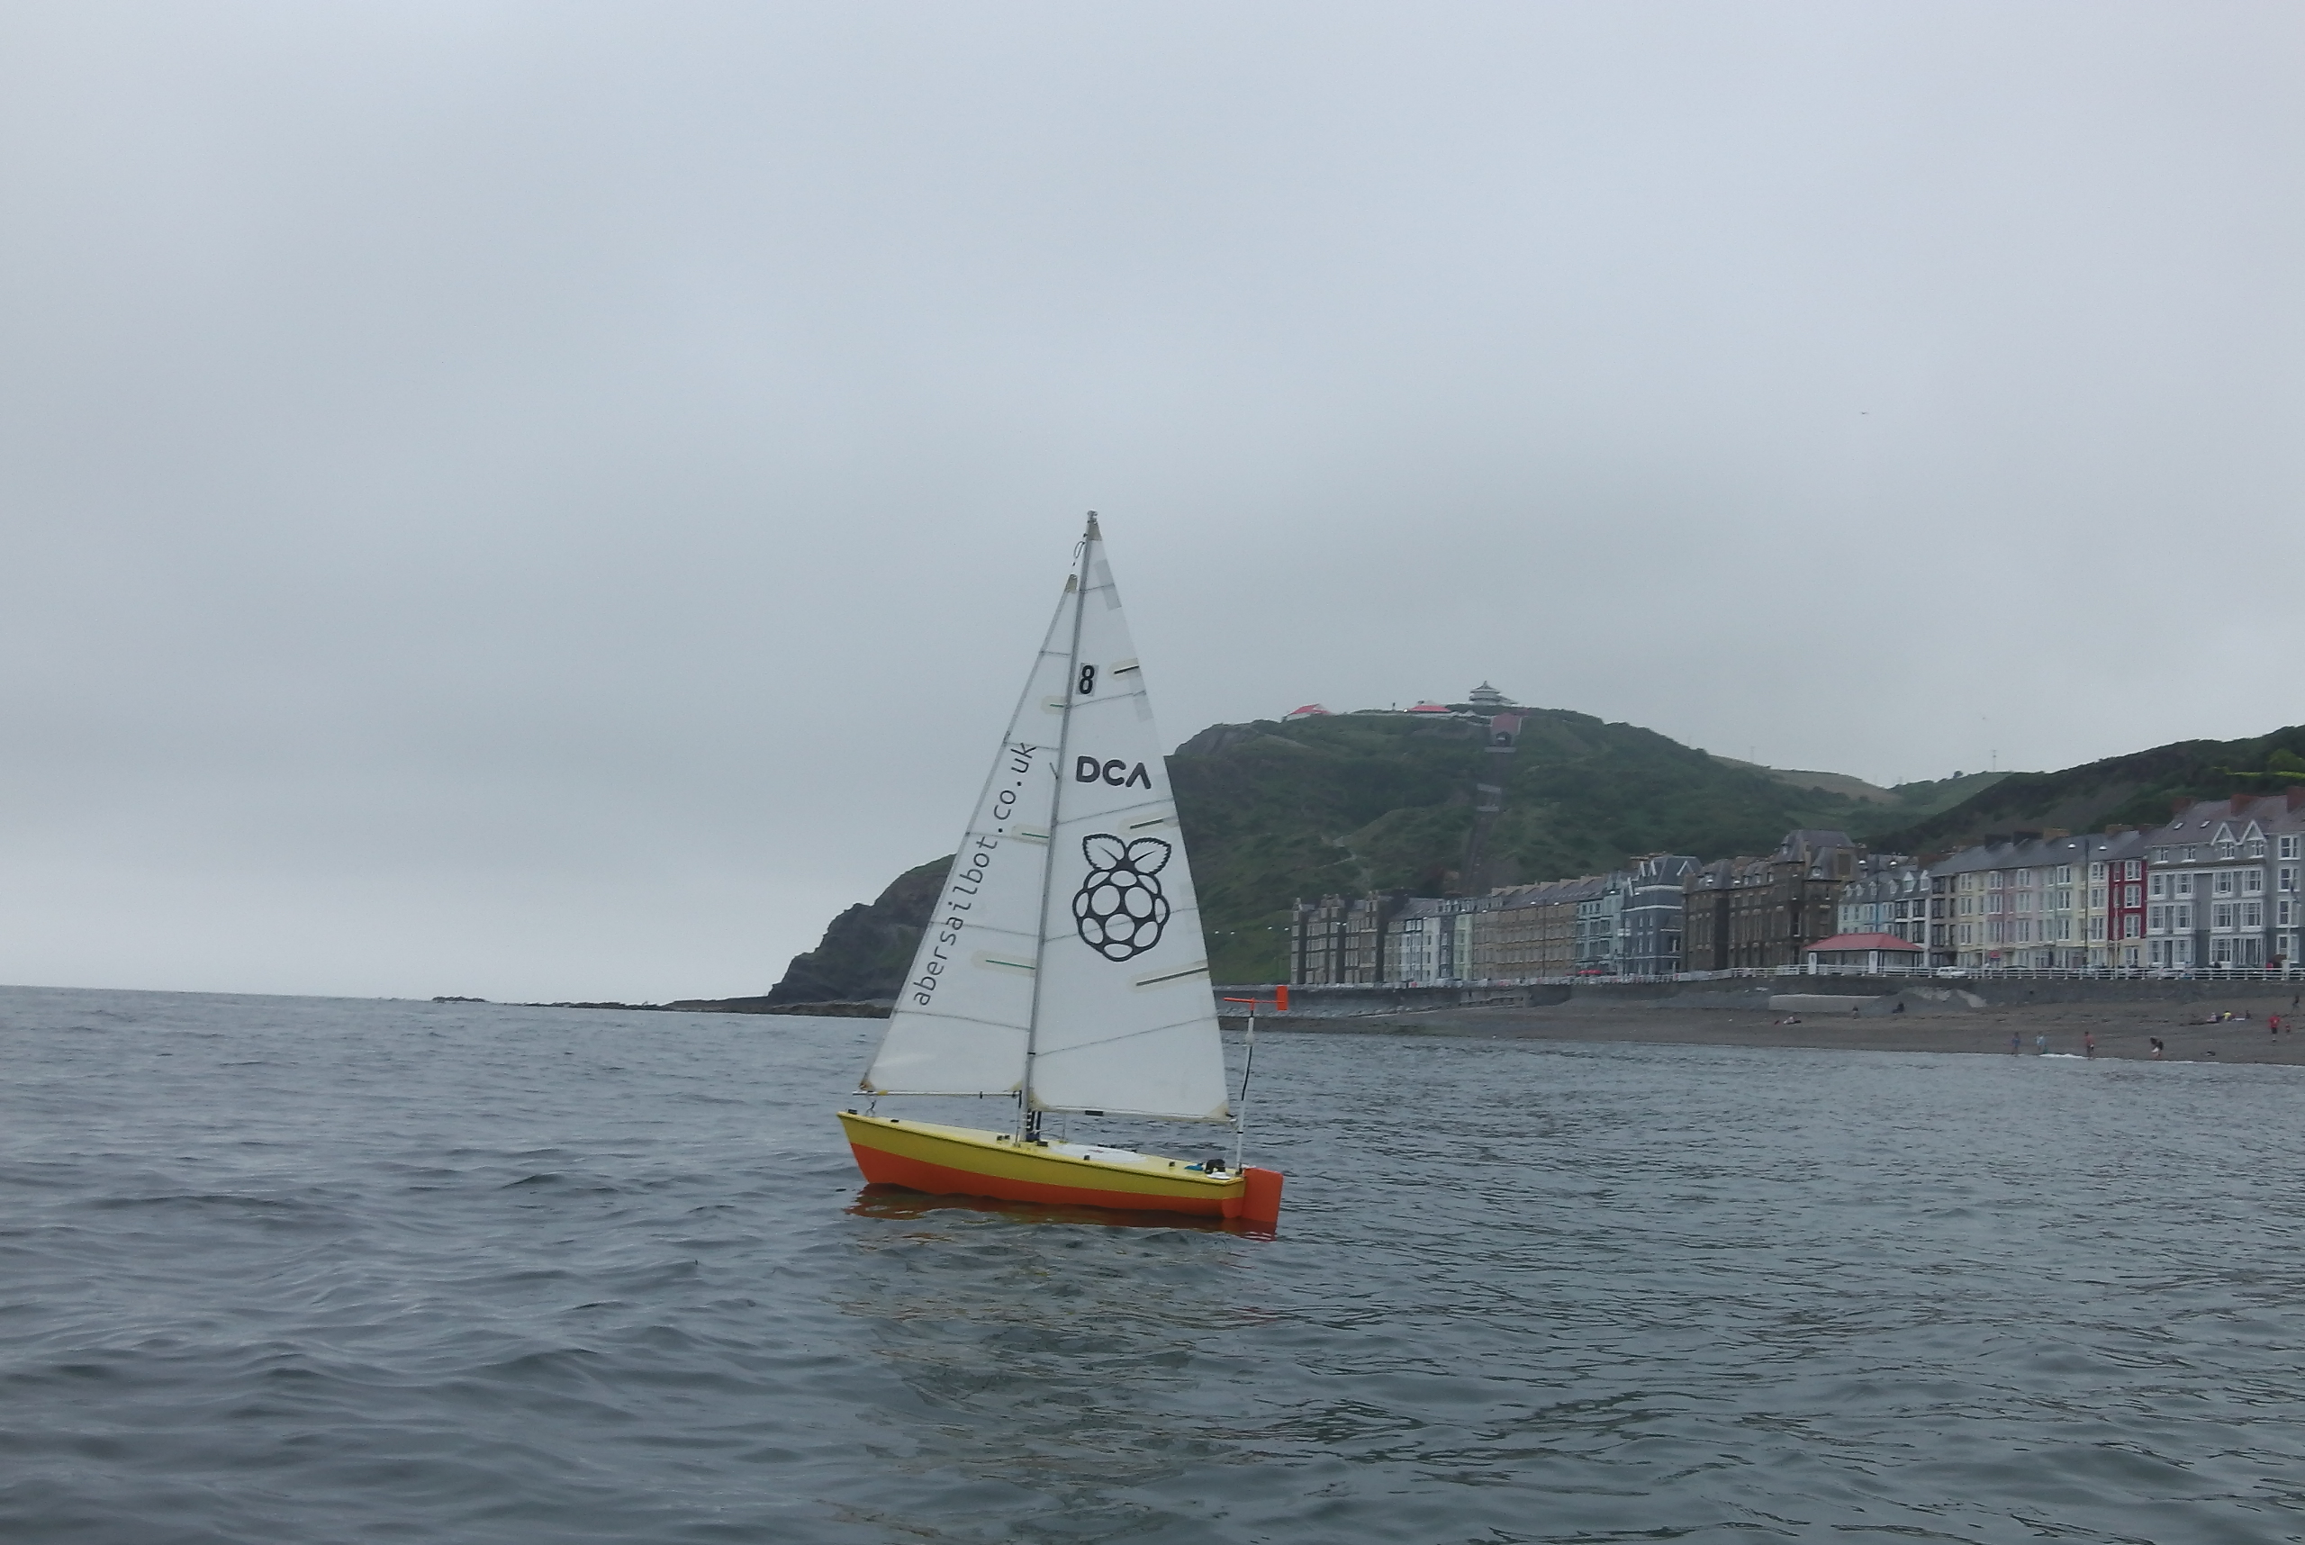

Notes:
---Lizzie---
Introduction

Slide 2
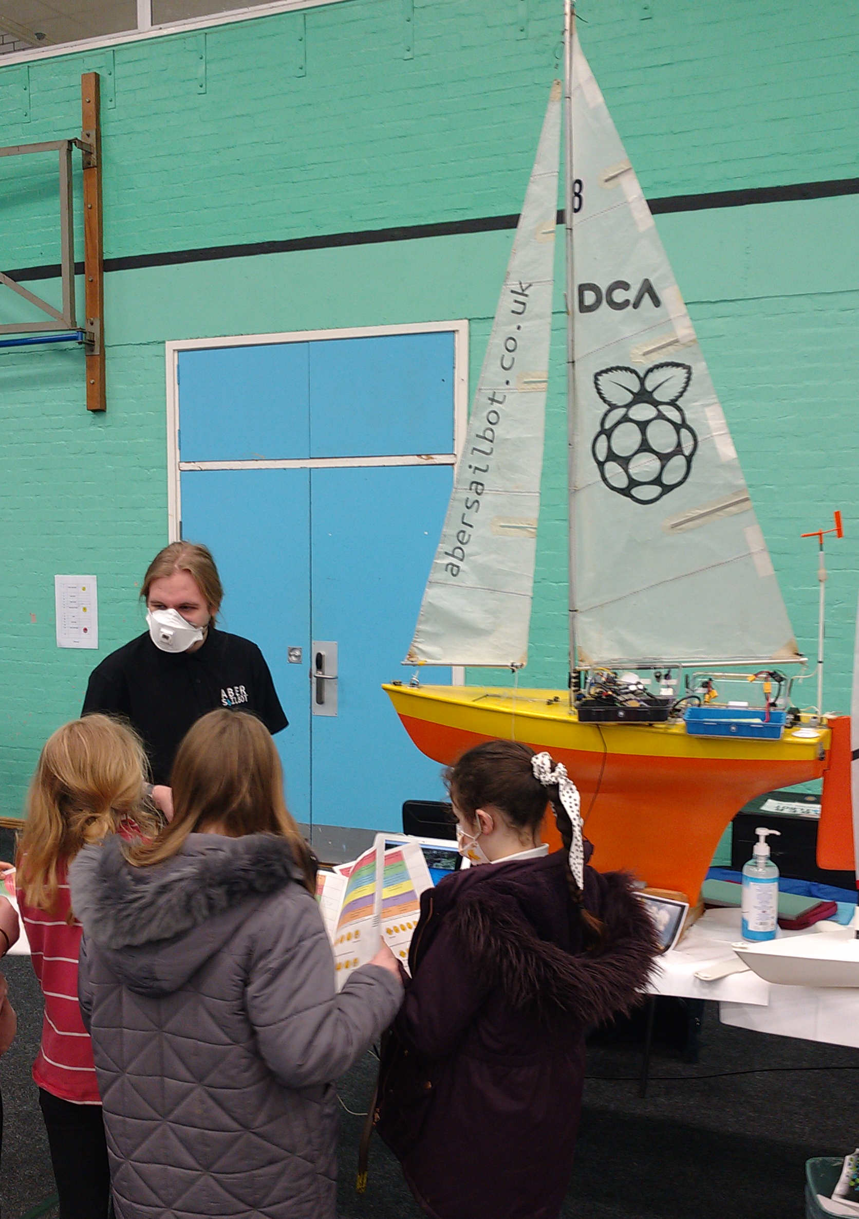
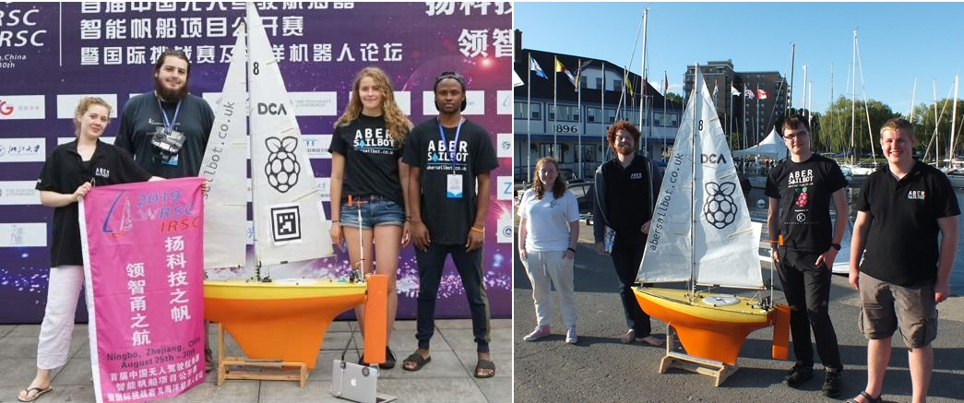
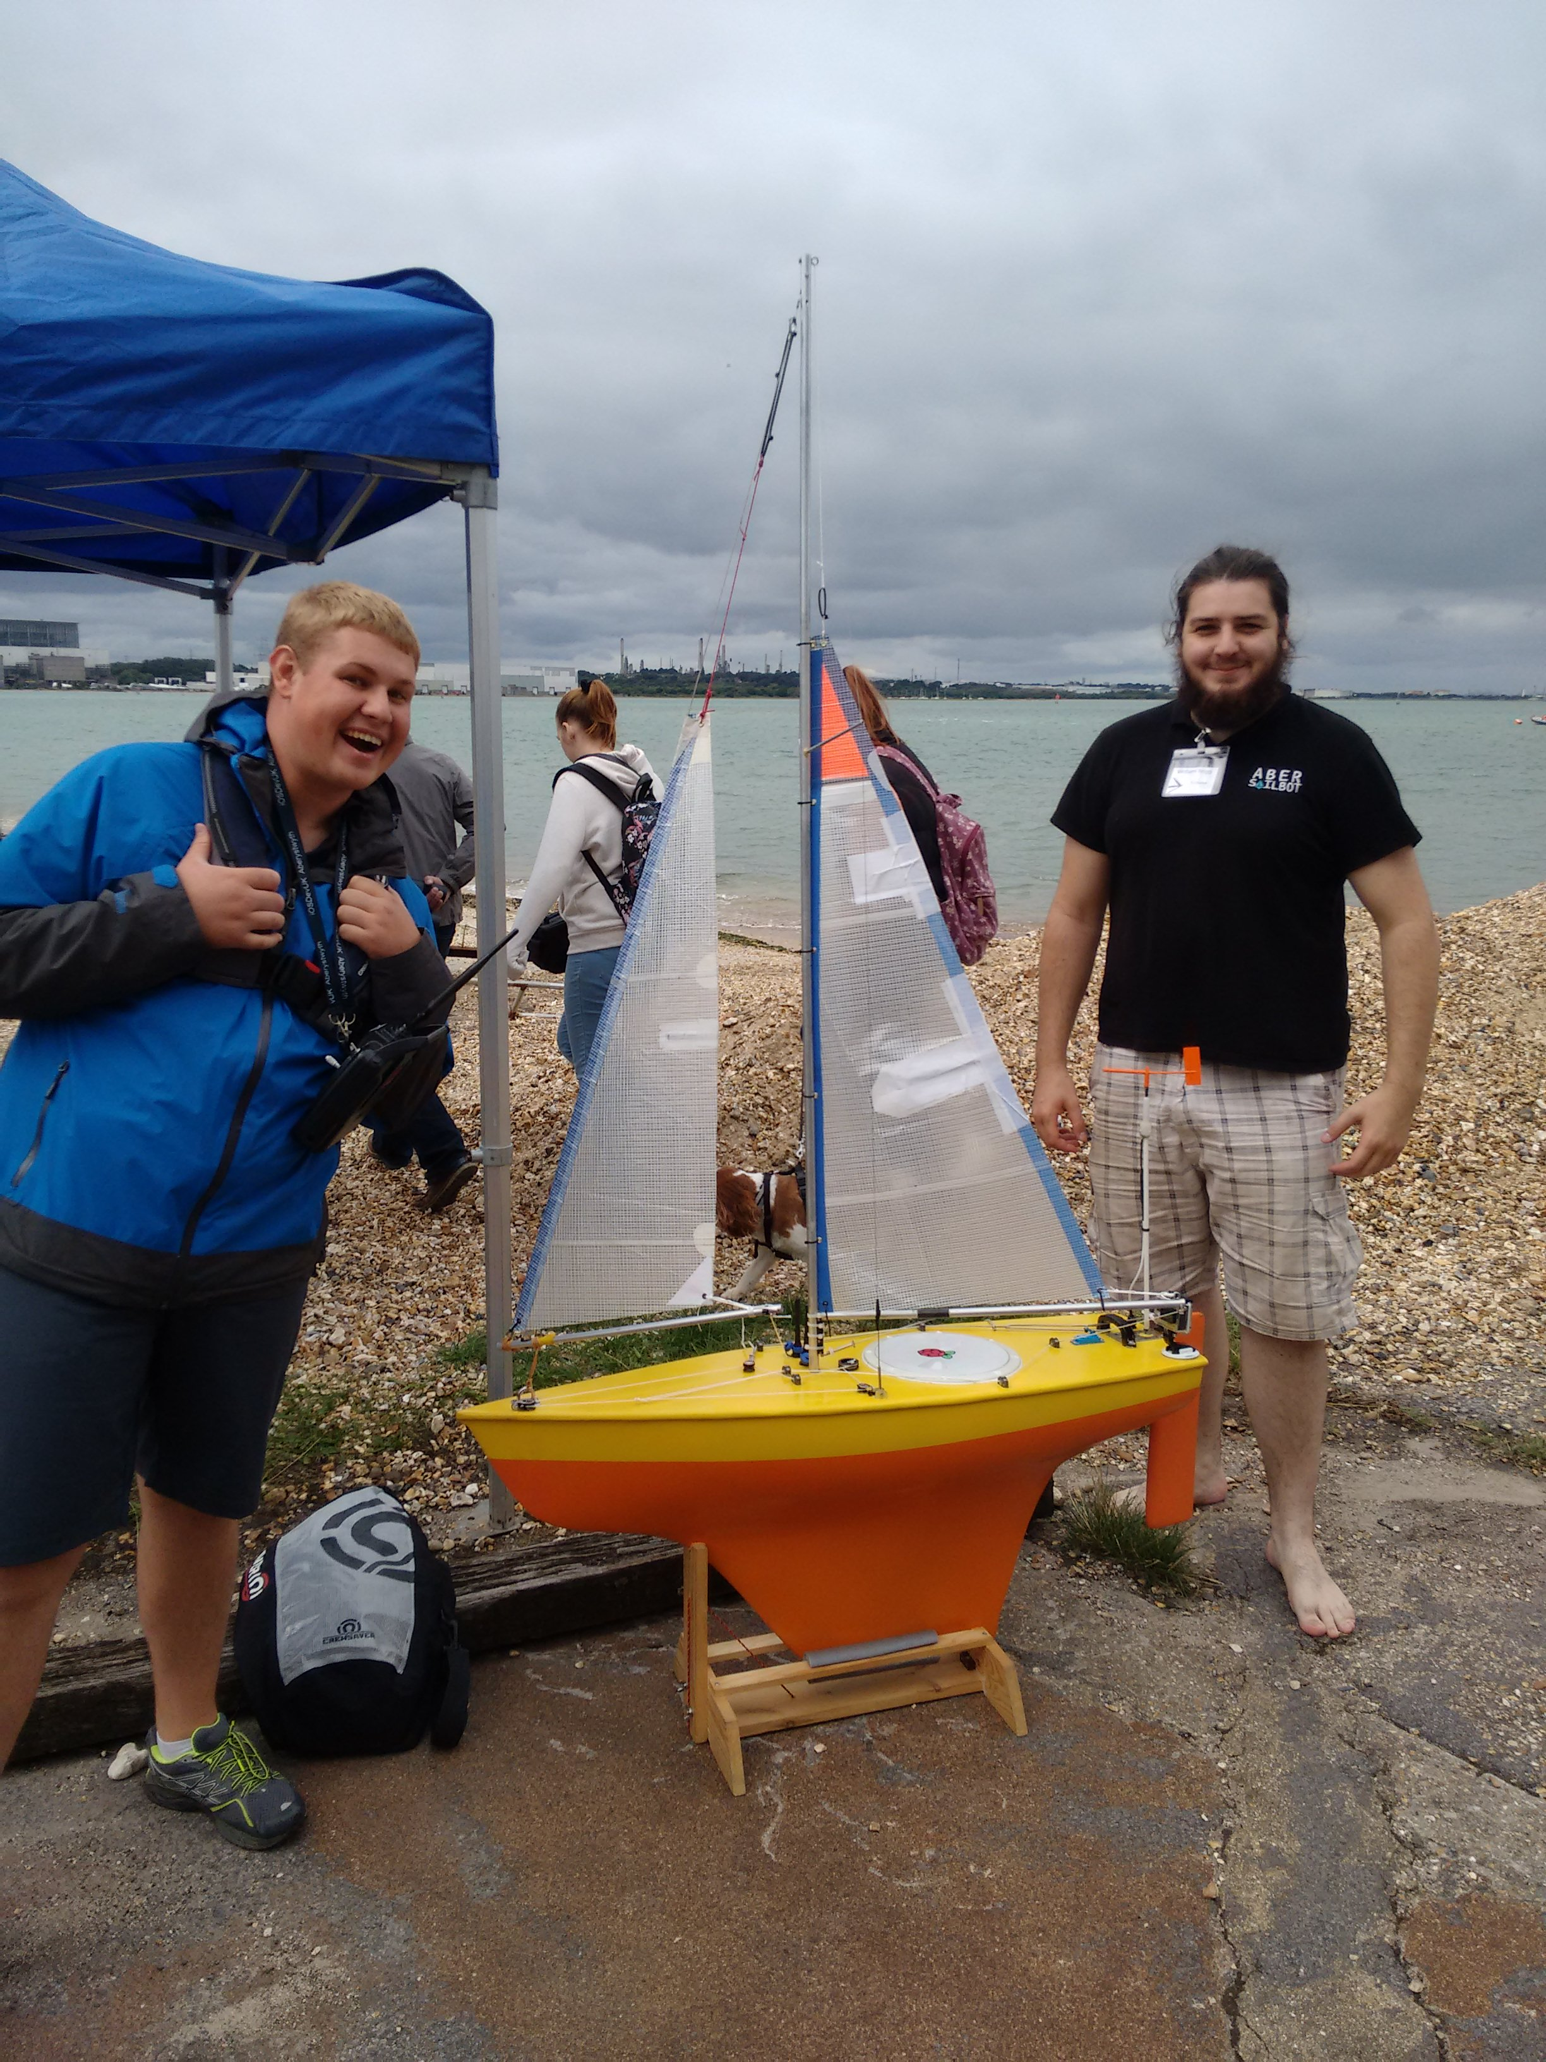
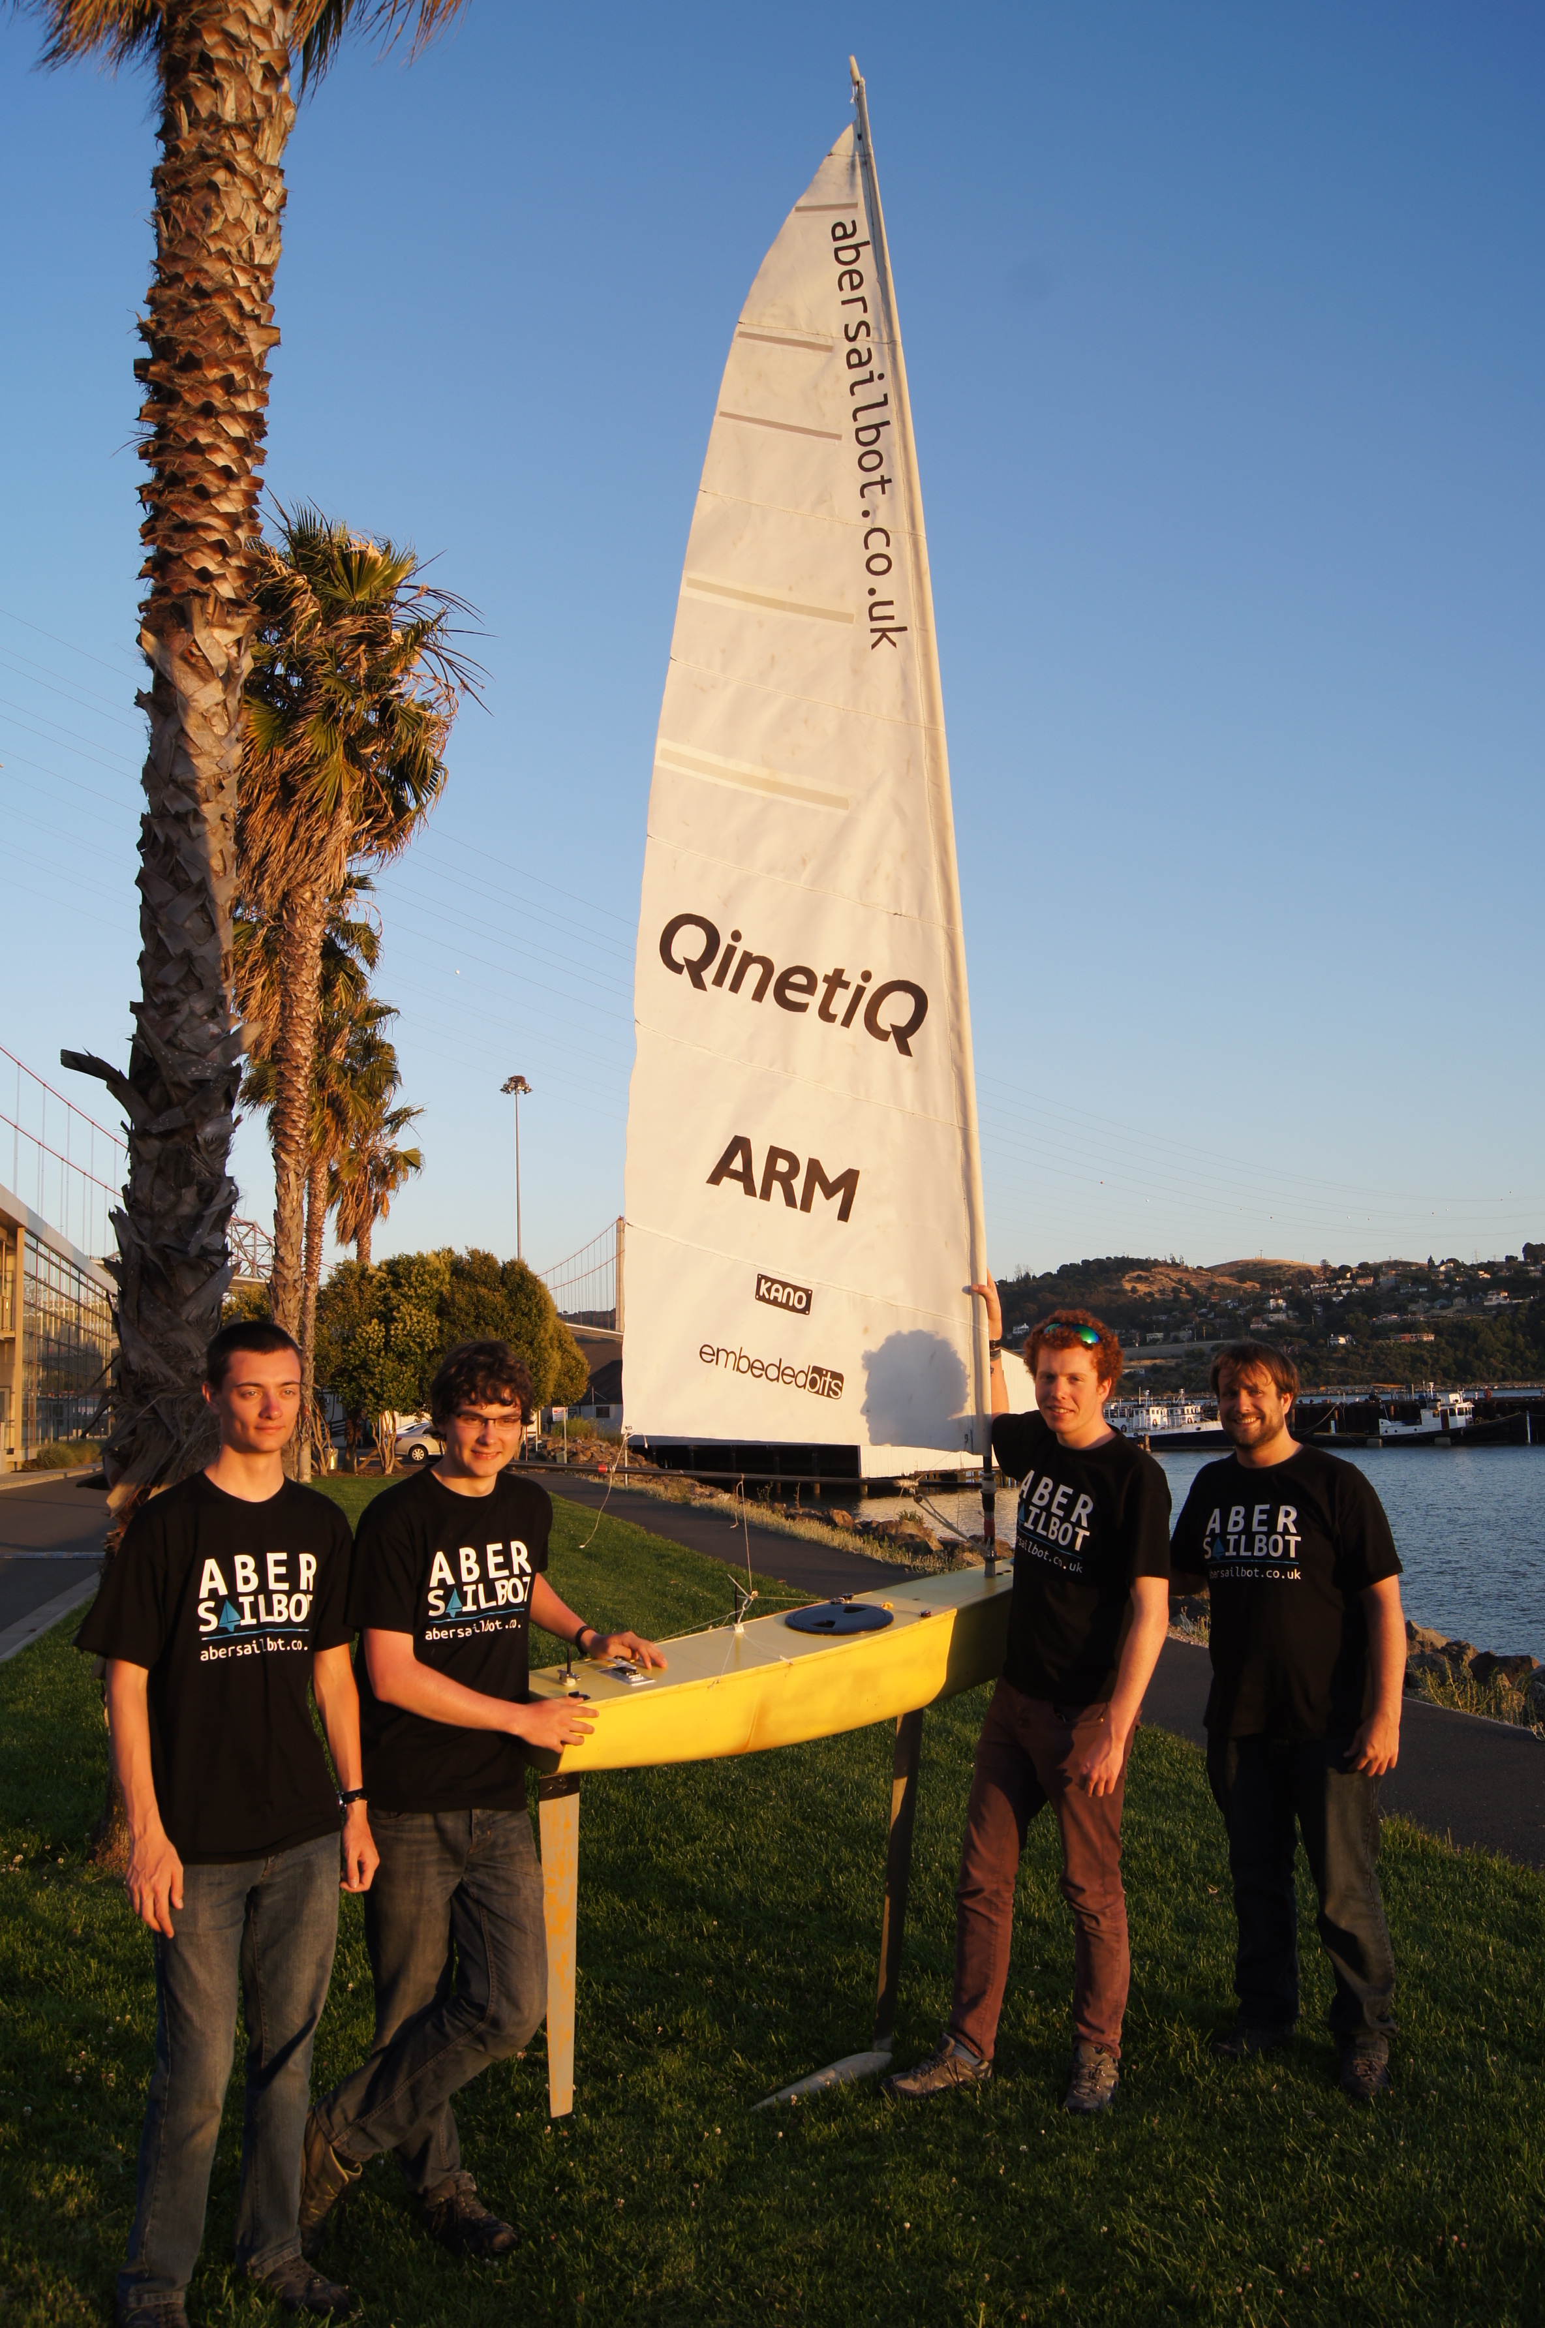



What do we do?
Build Robotic Sailing Boats
Write code
Solve the ton of issues that result
Compete around the world
Demonstrate boats to the public
Have fun!
fb.com/abersailbot @abersailbot sailbot@aber.ac.uk
Notes:
Robotic Boats
RC and Sail Themselves
Code (boatd etc)
Competitions
Microtransat
Not alone - community of people

Slide 3
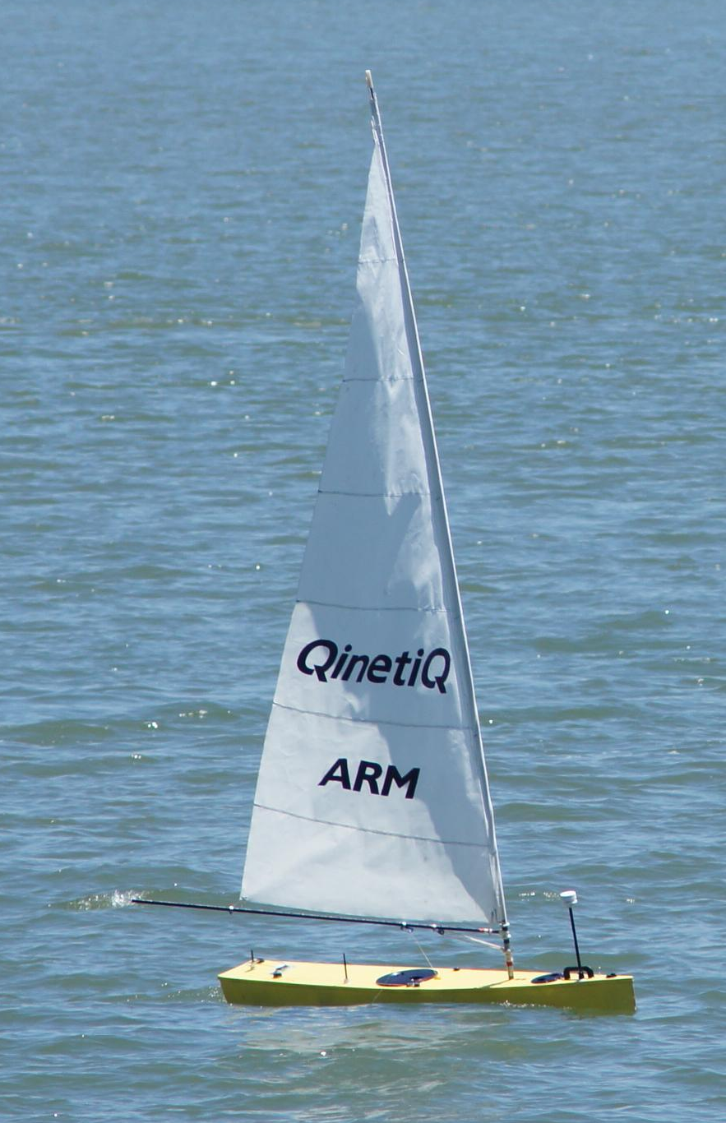
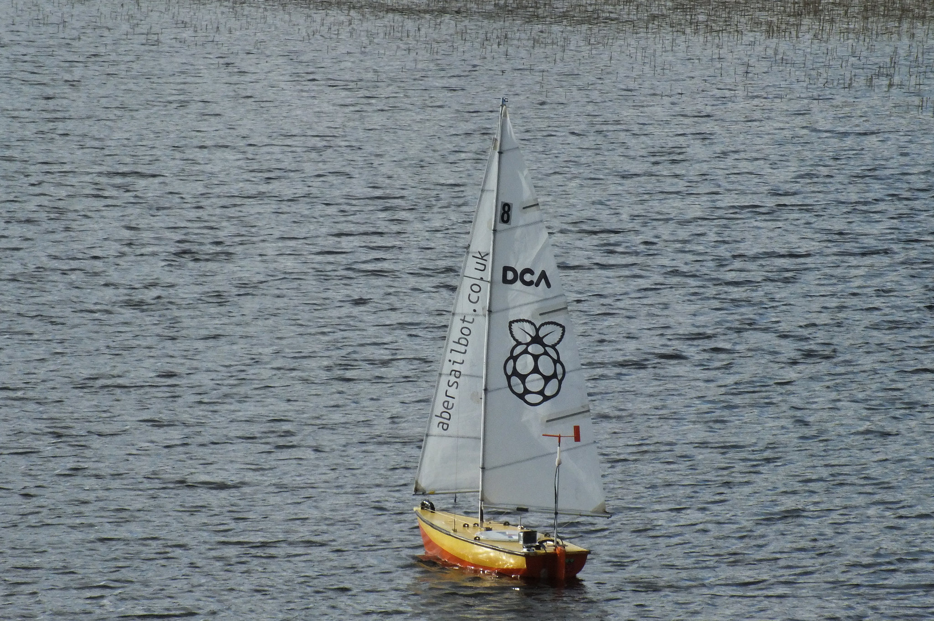
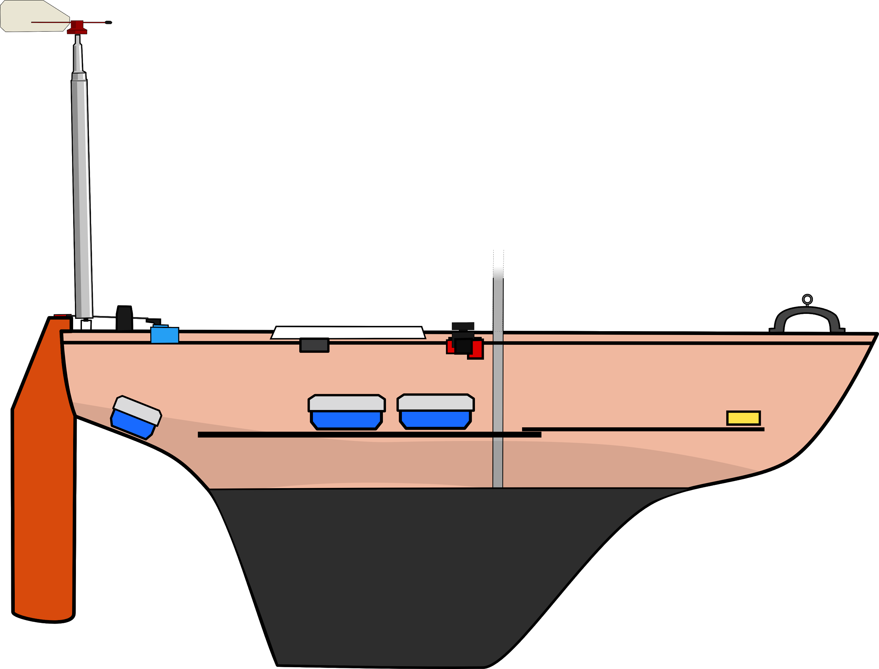
The Boats
Dewi’r Ddraig
Kitty
fb.com/abersailbot @abersailbot sailbot@aber.ac.uk
Notes:
Dewi’r Ddraig
Facts
Main and Jib
Maxi-MOOP hull - Paul Miller
1.2M, not the fastest, strong wind
Stable & reliable
New
Wind Sensor - dept design (rotary encoder)
Handle
Storm Sails
Electronics…
We have a simulator...
Kitty
Still work to be done
Needs new sail
Boat much larger
Detachable keel

Slide 4
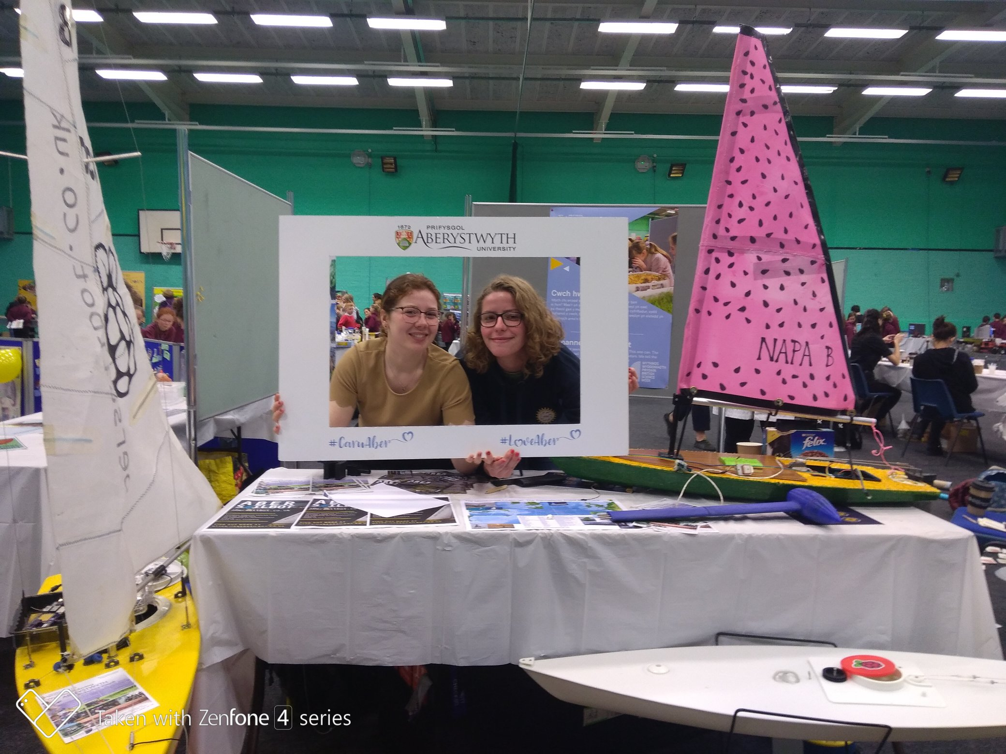
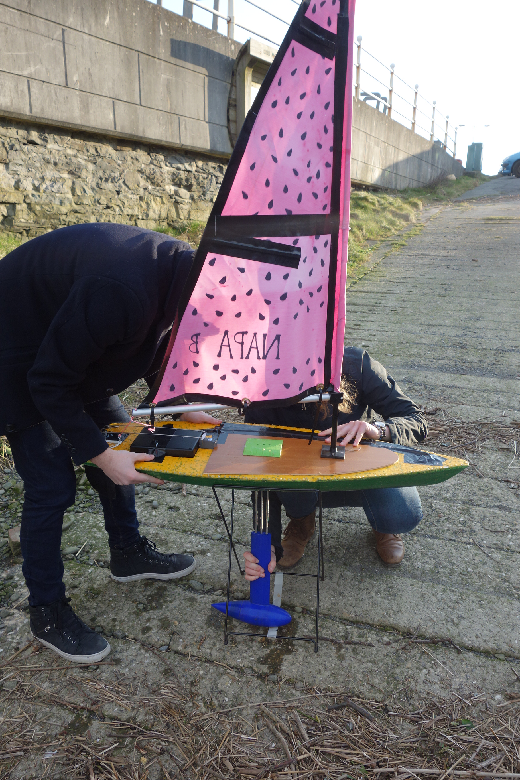
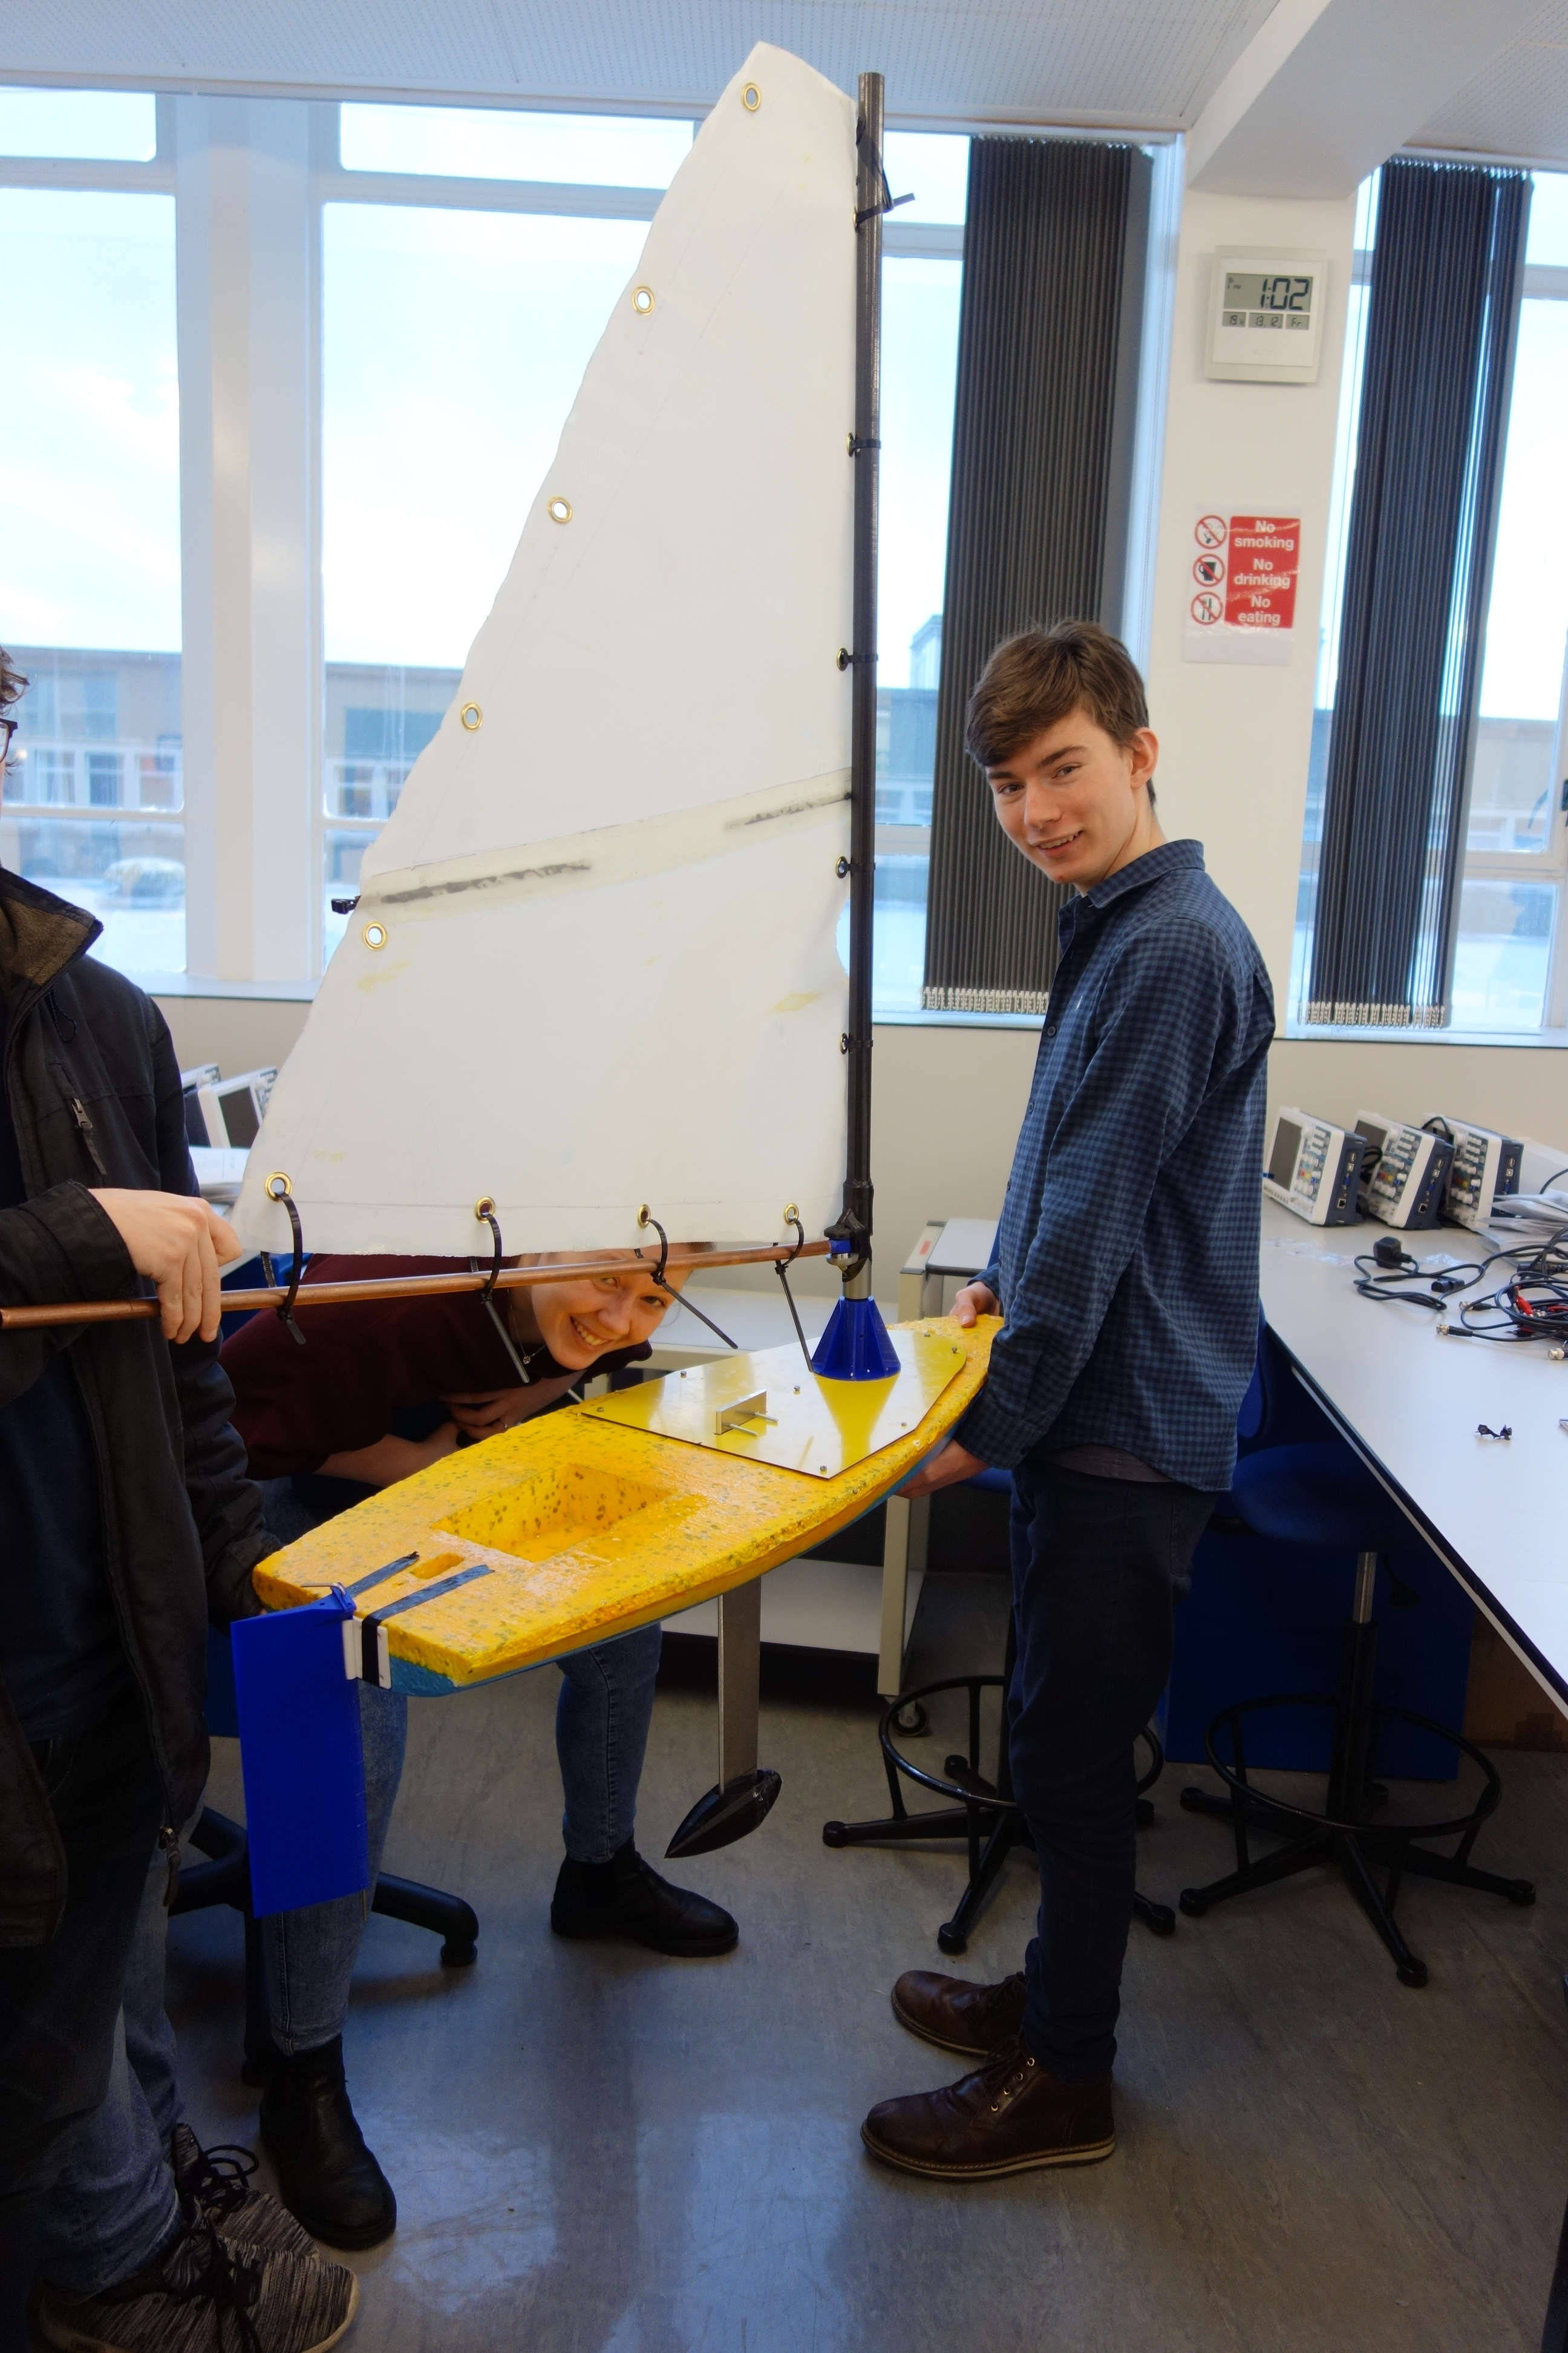
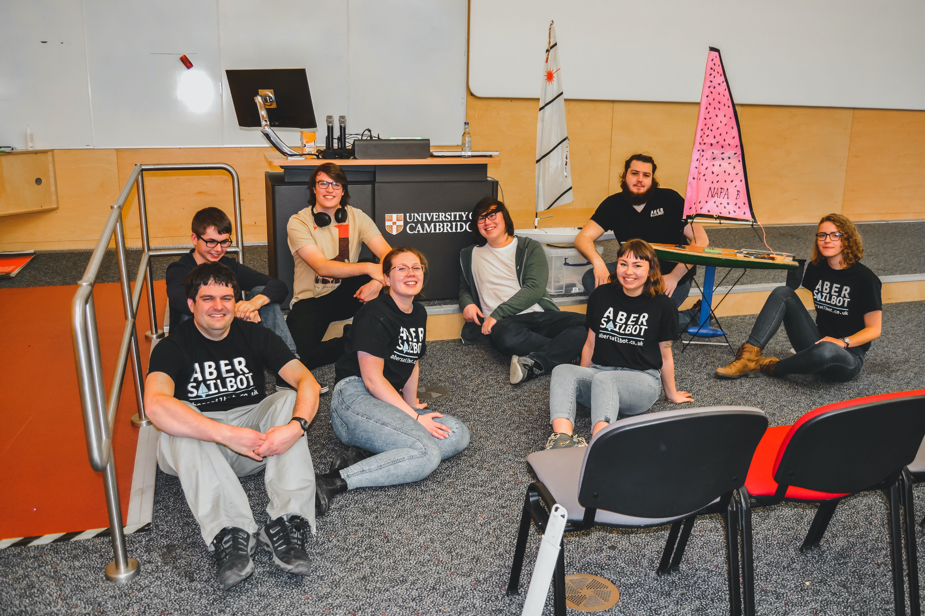
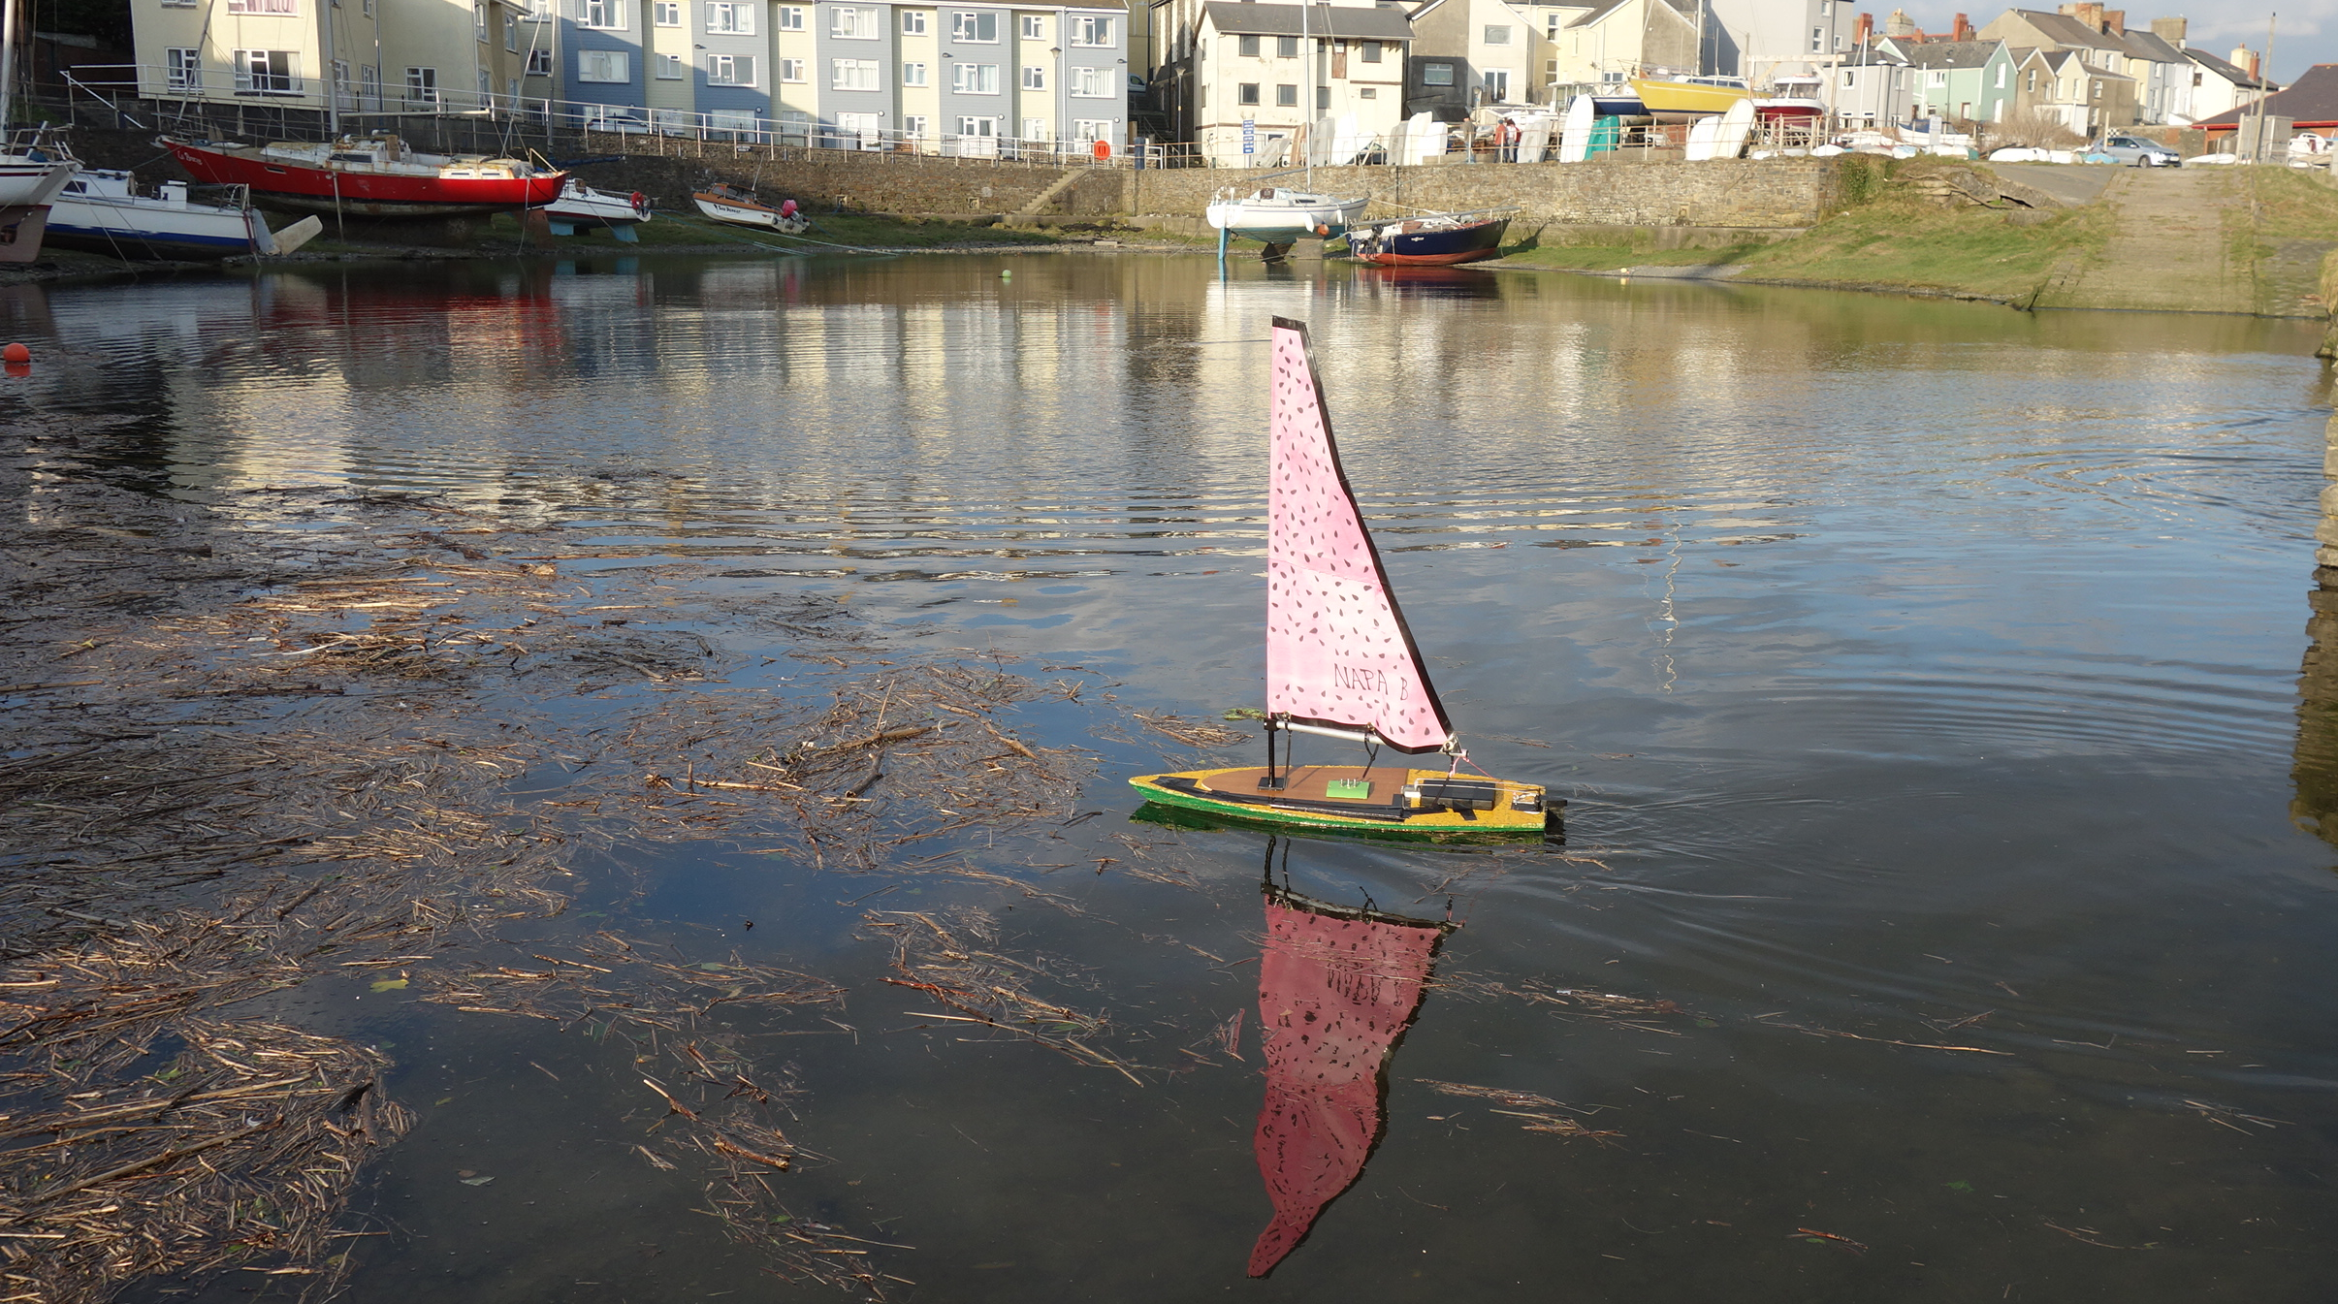
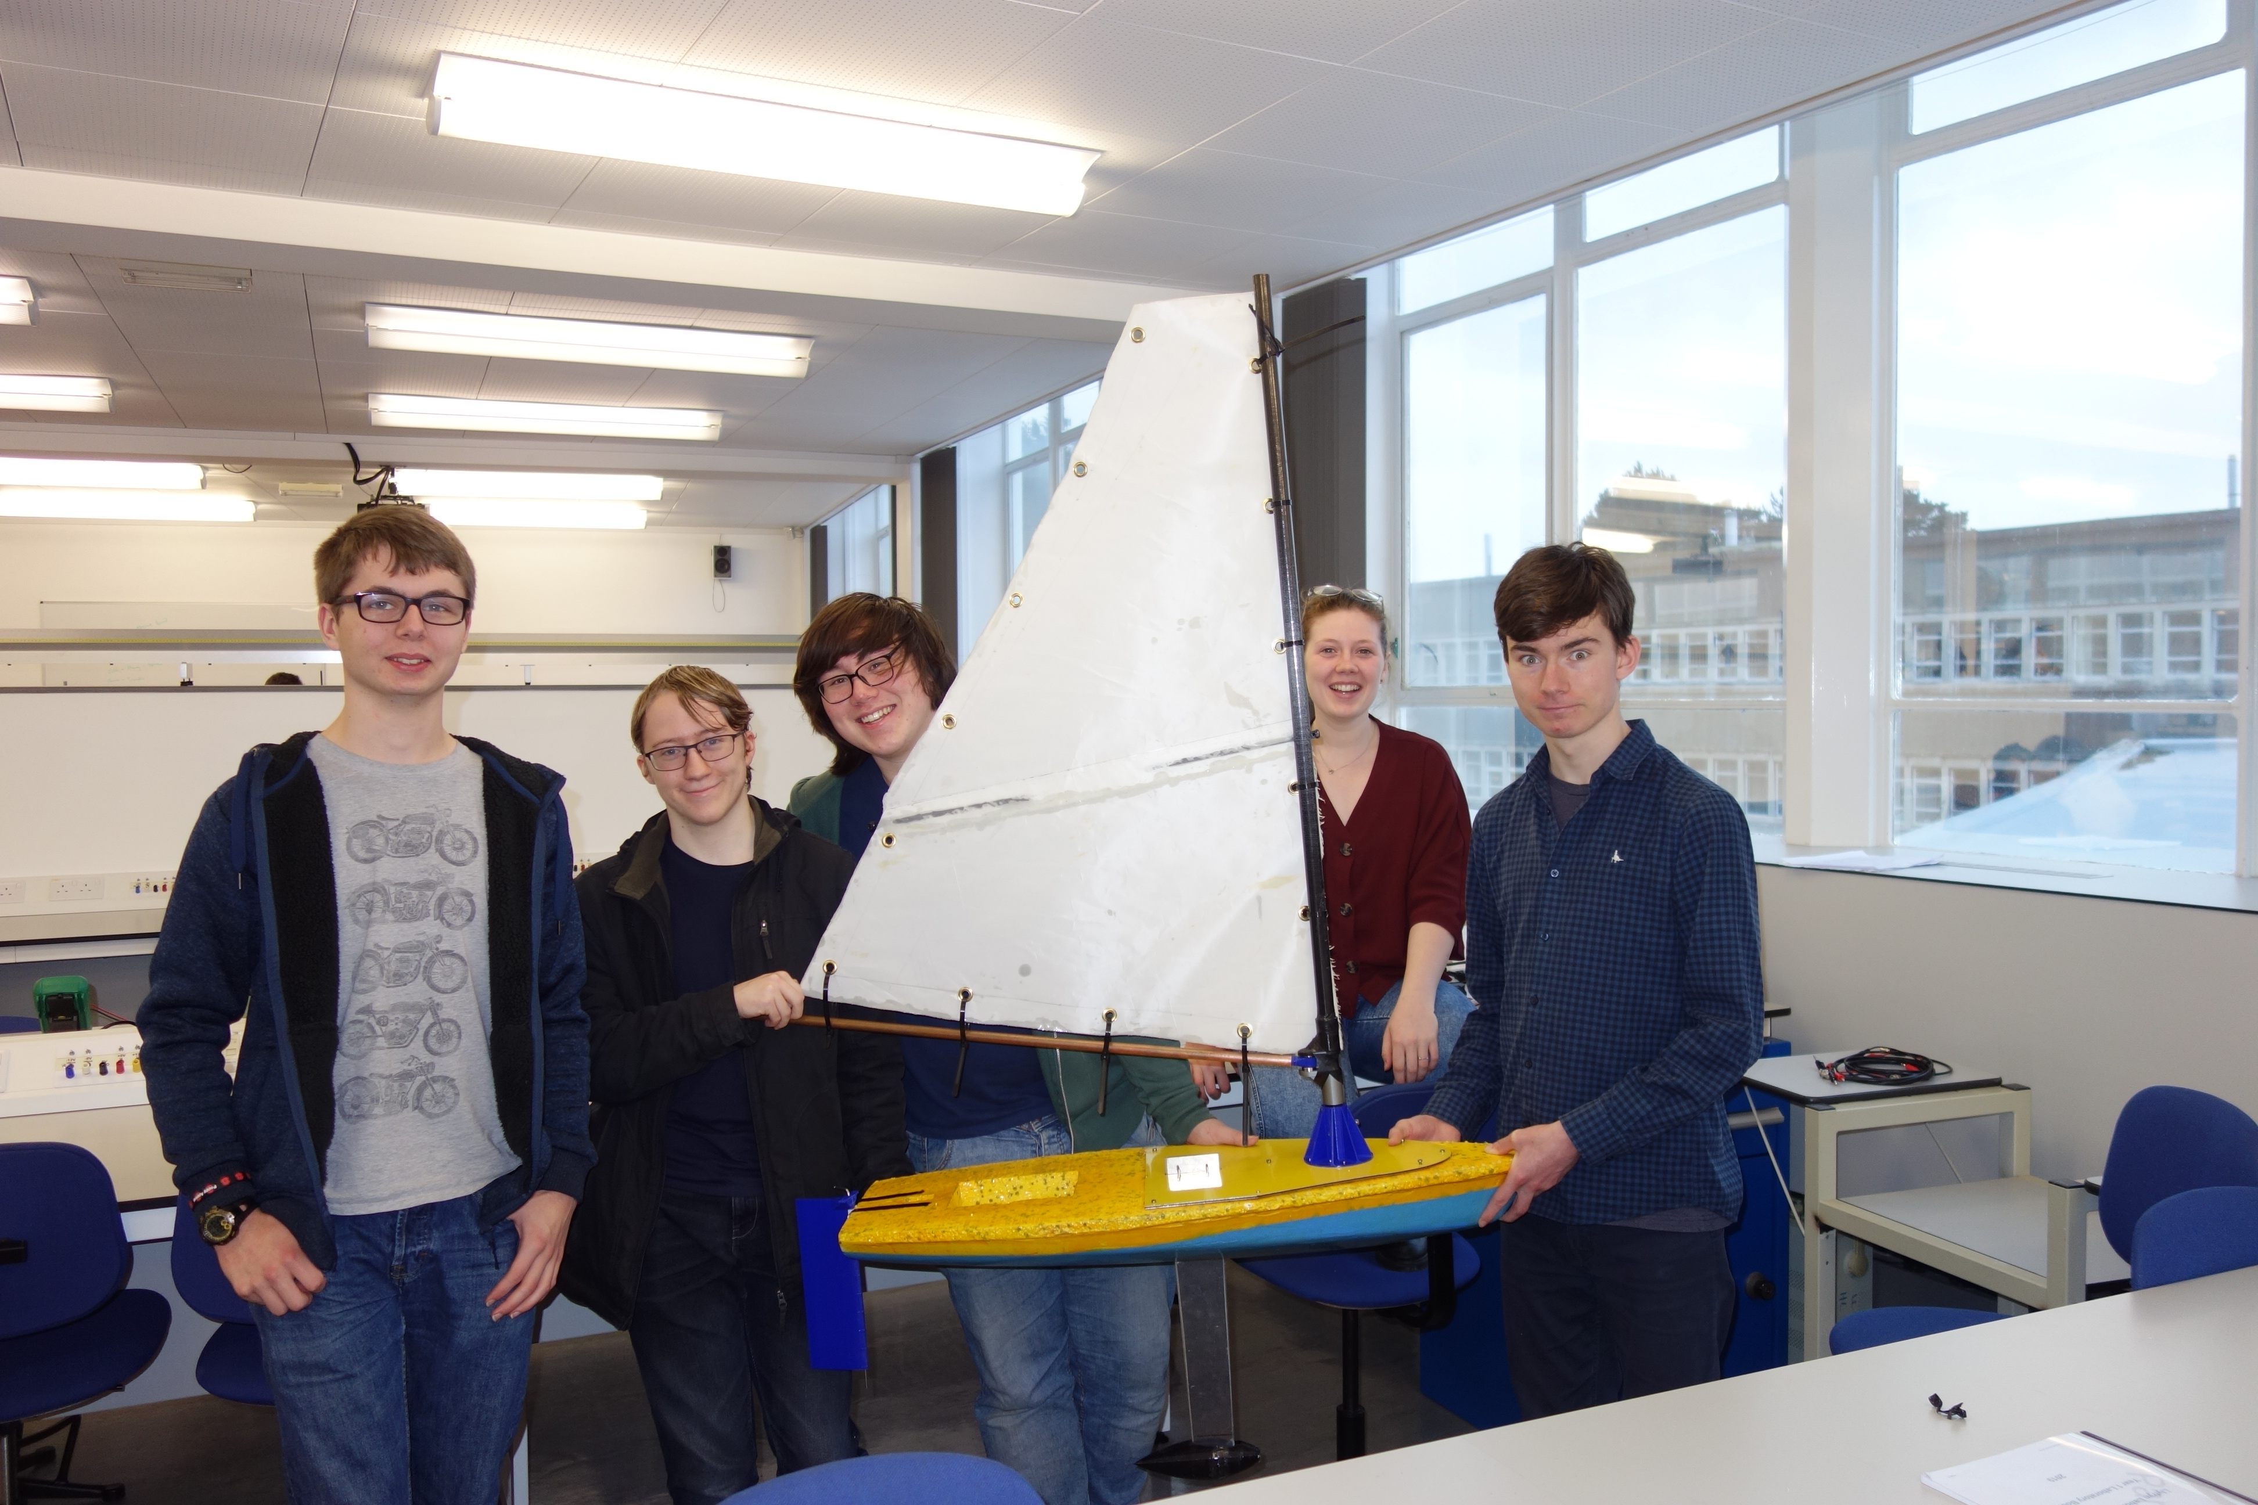
Polystyrene Boats
fb.com/abersailbot @abersailbot sailbot@aber.ac.uk
Notes:
Dewi’r Ddraig
Facts
Main and Jib
Maxi-MOOP hull - Paul Miller
1.2M, not the fastest, strong wind
Stable & reliable
New
Wind Sensor - dept design (rotary encoder)
Handle
Storm Sails
Electronics…
We have a simulator...
Kitty
Still work to be done
Needs new sail
Boat much larger
Detachable keel

Slide 5
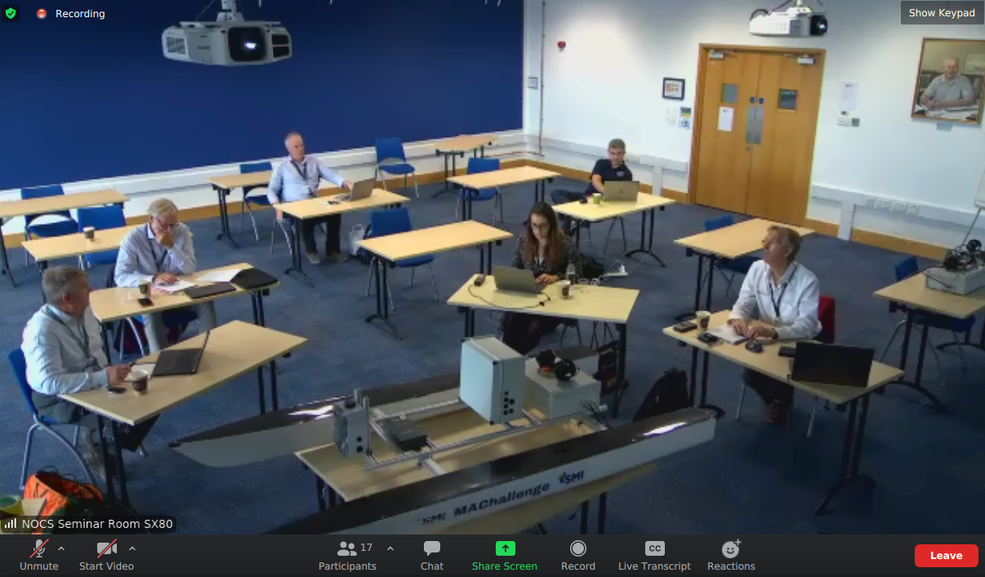
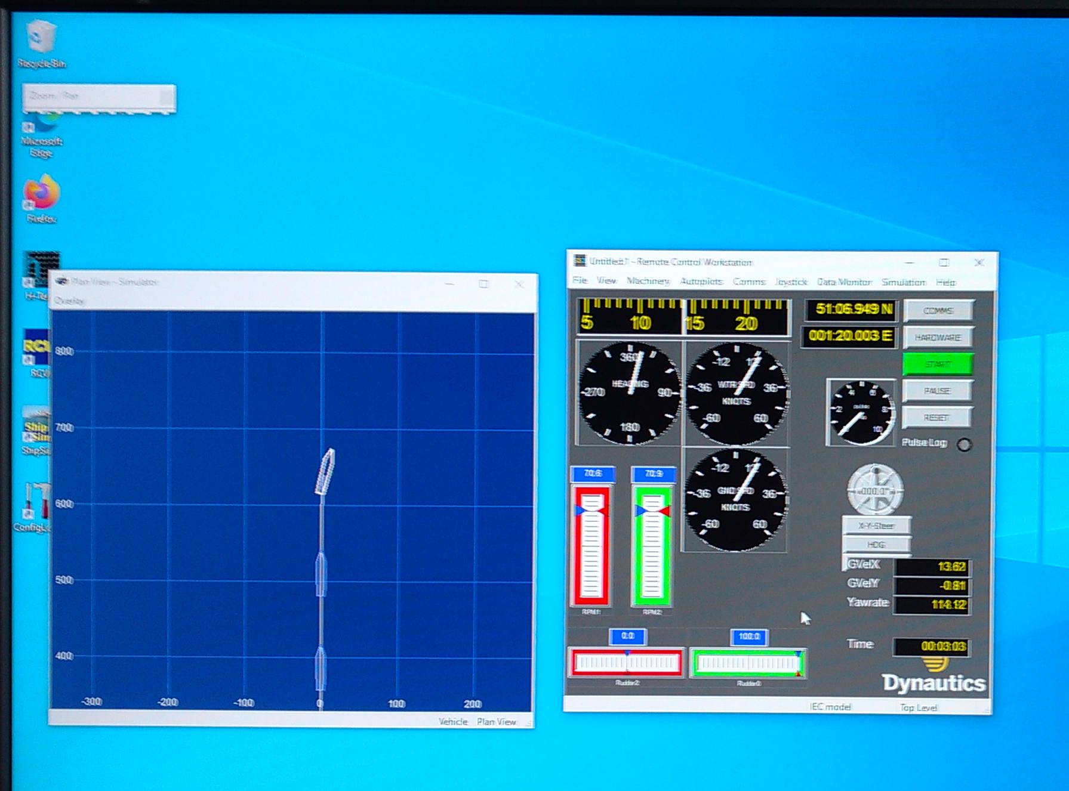
Marine Autonomy Challenge
Industry sponsored competition
Remote access to a motorboat running our code
Access to commercial grade simulators
fb.com/abersailbot @abersailbot sailbot@aber.ac.uk
Notes:
Dewi’r Ddraig
Facts
Main and Jib
Maxi-MOOP hull - Paul Miller
1.2M, not the fastest, strong wind
Stable & reliable
New
Wind Sensor - dept design (rotary encoder)
Handle
Storm Sails
Electronics…
We have a simulator...
Kitty
Still work to be done
Needs new sail
Boat much larger
Detachable keel

Slide 6
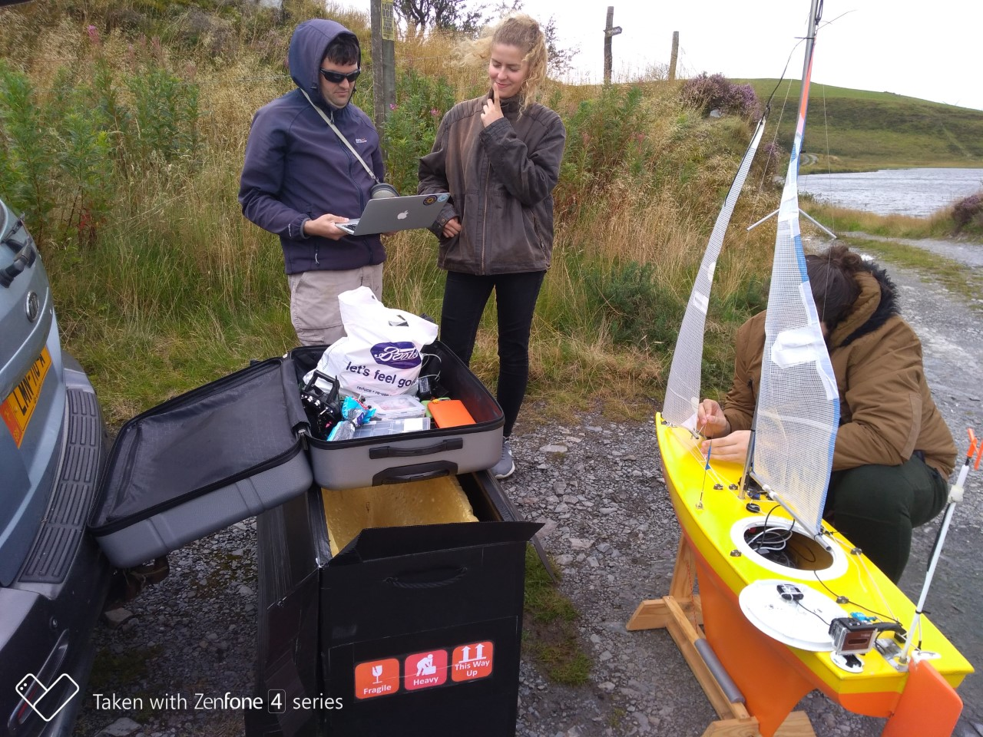
Plan for this year
Get lots of you involved!
Enter Marine Autonomy Challenge
Finish polystyrene boats and race them
Convert an RC laser to autonomous
Go to Sailbot Competition in USA
Transatlantic/long distance boat?
fb.com/abersailbot @abersailbot sailbot@aber.ac.uk
Notes:
Robotic Boats
RC and Sail Themselves
Code (boatd etc)
Competitions
Microtransat
Not alone - community of people

Slide 7
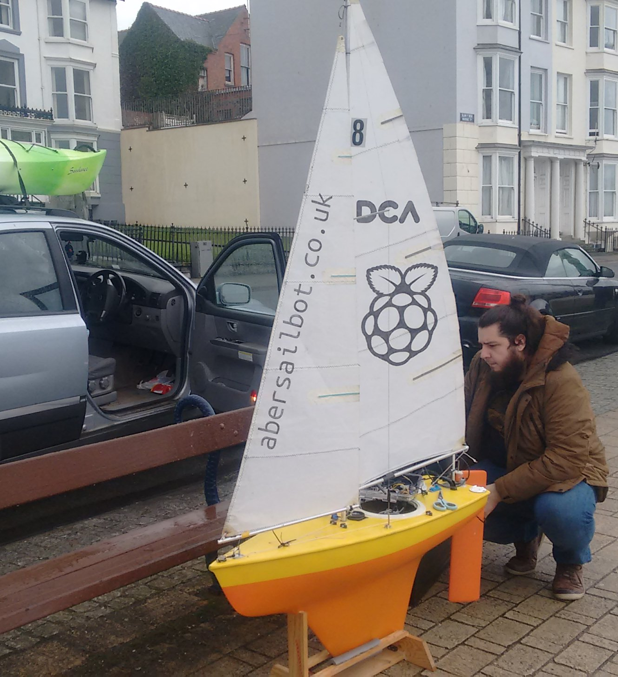
First Meeting
Submit your email address https://abersailbot.co.uk/joinus
We’ll invite you to our Discord server
First meeting next week.
fb.com/abersailbot @abersailbot sailbot@aber.ac.uk
Notes:
Robotic Boats
RC and Sail Themselves
Code (boatd etc)
Competitions
Microtransat
Not alone - community of people

Slide 8
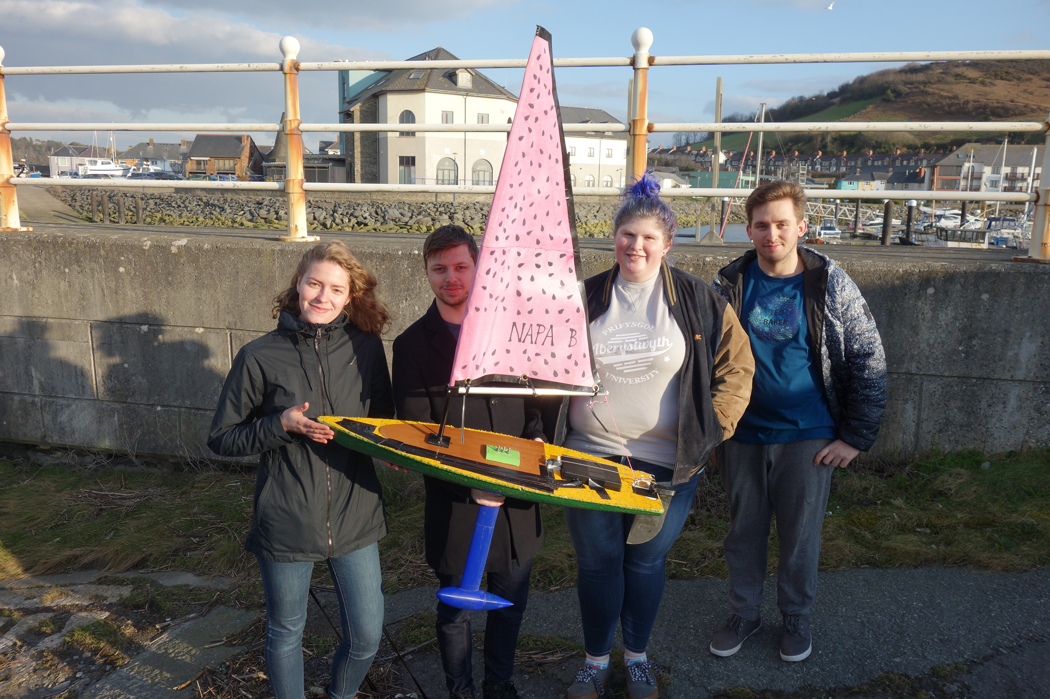
Thanks for Listening!
JOIN US!
abersailbot.co.uk/joinus
fb.com/abersailbot @abersailbot sailbot@aber.ac.uk
Notes:
Fill form (abersailbot.co.uk/joinus)
Give us email in ThinkTank
Facebook Message, Tweet, Email

