Slide 1

METHODOLOGY
PROCEDURE
Keyword extraction using text rank algorithm.
Breaking of paragraph into sentences, and the words.
Each word is a node in Page Rank.
Any two word-pair in window have undirected edge.
Based on graph , weight of every word is calculated on formula:
The most important words are considered keywords.

Slide 2
METHODOLOGY
Metrics used in the system.
Levestenian’s distance measures the difference in length.
Percent match measure percentage of words matched.
Cosine similarity converts words to vectors for calculation.
Synonyms are checked for every word .
Grammar evaluation involves lemmatization and stemming.
Fuzzy logic is used for sentence similarity.

Slide 3
METHODOLOGY
ACCURACY
Testing of the matrices on large amount of dataset.
Accuracy increased using formula of research paper.
Use of bayesian classifier model for class prediction.
Analysis of manually checked answer sheet of students for prediction.

Slide 4
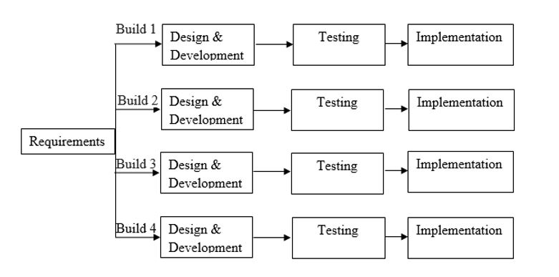
METHODOLOGY
LIFE CYCLE MODEL
Fig: Incremental Model

Slide 5
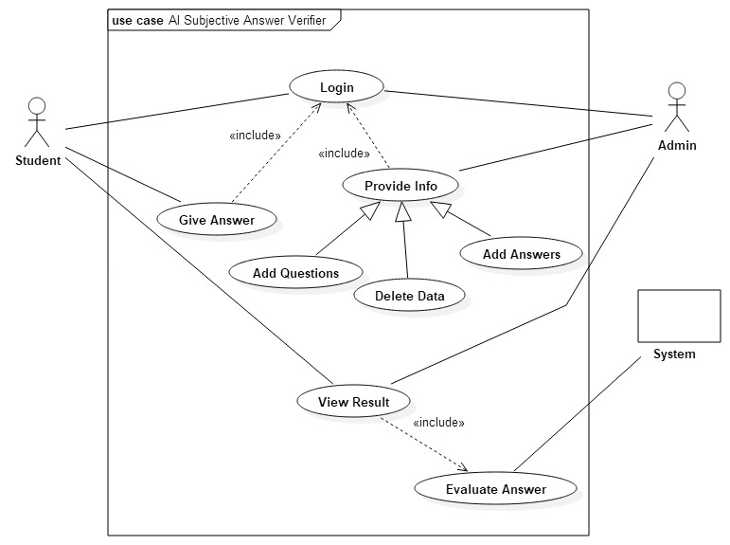
METHODOLOGY
USE CASE DIAGRAM
Fig: Use-case diagram

