Slide 1


K.RAMAKRISHNAN COLLEGE OF TECHNOLOGY
(AUTONOMOUS), TRICHY
An Edge-Optimized Multimodal System for Regional Code-Mixed Speech Emotion and Speaker Recognition
PRESENTED BY
ABETHA M K - 2403811724322001
ACHUTHAN G K R - 2403811724321002
ADARSHINI M - 2403811724322003
HARIHARAN R - 2403811724321028
GUIDED BY
Ms. ADEEBA AAISHA F
TRAINING ASSISTANT/AIDS

Slide 2
PRESENTATION OVERVIEW
Abstract
Objective
Architecture diagram
Existing system
Proposed system
Modules
Conclusion
Future enhancement

Slide 3
ABSTRACT
This project develops a lightweight Multimodal Speech Emotion Recognition (SER) system for code-mixed languages like Tanglish using MobileNetV3 for audio analysis and MobileBERT for text understanding. With Gated Fusion and ONNX Runtime, it enables real-time, privacy-preserving emotion detection directly on edge devices with low computational overhead.

Slide 4
OBJECTIVE
Identify the speaker from voice characteristics.
Detect the speaker's emotional state.
Understand regional code-mixed speech.
Enable fast and privacy-preserving edge processing.

Slide 5
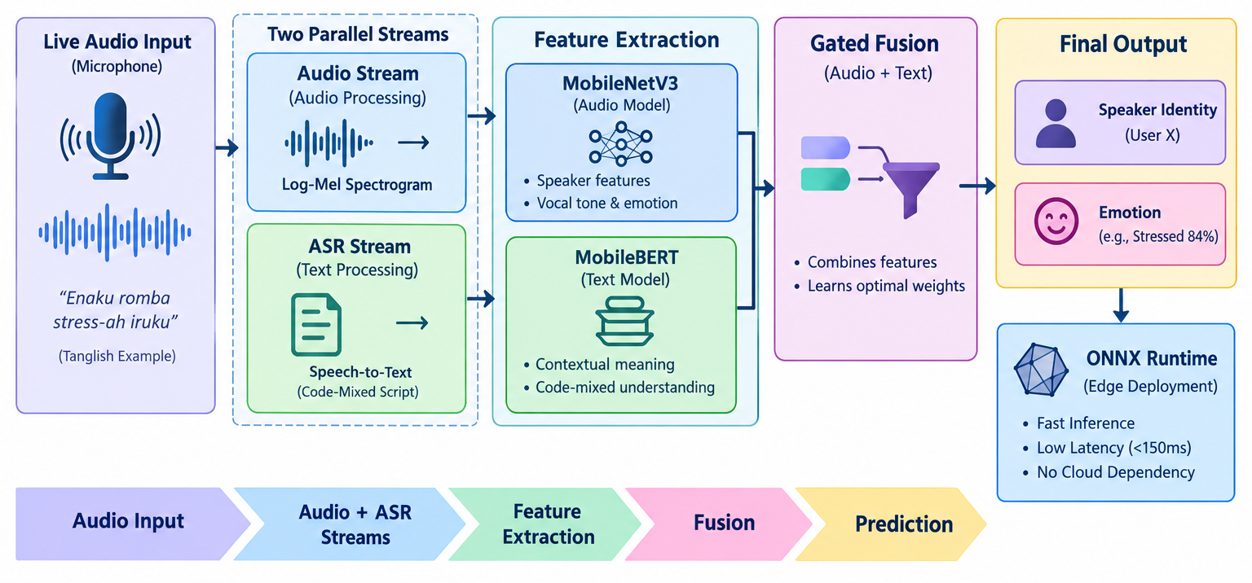
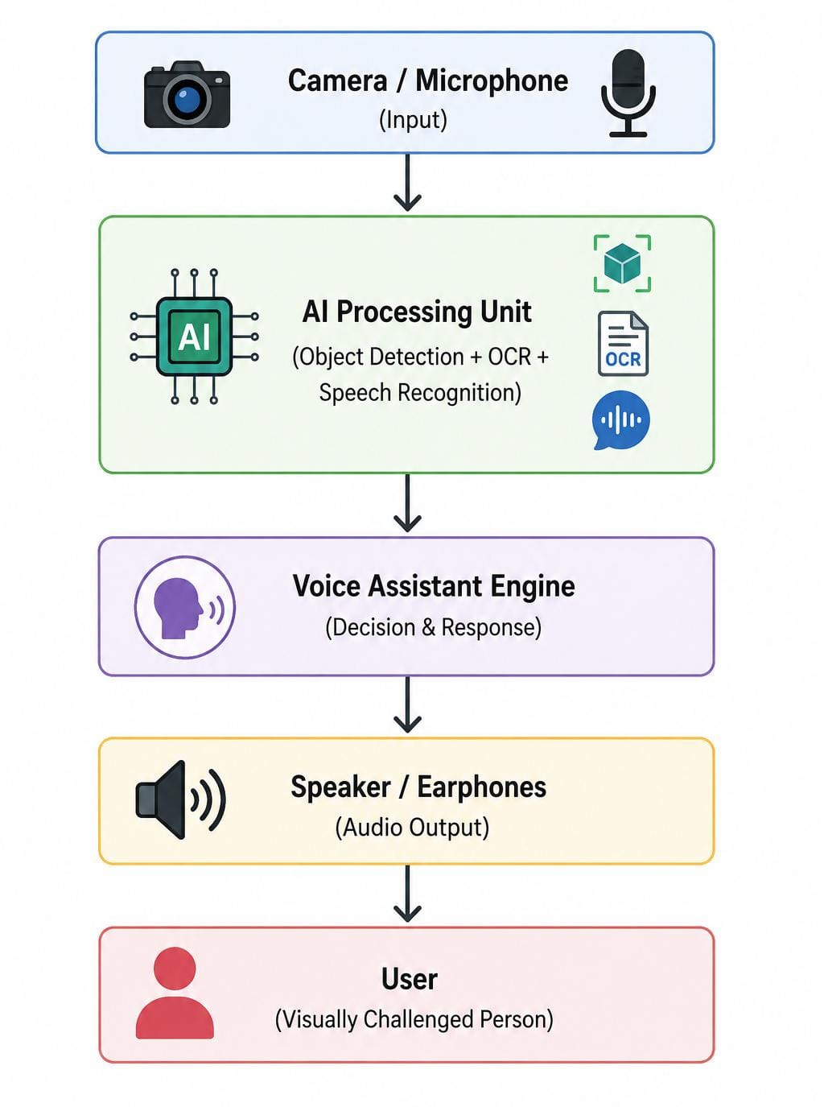
ARCHITECTURE DIAGRAM

Slide 6
EXISTING SYSTEM
Mostly supports monolingual speech.
Many systems use heavy deep learning models.
Cloud processing causes latency and dependency.
Speaker and emotion recognition are often separate tasks.

Slide 7
PROPOSED SYSTEM
Multimodal Edge-AI: Combines audio features and speech-text information for better recognition.
Lightweight Models: Uses MobileNetV3 for speaker/vocal features and MobileBERT for code-mixed emotional context.
Gated Fusion: Intelligently combines both modalities to improve emotion and speaker prediction.
Real-Time & Private: Uses ONNX Runtime for low-latency processing directly on local/edge devices without cloud dependency.

Slide 8
MODULES
Python Audio Engineering (sounddevice & NumPy
Voice Biometrics (librosa & scikit-learn SVM)
Distilled Transformers (OpenAI Whisper-Tiny & DistilBERT)
Pipeline Execution & UI (ONNX Runtime & Streamlit)

Slide 9
MODULES
Python Audio Engineering (sound device & NumPy) :
Uses sound device/PyAudio to capture live microphone audio and NumPy to process audio signals efficiently in memory. It supports real-time audio normalization and segmentation for faster emotion recognition.
Voice Biometrics. :
Uses librosa to extract MFCC features representing voice characteristics and Scikit-learn SVM to classify speaker patterns efficiently with low computational overhead.

Slide 10
MODULES
Distilled Transformers :
Uses Whisper-Tiny to convert speech into text and DistilBERT to analyze contextual and emotional cues in regional, code-mixed languages like Tanglish, classifying emotions such as joy, sadness, anger, fear, and neutral..
Pipeline Execution & UI :
Uses ONNX Runtime to optimize model inference for efficient edge deployment and Streamlit to provide an interactive dashboard displaying live audio input, speech transcripts, and predicted emotions in real time..

Slide 11
CONCLUSION
Combines speaker and emotion recognition in one system.
Multimodal processing improves speech understanding.
Lightweight models support edge deployment.
Local processing improves privacy and response speed.
Notes:
11

Slide 12
FUTURE ENHANCEMENT
Support more Indian regional languages.
Improve performance using larger code-mixed datasets.
Add multi-speaker detection.
Optimize models further for mobile and embedded devices.

Slide 13
THANK YOU

