Slide 1
For non-CT images, Adjust the parameters!
Default parameters are set for CT. IBEX CT number=Hounsfield Unit+1000.
For non-CT modality images, users must adjust the parameters to get the meaningful result. See Page2 for example.
After adjusting parameters, test to see if parameters are reasonable. See page3 for example.
For changing the parameter permanently, modify the file *.INI.
For features, INI file is at
\(RootPath\IBEX_mcr\Work\MyProgram\Matlab\ImageFeatureOutcomeAnalysis\FeatureAlgorithm\Category\(Feature)\(Feature).INI
For preprocess, INI file is at
\(RootPath\IBEX_mcr\Work\MyProgram\Matlab\ImageFeatureOutcomeAnalysis\FeatureAlgorithm\Preprocess\(Preprocess).INI

Slide 2
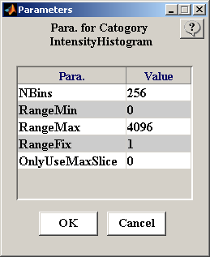
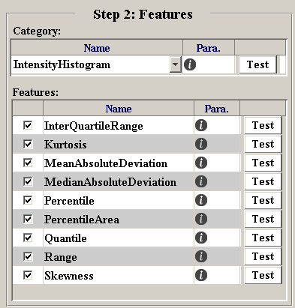
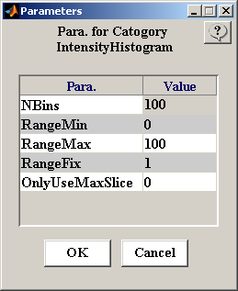
Example how to adjust the parameters
CT
PET

Slide 3
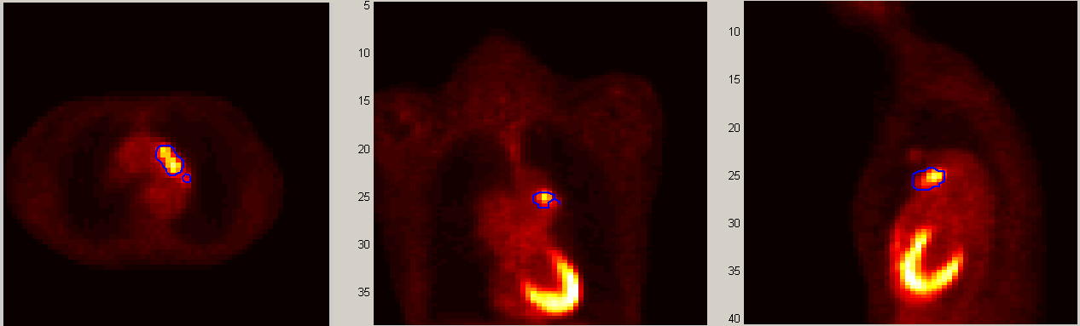
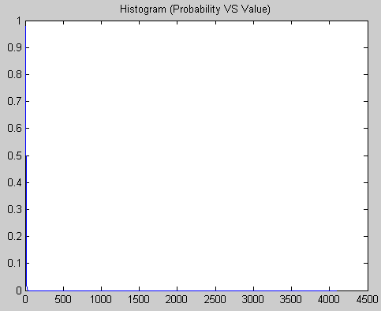
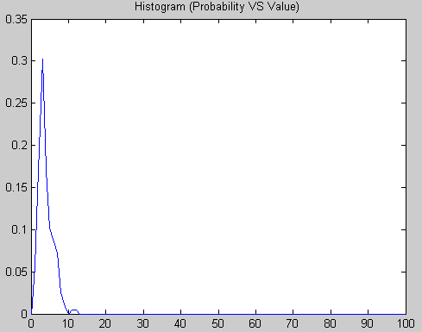
Example how to test the parameters
Histogram from CT parameters
Histogram from PET parameters

