Slide 1
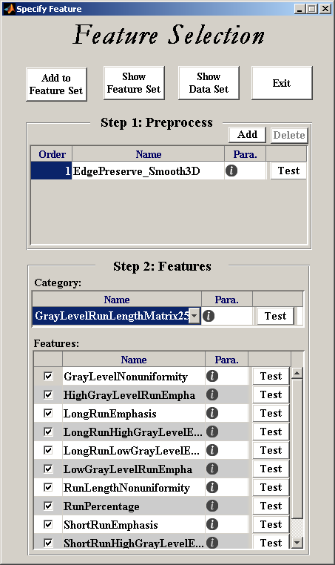
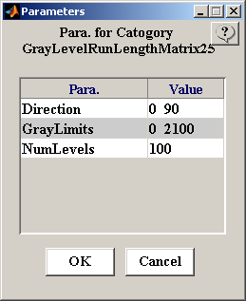
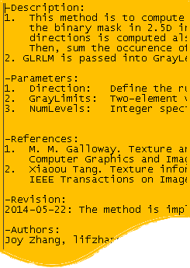
How to explore feature algorithms
Method 1: Check algorithm and parameter description
How: Select algorithms -> Click icon -> Click icon

Slide 2
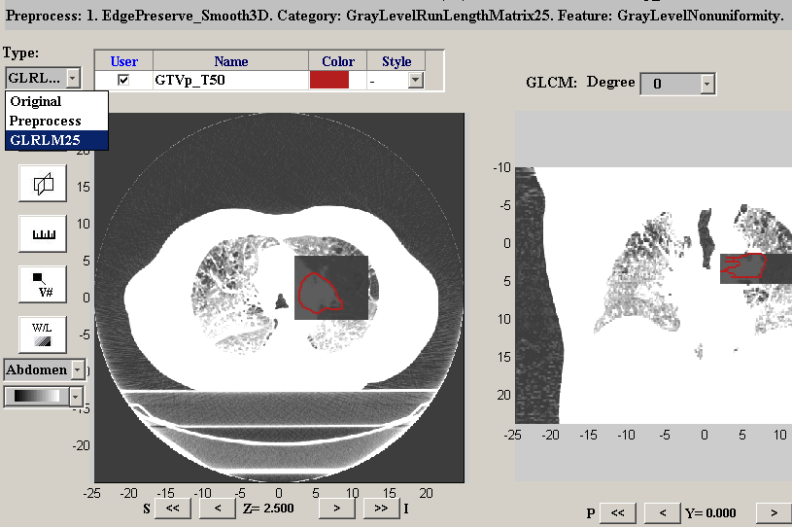
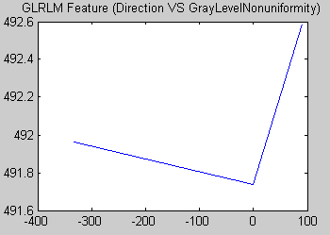
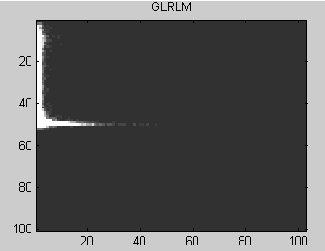
How to explore feature algorithms
Method 2: Test the algorithm to review intermediate data and result
How: Select algorithms -> Click icon

