Slide 1
ICT304 AI System Design · TSA 2026
Tutorial 3: Data & Feature Engineering
Sampling · Imbalanced data (Abalone) · Batch vs stream processing · Feature importance & extraction · Data leakage
Group 4 — Abey Joseph · Ruben · Siam
DRAFT for review — references and AI-use declaration at the end

Slide 2
Contents
Q | Topic | What we deliver
1 | Types of sampling | Explanation, examples, advantages & disadvantages, simulation chart
2 | Imbalanced data — Abalone | Steps + Python notebook, before/after comparison of models
3 | Batch vs stream processing | Differences with examples, two ML techniques for streams
4 | Feature importance, selection & extraction | ~10-minute research presentation
5 | Data leakage (Kaggle tutorial) | ~5-minute presentation: problem + what we learned
ICT304 Tutorial 3 · Group 4 · DRAFT
2
Notes:
Quick roadmap. Q4 is the 10-minute part and Q5 the 5-minute part, so they have more slides.

Slide 3
Question 1
Types of sampling
What sampling is, the two families of methods, and the pros & cons of each

Slide 4
Why sampling matters in ML
Q1
• Sample: a subset of data chosen to represent a bigger population
• Needed because: we never have all real-world data, and sometimes we have too much to process
• Sampling happens at many points: collecting data, building train/validation/test splits, labelling, monitoring
• Two families:
– Non-probability sampling — chosen by convenience or judgement, not by chance
– Probability (random) sampling — every item has a known chance of being picked
• Risk: a bad sample gives a biased model ("garbage in, garbage out")
Key idea: the model only learns the world it is shown. If the sample is skewed, the model is skewed — and test scores on a skewed test set will not reveal it.
Source: Huyen (2022), ch. 4; ICT304 Topic 5 slides.
ICT304 Tutorial 3 · Group 4 · DRAFT
4
Notes:
Plain English: we almost never train on 'all the data in the world'. Whatever subset we pick is a sample, and the way we pick it decides what the model learns — including its biases.

Slide 5
Non-probability sampling
Q1
Method | How it works | Example | Advantages | Disadvantages
Convenience | Take whatever data is easiest to get | Training a food-image classifier on photos the team took at nearby hawker centres | Fast, cheap, no planning | Strong selection bias; not representative
Snowball | Each sample leads to more samples | Scraping social-media accounts by following the friends of a starting set of users | Reaches hidden / connected groups | Over-represents one network; bias grows
Judgement | Experts choose which items to include | A doctor picks 'typical' X-rays to label | Uses domain knowledge; good for rare cases | Subjective; expert's blind spots become model's
Quota | Fill fixed quotas per group, no randomness inside | Survey 100 people from each age group, whoever answers first | Guarantees every group appears | Who fills the quota is still not random
Overall: easy and quick, but samples are not representative → models can be biased and results unreliable.
ICT304 Tutorial 3 · Group 4 · DRAFT
5
Notes:
These are quick and cheap, which is why they are common in early prototypes, but none of them give a representative sample. Mention a real example for each.

Slide 6
Probability (random) sampling
Q1
Method | How it works | Example | Advantages | Disadvantages
Simple random | Every item has the same chance | Pick 10% of all customer records at random | Easy; unbiased on average | Rare classes may be missed entirely
Stratified | Split into groups (strata), sample each group | Keep the same 9% 'old' share in train and test (our Q2 split) | Every group represented in the right share | Hard when groups overlap (multi-label)
Weighted | Each item has a weight = chance of selection | Give recent data weight 0.5, older 0.2 | Uses domain knowledge | Wrong weights add bias
Cluster | Group data into clusters, sample whole clusters | Pick 5 random schools, use all students | Cheap when data is grouped | Rare cases may sit in unpicked clusters
Reservoir | Keep k items while a stream flows; item n replaces a slot with prob. k/n | Keep 1,000 random tweets from a live feed | Works on streams of unknown length | Only gives a uniform sample
Importance | Sample from easy Q(x), re-weight by P(x)/Q(x) | Policy evaluation in reinforcement learning | Estimates hard distributions | High variance if Q is far from P
ICT304 Tutorial 3 · Group 4 · DRAFT
6
Notes:
Walk through each row. Emphasise stratified and reservoir sampling, since they come up again in Q2 (stratified split) and Q3 (streams).

Slide 7
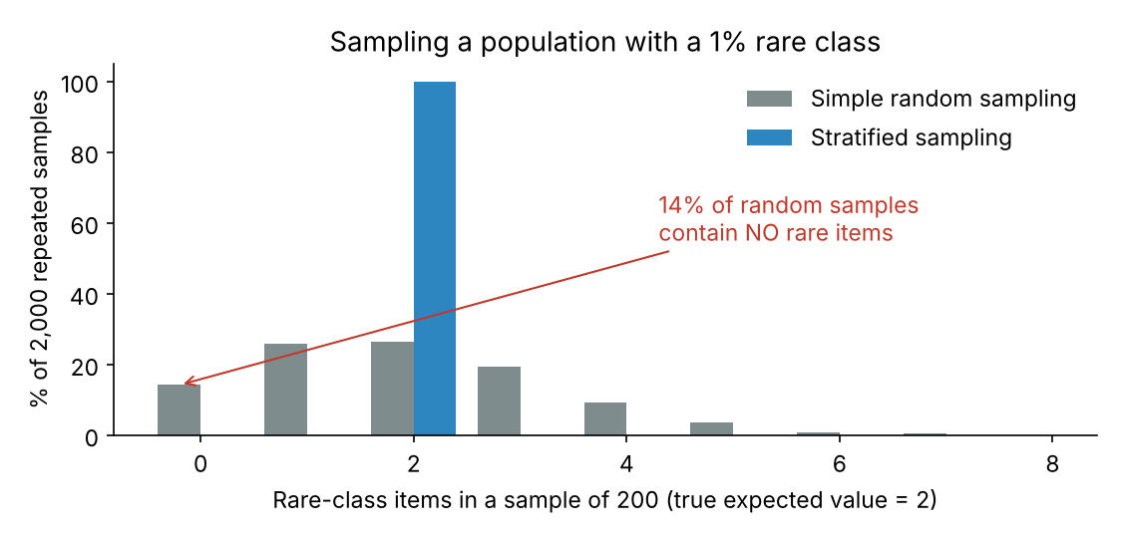
Illustration: simple random vs stratified sampling
Q1
• Population: 10,000 items, 1% rare
• Sample size 200, repeated 2,000 times
• Simple random: 0 to 8 rare items; ~14% of samples have none
• Stratified: always exactly 2 (the true share)
• Lesson: for imbalanced data, use stratified sampling for splits
Code: make_figs.py (in the repo). Seed = 42.
ICT304 Tutorial 3 · Group 4 · DRAFT
7
Notes:
Our own simulation: population of 10,000 items with 100 rare items (1%). We draw a 200-item sample 2,000 times. Simple random sampling gives anywhere from 0 to 8 rare items, and about 1 in 7 samples has none at all, so a model trained on it would not know the rare class exists. Stratified sampling gives exactly 2 every time.

Slide 8
Question 2
Handling imbalanced data — Abalone
Steps and code to fix the imbalance, and model performance before vs after

Slide 9
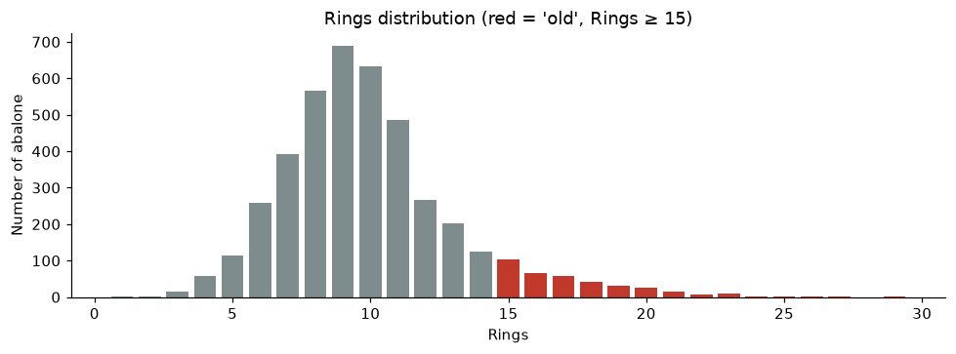
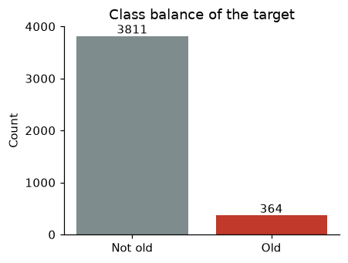
The dataset and the imbalance problem
Q2
• Data: UCI Abalone — 4,177 rows; Sex + 7 size/weight measurements; target Rings (age ≈ Rings + 1.5 years)
• Task: predict Old = Rings ≥ 15 (≈16.5+ years) → about 9% old vs 91% not old (≈ 1 : 10.5)
• Problem: a model that always says "not old" is ~91% accurate yet useless — accuracy hides the failure
• Cleaning: 2 rows with Height = 0 removed (impossible values); no missing values
ICT304 Tutorial 3 · Group 4 · DRAFT
9
Notes:
Abalone = 4,177 sea snails, 8 physical measurements, target = number of shell rings (age = rings + 1.5). As a 28-class problem, some ring values have only 1 or 2 examples. We set a practical binary task: is the abalone old (15+ rings)? Only about 9% are, so a model can be 91% accurate by always saying 'not old'.

Slide 10
Steps we followed (see notebook)
Q2
1
Load & check
No missing values;
remove Height = 0
2
Define target
Old = Rings ≥ 15;
measure imbalance
3
Stratified split
80% train / 20% test,
same 9% in both
4
Baseline
LogReg + Random Forest
with NO fix
5
Apply fixes
Train data only, inside
an imblearn Pipeline
6
Compare
Recall, precision, F1,
balanced acc., PR-AUC, CV
pipe = Pipeline([
("prep", ColumnTransformer([("sex", OneHotEncoder(), ["Sex"]),
("num", StandardScaler(), numeric_cols)])),
("resample", SMOTE(random_state=42)), # only runs during fit()
("model", LogisticRegression(max_iter=2000)),
])
pipe.fit(X_train, y_train) # test set is never resampled
Why a pipeline? Scaling, encoding and resampling are fitted on training data only — inside every cross-validation fold too. This prevents data leakage (links to Q5).
ICT304 Tutorial 3 · Group 4 · DRAFT
10
Notes:
Order matters. Split first, then put preprocessing and resampling inside a pipeline so they only ever see training data. Resampling before the split would leak copies of test rows into training.

Slide 11
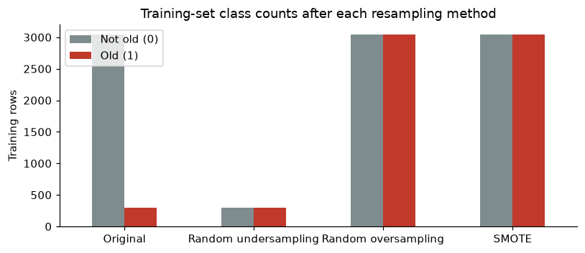
Four ways to handle the imbalance
Q2
Method | What it does | Trade-off
Class weighting | Errors on the rare class cost more in training | Simple; no data changed
Random undersampling | Drop majority rows until balanced | Fast, but discards ~80% of data
Random oversampling | Duplicate minority rows | Keeps data; may overfit to copies
SMOTE | Create synthetic minority rows between neighbours | Less overfitting; can blur boundary
Other options (not used here): collect more rare data, threshold moving, ensemble methods (e.g. balanced random forest), focal loss for neural networks.
ICT304 Tutorial 3 · Group 4 · DRAFT
11
Notes:
Class weighting changes the training penalty; the other three change the training data itself. SMOTE creates new points on the line between a rare example and one of its 5 nearest rare neighbours.

Slide 12
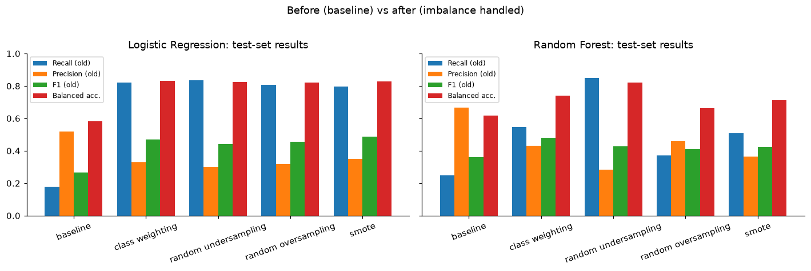
Results: before vs after (test set)
Q2
Model / method | Accuracy | Recall (old) | Precision (old) | F1 (old) | Balanced acc. | PR-AUC
Logistic Regression — baseline | 0.91 | 0.18 | 0.52 | 0.27 | 0.58 | 0.48
Logistic Regression — smote | 0.85 | 0.80 | 0.35 | 0.49 | 0.83 | 0.46
Random Forest — baseline | 0.92 | 0.25 | 0.67 | 0.36 | 0.62 | 0.47
Random Forest — class weighting | 0.90 | 0.55 | 0.43 | 0.48 | 0.74 | 0.45
ICT304 Tutorial 3 · Group 4 · DRAFT
12
Notes:
Read the recall column first — that is how many old abalone we actually catch. Accuracy goes down a little after the fix because we now say 'old' more often, which is the expected precision/recall trade-off. F1 and balanced accuracy show whether the trade is worth it.

Slide 13
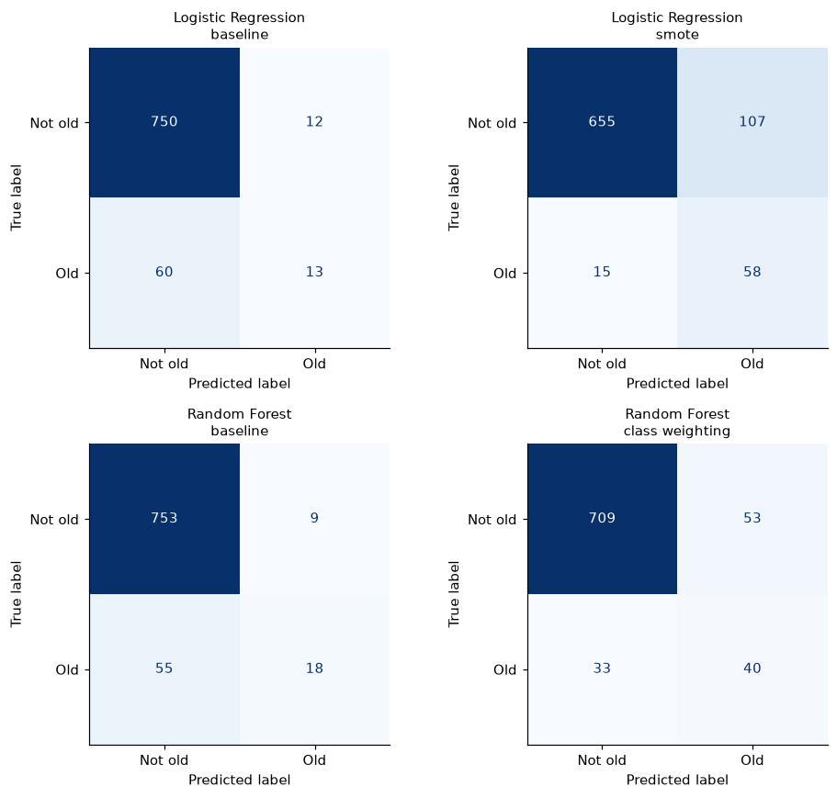
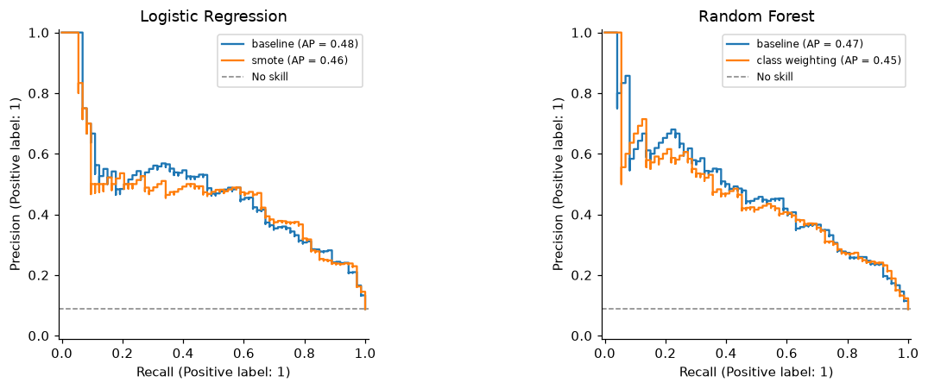
Confusion matrices and precision–recall curves
Q2
ICT304 Tutorial 3 · Group 4 · DRAFT
13
Notes:
Top-left vs top-right: how many of the old abalone in the test set move from 'missed' (bottom-left cell) to 'found' (bottom-right). PR curves: the dashed line is a model with no skill.

Slide 14
Q2 conclusions
Q2
Test set (73 old of 835) | Old found | False alarms | F1 (old) | Balanced acc. | Accuracy | PR-AUC
Logistic Regression — baseline | 13 (18%) | 12 | 0.27 | 0.58 | 0.91 | 0.48
Logistic Regression — SMOTE | 58 (79%) | 107 | 0.49 | 0.83 | 0.85 | 0.46
Random Forest — baseline | 18 (25%) | 9 | 0.36 | 0.62 | 0.92 | 0.47
Random Forest — class weighting | 40 (55%) | 53 | 0.48 | 0.74 | 0.90 | 0.45
• Before: 91-92% accuracy but only 18-25% of old abalone found — accuracy hides the problem
• After: recall 55-79%, F1 up from ~0.3 to ~0.49, balanced accuracy up to 0.74-0.83 (CV agrees)
• Price: many more false alarms and slightly lower accuracy — the normal precision/recall trade-off
• PR-AUC barely moves (~0.46): the fixes shift the decision point; they don't make the model rank better
• Choice: pick by the cost of each error; always split first and resample only training data
ICT304 Tutorial 3 · Group 4 · DRAFT
14
Notes:
Numbers are from the test set (835 abalone, 73 old). Point at the 'found' column: logistic regression goes from finding 13 old abalone to 58. Then be honest about the cost: 107 false alarms. Finish with the PR-AUC point — the fixes move the decision point, they don't make the model smarter.

Slide 15
Question 3
Batch vs stream processing
Differences with examples, and ML techniques for streaming data

Slide 16
Batch processing vs stream processing
Q3
 | Batch processing | Stream processing
Data | Historical data at rest (database, data lake, warehouse) | Data in motion — events arriving continuously
When it runs | Periodically (hourly, nightly, monthly) | Continuously; results within milliseconds–seconds
Data size per job | Large, known and complete | Small windows; total size unknown / unbounded
Latency | High (minutes to hours) | Low (real-time or near real-time)
Typical tools | Hadoop MapReduce, Spark, SQL jobs | Apache Kafka, Flink, Spark Structured Streaming
Example | Nightly job retrains a recommender on yesterday's sales; monthly bank statements | Card-fraud check on each transaction as it happens; live ride-hailing surge pricing
ML features | Batch features: e.g. a shop's average rating over 30 days | Streaming features: e.g. number of orders in the last 5 minutes
ICT304 Tutorial 3 · Group 4 · DRAFT
16
Notes:
Batch = process stored, historical data in big scheduled jobs. Stream = process each event within seconds as it arrives. Many real systems use both (lambda / kappa architectures).

Slide 17
Stream ML techniques (1): incremental learning
Q3
• Online / incremental learning: update the model with each new example, then discard it
• Online linear models (SGD): logistic regression / perceptron updated by one gradient step per example
– scikit-learn: SGDClassifier.partial_fit(); River: linear_model.LogisticRegression
• Hoeffding Tree (VFDT): a decision tree that grows while data streams in
– Splits a node once enough examples arrive to be statistically confident (Hoeffding bound)
– Reads each example once; memory stays constant (Domingos & Hulten, 2000)
• Evaluation: "test-then-train" (prequential) — predict each new example first, then learn from it
Example: a spam filter updates its weights each time a user marks an email as spam, instead of waiting for a nightly retrain.
Library: River — machine learning for streaming data in Python (Montiel et al., 2021).
ICT304 Tutorial 3 · Group 4 · DRAFT
17
Notes:
Normal ML trains once on a fixed dataset. Streaming ML updates the model one example (or one mini-batch) at a time, never storing the whole stream.

Slide 18
Stream ML techniques (2): handling concept drift
Q3
• Concept drift: the link between inputs and the label changes over time
• Drift detectors: e.g. ADWIN keeps a sliding window and cuts old data when the average error changes
• Adaptive Random Forest (ARF): an ensemble of Hoeffding trees, each with a drift detector
– When a tree's error rises, a background tree starts; it replaces the old one if drift is confirmed
– Strong accuracy on evolving streams (Gomes et al., 2017)
• Other options: sliding-window retraining, online k-means for streaming clustering
Example: card-fraud detection. Fraud patterns change every few weeks. ARF scores each transaction in real time and replaces trees that stop working when the pattern shifts.
ICT304 Tutorial 3 · Group 4 · DRAFT
18
Notes:
Streams change over time — customer behaviour shifts, fraudsters change tactics. That change is concept drift. These methods detect it and adapt.

Slide 19
Question 4 (≈10 min)
Feature importance, selection & extraction
How feature importance relates to feature selection, and the different ways to perform feature extraction

Slide 20
Why care about features?
Q4
• Feature: one input column the model learns from (e.g. shell weight, word count, pixel)
• More is not always better — too many features cause:
– Overfitting (model memorises noise)
– More memory and slower predictions (higher inference latency)
– Harder to explain the model
• Three related ideas:
– Feature importance — how much does each feature help the model?
– Feature selection — keep a useful subset of the original features
– Feature extraction — build new, fewer features from the original ones
ICT304 Tutorial 3 · Group 4 · DRAFT
20
Notes:
From the Topic 6 lecture: the biggest performance boost often comes from the right features, and too many features cause overfitting, more memory and slower predictions.

Slide 21
What is feature importance?
Q4
Approach | Idea in plain English | Notes
Drop-column / permutation importance | Shuffle (or remove) one feature; measure how much the score drops | Works with any model; matches the lecture definition (Breiman, 2001)
Impurity-based (tree models) | How much each feature reduces impurity across all tree splits | Free with Random Forest/XGBoost; biased towards many-valued features
Model coefficients | Size of each weight in a linear model (after scaling) | Simple; only for linear models
SHAP values | Fair share of each feature in every single prediction (game theory) | Explains individual predictions; slower (Lundberg & Lee, 2017)
Also useful for interpretability: importance shows how the model works "under the hood" (Huyen, 2022, ch. 5).
ICT304 Tutorial 3 · Group 4 · DRAFT
21
Notes:
Lecture definition: a feature's importance is how much the model's performance drops if that feature is removed. Permutation importance is the practical version of that: shuffle the column instead of removing it.

Slide 22
How feature importance relates to feature selection
Q4
Measure
Compute importance
of every feature
Rank
Sort features from
most to least useful
Select
Keep top-k or those above
a threshold; drop the rest
Re-check
Retrain and confirm the
score did not fall
• *Feature importance = the measurement; feature selection = the decision made using it
• Embedded selection uses importance directly: e.g. sklearn SelectFromModel keeps features whose importance is above a threshold
• Recursive Feature Elimination (RFE): repeatedly drop the least important feature and retrain
• Caution: low importance ≠ useless — two correlated features can "share" importance; check by retraining
• *Importance needs a trained model, so compute it on training data only (avoid leakage)
ICT304 Tutorial 3 · Group 4 · DRAFT
22
Notes:
Key message: importance is the measurement, selection is the decision. Importance scores rank the features; selection uses that ranking to keep or drop them.

Slide 23
Approaches to feature selection
Q4
Family | How it works | Examples | Pros | Cons
Filter | Score each feature with a statistic, independent of any model | Correlation, chi-square, mutual information, variance threshold | Fast; scales to many features | Ignores feature interactions
Wrapper | Train models on different feature subsets; keep the best subset | Forward selection, backward elimination, RFE | Considers interactions; usually most accurate | Slow; risk of overfitting
Embedded | Selection is built into model training | Lasso (L1) shrinks weights to 0; tree importances; SelectFromModel | Good balance of speed and accuracy | Tied to one model type
ICT304 Tutorial 3 · Group 4 · DRAFT
23
Notes:
The three classic families from Guyon & Elisseeff (2003). Filter = fast and model-free; wrapper = most accurate but slow; embedded = selection happens during training.

Slide 24
Approaches to feature extraction
Q4
Approach | Method | What it does / example
Linear projection | PCA (principal component analysis) | Combines correlated columns into a few uncorrelated components that keep most of the variance (Jolliffe & Cadima, 2016)
Supervised projection | LDA (linear discriminant analysis) | Finds directions that best separate the classes
Non-linear / learned | Autoencoders, CNN or transformer embeddings | Neural network learns a compact representation (e.g. image → 512-number vector)
Handcrafted (engineered) | n-grams, TF-IDF, ratios, date parts | "I like food" → [I, like, food, I like, like food]; price per m²; day-of-week
Feature crossing | Combine two features | Marital status × number of children (lecture example)
Visualisation-oriented | t-SNE, UMAP | Squeeze data to 2-D for plots; not usually used as model input
ICT304 Tutorial 3 · Group 4 · DRAFT
24
Notes:
Extraction creates NEW features. Unlike selection, the original columns are transformed, so the new features can be harder to explain.

Slide 25
Selection vs extraction — when to use which?
Q4
 | Feature selection | Feature extraction
Output | Subset of original features | New, transformed features
Interpretability | High — features keep meaning | Often lower (e.g. PCA component 3)
Information | Dropped features are lost | Can keep info from all features
Good when | Need to explain the model; many useless columns | Many correlated columns; images, text, audio
Summary
• Importance tells us which features matter.
• Selection uses that to keep the useful ones.
• Extraction builds new, compact features.
• All must be fitted on training data only.
ICT304 Tutorial 3 · Group 4 · DRAFT
25
Notes:
Wrap-up for Q4. Selection keeps meaning; extraction may give better compression. In practice teams often do both: engineer/extract features, then select the most useful ones.

Slide 26
Question 5 (≈5 min)
Data leakage
Kaggle Learn tutorial — the problem and what we learned

Slide 27
What is data leakage?
Q5
• Data leakage: the training data contains information about the answer that will not be available at prediction time
• Result: excellent validation scores, poor real-world performance
• Type 1 — Target leakage: a feature is created or updated after the outcome is known
– Example: predicting pneumonia using took_antibiotic_medicine — people take antibiotics after they get sick
• Type 2 — Train-test contamination: test data influences training or preprocessing
– Example: fitting an imputer or scaler on all data before train_test_split()
Real case (lecture): COVID-19 models learned that patients scanned lying down were sicker, and even learned hospital label fonts — great test scores, useless in hospitals (Heaven, 2021).
ICT304 Tutorial 3 · Group 4 · DRAFT
27
Notes:
Kaggle's definition: training data contains information about the target that will not be available when the model is used. The model looks great in testing and fails in real use.

Slide 28
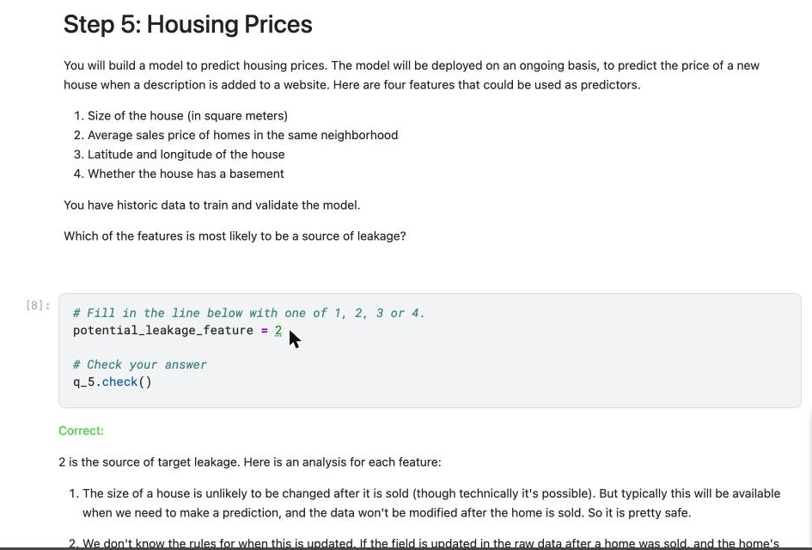
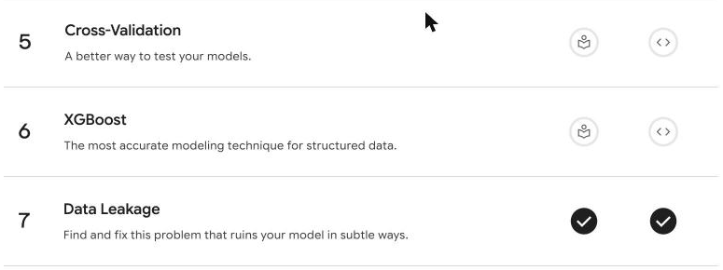
Tutorial example: credit card applications
Q5
Step | Result
Random forest, all features, 5-fold CV | Accuracy ≈ 98.1% — suspiciously high
Check 'expenditure' | 100% of rejected applicants had 0 spending vs 2% of accepted
Diagnosis | Spending is on the NEW card → only exists after acceptance = target leakage
Drop expenditure, share, active, majorcards | Accuracy ≈ 83.1% — lower, but honest
Our completed Kaggle exercise (all 5 steps correct) and lesson 7 ticked. Source: Cook, A. — Kaggle Learn, Intermediate ML.
ICT304 Tutorial 3 · Group 4 · DRAFT
28
Notes:
The drop from 98% to 83% looks bad but the 83% is the honest number. Exercise answers: shoelaces - leather used is leakage if only known during the month; housing - feature 2 (neighbourhood average price) is the leak because it can be updated with the house's own sale price.

Slide 29
How to prevent leakage — and what we learned
Q5
• Think about timing: would this feature exist at the moment of prediction?
• *Split first — before scaling, imputing, resampling or EDA
• *Use pipelines so preprocessing is fitted inside each CV fold
• *Split time-based data by time, not randomly
• *Keep groups together (e.g. one patient's scans in the same split)
• *Be suspicious of ~98% accuracy — investigate the top features
What we learned
• A high score is not proof of a good model.
• Leakage is usually invisible in the numbers — you find it by asking how each column was created.
• In our Q2 notebook we applied this: SMOTE and scaling run only on training data inside the pipeline.
• Honest 83% beats a fake 98% that fails in production.
ICT304 Tutorial 3 · Group 4 · DRAFT
29
Notes:
Link back to Q2: we split before resampling and used a pipeline so no test information leaked. Personal takeaway: be suspicious of results that look too good.

Slide 30
References
Refs
Bifet, A., & Gavaldà, R. (2007). Learning from time-changing data with adaptive windowing. Proc. SIAM Int. Conf. on Data Mining, 443–448.
Breiman, L. (2001). Random forests. Machine Learning, 45(1), 5–32. https://doi.org/10.1023/A:1010933404324
Chawla, N. V., Bowyer, K. W., Hall, L. O., & Kegelmeyer, W. P. (2002). SMOTE: Synthetic minority over-sampling technique. JAIR, 16, 321–357.
Cook, A. (n.d.). Data leakage [Kaggle Learn tutorial]. https://www.kaggle.com/code/alexisbcook/data-leakage/tutorial
Domingos, P., & Hulten, G. (2000). Mining high-speed data streams. Proc. ACM SIGKDD, 71–80. https://doi.org/10.1145/347090.347107
Gomes, H. M., et al. (2017). Adaptive random forests for evolving data stream classification. Machine Learning, 106, 1469–1495.
Guyon, I., & Elisseeff, A. (2003). An introduction to variable and feature selection. JMLR, 3, 1157–1182.
Heaven, W. D. (2021, July 30). Hundreds of AI tools have been built to catch covid. None of them helped. MIT Technology Review.
Huyen, C. (2022). Designing machine learning systems. O'Reilly Media. (Chapters 3–5)
Jolliffe, I. T., & Cadima, J. (2016). Principal component analysis: A review and recent developments. Phil. Trans. R. Soc. A, 374, 20150202.
Kleppmann, M. (2017). Designing data-intensive applications. O'Reilly Media. (Chapters 10–11)
Lemaître, G., Nogueira, F., & Aridas, C. K. (2017). Imbalanced-learn. JMLR, 18(17), 1–5.
Lundberg, S. M., & Lee, S.-I. (2017). A unified approach to interpreting model predictions. NeurIPS 30.
Montiel, J., et al. (2021). River: Machine learning for streaming data in Python. JMLR, 22(110), 1–8.
Murdoch University. (2026). ICT304 AI System Design: Topic 5 Data engineering; Topic 6 Feature engineering [Lecture slides].
Nash, W. J., et al. (1994). Abalone [Dataset]. UCI Machine Learning Repository. https://doi.org/10.24432/C55C7W
Pedregosa, F., et al. (2011). Scikit-learn: Machine learning in Python. JMLR, 12, 2825–2830.
ICT304 Tutorial 3 · Group 4 · DRAFT
30

Slide 31
Declaration of AI tool use
AI
• Tool: Claude (Anthropic), October 2026
• Used for: drafting slide text, the Q2 notebook code, the Q1 simulation chart, and finding references
• Our own work: checking every answer against the lecture slides, running and checking the code, editing the slides
• Prompt used (example):
– "Help me do ICT304 Tutorial 3 from start to end … draft PowerPoint slides … I will later check and finalise."
• *Referenced as per Murdoch APA 7 guide for generative AI
[Insert screenshots of the AI prompts and answers here]
Anthropic. (2026). Claude [Large language model]. https://claude.ai
ICT304 Tutorial 3 · Group 4 · DRAFT
31
Notes:
Required by the tutorial sheet: declare every AI tool, the prompts, and screenshots of the answers. Replace the placeholders with your own screenshots before submitting.

