Slide 1
Data Analysis with R
Introduction to Data Science

Slide 2

Predicting the Future
Historic methods to predict future
… any issues?

Slide 3
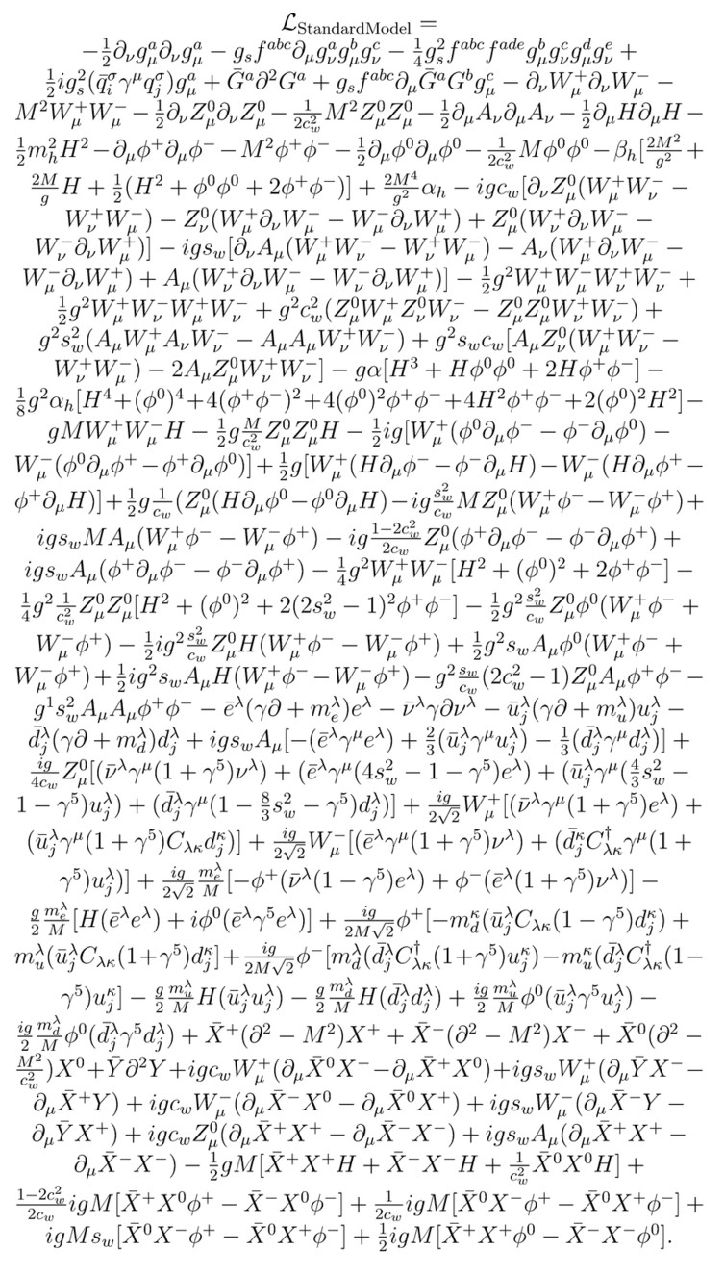
Predicting the Future
The physics model of everything
… well, except for gravity
Models of processes
… any issues?

Slide 4
Predicting Future – Data Science
Models of processes vs. models of data
“Generalize” processes from data
Challenges:
  Need lots of data
  Need quality data
  Art more than science

Slide 5
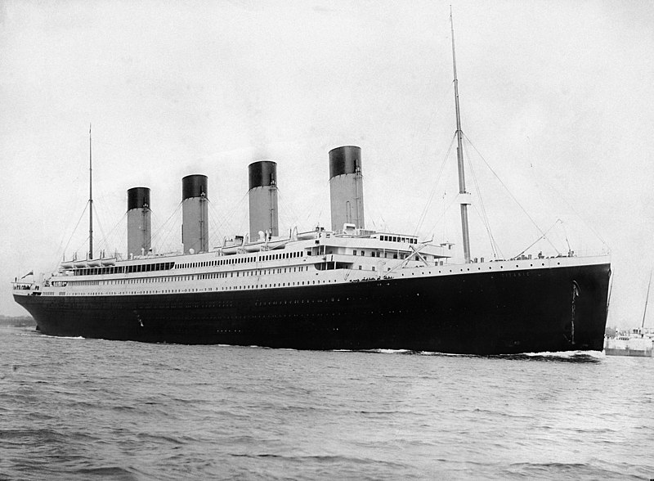
Use cases – Titanic
Predict who survives on Titanic
  Sex
  Age
  Fare
  Embarked port
  Number of parents/children/siblings/spouses on board
  Name
  Cabin number

Slide 6

Use cases – Obama’s campaign 2012
Identify persuadables, “sleeping dogs”, “sure-thingers”, and “lost causes”
How to persuade the “persuadables”?
  Phone call
  Visit
  Card
  Other

Slide 7
Other use cases
Find & discuss

Slide 8
Platform
Jupyter notebook
  Anaconda
  Markdown
  Python, Java, other kernels
R Kernel

Slide 9
Anaconda
Download & install Anaconda
Install R
Register R Kernel: https://www.datacamp.com/community/blog/jupyter-notebook-r
Run: jupyter notebook

