Slide 1
Gantt Chart Project Timeline
Task 1 Here
Jan 5 - Jun 1
Task 2 Here
Mar 2 - Jul 14
Task 3 Here
Mar 14 - Oct 2
Task 4 Here
Apr 25 - Oct 20
Task 5 Here
Aug 29 - Nov 30
Project Kickoff
Milestone 1 Here
Milestone 2 Here
Milestone 3 Here
Project Close
Jan 10
Apr 14
Jun 29
Sep 4
Nov 30
2013
Jan
Feb
Mar
Apr
May
Jun
Jul
Aug
Sep
Oct
Nov
Today

Slide 2
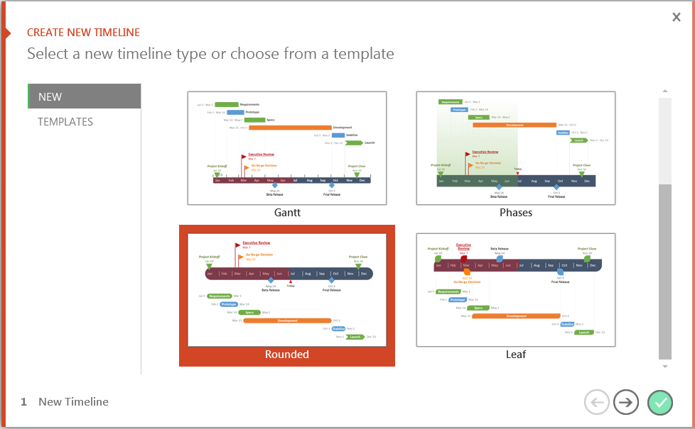
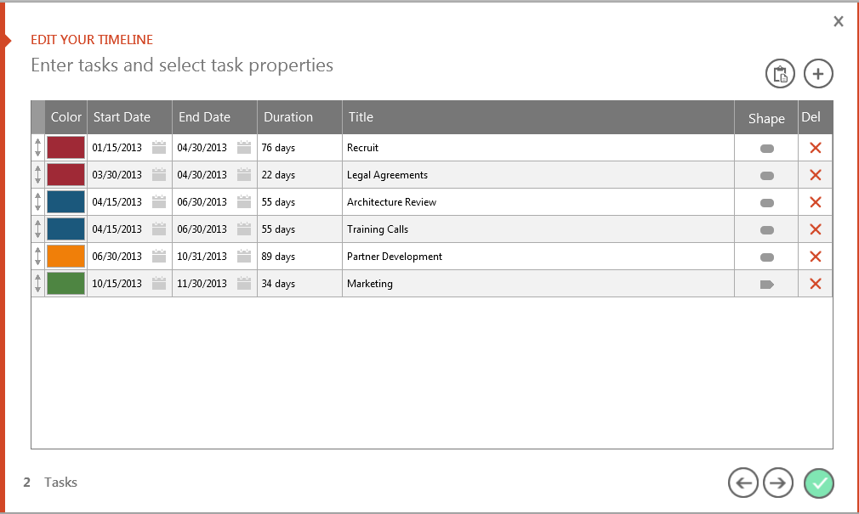
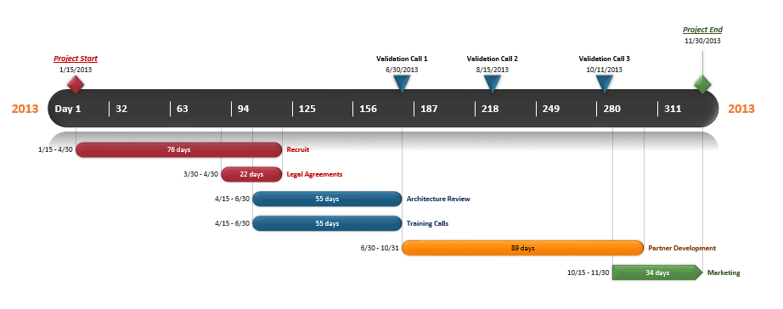
You can easily change this template or build new timelines quickly, right inside PowerPoint!
Office Timeline is a FREE, award winning, timeline maker that's really easy to use.
Simple, easy-to-use wizards.
Professional, quick results.
Built directly into PowerPoint
1
Open your template or select a new one.
2
Choose dates, colors and shapes.
3
Click Finish to create your slide.

Slide 3

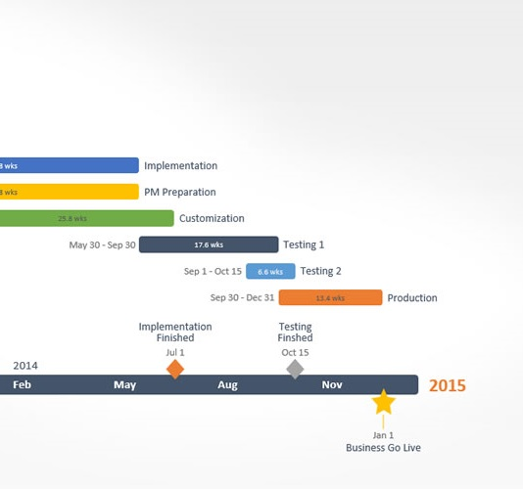
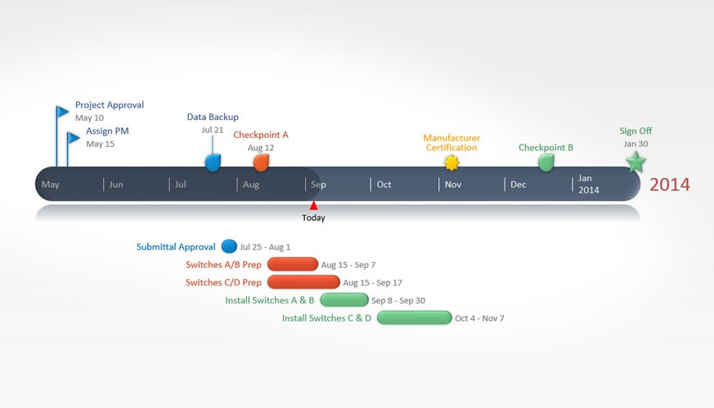
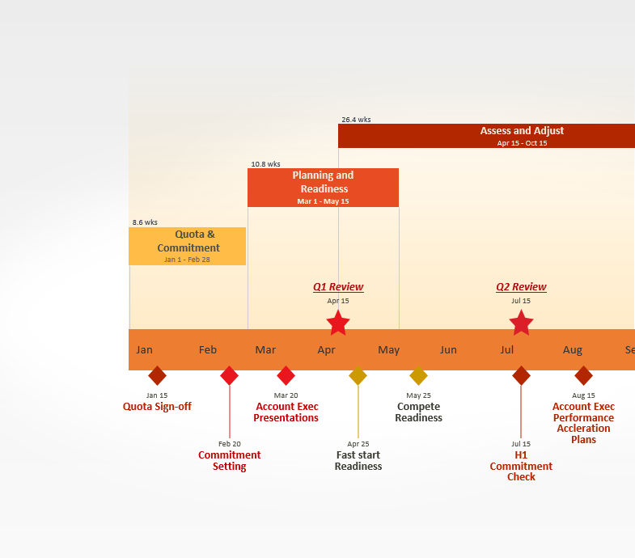

Get the Free Edition Now
FREE DOWNLOAD
Easily edit this template and create other beautiful timelines quickly, right inside PowerPoint.
Copyright © 2012, Office Timeline, LLC. All rights reserved.
Download Now
www.FPPT.com/OfficeTimeline

Slide 4
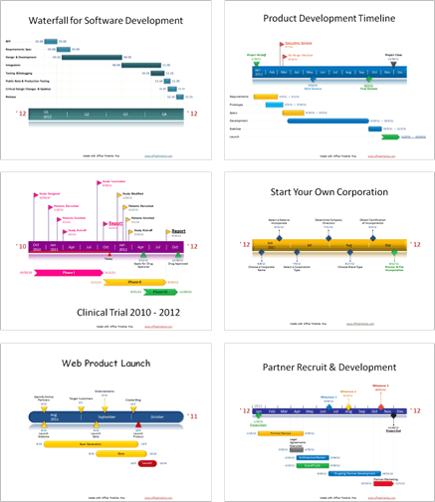
Stand out in a competitive market.
Impress customers, colleagues, and managers with professional timeline presentations built right from PowerPoint.
“
“I love this! I’ve been creating all these graphics manually for months and just wanted to smack myself upside the head when I saw this.”
“I can’t believe I’ve been using VISIO all these years! I've been missing out.”
“I've been building timelines for 22 years and this is the first tool I have found that quickly makes the kinds of slides my clients and management expect to see.
Copyright © 2012, Office Timeline, LLC. All rights reserved.

