Slide 1


Slide 2
FaceIt
A website used to share links, ideas, connect people, and facilitate growth driven conversation in an online environment.
“Facilitate conversation, share knowledge, and connect like minded people.”
Notes:
We wanted to create a social media platform that encouraged free, candid conversation like reddit, but with the personal relationships of facebook.

Slide 3
Members
Brandon Zink
Channing Hurley
Cam Connor
Abiel Fattore
Phillip Kickbush

Slide 4
Development Methodologies
Agile - Multiple pages of the site in progress at once
Pair Programming - More experienced web developers teach the less experienced how to get started

Slide 5

Project Tracker
Trello (3/5)
Useful for seeing what needs to be done, but provides no type of timeline for date to completion on parts.

Slide 6

VCS Repo
GitHub (5/5)
What’s not to love?

Slide 7

XAMPP
XAMPP (5/5)
Used to turn our machine into a local host (.php and SQL), works greats and easy to use.

Slide 8

phpMyAdmin
phpMyAdmin (4/5)
Used to set up our database. A bit confusing to get started with but other than that easy to use.

Slide 9

Sublime
Sublime (5/5)
Text editor. Worked amazing.

Slide 10

Testing
BrowserStack (4/5)
Live, web-based browser testing. Allowed us to preview our website across multiple web browsers.

Slide 11

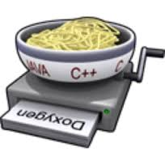
Documentation
Travis CI with Doxygen
Doxygen (2/5)
Travis CI (3/5)

Slide 12
Challenges
Learning curve for web development (HTML, CSS, SQL, etc.)
Just took time to overcome and redoing stuff as we became more familiar with the language.

Slide 13
Overcoming Challenges
Use your resources.
Wide array of web development tutorials online
Experienced team members teach the others
How did these challenges change the project plan?
We originally had a lot of ambitious ideas and concepts, but did not necessarily know how to implement those ideas. Had to stick to what we knew as we moved forward

Slide 14
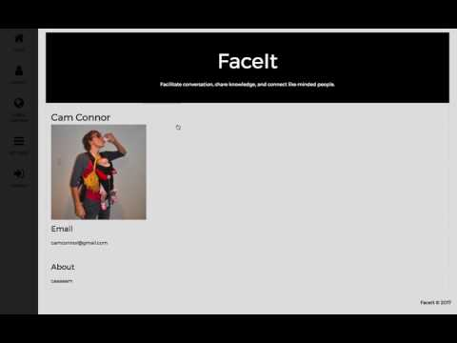
D
E
M
O

